Slide 1




The role of tropical and extratropical weather systems on the moist margin
EGU 2025, 28 Apr 2025
Corey Robinson^{1,2,3} (corey.robinson@monash.edu),
Sugata Narsey⁴, Christian Jakob^{1,3}, Hanh Nguyen⁴
¹ Monash University
² ARC CoE for Climate Extremes
³ ARC CoE for 21st Century Weather
⁴ Bureau of Meteorology

Slide 2
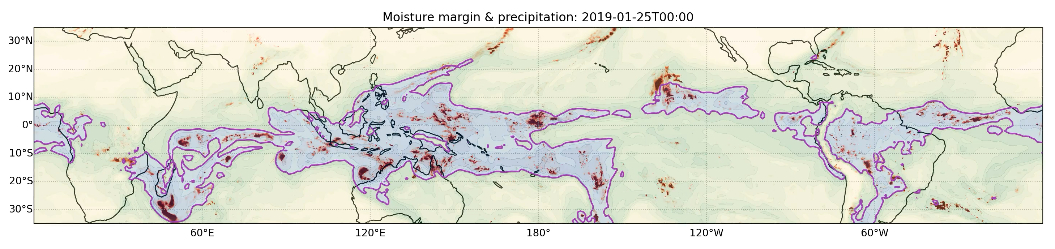
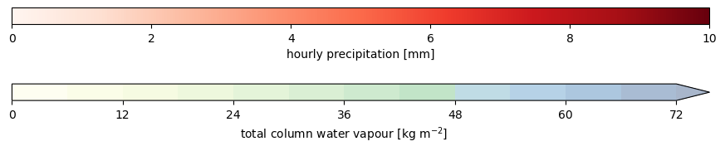
The “meandering moist margin”
A boundary separating rainy and clear regions in the tropics
TCWV = 45 kg m⁻²
Some questions and goals:
How can we characterise variability in the moist margin?
How is this related to weather systems?
Mapes, B. E., E. S. Chung, W. M. Hannah, H. Masunaga, A. J. Wimmers and C. S. Velden (2018). "The Meandering Margin of the Meteorological Moist Tropics." Geophysical Research Letters 45(2): 1177-1184.

Slide 3
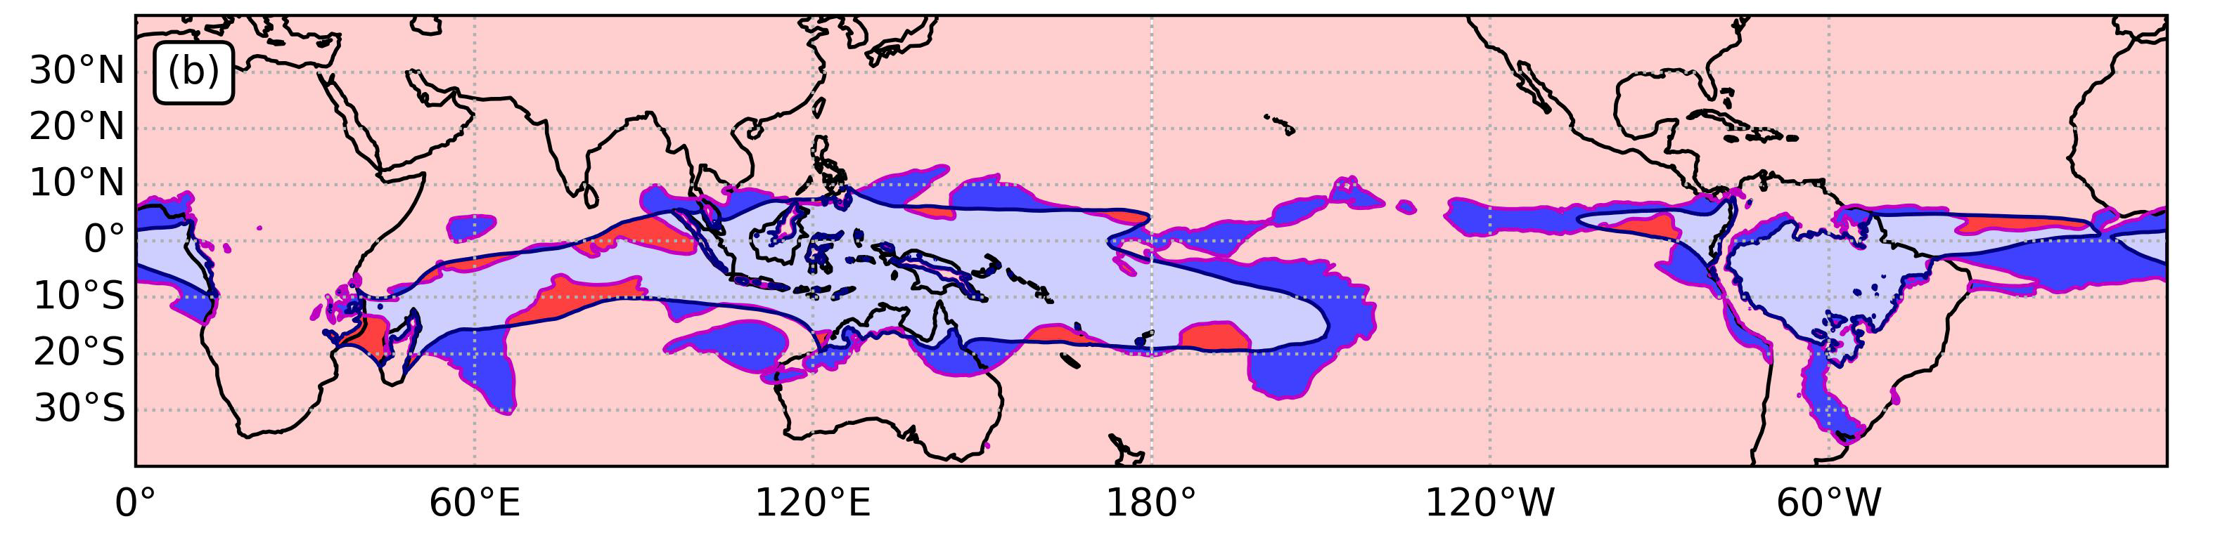


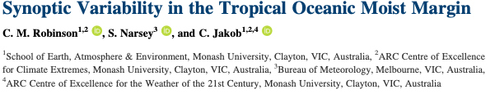
Characterising movement of the moist margin
Compare current position of moist margin to “background”
Define wet perturbations and dry perturbations
28 Jan 2019
Purple line = current margin
Blue line = 15-day moving average climatology
Wet perturbations rain more,
dry perturbations rain less

Slide 4
Linking the moist margin with weather objects
3 Jan 2018

Slide 5
Linking the moist margin with weather objects
3 Jan 2018
Notes:
Only talking about extratropics
Point out the two red circles… can see this repeating pattern, but it this common?

Slide 6
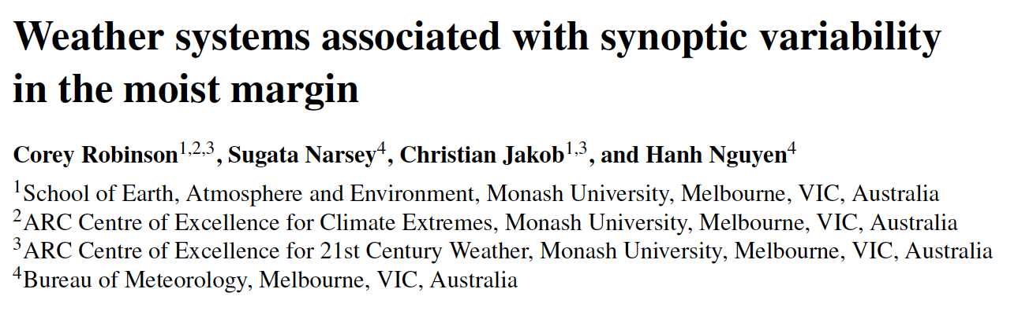


How do extratropical weather systems interact?
Odds ratios
Less likely
More likely
Notes:
One way of doing this is using odds ratios…
So we see this strong relationship with PV anomalies, in particular, with the anticyclonic ones (can jump back to previous slidf

Slide 7
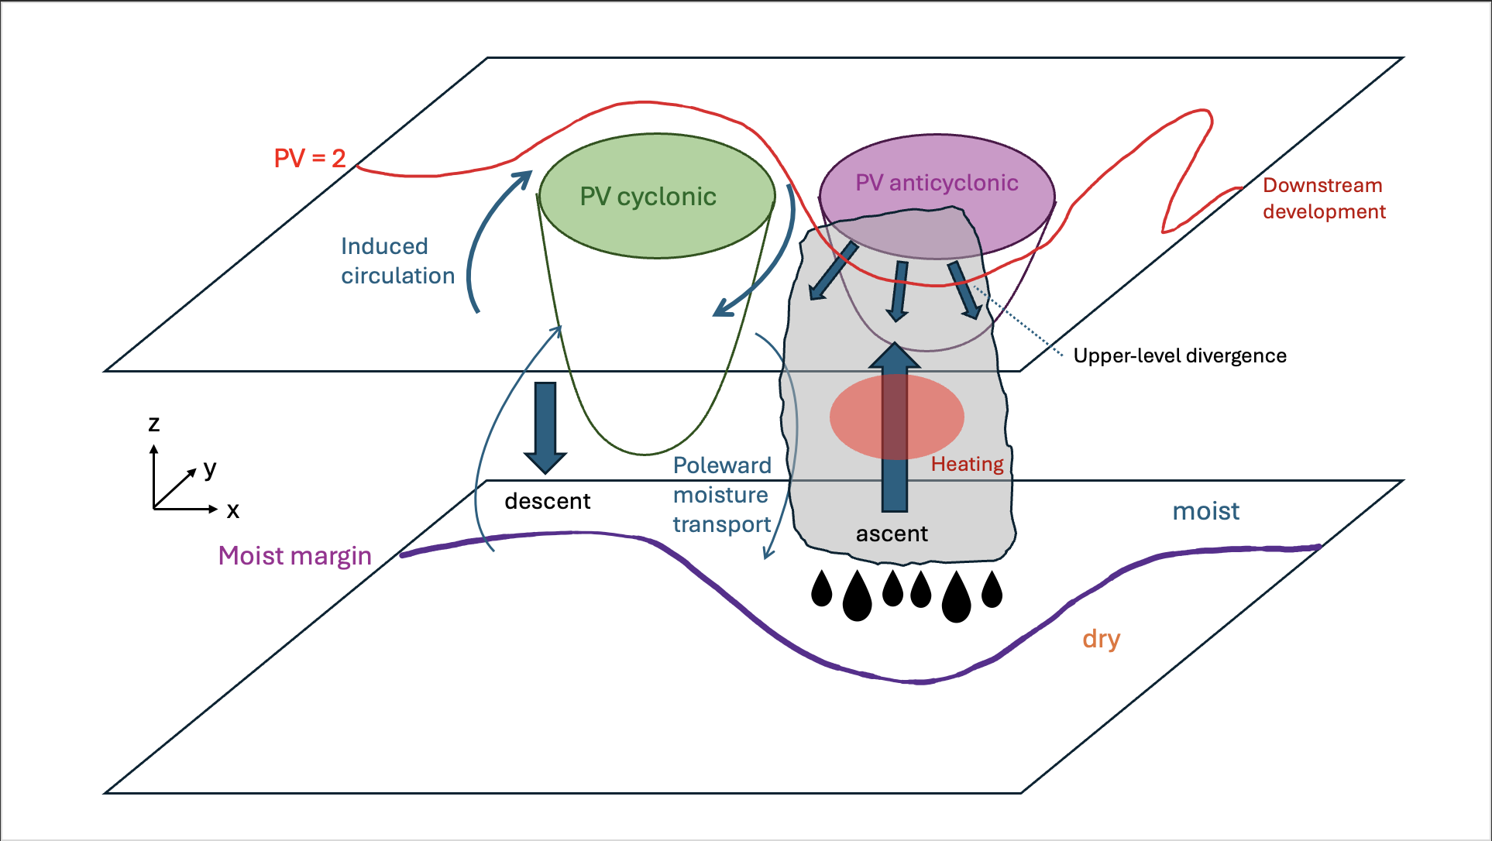
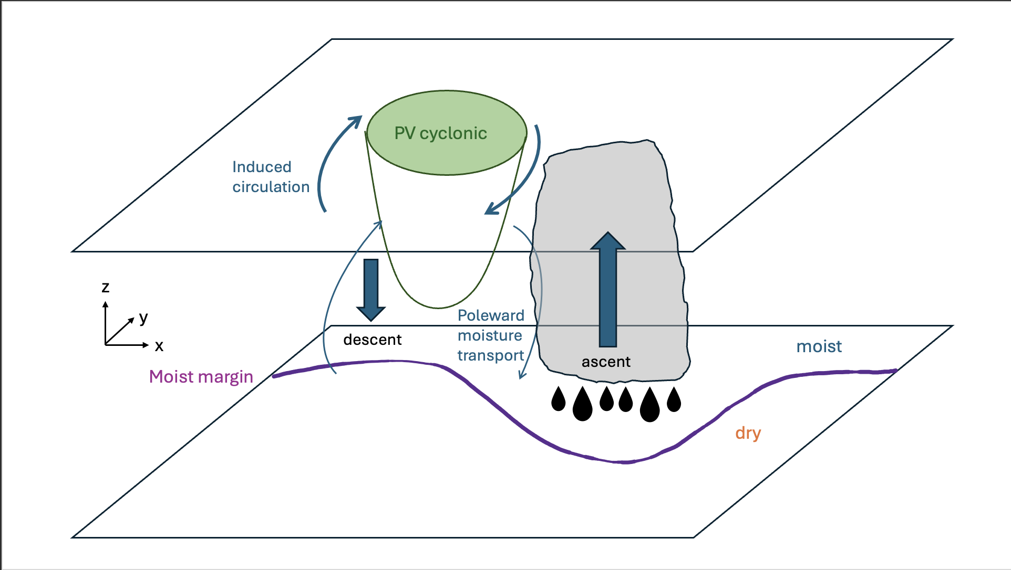
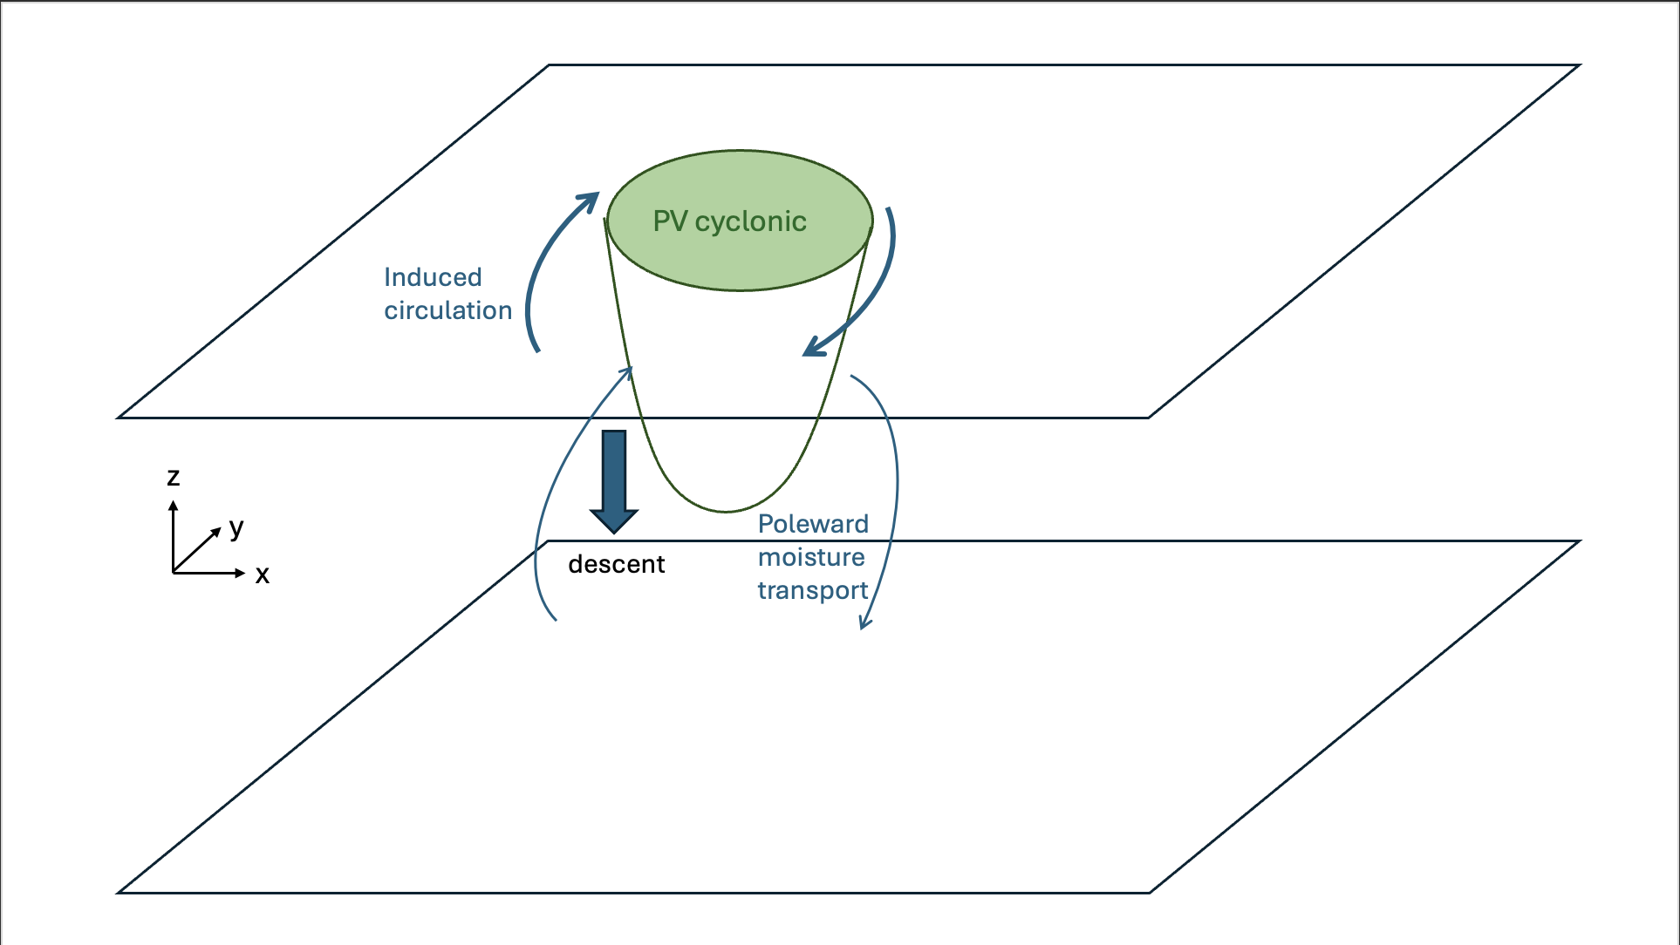
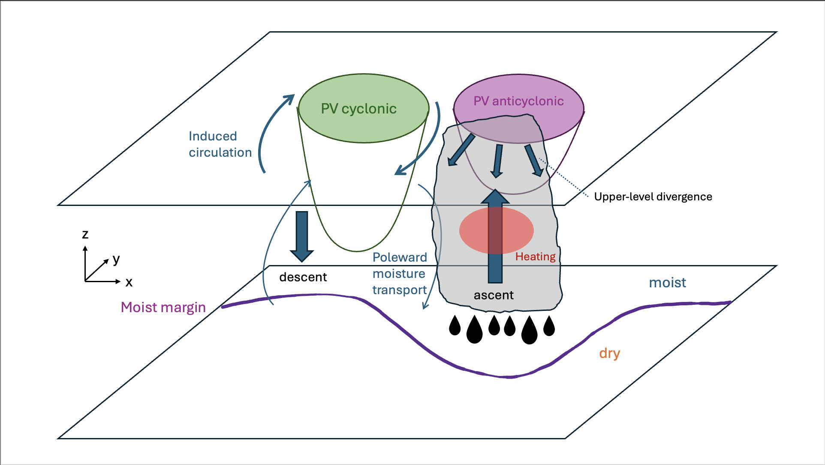
2-way interactions between PV and the moist margin
Southern Hemisphere
Notes:
Focus here is that the interact goes two ways.

Slide 8
Conclusions
1. The moist margin is a useful diagnostic that describes a sharp boundary between the rainy “deep tropics” and the clear “dry subtropics”.
2. Weather systems are closely connected with the moist margin, particularly extratropical PV anomalies.
3. Interactions between the moist margin and PV anomalies can occur in both directions.

