Slide 1
The potential of irrigation for cereals production in Sub-Saharan Africa: A machine learning application for emulating crop growth at large scale
Klinnert, Ana; Rogna, Marco; Barbosa, Ana Luisa; Tillie, Pascal and Edoardo Baldoni
EC Joint Research Centre-Seville, Unit D.4 - Economics of the Food System
European Geosciences Union (EGU) Annual Meeting 2025

Slide 2
Introduction
Agriculture and irrigation in Sub-Saharan Africa:
Low productivity compared to world average (e.g. Maize 2 tons/ha in SSA)
Just 3.5% of cultivated land is irrigated, versus a world average of 17.7% (You et al., 2011)
SSA is among the most exposed and vulnerable regions to climate change
Steady rising population, with one of the highest birth rate in the world
Very limited use of modern agricultural inputs
High percentage of people working in the primary sector

Slide 3
Objective
Premises:
Need to increase agricultural productivity while stabilizing yields
Water (irrigation) is a fundamental input that, by fostering both land productivity and yields stability, can improve food security and incomes
Several studies have found high potentials of irrigation in different African countries or in the whole continent (e.g. You et al. (2011), Xie et al. (2014))
Maximization of returns from private and public spending calls for individuation of priority areas (with higher returns and feasible conditions) for irrigation projects

Slide 4
Methodology
Focus on four staples: Maize, Millet, Rice and Sorghum
Computation of yields differentials under rain-fed conditions and optimal irrigation for the four cereals for all SSA agricultural locations (1Km cells)
Computation of water requirements to obtain optimal irrigation
DSSAT crop model used to compute yields and water requirement but…
Almost 500,000 agricultural locations in SSA (too many)
DSSAT simulations conducted on approximately 5,000 locations
Machine learning (XGBoost) used to impute values to remaining locations

Slide 5
DSSAT Simulations
3 Sets of data inputs required by DSSAT:
Soil characteristics: ISRIC Africa Soil Maps, HiHydroSoil (V2.0)
Weather data: NASA POWER
Management practices (e.g. inputs, type of irrigation, etc.): Low and moderate levels of fertilization, rain-fed (no irrigation added) and optimal (unconstrained) irrigation (water is added whenever the model registers water-stress levels)
Agro Ecological Zones (AEZs) used as unit of analysis
Soil, weather and management parameters used as explanatory variables in XGBoost

Slide 6
NASA weather data – GMAO MERRA-2
Global coverage
Resolution: ½° x ⅝° lat/lon (≈ 55.5 km x 69.4 km) = low resolution
Time: January1981 – current. We only focused at data from 2017 -2022.
Model: GMAO MERRA-2
https://journals.ametsoc.org/view/journals/clim/30/14/jcli-d-16-0758.1.xml
Modern-Era Retrospective Analysis for Research and Applications, version 2 (MERRA-2)
Atmospheric reanalysis -> data assimilation system -> meteorological observations
Upgrade from MERRA
MERRA-2 is the first long-term global reanalysis to assimilate space-based observations of aerosols and represent their interactions with other physical processes in the climate system.
Extraction process:
POWER API – accessed through python script
Point level (very suitable for our study – but to be improved for general use)
Problems encounter: blocked for too many requests - solved
NASA weather research team open to help and collaborate further

Slide 7
XGBoost – Tree based
What is XGBoost?
An optimized, scalable, and flexible implementation of gradient boosting, designed to enhance model performance and speed.
Ensembles learning strategy, as it combines weak learners iteratively to minimize error and improve predictive accuracy.
Can be used both for regression and classification problems. Here we use it for regression!

Slide 8
XGBoost – crop growth emulators
4 XGBoost crop models (trained with ca. 18’000 data points on yields from the DSSAT crop growth model)
Input
Output
Soil
Weather
Managements practices
Yields (high, low fertilization with and without irrigation)

Slide 9
Model details
Model details
Removed highly correlated features (not an inherent problem for tree based models – but interpretability improves)
Test/ train split – 70/ 30%
Hyper parameter tuning (number of trees, depth of trees, learning rate, gamma – controlling the threshold of a “”worthwhile” split)
Model performance

Slide 10
More on model performance…
SHAP (SHapley Additive exPlanations:
Interpretable Model Insights: SHAP values provide interpretable, feature-level insights into XGBoost predictions, making it easier to understand which factors drive outcomes.
Feature Importance by Scenario: SHAP values highlight the most influential features for specific scenarios or predictions, helping identify scenario-dependent patterns in the data.
How does it work? SHAP values are based on Shapley values, which come from cooperative game theory. In this framework, each feature is treated as a “player” in a game that contributes to the final prediction. How does it do it? In simple terms: Removing the feature, making a prediction with the remaining features, adding the feature back, making another prediction and calculating the difference.

Slide 11
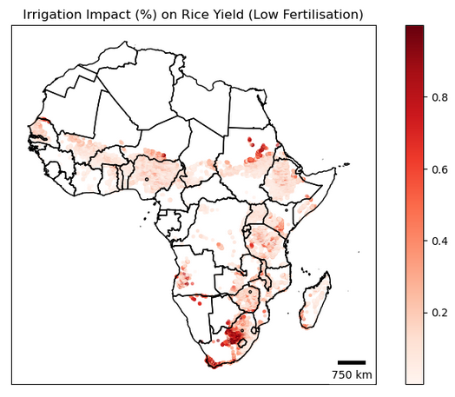
Results I
Yields Differentials (%)

Slide 12
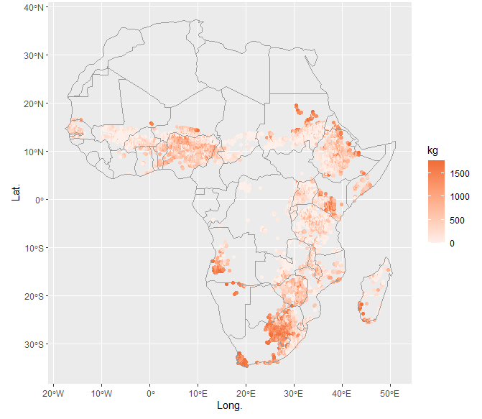
Results II
Yields Differentials (kg/ha)
Maize
Millet

Slide 13
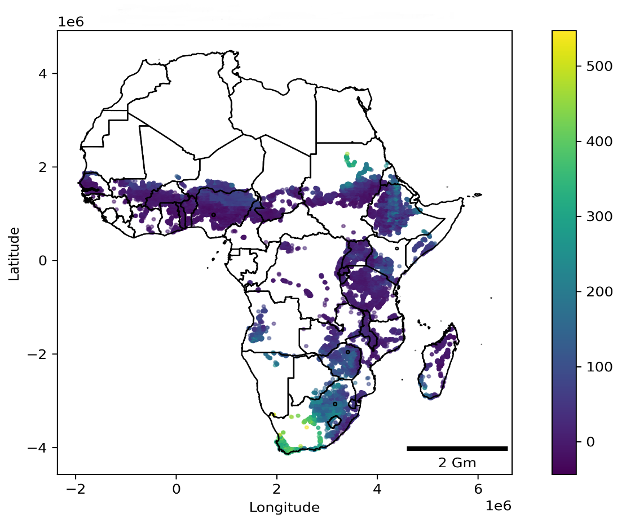
Results III
Water requirements (mm/ha per cropping season)
Maize
Millet

Slide 14
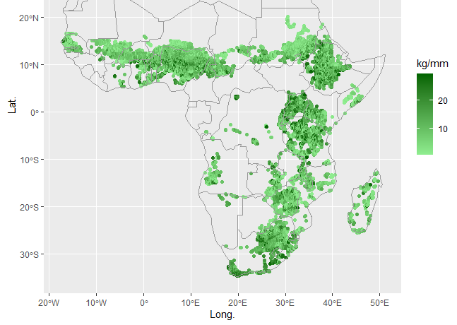
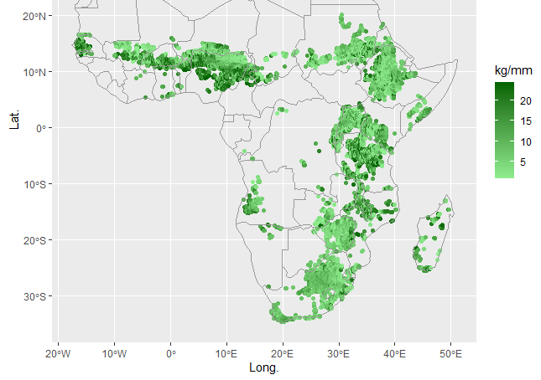
Results IV
Water productivity (kg/mm yield increase per unit of added water)
Maize
Millet

Slide 15
Average Gains through Irrigation by Country
Country | Unit | Maize | Millet | Rice | Sorghum | Country | Maize | Millet | Rice | Sorghum
Angola | Kg/ha | 744.8 | 1567.2 | 1904.9 | 2272.4 | Mali | 462.7 | 47.7 | 354.0 | 302.5
 | PPP$/ha | 281.9 | - | 854.5 | 1652.5 |  | 229.0 | - | 148.6 | 388.5
Burundi | Kg/ha | 364.7 | 106.2 | 619.6 | 651.1 | Mozambique | 585.1 | 292.8 | 757.6 | 1128.3
 | PPP$/ha | 205.1 | - | 362.2 | 765.0 |  | 247.7 | - | 475.2 | 726.5
Benin | Kg/ha | 548.1 | 389.4 | 171.8 | 329.2 | Mauritania | 490.7 | 352.5 | 933.3 | 532.9
 | PPP$/ha | 259.7 | - | 155.0 | 180.4 |  | 237.3 | - | 257.2 | 1016.9
Burkina Faso | Kg/ha | 617.2 | 227.7 | 342.3 | 458.4 | Malawi | 693.4 | 480.5 | 759.0 | 1187.9
 | PPP$/ha | 296.6 | - | 218.9 | 365.9 |  | 350.7 | - | 595.8 | 839.1
Botswana | Kg/ha | 1000.8 | 682.1 | 2235.0 | 1384.0 | Namibia | 2257.3 | 2109.7 | 3150.6 | 3018.9
 | PPP$/ha | 413.5 | - | 567.6 | 2038.6 |  | 827.0 | - | 1102.4 | 2564.3
Central African Republic | Kg/ha | 904.3 | 399.4 | 223.0 | 380.1 | Niger | 474.8 | 264.1 | 600.6 | 913.1
 | PPP$/ha | 351.4 | - | 146.2 | 191.1 |  | 208.1 | - | 396.4 | 580.5
Cote d'Ivoire | Kg/ha | 523.9 | 361.7 | 233.2 | 244.9 | Nigeria | 707.5 | 607.9 | 380.9 | 424.3
 | PPP$/ha | 228.6 | - | 106.0 | 225.1 |  | 292.0 | - | 173.7 | 351.1
Cameroon | Kg/ha | 642.1 | 584.5 | 460.2 | 572.6 | Rwanda | 449.0 | 100.2 | 430.6 | 453.1
 | PPP$/ha | 287.8 | - | 254.9 | 458.1 |  | 210.5 | - | 210.9 | 448.6
Congo, Dem. Rep. | Kg/ha | 538.7 | 199.8 | 636.6 | 591.3 | Sudan | 307.8 | 213.0 | 336.4 | 784.3
 | PPP$/ha | 197.6 | - | 215.2 | 519.1 |  | 138.9 | - | 348.2 | 334.0
Congo, Rep. | Kg/ha | 488.4 | 56.6 | 104.4 | 56.1 | Senegal | 524.9 | 351.0 | 513.1 | 315.3
 | PPP$/ha | 174.6 | - | 19.9 | 83.3 |  | 227.5 | - | 135.7 | 492.3
Eritrea | Kg/ha | 1190.2 | 892.9 | 912.5 | 2501.4 | Somalia | 605.4 | 535.4 | 529.0 | 845.0
 | PPP$/ha | 630.7 | - | 1311.3 | 1068.6 |  | 381.7 | - | 521.9 | 688.4
Ethiopia | Kg/ha | 578.4 | 426.7 | 588.2 | 1548.7 | Eswatini | 677.3 | 277.4 | 439.4 | 1031.9
 | PPP$/ha | 325.6 | - | 859.5 | 723.6 |  | 285.1 | - | 432.6 | 410.5
Ghana | Kg/ha | 576.7 | 314.7 | 307.6 | 303.4 | Chad | 335.4 | 162.9 | 180.8 | 170.1
 | PPP$/ha | 283.3 | - | 148.4 | 332.8 |  | 137.2 | - | 69.2 | 165.4
Guinea | Kg/ha | 556.6 |  | 321.2 | 0.0 | Togo | 369.7 | 298.9 | 393.0 | 312.3
 | PPP$/ha | 299.0 |  | 0.0 | 381.7 |  | 167.0 | - | 140.0 | 393.4
Gambia, The | Kg/ha | 653.8 | 376.7 | 526.2 | 637.4 | Tanzania | 691.4 | 311.4 | 742.1 | 897.1
 | PPP$/ha | 398.0 | - | 385.0 | 703.6 |  | 346.5 | - | 443.5 | 818.0
Guinea-Bissau | Kg/ha |  |  | 325.5 | 162.2 | Uganda | 726.3 | 165.7 | 336.3 | 342.6
 | PPP$/ha |  |  | 75.6 | 338.7 |  | 390.8 | - | 182.5 | 398.0
Kenya | Kg/ha | 628.0 | 499.6 | 753.9 | 645.6 | South Africa | 2755.1 | 1854.1 | 3543.0 | 1249.2
 | PPP$/ha | 292.1 | - | 297.2 | 768.6 |  | 1018.9 | - | 460.5 | 2909.1
Lesotho | Kg/ha | 1588.8 | 1061.4 | 1060.8 | 134.3 | Zambia | 624.2 | 287.4 | 1070.7 | 1901.1
 | PPP$/ha | 704.3 | - | 59.4 | 1045.1 |  | 278.9 | - | 844.9 | 1070.5
Madagascar | Kg/ha | 784.8 | 693.2 | 662.6 | 1163.4 | Zimbabwe | 936.1 | 445.8 | 1013.4 | 1520.0
 | PPP$/ha | 474.5 | - | 696.8 | 881.5 |  | 257.0 | - | 432.7 | 810.2

Slide 16
Results Va
Water productivity (kg/mm) computed by dividing yield differentials by water need
Priority Areas (2 types): water capture and storage (e.g. ponds) and more complex irrigation systems (water sourced from rivers or from underground reserves)
Areas 1 - Water Capture and Storage: Locations with highest water productivity (top 50th percentile) and highest total run-off values (top 25th percentile) [run-off values from Akpoti et al. (2024)]
Areas 2 – Complex Irrigation Systems: Locations with highest water productivity (top 25th percentile) and zero total run-off values

Slide 17
Run-off Values
Run-off values from Akpoti et al. (2024)

Slide 18
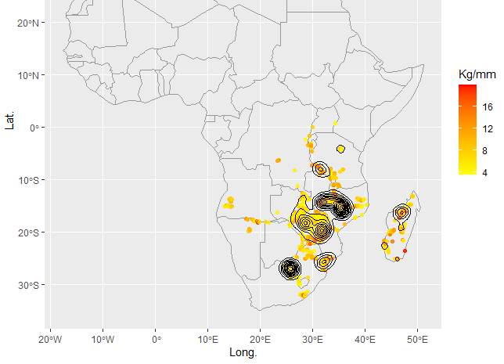
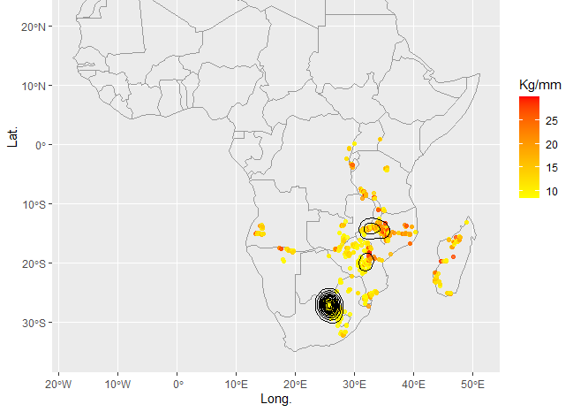
Results Vb
Areas of Type 1: Water Capture and Storage Devices
Sorghum
Millet

Slide 19
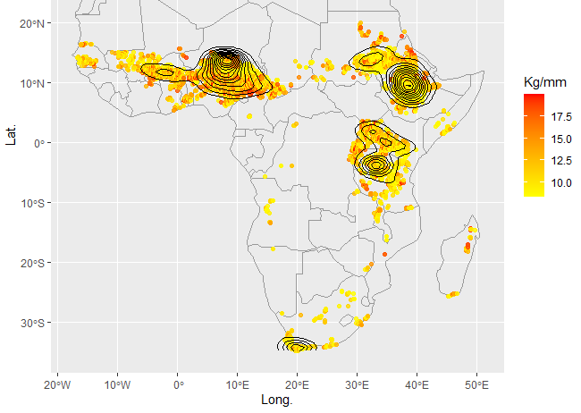
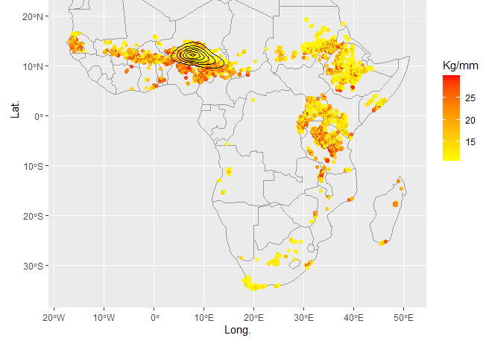
Results Vc
Areas of Type 2: Complex Irrigation Systems
Sorghum
Millet

Slide 20
Conclusions and Policy Insights
Significant potentials for irrigation in terms of yields and, consequently, revenues
High degree of variability even at local level, calling for ad-hoc studies for actual irrigation plans
In the area surrounding Pretoria, in South Africa, and in the south–eastern region of Africa (Malawi, Zambia and Mozambique), ponds and other water capture and storage devices could be highly beneficial and viable, since several locations exhibit both high water productivity and total run–off values.
In the southern border of the Sahara desert, in Ethiopia and in the border between Kenya and Tanzania, there are also high concentrations of locations with a good water productivity, but more complex irrigation systems may be necessary since these locations are characterized by total run–off values equal to zero

Slide 21
Keep in touch
EU Science Hub: ec.europa.eu/jrc
@EU_ScienceHub
EU Science Hub – Joint Research Centre
EU Science, Research and Innovation
EU Science Hub
EU science
Notes:
Delete/update as appropriate

Slide 22
Thank you
© European Union 2021
Unless otherwise noted the reuse of this presentation is authorised under the CC BY 4.0 license. For any use or reproduction of elements that are not owned by the EU, permission may need to be sought directly from the respective right holders.

