Slide 1
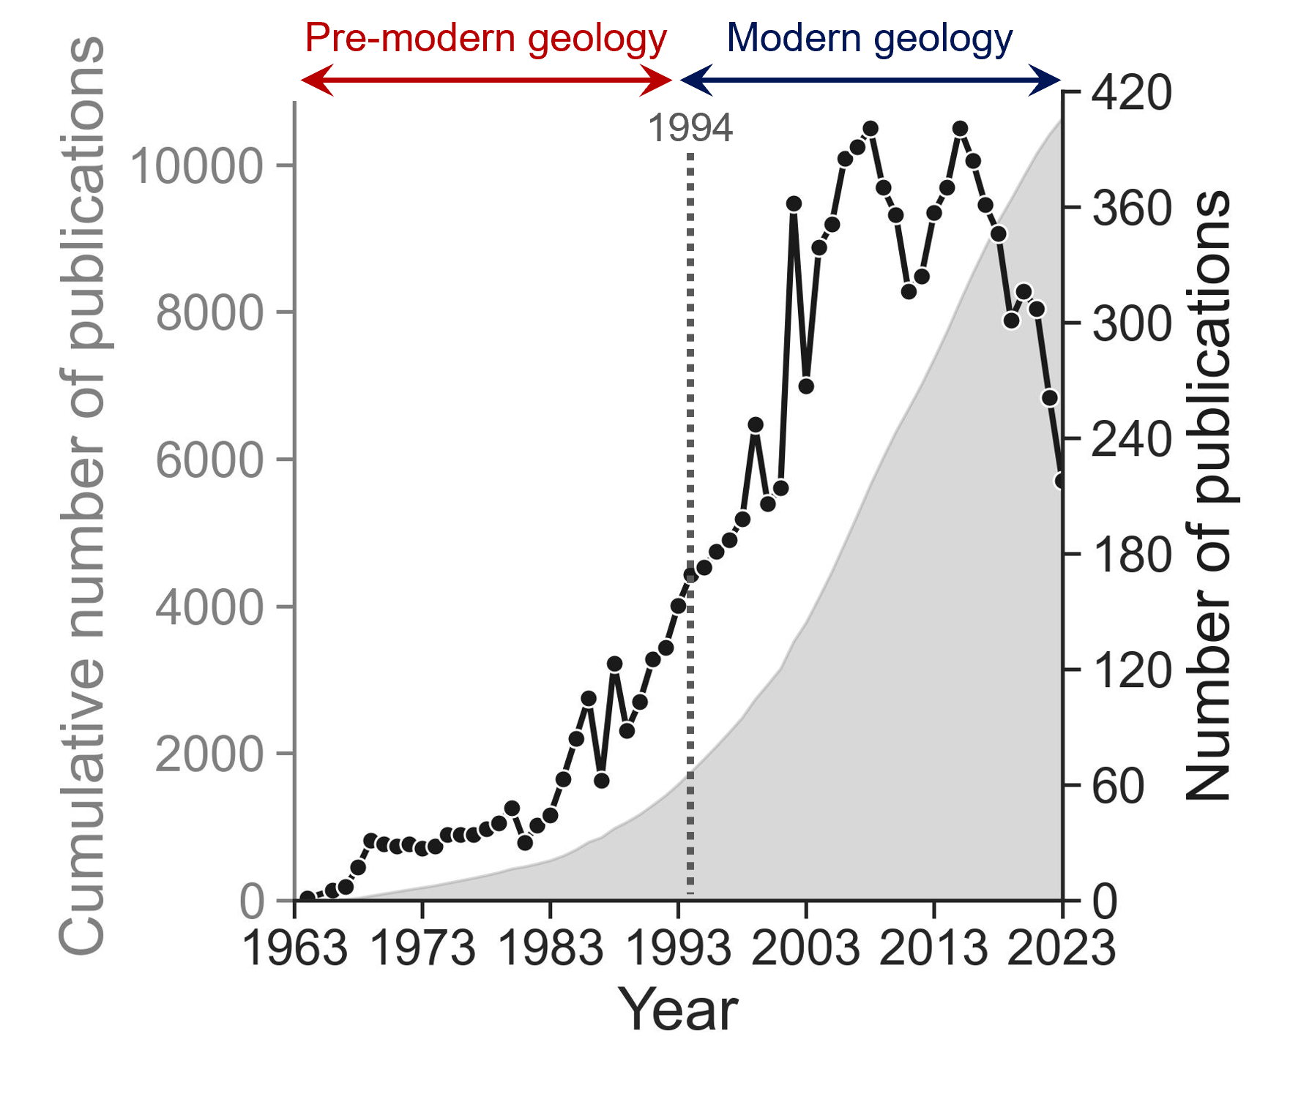
Exploring Geological Research Themes and Trends in South Korea Using Topic Modeling
EGU25-14874
Taeyong Kim¹, and Minjune Yang^{2,3*}
¹Division of Earth Environmental System Sciences, Pukyong National University
²Division of Earth and Environmental System sciences-Major of Environmental Geosciences, Pukyong National University
³Wible Co., Ltd
Why Topic Modeling (Latent Dirichlet Allocation, LDA)?
Too many publications to read manually
LDA automatically discovers key research topics and trends
What did we do?
Analyzed 10,380 publications from 10 Korean geological journals
Applied Topic Modeling (LDA) to titles, keywords, and abstracts
Visualized and quantified research themes, trends, and their relationships
To develop schematic literature review flow using topic modeling for identifying research themes and trends in large scientific literature

Slide 2
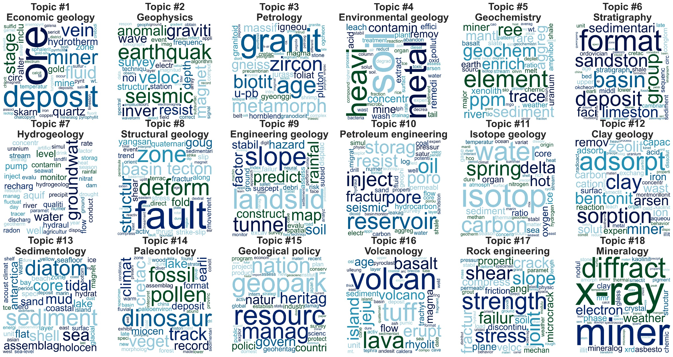
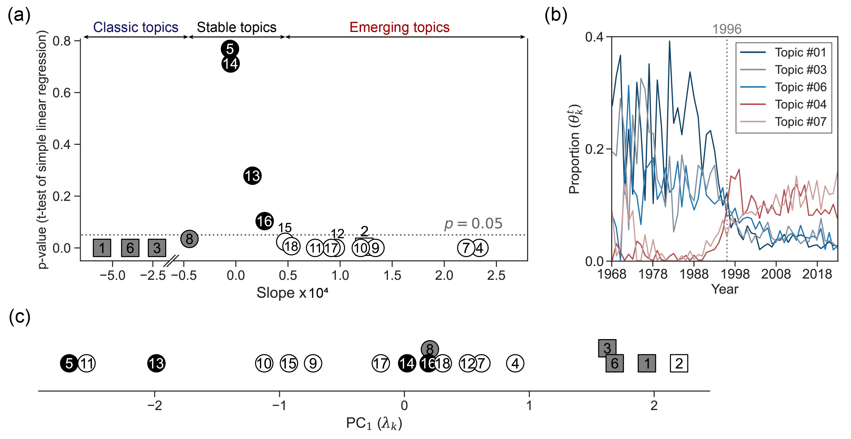
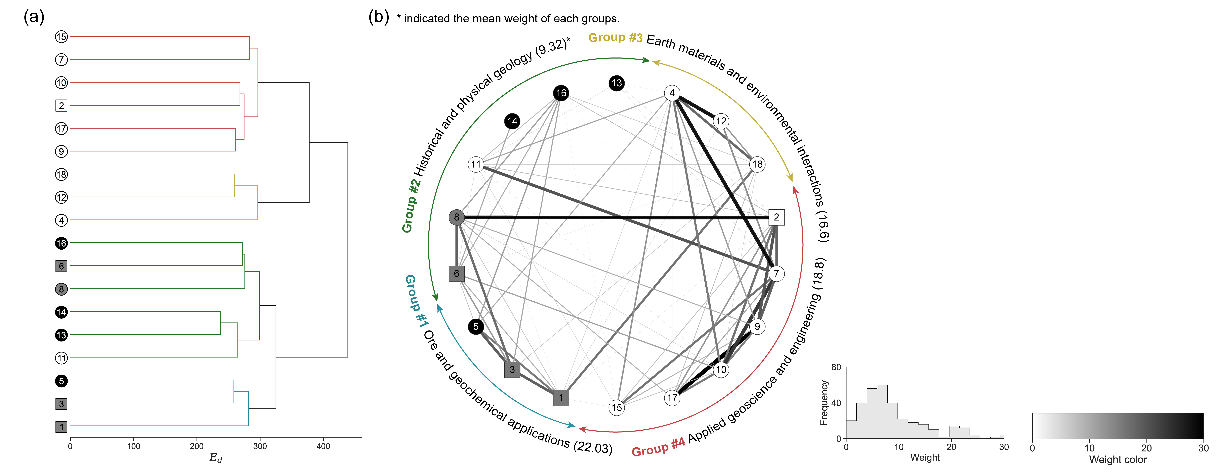
Key Results & Insights
18 main research topics identified in 10,380 publications
Research focus shifted significantly over 60 years
Strong links found between environmental and hydrogeology topics
Scalability & Adaptability
This workflow can be easily adapted for large-scale literature analysis in any scientific field

Slide 3
Exploring Geological Research Themes and Trends
in South Korea Using Topic Modeling
Taeyong Kim¹, and Minjune Yang^{2*}
¹Division of Earth Environmental System Sciences, Pukyong National University
²Division of Earth and Environmental System sciences-Major of Environmental Geosciences, Pukyong National University
³Wible Co., Ltd
EGU25-14874

Slide 4
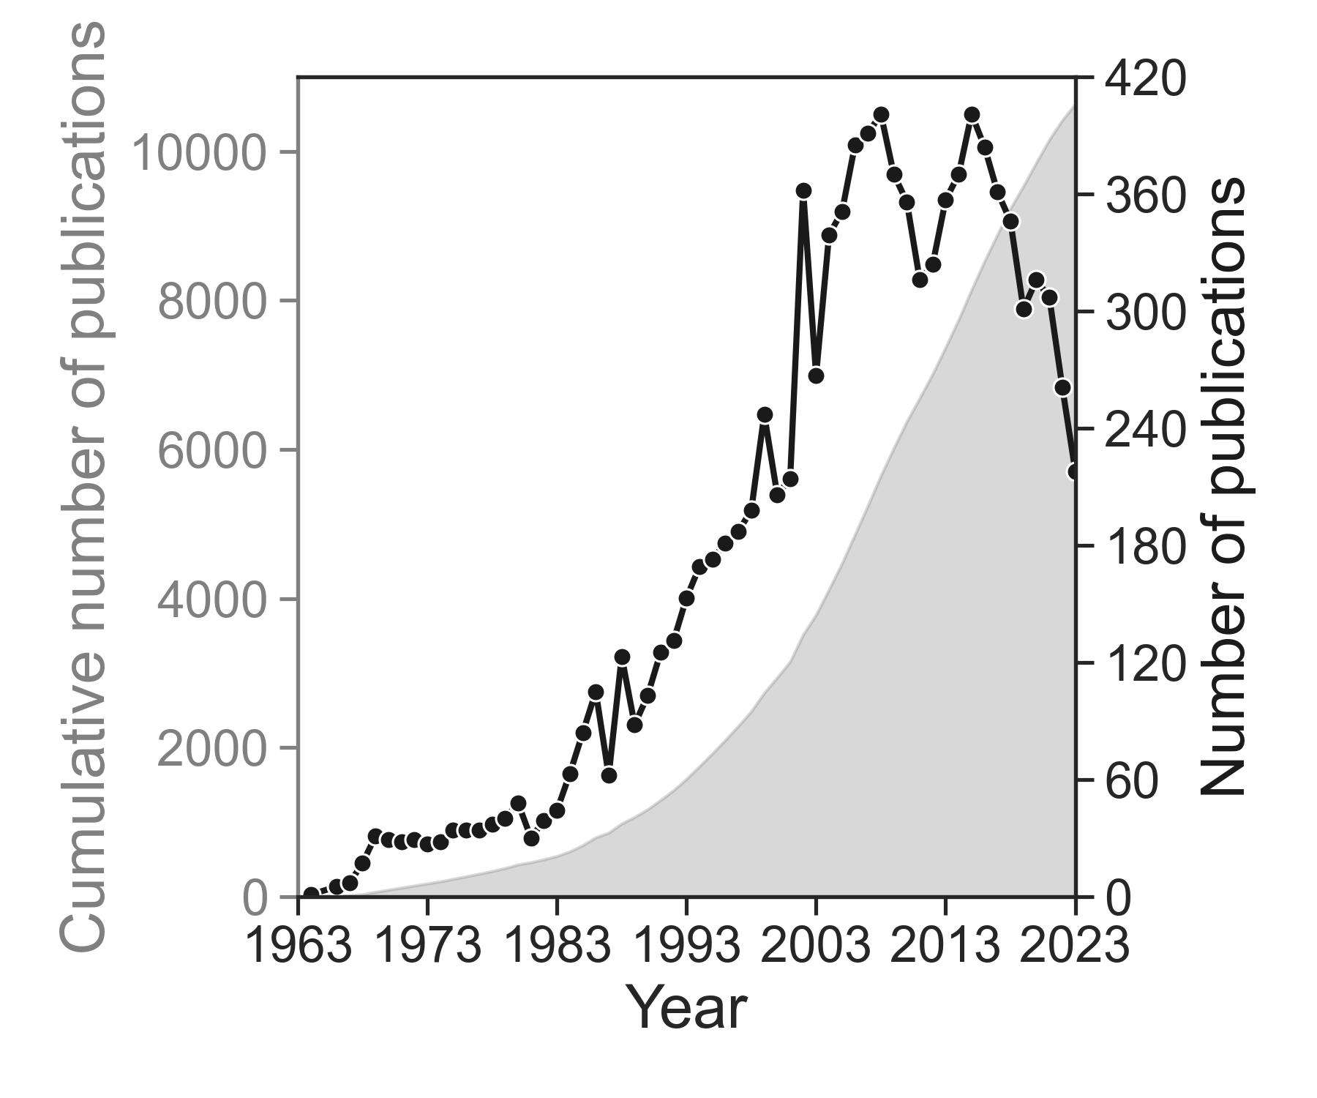
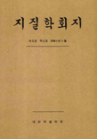
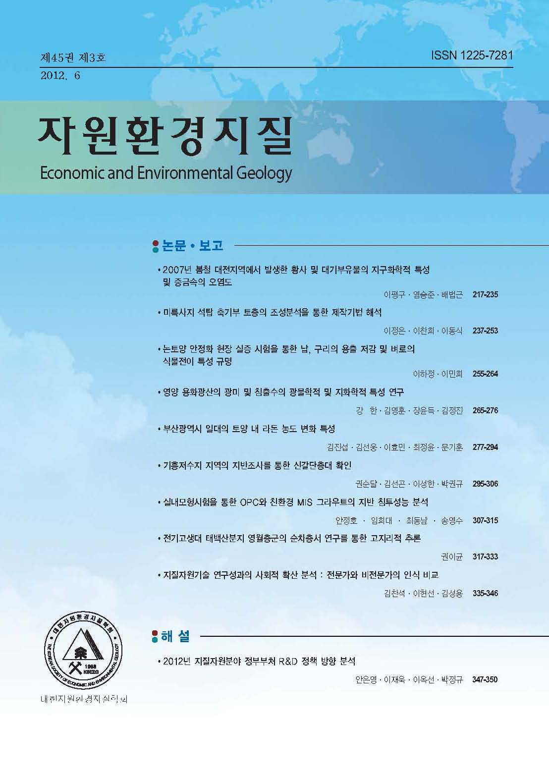
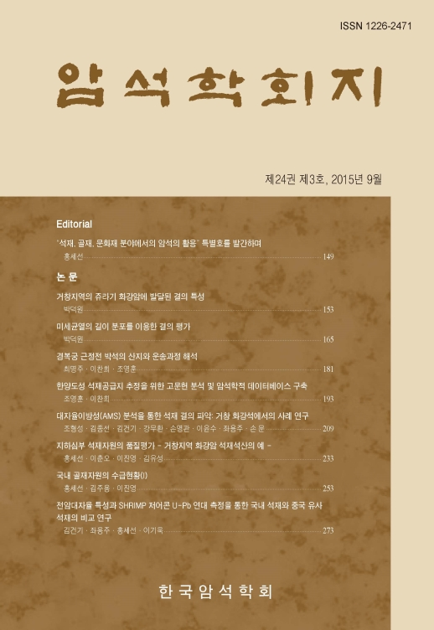
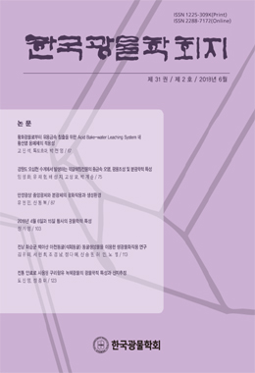
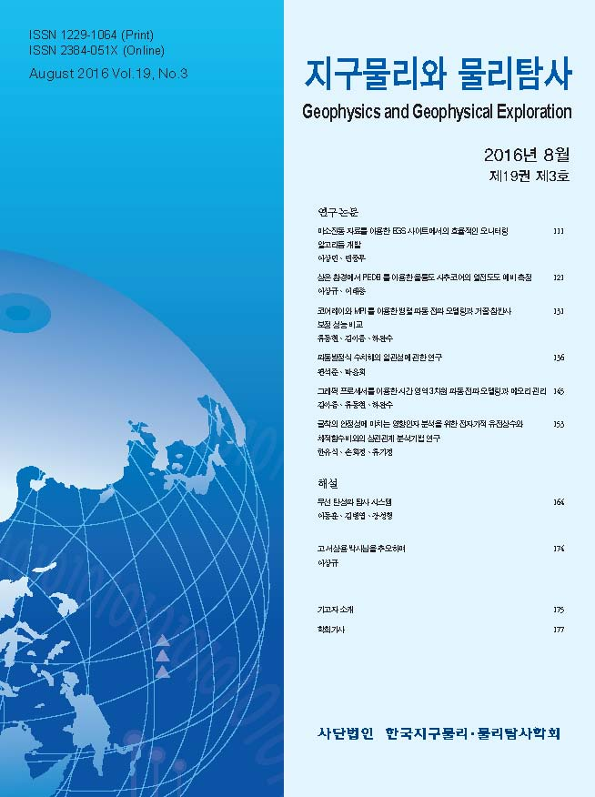
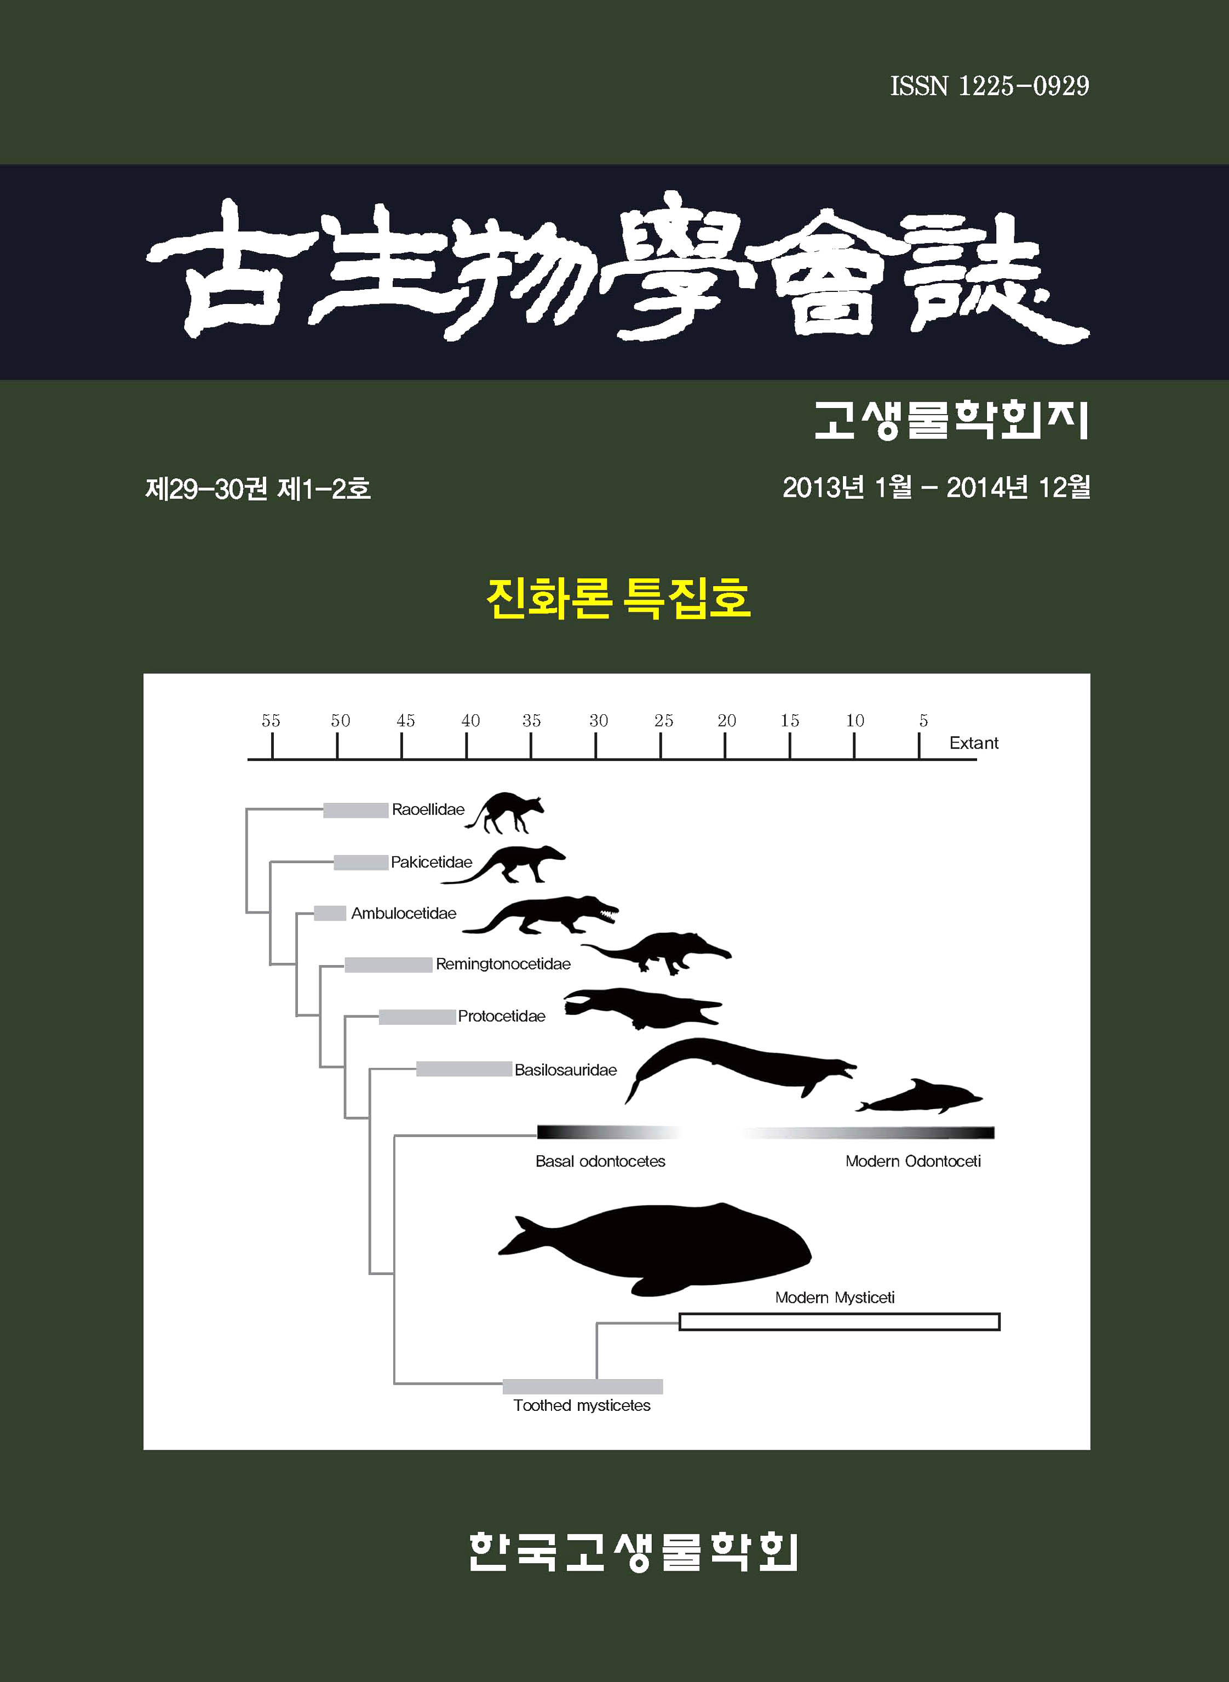
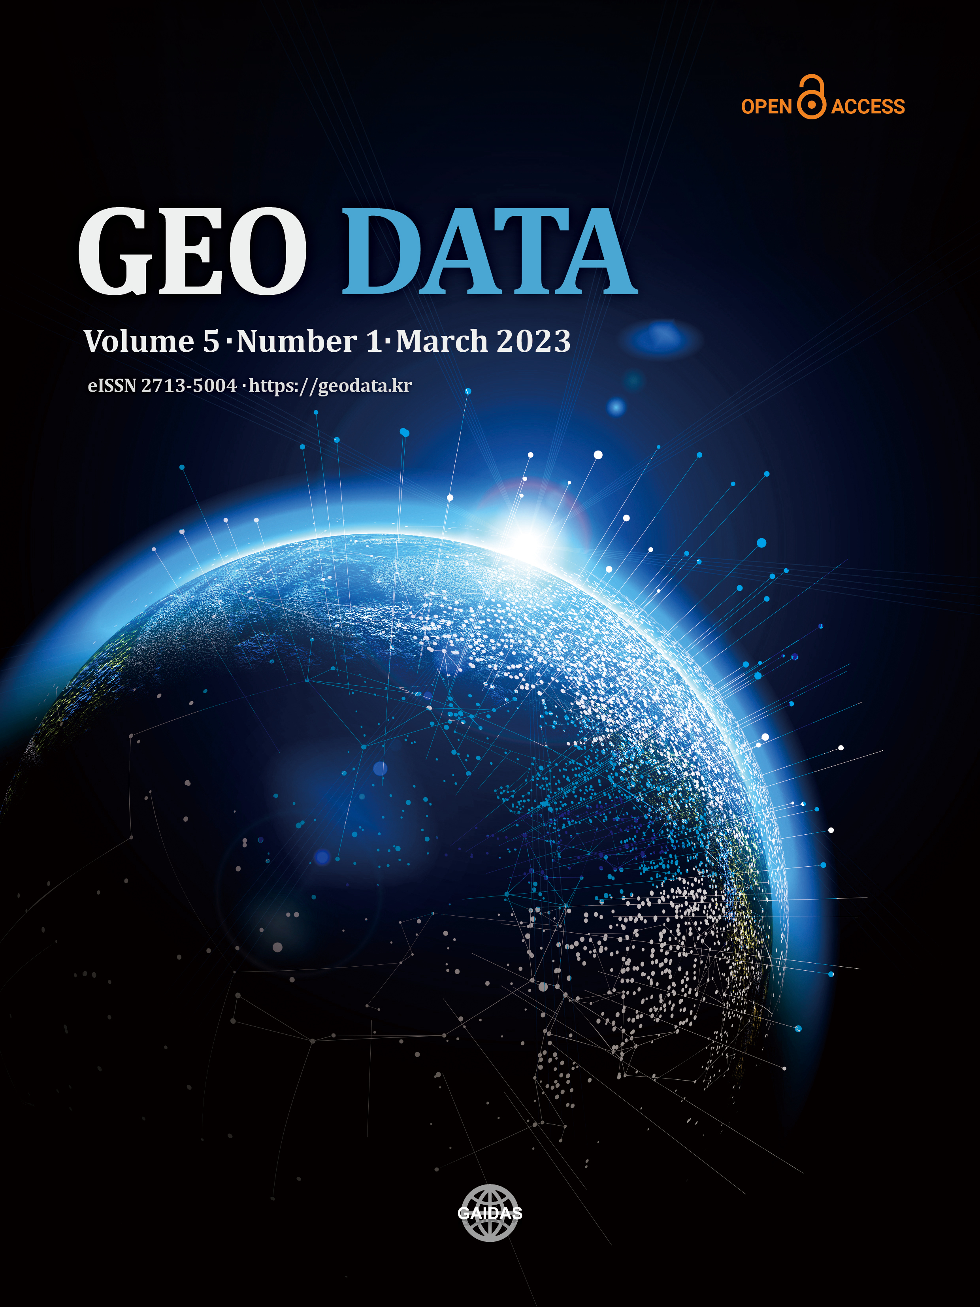
1.1. Study rationale
Pre-modern geology
Modern geology
1994
The first geological issue
in South Korea (1964.08)
The first geological paradigm shifting
in South Korea (1994.02)
Figure 1. The number of publications per year (black line plot) and the cumulative number of publications (grey area plot) from 1964 to 2023 in Korean geological journals (n=10).

Slide 5
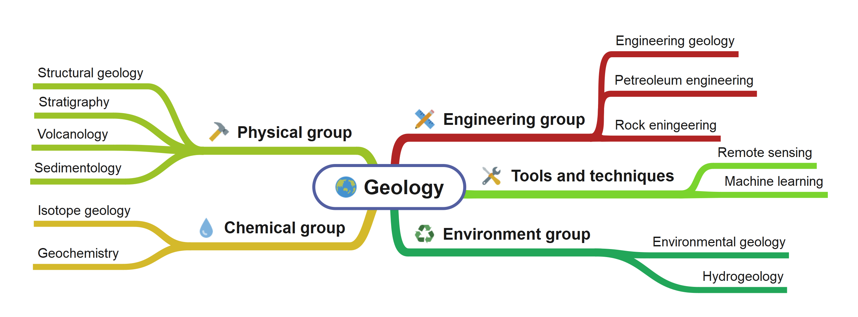
1.1. Study rationale
Modern geology has expanded through interdisciplinary studies, blurring the boundaries between fields.
However, comprehensive research covering the entire field of geology remains lacking.

Slide 6
1.1. Study rationale
Topic modeling
Latent Dirichlet Allocation (LDA)
“Probabilistic topic models are a suite of algorithms whose aim is to discover the hidden thematic structure in large archives of documents.” (Blei et al., 2012)

Slide 7
2.1. Data collection and pre-processing
Collected from RISS (Korean academic DB)
Duration : 1964 ~ 2023, total 60 years
Total publications : 10,380
Using titles, keywords, and abstract of papers
Nature Language Processing (NLP)
- Removing the stop words
- Using stemming, transform to root word
Building data set for modeling
Figure 1. The number of publications per year (black line plot) and the cumulative number of publications (grey area plot) from 1964 to 2023 in Korean geological journals (n=10).
Notes:
여기서 LDA 모델이 문서를 생성하는 가정과 어떻게 Inference 되는지를 얘기해주자.

Slide 8
2.2. Latent Dirichlet Allocation (LDA)
Figure 2. Latent Dirichlet allocation (LDA) process and its two outputs. (a) LDA document generation process, (b) An illustrative example of the LDA document generation process, (c) Two outputs of LDA; 1) Word distribution per topic($β_{k}$) and 2) Topic distribution per-document ($θ_{d}$).
Notes:
여기서 LDA 모델이 문서를 생성하는 가정과 어떻게 Inference 되는지를 얘기해주자.

Slide 9
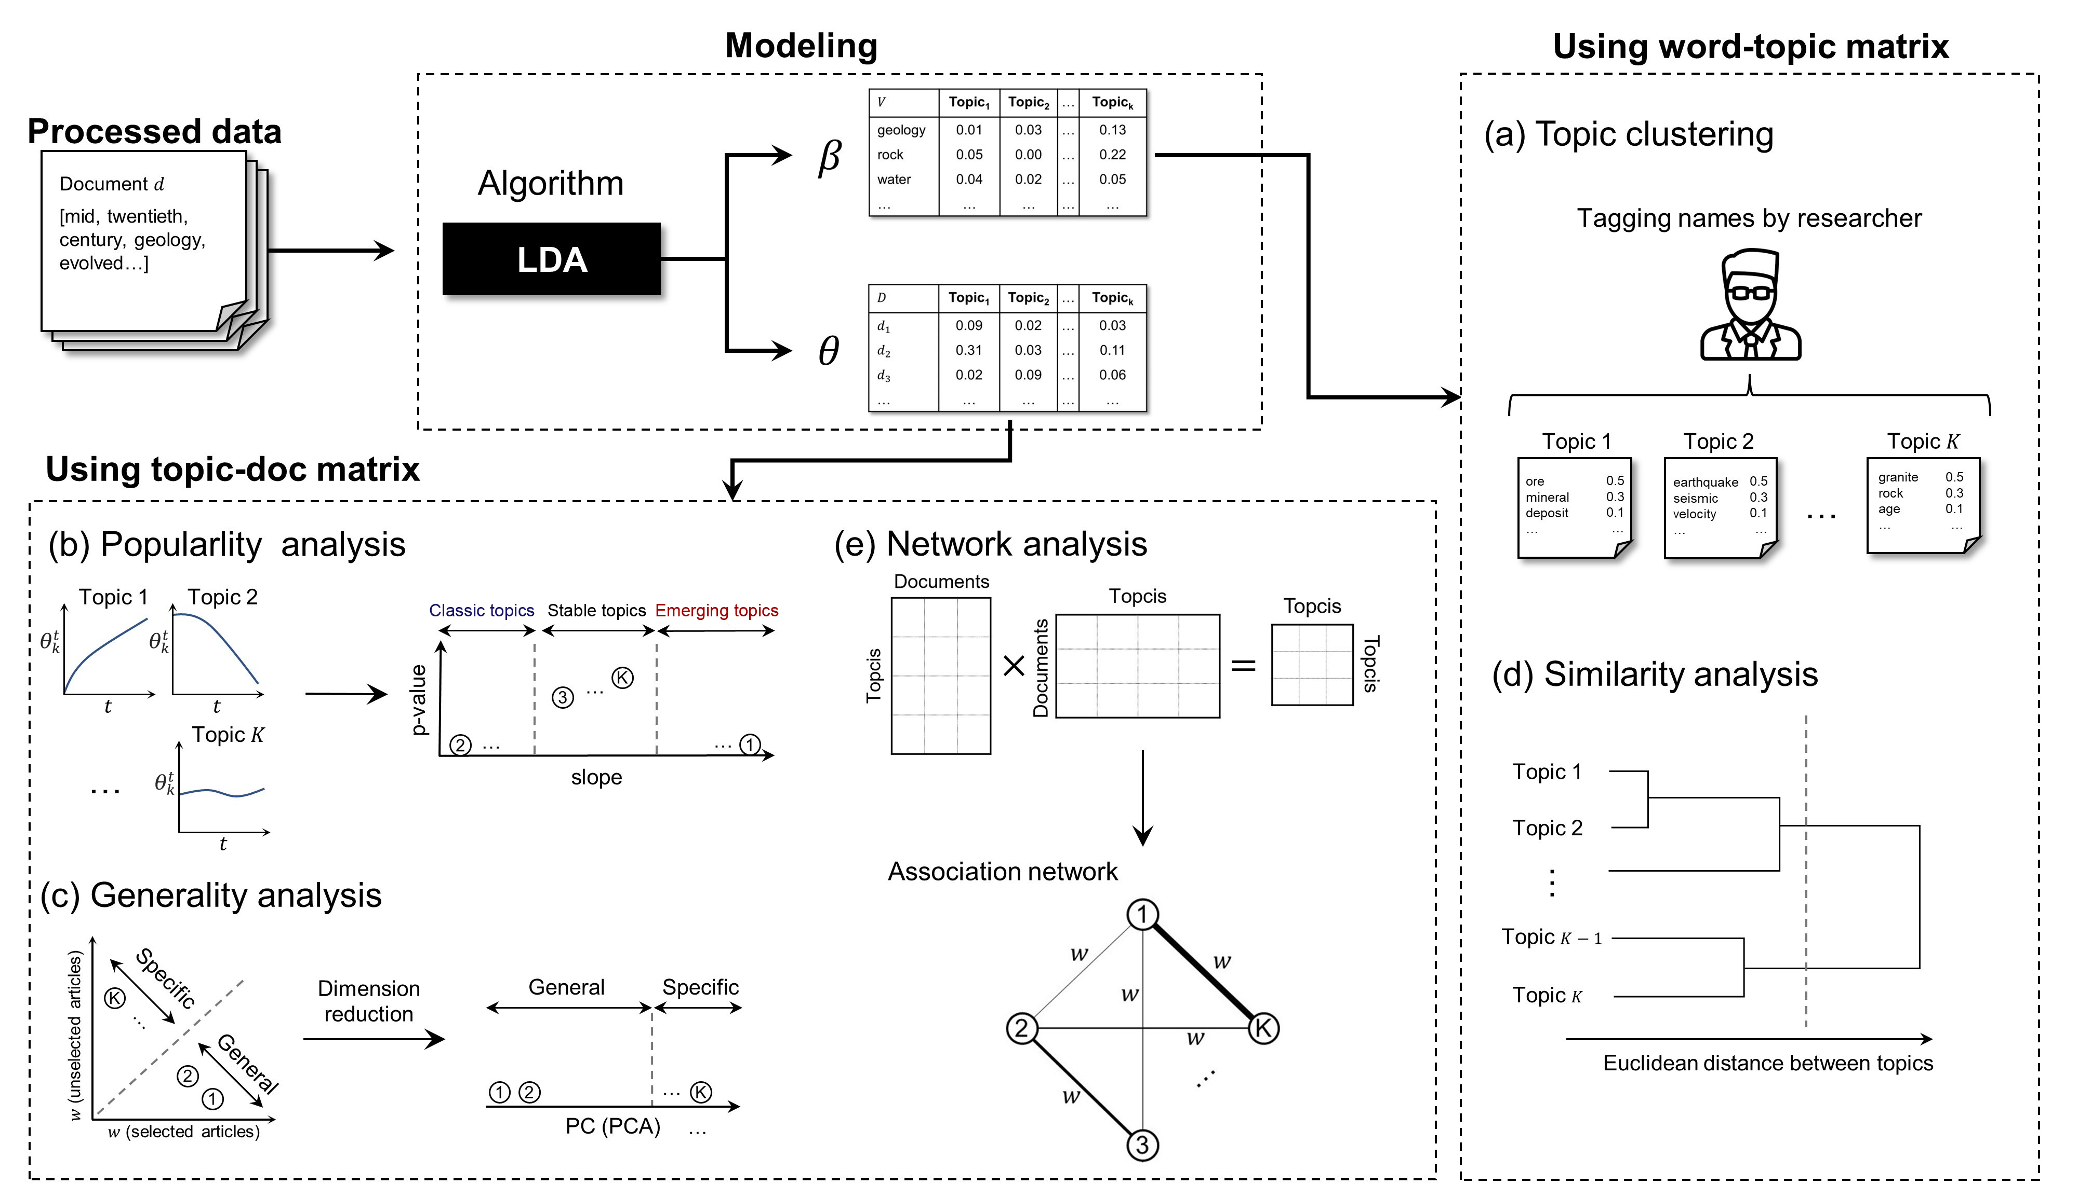
2.3. Topic analysis with various statistical approach
Statistical analysis
(b) Linear regression with t-test
(c) PCA (principal component analysis)
→ Visualized as 1-D plots
(d) Hierarchical clustering based on euclidean distance
(e) Network analysis
Figure 3. The flow charts of LDA and topic analysis with various statistical models consist of (a) Topic clustering, (b) Popularity analysis, (c) Generality analysis, (d) Similarity analysis, and (e) Network analysis.

Slide 10
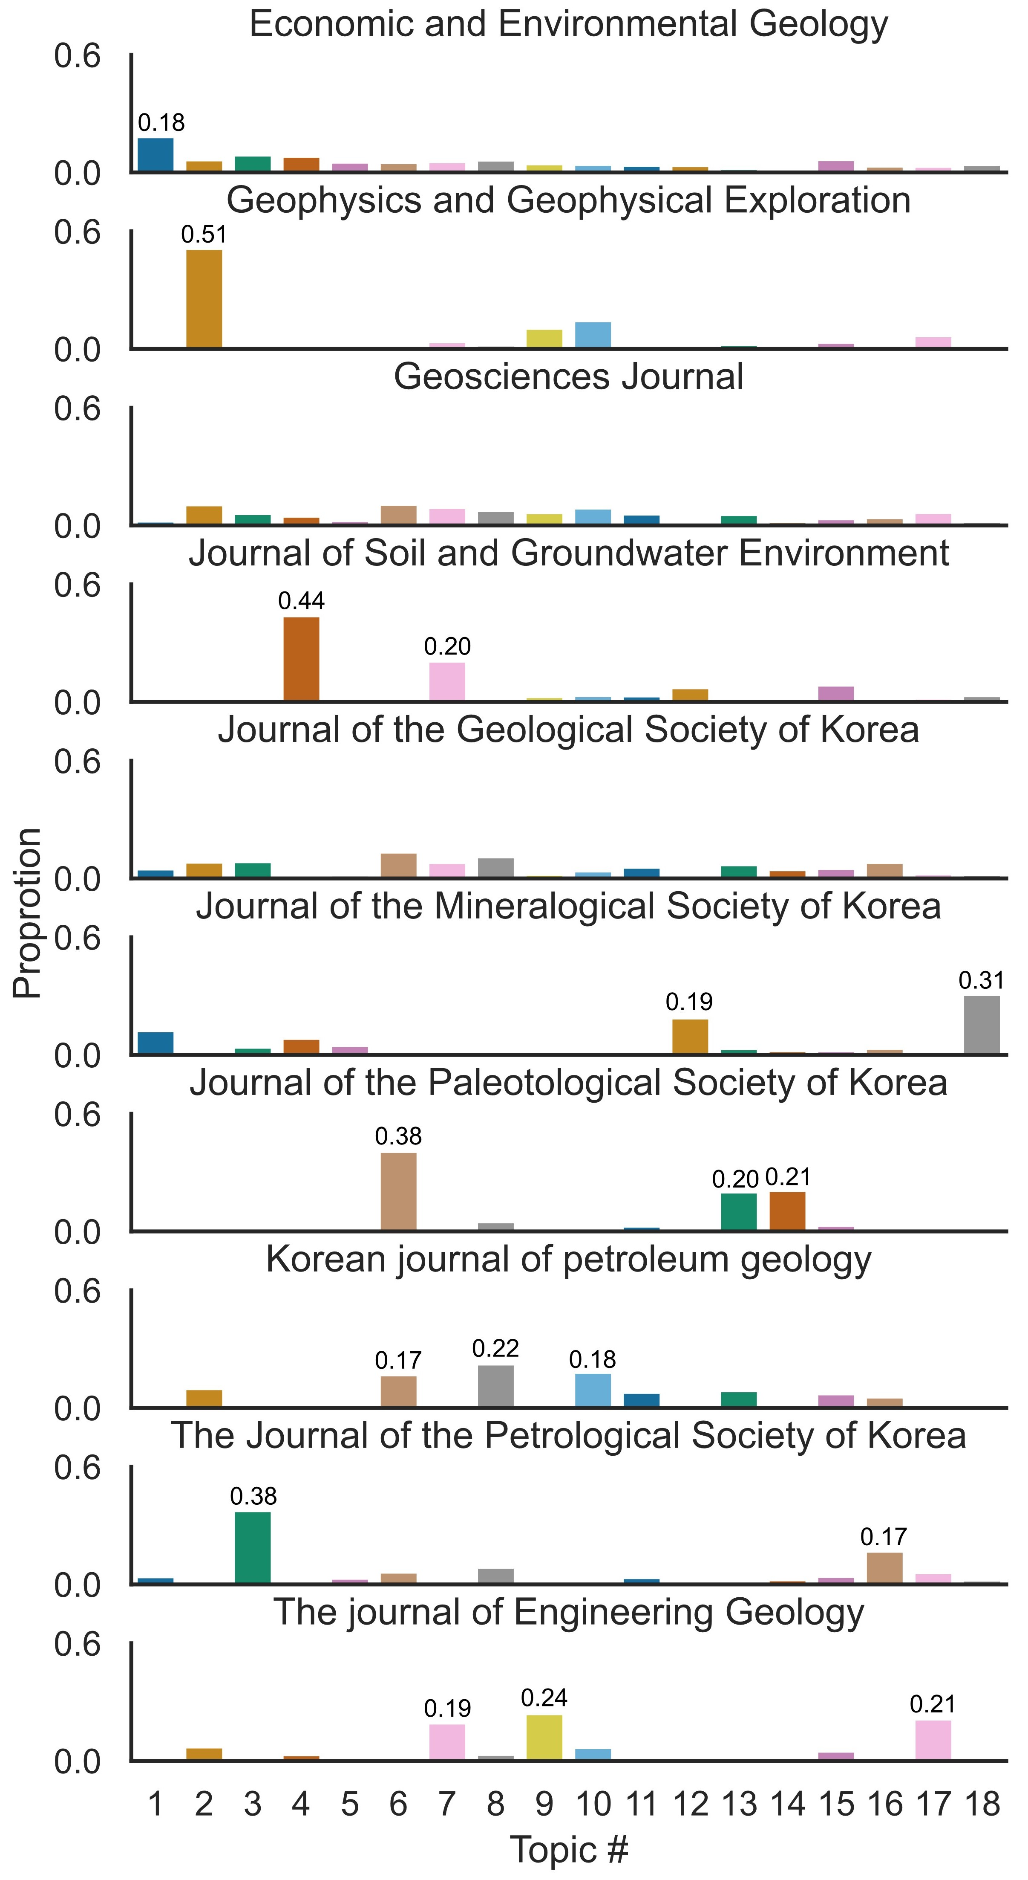
3.1. Discovering topics in the Korean geological journals
(a)
(b)
Figure 4. (a) Wordcloud of each geological topic (K = 18) in the Korean geological journals. The size of the words representing the proportion of the words in the topic from the corpus. (b) The example of topic distributions per each geological journals in South Korea.

Slide 11
3.2. The result of popularity and generality analysis
Topic #1: Economic geology
Topic #3: Petrology
Topic #6: Stratigraphy
Topic #4: Environmental geology
Topic #7: Hydrogeology
Topic #2: Geophysics
Topic #5: Geochemistry
Topic #11: Isotope geology
General topics
Specific topics
Figure 5. (a) Popularity analysis representing the trend states of the topic with t-test. (b) the significant topic proportion over time based on the results of popularity analysis. (c) generality analysis showing the scope of each topic (general or specific) with 1-D plot.

Slide 12
3.3. The result of similarity and network analysis
The most central topics in each groups
Group #1: Petrology (Topic #3)
Group #2: Stratigraphy (Topic #6)
Group #3: Clay geology (Topic #12)
Group #4: Engineering geology (Topic #9)
The highest connectivity within topics
Environmental geology-Hydrogeology (#4-#7)
Environmental geology-Clay geology (#4-#12)
Geophysics-Structural geology (#2-#8)
Engineering geology-Rock engineering (#9-#17)
Figure 6. (a) Similarity analysis of the distance between each topics by categorizing four groups. (b) Association network of the relationship between 4 groups using the topic-topic connectivity.

Slide 13
This study aimed to introduce how to classify the research themes and estimate the research trends of each geological topic in South Korea using Latent Dirichlet Allocation (LDA).
The optimal number of identified topics was 18, and this study presented the trend of each topic (classic topics, stable topics, and emerging topics).
The results of this study showed the relationships between topics to apply the various statistical analysis methods (trend analysis, generality analysis, similarity analysis, and network analysis).
The corpus review tool used in this study can help the interdisciplinary researcher who needs to review large archives of documents published from diverse disciplines.

Slide 14
Thank you for your attention
EGU25-14874

