Slide 1
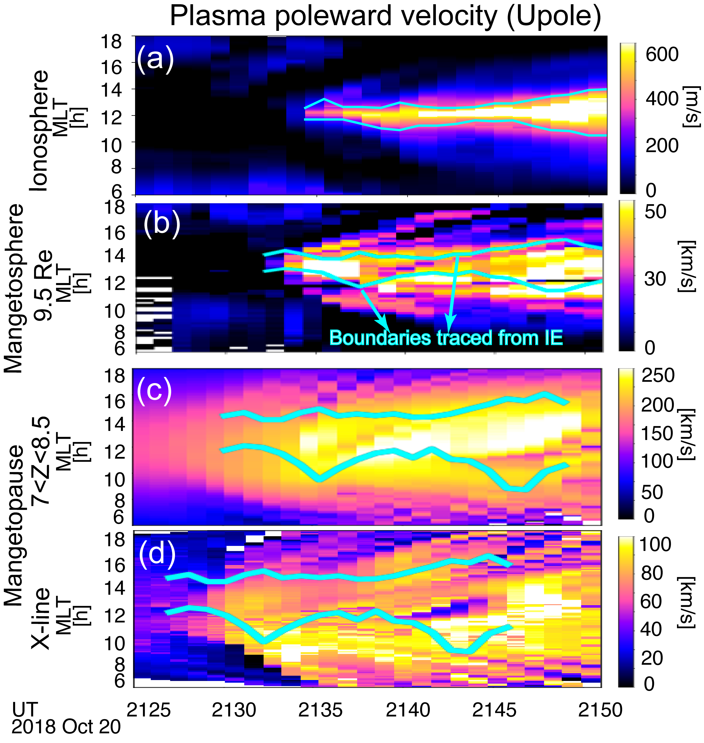
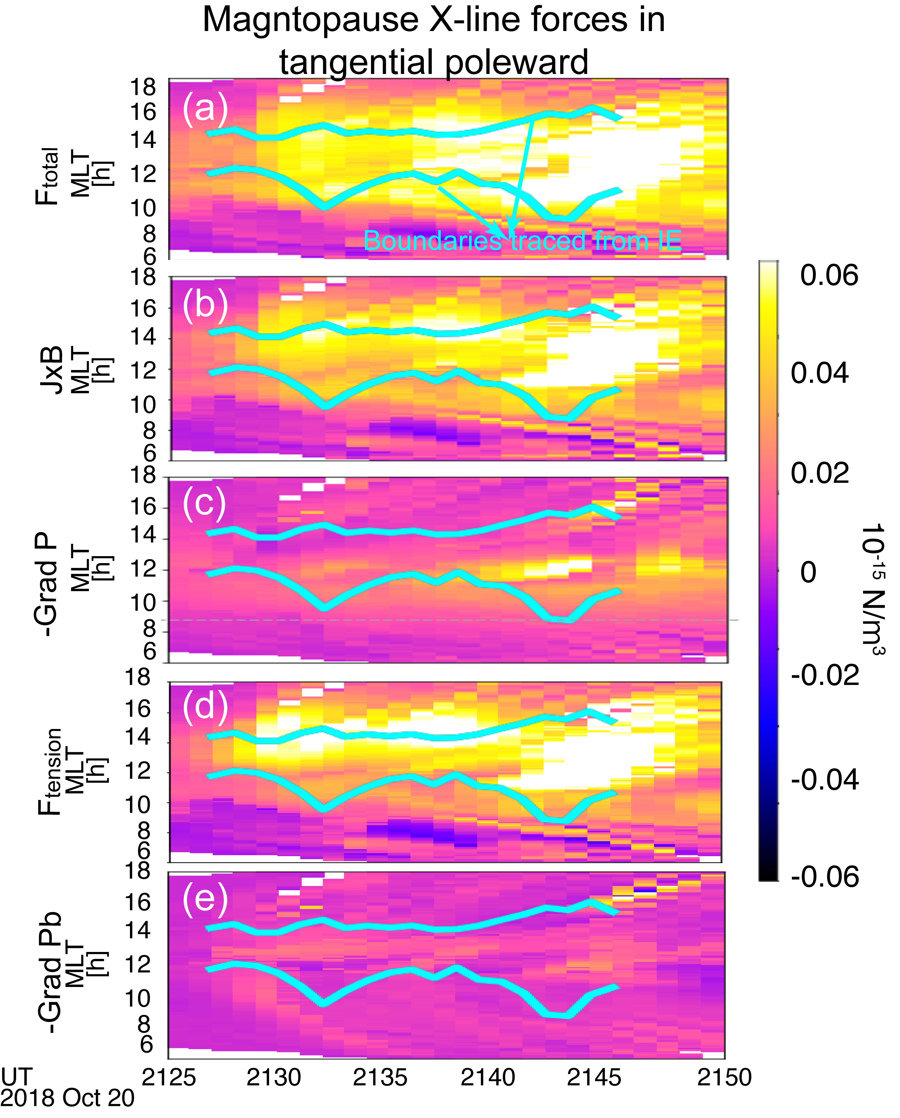
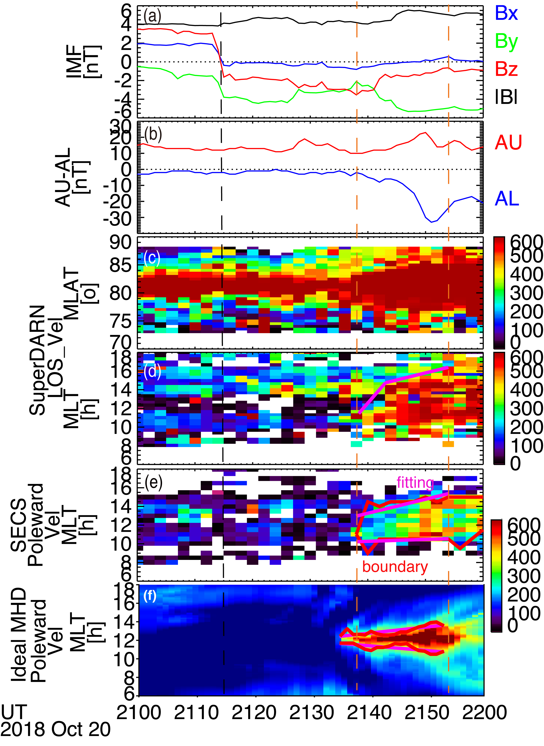
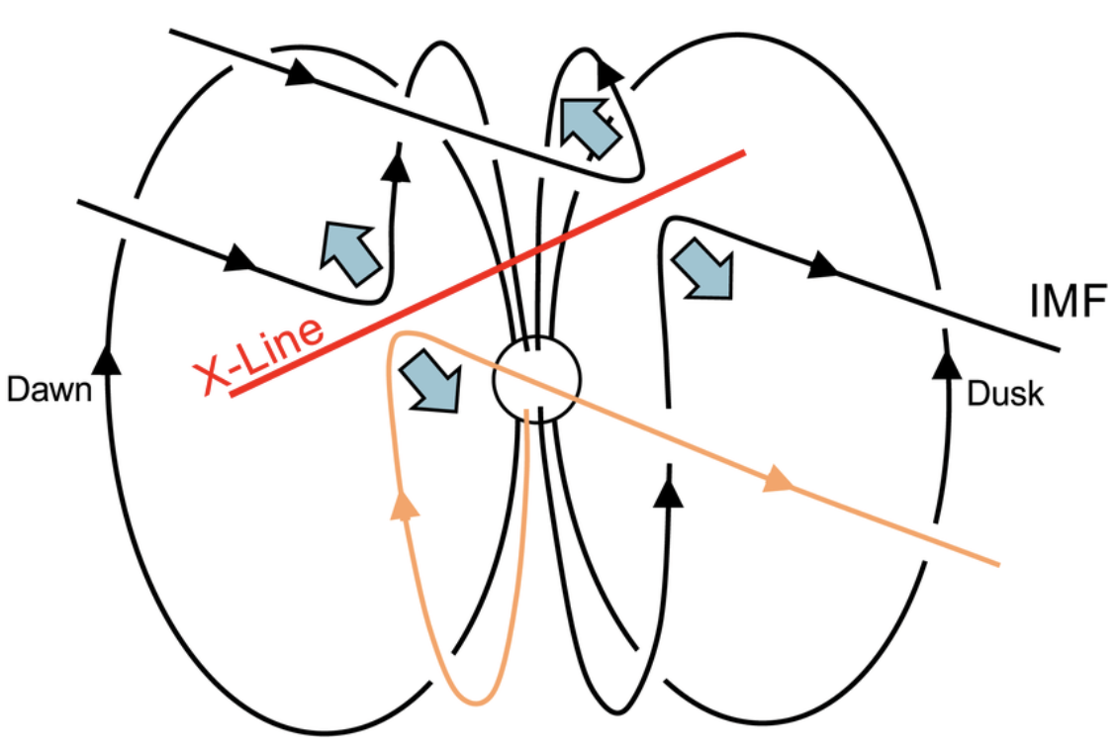
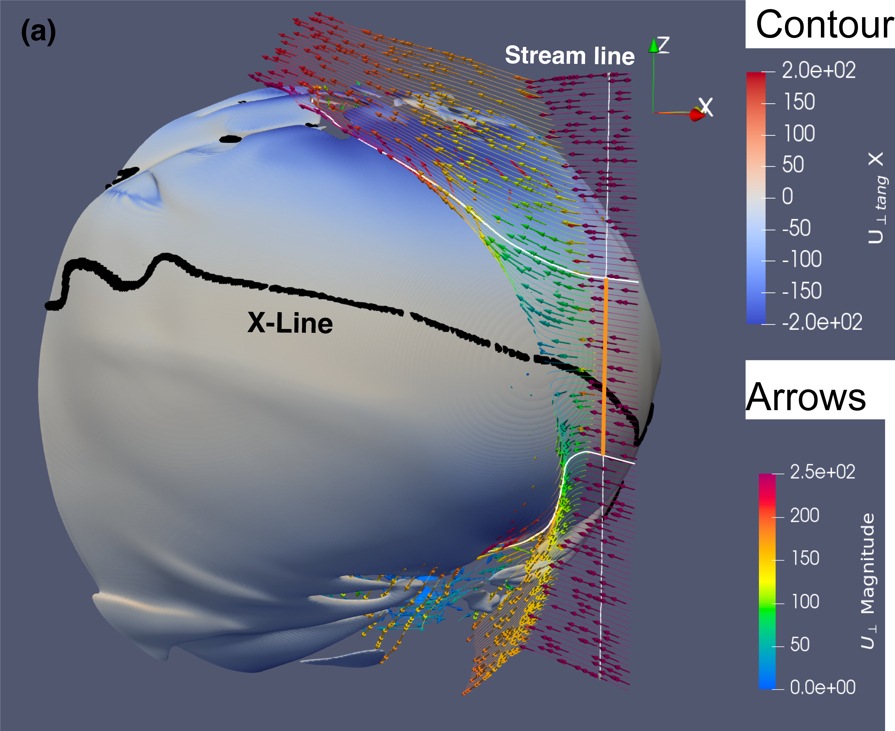
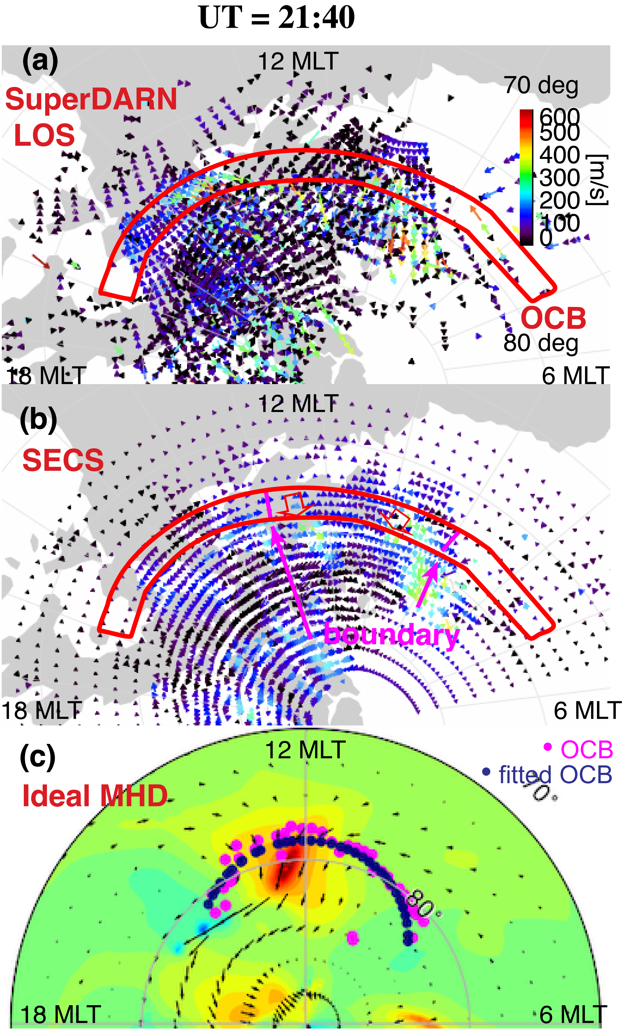
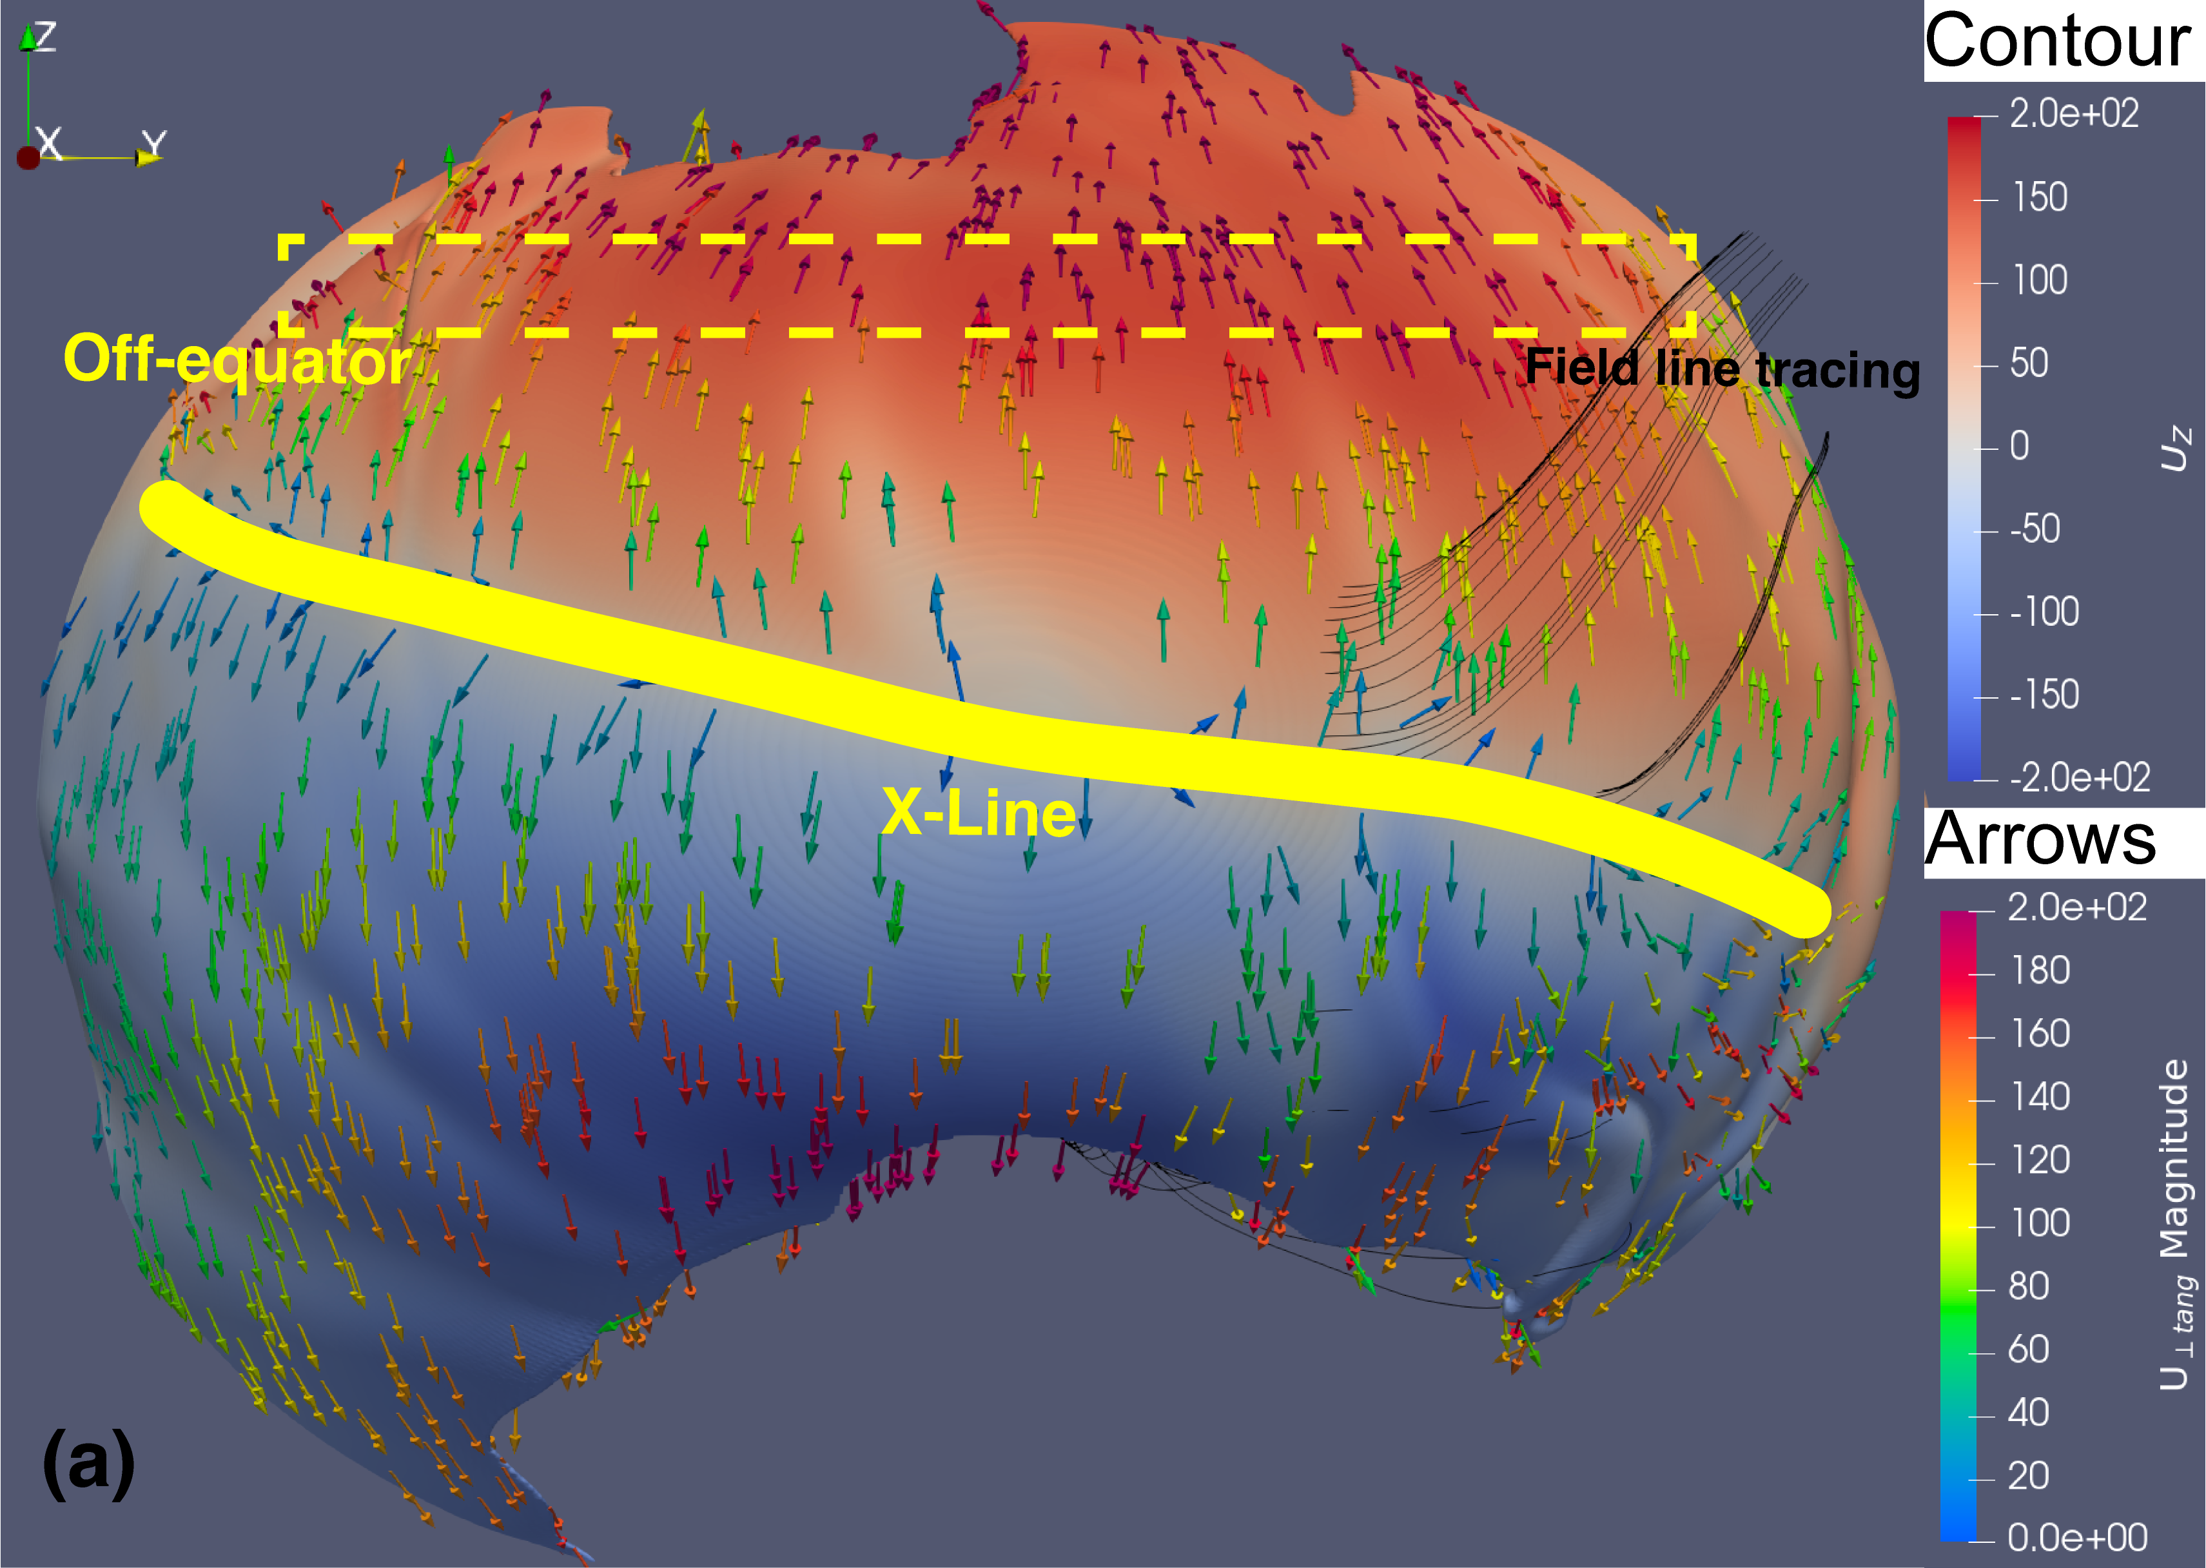
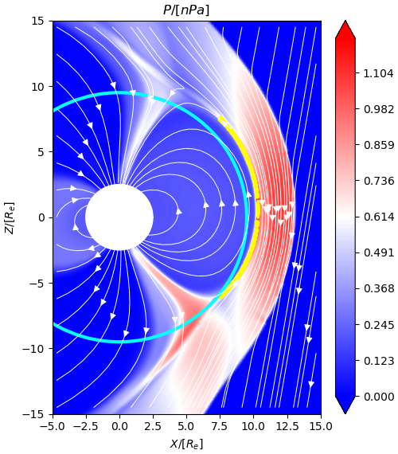
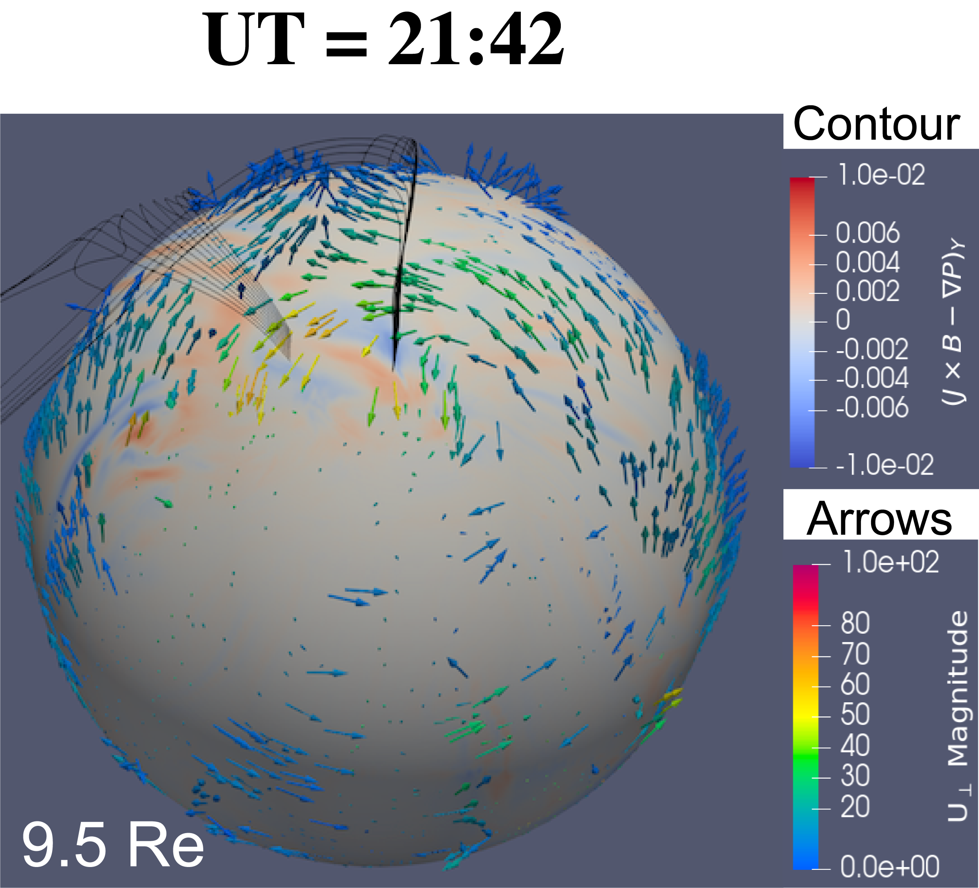
Ionosphere Plasma Response to Magnetopause X-line Evolution for Ideal MHD
W. Zhang$^{1}$(wzhang1@bu.edu), Y. Nishimura$^{1}$, Y. Chen$^{2}$, P. Cassak$^{3}$, G. Poh$^{4}$, N. Nishitani$^{5}$
1 Boston University; 2 University of Michigan; 3 West Virginia University; 4 NASA; 5 Nagoya University
1. Introduction and motivation
3. Results: observation and simulation in Ionosphere.
Figure 7. Keograms of the poleward component of forces along the magnetopause in the X-line region. Panels (a–e) show the total force, JxB, thermal pressure gradient, magnetic tension force, and magnetic pressure gradient, respectively. Aqua lines represent the flow channel boundaries traced from the ionosphere to the magnetopause X-line region.
Background
Figure 3. Panels (a) and (b) show the IMF condition and the AU-AL indices. Panels (c) and (d) present keograms of SuperDARN LOS velocity with MLAT and MLT distributions. Panel (e) and (f) display the poleward component of plasma velocity from SECS model and ideal MHD simulation, respectively. The black dashed line marks the IMF southward turning and the orange dashed lines denote the plasma flow channel expansion.
1. IMF orientation affects the X-line geometry and extent (Palmroth et al., 2006 ).
2. A large continuous X-line or multiple X-lines can exist over the magnetopause (Trattner et al., 2021 ).
Figure 1. X-line with negative IMF By
(Fuselier et al., 2019)
3. The magnetopause X-line is dynamic, and the extent varies because of IMF condition, X-line spreading by the tension forces or guide field, and localized perturbations (Zou et al., 2019).
4. The X-line affects the ionosphere convection, controlling the poleward plasma flows in the dayside open-closed boundary (OCB) region (Milan et al., 2016; Zou et al., 2018 ).
Challenges
The total force in poleward (= JxB - $∇P_{th}$) can partially explain the localized flow near noon, indicating other mechanism is necessary.
The radar line-of-sight (LOS) velocity convolutes poleward and azimuthal flows, and the fitting technique depends on empirical model (Nishimura et al., 2024).
The extent of magnetopause X-line has been difficult to determine due to satellite observation limitations.
5. Results: magnetosheath upstream condition
IMF southward turning was at 2114 UT (black dashed line). IMF By was steadily negative.
The reconnection signal arrival to the ionosphere can be seen as the AL decreases (orange dashed line).
SuperDARN LOS velocity and SECS poleward velocity both show duskward expansion.
The kinetic effect may be important for the inconsistency between panel e and f and will be investigated in the future.
Figure 5. Poleward component of plasma velocity shown at (a) the ionosphere OCB, (b) the magnetosphere OCB at 9.5 Re, (c) along the magnetopause off-equator, and (d) along the magnetopause X-line. In panel a, aqua lines denote the flow channel boundaries identified using the FWHM method. In panel (b-d) aqua lines represent magnetic field lines traced from panel (a).
Objectives
Determine the magnetopause X-line evolution under IMF southward turning through SuperDARN remote sensing and global MHD simulation.
Plasma flow channel in the X-line region does not agree with the ionosphere plasma flow channel based on the field lines tracing.
From the magnetopause X-line region to off-equator region and to 9.5 Re in the magnetosphere, the flow channel becomes more consistent with the ionosphere.
2. Methods: observations and Global simulation
Ideal MHD shows a flow enhancement during the same timespan, with a preference for the postnoon sector. Ideal MHD provides insights for the event.
Figure 2. Dayside ionosphere convection maps from (a) SuperDARN LOS velocity, (b) SECS model results and (c) ideal MHD simulation. Length and direction of vectors show the magnitude and direction of plasma velocity. In panel a, the color of arrow represents LOS velocity, while it shows the poleward component of plasma velocity in panels b-c. The OCB region are highlighted. In panel b, the flow channel boundaries identified using FWHM method are marked with magenta lines.
4. Results: magnetopause analysis
(a)
(b)
Figure 8 shows the $U_{⟂ }$ Streamlines traced from solar wind. The magnetopause contour illustrates the tangential $U_{⟂ }$ in the X direction. Arrows indicate the direction and magnitude of $U_{⟂ }$. X-line locations are marked by black dots. The geoeffective length (orange line) is approximately 7 Re.
The off-equator region is under the effect of upstream flows, rather than solely the magnetopause X-line region.
The upstream flows decelerate in the magnetosheath region and then accelerate in the magnetosheath flanks.
Figure 6. Panel (a) shows the thermal pressure contour. Arrows show the magnetic field direction. Aqua line and yellow dots indicate the location of 9.5 Re and magnetopause surface location, respectively. Panel b shows the contour of total force in the GSM Y direction. Arrows indicate the directions and magnitude of plasma flow perpendicular to the local magnetic field ($U_{⟂ }$). Black lines are the dawnside and duskside flow channel boundaries traced from the ionosphere.
6. Conclusion
The observation reveals that the enhanced plasma flows emerge approximate 20 min after IMF southward turning in the ionosphere OCB region.
Ideal MHD simulation shows the same flow enhancement period. The enhanced flow becomes more consistent with the magnetopause off-equator region compared with the reconnection X-line site.
The generation mechanism for the plasma flows in the magnetopause off-equator region is not solely driven by the X-line reconnection but also by the upstream flows and JxB force in the cusp.
Figure 4 shows the magnetopause surface (Bz=0). The X-line and off-equator regions are indicated by solid and dashed yellow lines. The contour is colored by the Z component of plasma velocity and arrows represent $U_{⟂ }$ that is along the magnetopause surface. Black lines are the traced magnetic field lines originated from the ionosphere flow channel boundary.
The Spherical Elementary Current System (SECS) model uses the SuperDARN data to give the high-resolution plasma convection pattern. SECS does not rely on any empirical convection models or fitting functions (Nishimura et al., 2024).
Panel (a) illustrates the magnetospheric geometry, magnetopause locations (marked by yellow dots), and magnetic field lines.
Field lines at the flow channel boundaries (red lines in Figure 3f) are traced toward magnetopause.
Panel b demonstrates that the flows between the channel boundaries are affected by the forces in the cusp region.
The global MHD simulation based on the Space Weather Modeling Framework (SWMF) (Toth et al., 2005) uses the 2-D ionospheric dynamic model (Ridley et al., 2004) in the ionosphere. The input is from OMNI dataset.
$U_{⟂ }$is uniform near X-line region but localized at off-equator region.
The magnetopause shows weak and wide $U_{⟂ }$at low latitude region and strong $U_{⟂ }$at high latitude region, indicating acceleration from X-line region.

