Slide 1


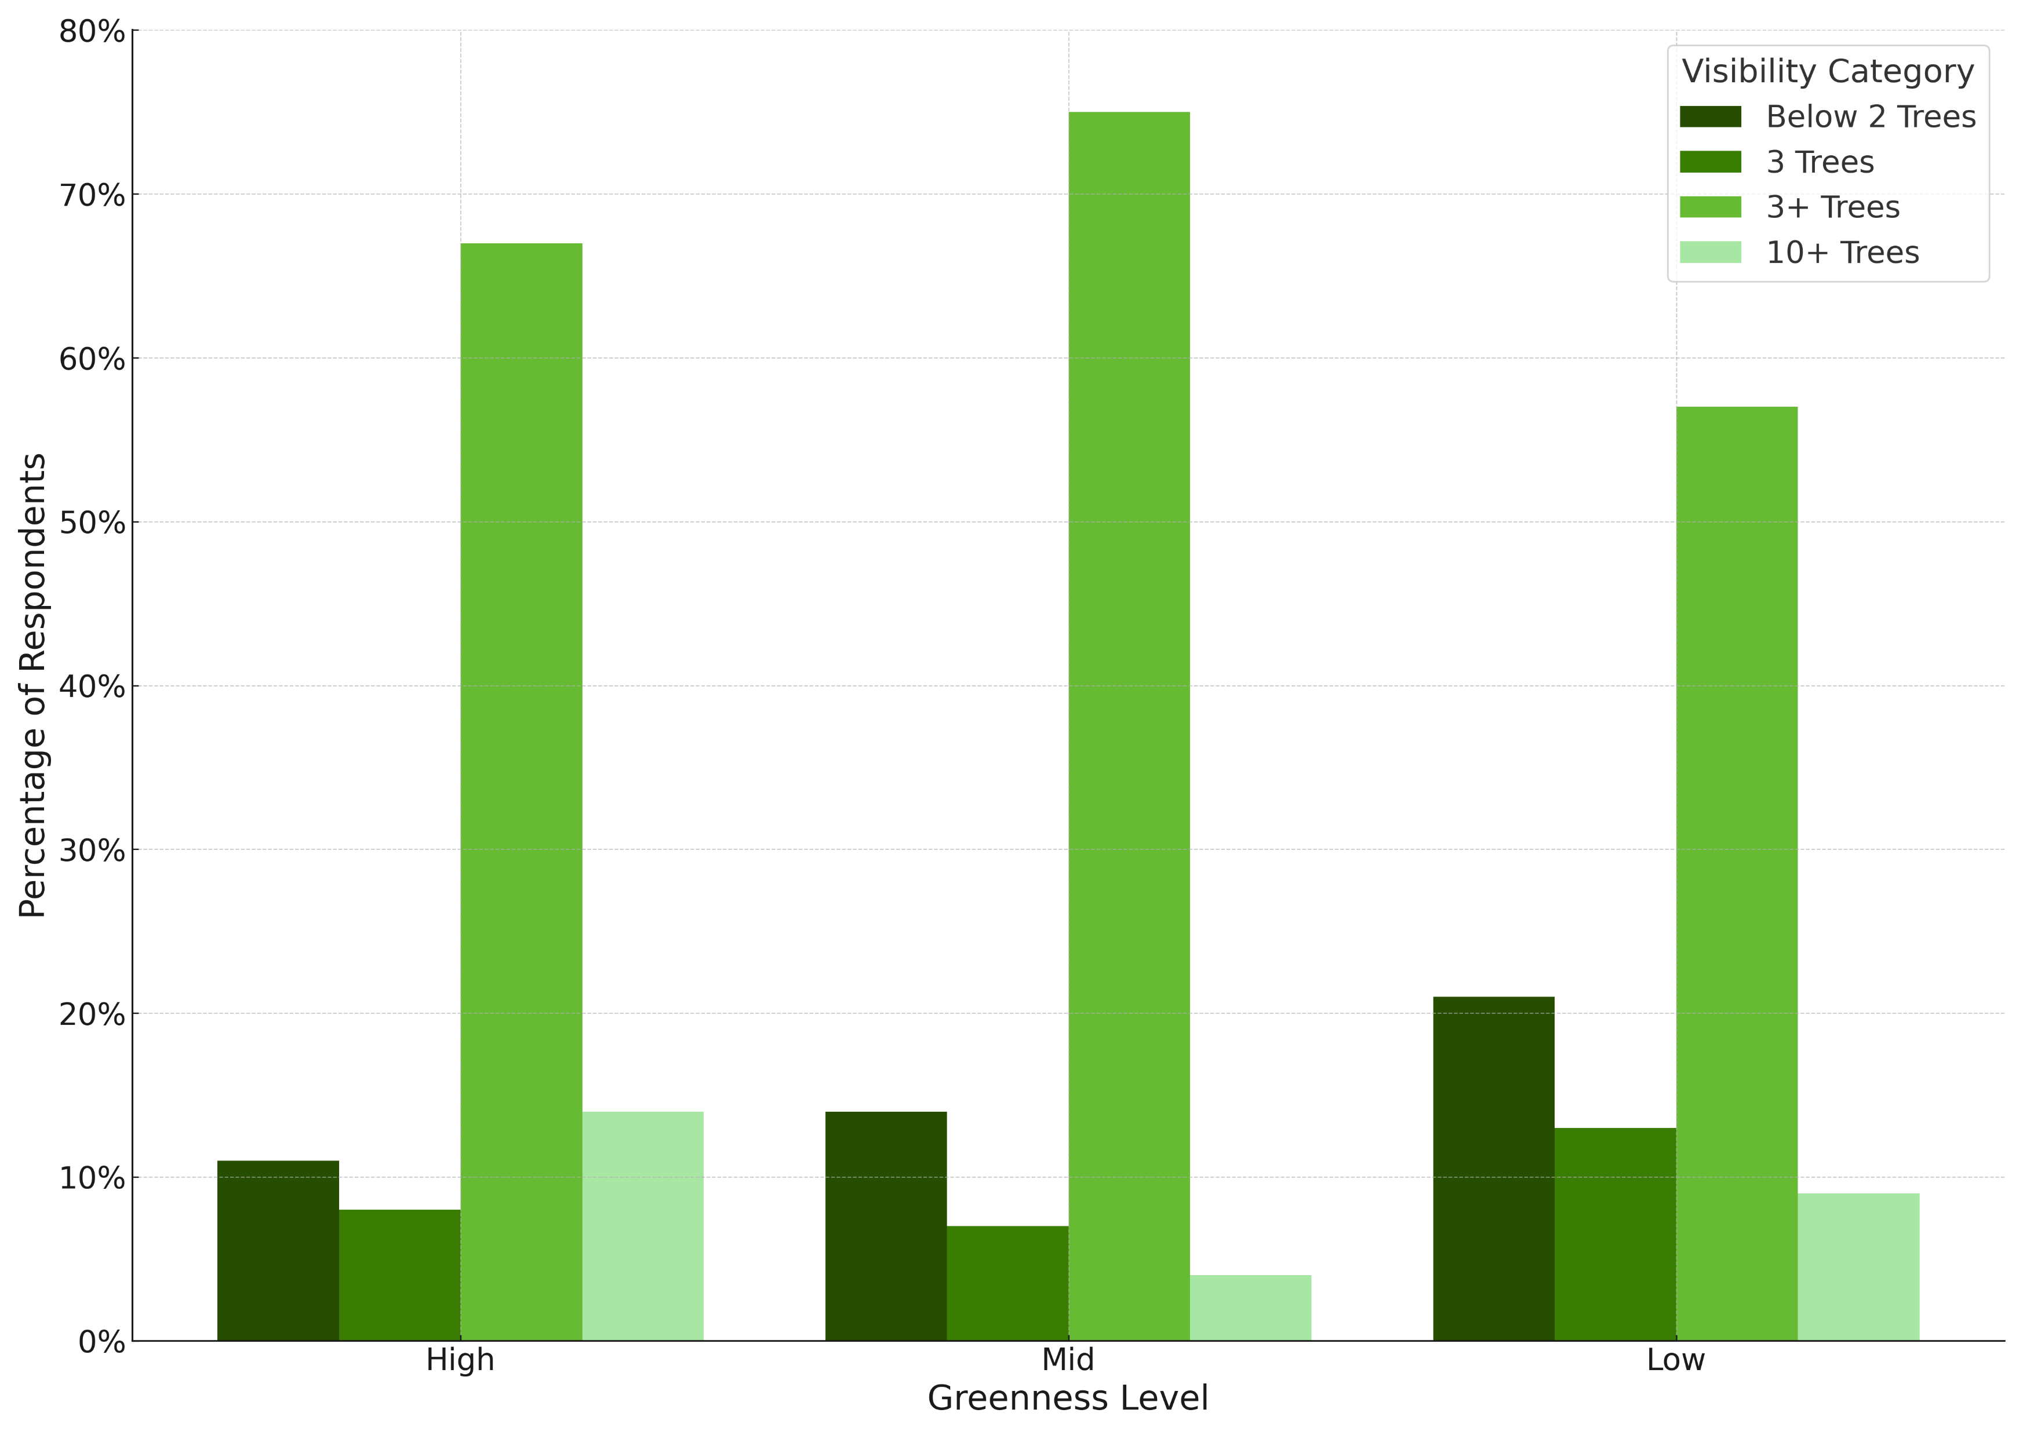
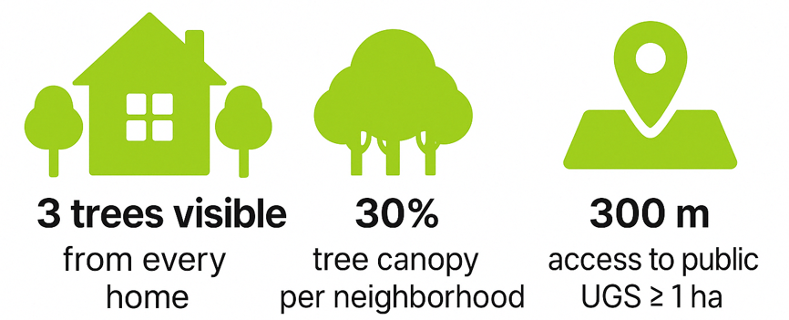
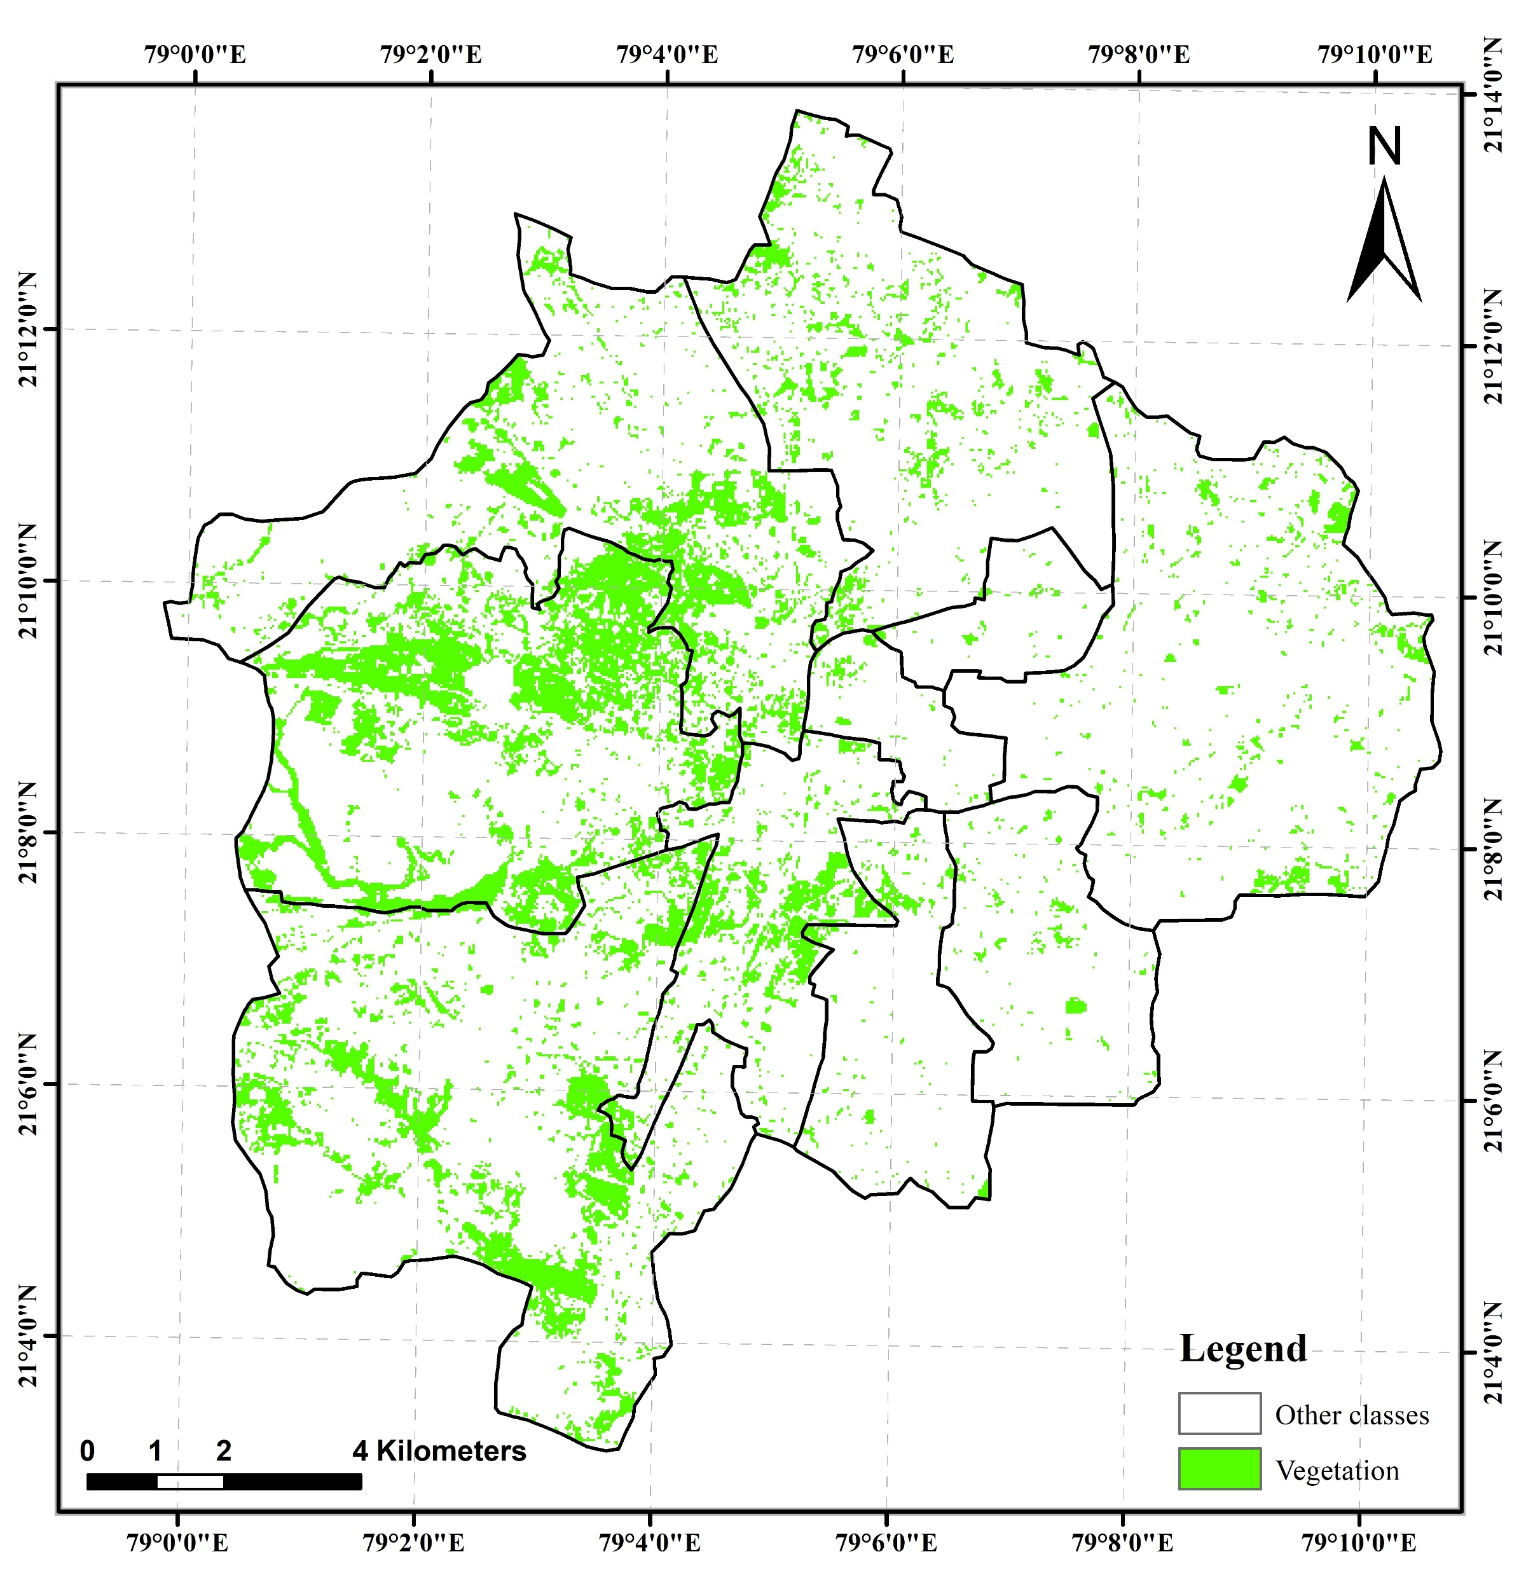
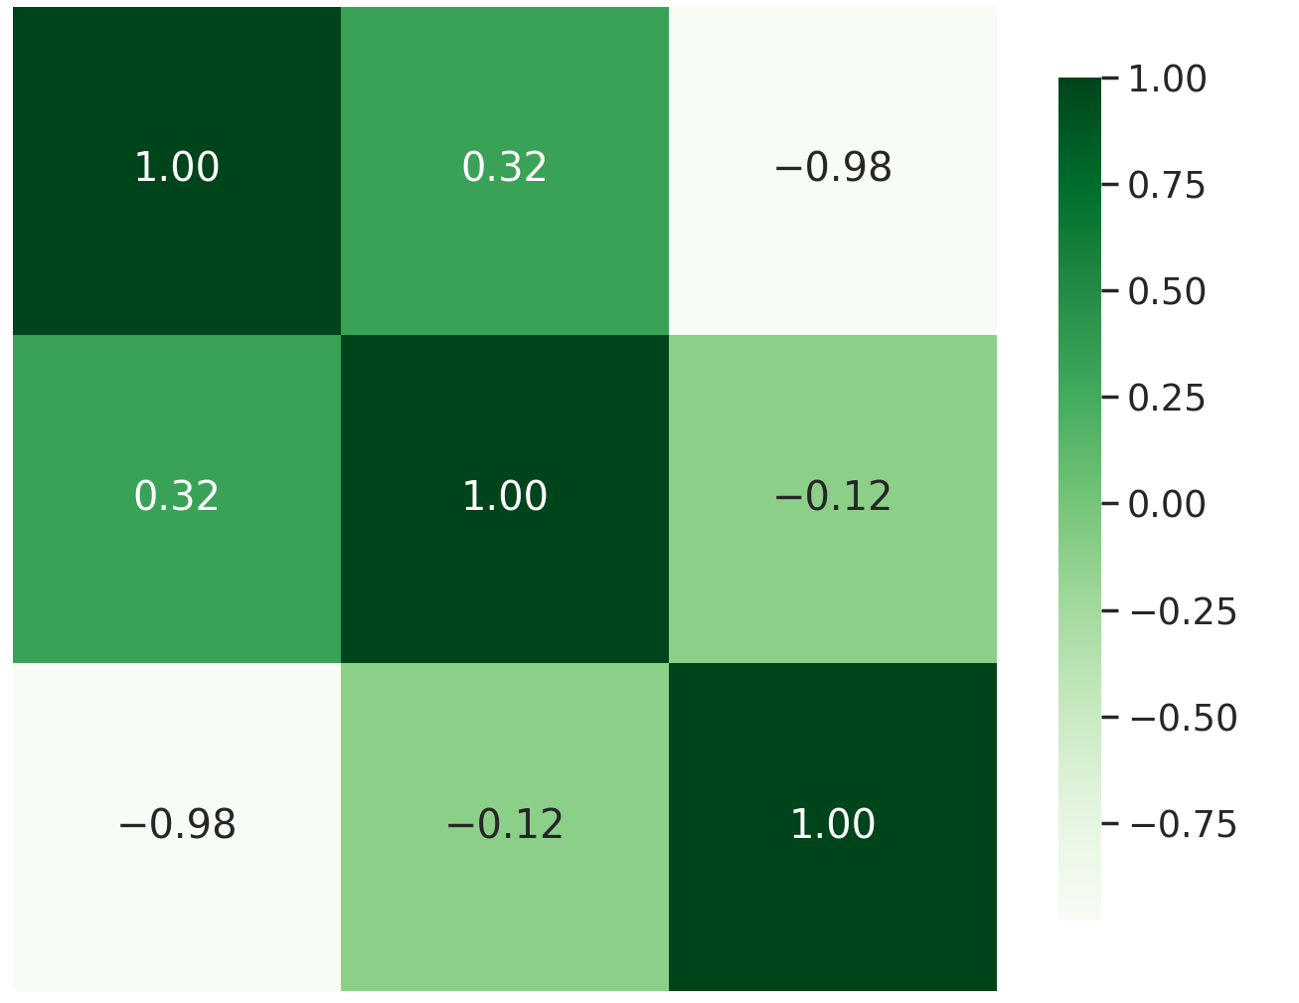
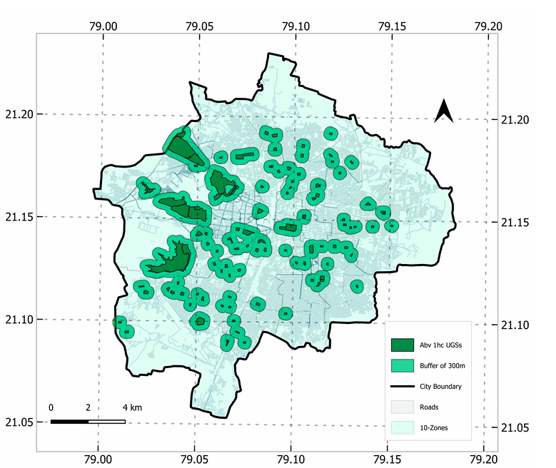
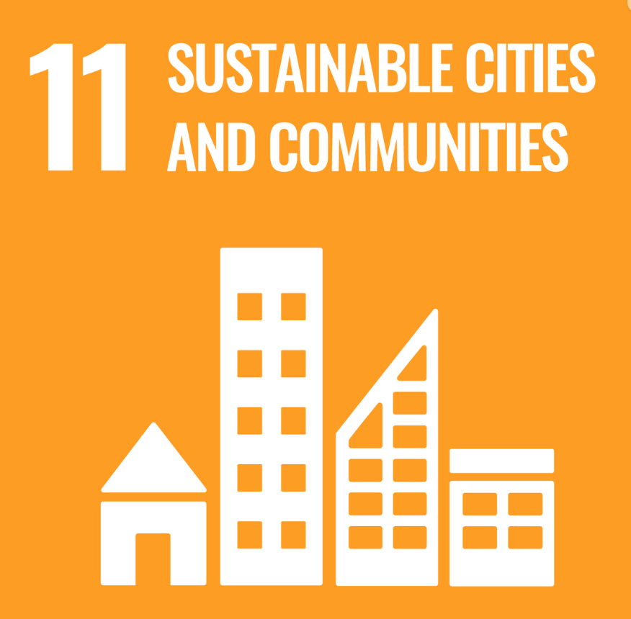

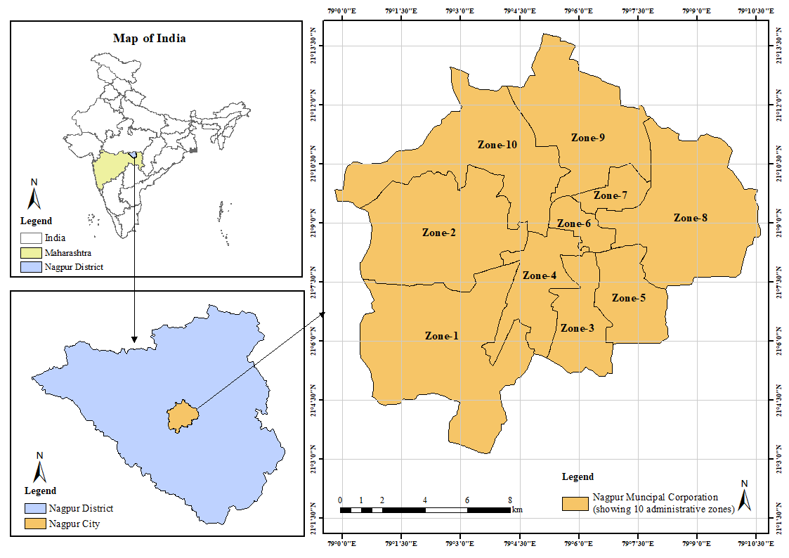
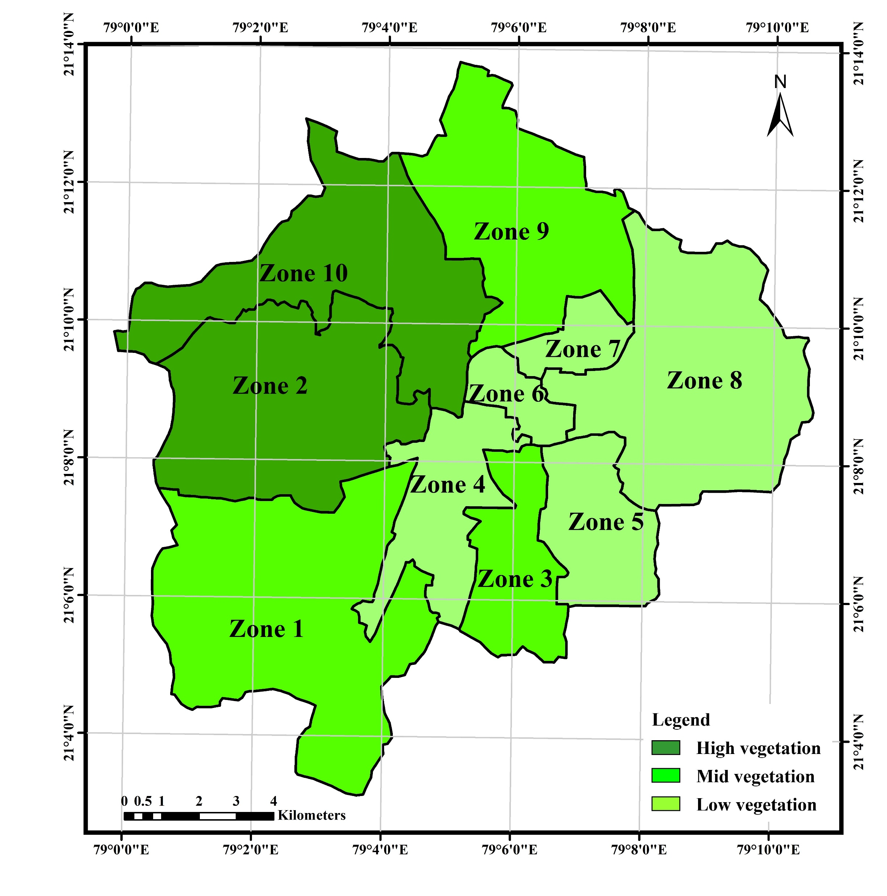
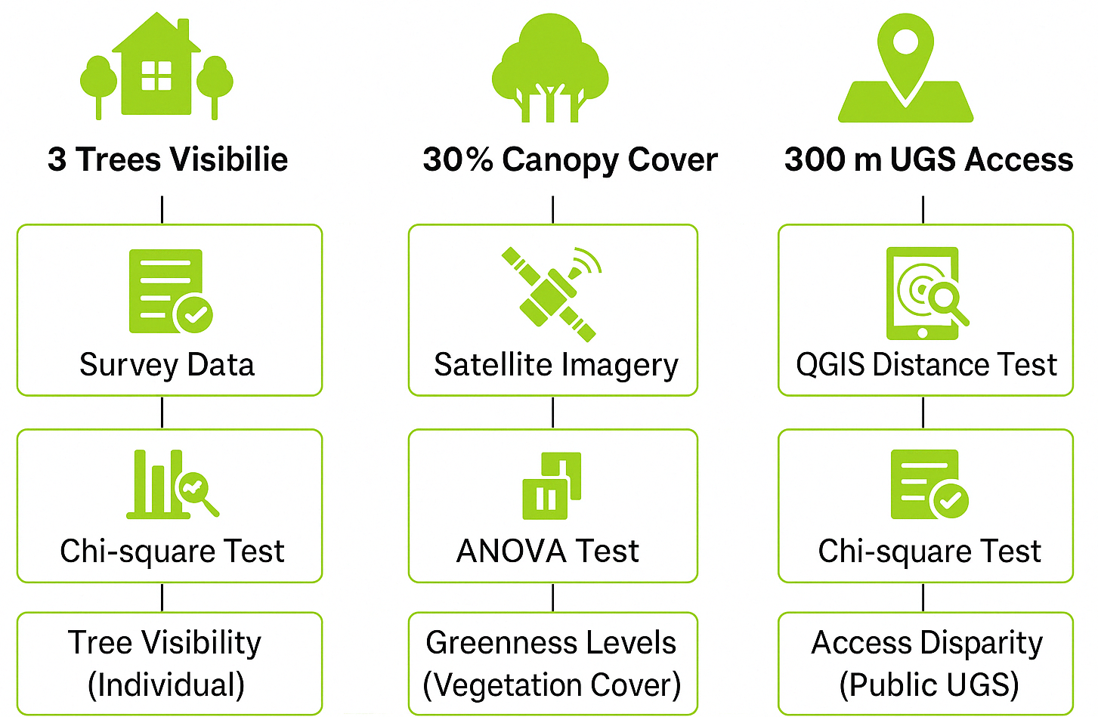

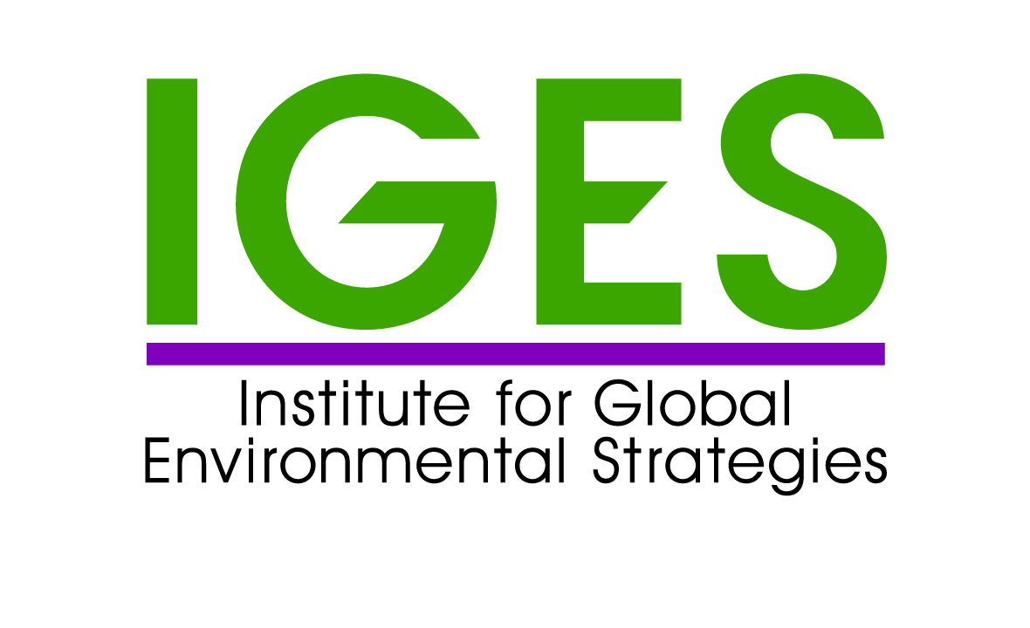
Implementing the 3-30-300 Rule in Indian Cities: A Framework
for Addressing Urban Challenges
Shruti Lahoti¹, Manu Thomas ² , Pankaj Kumar¹ , Shalini Dhyani² and Prajakta Pimpalshende ²
1 -Institute for Global Environmental Strategies (IGES), Japan, 2- CSIR-National Environmental Engineering Research Institute, Nagpur, Maharashtra, India
INTRODUCTION
RESULTS DISCUSSION
Background:
Cities in the Global South face heightened vulnerabilities from climate change – urban heat islands, extreme rainfall, and spatial inequities.
Nature-Based Solutions (NBS) offer sustainable pathways for urban areas
Urban Green Spaces (UGS) are key NBS for mitigation and resilience.
First Empirical Assessment in a rapidly urbanizing Indian city, addressing its feasibility and limitations in terms of the application of the 3-30-300 rule.
Tree Visibility Must Go Beyond Public UGS - Street trees, private gardens, and vertical greenery should be factored into visibility assessments.
30% Canopy Cover May Not Be Uniformly Attainable—Land scarcity, high-density areas in the city, and socio-economic disparities challenge the 30% benchmark.
Proximity ≠ Accessibility ≠ Usability - Over 80% of residents in low-greenness zones lacked access to UGS within 300 m. However, access alone is insufficient—functionality, safety, and quality also matter for meaningful use.
Global Framework, Local Fit - The rule, though developed in European/North American contexts, holds promise if adapted for the spatial and social realities of the Global South.
3 Trees Visible (Tree Visibility Component)
Significant variation by greenness zone
(χ² = 18.87, p = 0.0044)
70% of residents in mid & high-greenness areas saw 3+ trees
Only ~25% in low-greenness zones reported seeing even 2 trees
Visibility of 10+ trees was lowest in low-greenness
Tree visibility varies systematically, reflecting inequitable tree cover distribution
What and Why 3–30–300 rule :
Proposed by urban forestry expert Dr. Konijnendijk, the rule offers a simple, science-based guideline to enhance the presence, accessibility, and impact of UGSs.
3
trees are visible
from every home
Greenness is not evenly distributed, indicating structural inequality in everyday exposure to nature.
Urbanization & Well-Being -As urban populations grow, green spaces become essential for supporting physical and psychological health.
Measurable Framework - Clear, actionable criteria:
Proven Co-Benefits - Green spaces help reduce stress, improve air quality, cool urban heat islands, and support biodiversity.
Focus on Implementation- practical assessment and mapping to guide equitable and resilient city planning.
30% Canopy Cover (Canopy Component)
Significant difference in canopy cover across zones
(ANOVA: F = 4.75, p = 0.0498)
Average canopy cover: High-greenness: ~26%
  Mid-greenness: ~13%
  Low-greenness: ~7%
Citywide average: ~15.9%, well below the 30% benchmark
Some mid-greenness zones had poor visibility, showing greenery may be in non-residential/ inaccessible areas
Adaptation Is Key–High pace transitioning cities must reinterpret the 3–30–300 rule:
Integrate street-level greening into planning norms
Expand community-based greenery in vacant or underused spaces
Consider composite greenness metrics that reflect visibility, access, and functionality
Our Goals in Realizing the 3–30–300 rule:
Assess the feasibility of implementing the rule in Indian City
Compare urban greenness exposure in Nagpur and Jaipur
Develop a replicable spatial and statistical framework
Inform urban policy and planning in resource-constrained contexts
Case Study Site: Nagpur City, India
Tree canopy alone does not guarantee residential exposure; placement and accessibility are key.
METHODS and MATERIALS
Correlation between 3-30-300 component
Nagpur is a Tier II city in central India, covering ~218 km² with a population of 2.4 million.
The city is governed by the Nagpur Municipal Corporation (NMC), divided into 10 administrative zones.
Historically known for its greenery, the city has experienced a decline in natural green spaces.
Green and blue infrastructure includes urban forests, parks, institutional greens, river basins, lakes, playgrounds, and roadside plantations.
Disparities in the distribution and availability of public UGSs across zones.
Public UGS per capita is 3.65 m², below the WHO standard, with significant inter-zonal variation.
300 m Access to UGS (Access Component)
Accessibility strongly linked to greenness (χ² = 8792.52, p < 0.0001)
% of population without UGS access:
  High-greenness: 64%
  Mid-greenness: 79%
  Low-greenness: 81%
  Access inequalities persist, and tree cover doesn’t guarantee UGS availability
  Some mid-greenness zones had unexpectedly poor access, suggesting tree distribution ≠ functional access
Policy Alignment & Global Relevance
3–30–300 can be a powerful planning framework when localized, promoting equitable, resilient, and inclusive urban greening.
Supports India's national greening and urban resilience goals:
Aligned with the Urban Greening Guidelines, Green India Mission (GIM), NCAP, and the Climate Smart Cities Assessment Framework (CSCAF), reinforcing the role of data-driven, evidence-based urban planning.
Advances global sustainability commitments:
Contributes to SDG 11 (Sustainable Cities and Communities) and the Paris Agreement by promoting nature-based solutions for equitable and climate-resilient cities.
Green space proximity is spatially uneven, revealing critical planning gaps in equitable access.
CONTACT
ACKNOWLEDGEMENTS
Shruti Lahoti - lahoti@iges.or.jp
This research was funded by the Special Research Fund of the Institute for Global Environmental Strategies (Grant No. SRF2-UNature). We sincerely thank the researchers from CSIR-NEERI for their valuable support in data collection. Special thanks to Manu Thomas for data curation related to the 30% canopy cover component, and to Prajakta Pimpalshende for conducting the household questionnaire survey.

