Slide 1
Filling Streamflow Data Gaps in Indian Catchments using Machine Learning
Hiren Solanki¹ and Vimal Mishra^{1,2}
¹Earth Sciences, IIT Gandhinagar, Gujarat, India.
²Civil Engineering, IIT Gandhinagar, Gujarat, India.

Slide 2
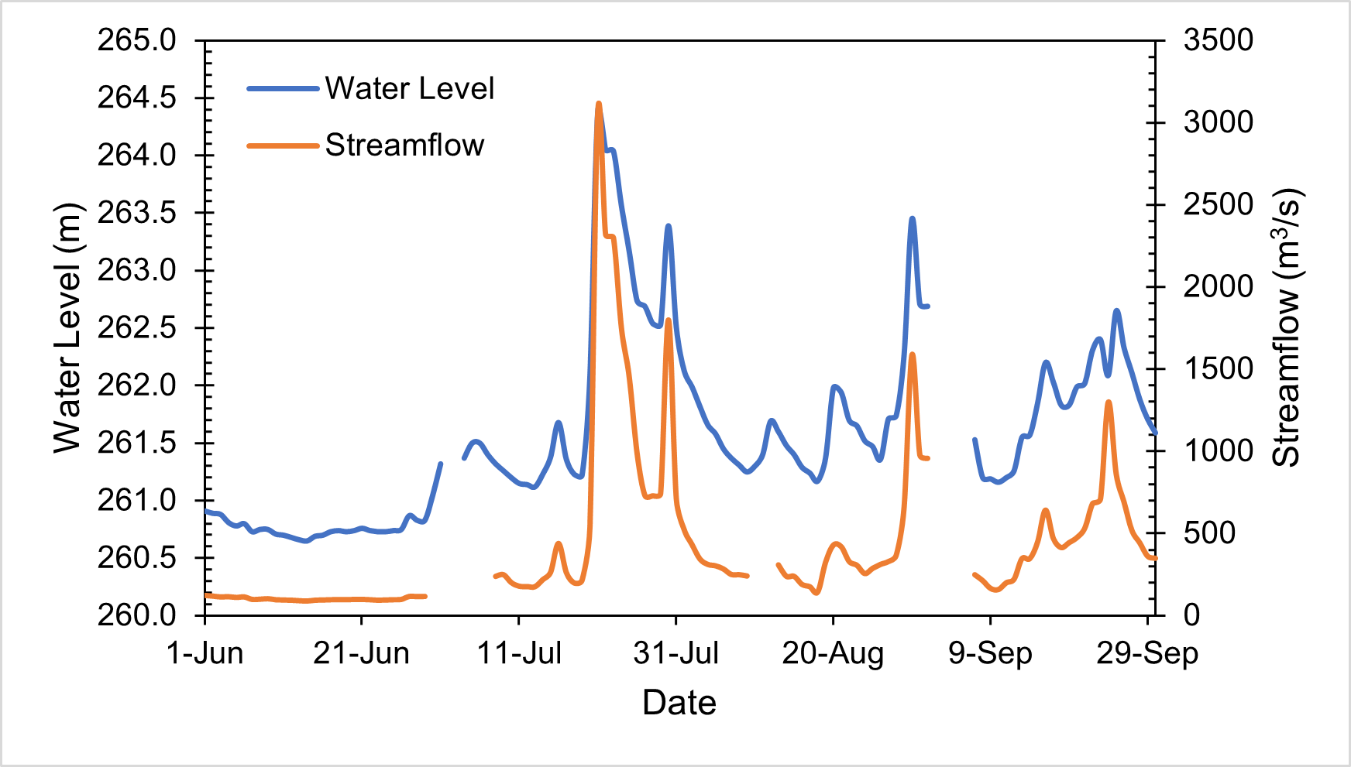
Why data gap-filling?
Hydrological time series data, particularly streamflow and water level, are important for a wide range of applications, including
Planning, design, and operations of hydraulic infrastructures,
Disaster management
Water resource management
Groundwater monitoring
Biodiversity conservation
Water quality monitoring
Irrigation planning
Hydropower generation
A gap in a streamflow time series can occur due to various reasons, including:
Instrumentation issues
Data processing or quality control issues
Technological limitations
Data transmission problems
Funding or resource constraints
Maintenance or upgrades
Extreme events
Human error
Natural Events
Environmental factors
Missing Data
Figure. Causes of missing data
Data gaps in streamflow can lead to incomplete or inaccurate streamflow records, affecting hydrological studies, water resource management, and flood forecasting.

Slide 3
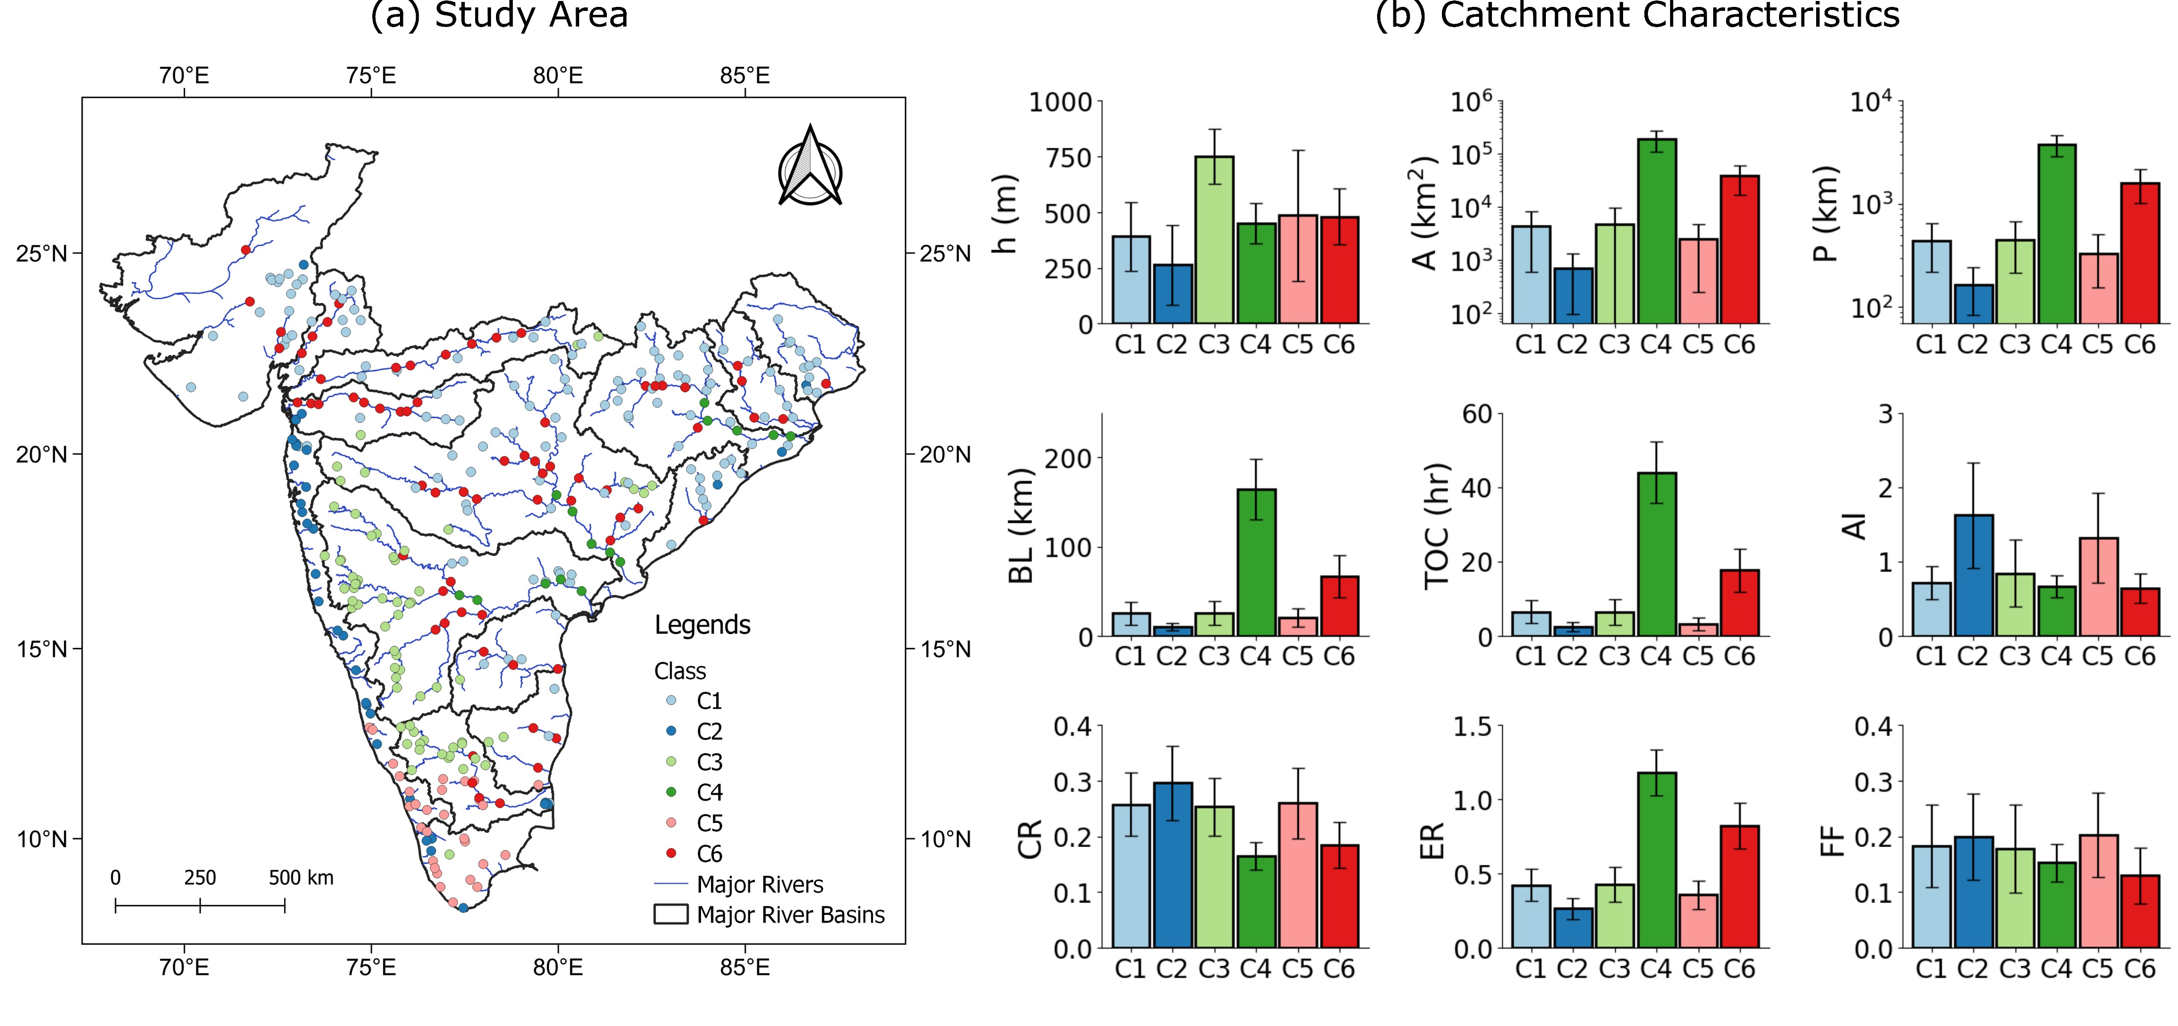
Study Area
Figure. Spatial Distribution and Morphometric Characterization of Catchments Across Peninsular India

Slide 4
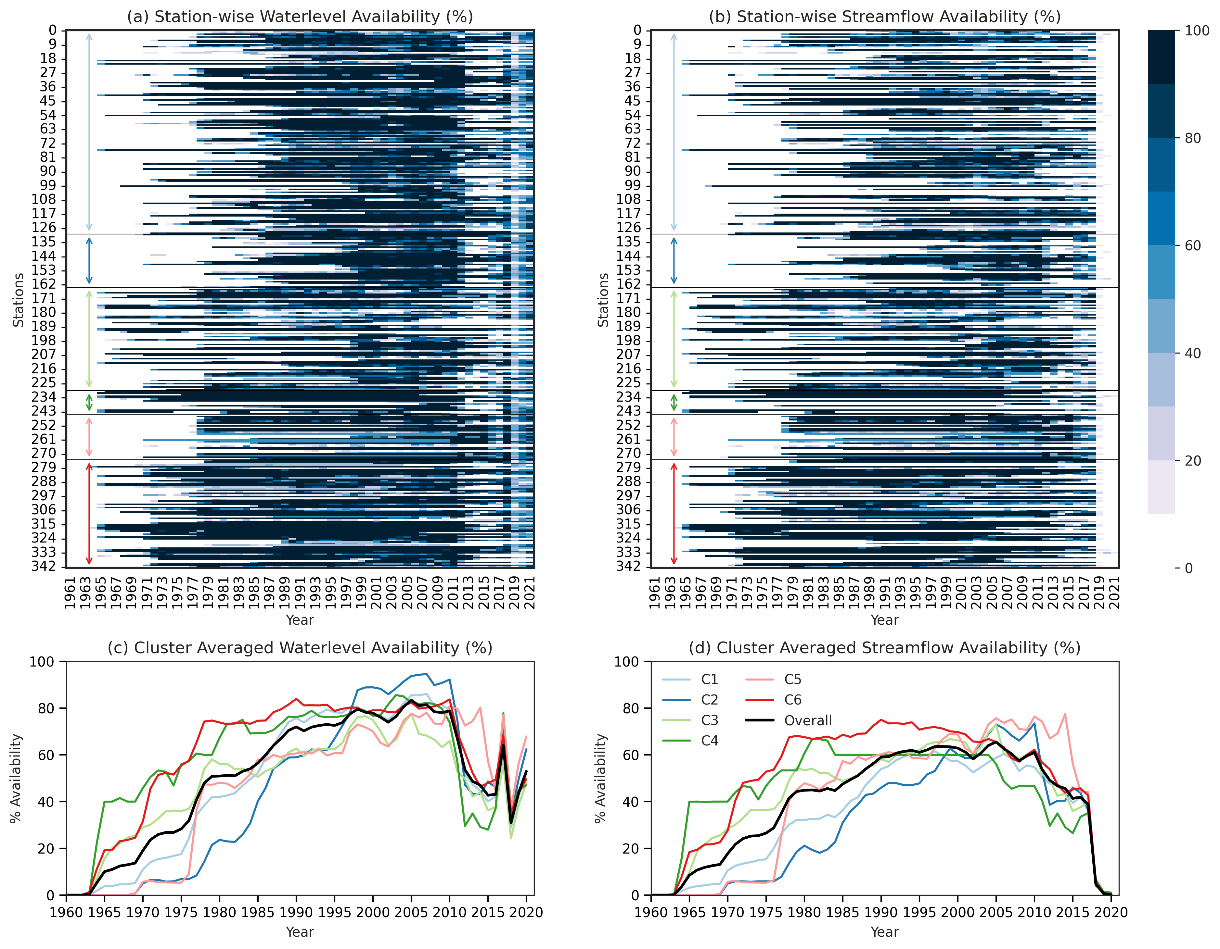
Gaps in Data
Data Download
(India-WRIS)
Waterlevel & Streamflow
Quality Check
Inconsistent reference
(w.r.t. MSL or bed level)
Zero streamflow during monsoon
Number swapping
616.15 → 166.15
% Availability
Yearly availability of streamflow and waterlevel
Figure. Percentage Data availability for waterlevel and streamflow observations

Slide 5
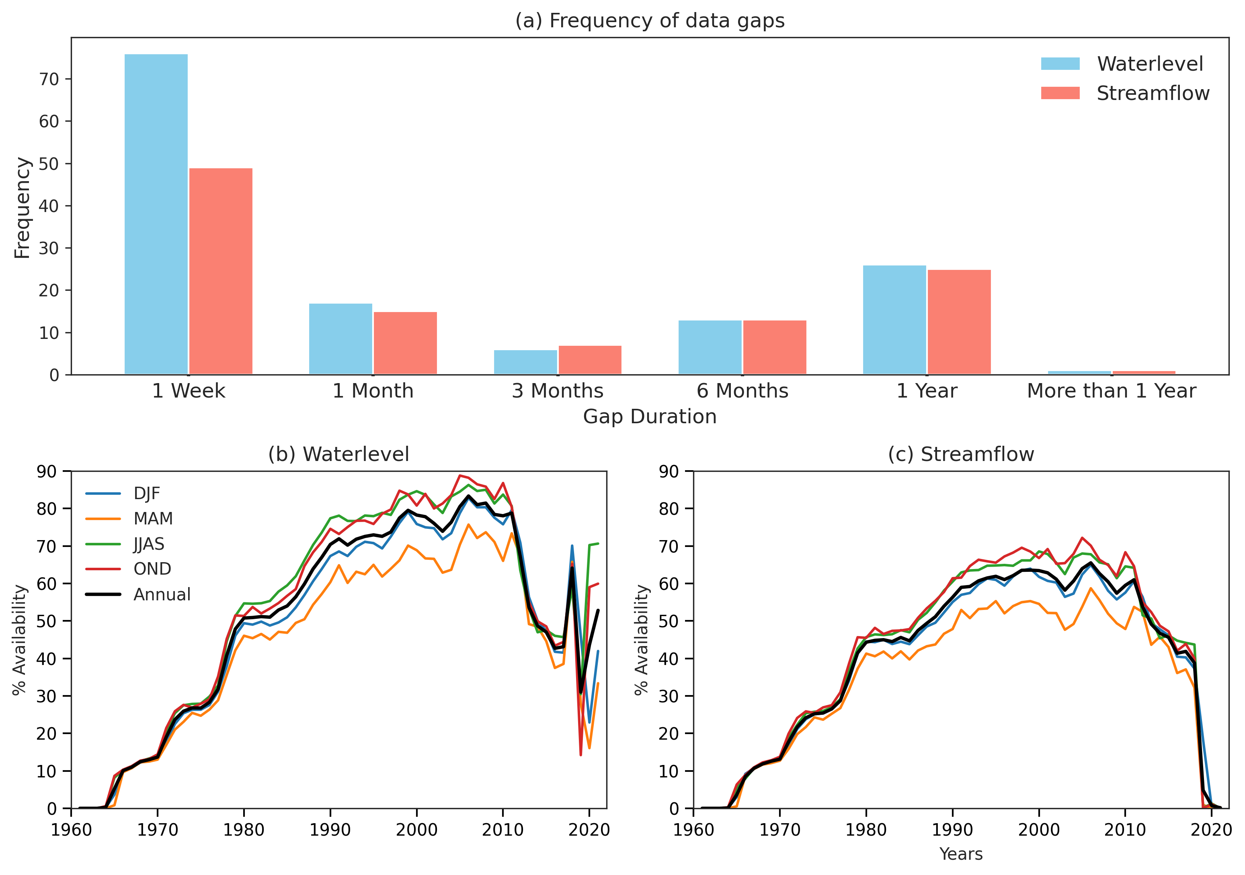
Gaps in Data
1 to 7 days of continuous gaps
Data Download
(India-WRIS)
Waterlevel & Streamflow
Note
1 week: 1 to 7 days of continuous gaps
1 Month: 8 to 30 days of continuous gaps
3 Months: 31 to 90 days of continuous gaps
181 to 365 days of continuous gaps
Quality Check
Inconsistent reference
(w.r.t. MSL or bed level)
Zero streamflow during monsoon
Number swapping
616.15 → 166.15
% Availability
Seasonal availability of streamflow and waterlevel
Major Data is missing during the MAM Season
Figure. Distribution of data gaps and seasonal data availability for waterlevel and streamflow observations

Slide 6
Available Streamflow Products
Various efforts have already been made in India to generate a complete time series of hydrological variables (Chuphal & Mishra, 2023; Goteti, 2023; Mangukiya et al., 2024; Patidar et al., 2024).
These studies have contributed significantly to advancing data availability; however, certain limitations remain.
For instance, instead of selectively addressing gaps within observed records, some approaches focus on reconstructing the entire time series (Chuphal & Mishra, 2023; Mangukiya et al., 2024), which may overlook the value of partial but reliable observed data.
Some datasets (Goteti, 2023) are generated at coarser temporal resolutions, such as monthly or annual scales, rather than at the daily scale required for many operational applications.
GUARDIAN data (Patidar et al., 2024), which is available at a sub-daily scale but starts only from 2020, limiting their utility for long-term hydrological analysis and trend assessment.
Therefore, filling the gaps in data is essential to enhance the reliability of hydrological assessments and ensure sustainable water resource management.

Slide 7
Objectives
We used geomorphological, meteorological, and hydrological parameters in combination with the Random Forest method to gap-fill water level and streamflow data at 352 stations across India, except the transboundary basins. Our objectives include:
To generate a complete time-series dataset of water level and streamflow from 1980 to 2021.
To assess the effectiveness of clustering algorithms in improving gap-filling performance under various sequential missing data scenarios; and
To evaluate the robustness of the gap-filling approach in stations influenced by human interventions such as reservoir operations.

Slide 8
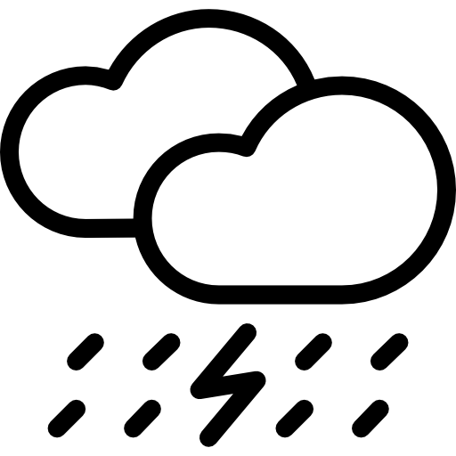
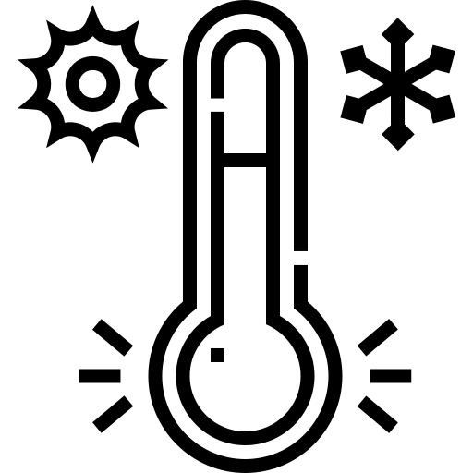
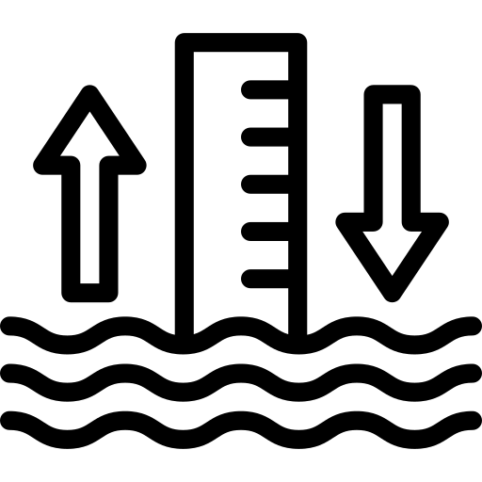
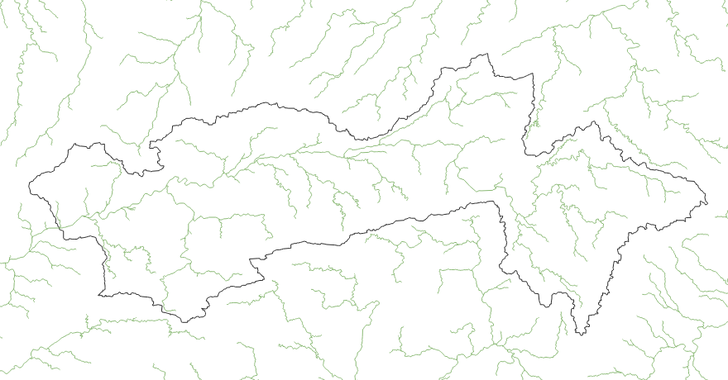
Data
Meteorological Data
Water level
Streamflow
DEM
Handia
Climate Data | Source | Spatial Resolution | Temporal Resolution
Rainfall | IMD | 0.25˚x 0.25˚ | Daily (1951-2021)
Maximum Temperature | IMD | 0.25˚x 0.25˚ | Daily (1951-2021)
Minimum Temperature | IMD | 0.25˚x 0.25˚ | Daily (1951-2021)
Model Discharge | Chuphal & Mishra, 2023 | Segment wise | Daily (1951-2021)
Observed Discharge | India-WRIS | Station wise (352) | Daily (variable)
Water level | India-WRIS | Station wise (352) | Daily (variable)
DEM | Hydroshed | 30 m x 30 m | NA
Sample Data
Narmada River Basin
Year | Month | Day | Water Level | Streamflow | Rainfall | Tmax | Tmin | Model Streamflow
 |  |  | m | m3/s | mm | ⁰C | ⁰C | m3/s
1977 | 7 | 1 | 263.55 | 2970 | 8.7426 | 30.903 | 22.97 | 1143.5
1977 | 7 | 2 | 262.68 | 2080 | 8.6385 | 30.587 | 22.837 | 1053.7
1977 | 7 | 3 | 262.11 | 1560 | 5.954 | 30.433 | 23.39 | 1037.3
1977 | 7 | 4 | 262.38 | 1805 | 12.569 | 30.233 | 23.347 | 1061.8
1977 | 7 | 5 | 262.13 | 1580 | 23.993 | 29.033 | 23.143 | 1048.2
1977 | 7 | 6 | 261.71 | 1240 | 28.363 | 26.63 | 22.537 | 1429.6
1977 | 7 | 7 | 262 | 1470 | 22.347 | 25.647 | 22.503 | 2276.3
1977 | 7 | 8 | 265.02 | 5060 | 4.2258 | 27.7 | 22.527 | 3802.9
1977 | 7 | 9 | 264.57 | 4400 | 5.1932 | 30.047 | 23.1 | 3301.8
1977 | 7 | 10 | 262.44 | 1850 | 4.6083 | 30.293 | 23.207 | 2280
1977 | 7 | 11 | 262.6 | 2000 | 10.674 | 28.36 | 22.62 | 1735.9

Slide 9
Methodology
Feature Selection
Morphometric Analysis
Input Data
Meteorological Forcing
Handia
Rainfall
Tmax
Tmin
Input Variables
Year, Month, Day
Tmax, Tmin
Q, Qt-1, Qt-2
P7, P8, P9
Catchment Characteristics
Hydrological Forcing
Note: Qt-3 represents streamflow at t-3 day, and P3 shows cumulative rainfall of the last three days.
Model Q
Time Variables
Predict Water Level / Streamflow
Day
Missing Data
Available Data
70% Training
30% Validation
Sequential gaps of 1 week, 1 month, 3 month, 6 month, and 1 year gap
Year
Predict Missing Data
Training & Testing on Available Data
Month
Random Forest
Random Forest

Slide 10
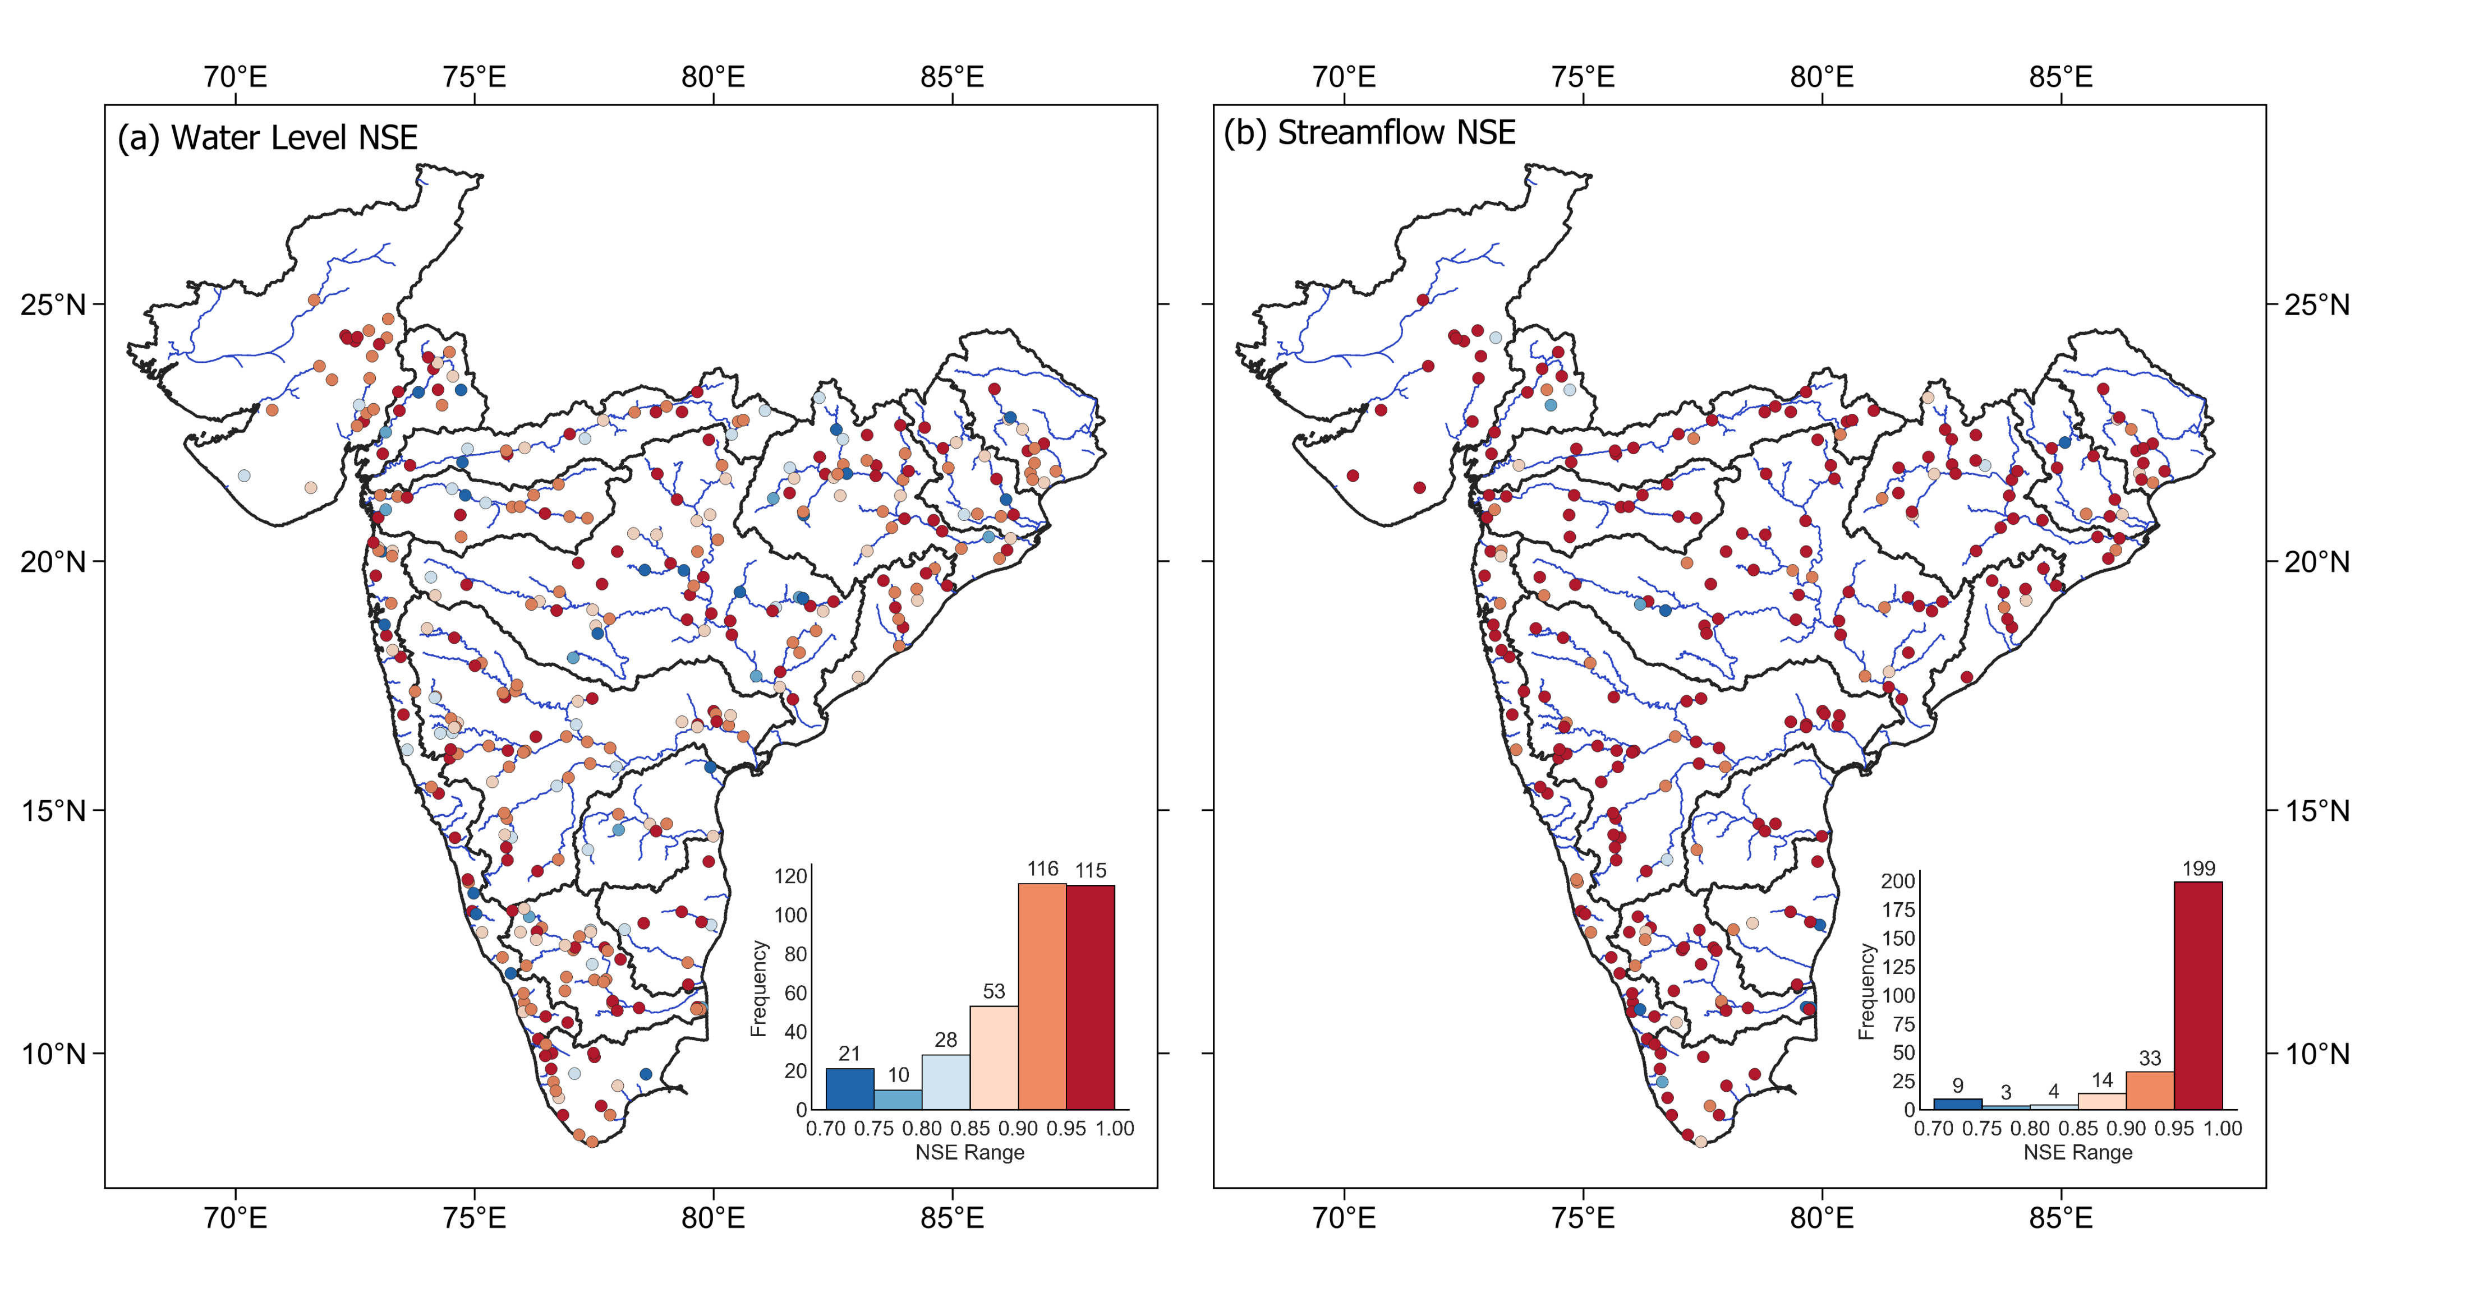
Model Performance
Figure. Validation performance of the RF model for (a) water level and (b) streamflow gap-filling across Peninsular India.

Slide 11
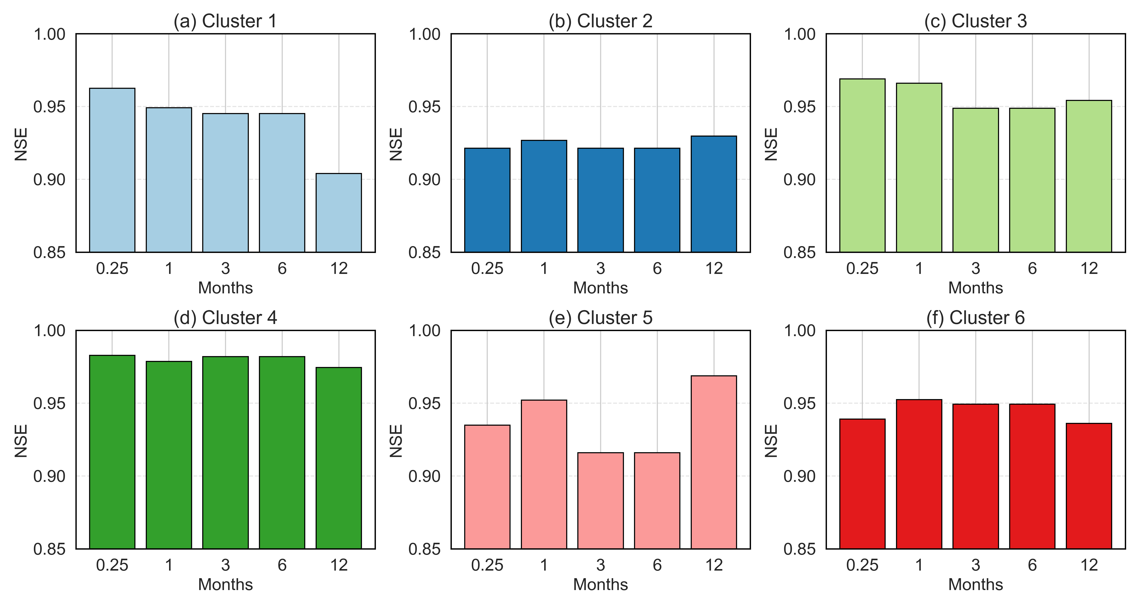
Effect of Gap Size
Figure. Cluster-wise performance of the Random Forest model across varying gap durations. NSE values are shown for six clusters (a–f), with synthetic gap durations of 0.25 (1 week), 1, 3, 6, and 12 months.

Slide 12
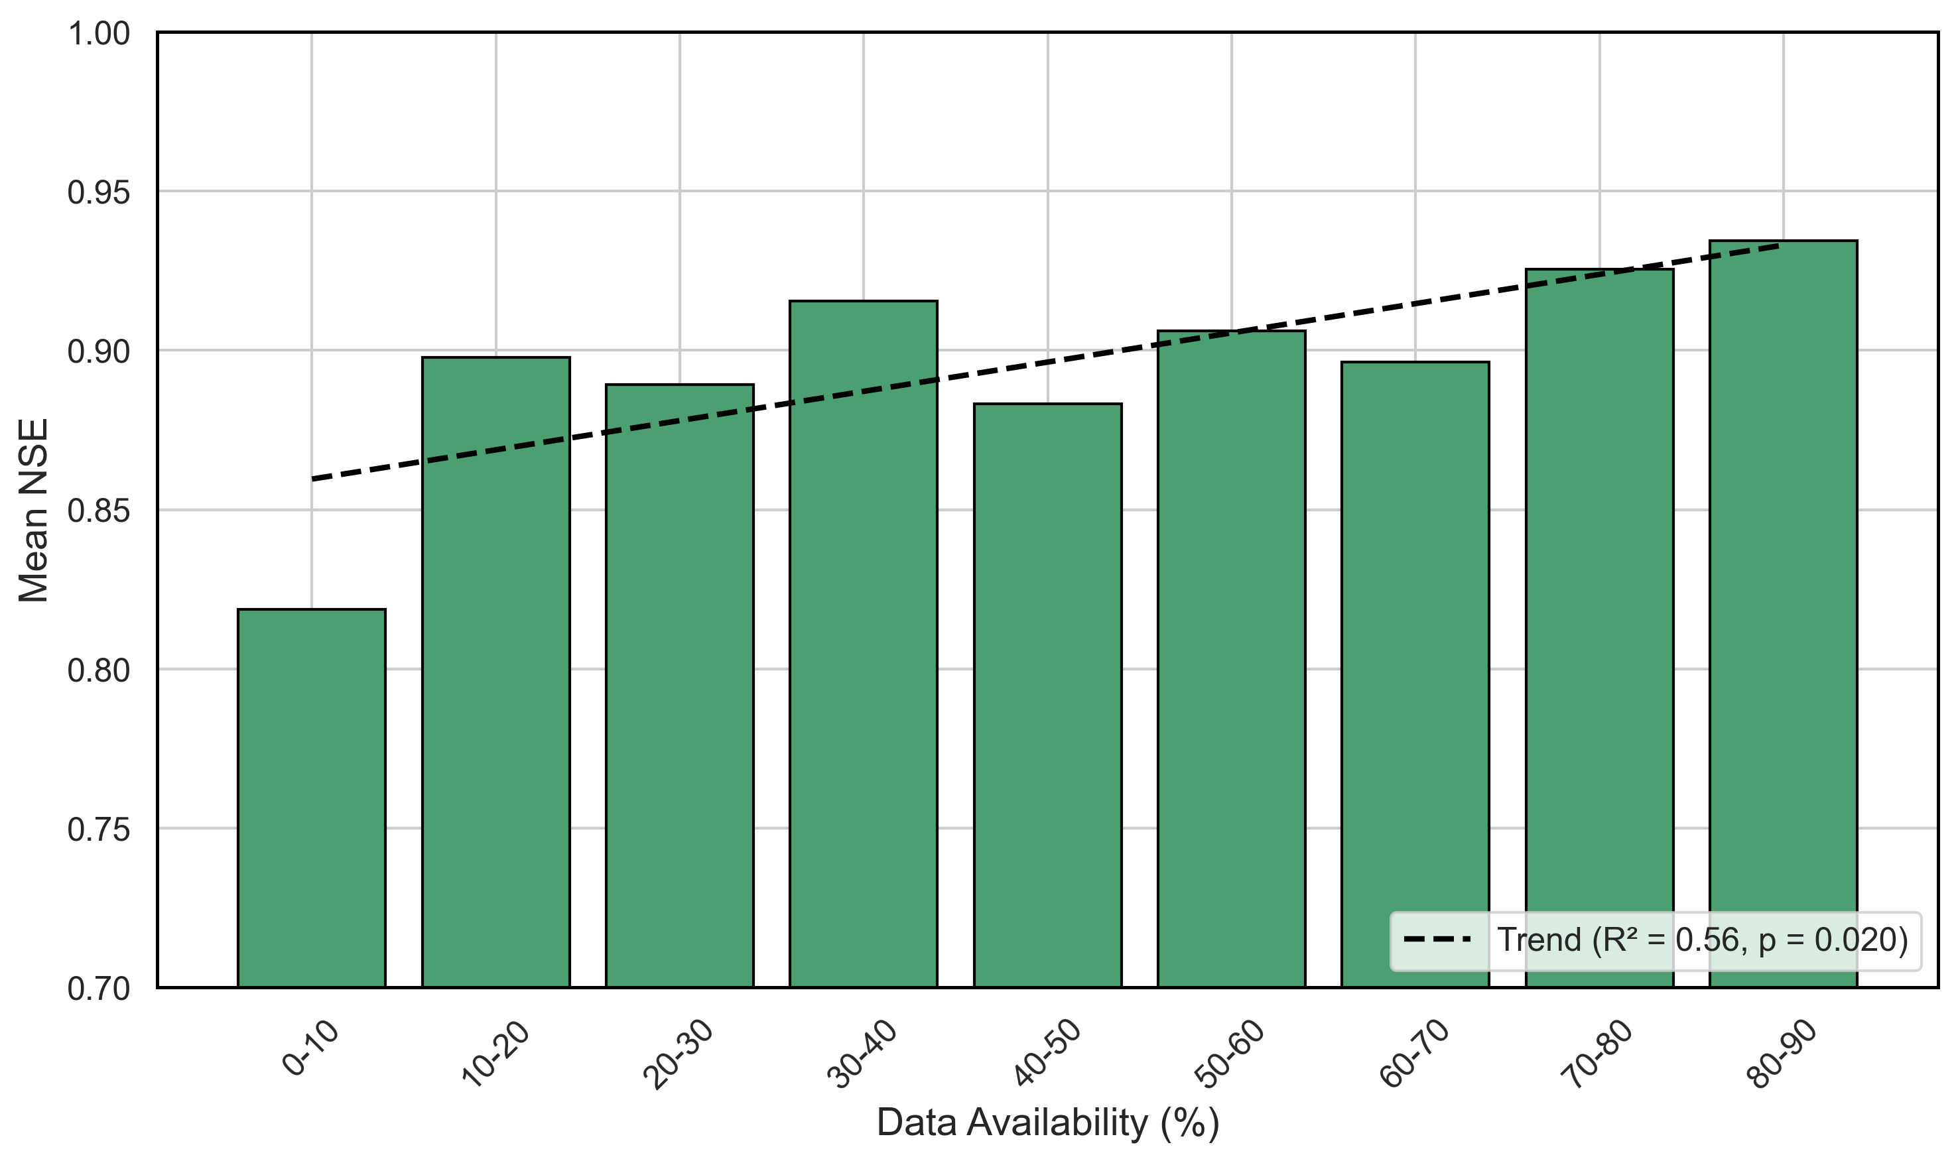
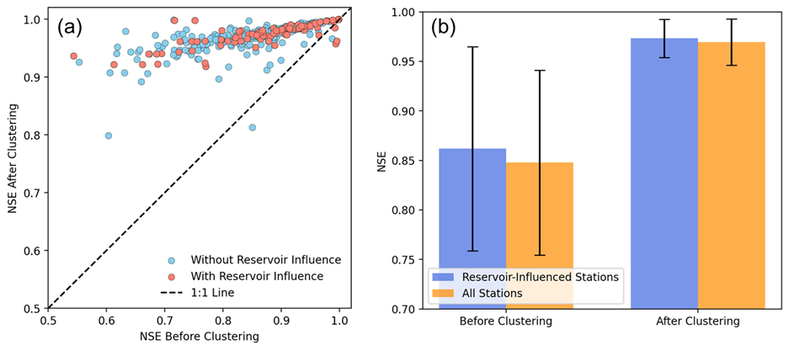
Factors affecting the model performance
Effect of data availability
As data availability increases, the mean NSE improves, suggesting that the RF model benefits from having more training data when predicting missing values.
The positive trendline (R² = 0.56) and p-value (0.020) confirm that the relationship is statistically significant, reinforcing the idea that data-rich environments yield more accurate gap-filling predictions.
Figure. Effect of data availability
Effect of human influences
Before clustering, reservoir-influenced stations show lower average NSE (~0.85) and higher uncertainty (larger error bars).
However, after clustering, the mean NSE increases to more than 0.95 for both groups, with reduced variability.
Figure. Effect of human influences

Slide 13
Comparison with other Products
We compared our gap-filled streamflow data with CAMELS-IND continuous streamflow data generated using LSTM (Mangukiya et al., 2024).
Figure. Comparison of gap-filled streamflow with observed and CAMELS-IND (LSTM) modeled streamflow at four gauging stations.

Slide 14
Conclusion
We used clustering based on the morphometric parameters, which helped us to extend the data records for extreme events and capture human interventions.
Training a random forest model over clusters improved the model's performance significantly. We find that around 83% of stations achieve NSE > 0.85 for water level, and 94% of stations achieve NSE > 0.85 for streamflow.
We note the reduction in the model performance with the increasing data gap across all the clusters. However, the NSE value for streamflow is always more than 0.85.
The clustering approach improved the model performance by 11% over stations influenced by the reservoirs.

Slide 15
References
Chuphal, D. S., & Mishra, V. (2023). Hydrological model-based streamflow reconstruction for Indian sub-continental river basins, 1951–2021. Scientific Data, 10(1), 717. https://doi.org/10.1038/s41597-023-02618-w
Goteti, G. (2023). Geospatial dataset for hydrologic analyses in India (GHI): A quality-controlled dataset on river gauges, catchment boundaries and hydrometeorological time series. Earth System Science Data, 15(10), 4389–4415. https://doi.org/10.5194/essd-15-4389-2023
Mangukiya, N. K., Kumar, K. B., Dey, P., Sharma, S., Bejagam, V., Mujumdar, P. P., & Sharma, A. (2024). CAMELS-INDIA: Hydrometeorological time series and catchment attributes for 472 catchments in Peninsular India. Earth System Science Data Discussions, 1–43. https://doi.org/10.5194/essd-2024-379
Patidar, G., Indu, J., & Karmakar, S. (2024). ExtendinG SUb-DAily River Discharge data over INdia (GUARDIAN). Scientific Data, 11, 1155. https://doi.org/10.1038/s41597-024-03923-8

