Slide 1
How can the Complex Citation be implemented in the IPCC AR7 using existing frameworks and interactive notebooks?
Martina Stockhause, Lina Sitz, Charlotte Pascoe, Deborah Agarwal, James Ayliffe, Justin Buck, Joan Damerow, José Manuel Gutiérrez, Birgit Hassler, Forrest M. Hoffman, Graham Parton, Jared Lewis, Molly MacRae, Shelley Stall, Lesley Wyborn, and Fernando Pérez
EGU25, 27 April – 2 May 2025 https://doi.org/10.5194/egusphere-egu25-15036

Slide 2
IPCC’s FAIR and open data approach
IPCC AR6 FAIR Guidelines enhance the transparency of IPCC’s outputs:
Traceability of key statements of the report by documentation of data usage in figure/table generation
Credit for input data like CMIP6, created scripts, intermediate and final data
Preservation of curated input data, scripts, intermediate and final data
IPCC TG-Data Recommendations for AR7:
Complex Citation implementation to improve traceability
Better support for authors in generating the requested information
References:
Pirani et al. (2022) The implementation of FAIR data principles in the IPCC AR6 assessment process. https://doi.org/10.5281/zenodo.6504468
Intergovernmental Panel on Climate Change. (2023). TG-Data Recommendations for AR7 (1.0). Zenodo. https://doi.org/10.5281/zenodo.10059282
Stockhause M et al. (2024) Implementing FAIR data principles in the IPCC seventh assessment cycle: Lessons learned and future prospects. PLOS Clim 3(12): e0000533. https://doi.org/10.1371/journal.pclm.0000533

Slide 3
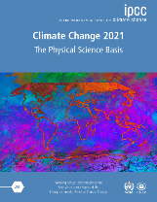
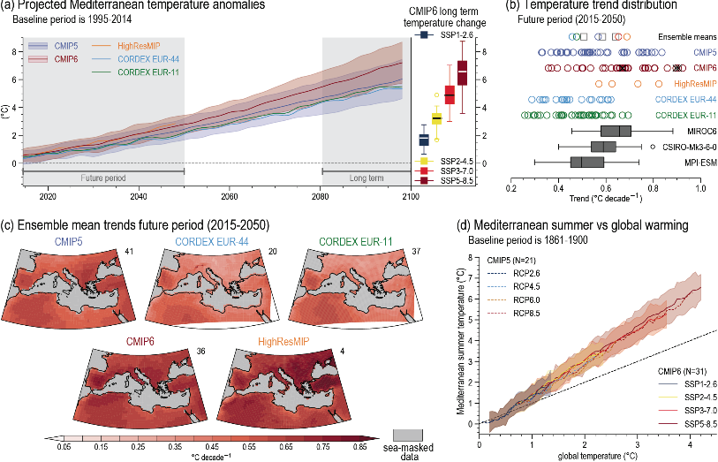
Structure of report and data
DOI
17 citable parts / 13 Chapters,
514 Figures,
448 Data Figures,
>172 Model Data Figures in 9 Chapters
Fig. 10.21
AR6 WGI
CMIP6 Input Data
CORDEX Input Data
173 Model Exp. 346 Datasets
30 Model Exp. 129 Datasets
CMIP6.HighResMIP.CMCC. CMCC-CM2-VHR4.hist-1950
DOI
HDL
cordex.output.EUR-11. historical.CCLM4-8-17
cordex.output.EUR-11.CLMcom. CNRM-CERFACS-CNRM-CM5.historical. r1i1p1.CCLM4-8-17.v1.mon.pr.20140515
CMIP6.HighResMIP.CMCC.CMCC-CM2-VHR4. hist-1950.r1i1p1f1.Amon.pr.gn.20180705
…
HDL
cordex.output.EUR-11.CLMcom. MOHC-HadGEM2-ES.historical. r1i1p1.CCLM4-8-17.v1.mon.tas.20150320
CMIP6.HighResMIP.CMCC.CMCC-CM2-VHR4. hist-1950.r1i1p1f1.Amon.tas.gn.20180705
DOI
Ch3
49 Figures, 48 Data Figures,
47 Model Data Figures
…
…
…
…
URL
CMIP5 Input Data
MPI-GE Input Data
Fig. 3.16
145 Model Exp. 227 Datasets
2 Model Exp. 202 Datasets
…
…
…
…
Figure 10. 21 | Projected Mediterranean summer warming.
cmip5.output1.IPSL. IPSL-CM5A-LR.rcp85
cmip5.output1.IPSL.IPSL-CM5A-LR.rcp85. mon.atmos.Amon.r1i1p1.20111103.pr
mpi-ge.output1.MPI-M. MPI-ESM.historical
mpi-ge.output1.MPI-M.MPI-ESM.historical. mon.atmos.pr.r001i1850p3.20190123
…
cmip5.output1.IPSL.IPSL-CM5A-LR.rcp85. mon.atmos.Amon.r1i1p1.20111103.tas
mpi-ge.output1.MPI-M. MPI-ESM.rcp85
mpi-ge.output1.MPI-M.MPI-ESM.historical. mon.atmos.tas.r001i1850p3.20190123
Ch10
DOI
27 Figures, 18 Data Figures,
16 Model Data Figures
…
…
…
URL
DOI
Fig. 10.21
Code
…
…
…
…
DOI
Many further datasets like observations are used for figure generation ….
…
Final Data

Slide 4
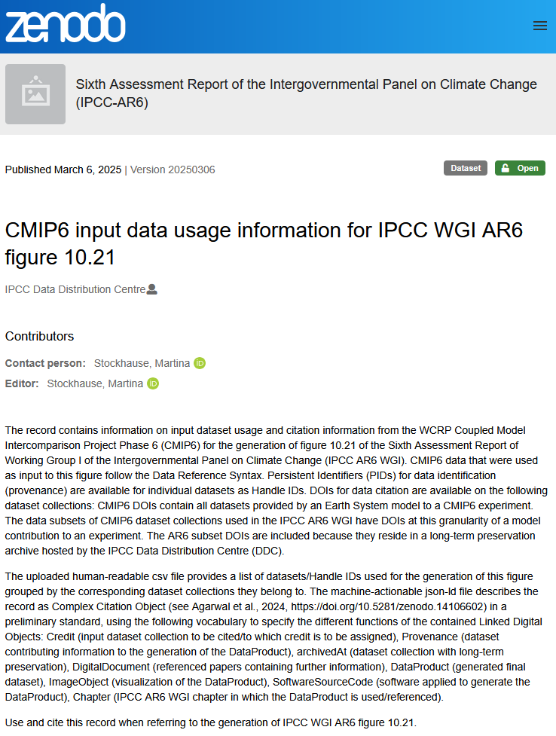
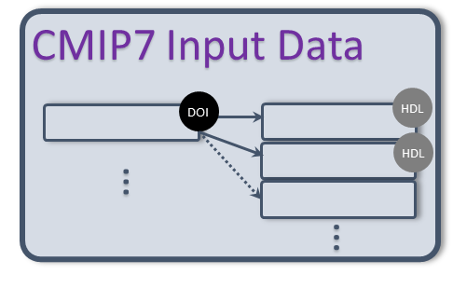
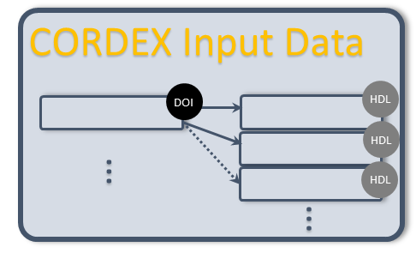
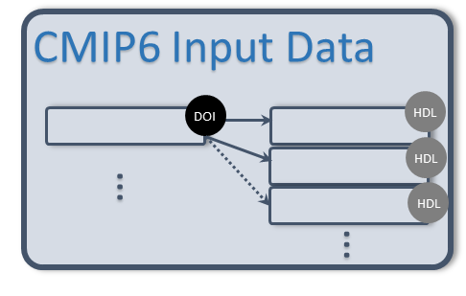
IPCC AR7 Plans on Complex Citation
Complex Citation approach: a simple and flexible solution for traceability and credit assignment for a large number of datasets (partly subsets) stored across multiple repositories Complex Citation Object (CCO): a new type of Digital Object Identifier (DOI) that includes, as its primary content, a list of Linked Digital Objects.
CCO – Figure a.x
DOI
Pilot Implementation for WGI AR6 figures: Example (Fig. 10.21): https://doi.org/10.5281/zenodo.14986318
Complex Citation in IPCC AR7: 1. create Complex Citation Object for every figure 2. add a Complex Citation Object reference in every figure caption 3. add references to the Complex Citation Object to the data archived at the DDC Partners
DOI
Provenance
HDL
AR7 Ch.
References:
Agarwal, D., Ayliffe, J., J. H. Buck, J., Damerow, J., Parton, G., Stall, S., Stockhause, M., & Wyborn, L. (2024). Complex Citation Working Group Recommendation (Version 1). Zenodo. https://doi.org/10.5281/zenodo.14106602

Slide 5
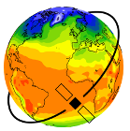
IPCC AR7 Plans: Complex Citation through provenance records (1)
….in collaboration with community tool/framework providers.
Why provenance? Established standard and CCOs should be owned by IPCC
CMIP7 Rapid Evaluation Framework (REF) project: REF is a community owned evaluation framework, built upon, and compatible with, existing community evaluation packages. ESMValtool was used in 3 AR6 WGI chapters for figure generation.
Jupyter and Notebooks Now! projects: Jupyter is a non-profit, open-source project, that supports interactive data science and scientific computing across all programming languages. Jupyter Notebooks were used by 9 AR6 WGI chapters for figure generation.
Planned steps:
Derive a provenance template with REF based on implementations in ESMValtool and MetaClip
Implement provenance into Jupyter metadata based on REF provenance template
Use provenance template for all IPCC AR7 chapters
References:
REF: https://wcrp-cmip.org/cmip7/rapid-evaluation-framework/ ESMValtool: https://esmvaltool.org/
Jupyter: https://jupyter.org/ Notebooks Now!: https://data.agu.org/notebooks-now/
IPCC WGI GitHub repo: https://github.com/IPCC-WG1

Slide 6
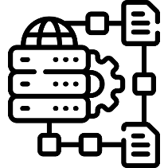
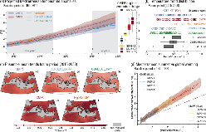
IPCC AR7 Plans: Complex Citation through provenance records (2)
Writing
Tool Framework
generate
Authors
Figure
Provenance Record
generate + publish
Editing
TSU
reference
update*
AR7
CCO
TSU / DDC
* CCO updates/new versions will also be required in the Errata & Corrigenda phase.

Slide 7
Conclusion
Complex Citation (CC) approach can enhance the traceability and credit assignment for figures in the IPCC reports.
Provenance records have been identified as way to gather required information for CC but also for other purposes
CMIP7 REF and Jupyter projects support the CC implementation into AR7
Integration of CC requirements in a robust and simple workflow is challenged by the need to align several activities under time and resource constraints
Ongoing tasks among others are:
TSU/DDC: definition of CCO content and integration of CC into the overall AR7 data workflow
RDA Complex Citation WG: definition of standards for implementation and stakeholder engagement
CMIP7 REF works with input data providers on data DOIs to be integrated in an agreed provenance template
Jupyter and TG Data work on provenance implementation into Jupyter Notebooks
Join the RDA Complex Citation WG ! https://www.rd-alliance.org/groups/complex-citations-working-group/
Martina Stockhause (DKRZ/IPCC DDC)
https://orcid.org/0000-0001-6636-4972
…

