Slide 1
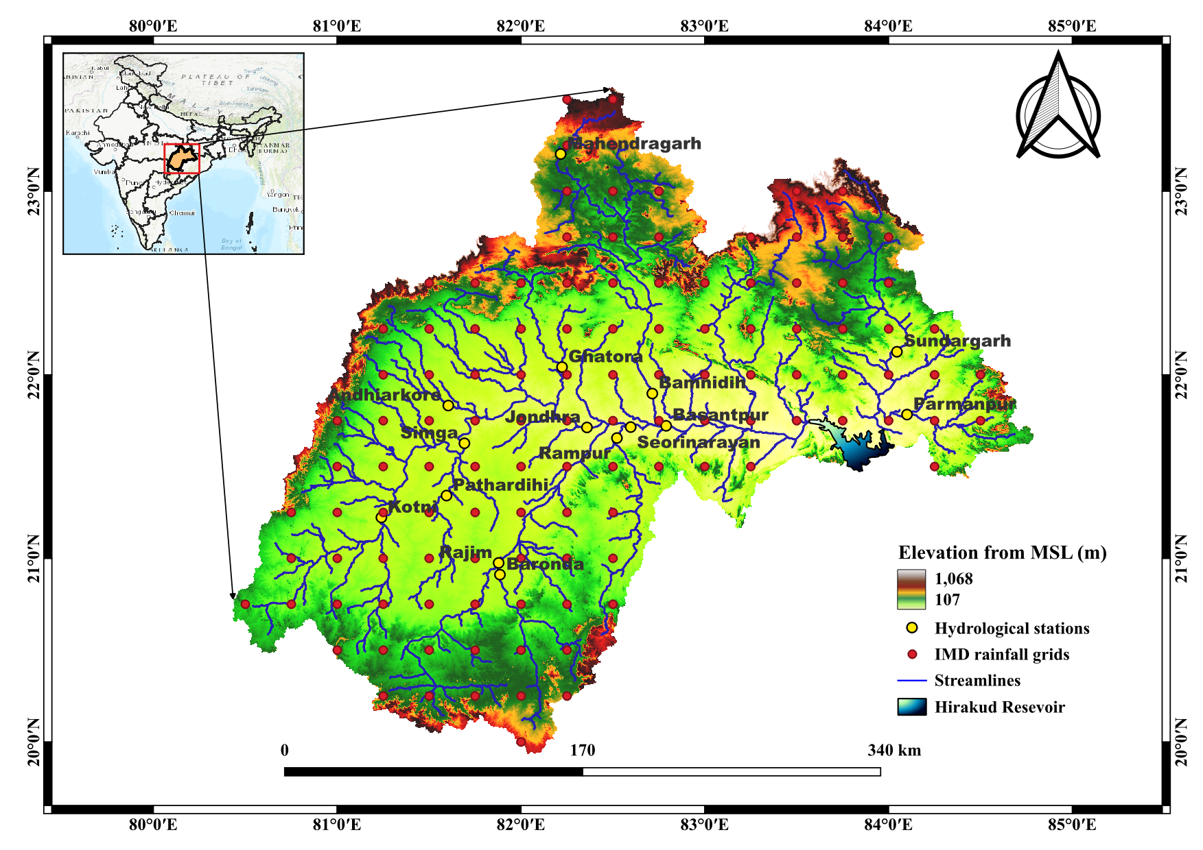
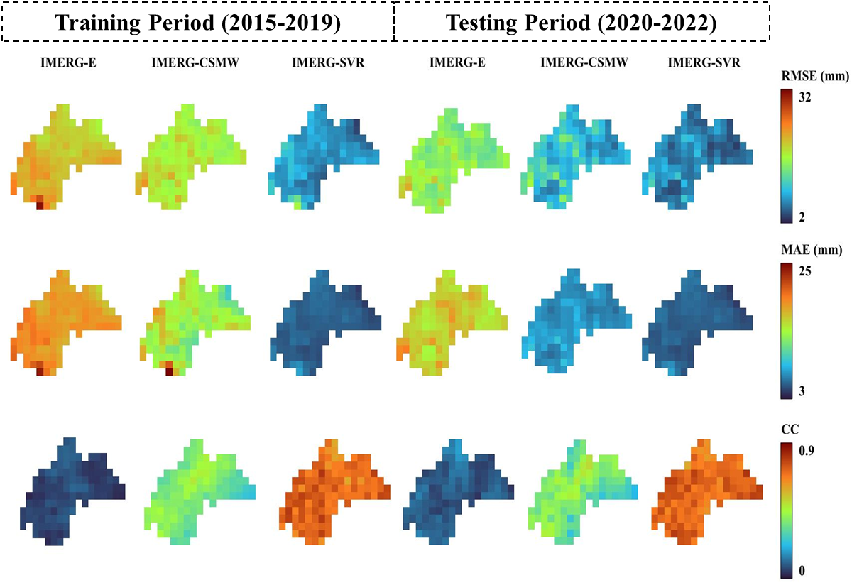
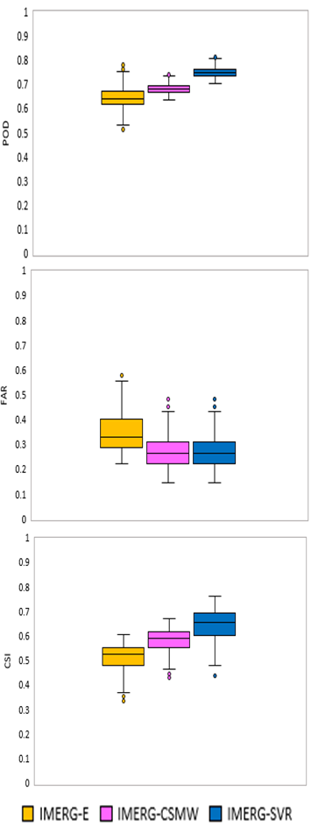
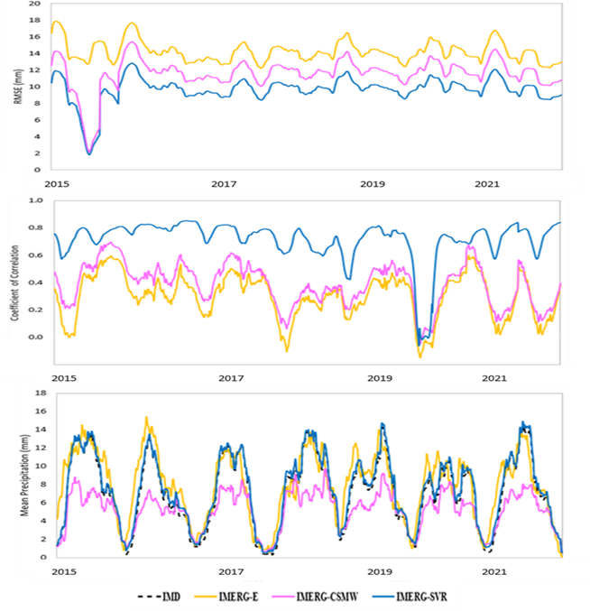
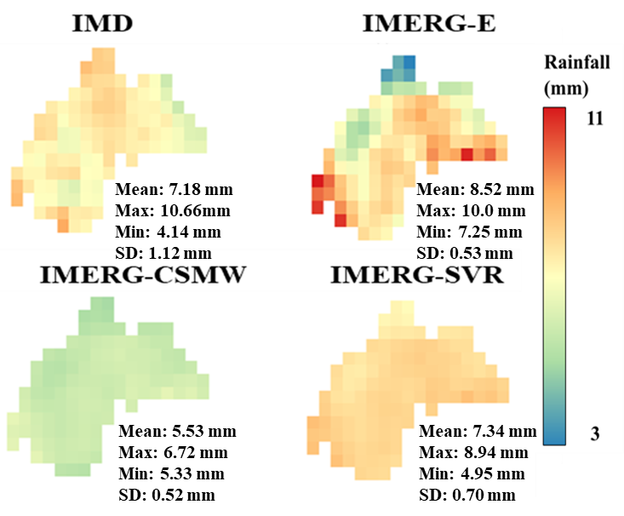
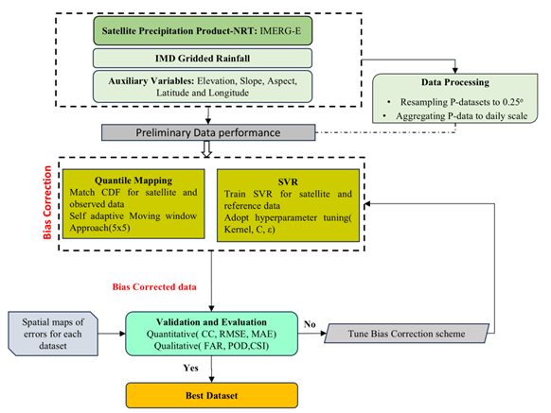
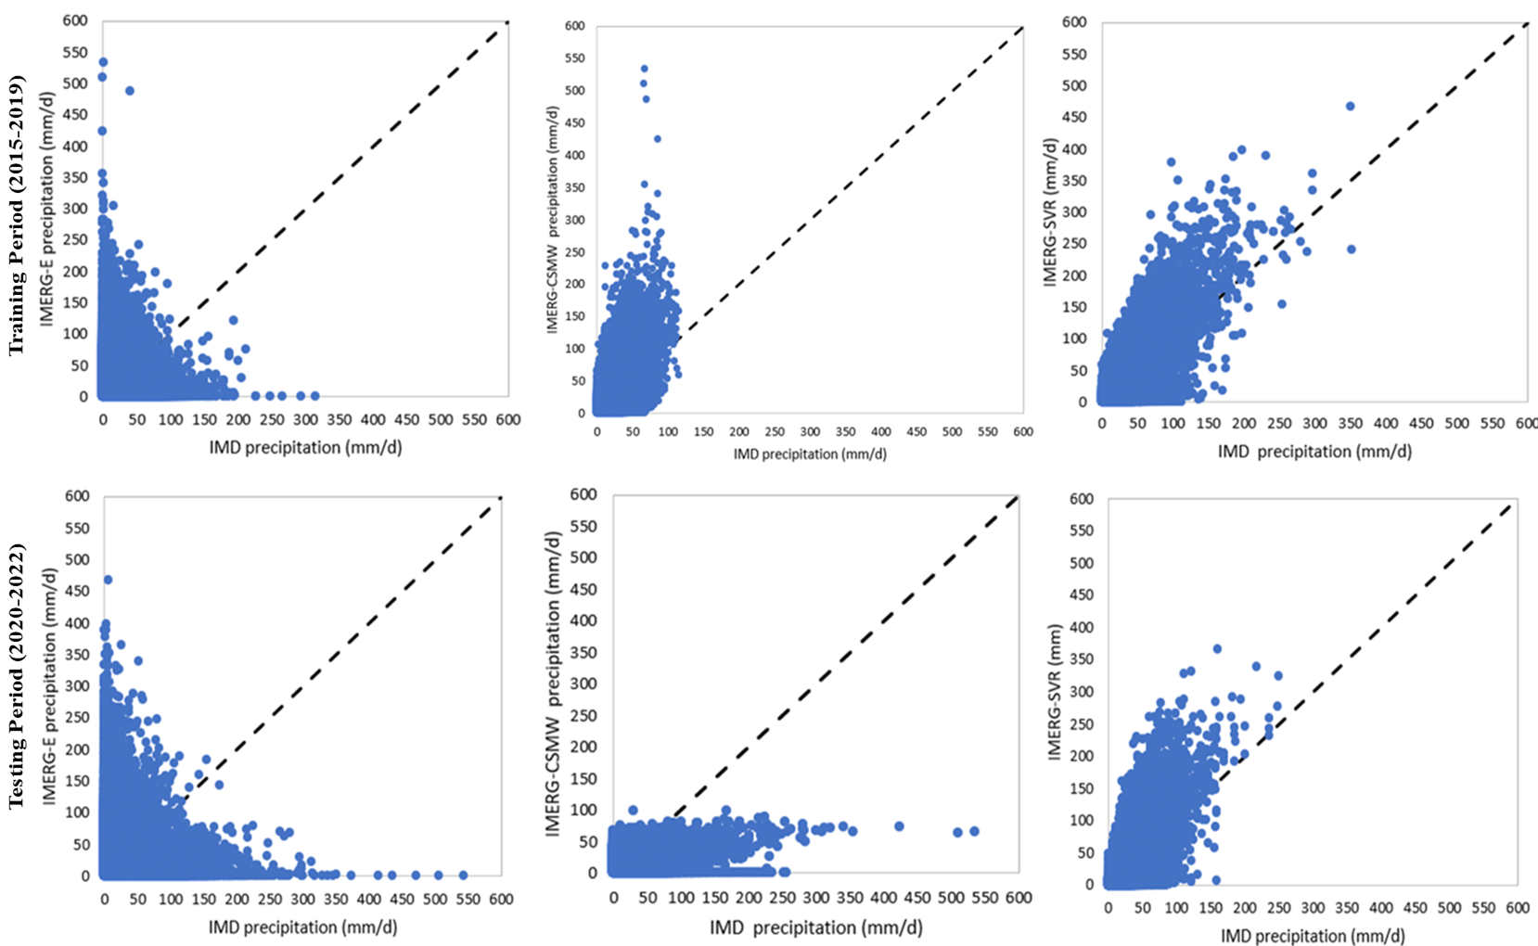
Enhancing accuracy of IMERG-E satellite rainfall products for Mahanadi River Basin using Bias-correction Methods
Roshan Suryakant Mohanty(1), Chandranath Chatterjee(2) and Bhabagrahi Sahoo(1)
(1)School of Water Resources, Indian Institute of Technology Kharagpur, West Bengal–721302, India
(2)Agricultural and Food Engineering Department, Indian Institute of Technology Kharagpur, West Bengal–721302, India
Background and Introduction
UPPER MAHANADI BASIN
Area: 83,000 Km²
Longitudes:
80° 30' to 85° 50’ E
Latitudes:
20° 10' to 23° 35’ N
Max Elevation(m): 1068
Min Elevation(m): 107
Mean Annual Rainfall: 1292 mm
Mean Max Temperature: 39.5 ℃
Mean Min Temperature : 20 ℃
Satellite-based precipitation products have become essential tools for global precipitation assessment, offering spatially continuous and temporally complete data coverage. However, these estimates often suffer from significant uncertainties due to the indirect methods involved in remote sensing retrieval processes.
Various Bias correction methods are employed to adjust satellite precipitation products in real time using statistical and machine learning techniques.
Objective
Development of bias correction schemes using CDF based and ML-based(SVR) approaches for IMERG-E products
Evaluate the performance of different precipitation products before and after bias correction
Figure 5. Spatial pattern of RMSE, MAE and CC of IMERG-E, IMERG-CSMW and IMERG-SVR model for training and testing periods.
Methodology and Datasets
Figure 2. Location of the study area.
(a)
(b)
Study aims to provide new insights into improving the NRT-satellite precipitation products. CDF-based moving window approach and SVR based bias correction is implemented for real time satellite precipitation products of IMERG-E
Results and Discussion
Figure 3. Mean rainfall of different precipitation products across the grids.
Figure 6. (a) Box-plot of POD,FAR and CSI and (b) Time series plot of RMSE, CC and mean precipitation of IMERG-E, IMERG-CSMW and IMERG-SVR at daily scale.
(a)
(b)
(c)
Conclusion
Both CSMW and SVR approaches improve the accuracy of IMERG-E satellite rainfalls.
IMERG-SVR leads to a mean closer to IMD with balanced spatial spread of rainfall (Fig. 3) .
IMERG-CSMW underpredicts rainfall but IMERG-SVR successfully captures low to moderate rainfall but misses some high rainfalls.
SVR better able to learn non-linear relationships between raw IMERG-E data and IMD rainfall using terrain data much better than CSMW.
CSMW based correction slightly improves but largely underpredicts whereas SVR-corrected IMERG shows best agreement with IMD rainfall.
SVR bias correction significantly improves rainfall detection (Fig.6 (a)) and reduces false alarms.
SVR-based bias correction is more robust and reliable for capturing spatio-temporal rainfall variability.
Figure 1. Flowchart for the proposed methodology.
Table 1. Details of the datasets used in this study.
Product | Gridded datasets | Version | Temporal | Spatial resolution | Available Period | Latency | Coverage | Study Period
Satellite | IMERG | Early V7.0 | Daily | 0.10º x 0.10º | 06/2000-present | 4 h | 60ºS-60ºN | 2015-2022
IMD |  | - | Daily | 0.25º x 0.25º | 1901-2023 | - | INDIA | 2015-2022
SRTM DEM |  | - | - | 90m | - | - | 60ºS-60ºN | -
Figure 4. Scatterplots of (a) IMERG-E, (b) IMERG-CSMW and (c) IMERG-SVR for training and testing periods.
Contact:
roshanmohanty96@gmail.com
ROSHANMOHANTY@kgpian.iitkgp.ac.in
Linkedin: Google scholar:
Acknowledgments:
The author gratefully acknowledges Prof. Chandranath Chatterjee and Dr. Bhabagrahi Sahoo for their guidance and support. The author gratefully acknowledges IMD for rainfall data and the Ministry of Education, Govt. of India, for Doctoral Fellowship support.
References:
Shen, Z., Yong, B., Gourley, J. J., & Qi, W. (2021). Real-time bias adjustment for satellite-based precipitation estimates over Mainland China. Journal of Hydrology, 596, 126133.
Kumar, A., Ramsankaran, R. A. A. J., Brocca, L., & Munoz-Arriola, F. (2019). A machine learning approach for improving near-real-time satellite-based rainfall estimates by integrating soil moisture. Remote Sensing, 11(19), 2221.

