Slide 1






A new way to incorporate storage change term improves the efficacy of the Budyko framework as compared to using effective precipitation
Balaram Shaw^{1,*}, and Bramha Dutt Vishwakarma^{1,2}
¹Interdisciplinary Centre for Water Research, Indian Institute of Science, Bangalore – 560012
²Centre for Earth Sciences, Indian Institute of Science, Bangalore – 560012
*balaramshaw@iisc.ac.in
HS 2.2.1 / EGU25-15213

Slide 2
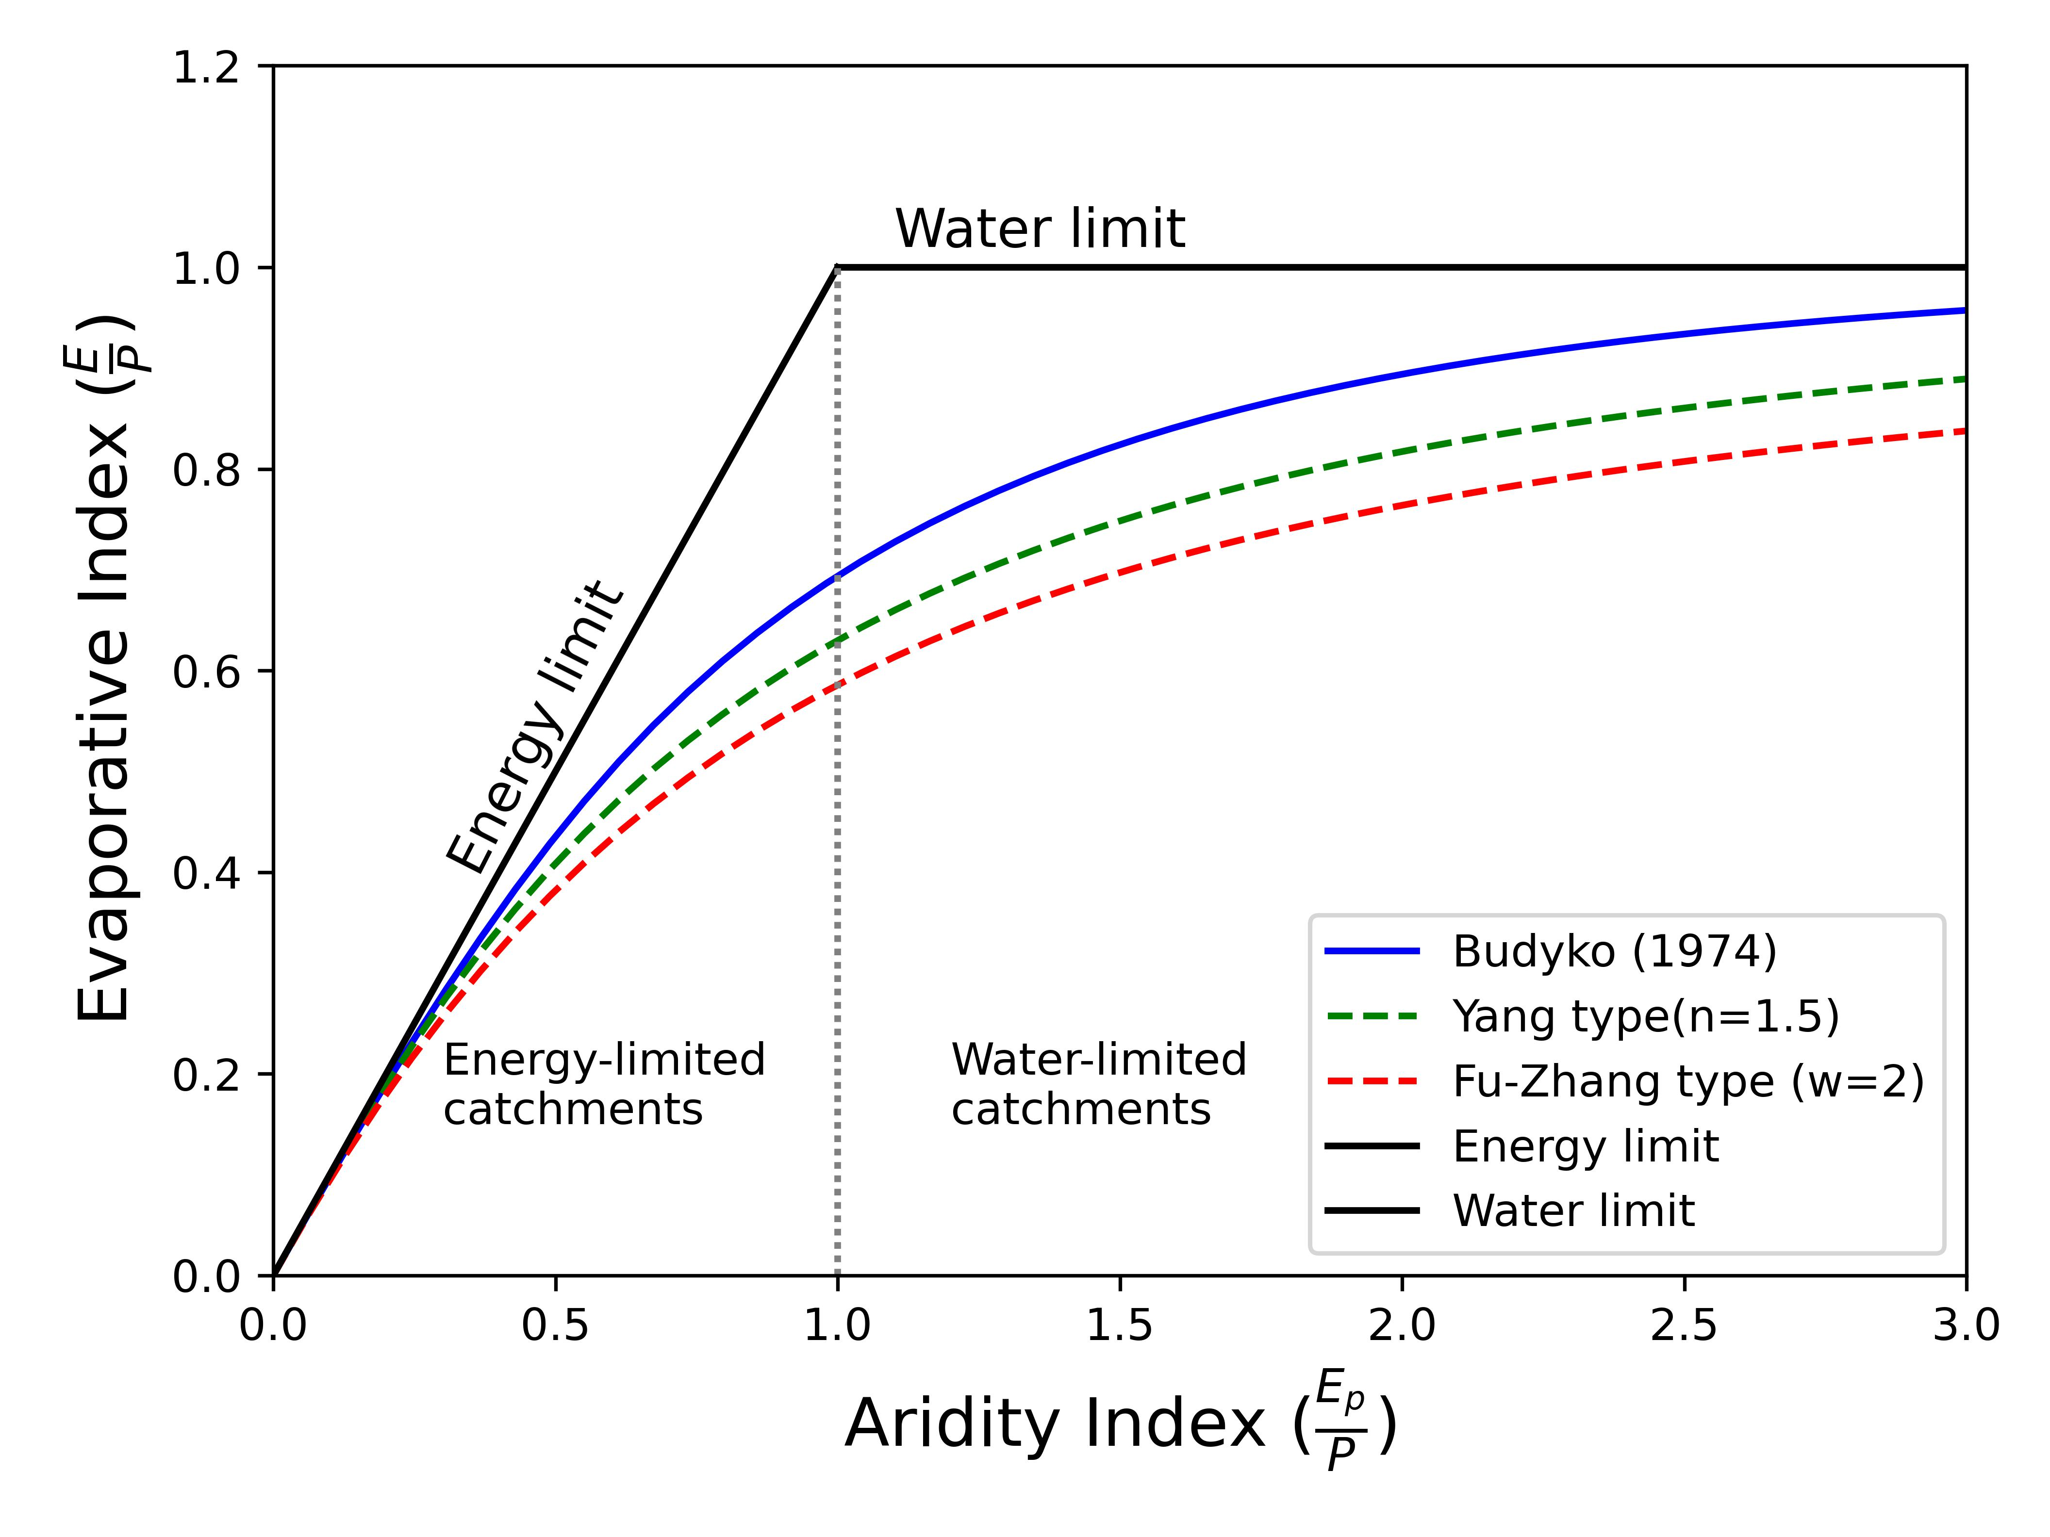
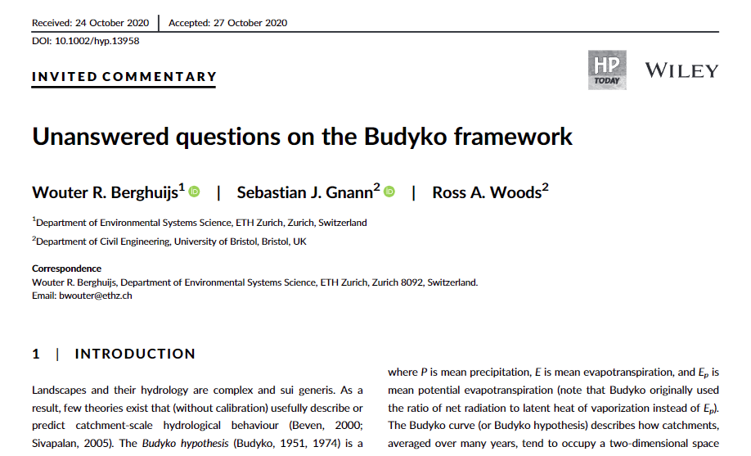
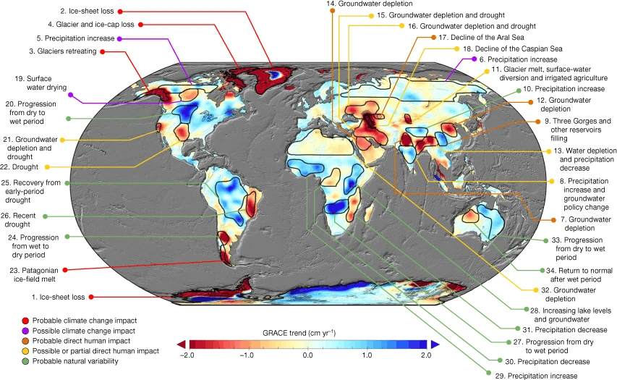



Introduction
Budyko Hypothesis
Long-term mean water balance at a large basin scale under a steady-state condition
Limitations
$$P=ET+Q$$
Budyko Diagram
$$∆S=0$$
$$P=ET+Q+ ∆S$$
P → precipitation; ET → actual evapotranspiration
Q → runoff; ∆S → change in storage
Source: Rodell, et al. (2018)

Slide 3

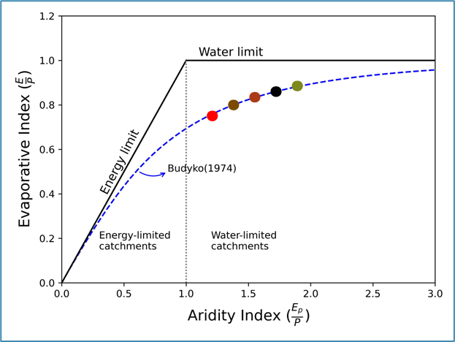
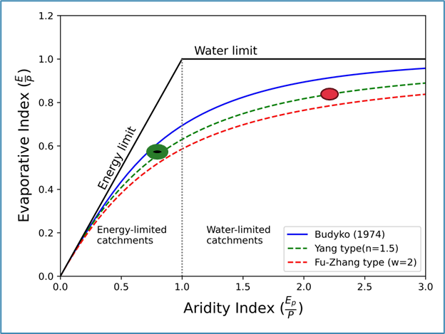
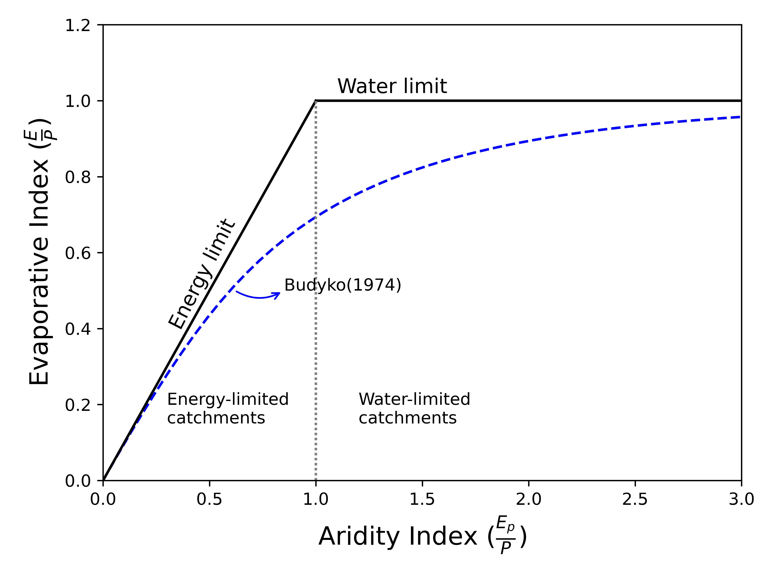
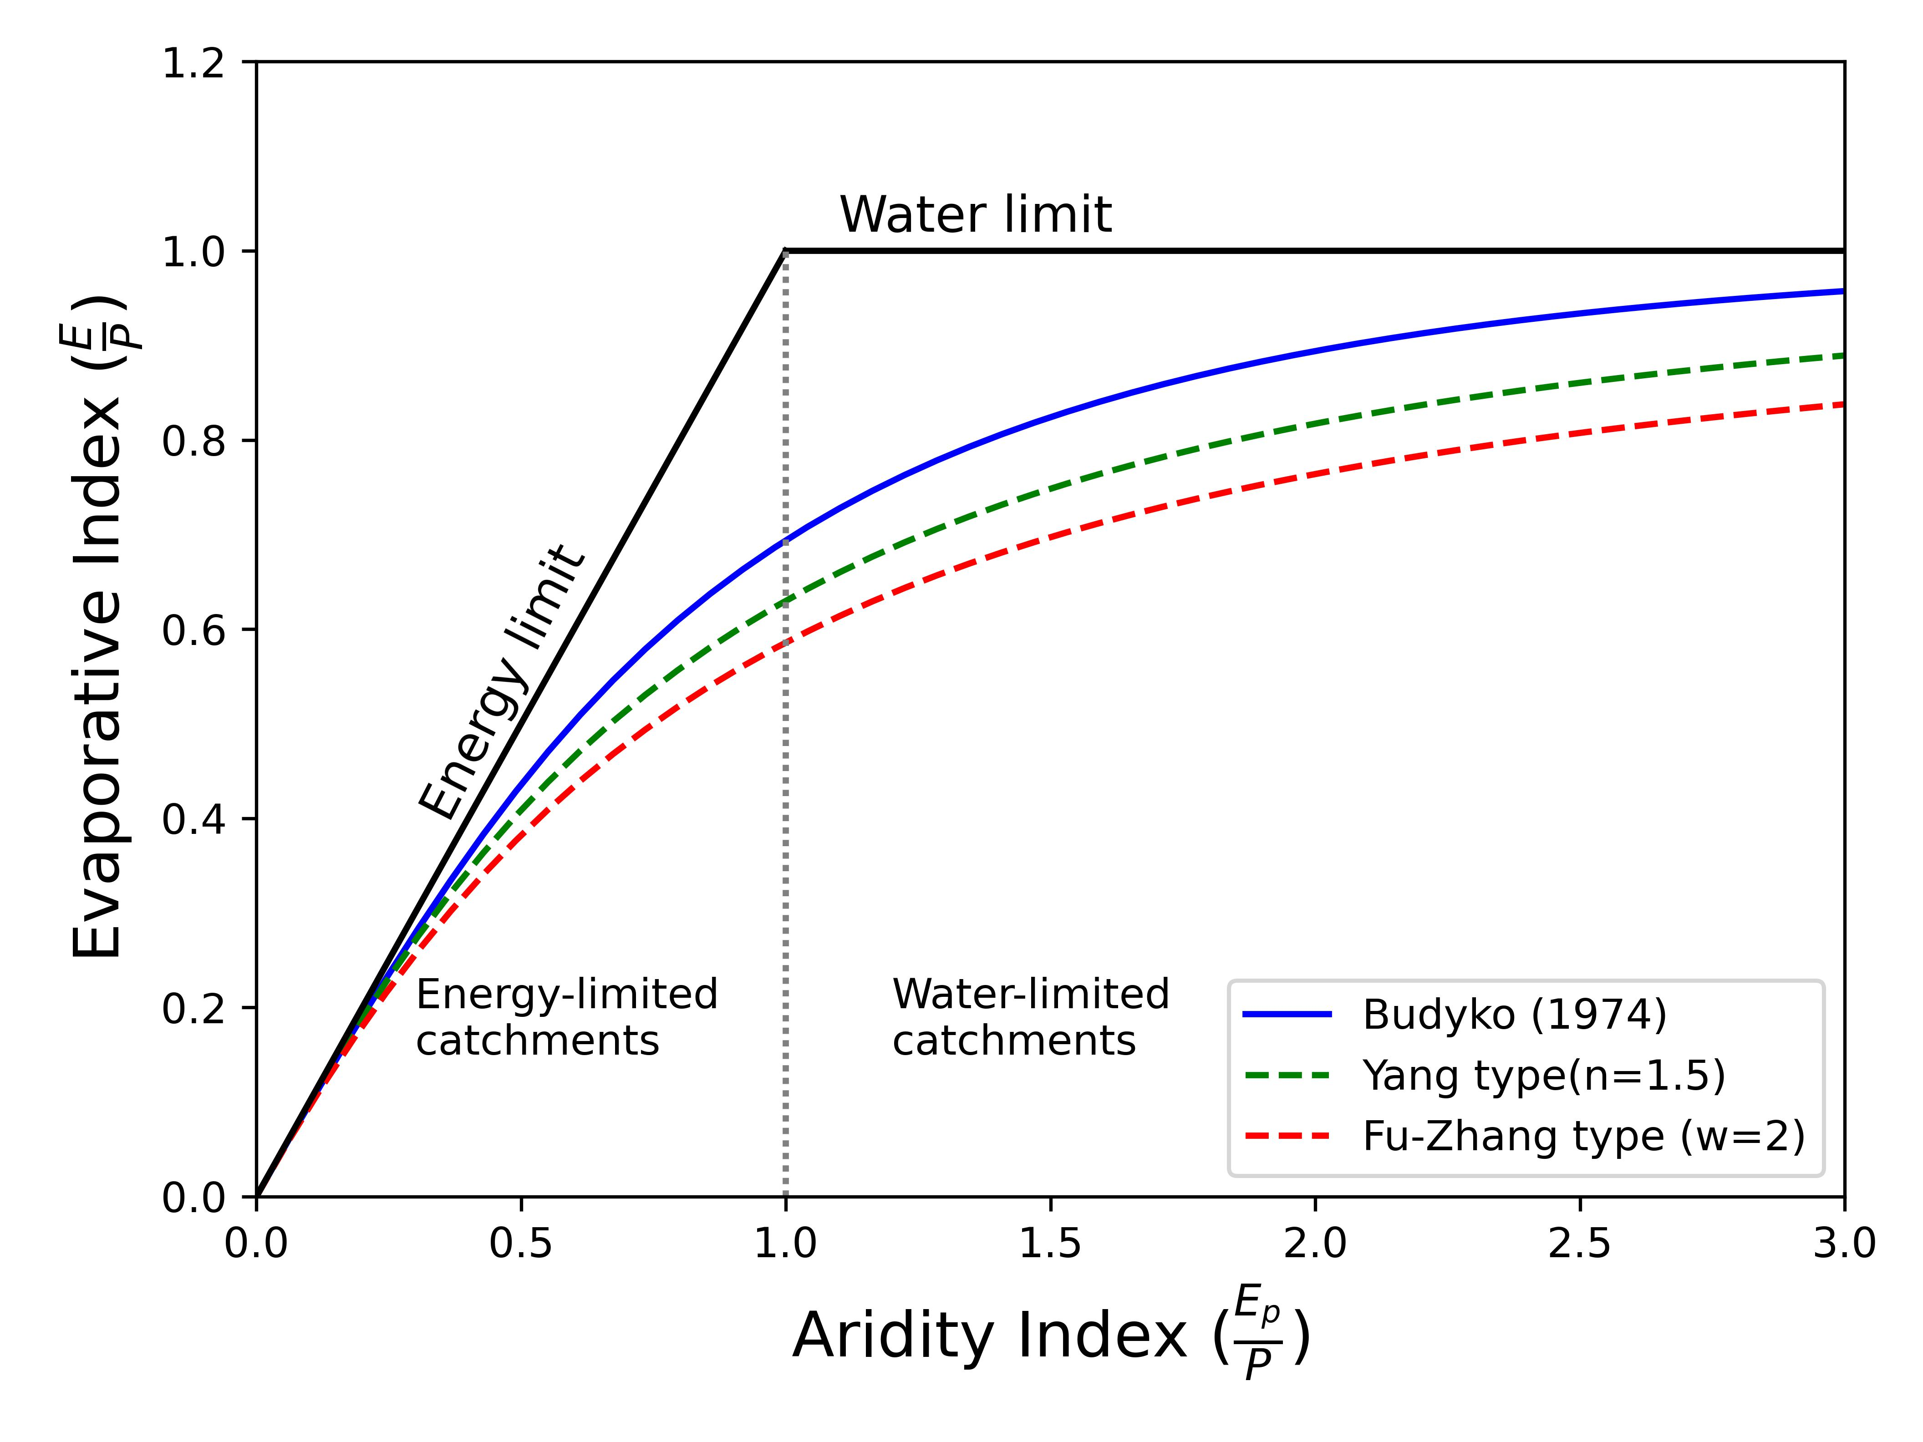
Question!
How to incorporate the storage change term to improve the efficacy of the Budyko framework?
.
.
.
.
.

Slide 4
Methodology
Closed loop environment
Synthetically generated data
SWAT
Different scenarios
Different climatic zones
Outputs: E, Ep, SW
Analysis and Outcomes

Slide 5
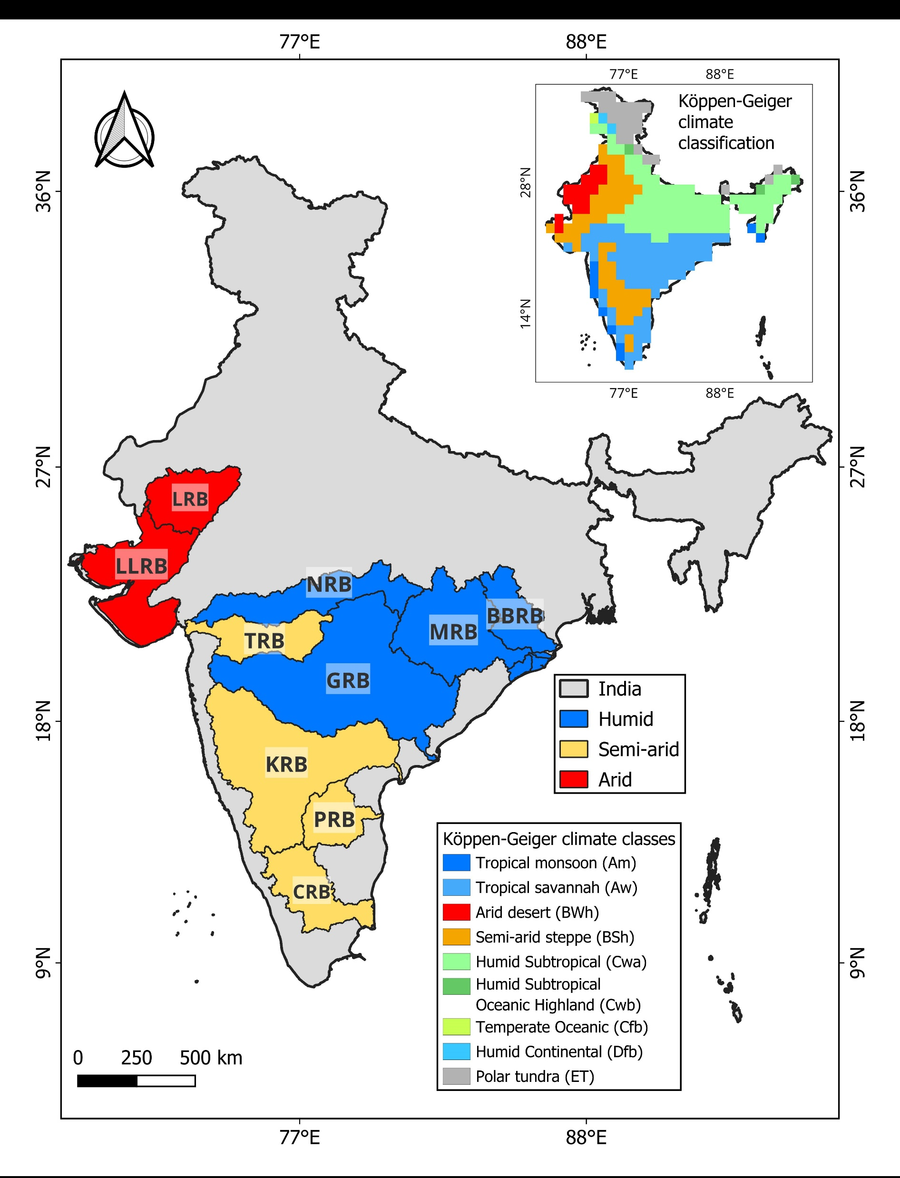
Study Area

Slide 6
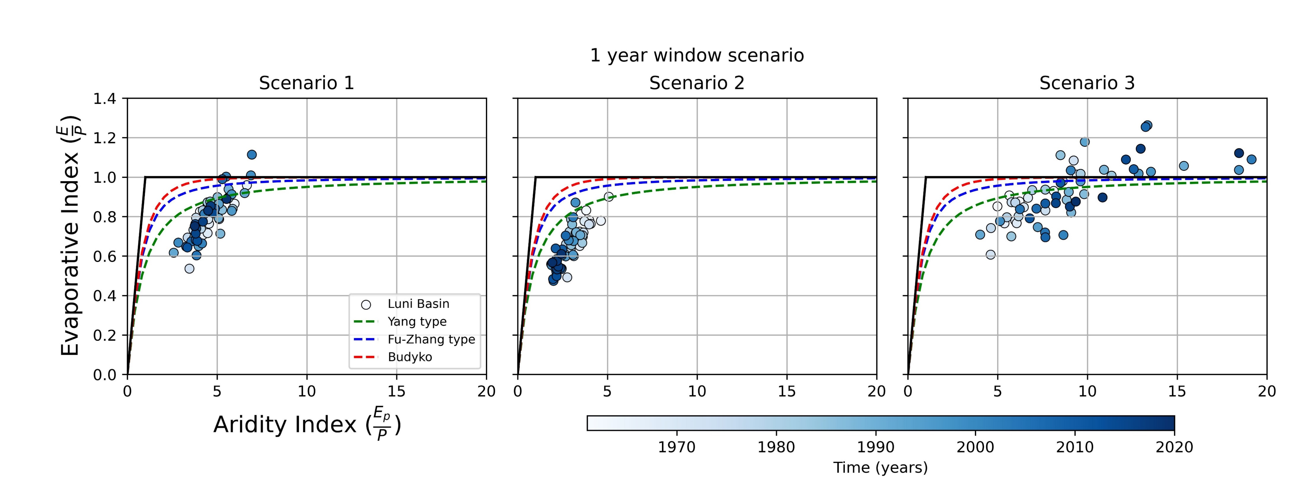
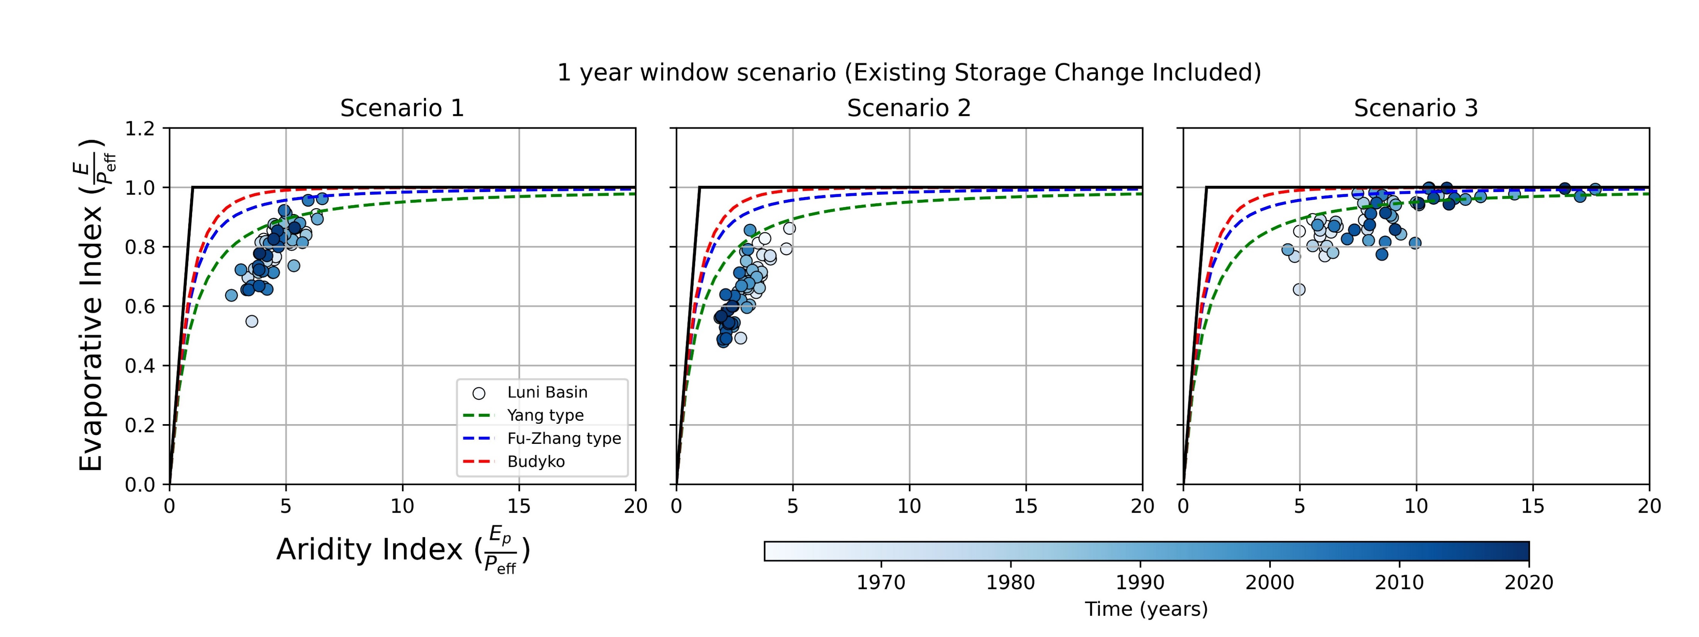

Natural storage change impact?
Sl. No. | Scenarios
 | P (mm) | T (ºC)
1 | P | T
2 | P_{inc} | T
3 | P_{dec} | T
(a)
(a) Budyko plots of LRB at 1 year timescale
$$P_{eff}=P − ∆S$$
(b)
(b) Budyko plots considering effective precipitation including existing storage change
Incorporating the storage change term by replacing the precipitation with effective precipitation improves the efficacy of the traditional Budyko framework.

Slide 7
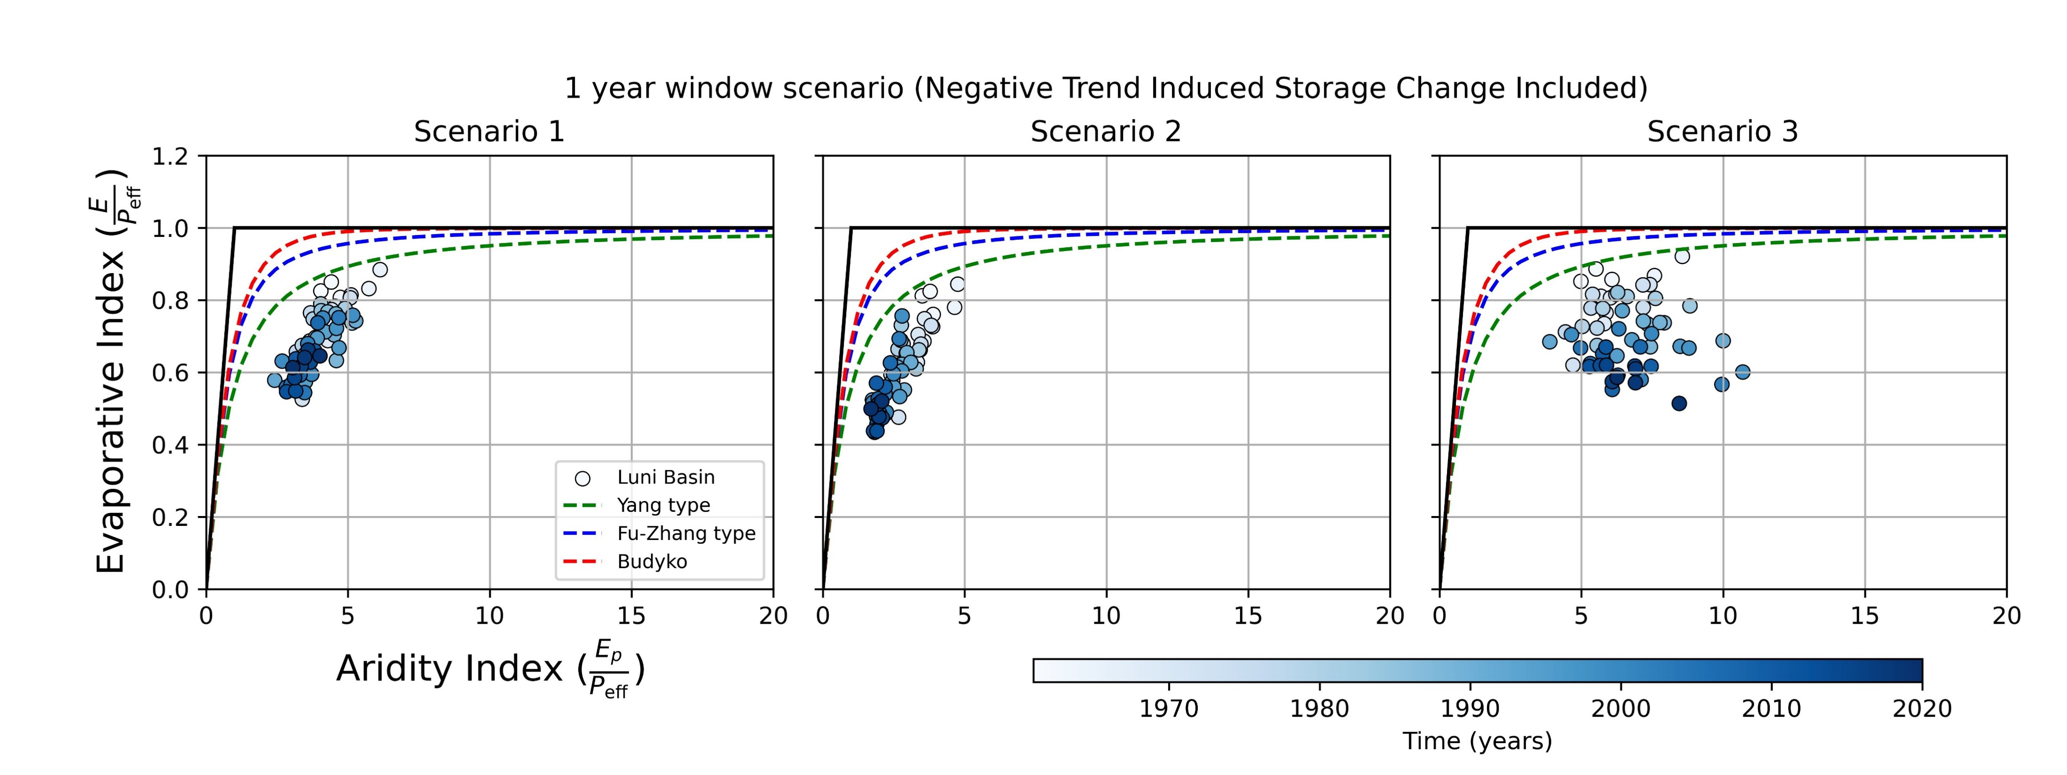
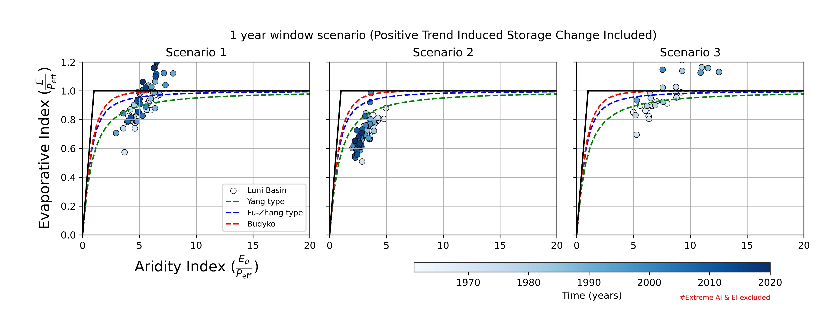

Human-induced storage change impact?
$$P_{eff}=P − ∆S$$
Budyko plots considering effective precipitation including human-induced (a) negative storage change; (b) positive storage change
A robust implementation of storage change term in the traditional Budyko framework is an utmost necessity.

Slide 8



Generalised Budyko Framework
Water limit
1
$$EI\left(\frac{E}{P}\right)$$
Energy limit
Budyko-type curve
-1
$$SCI\left(\frac{∆S}{P}\right)$$
1
1
$$AI\left(\frac{E_{P}}{P}\right)$$
AI: Aridity Index
EI: Evaporative Index
SCI: Storage Change Index

Slide 9
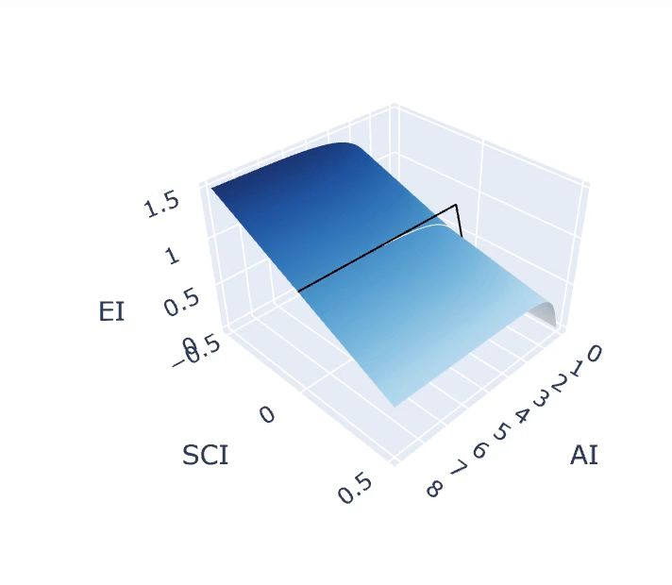
3D Budyko surface

Slide 10
References
Berghuijs, W. R., Gnann, S. J., & Woods, R. A. (2020). Unanswered questions on the Budyko framework. Journal of Hydrology, 265(26), 164-177.
Mianabadi, A., Davary, K., Pourreza-Bilondi, M., & Coenders-Gerrits, A. M. J. (2020). Budyko framework; towards non-steady state conditions. Journal of Hydrology, 588, 125089.
Moussa, R., & Lhomme, J. P. (2016). The Budyko functions under non-steady-state conditions. Hydrology and Earth System Sciences, 20(12), 4867-4879.
Rodell, M., Famiglietti, J. S., Wiese, D. N., Reager, J. T., Beaudoing, H. K., Landerer, F. W., & Lo, M. H. (2018). Emerging trends in global freshwater availability. Nature, 557(7707), 651-659.
Yang, H., Yang, D., Lei, Z., & Sun, F. (2008). New analytical derivation of the mean annual water‐energy balance equation. Water resources research, 44(3).
Zhang, L., Hickel, K., Dawes, W. R., Chiew, F. H., Western, A. W., & Briggs, P. R. (2004). A rational function approach for estimating mean annual evapotranspiration. Water resources research, 40(2).
I acknowledge Prime Minister Research Fellowship (PMRF) scheme for its support.

Slide 11
Thanks for your attention!
balaramshaw@iisc.ac.in

