Slide 1
Enhancing PPP Performance with Multi-GNSS Satellite Products and Integer Ambiguity Resolution
Marcus Franz Wareyka-Glaner¹, Gregor Möller¹
¹ Department of Geodesy and Geoinformation, Technische Universität Wien, Austria
29 April 2025
marcus.glaner@geo.tuwien.ac.at

Slide 2
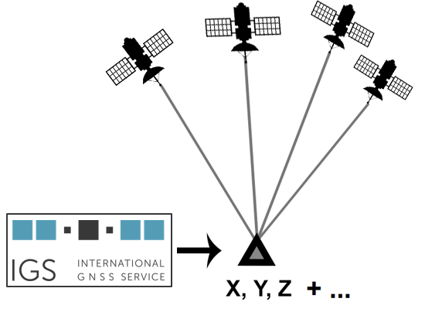
Precise Point Positioning
PPP requires precise satellite products and complex models and algorithms
position accuracy: cm, or even mm
major drawback: convergence time
satellite products
PPP with integer ambiguity resolution → PPP-AR
Wareyka-Glaner, 29/04/2025

Slide 3
improve PPP
multi-GNSS
multi-frequency
modern satellite products
innovative PPP models
integer ambiguity fixing
accurate error models
Wareyka-Glaner, 29/04/2025

Slide 4
Satellite products
operational final MGEX products
with phase biases
latency: ∼ 9 days
Analysis Center |  | GNSS | Source
COD | Center of Orbit Determination Europe | GRECJ | ftp.aiub.unibe.ch/CODE_MGEX/CODE
GRG | Centre National d’Études Spatiales | GREC | https://cddis.nasa.gov/archive/gnss/products/
HUS | Huazhong University of Science and Technology | GREC | ftp://ggda.ac.cn/pub/mgex/products/
WUM | Wuhan University | GRECJ | https://cddis.nasa.gov/archive/gnss/products/
WMC | Combined product | GRECJ | ftp://igs.gnsswhu.cn/pub/whu/phasebias/
G…GPS R…GLONASS E…Galileo C…BeiDou J…QZSS
Wareyka-Glaner, 29/04/2025

Slide 5
Test case
Software | (https://github.com/TUW-VieVS/raPPPid)
Data | 21 IGS MGEX stations, January 1, 2025
Observations | GPS: L1+L2, GLONASS: G1+G2, Galileo: E1+E5a 30 sec interval, reset of solution: every 20 min
Satellite products | COD or GRG or HUS or WUM or combined product
Wareyka-Glaner, 29/04/2025

Slide 6
Software raPPPid (VieVS PPP) [Glaner & Weber, 2023]
Data 21 globally distributed IGS MGEX stations (January 1, 2025)
Observations GPS: L1+L2, GLONASS: G1+G2, Galileo: E1+E5a
Observation ranking GPS: WCLQ, GLONASS: PCQX, Galileo: CQX
Observation interval 30 sec, reset of solution: every 20 min
Processing mode Post-processing, ionosphere-free LC, static
Raw observation noise Code 30cm, phase 2mm
Observation weighting Elevation weighted, sin²(elev), cutoff angle 5°
Correction models Phase Wind-Up, solid Earth tides, relativistic effects, PCO + PCV, ocean loading
Troposphere model VMF3 + GRAD, residual zenith wet delay is estimated, process noise 5mm /√h
Adjustment Filter (float solution) and Least-Squares-Adjustment (fixed solution)
Float ambiguities Constant, zero-difference, cycle-slip detection: dL1-dL2
PPP-AR Fixing cutoff 10°, reference satellite = highest satellite, fixing start after 120s
Fixing WL with HMW LC of the last 5minutes, NL with LAMBDA 4.0
Orbits, Clocks, Biases COD or GRG or HUS or WUM or combined product
Satellite attitude From ORBEX
Wareyka-Glaner, 29/04/2025

Slide 7
Results
fixed position | COD | GRG | HUS | WUM | WMC
Ø TTCF [min] | 3.56 | 3.66 | 3.28 ⁽*⁾ | 4.17 | 4.40
median 2D error [cm] | 0.90 | 0.92 | 0.78 ⁽*⁾ | 1.46 | 0.90
Ø 3D error after 20 min [cm] | 3.28 | 3.50 | 3.25 ⁽*⁾ | 3.91 | 3.54
⁽*⁾ only stations tracking Galileo CQ-signals (no X code biases)
TTCF … time to correct fix
TTCF is achieved when 2D < 5 cm for the complete remaining period

Slide 8
Results
fixed position | COD | GRG | HUS | WUM | WMC
Ø TTCF [min] | 3.24 | 3.28 | 3.28 | 3.76 | 3.96
median 2D error [cm] | 0.84 | 0.84 | 0.78 | 1.40 | 0.85
Ø 3D error after 20 min [cm] | 3.19 | 3.56 | 3.25 | 3.87 | 3.45
stations tracking Galileo CQ-signals
TTCF … time to correct fix
TTCF is achieved when 2D < 5 cm for the complete remaining period

Slide 9
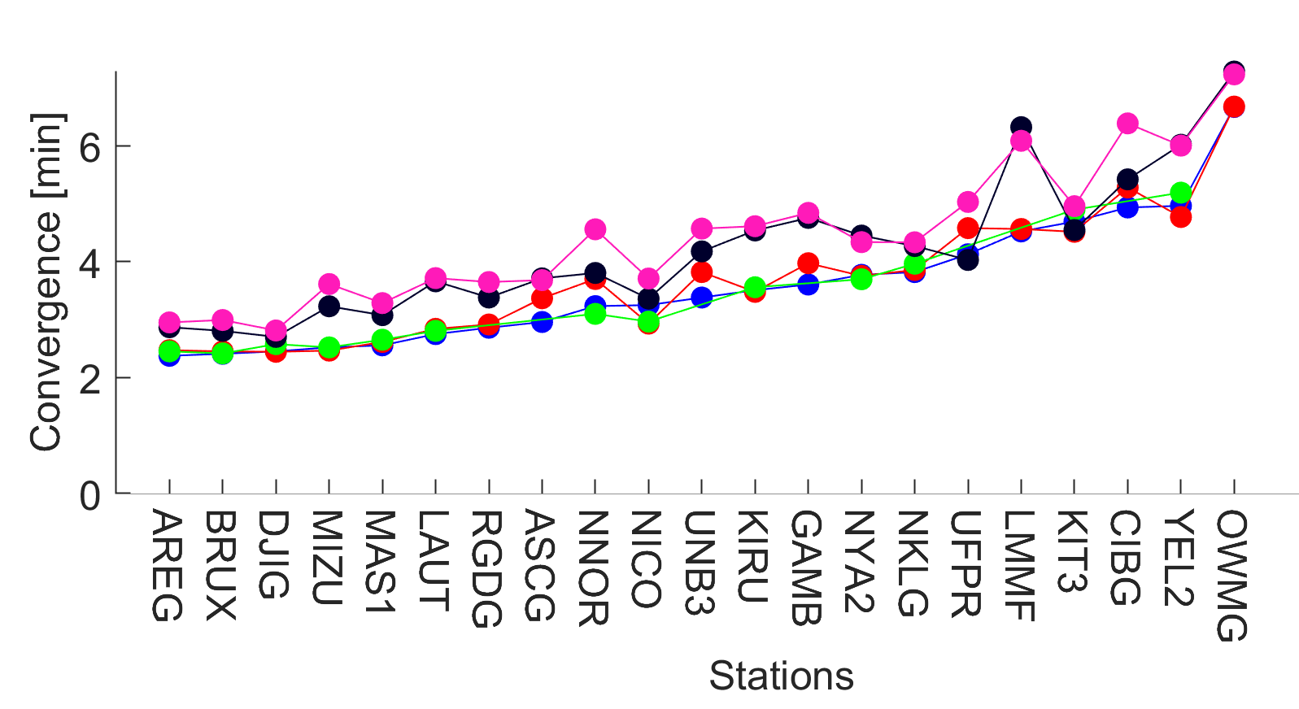
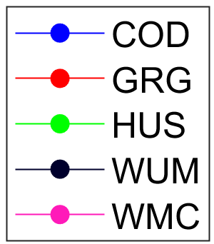
Ø TTCF / station
TTCF is achieved when 2D < 5 cm for the complete remaining period
TTCF … time to correct fix
… station tracks Galileo X signals
Wareyka-Glaner, 29/04/2025

Slide 10
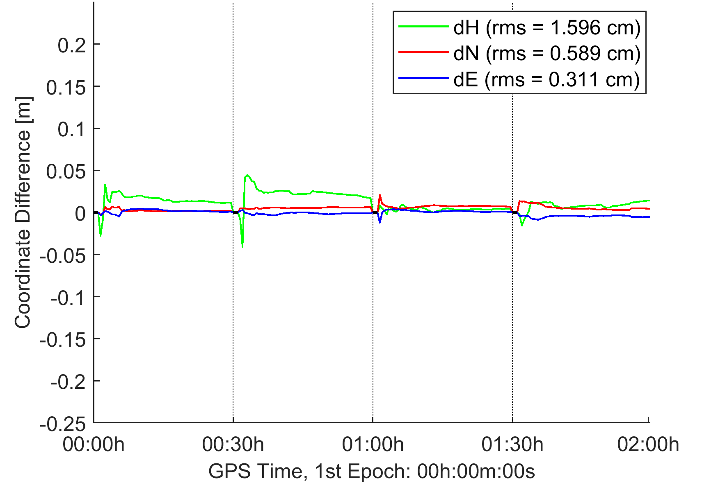
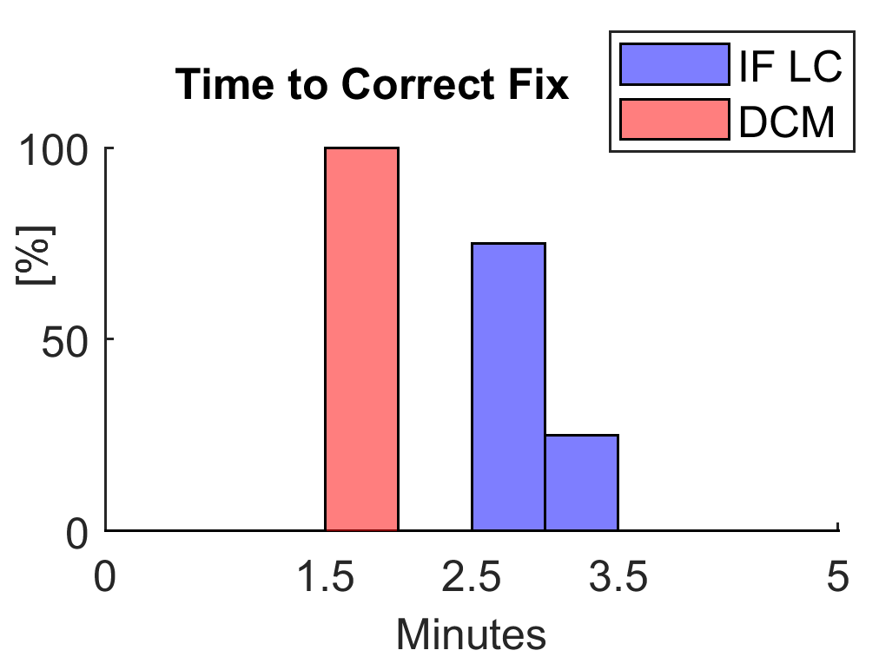
3+ Frequencies
UNB3 2024/001, fixed UTM
all tested products enable PPP-AR with IF LC
only WUM allows multi-frequency fixing
for example: Decoupled Clock Model ¹
WUM MGEX rapid, GrEC, 3 frequencies
→ improves convergence
¹ Naciri & Bisnath, 2021
Wareyka-Glaner, 29/04/2025

Slide 11
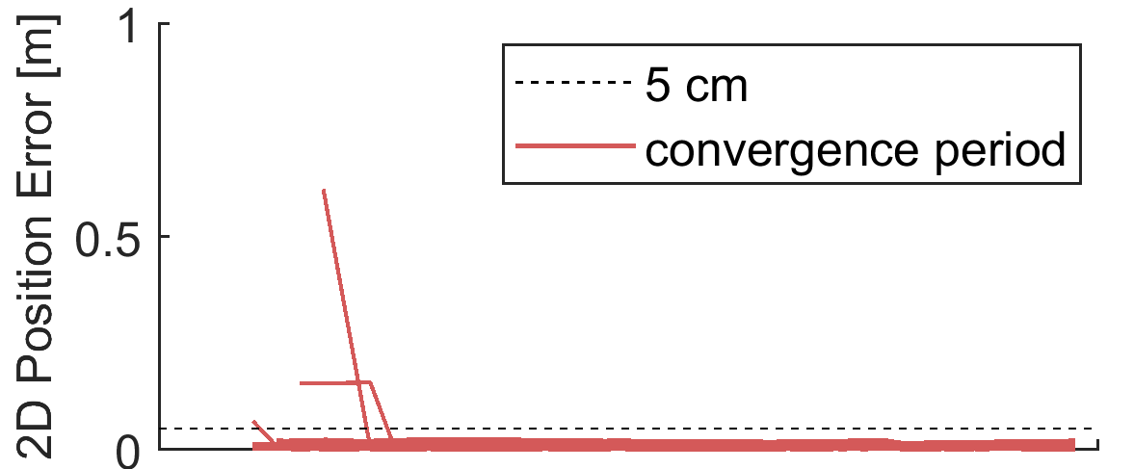
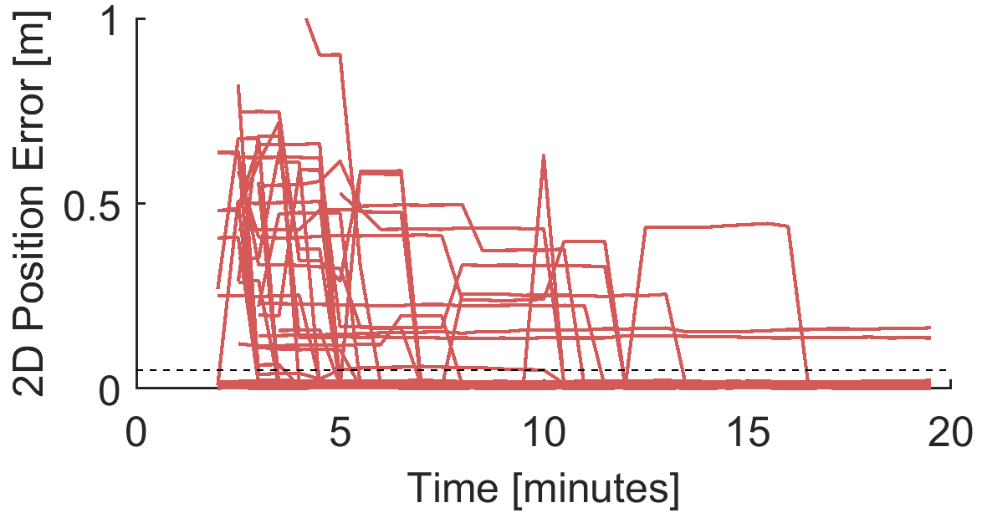
igs20.atx
PCO/PCVs of some satellites changed in week 2345
backward compatibility is lost, for example:
satellite products were generated with old values
PPP user applies latest igs20.atx file
AREG, GRG products
correct igs20.atx
latest igs20.atx
igs20_2356.atx, https://files.igs.org/pub/station/general/

Slide 12
Summary
several high-quality satellite products
only WUM endorses 3+ frequencies
rapid ∼ final products
igs20.atx: ”valid from” / “valid to” tags?

Slide 13
References
Naciri, N., & Bisnath, S. (2021). An uncombined triple-frequency user implementation of the decoupled clock model for PPP-AR. Journal of Geodesy, 95(5), 60. https://doi.org/10.1007/s00190-021-01510-y
Glaner, M. F., & Weber, R. (2023). An open-source software package for Precise Point Positioning: raPPPid. GPS Solutions, 27(4), 174. https://doi.org/10.1007/s10291-023-01488-4

Slide 14
Thank you for your attention!
© Thomas Fabian (flickr)

Slide 15
Supplementary

Slide 16
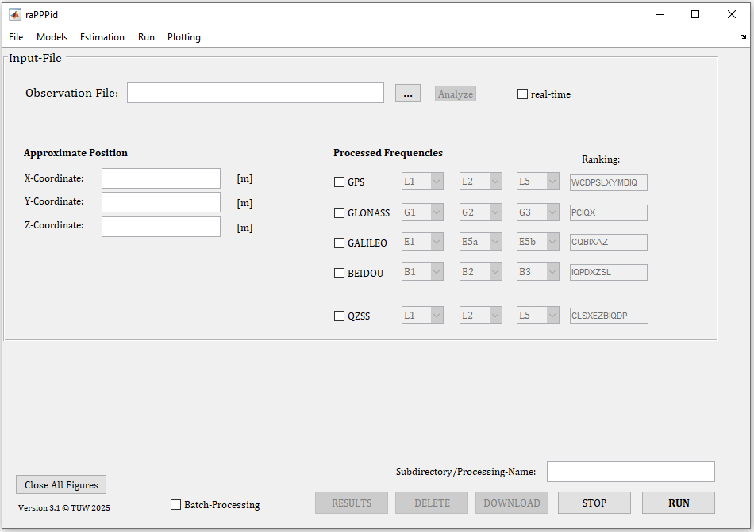
raPPPid
open-source PPP software
GitHub: https://github.com/TUW-VieVS/raPPPid
Documentation: https://vievswiki.geo.tuwien.ac.at/en/raPPPid
Wareyka-Glaner, 29/04/2025

Slide 17
Results
2D, 95% Quantile
3D, 95% Quantile
HUS: only stations tracking Galileo CQ-signals (no X code biases)

Slide 18
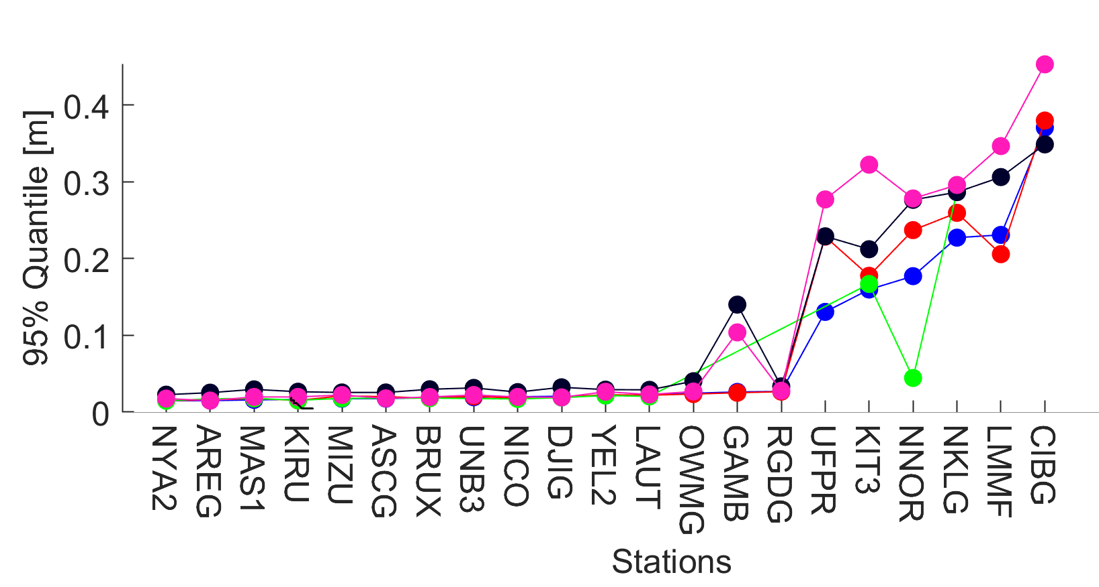
2D error / station
… station tracking Galileo X signals
Wareyka-Glaner, 29/04/2025

Slide 19
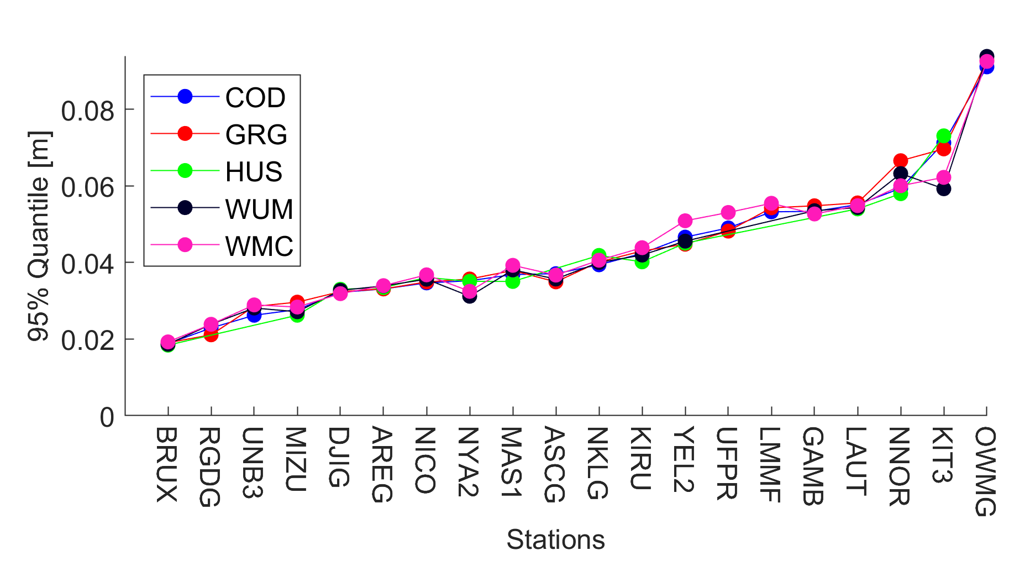
Results: ZTD

Slide 20
CODr vs CODf (GrE)
float
float
fixed results | rapid | final
Ø TTCF [min] | 3.52 | 3.56
median 2D error [cm] | 0.89 | 0.90
Ø 3D error after 20 min [cm] | 3.30 | 3.28
fixed
fixed
TTCF … time to correct fix
TTCF is achieved when 2D < 5 cm for the complete remaining period

Slide 21
Results: GrEC
fixed position | COD | GRG | HUS | WUM | WMC
Ø TTCF [min] | 3.54 | 3.92 | 3.34 ⁽*⁾ | 4.65 | 4.47
median 2D error [cm] | 0.90 | 0.92 | 0.78 ⁽*⁾ | 1.51 | 0.91
Ø 3D error after 20 min [cm] | 3.21 | 3.52 | 3.22 ⁽*⁾ | 4.14 | 3.53
⁽*⁾ only stations tracking Galileo CQ-signals (no X code biases)
TTCF … time to correct fix
TTCF is achieved when 2D < 5 cm for the complete remaining period

Slide 22
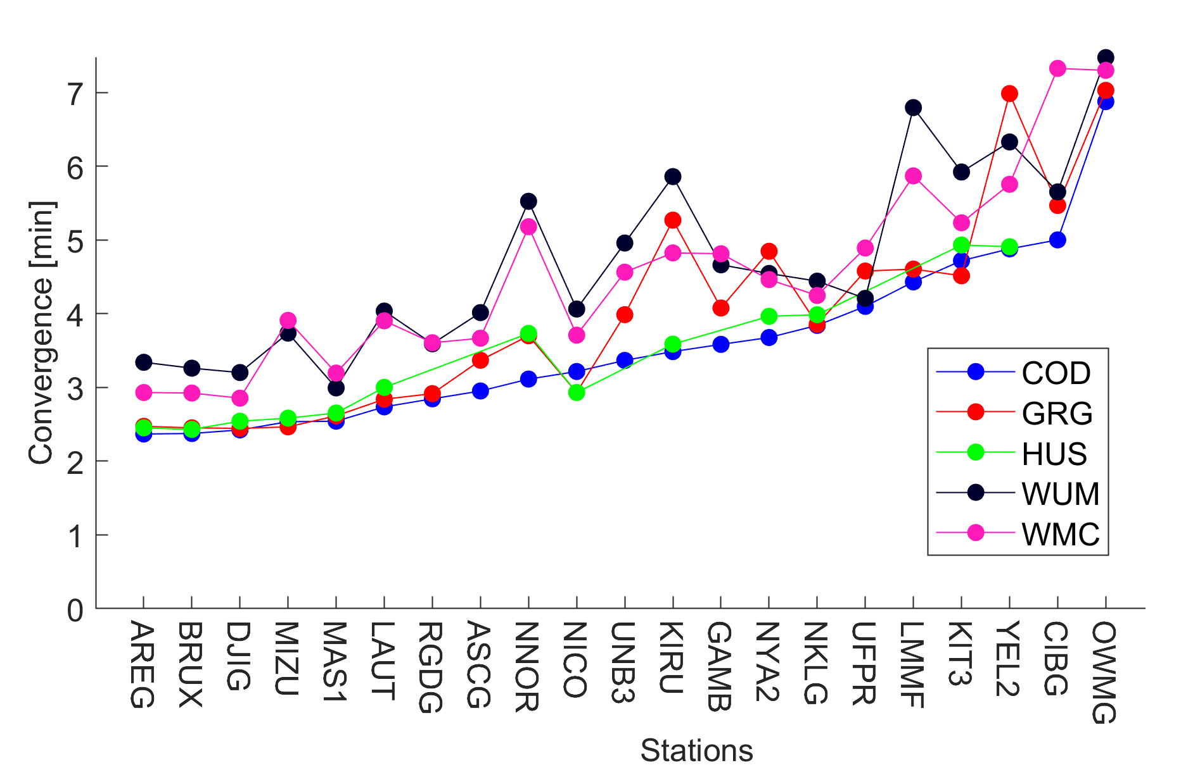
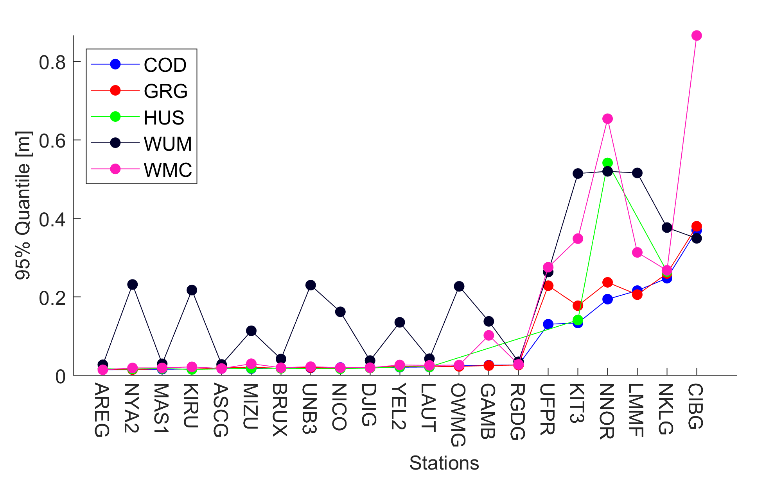
Results: GrEC
Ø TTCF
2D error

Slide 23
Another Day (032/2025)
fixed position | COD | GRG | HUS | WUM | WMC
Ø TTCF [min] | 3.66 | 3.66 | 3.61 ⁽*⁾ | 4.23 | 4.55
median 2D error [cm] | 0.90 | 0.89 | 0.80 ⁽*⁾ | 1.13 | 0.88
Ø 3D error after 20 min [cm] | 4.00 | 3.78 | 3.34 ⁽*⁾ | 4.32 | 3.88
⁽*⁾ only stations tracking Galileo CQ-signals (no X code biases)
TTCF … time to correct fix
TTCF is achieved when 2D < 5 cm for the complete remaining period

Slide 24
Another Day (032/2025)
fixed position | COD | GRG | HUS | WUM | WMC
Ø TTCF [min] | 3.29 | 3.34 | 3.61 | 3.90 | 4.31
median 2D error [cm] | 0.82 | 0.81 | 0.80 | 1.05 | 0.82
Ø 3D error after 20 min [cm] | 3.72 | 3.35 | 3.34 | 3.87 | 3.40
only stations tracking Galileo CQ-signals
TTCF … time to correct fix
TTCF is achieved when 2D < 5 cm for the complete remaining period

