Slide 1
EGU General Assembly 2025
(April 27- May 02, 2025)
Presentation on
Assessing the Impact of Land Use and Land Cover Changes on Wetland Landscape Patterns and Hydroecology: A Case Study of the Bakhira Wetland
Presented by
Manish Rawat
Indian Institute of Technology Roorkee, India
Deptt. of Water Resources Development &Management
E-mail: manish.wr@sric.iitr.ac.in

Slide 2
Background
Wetlands (as per Ramsar Convention) are regions of marshy land, fen, bog, or water, whether natural or manmade, permanent or temporary, with water that is static or flowing, fresh, brackish, or salt, including depth that does not exceed six meters.
Three Characteristics of a wetland: Vegetation, Hydric soil, and Hydrology.
Wetlands are ecologically significant as they support diverse species and serve as transition zones between aquatic and terrestrial environments. Their complex ecosystems are sensitive to changes over time and space, making it crucial to understand their distribution and evolution.
With advances in technology, automated and semi-automated techniques are now being employed to map and analyze wetland structures, both at national and state levels.
Wetlands face increasing pressure from human activities and climate change, leading to their fragmentation. As wetlands become more fragmented, species such as birds are forced into shrinking or degraded habitats, resulting in a loss of biodiversity.
The use of fragmentation measures has gained governmental and scientific attention as an important landscape indicator. They aid researchers and policymakers in understanding complex landscape dynamics, providing insights into how wetland ecosystems react to environmental changes.

Slide 3
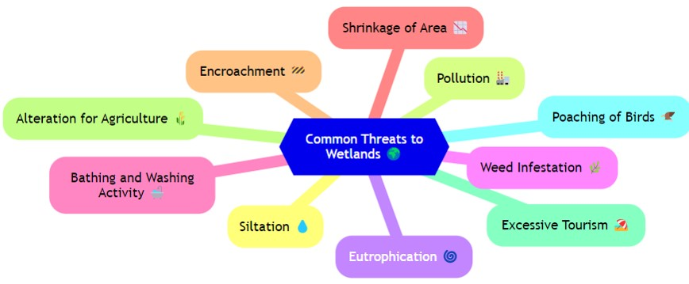
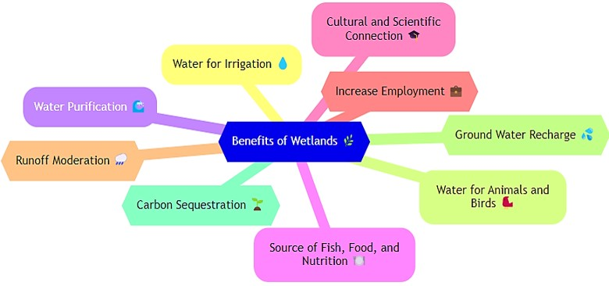
Background
Factors responsible for stress on wetlands
Various tangible and intangible benefits of wetlands

Slide 4
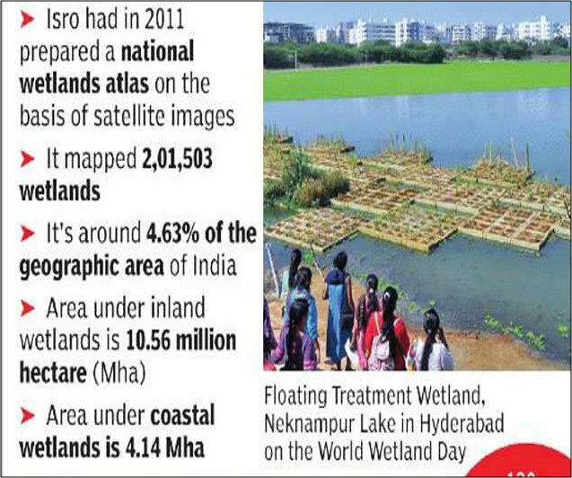
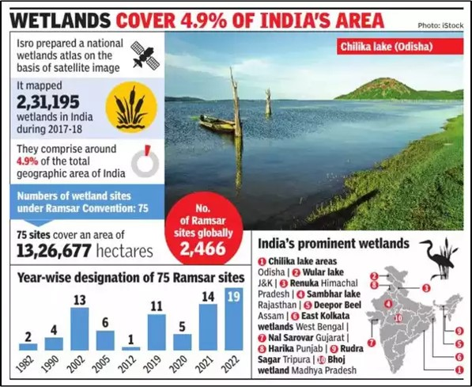
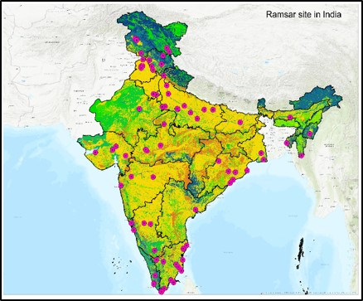
Status of Wetlands in India
There are currently 85 Ramsar Sites in India. This is the highest number in South Asia.

Slide 5
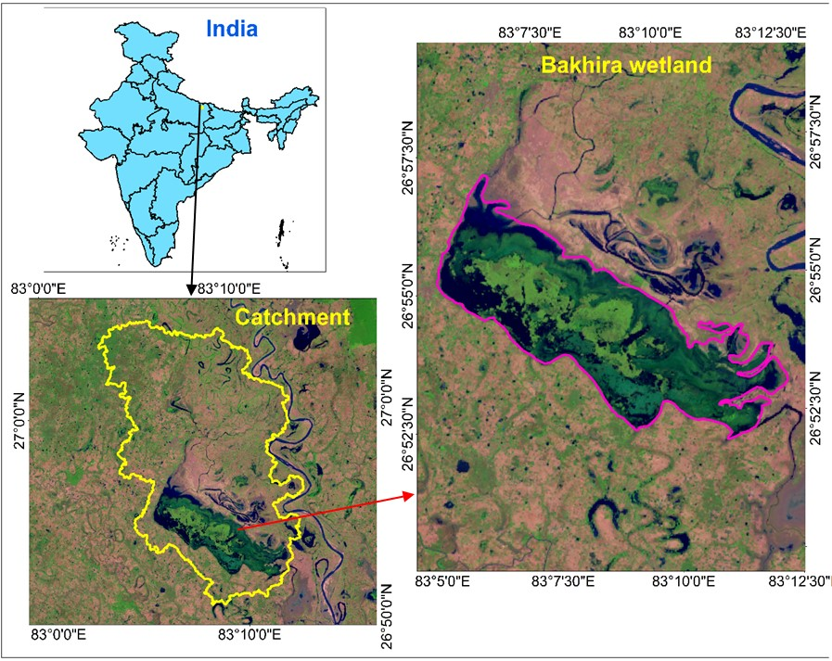
Study Area
Bakhira Wildlife Sanctuary, also called Bakhira Tal (26° 54.102' N, 83° 8.95' E), is a shallow-water wetland located in Sant Kabir Nagar district of Eastern Uttar Pradesh.
It is spreading over a 40.32 km² with a catchment area of 264.57 km² .
It's the 49th Ramsar Site in India and the 10th in Uttar Pradesh.
Bakhira Wildlife Sanctuary faces several challenges, including encroachment for agriculture and settlement expansion, pollution from agricultural runoff, and unsustainable fishing practices.

Slide 6
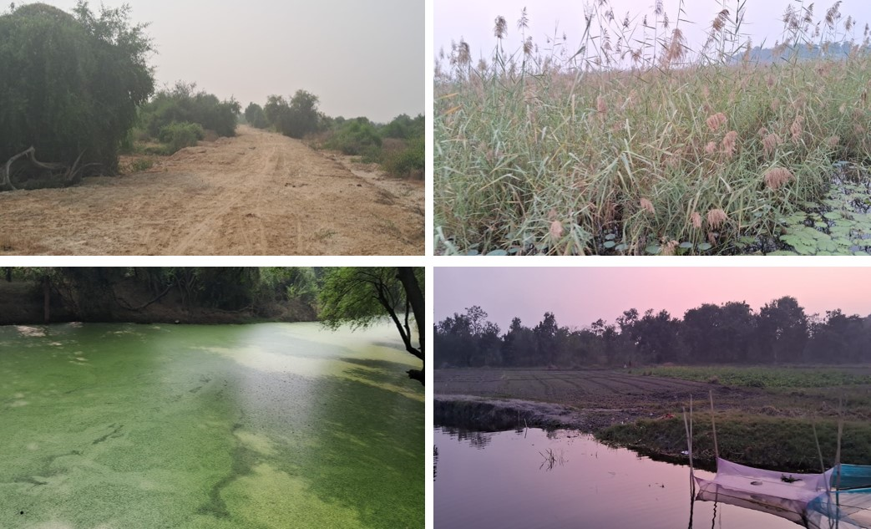
Challenges facing Bakhira Wildlife Sanctuary
Reduction of water storage capacity
Deterioration of water quality.
Flourishing growth of Invasive aquatic plants.
Eutrophication.
Habitat Fragmentation.

Slide 7
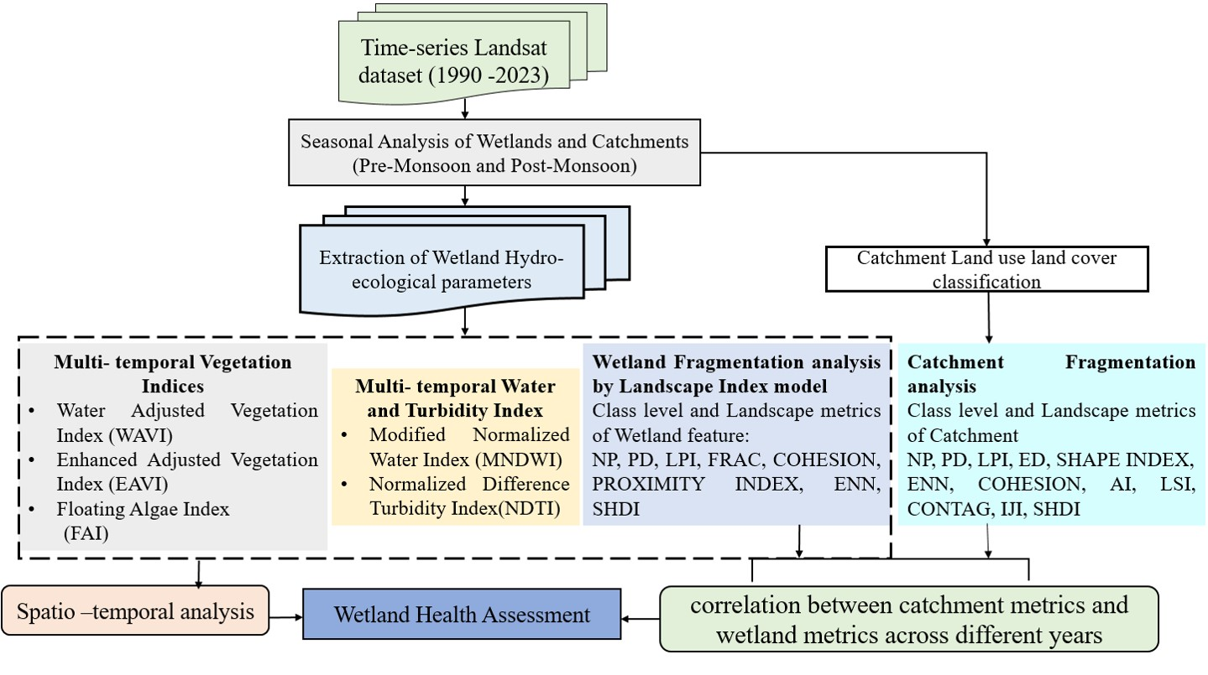
Methodology Flowchart

Slide 8
Hydro-ecological and Landscape Metric Indicators
Hydro-ecological Indicators | Best For | Strengths
WAVI (Water-Adjusted Vegetation Index) | Detecting and monitoring emergent vegetation in water-influenced environments. | It enhances the visibility of emergent vegetation, providing a more accurate assessment of wetland vegetation health.
EAVI (Enhanced Aquatic Vegetation Index) | Analysis of floating and submerged vegetation in wetlands | EAVI provide precise measurements of vegetation density and biomass in wetlands, offering a comprehensive understanding of vegetation types and health under various hydrological conditions.
FAI (Floating Algae Index) | Monitoring and detecting floating algae in wetland water bodies | FAI is helpful to monitoring nutrient levels, providing critical insights into water quality and ecosystem health in wetland environments.
MNDWI (Modified Normalized Difference Water Index) | Identifying open water bodies and monitoring seasonal water changes | It is highly effective for mapping water boundaries, following hydrological changes, and monitoring seasonal water dynamics, making it an essential tool for wetland hydrology analysis.
NDTI (Normalized Difference Turbidity Index) | Assessing water turbidity and monitoring sediment levels in wetlands | It provides insights into water quality by tracking sediment transport and turbidity levels, essential for understanding erosion patterns.

Slide 9
Landscape Metrics | Description | Importance | Units
Number of Patches (NP) | Total count of discrete patches within a defined landscape | A higher NP value indicates greater fragmentation, suggesting the landscape is divided into smaller patches. | Dimensionless (count)
Patch Density (PD) | Number of patches per unit area, | A high patch density often indicates habitat fragmentation, which may result in decreased biodiversity. | Patches per hectare (patches/ha)
Large Patch Index (LPI) | Percentage of the landscape covered by the largest patch, indicating dominance. | A higher LPI indicates a single patch dominates the landscape, suggesting less fragmentation. | Percentage (%)
Fractal Dimension Index (FRAC) | Quantifies the complexity of patch shapes. | Helps assess edge complexity, which may influence habitat diversity. Higher values indicate more irregular patch shapes. | Dimensionless
Cohesion Index (COHESION) | Measures the physical connectedness of patches, assessing their proximity. | A higher COHESION value suggests a more connected landscape, beneficial for species movement and ecosystem health. | Percentage (%)
Proximity Index (PROX) | Measures the spatial relationship of a patch to other patches within a specified radius. | Indicates how isolated or clustered patches, with higher values suggesting patches are closer and less isolated. | Dimensionless
Euclidean Nearest Neighbor Distance (ENN) | Shortest straight-line distance between the edge of one patch and the nearest neighboring patch of the same type. | Helps understand spatial arrangement and isolation degree of patches. | Meters (m)

Slide 10
Shannon's Diversity Index (SHDI) | Quantifies the diversity of patch types within the landscape | Higher diversity implies a more varied and resilient ecosystem with multiple habitat types supporting different species and functions | Dimensionless
Edge Density (ED) | Total length of patch edges per unit area, quantifying the amount of edge habitat available. | Higher values indicate a more fragmented or edge-rich landscape. | Meters per hectare (m/ha)
Shape Index (SHAPE INDEX) | Quantifies the complexity of patch shapes. | Helps to understand the complexity of patch shapes; irregular shapes could indicate fragmentation. Higher values indicate more irregular or complex patch shapes. | Dimensionless
Aggregation Index (AI) | Measures the degree to which patches are clumped or aggregated. | Indicates the extent to which patches are aggregated, showing connectivity within the landscape. A higher value indicates more aggregation | Percentage (%)
Landscape Shape Index (LSI) | Quantifies the overall shape complexity of patches in the catchment. | Reflects landscape shape complexity; higher values indicate more fragmentation. | Dimensionless
Contagion Index (CONTAG) | Measures the extent to which patch types are aggregated or contiguous in the landscape. | Measures the aggregation level; higher values indicate greater patch contiguity. | Percentage (%)
Interspersion and Juxtaposition Index (IJI) | Quantifies how different patch types are interspersed and juxtaposed with one another. | Higher values suggest greater mixing of patch types, indicating landscape heterogeneity. | Percentage (%)

Slide 11
Formula of Indices for Wetland Analysis

Slide 12
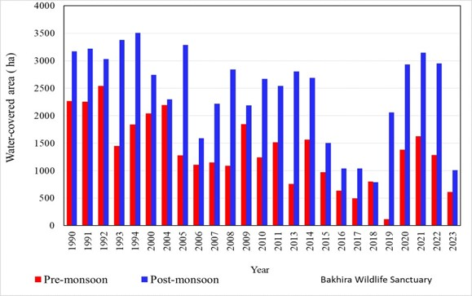
Average Seasonal Water Occurrence (1990-2023)
The maps shows the spatial distribution of water occurrence in the Bakhira Wildlife Sanctuary.
Post-monsoon water-covered areas are consistently higher than pre-monsoon levels.
Both seasons show a decreasing trend over time.
This decline is attributed to the overgrowth of aquatic vegetation
and increased water extraction for human use.
Pre-Monsoon: Maximum area was 2,265.57 hectares in 1990,
while the minimum was 120.51 hectares in 2019.
Post-Monsoon: The highest coverage reached 3,505.77 hectares
in 1994, with a low of 610.65 hectares in 2023.

Slide 13
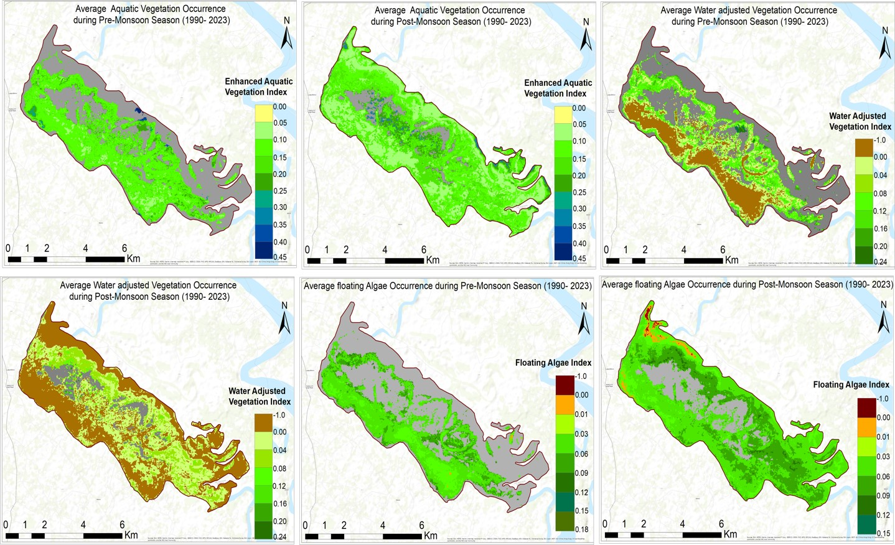
Seasonal Variations in Aquatic Vegetation
Aquatic vegetation plays a crucial role in regulating lake ecosystems. The decline in water quality is characterized by severe eutrophication, frequent algal blooms, shrinking aquatic vegetation areas, and even the extinction of some vegetation species.
Monitoring spatial and temporal changes in aquatic vegetation in lakes can clarify ecosystem responses to anthropogenic and natural factors and provide data for future ecological restoration efforts.
The maps illustrate the presence of aquatic vegetation (emergent submerged and algae) in the wetland over the past three decades.

Slide 14
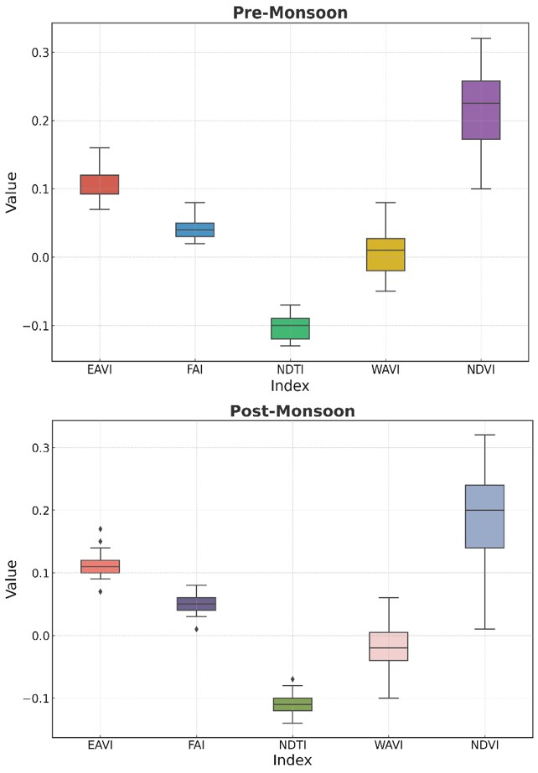
Comparison of Vegetation Indices Pre-Monsoon and Post-Monsoon
Box plot visualizes the distribution of five key wetland ecosystem indices
EAVI reflects stable vegetation health, with uniform recovery post-monsoon. (Range: 0.08–0.15).
FAI indicates consistent algae presence across both periods, supporting stable growth without harmful levels. (Range: 0.02–0.06).
NDTI values indicate stable turbidity levels, with post-monsoon outliers pointing to localized sediment inflows. (Range: -0.13 to -0.07).
WAVI shows greater variability in post-monsoon, likely due to changes in water levels. (Range: -0.05 to 0.05).
NDVI suggests strong vegetation density, with post-monsoon variability indicating diverse recovery patterns. (Range: 0.15–0.32)

Slide 15
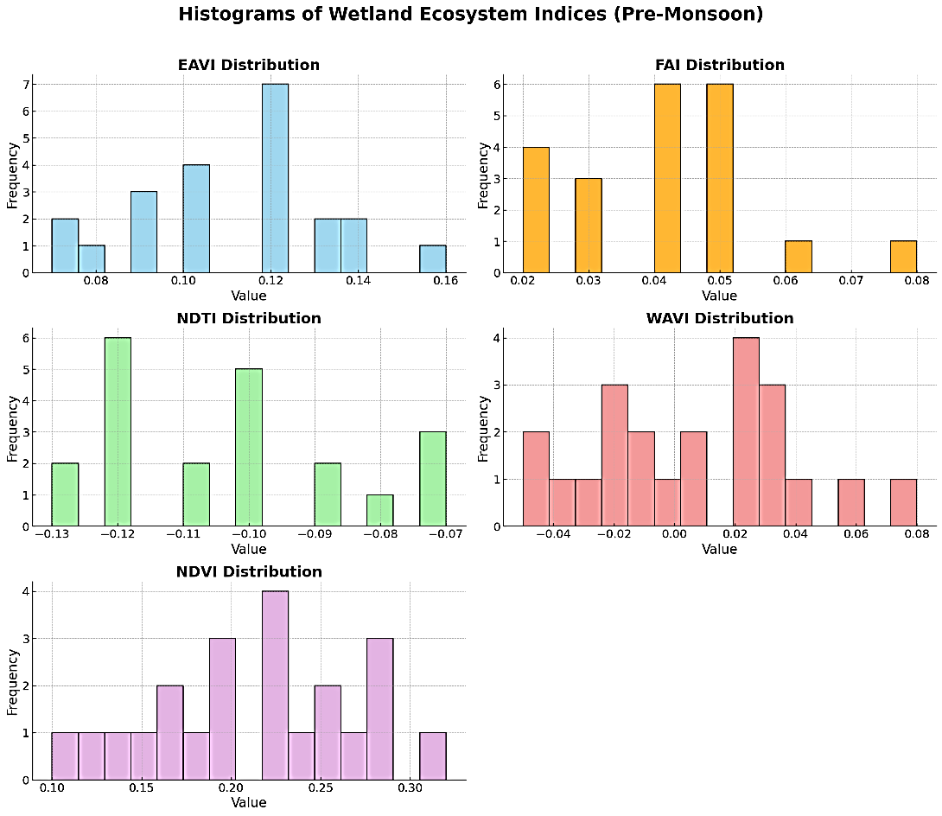
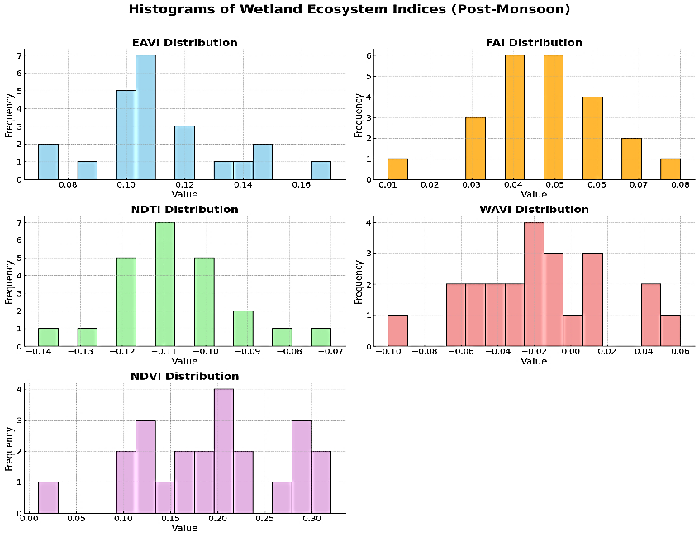
Distribution of Wetland Ecosystem Indices
Each histogram represents the frequency distribution of specific values within each index.
EAVI: Peaks shift from 0.12 (pre) to 0.10 (post), indicating moderate vegetation presence and consistent recovery post-monsoon.
FAI: Both periods show peaks around 0.04-0.05, suggesting stable but slightly variable algae levels influenced by nutrient availability.
NDTI: Values remain around -0.12 to -0.10 (pre) and concentrate at -0.11 (post), indicating stable turbidity levels with minor increases due to runoff.
WAVI: Both periods show variation, with post-monsoon highlighting changes in water levels and their impact on vegetation dynamics. The most frequent values are around 0.02.
NDVI: Consistent peaks around 0.20-0.25 (pre) and a wide range post-monsoon reflect stable vegetation health and diverse recovery patterns influenced by soil and water conditions.

Slide 16
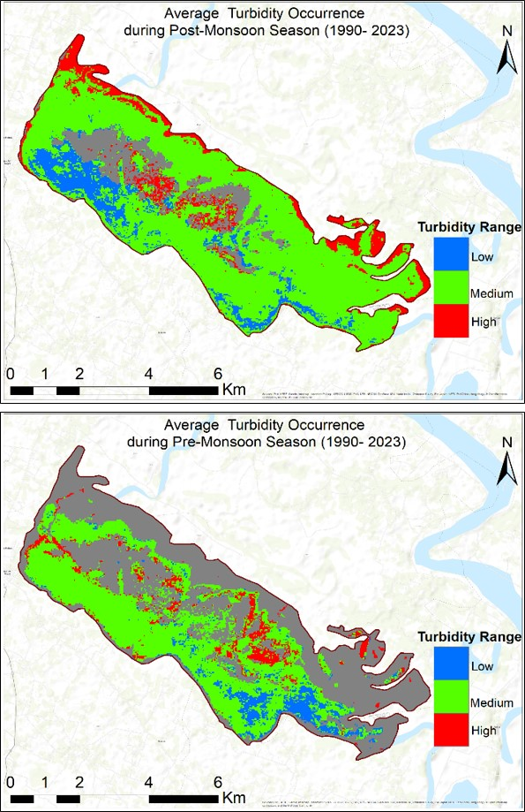
Turbidity Occurrence
High levels of aquatic vegetation or eutrophication increase turbidity, resulting in the deterioration of water quality.
The turbidity level of lake water was categorized into three classes: high turbidity, medium turbidity and low turbidity
The standard formula to classify turbidity ranges (Somvanshi et al., 2011) is shown below:
Low Turbidity = Mean pixel value - Standard deviation
Medium Turbidity = Mean pixel value + Standard deviation
High Turbidity = Value greater than Medium turbidity.
Medium turbidity levels dominate across the study area for both season.

Slide 17
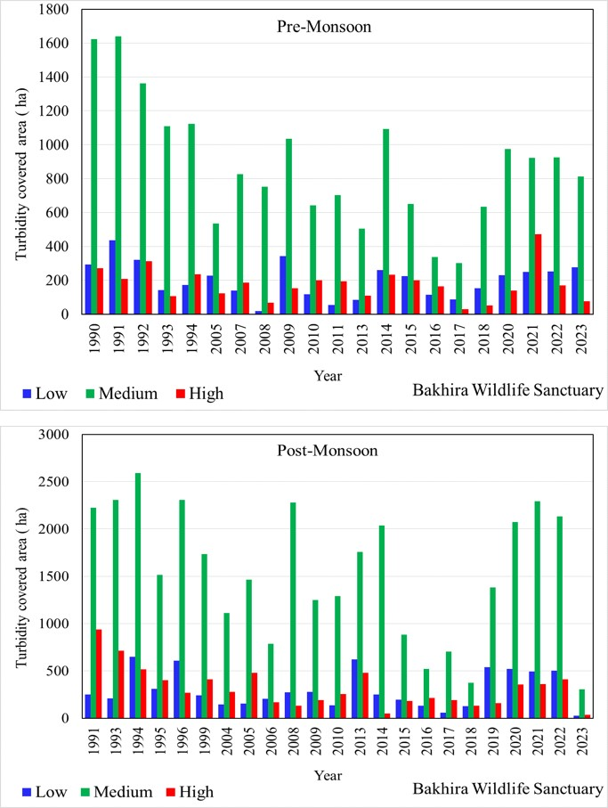
Temporal Variation of Turbidity Covered Area
Post-monsoon turbidity levels are consistently higher than pre-monsoon, due to increased runoff and sediment transport from the monsoon season.
Low Turbidity areas:
Pre-Season: The highest value recorded was in 1991 (434.97 km²), while the lowest was in 2008 (17.01 km²).
Post-Season: The maximum area of low turbidity was observed in 1994 (650.61 km²), while the smallest area was in 2023 (27.63 km²).
High Turbidity areas:
Pre-Season: The peak value was in 2021 (472.77 km²), whereas the lowest was in 2017 (27.81 km²).
Post-Season: The maximum high turbidity area was recorded in 1991, measuring 938.88 km², whereas the minimum was in 2023, with a decline to 36.63 km².

Slide 18
How does fragmentation impact landscape biodiversity?
Reduced Habitat Size: Fragmentation reduces the overall size of habitats, limiting the amount of space available for species.
Disruption of Ecological Processes: Fragmentation disrupts natural ecological processes such as migration, dispersal, pollination, seed dispersal, and predator-prey dynamics.
Increased Vulnerability to Invasive Species: Fragmentation often creates disturbed or modified environments that can be more easily colonized by invasive species.
Impacts on Large Animals and Wide-Ranging Species: Habitat fragmentation restricts their movement, leading to increased human-wildlife conflict, lack of food sources, and decreased genetic diversity.
Local Extinctions: In highly fragmented landscapes, small and isolated patches may not provide enough resources or conditions for species to survive, leading to local extinctions.

Slide 19
How can wetland fragmentation and biodiversity loss be minimized?
Habitat Restoration: Restoration efforts, such as reforesting cleared areas or rehabilitating wetlands, create more continuous habitats, allowing species to move freely and access larger, healthier ecosystems.
Reducing Infrastructure Barriers: Remove barriers such as roads, fences, and urban development that cut across habitats. Establish buffer zones around wetlands to reduce nutrient and pollutant runoff from agricultural lands.
Managing Invasive Species: Control and manage invasive species that contribute to fragmentation by displacing native species and disrupting ecological balance.
Reconnecting Rivers and Water Bodies: Remove or modify dams, levees, and other obstructions in rivers and streams to restore the natural flow of water and reconnect aquatic ecosystems.
Monitor and Assess Wetland Health: Regular Monitoring: Implement a regular monitoring program using the Wetland Health Index (WHI) to assess changes in wetland health and inform management decisions.
Community Engagement and Education: Involve local communities, farmers, and stakeholders in wetland management to promote stewardship and shared responsibility. Educate the public on the importance of wetlands, their benefits, and the effects of human activities on wetland health.

Slide 20
Analysis of Wetland Class-Level Landscape Metrics
Wetland Bare Soil: Experiences increased fragmentation (NP, PD) due to post-monsoon, while LPI and FRAC remain stable, showing no change in patch complexity. The LPI remains consistent (5.55 to 8.47), suggesting fragmented patches have minimal impact on the largest patch size.
Wetland Vegetation: Vegetation shows reduced LPI and Proximity Index, indicating connectivity loss, while stable ENN reflects consistent patch distances. LPI declines (72.08 to 56.41), signifying fragmentation of larger patches.
Wetland Water: Water patches show resilience, exhibiting minimal fragmentation and enhanced connectivity after the monsoon, as smaller water bodies form and merge.
Table: displaying the mean values for landscape class level metric (pre- post monsoon) across the different classes
Class | NP Pre | NP Post | PD Pre | PD Post | LPI Pre | LPI Post | FRAC Pre | FRAC Post | Cohesion Pre | Cohesion Post | Proximity Index Pre | Proximity Index Post | ENN Pre | ENN Post
Bare soil | 280 | 449 | 6.93 | 11.12 | 5.55 | 8.47 | 1.05 | 1.05 | 95.18 | 93.55 | 84.72 | 193.30 | 96.28 | 82.73
Vegetation | 112 | 145 | 2.77 | 3.60 | 72.08 | 56.41 | 1.03 | 1.04 | 99.78 | 98.27 | 3029.89 | 2593.74 | 91.81 | 84.96
Water | 98 | 174 | 2.44 | 4.32 | 3.42 | 8.58 | 1.05 | 1.05 | 87.23 | 92.29 | 57.69 | 254.15 | 206.03 | 131.45

Slide 21
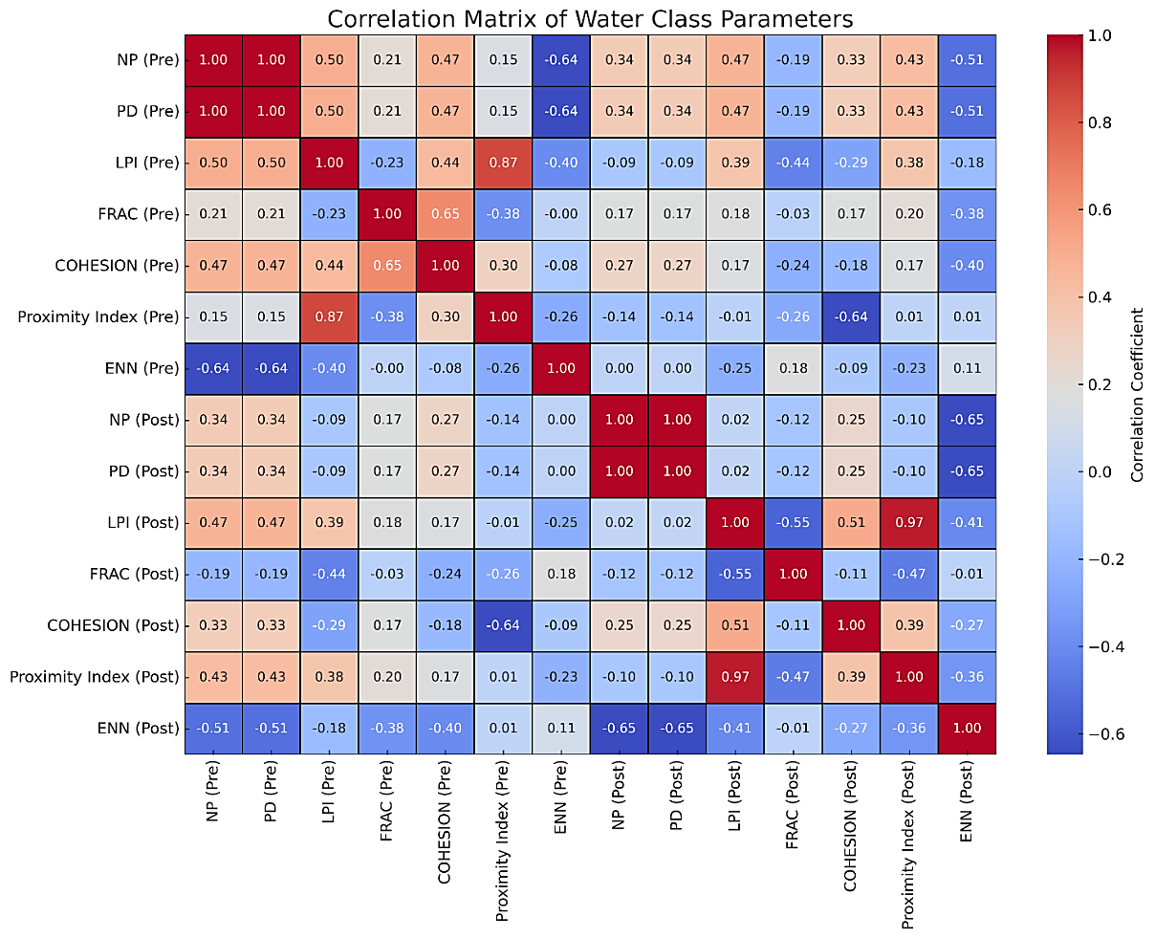
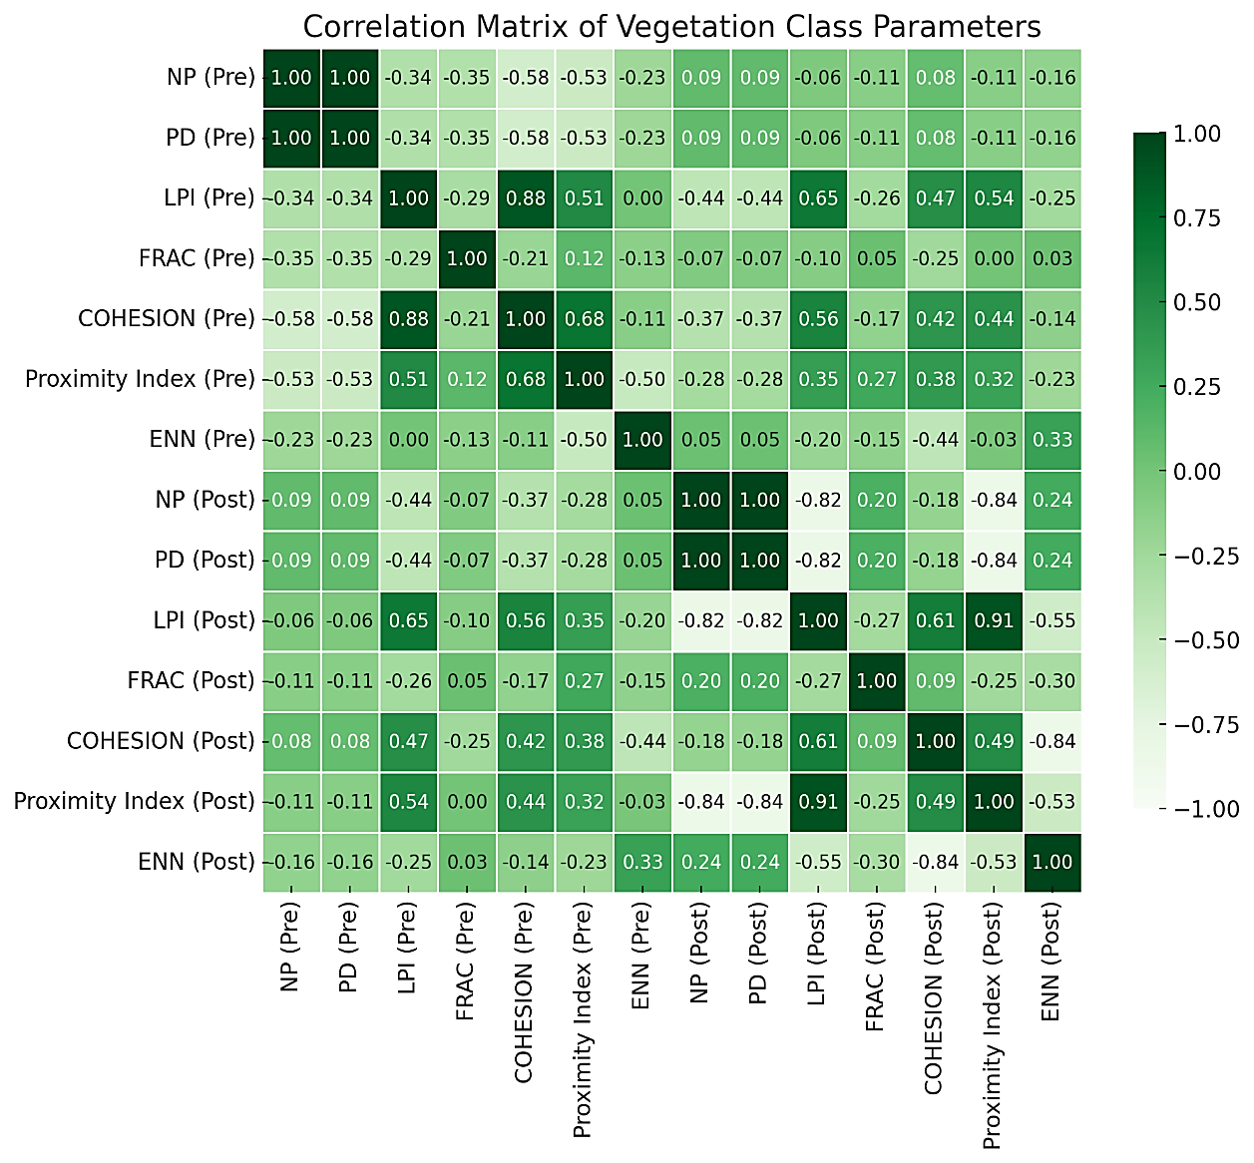
Correlation Matrix of Wetland Water and Vegetation Class Parameters
The Water class correlation matrix highlights the importance of larger water patches in maintaining ecosystem connectivity and integrity. It also emphasizes the fragmentation of smaller patches, informing conservation and management strategies to preserve aquatic ecosystems and promote resilience and functionality.
The Vegetation correlation matrix highlights the importance of maintaining cohesion in larger patches for ecological stability. It identifies areas at risk of fragmentation, guiding restoration efforts and informing management strategies. Recognizing seasonal variations aids in adapting practices to enhance connectivity and promote biodiversity.

Slide 22
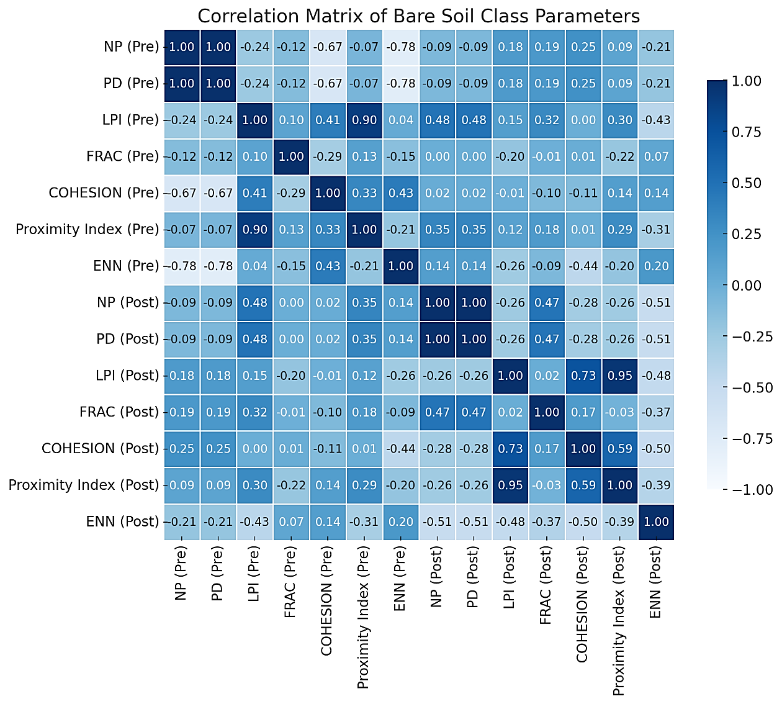
Correlation Matrix of Wetland Bare Soil Parameters
The analysis of bare soil parameters in wetland shows significant correlations between Landscape Patch Index and the Proximity Index indicate that larger patches enhance connectivity for pre- and post-monsoon. Conversely, increased patch numbers before the monsoon negatively impact cohesion, resulting in reduced connectivity and greater isolation.
The Bare soil correlation matrix highlights the importance of bare soil dynamics for ecosystem health. Maintaining larger patches is essential for enhancing connectivity and cohesion. These shifts emphasize the need for adaptive management strategies to address fragmentation and isolation, ensuring the resilience of wetland habitats and promoting biodiversity.

Slide 23
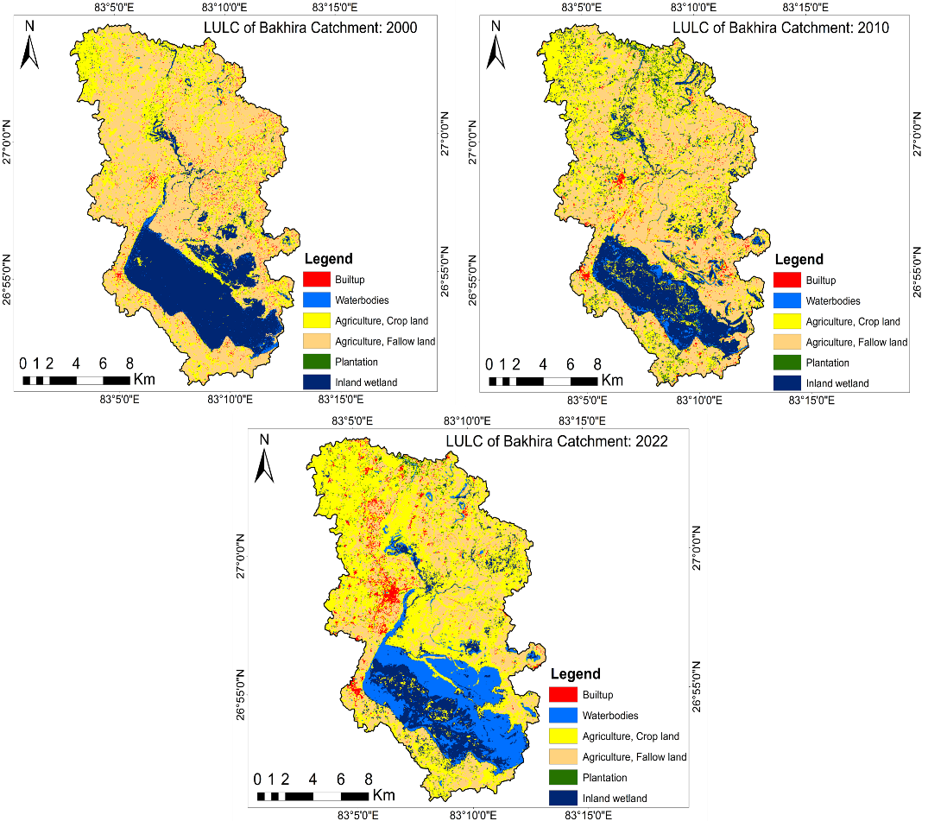
LULC changes in the Catchment Area of Bakhira Wetland
The findings indicate a gradual increase in agricultural cropland within the Bakhira catchment, expanding from 62.44 km² in 2000 to 114.93 km² in 2022.
Built-up areas expanded from 5.77 km² in 2000 to 8.40 km² in 2022. This expansion underscores the impact of human activities on the landscape and the subsequent reduction of natural areas.
LULC classes | Area (km²), 2000 | Area (km²), 2010 | Area (km²), 2022
Built Up land | 5.77 | 6.24 | 8.40
Water bodies | 3.23 | 5.90 | 38.57
Agriculture, Crop Land | 62.44 | 81.56 | 114.93
Agriculture, Fallow Land | 135.67 | 119.14 | 70.18
Plantation | 2.61 | 4.98 | 3.01
Wetland | 54.44 | 46.64 | 29.37

Slide 24
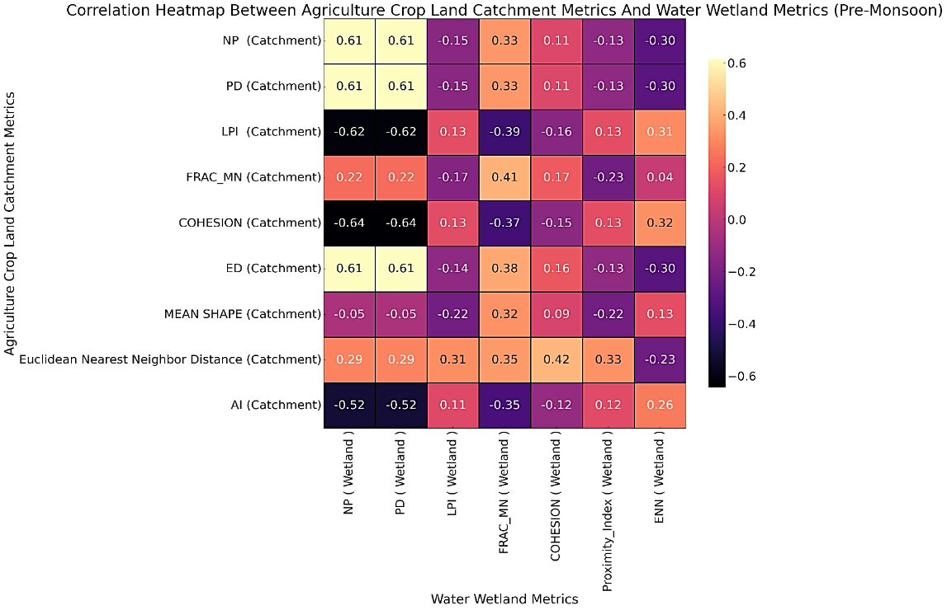
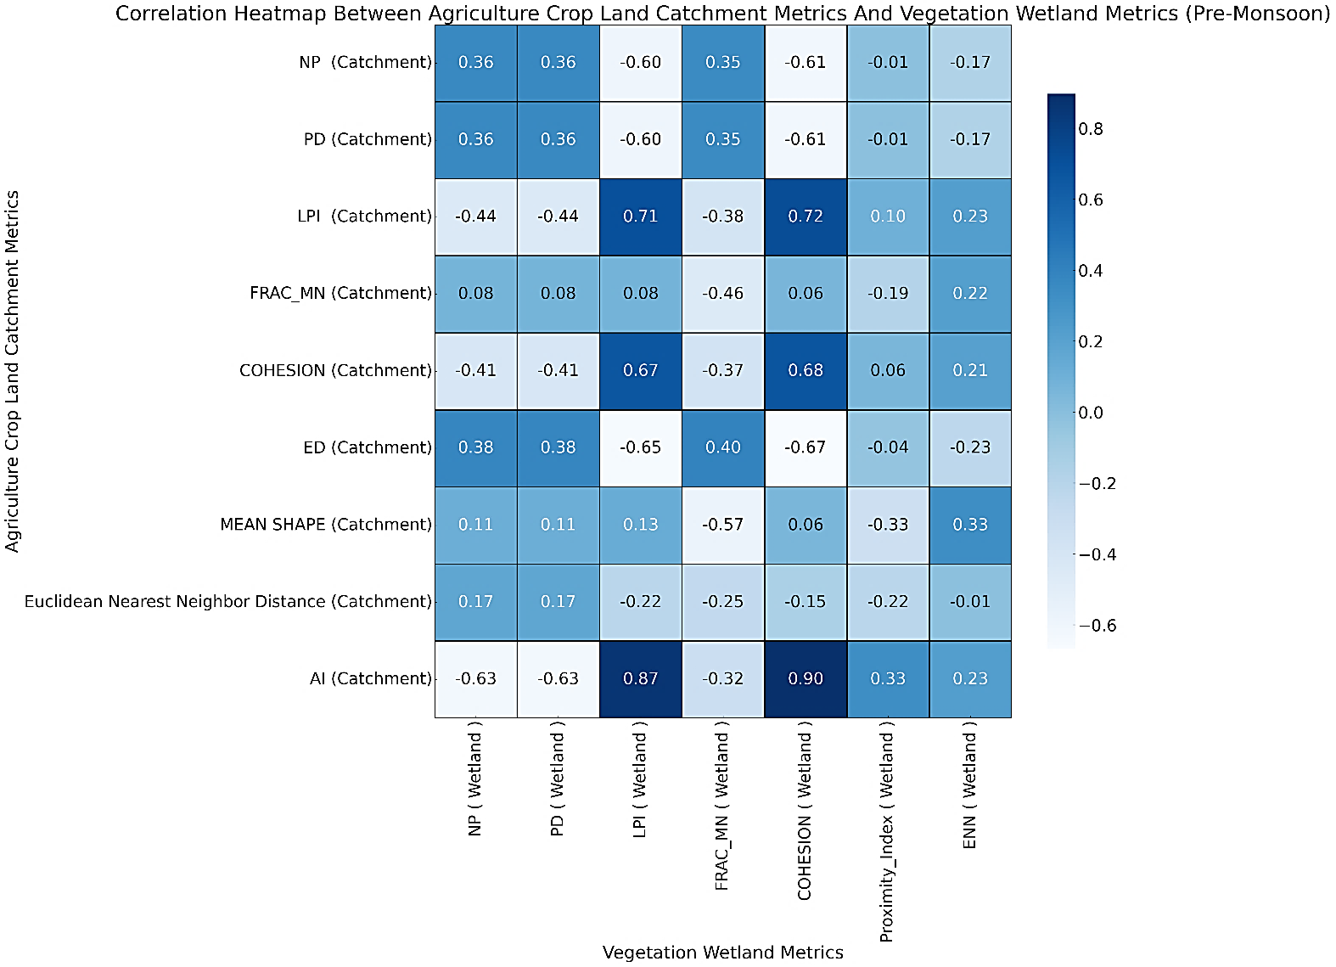
Analysis of Metrics Between Cropland in the Catchment Area and Wetland Vegetation and Water (Pre-Monsoon)
These findings underscore the significance of cohesive agricultural landscapes for maintaining healthy wetland ecosystems. Agricultural fragmentation adversely affects wetland vegetation, while cohesive landscapes with connected vegetation patches exhibit the necessity for sustainable land-use practices.
The correlation analysis between catchment cropland and wetland water bodies reveals that greater distances between cropland patches enhance water body connectivity, while larger agricultural patches reduce the diversity of wetland features, leading to degradation. These findings highlight the urgent need for sustainable agricultural practices to protect wetland water bodies, particularly during pre-monsoon seasons.

Slide 25
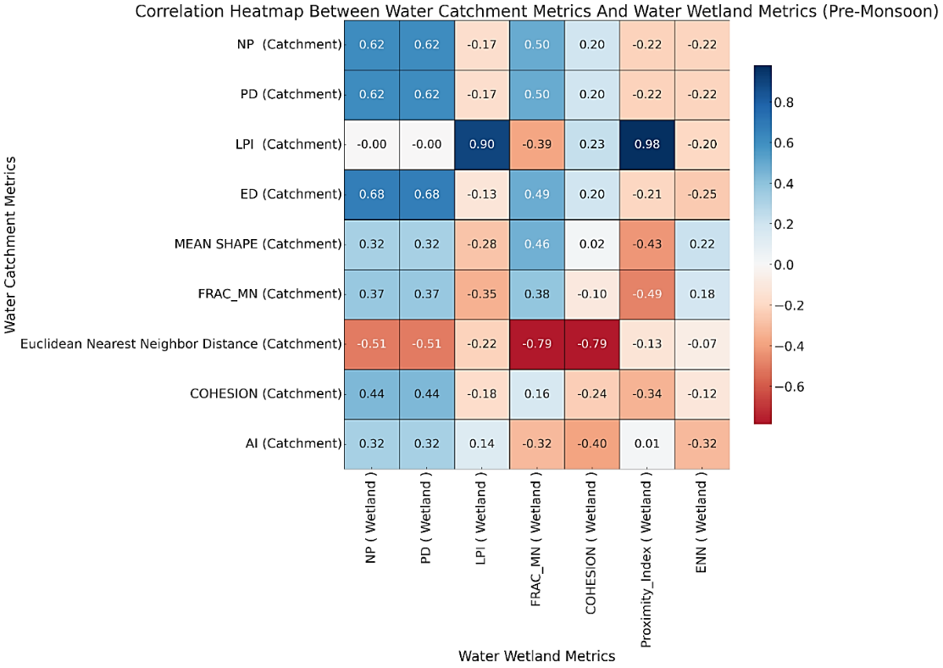
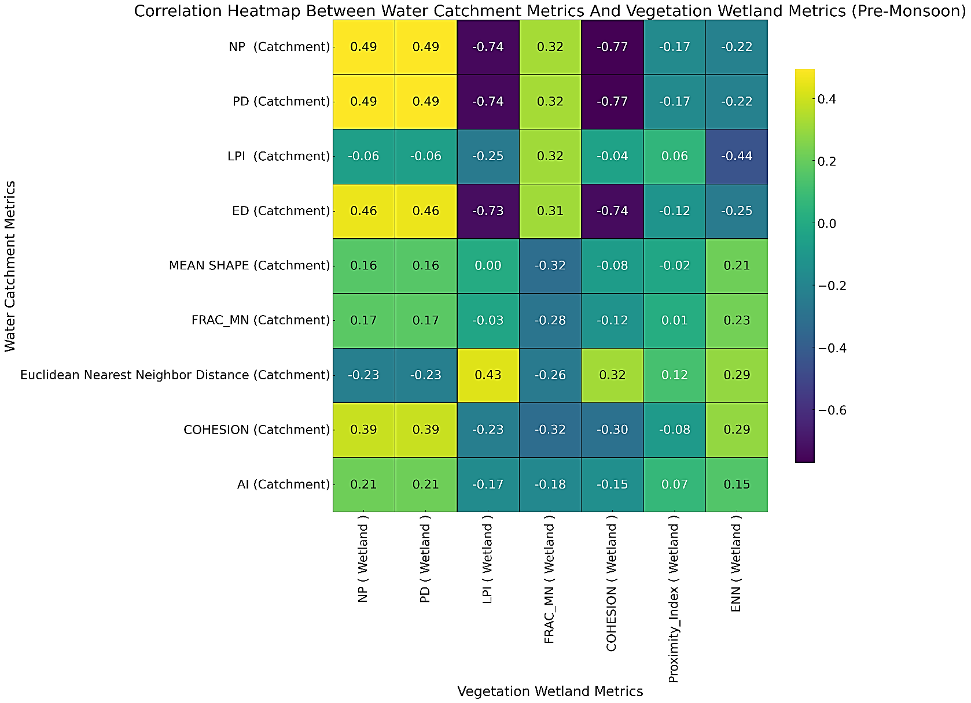
Correlation Between Water Bodies in the Catchment and Wetland Vegetation and Water Metrics: Pre-Monsoon
The correlation analysis shows that larger water patches in the catchment are linked to reduced vegetation fragmentation, while more connected water patches enhance connectivity among vegetative patches. These findings highlight the importance of preserving connected water bodies in the catchment to support healthy wetland vegetation.
The correlation matrix analysis between water bodies in the catchment and wetland water metrics reveals that an increase in the number of water patches in the catchment is associated with greater fragmentation of wetland water patches. These findings highlight the significant influence of catchment water body characteristics on wetland configuration.

Slide 26
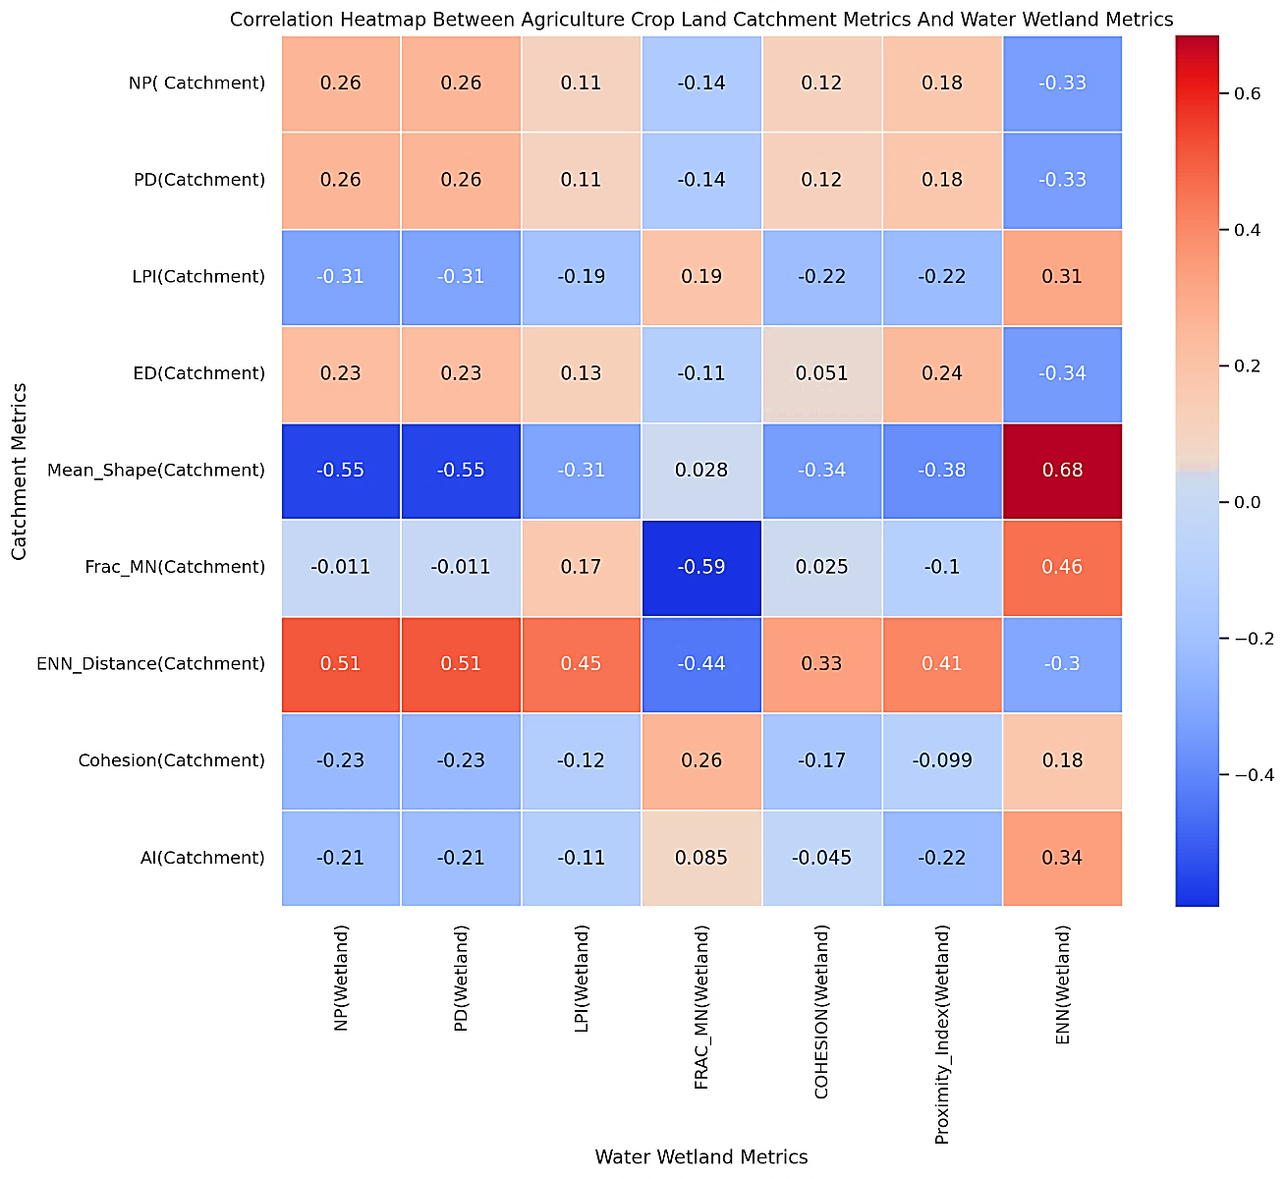
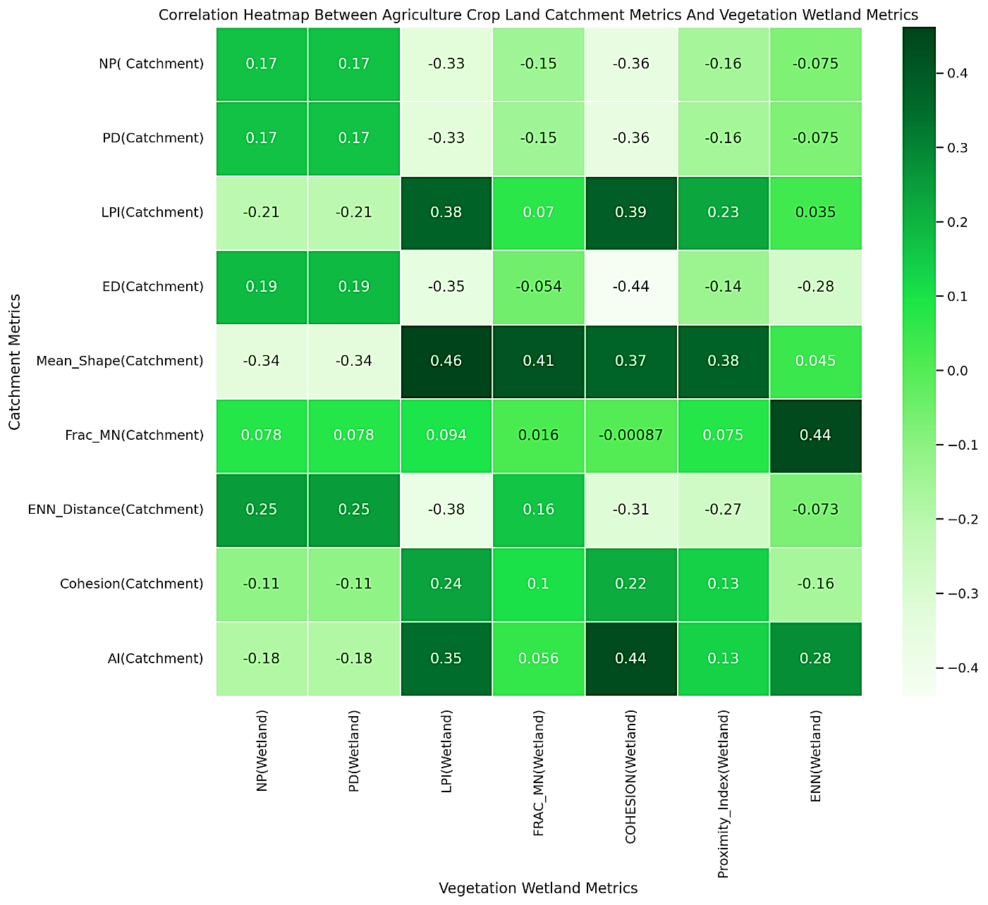
Metrics Analysis Between Catchment Cropland and Wetland Vegetation and Water (Post-Monsoon)
The metrics analysis of catchment cropland and wetland vegetation shows that larger agricultural patches are positively correlated with larger wetland vegetation patches. In contrast, fragmented cropland is linked to reduced size and continuity of wetland vegetation.
The correlation analysis shows that greater distances between agricultural patches in the catchment lead to closer proximity of wetland water patches. This suggests that cropland fragmentation negatively impacts the size and connectivity of wetland water patches. Maintaining larger and more complex agricultural patches can enhance water body connectivity in wetland.

Slide 27
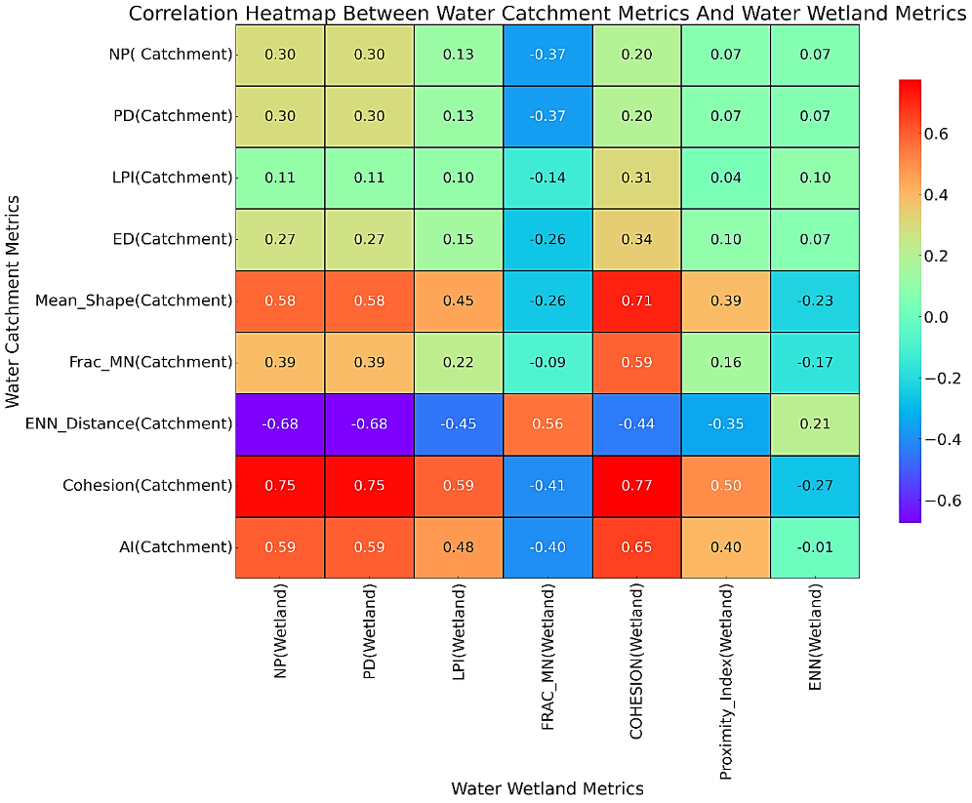
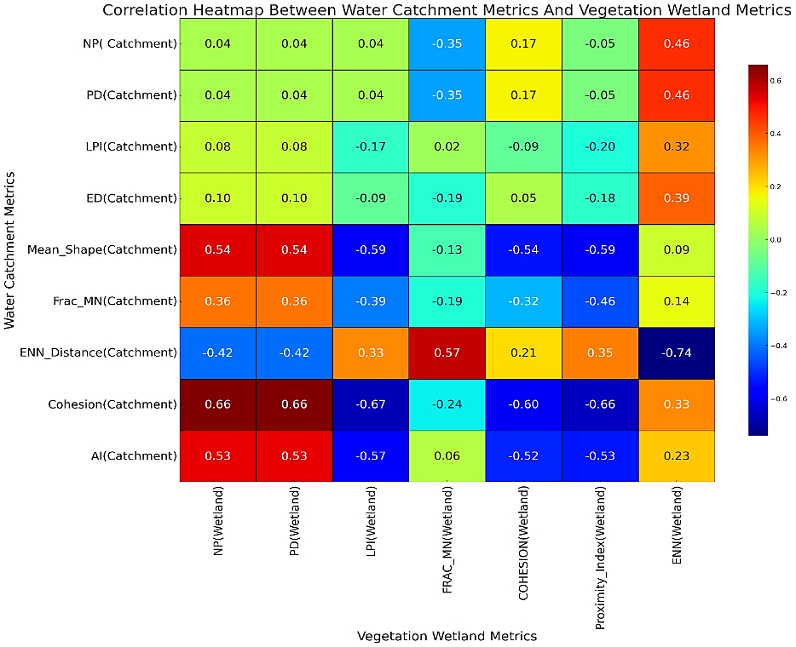
Metrics Analysis of Water Bodies in the Catchment and Wetland Water and Vegetation (Post-Monsoon)
The metrics analysis shows correlations between catchment water bodies and wetland water metrics post-monsoon. High connectivity in catchment water bodies enhances connectivity in wetland water patches, while greater distances between water patches in the catchment reduce the number of wetland water patches.
The metrics analysis reveals key relationships between catchment water bodies and wetland vegetation. Enhanced connectivity among catchment water bodies can fragment vegetative patches in wetlands, reducing cohesion and potentially compromising wetland integrity. Furthermore, fragmented water patches in the catchment negatively affect the size of wetland vegetation patches.

Slide 28
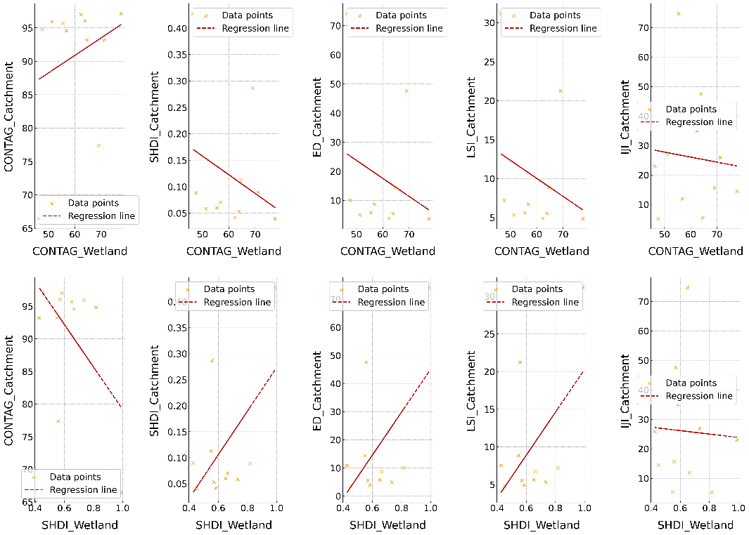
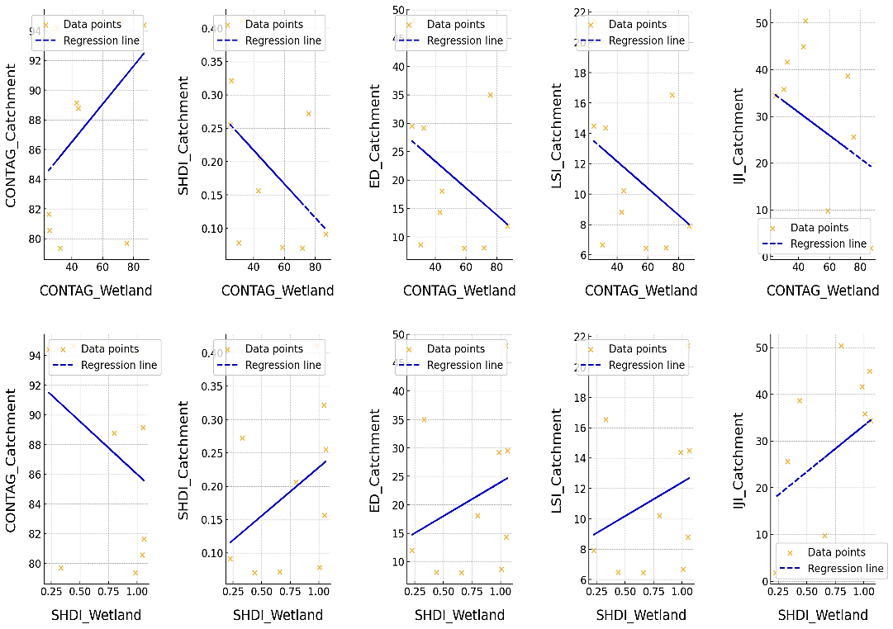
Scatter Plots of Wetland Metrics and Catchment Metrics
In both periods, negative correlation between wetland contagion and catchment edge density This indicates that less fragmented wetlands (higher contagion) are associated with less fragmented catchments that have fewer edges.
Pre-Monsoon: Wetland fragmentation significantly impacts catchment fragmentation and biodiversity during the dry season. Management efforts should prioritize reducing dry-season stress to enhance connectivity between wetlands and catchments.
Post-Monsoon: Wetland recovery during the rainy season enhances landscape health, boosts biodiversity, and reduces fragmentation.
Scatter Plots of Pre-Monsoon Wetland vs. Catchment Metrics
Scatter Plots of Post-Monsoon Wetland vs. Catchment Metrics

Slide 29
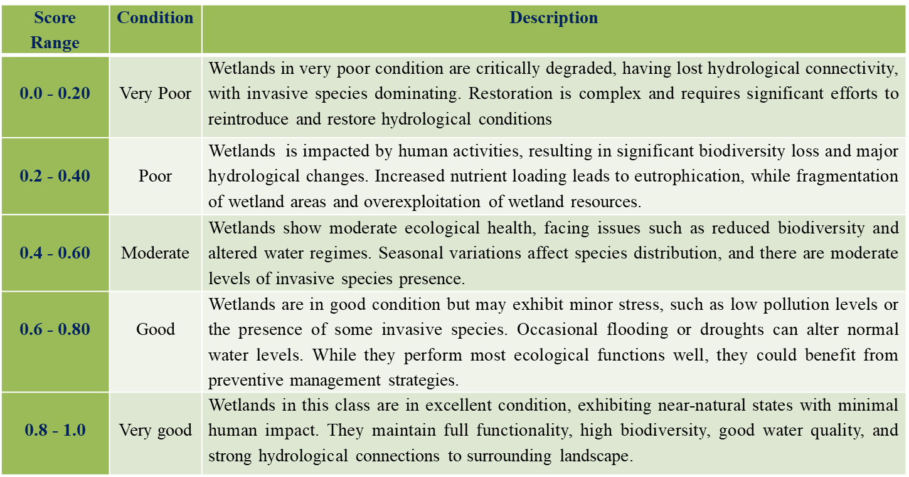
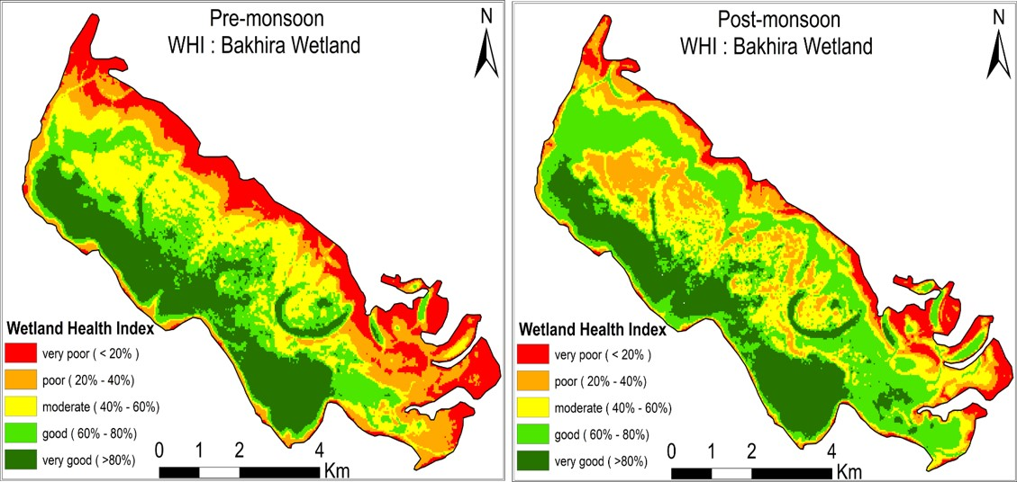
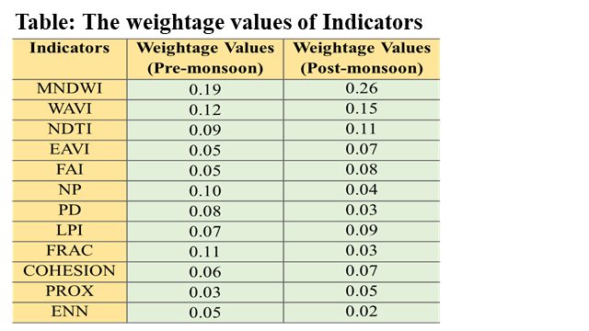
Analysis of the Bakhira Wetland Health Index
Wetland Health Index (WHI) is used to evaluate the health and stability of a Wetland ecosystem.
The Wetland Health Index (WHI) integrates various health indicators and weights related to hydrology, vegetation, water quality, and landscape fragmentation metrics.
In the pre-monsoon, the Wetland's health score was 0.52, indicating moderate health due to pollution and altered water regimes from nearby agriculture. In contrast, the post-monsoon Wetland Health Index (WHI) improved to 0.58, benefiting from monsoon rains and the good growth of aquatic vegetation that helps reduce pollutants.
Table : Classification of Wetland Health Index (WHI)
Wetland Health Index Map

Slide 30
Conclusion
Wetland Health: The Wetland Health Index (WHI) improved from 0.52 pre-monsoon to 0.58 post-monsoon, mainly due to the positive impact of monsoon rains and the growth of aquatic vegetation, which helped reduce pollution.
Fragmentation and Habitat Connectivity: The study found significant habitat fragmentation and reduced connectivity due to human activities, especially during the dry season.
Impact on Water and Vegetation: There is a significant correlation between the fragmentation of water bodies and vegetation in wetlands, showing how connected and fragmented water patches affect wetland ecosystem health.
Fragmentation in Catchment Leads to Fragmentation in Wetland: Positive correlations between catchment and wetland metrics indicate that larger, more connected water patches in catchments lead to healthier, more cohesive wetland water bodies.
Managing Agricultural Landscapes is Crucial: Sustainable practices in catchment areas, especially concerning cropland and water management, are essential to prevent further fragmentation and to support wetland conservation efforts.

Slide 31
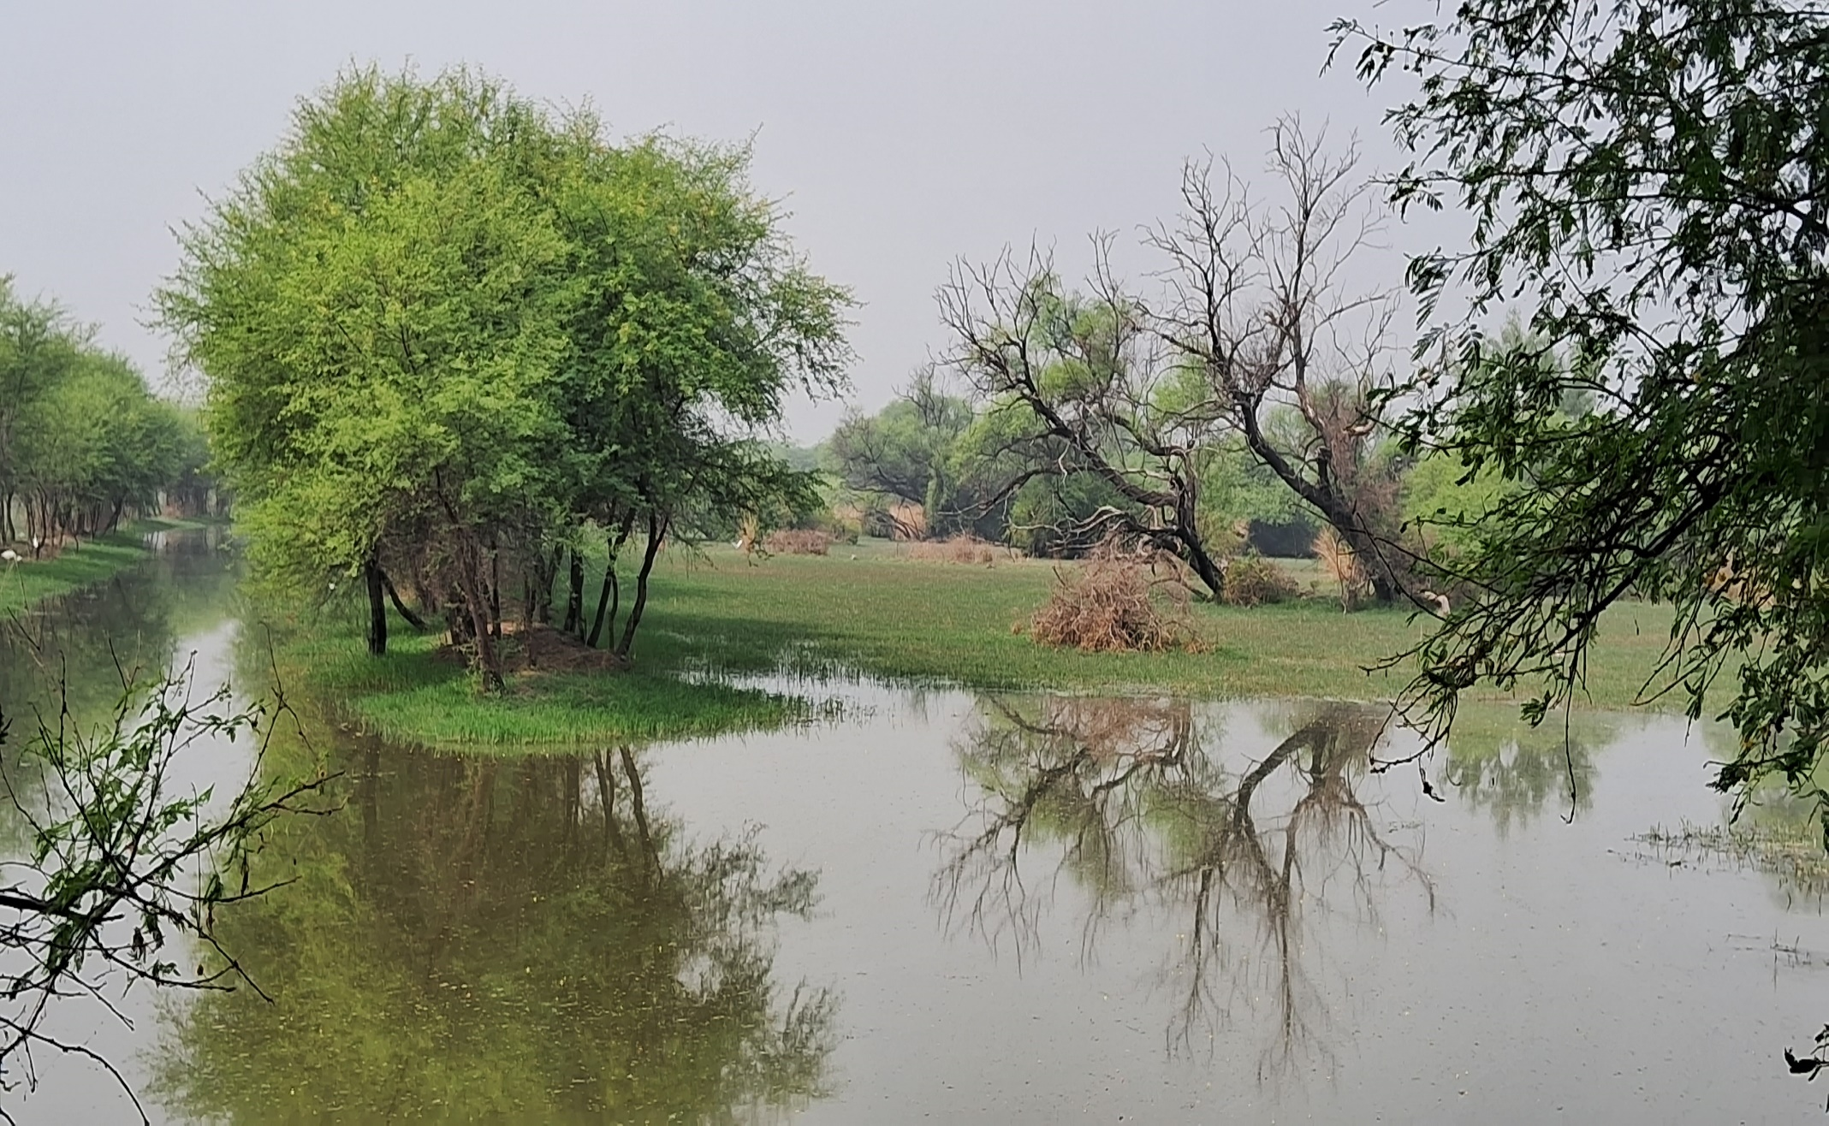
THANK YOU

