Slide 1
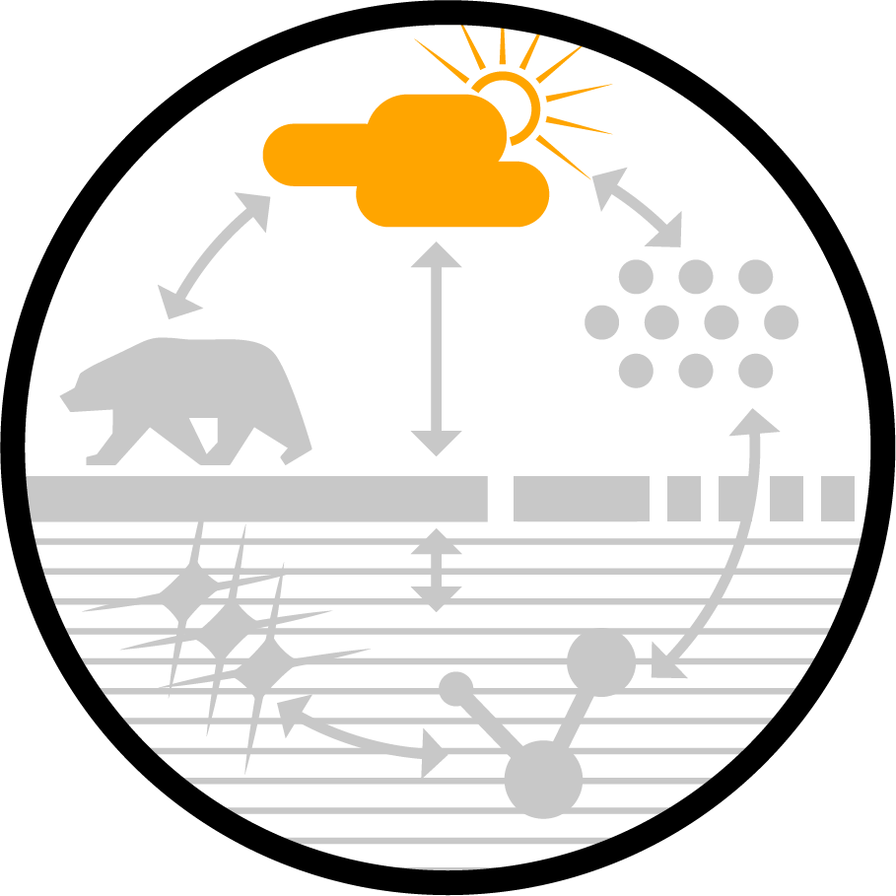
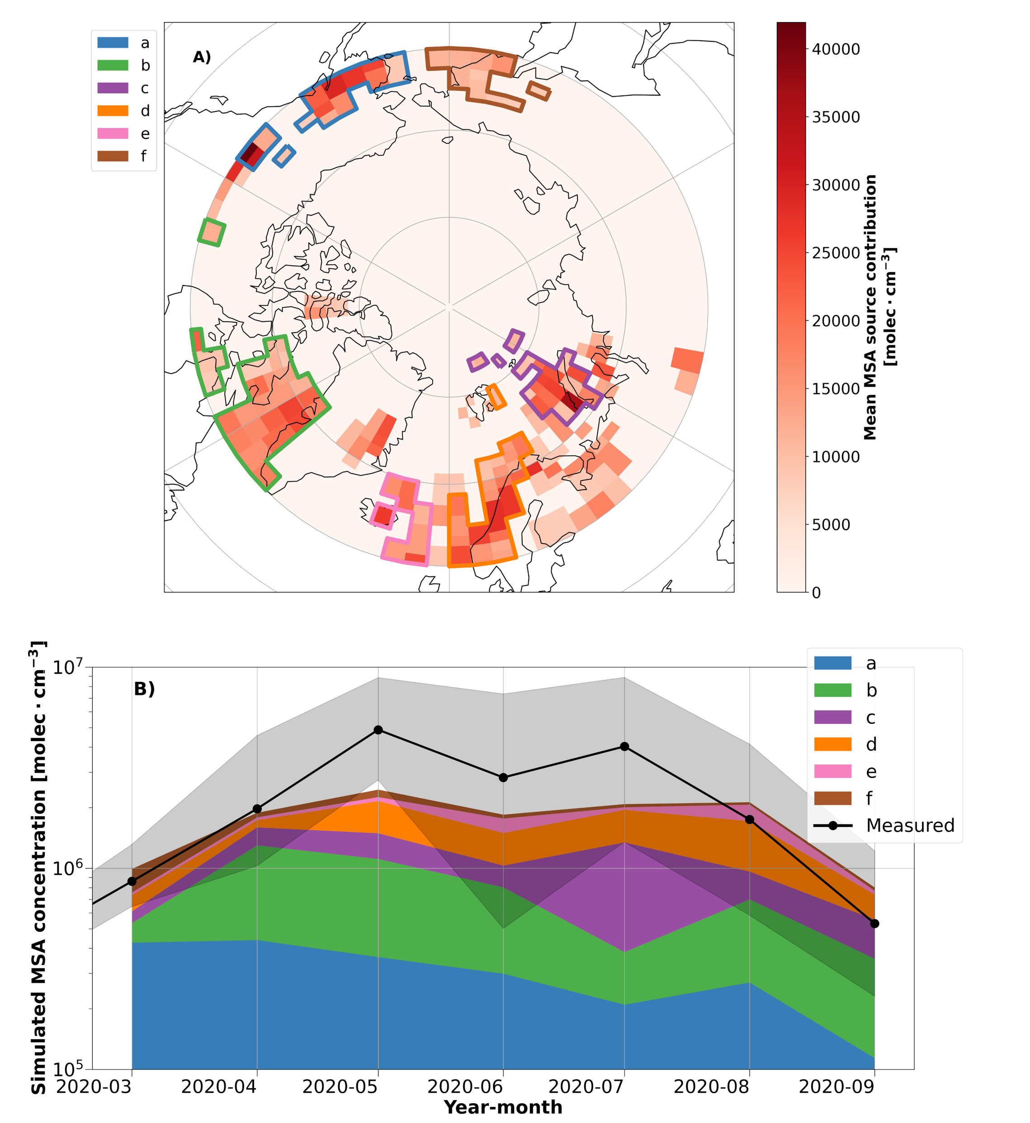
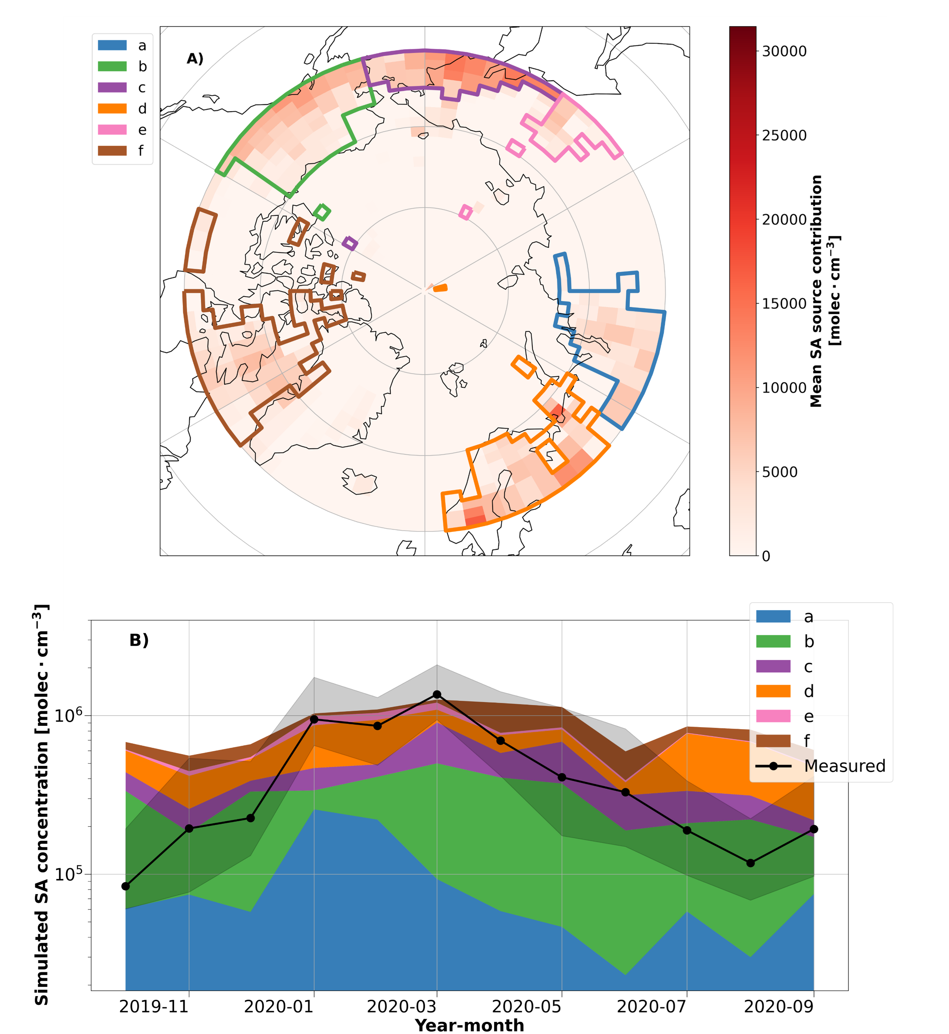
The annual cycle and sources of relevant aerosol precursor vapors in the central Arctic
Matthew Boyer¹, Diego Aliaga¹, Lauriane L. J. Quéléver¹, Silvia Bucci², Hélène Angot^{3,4}, Lubna Dada^{3,5}, Benjamin Heutte³, Lisa Beck⁶, Marina Duetsch², Andreas Stohl², Ivo Beck³, Tiia Laurila¹, Nina Sarnela¹, Roseline C. Thakur¹, Branka Miljevic⁷, Markku Kulmala¹, Tuukka Petäjä¹, Mikko Sipilä¹, Julia Schmale³, Tuija Jokinen^{1,8}
1Institute for Atmospheric and Earth System Research (INAR)/Physics, Faculty of Science, University of Helsinki, P.O. Box 64, Helsinki, 00014, Finland
2Department of Meteorology and Geophysics, University of Vienna, Vienna, Austria
3Extreme Environments Research Laboratory, Ecole Polytechnique Fédérale de Lausanne (EPFL), Sion, 1951, Switzerland
4Univ. Grenoble Alpes, CNRS, INRAE, IRD, Grenoble INP, IGE, Grenoble, France
5Laboratory of Atmospheric Chemistry, Paul Scherrer Institute, 5232, Villigen, Switzerland
6Institute for Atmospheric and Environmental Sciences, Goethe University Frankfurt, 60438 Frankfurt am Main, Germany
7School of Earth and Atmospheric Sciences, Queensland University of Technology, Brisbane, Australia
8Climate & Atmosphere Research Centre (CARE-C), The Cyprus Institute, P.O. Box 27456, Nicosia, 1645, Cyprus
Find the published article here:
Introduction
Results
Aerosol processes impact the Arctic surface radiation budget, yet measurements over the Central Arctic Ocean are scarce. This study evaluates the first continuous record of aerosol precursor vapors associated with aerosol formation processes for a full year over the central Arctic Ocean during the MOSAiC expedition. The analysis focuses on seasonal trends observed in the aerosol precursor vapor concentrations, including of sulfuric acid (SA), methanesulfonic acid (MSA), and iodic acid (IA), and relevant source regions in our measurements.
Measurements
Observations from the MOSAiC expedition (September 2019 – October 2020)
Aerosol precursor vapor concentrations:
Chemical Ionization Mass Spectrometer (NO₃-CI-APi-ToF)
Figure 1: The annual cycle of aerosol precursor vapor concentrations and related parameters during MOSAiC. (A) The monthly median vapor concentrations and the corresponding interquartile ranges of iodic acid (IA), methanesulfonic acid (MSA), and sulfuric acid (SA). (C) The chl-a concentrations between 60 – 90°N from the OC-CCI satellite dataset. The solid black line denotes the monthly median latitude of Polarstern during the MOSAiC. The orange circles show the sea surface chl-a influence index, a timeseries that quantifies potential air mass exposure to ocean regions with chl-a derived from the convolution of the FLEXPART FES with the satellite chl-a concentrations.
Full dataset available here:
Figure 3: Inverse Modeling results for MSA. (A) The potential source contribution map of MSA between March – September simulated by the inverse model. The colored polygons show the source region clusters that were identified to have a significant contribution (> 5% annual average) on the simulated MSA concentrations during the year. (B) A timeseries of the simulated monthly median MSA concentrations from the source region polygons identified by the inverse model. Due to the limited domain of the FLEXPART simulations (> 60°N), source regions polygons “a” and “f” may represent the contribution of MSA transport from regions further south than the polygons depicted on the map, such as the oceanic regions on the western coast of North America and the Bering Sea, respectively.
Analysis Tools
Pollution detection:
Pollution detection algorithm
(Beck et al., 2022)
FLEXPART Simulations:
Footprint emissions sensitivity (<100m) (Pisso et al., 2019)
Inverse modelling (Aliaga et al., 2021)
Emissions inventory (ECLIPSE v6b) (Klimont et al., 2013)
Biological tracers:
Chlorophyll-a satellite data (https://www.oceancolour.org/)
Conclusions
Aerosol precursor vapor concentrations show distinct seasonality:
SA reaches a maximum during winter/spring due to favorable transport from both natural and anthropogenic sources further south (Arctic Haze) .
MSA dominates during summer when biological activity is enhanced. Transport from oceanic regions south of the marginal ice zone appears to comprise the primary contribution to MSA.
IA peaks during seasonal transitions, likely due to sea ice freeze/thaw processes and low solar irradiance.
Future changes in sea ice extent and anthropogenic activities in the Arctic are expected to impact aerosol precursor vapor concentrations.
Contact: matthew.boyer@helsinki.fi
References: Aliaga et al., 2021, https://doi.org/10.5194/acp-21-16453-2021; Beck et al., 2022, https://doi.org/10.5194/amt-15-4195-2022; Klimont et al., 2013, https://doi.org/10.1088/1748-9326/8/1/014003; Pisso et al., 2019, https://doi.org/10.5194/gmd-12-4955-2019
Figure 2: Inverse modeling results for SA. (A) The potential source contribution map of SA simulated by the inverse model. The colored polygons show the source region clusters that were identified to have a significant contribution (> 5% annual average) on the simulated SA concentrations during the year. (B) The potential contribution of each source region polygon to SA concentrations throughout the year.
Acknowledgements: We acknowledge funding from the Swiss National Sciences Foundation grant no. 188478 and the Swiss Polar Institute, the US DOE grant No. DE-SC0022046, European Union’s Horizon 2020 research and innovation programme under grant agreement No. 856612 and the Cyprus Government. JS holds the Ingvar Kamprad Chair, sponsored by Ferring Pharmaceuticals. Part of this project was funded by ERC grant (GASPARCON) and the Academy of Finland.

