Slide 1
Multi-model effective radiative forcing of the 2020 sulfur cap for shipping
Ragnhild Bieltvedt Skeie, Rachael Byrom, Øivind Hodnebrog, Caroline Jouan, and Gunnar Myhre
EGU2025
30th of April 2025
Photo: Unsplash.com

Slide 2
IMO International maritime organisation emission regulation (IMO2020):
SO₂ emissions from shipping:
From 1st of January 2020:
Allowed sulphur content of marine fuels 0.5 % (previously 3.5%)
Ships must use low sulphur fuel
or install scrubbers that remove SO₂ from the exhaust
→ 77 % reduction in SO₂ emissions from shipping (IMO, 2020)
2019: ~11 Tg
2020: ~2 Tg
Source: CEDS emissions (v2021) from 1950 to 2019 JGCRI/CEDS: Community Emissions Data System (CEDS) (github.com)

Slide 3
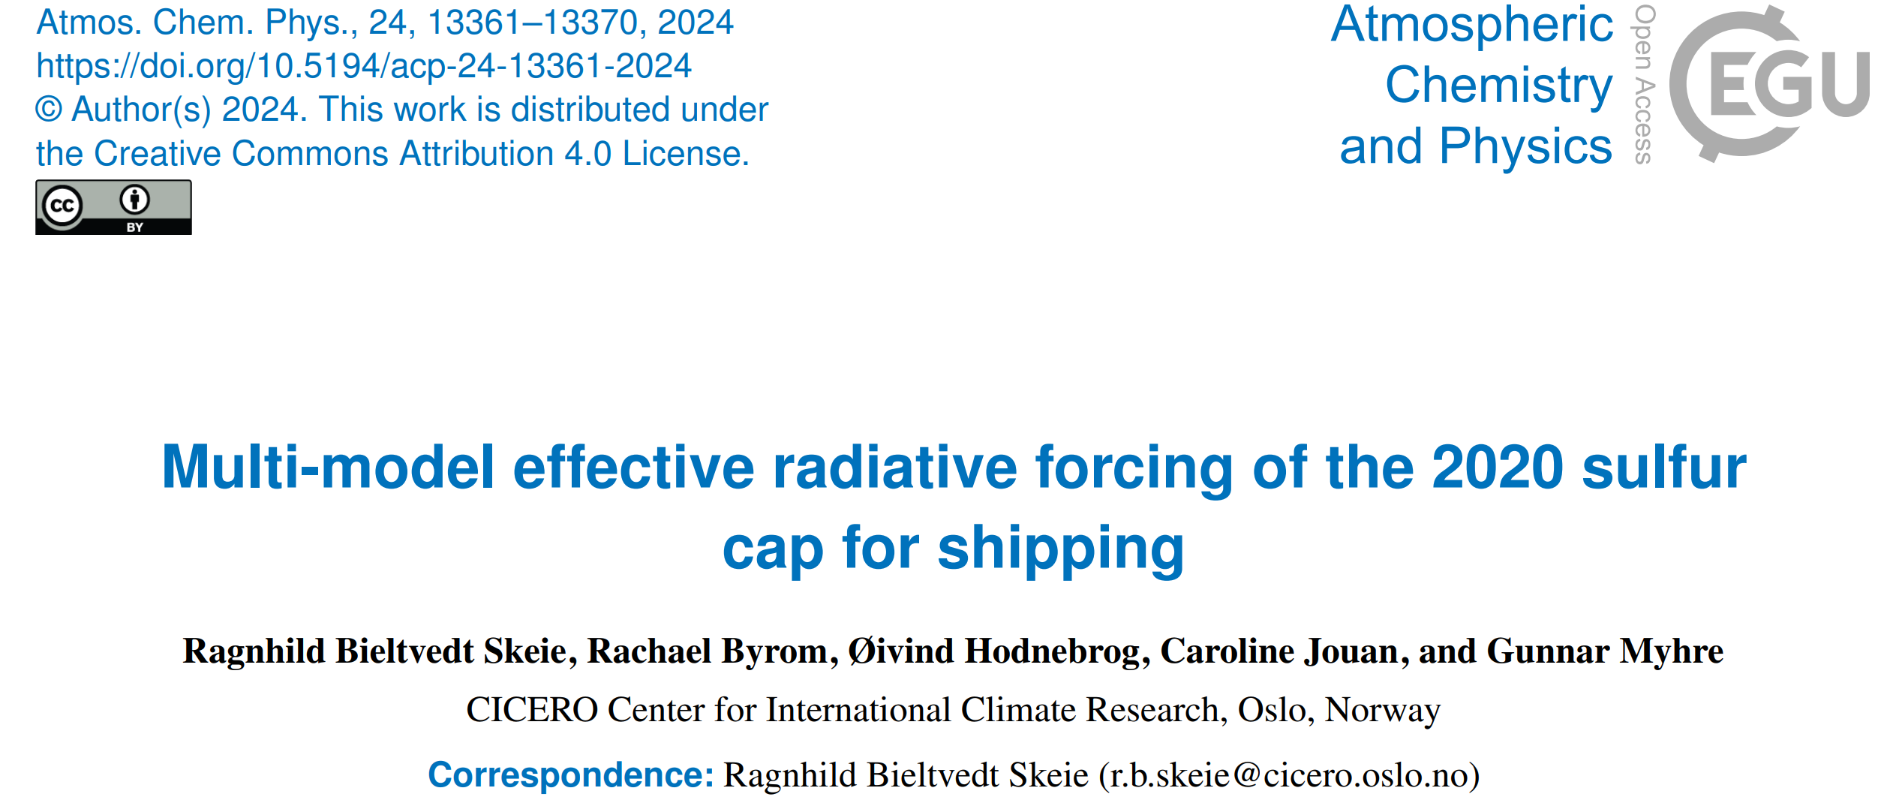
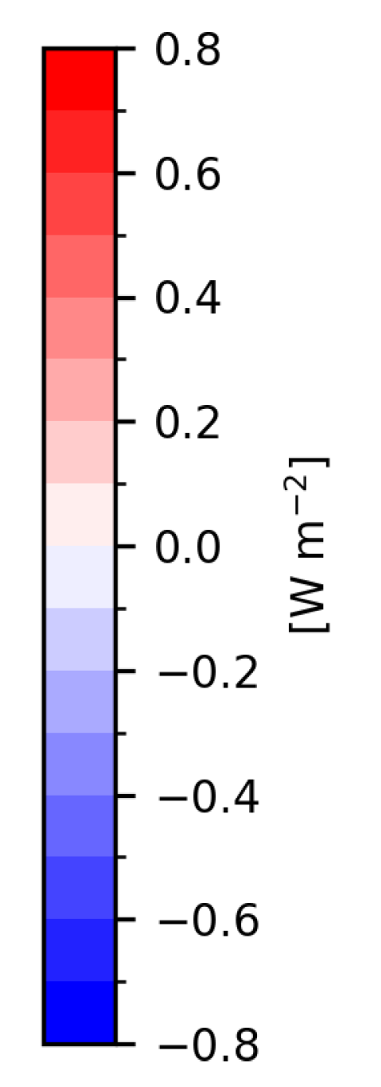
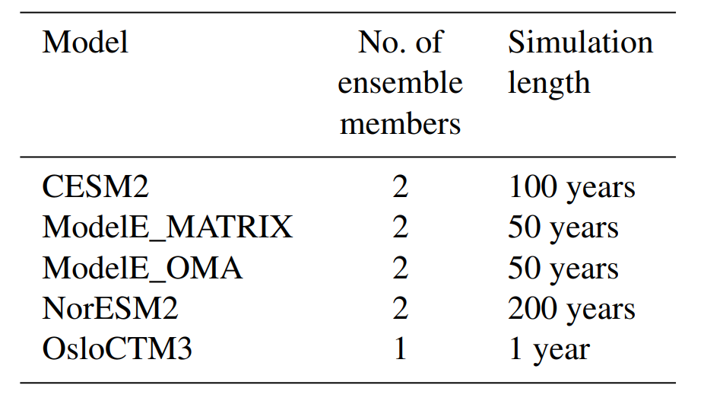
Effective Radiative Forcing
Multi-model mean:
Five models run with and without an 80% reduction in SO₂ emissions from shipping
Climate models run with fixed sea surface temperature and sea ice.
OsloCTM3 run with fixed meteorology with offline radiative transfer calculations for calculating RF.
Hatching is where the models (4 out of 5) agree in sign of change.

Slide 4
ERF of 80% reduction in SO₂ emissions from shipping:
Summary:
Model mean range: 0.06 to 0.09 W m⁻²
For two of the models, the two ensemble members are quite different → uncertainties related to how the ERF is calculated.
Multi-model mean of 0.07 W m⁻² ~ increase in CO₂ ERF over the last two years

Slide 5
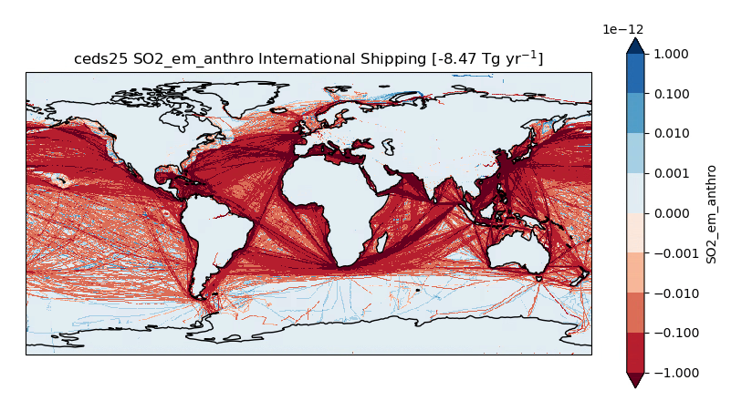
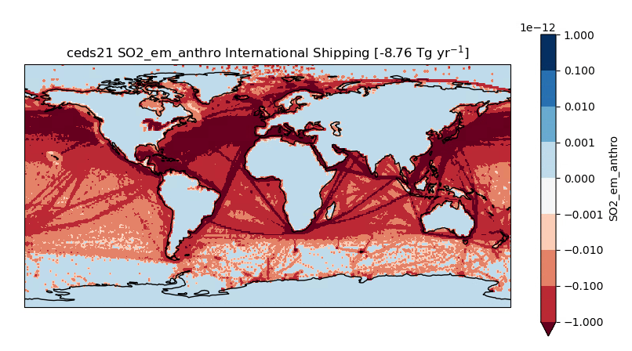
How large was the emission reduction? And where?
SO₂ emissions from shipping:
OsloCTM3:
RFari RFaci
2020 - 2019
80% emission reduction
CEDSv2025 CEDS-CMIP-2025-03-18
2020 relative to 2019
(CEDSv25)
20% of 2019
Different pattern of RF with more realistic emission perturbation.
Keep in mind: large uncertainties in total emissions
CEDSv2021 JGCRI/CEDS: Community Emissions Data System (CEDS) (github.com)

Slide 6
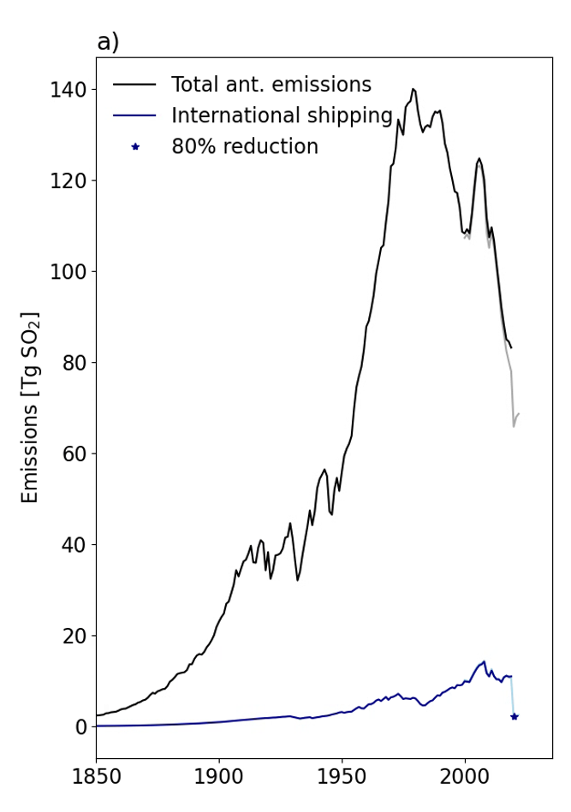
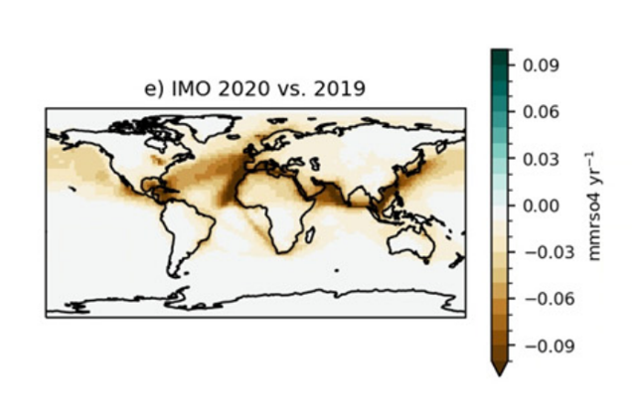
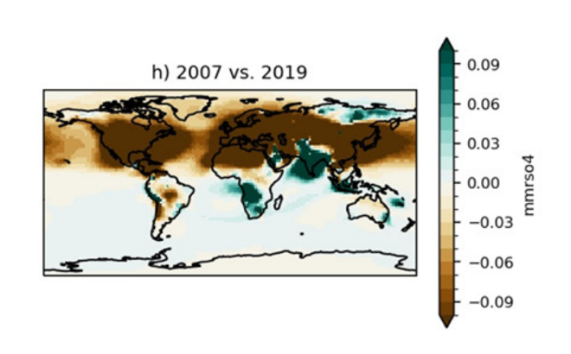
Compared to total anthropogenic SO₂ emissions:
Change in SO₄ surface concentration OsloCTM3:
CEDSv2025 CEDS-CMIP-2025-03-18
CEDSv2021 JGCRI/CEDS: Community Emissions Data System (CEDS) (github.com)

Slide 7
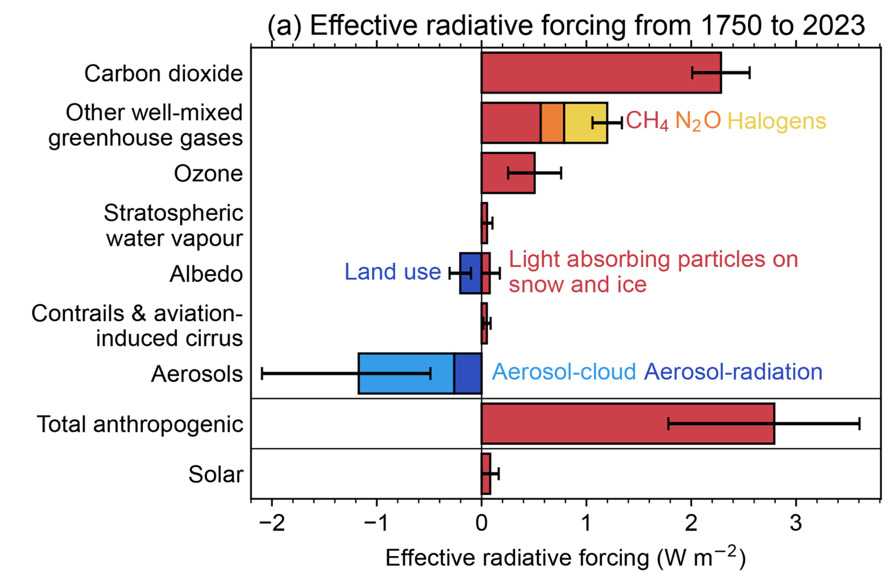
Keep in mind: Aerosol ERF uncertain
Forster et al. (2024)

Slide 8
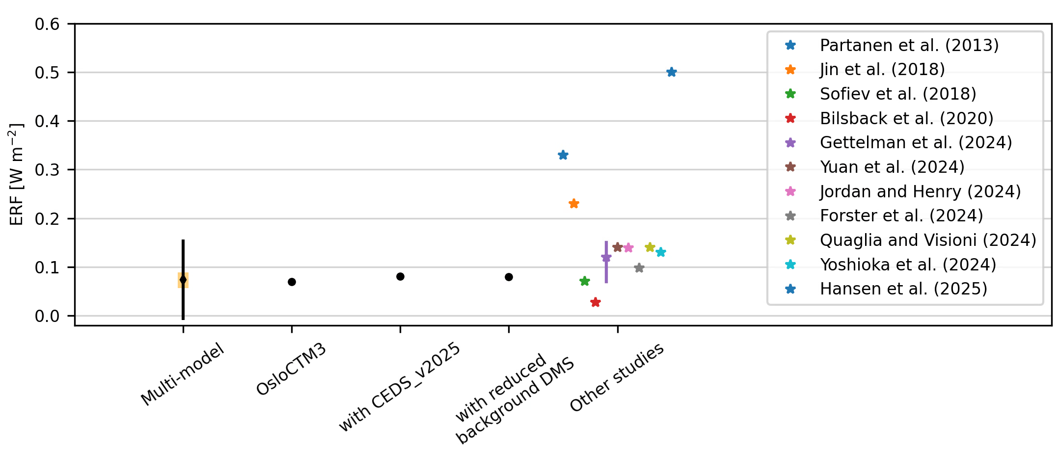
ERF of IMO2020:
Summary:
Radiative forcing for the IMO2020 shipping cap has large uncertainties (as for aerosol forcing in general) related to:
cloud adjustments,
emission uncertainties,
uncertainties in the sulphur cycle (including DMS, dimethylsulfide),
the impact of interannual variability on the method for calculating radiative forcing
Recent studies give radiative forcing values of ~0.1 W m⁻² (comparable to the increase in CO₂ ERF from 2019 to 2022)
Thank you!
Contact: r.b.skeie@cicero.oslo.no

Slide 9
Supporting Information:

Slide 10
Reference list
Bilsback, K. R., Kerry, D., Croft, B., Ford, B., Jathar, S. H., Carter, E., Martin, R. V., and Pierce, J. R.: Beyond SOx reductions from shipping: assessing the impact of NOx and carbonaceous-particle controls on human health and climate, Environ. Res. Lett., 15, 124046, https://doi.org/10.1088/1748-9326/abc718, 2020.
Forster, P. M., Smith, C., Walsh, T., Lamb, W. F., Lamboll, R., Hall, B., Hauser, M., Ribes, A., Rosen, D., Gillett, N. P., Palmer, M. D., Rogelj, J., von Schuckmann, K., Trewin, B., Allen, M., Andrew, R., Betts, R. A., Borger, A., Boyer, T., Broersma, J. A., Buontempo, C., Burgess, S., Cagnazzo, C., Cheng, L., Friedlingstein, P., Gettelman, A., Gütschow, J., Ishii, M., Jenkins, S., Lan, X., Morice, C., Mühle, J., Kadow, C., Kennedy, J., Killick, R. E., Krummel, P. B., Minx, J. C., Myhre, G., Naik, V., Peters, G. P., Pirani, A., Pongratz, J., Schleussner, C.-F., Seneviratne, S. I., Szopa, S., Thorne, P., Kovilakam, M. V. M., Majamäki, E., Jalkanen, J.-P., van Marle, M., Hoesly, R. M., Rohde, R., Schumacher, D., van der Werf, G., Vose, R., Zickfeld, K., Zhang, X., Masson-Delmotte, V., and Zhai, P.: Indicators of Global Climate Change 2023: annual update of key indicators of the state of the climate system and human influence, Earth System Science Data, 16, 2625–2658, https://doi.org/10.5194/essd-16-2625-2024, 2024.
Gettelman, A., Christensen, M. W., Diamond, M. S., Gryspeerdt, E., Manshausen, P., Stier, P., Watson-Parris, D., Yang, M., Yoshioka, M., and Yuan, T.: Has Reducing Ship Emissions Brought Forward Global Warming?, Geophysical Research Letters, 51, e2024GL109077, https://doi.org/10.1029/2024GL109077, 2024.
Hansen, J. E., Kharecha ,Pushker, Sato ,Makiko, Tselioudis ,George, Kelly ,Joseph, Bauer ,Susanne E., Ruedy ,Reto, Jeong ,Eunbi, Jin ,Qinjian, Rignot ,Eric, Velicogna ,Isabella, Schoeberl ,Mark R., von Schuckmann ,Karina, Amponsem ,Joshua, Cao ,Junji, Keskinen ,Anton, Li ,Jing, and and Pokela, A.: Global Warming Has Accelerated: Are the United Nations and the Public Well-Informed?, Environment: Science and Policy for Sustainable Development, 67, 6–44, https://doi.org/10.1080/00139157.2025.2434494, 2025.
Jin, Q., Grandey, B. S., Rothenberg, D., Avramov, A., and Wang, C.: Impacts on cloud radiative effects induced by coexisting aerosols converted from international shipping and maritime DMS emissions, Atmospheric Chemistry and Physics, 18, 16793–16808, https://doi.org/10.5194/acp-18-16793-2018, 2018.
Jordan, G. and Henry, M.: IMO2020 Regulations Accelerate Global Warming by up to 3 Years in UKESM1, Earth’s Future, 12, e2024EF005011, https://doi.org/10.1029/2024EF005011, 2024.
Partanen, A. I., Laakso, A., Schmidt, A., Kokkola, H., Kuokkanen, T., Pietikäinen, J.-P., Kerminen, V.-M., Lehtinen, K. E. J., Laakso, L., and Korhonen, H.: Climate and air quality trade-offs in altering ship fuel sulfur content, Atmospheric Chemistry and Physics, 13, 12059–12071, https://doi.org/10.5194/acp-13-12059-2013, 2013.
Quaglia, I. and Visioni, D.: Modeling 2020 regulatory changes in international shipping emissions helps explain anomalous 2023 warming, Earth System Dynamics, 15, 1527–1541, https://doi.org/10.5194/esd-15-1527-2024, 2024.
Skeie, R. B., Byrom, R., Hodnebrog, Ø., Jouan, C., and Myhre, G.: Multi-model effective radiative forcing of the 2020 sulfur cap for shipping, Atmospheric Chemistry and Physics, 24, 13361–13370, https://doi.org/10.5194/acp-24-13361-2024, 2024.
Sofiev, M., Winebrake, J. J., Johansson, L., Carr, E. W., Prank, M., Soares, J., Vira, J., Kouznetsov, R., Jalkanen, J.-P., and Corbett, J. J.: Cleaner fuels for ships provide public health benefits with climate tradeoffs, Nat Commun, 9, 406, https://doi.org/10.1038/s41467-017-02774-9, 2018.
Yoshioka, M., Grosvenor, D. P., Booth, B. B. B., Morice, C. P., and Carslaw, K. S.: Warming effects of reduced sulfur emissions from shipping, Atmospheric Chemistry and Physics, 24, 13681–13692, https://doi.org/10.5194/acp-24-13681-2024, 2024.
Yuan, T., Song, H., Oreopoulos, L., Wood, R., Bian, H., Breen, K., Chin, M., Yu, H., Barahona, D., Meyer, K., and Platnick, S.: Abrupt reduction in shipping emission as an inadvertent geoengineering termination shock produces substantial radiative warming, Commun Earth Environ, 5, 1–8, https://doi.org/10.1038/s43247-024-01442-3, 2024.

Slide 11
CEDSv2021 vs CEDSv2025
Source:
CEDSv2021 JGCRI/CEDS: Community Emissions Data System (CEDS) (github.com)
CEDSv2025 Anthropogenic short-lived climate forcer (SLCF) and CO2 emissions - input4MIPs Controlled Vocabularies (CVs) (CEDS-CMIP-2025-03-18)

Slide 12
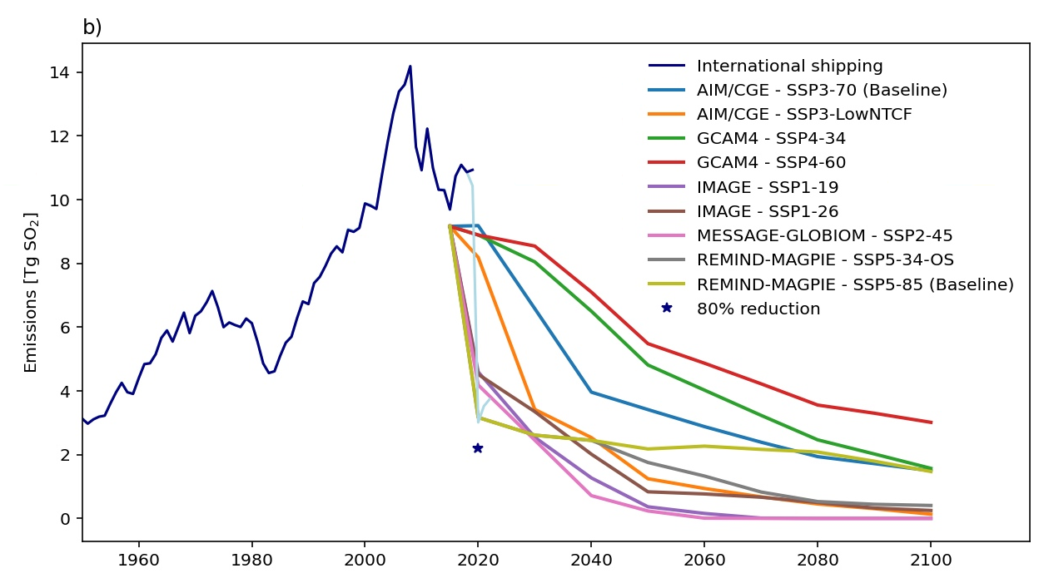
IMO regulation in SSP scenarios:
Decided in 2008 (with implementation in 2020 or 2025)
Source: CEDS emissions (v2021 and v2024 in brighter colors)
JGCRI/CEDS: Community Emissions Data System (CEDS) (github.com)
SSP emissions: SSP Database

Slide 13
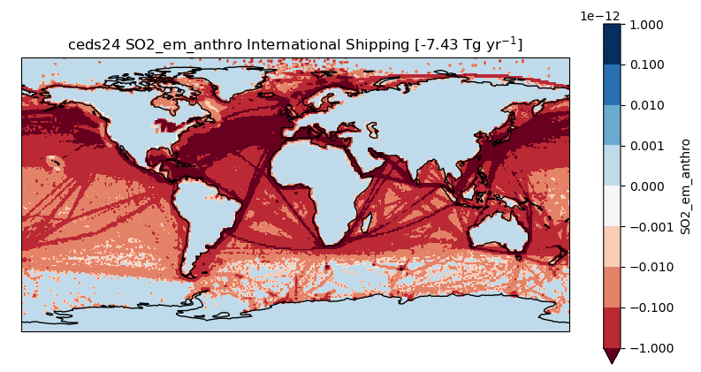
Emissions: CEDS_v2021 (80% of 2019 emissions), CEDS_v2024 and CEDS_v2025
CEDS_v2025 to be used in CMIP7 different from the CEDS_v2024 which were more similar to the scaling approach.

Slide 14
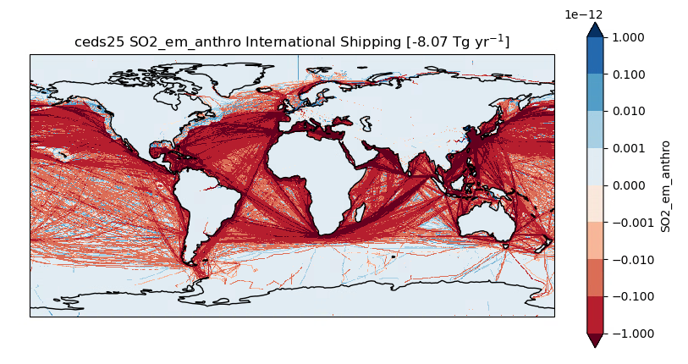
CEDS_v2025 2020-2019 and 2021-2019

Slide 15
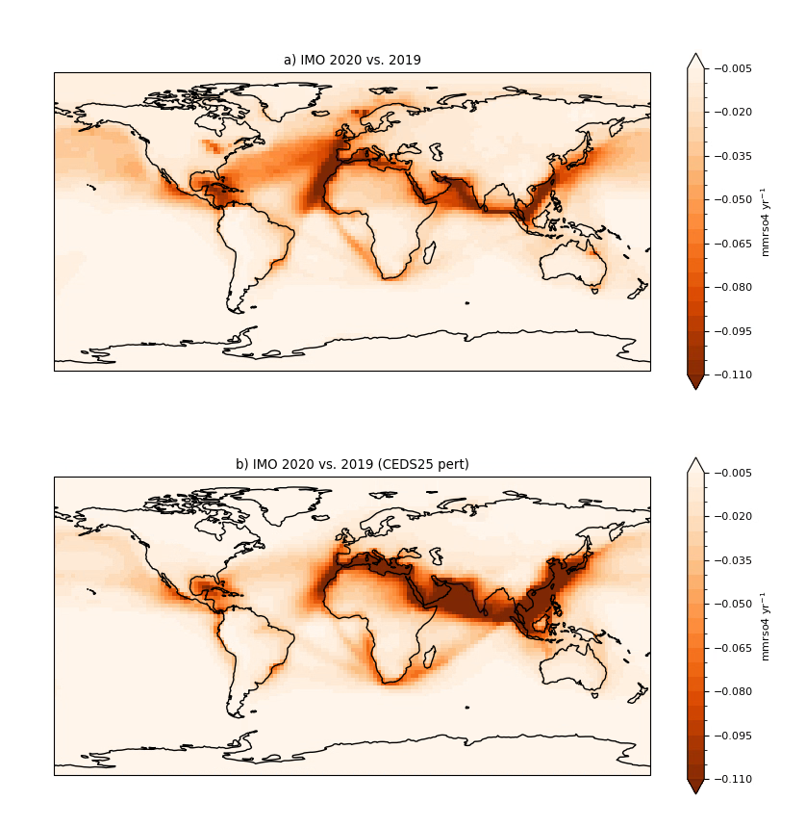
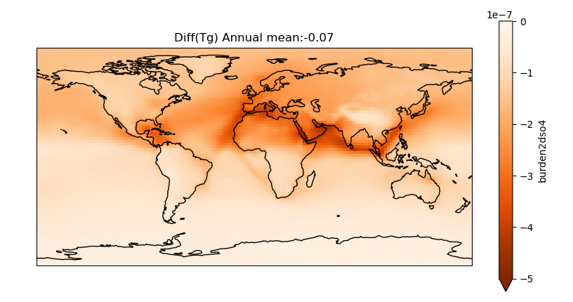
OsloCTM3 results
Surface concentration mmrSO4
Burden/Load [kg m⁻²]
20% of 2019 (CEDS_v2021)
2020 – 2019 (CEDS_v2025)

Slide 16
More info:
ACP - Multi-model effective radiative forcing of the 2020 sulfur cap for shipping

