Slide 1
How does the spatial scale of surface flux variability affect MCS properties?
Ben Maybee⁽¹⁾, Conni Klein^{(2,3)}, Helen Burns⁽¹⁾, Chris Taylor⁽²⁾, John Marsham⁽¹⁾, Doug Parker^{(1,4)} & Emma Barton^{(2,3)}
b.w.maybee@leeds.ac.uk
ICAS, School of Earth and Environment, University of Leeds, UK
UK Centre for Ecology and Hydrology (UKCEH), Wallingford, UK
National Centre for Earth Observation (NCEO), Wallingford, UK
NORCE Norwegian Research Centre AS, Bergen, Norway
LMCS project
EGU25 AS1.11, 30/04/2025

Slide 2
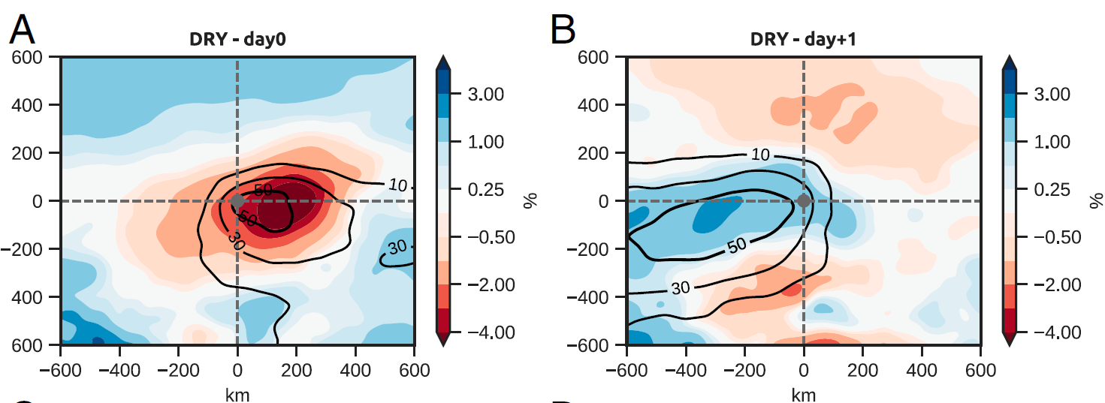
Flux variability ↔ MCSs in obs.
b.w.maybee@leeds.ac.uk
Surface heterogeneity provides a control and source of predictability for MCSs across scales.
Small scale
Mesoscale
Synoptic scale
Mature MCSs favoured over ~200km dry soil patches in Sahel. Post-storm rainfall suppressed for ~8 days.
Klein & Taylor, PNAS 2020
Taylor et al, GRL 2024
Chance of Sahelian MCS initiation doubled over ~30km soil moisture gradients due to enhanced local convergence.
Taylor et al, Nat. Geosci. 2011
6° meridional SM gradients drive wind shear patterns globally; 10-50% increase in MCS rainfall on shear days.
Barton et al, Nat. Geosci. 2025
Emma Barton:
Q: How sensitive is this mechanism to the spatial scale of surface variability?
Chris Taylor:

Slide 3
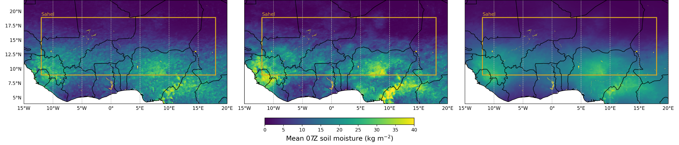
Scale sensitivity experiments
b.w.maybee@leeds.ac.uk
MetUM experiments initialised at 06 UTC with altered SM wavelet spectrum:
SM(Large+Small) D1
Control D1
SM(LargeOnly) D1
Large-only + small scale (<100km) wavelet modes
All SM variability @ <1000km scale smoothed out.
39 daily initialisations, each run 48hrs
1.5km grid, explicit convection (RAL3.2)
3 x 39 x 2 = 237 CP model days
JULES land, SM from 10 year CP run

Slide 4
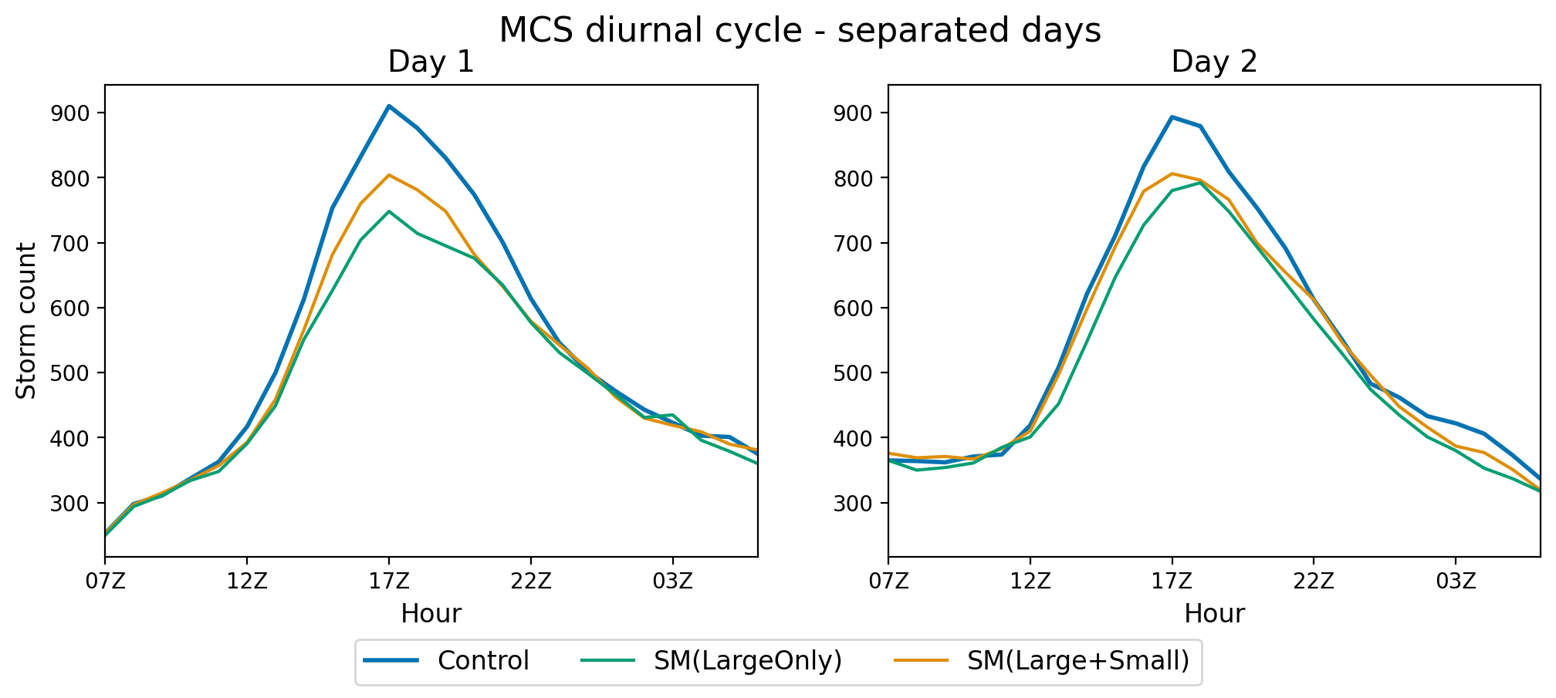
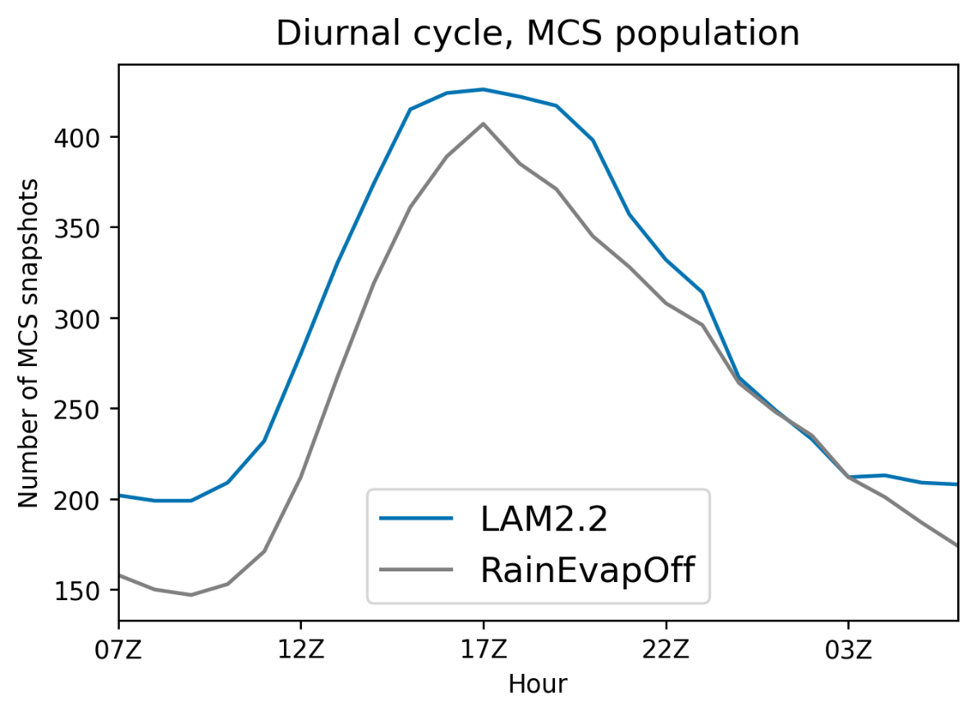
Impact of surface scales on MCS populations
b.w.maybee@leeds.ac.uk
Track full MCS lifecycles with simpleTrack algorithm (BT + rain)
L+S~ -15%
LO~ -22%
~7%
Cold pools
Peak counts ↓ when mesoscale SM variability suppressed. Begin recovery on D2.
SM variability stronger control on population than cold pools. Maybee et al, in rev. QJRMS

Slide 5
Why are mesoscale dry patches favourable?
b.w.maybee@leeds.ac.uk
SM patches
Find patches removed in sens; field diffs post patch.
n=423, find via power maxima
Dry patch H anomalies ↑ PBLH, ↑ convergence, ↑ background nocturnal monsoon flow
Control MCSs
Fields prior to n=669 17Z cores

Slide 6
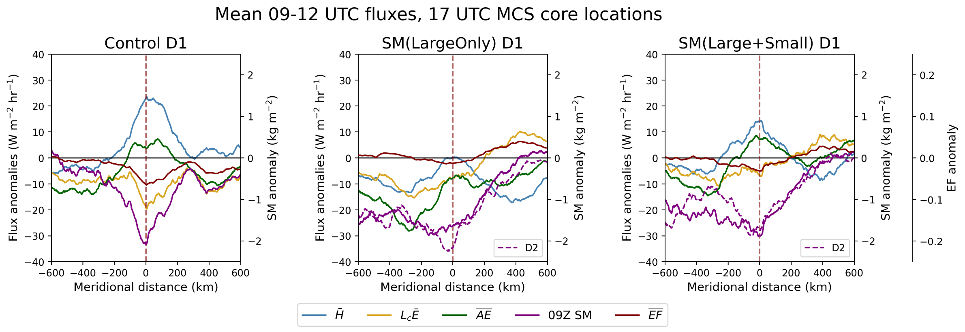
Cloud-free slots can replace SM mechanism
b.w.maybee@leeds.ac.uk
+ve H anomaly
+ve H & AE anomalies
Mesoscale dry patch
SM(L+S) D2 pre-MCS fields:
SM gradients
Nocturnal ↑q from monsoon
Mesoscale SW anomaly in cloud-free slot

Slide 7
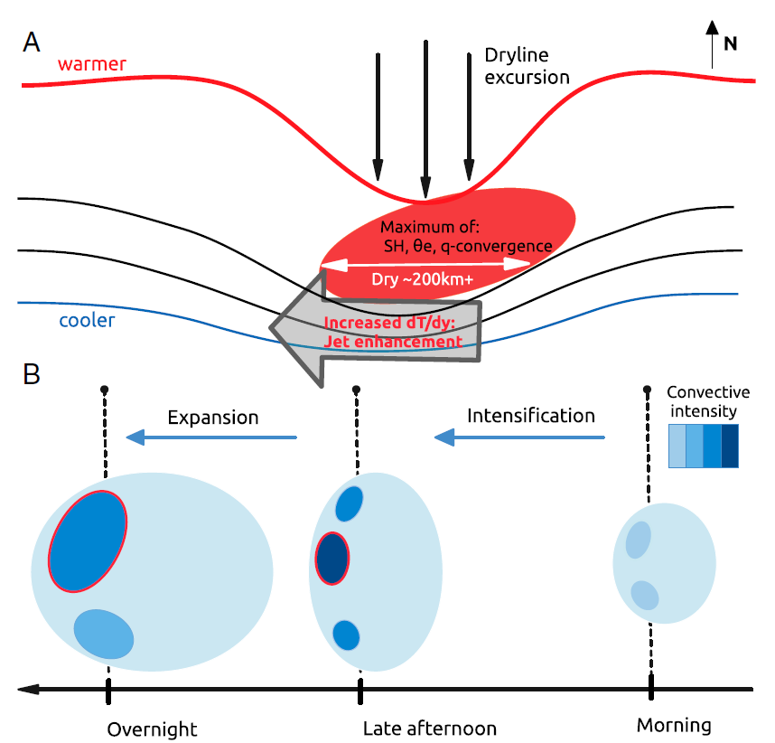
Conclusions
b.w.maybee@leeds.ac.uk
MetUM sensitivity experiments over West Africa probing influence of SM heterogeneity on MCSs.
Mesoscale dry soil patches modify local PBL fields such that they are more favourable for mature MCSs.
↑ PBLH, ↑ convergence, ↑ nocturnal flow
Removing mesoscale SM variability reduces MCS population by ~20% at diurnal peak of convection.
Stronger effect than cold pool suppression
Mesoscale cloud slots generate favourable dynamical conditions when SM heterogeneity removed.
Thermodynamic environment dominated by independent monsoon flow
Klein & Taylor, PNAS 2020
SM heterogeneity enhances MCS activity and provides spatial predictability

