Slide 1
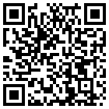
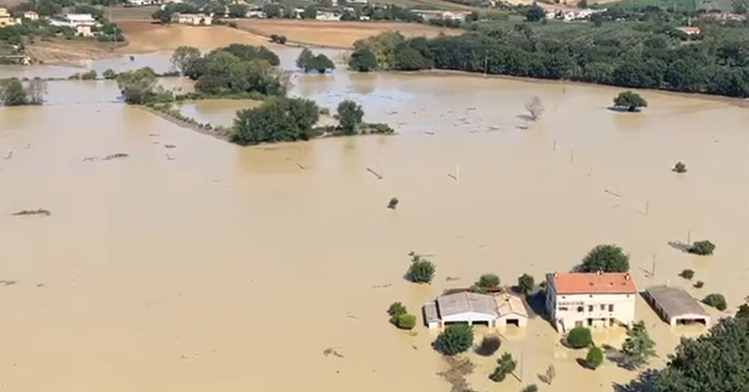
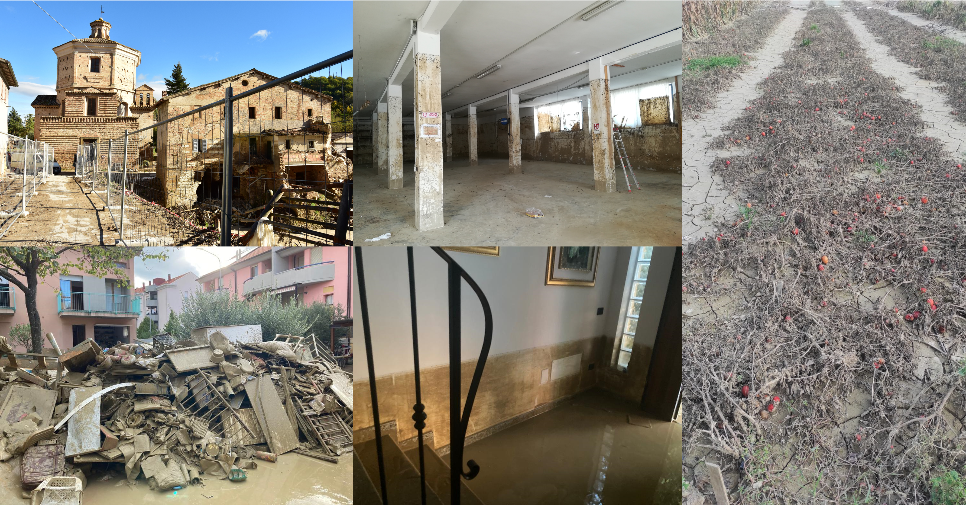
Flood human impacts within and beyond the flooded area: results of a survey conducted in Marche region after the flood of 2022
Sara Rrokaj¹, Philip Bubeck², Annegret Thieken², Daniela Molinari¹
¹ Politecnico di Milano, Civil and Environmental Engineering, Milan, Italy
² University of Potsdam, Institute of Environmental Science and Geography, Potsdam, Germany
Vienna, Austria & Online | 27 April–2 May 2025

Slide 2
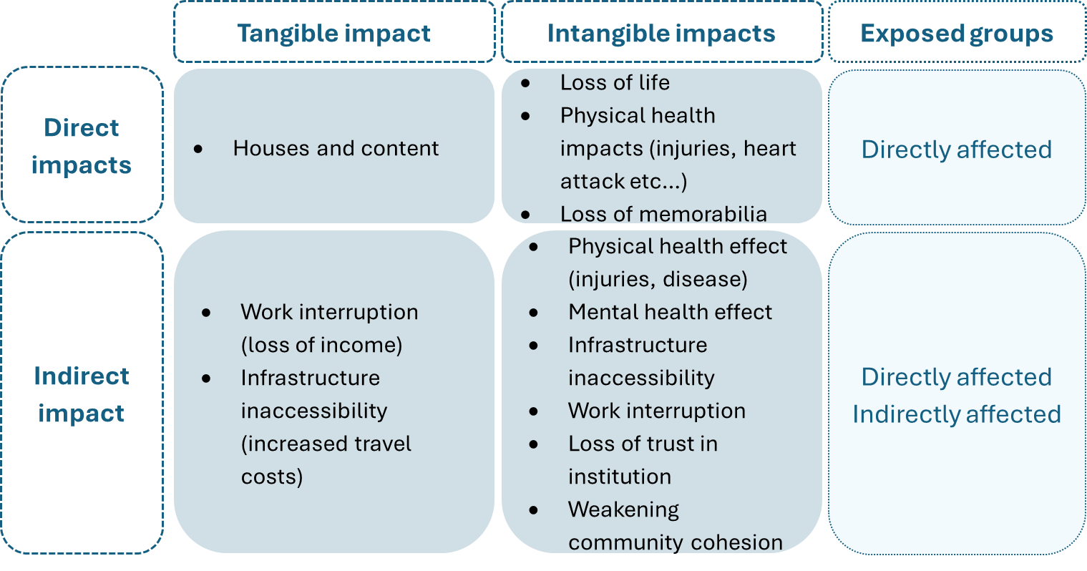
Motivation and Research questions
Motivation
Research questions
Priority of flood risk management: limit human impacts
lack of tools for assessing flood human impact
Italy: N. of exposed people as a proxy of human impact
lack of comprehensive definition of these impact
RQ1- which is the role of different human flood impact types with respect to the overall flood impact perceived by people?
RQ2- which are the exposed groups affected by these impacts?
Questionnaire
Flood event of Marche region, Italy, 2022
3 respondent groups:
Literature: human impact types
To answer
Directly affected
Indirectly affected
Not affected

Slide 3
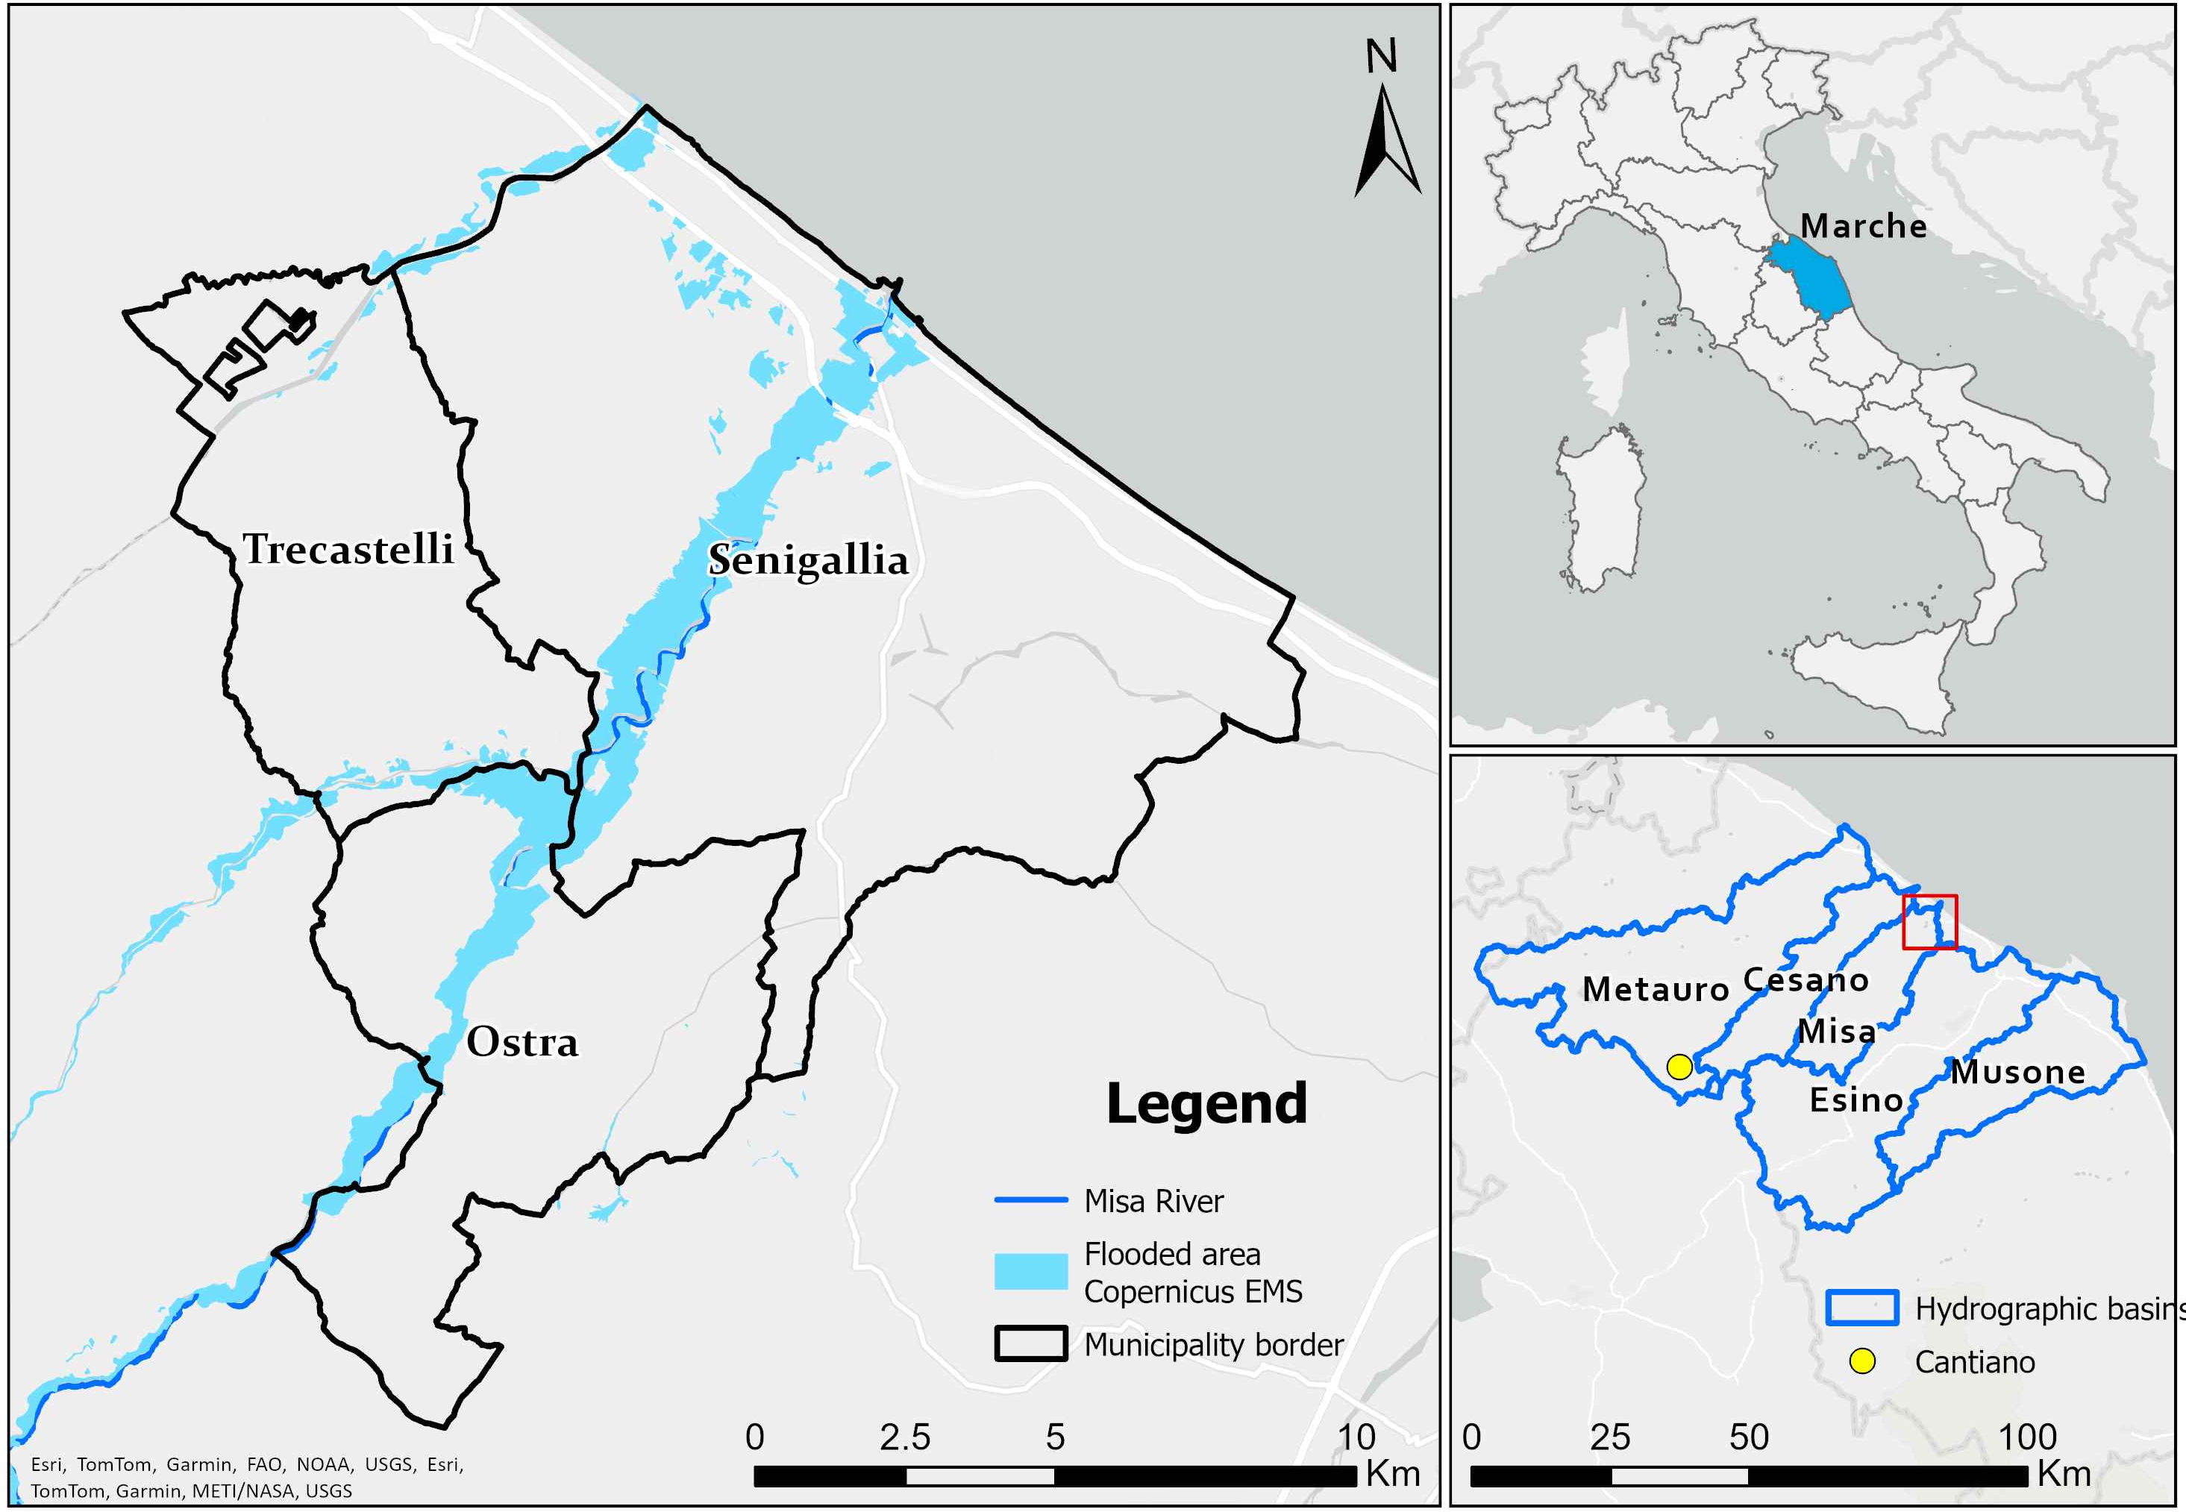
The flood event
15-16 September 2022
Marche region, Central Italy
V-shaped self-healing thunderstorm
Peak of 400 mm in Cantiano municipality
Less than 12 hours rainfall duration
Most severe impacts in Misa Basin
Ostra
Trecastelli
Senigallia
Historical series of maximum annual precipitation for 12 hours rainfall duration of the municipality of Cantiano, red dot depicts the rainfall recorded in the event in September 2022.
Notes:
https://www.youtube.com/watch?v=WWRRkBdaBY4&ab_channel=CentroPagina

Slide 4
Questionnaire distribution and responses
707 responses
Online questionnaire
77 questions
About 15 min to complete it
698 (99%) from Marche region
657 (93%) from people who live in the three municipalities
Newspaper
About 340 response
6 articles
Social media campaign (META)
About 360 responses
500 €
20 days
April – June 2024
(1year and 8 months after the event)

Slide 5
Questionnaire
General structure
General structure
Information
Information
Groups
Directly affected
Indirectly affected
Not affected
Groups
1° part
1° part
Warning
Mitigation actions
Water depth
Impacts
Warning
Mitigation actions
Water depth
Impacts
Event information
Event information
Three sections to fulfill multiple objectives.
This work focuses on the impact section
→ focus on how different exposed groups perceive the severity of impacts identified in literature
2° part
2° part
Bonding
Bridging
Social capital
Bonding
Bridging
Social capital
Demographic information
Education
Economic well-being
Household composition
Environment knowledge
3° part
Demographic information
Education
Economic well-being
Household composition
Environment knowledge
3° part
Socio-economic
variables
Socio-economic
variables

Slide 6
Perceived severity of impacts - questions
Asked to all respondents groups
Please define, on a scale from 1 to 6, how bad the following types of damage were for you personally:
1: Very low; 6:Very high
Question
Directly affected
Indirectly affected
Not affected
1 | 2 | 3 | 4 | 5 | 6 | I did not experience this damage
Converted into a continuous 7-point scale:
Scale from 1 to 6
“I did not experience this damage” = 0
Answers
Variable name | Description
BD | Building damage
LM | Loss of personal belonging (“Memorabilia”)
WI | Work Interruption
II | Infrastructure Inaccessibility
HI | Physical Health Impact
LI | Loss of trust in Institutions
LC | Loss of community Cohesion
PI | Psychological Impact
OD | Overall Damage
Impacts
To answer to the RQs
Multiple regression analysis for all the sample and for each group:
$OD= β_{BD}∗BD+ β_{LM}∗LM+β_{WI}∗WI+β_{HI}∗HI+β_{PI}∗PI+β_{LI}∗LI+β_{LC}∗LC$ $+ β_{II}∗II$
Impact types identified in literature

Slide 7
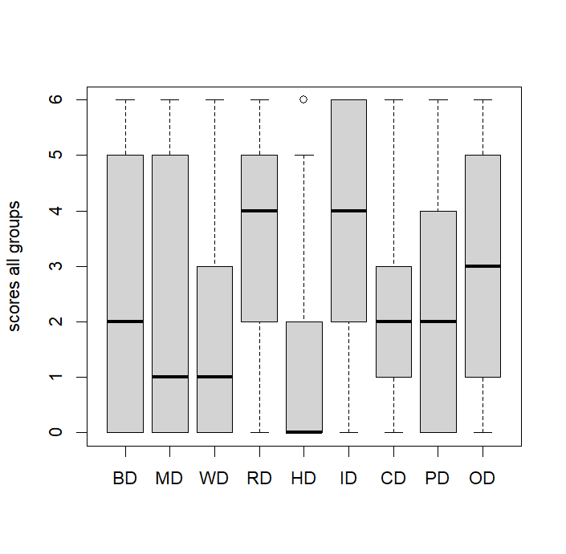
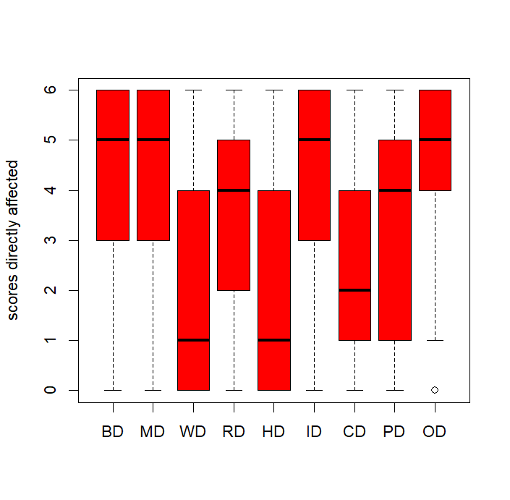
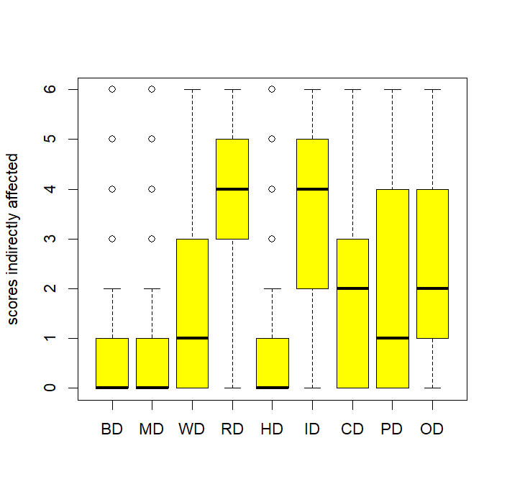
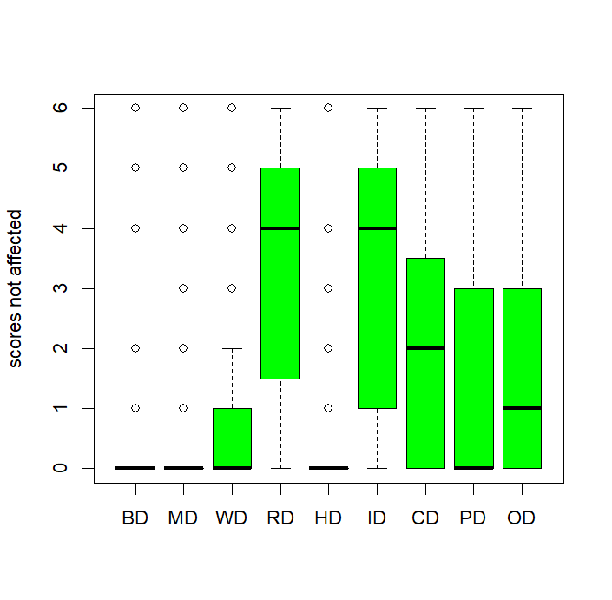
Perceived severity of impacts – results 1/2
Variable name | Description
BD | Building damage
LM | Loss of personal belonging (“Memorabilia”)
WI | Work Interruption
II | Infrastructure Inaccessibility
HI | Physical Health Impact
LI | Loss of trust in Institutions
LC | Loss of community Cohesion
PI | Psychological Impact
OD | Overall Damage
BD MD WI II HI LI LC PI OD
BD MD WI II HI LI LC PI OD
Boxplots of the scores of the perceived severity of impacts clearly show the differences across the groups
BD MD WI II HI LI LC PI OD
BD MD WI II HI LI LC PI OD

Slide 8
Perceived severity of impacts – results 2/2
 |  | All | Directly affected | Indirectly affected | Not affected
 | N=694 |  | N=305 | N=277 | N=112
 | R²= 0.53 |  | R²= 0.48 | R²= 0.33 | R²= 0.40
 | β |  | β | β | β
Intercept |  | 0.84*** | 1.66*** | 0.54* | 0.37
Building damage (BD) |  | 0.23*** | 0.31*** | 0.01 | -0.25
Loss of memorabilia (LM) |  | 0.20*** | 0.12** | 0.21** | 0.12
Work interruption (WI) |  | 0.08*** | 0.02 | 0.15* | 0.36**
Infrastructure inaccessibility (II) |  | 0.07* | -0.03 | 0.17** | 0.13
Physical health impact (HI) |  | -0.2 | -0.02 | -0.26 | 0.10
Loss of trust in institutions (LI) |  | 0.12*** | 0.09* | 0.17** | -0.01
Loss of community cohesion (LC) |  | -0.03 | 0.05 | -0.04 | -0.01
Psychological impact (PI) |  | 0.25*** | 0.20*** | 0.22*** | 0.35***
Signif. codes: ‘***’ p< 0.001, ‘**’ p<0.01, ‘*’ p<0.05
Impacts
Ranking (β*)
PI
BD
LM
LI
II
BD
PI
LM
LI
PI
LM
II, LI
WI
WI
PI

Slide 9
Conclusion
Abstract
RQ1 and RQ2 answered
Classification of impacts by three groups
inform flood risk management
support the design of policies and measures prioritizing the significant impacts for each group
Significant indirect impacts for non-flooded people
preparedness strategies should consider the impacts on the entire community
recovery efforts should be extended beyond the flooded area
High significance of psychological impact across all groups
Need for psychological assistance also beyond the flooded area
Next steps:
Development of a model to quantify the the overall impact

