Slide 1





PERISSOCYTHERIDEA (OSTRACODA) FROM THE NEOGENE OF WESTERN AMAZONIA
María Belén Zamudioª, Martin Grossª, Andres Salazar Ríos^{a,b}, and Werner E. Piller^{b}
ª Department for Geology & Palaeontology, Universalmuseum Joanneum, Weinzöttlstrasse 16, 8045 Graz, Austria.
^{b} Department of Earth Sciences. University of Graz. NAWI Graz Geocenter, Heinrichstrasse 26, 8010 Graz, Austria.
This research was funded by the Austrian Science Fund (FWF grant DOI: 10.55776/P35815)

Slide 2
INTRODUCTION
The genus Perissocytheridea Stephenson, is assumed to be Gondwanan origin and has an extensive paleobiogeographic (North and South America, Africa and Europe) and stratigraphic record (Cretaceous to recent)
Neogene sediments of western Amazonia are known for their high paleobiodiversity among the so-called “Pebasian” molluscs (Wesselingh, 2006). But also “Pebasian” ostracods exhibit a high degree of diversity and endemicity, which has led to the establishment of several new genera and species.
Over the last four decades, these ostracods have been thoroughly studied, although the focus has been on the genus Cyprideis Jones, which usually makes up the bulk of the ostracod fauna (representing more than 90%).

Slide 3
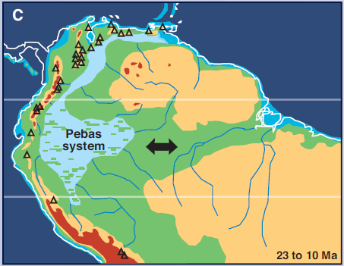
Pebas system
During the Miocene (c.23-10 Ma) climatic and tectonic changes gave rise to a large wetland of shallow lakes and swamps developed in Western Amazonia. These new aquatic environments of the “Pebas” system were colonized by rapidly radiating endemic invertebrate faunas composed of mollusks and ostracods.
Hoorn et al. (2010)

Slide 4
Aim of this investigation
To review the taxonomy of Amazonian Perissocytheridea species (To identify synonyms and new species)
To identify intraspecific variations
To identify evolutionary pathways
To compare Amazonian species with contemporary other species outside of Amazonia (especially Central and South America).
To explore their paleobiogeographic and paleoecological significance

Slide 5
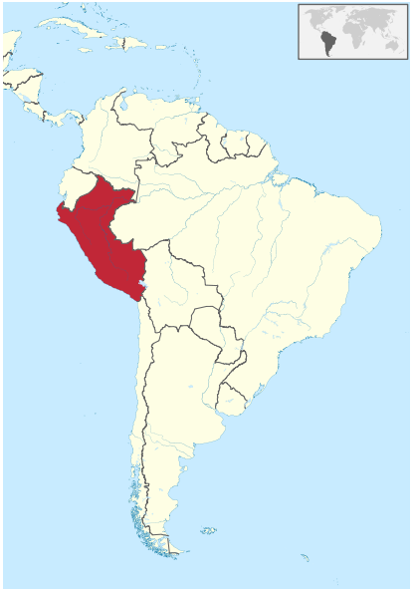
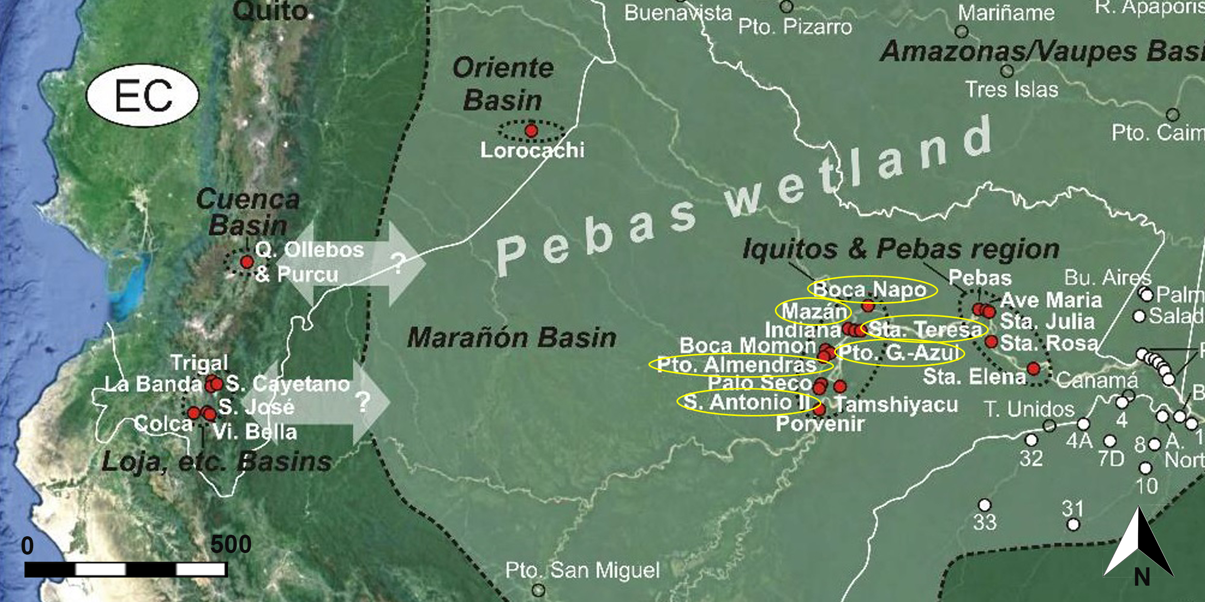
Materials and methods
At the moment 21 samples were analyzed from Iquitos (Peru) from nine localities:
covering the Middle Miocene mollusc zones MZ4-MZ9 according to Wesselling et al. (2006)
Modified from Wesselingh et al. 2006a, 2010, Jaramillo et al. 2017 (Satellite imagery from Google Earth®).

Slide 6

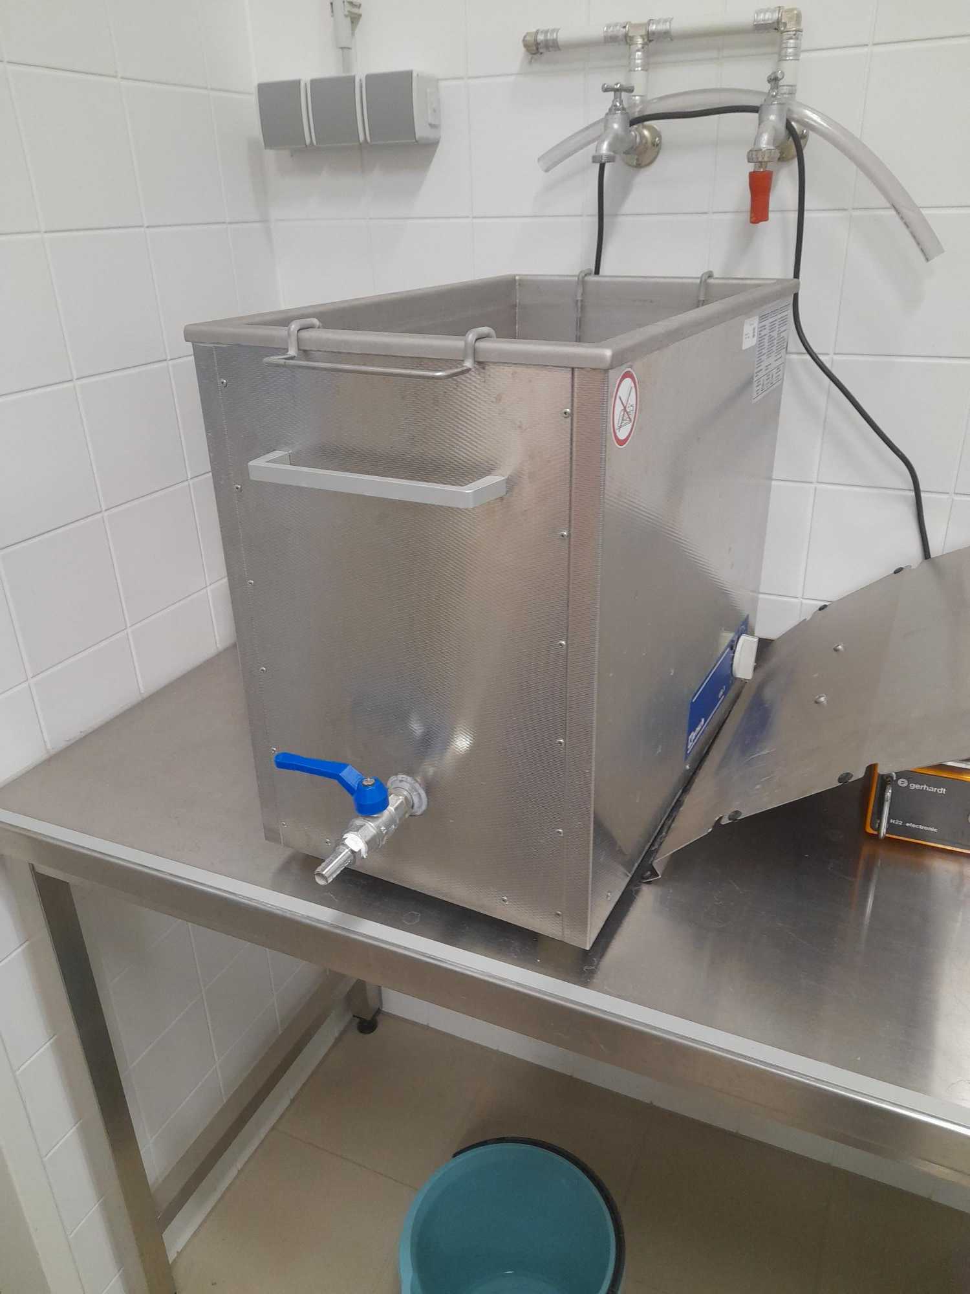
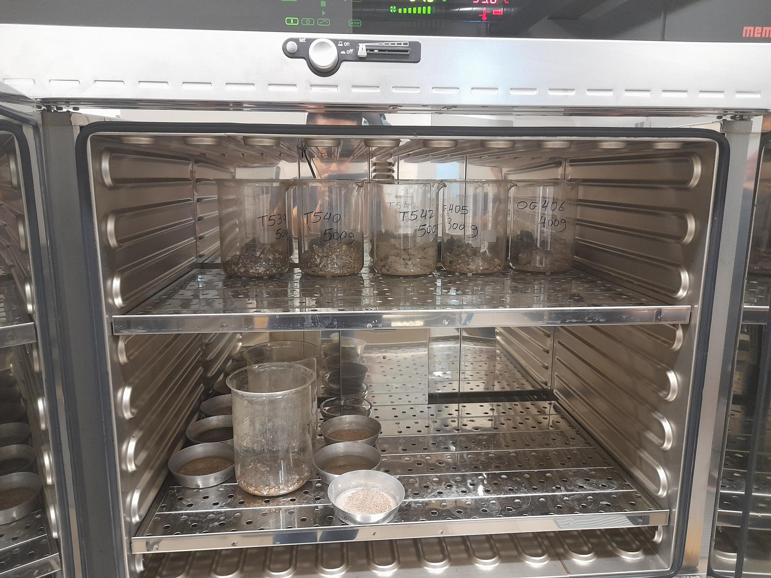
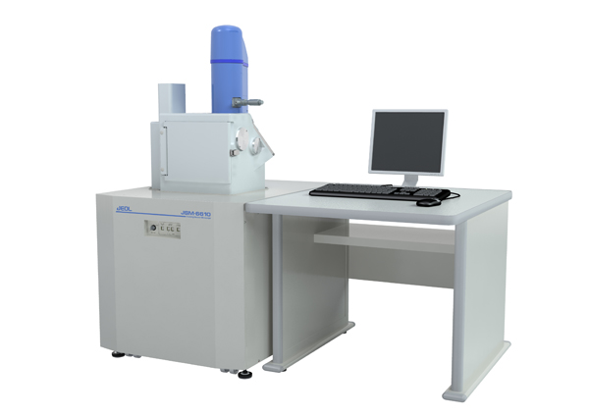
500 g of dried sediment (40° C, 24 h)
Using diluted hydrogen peroxide for disintegration
Were washed through standard sieves: 63, 125, 250, 500, 1000 μm
Residues washed with ethanol (96%) for 10 minutes.
Drying of residue (40° C, 24 h)
Microfossils picked out from the residues 125 and 63 μm (The current study considers only specimens of the ostracod genus Perissocytheridea acquired from that sieve-fraction).
Sieves in an ultrasonic bath for 15-20 min.
Sorting the microfossils for species into slides.
Photographs and measurements from optic (Keyence) and SEM photographs (JEOL- JSM6610LV).
For basic statistics, was used the software package Infostat (2014 Version).

Slide 7
Preliminary results
1218 specimens were recovered, from 11 productive samples.
Adults (females and males), juveniles (different instars). Most of them are represented by valves and are well preserved.
Were identified 3 different taxa; Perissocytheridea sp. 1, Perissocytheridea sp. 2 and : ?Perissocytheridea sp. 1
The section Boca Napo (sample BN-9) yielded the highest number of specimens.
Abundance of specimens from each sample (locality)

Slide 8
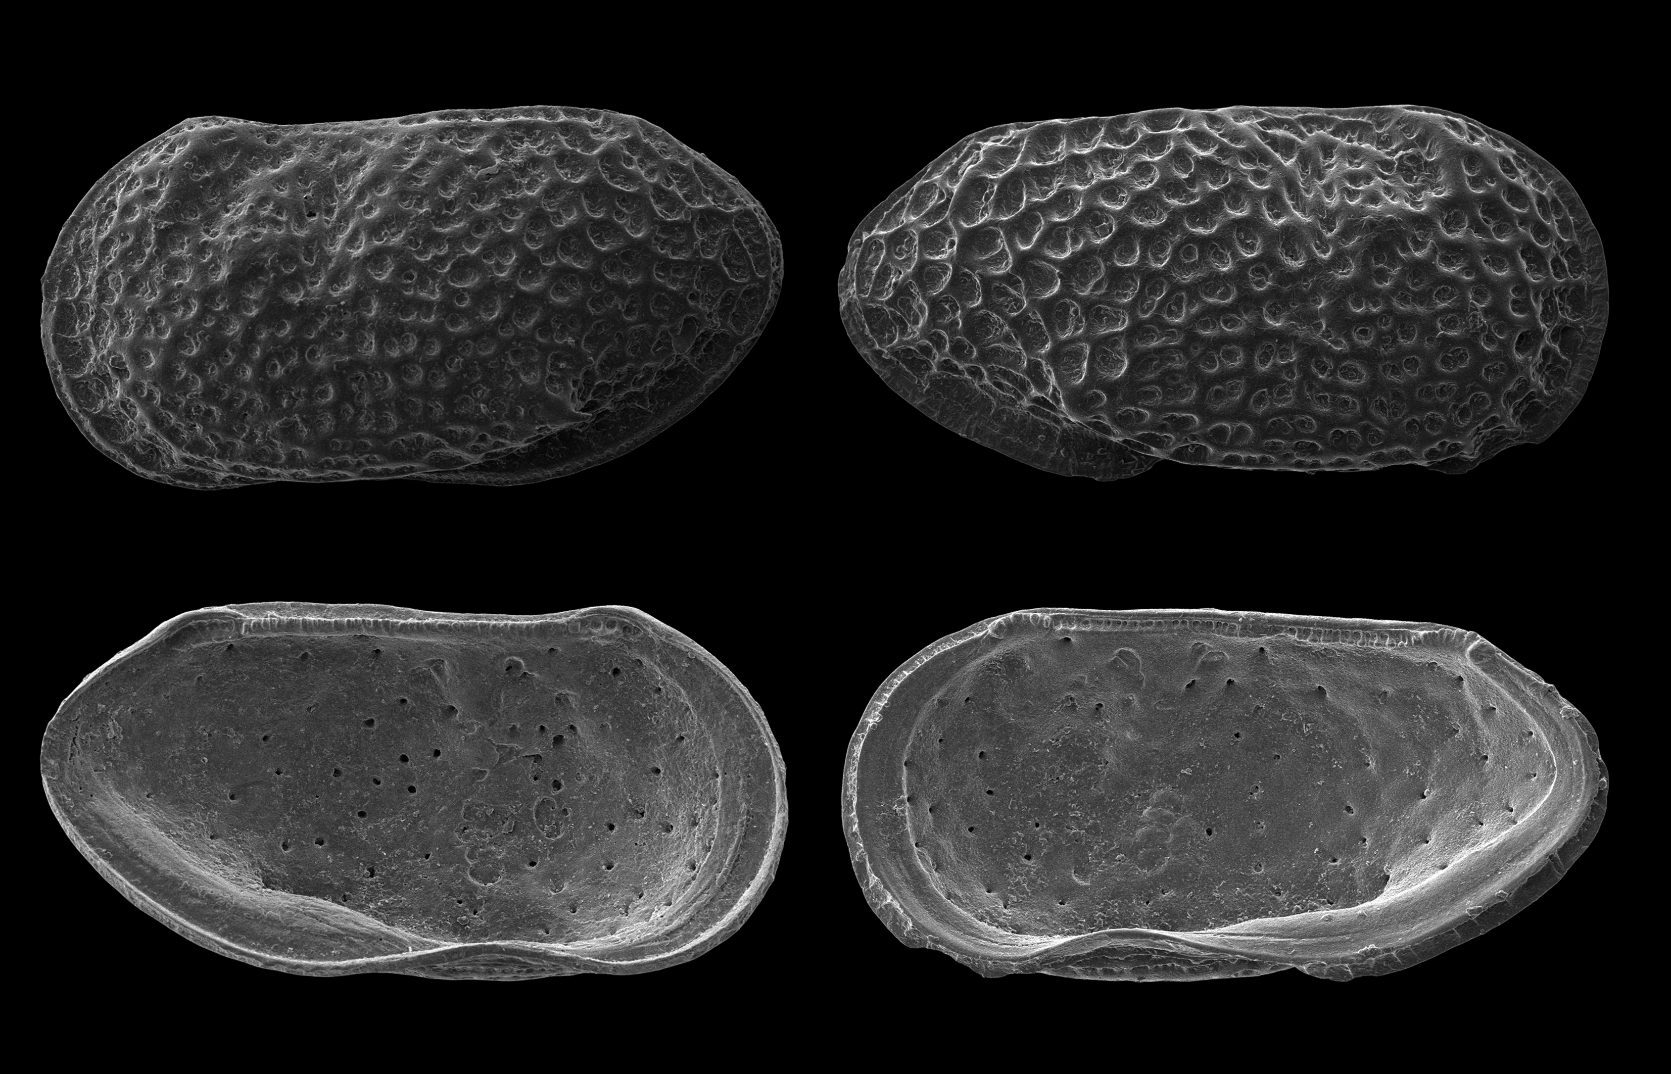
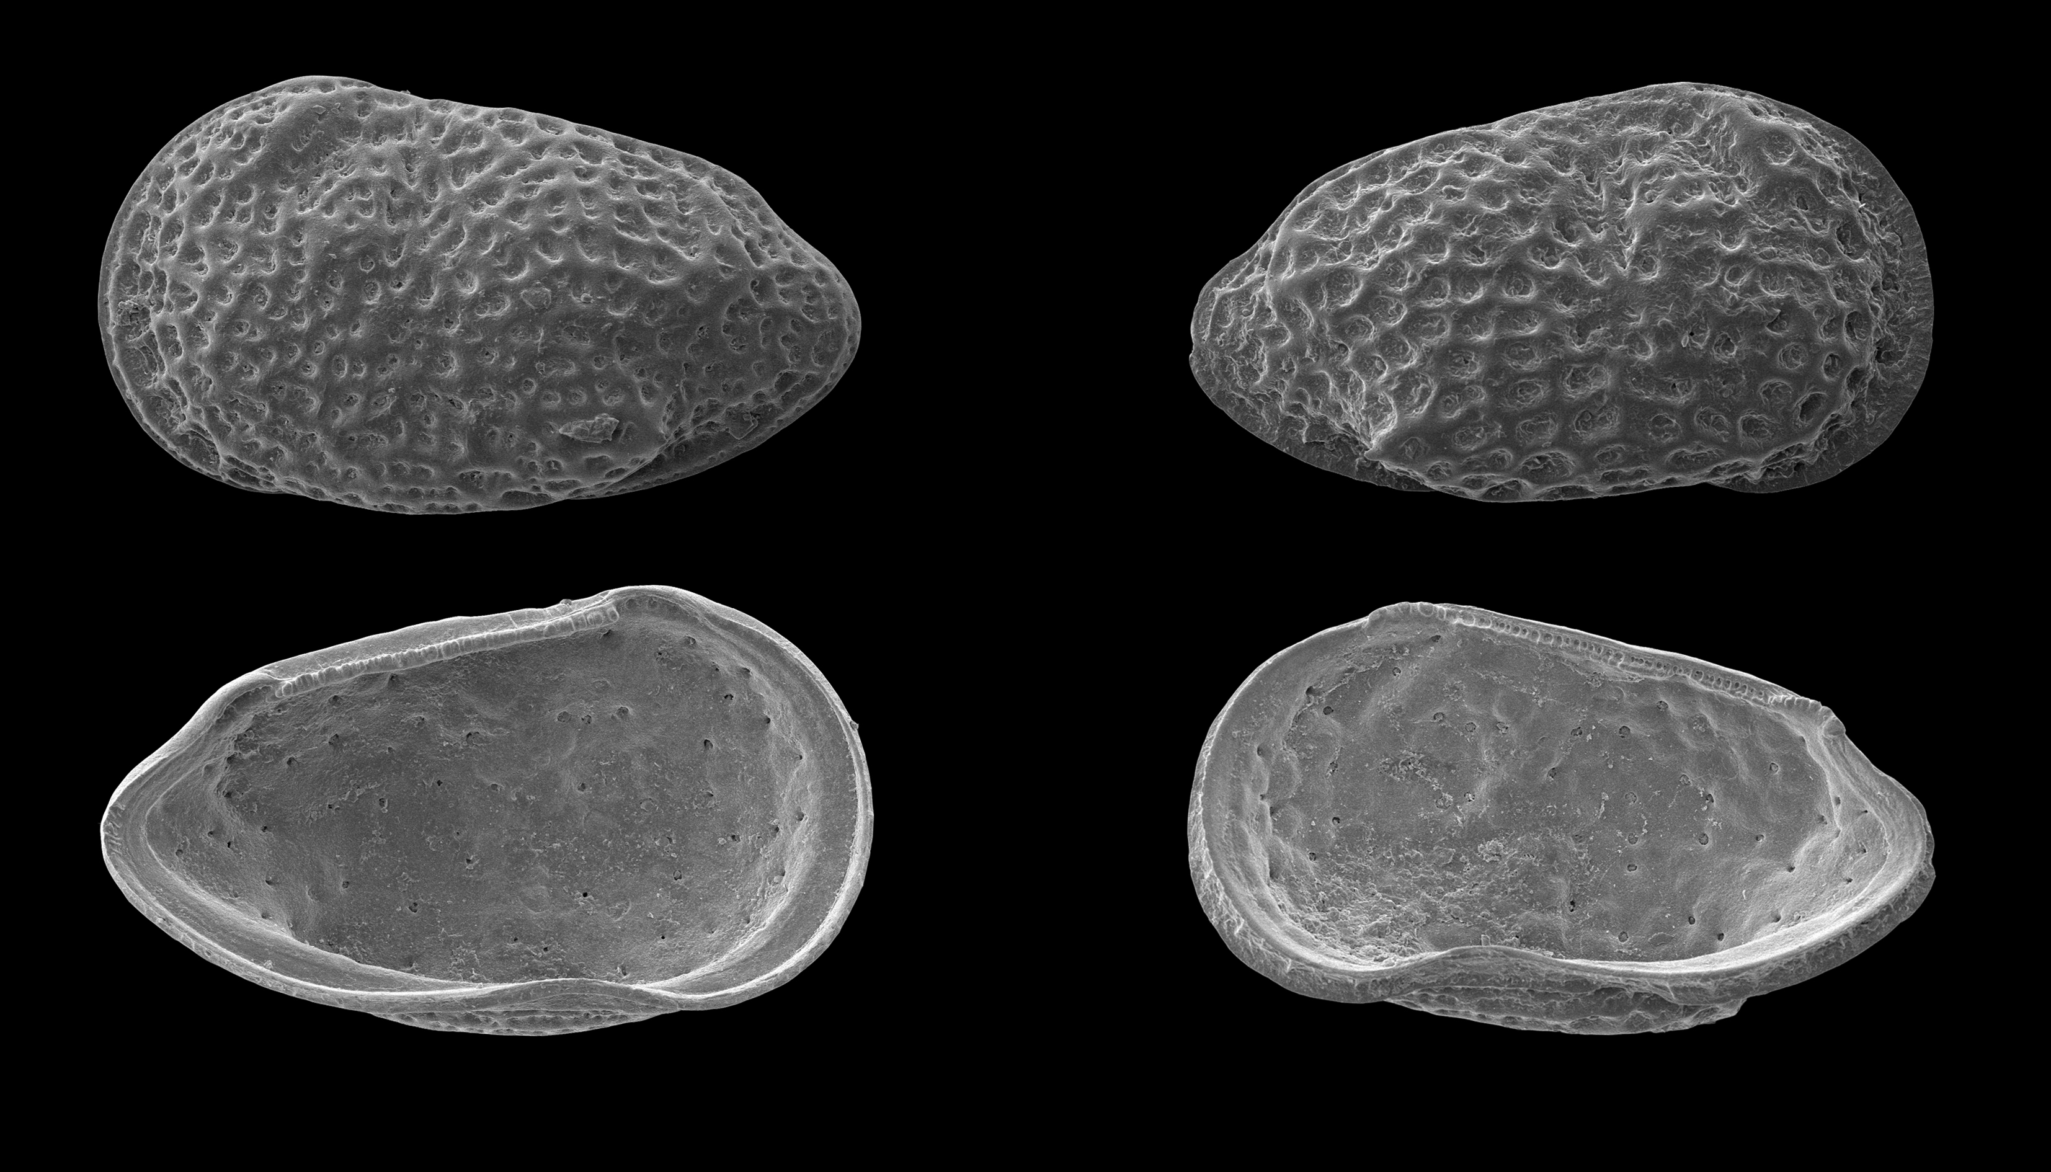
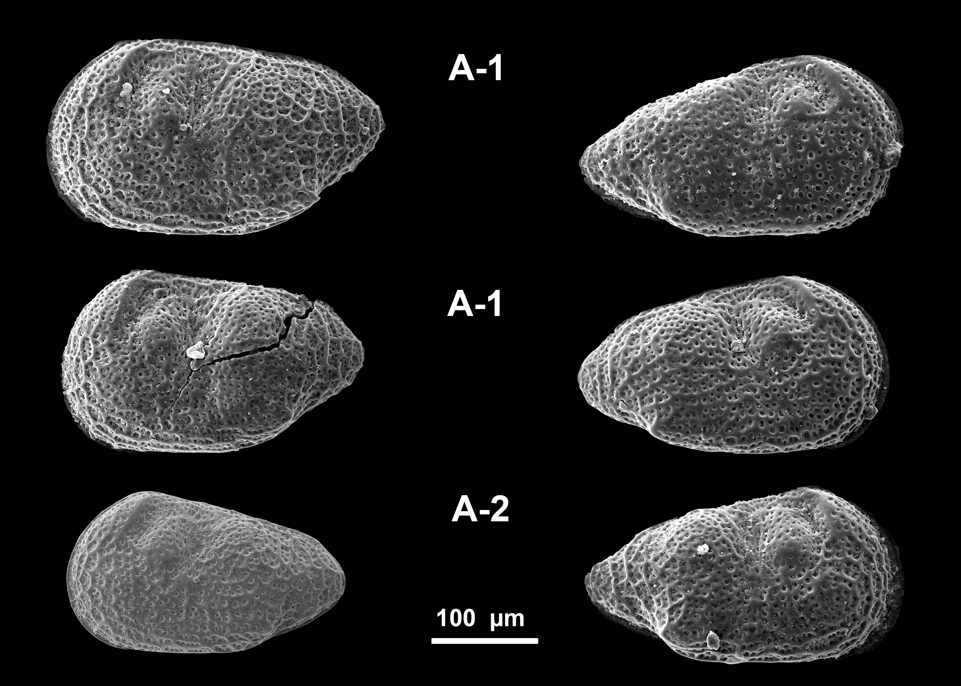
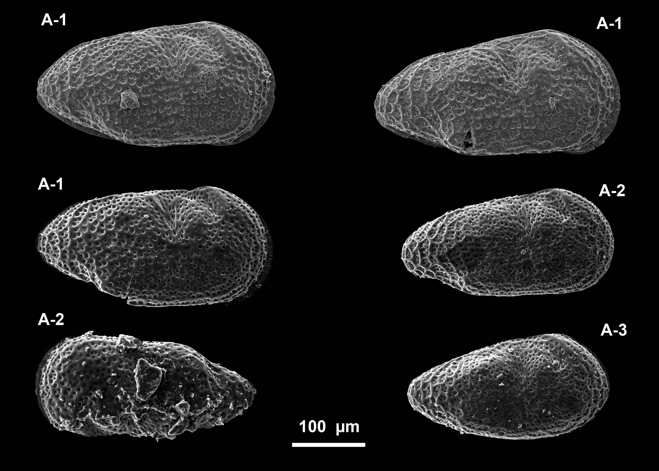
Perissocytheridea sp.1
(Boca Napo)
♂
♀
♀
♂
♀
♂
♀
♀
♀︎
Proto-female
Proto-male

Slide 9
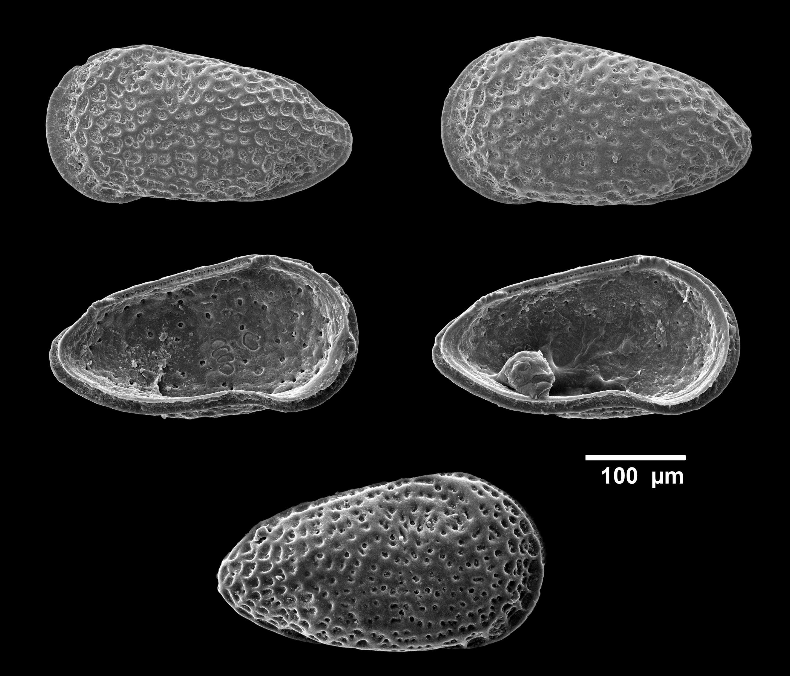
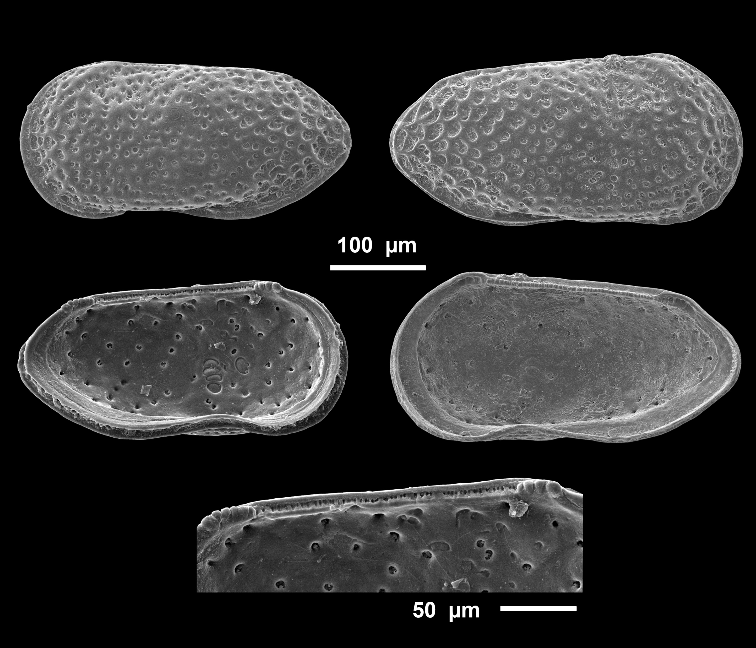

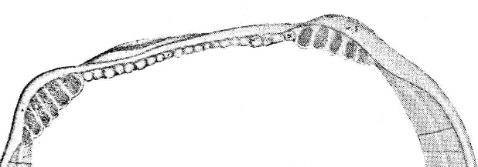
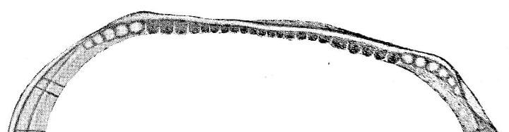
Perissocytheridea sp. 2
(Boca Napo)
♀
♂
♂
♀
♀
♂
♂
Antimerodont hinge
Extracted from Pinto & Pinto de Ornellas, 1970

Slide 10
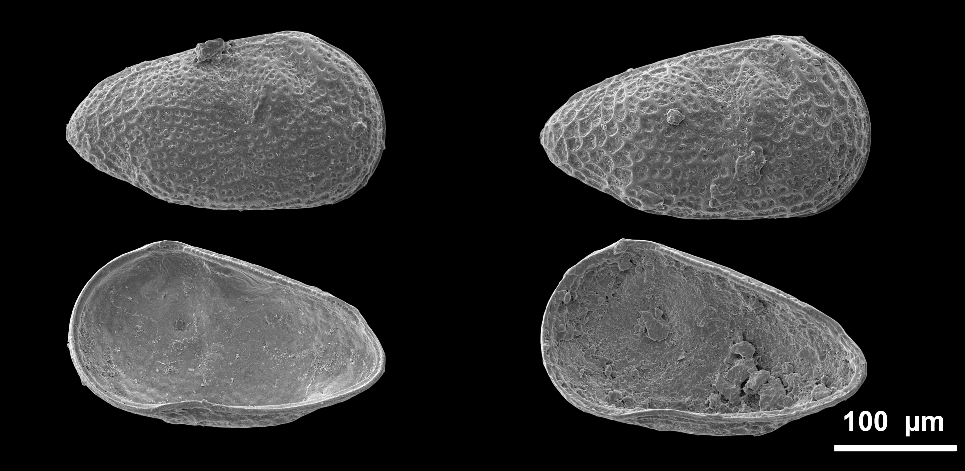
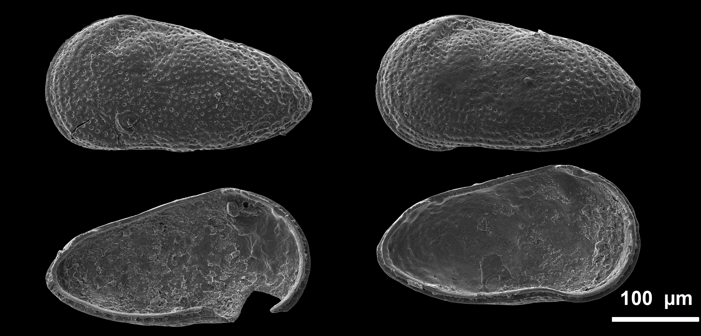
♀
♂
♀
♀
Proto-female
Proto-male
A-1
A-1
A-1

Slide 11
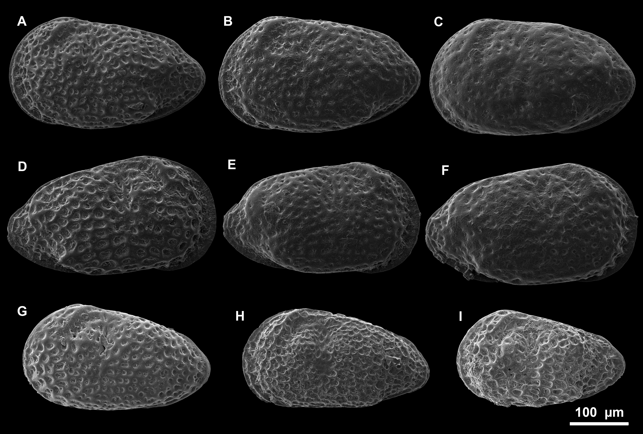
Variablility
Surface ornamentation
Alar process present/absent
Differences in the caudal process
A-F: Perissocytheridea sp. 1 ♀ (Boca Napo). G-H: ?Perissocytheridea sp. 1 ♀ (Puerto Almendras)

Slide 12
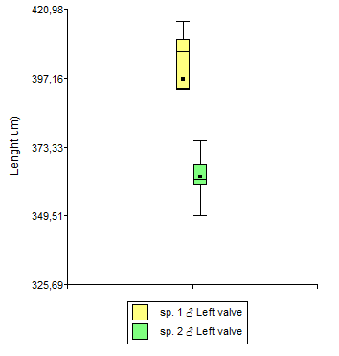
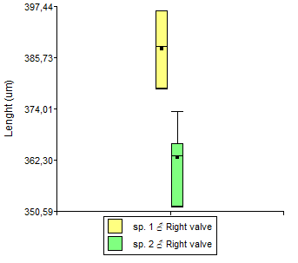
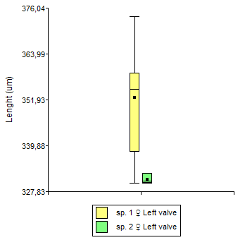
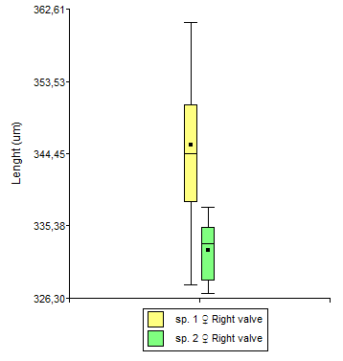
Boca Napo (BN-9)
Comparison in size (lenght) between Perissocytheridea sp.1 and P. sp. 2
n=17
n=13
n=13
n=22

Slide 13
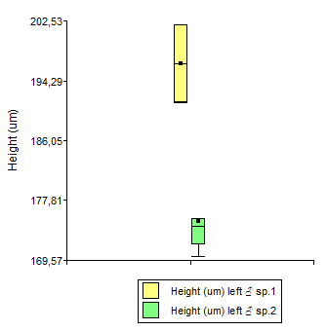
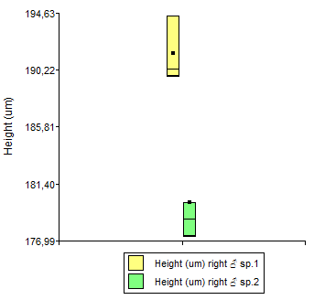
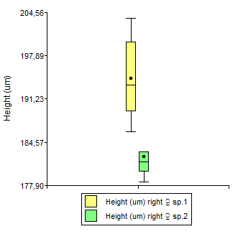
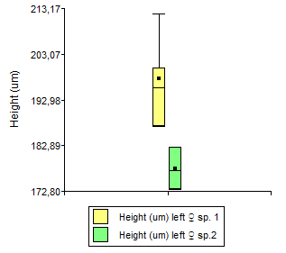
Comparison in size (height) between Perissocytheridea sp.1 and Perissocytheridea sp. 2
n=17
n=13
n=13
n=22

Slide 14
Discussion and conclusions
We identified two different forms of Perissocytheridea from Pebas system (Western Amazonia), which appear to be endemic.
Although there are many records of ‘Pebasian’ ostracods with ‘inverse’ hinges, most of them were documented in Cyprideis. Here, ‘inverse’ Perissocytheridea is reported for the first time.
Both forms (‘invers and normal’) co-occur in Boca Napo (BN4 and BN9) and Santa Teresa (ST-E-6).
These two forms seem to be reproductively separated; they are different in hinge and size.
A kind of premature sexual dimorphism was observed, in the Boca Napo samples (Perissocytheridea sp.1 and Perissocytheridea sp. 2)
Intraspecific variations are observed (ornamentation, alar and caudal process).

Slide 15
Further features remain to be compare (e.g., inner lamella, pores)
So far, chronological trend has not been established.
The presence of these ‘inverse’ forms could explain reproductive isolation and therefore, sympatric speciation, as suggested for the ‘Cyprideis species flock’ (Gross et al. 2014).
The trigger for the occurrence of these ‘inverse’ forms in ‘Pebasian’ ostracods is still unknown.
At this time, we prefer do not to assign to already described species from Pebas system, as potential synonyms are still under study.

