Slide 1
How Much Attention Should We Give to Overshoot Narratives?
Dr. rer. nat. Nadine Mengis

Slide 2
Increasing attention for overshoot pathways
If warming exceeds a specified level such as 1.5°C, it could gradually be reduced again by achieving and sustaining net negative global CO2 emissions. (IPCC, SYR, SPM, B.7)
noteworthy:
(net-)zero CO2 is expected to stabilise GMSAT under decreasing atmospheric CO2 concentrations (MacDougall et al., 2020; Palazzo Corner et al., 2023)
net-zero GHGs already implies net-negative CO2 emissions & is expected to decrease GMSAT (Rogelj et al., 2021)
Source: 10NICS, 2023, Insight 1
Notes:
- where do they come from? - carbon budget overshoot
- net-negative emissions to achieve carbon budget overshoot reversal
- overshoot implies reversibility

Slide 3
Reasons why I think overshoot narratives are dangerous:
Net-negative CO2 emissions are climate interventions
Probably! limited potential for (detectable) climate impact reversal
Overestimation of carbon dioxide removal capacity
Missing governance frameworks to regulate overshoots
Mitigation deterrence is real!

Slide 4
1) Net-negative CO2 emissions - CDR gone Climate Intervention
IPCC Expert Meeting Report on Geoengineering, 2012: “Geoengineering refers to a broad set of methods and technologies that aim to deliberately alter the climate system in order to alleviate the impacts of climate change. […] methods seek to […] increase net carbon sinks from the atmosphere at a scale sufficiently large to alter climate (Carbon Dioxide Removal). Scale and intent are of central importance.”
Notes:
Ok, but let’s pretend that we will be able to reach net-negative CO2 emissions.
Geoengineering refers to a broad set of methods and technologies that aim to deliberately alter the climate system in order to alleviate the impacts of climate change.

Slide 5
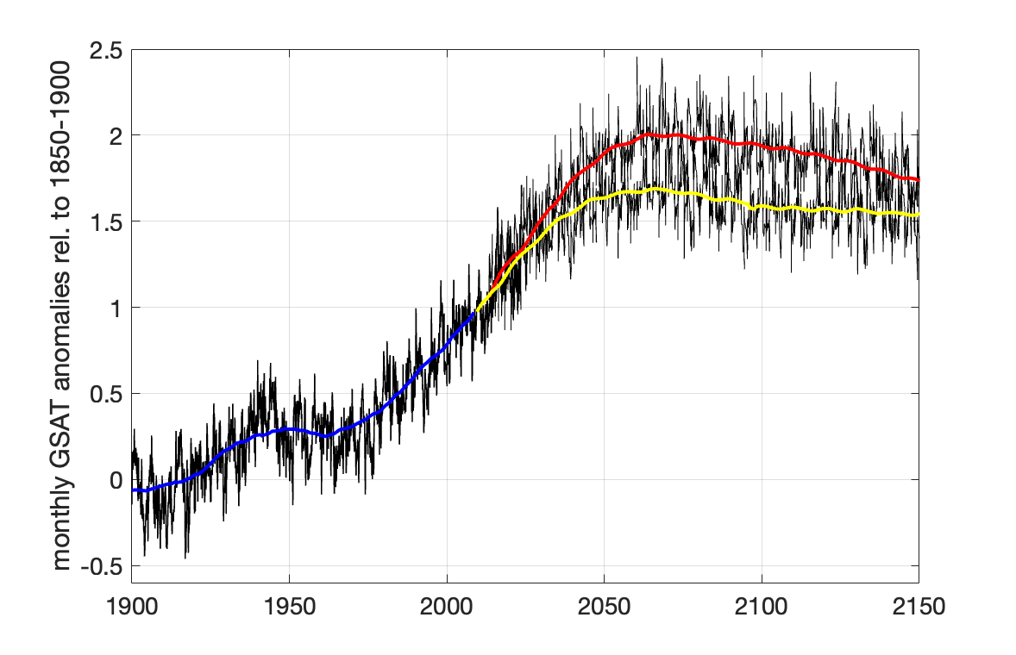
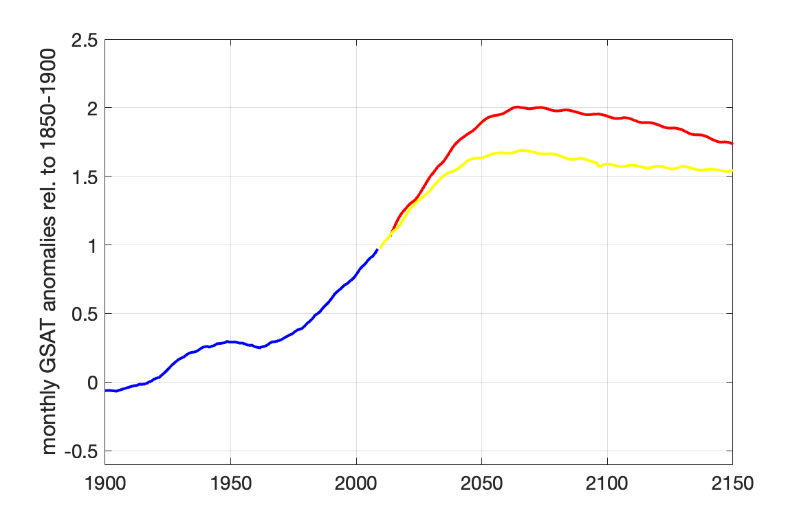
2) Probably! limited potential for (detectable) climate impact reversal
real-world GMSAT is not as smooth as often shown
significant difference between overshoot and non-overshoot will be difficult to assess
cumulative net-negative emissions in 1.5 ºC high overshoot scenarios until 2100: 380 (300, 470) Gt CO2 (IPCC, AR6, WG III, Table 3.6)
T overshoot of ~0.4 ºC => ~880 Gt CO2 cum. net-negative emissions
Notes:
- where do they come from? - carbon budget overshoot
- net-negative emissions to achieve carbon budget overshoot reversal
overshoot implies reversibility

Slide 6
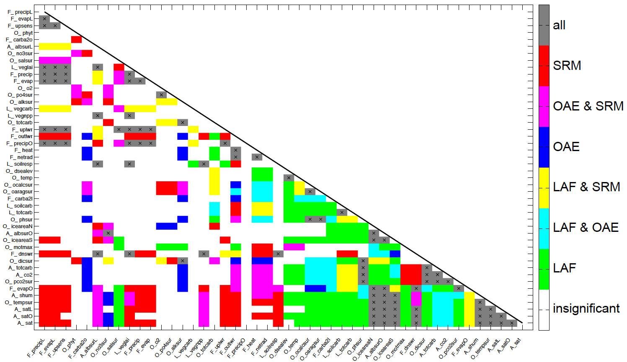
2) Probably! limited potential for (detectable) climate impact reversal
significant difference between overshoot and non-overshoot will be difficult to assess
Existing correlations in the Earth system break down under climate interventions (see also Schleussner et al., 2024, Overconfidence in climate overshoot)
Source: Mengis et al., 2019, Climate engineering–induced changes in correlations between Earth system variables
Notes:
https://doi.org/10.1007/s10584-019-02389-7

Slide 7
Contribution of CDR in 1.5 ºC conform pathways:
3) Overestimation of carbon dioxide removal capacity
cumulative CO2 until 2100 (GtCO2)
total ocean CO2 sink 1850-2022
total CDR
afforestation
BECCS
modified from: IPCC SR15 Figure 2.9

Slide 8
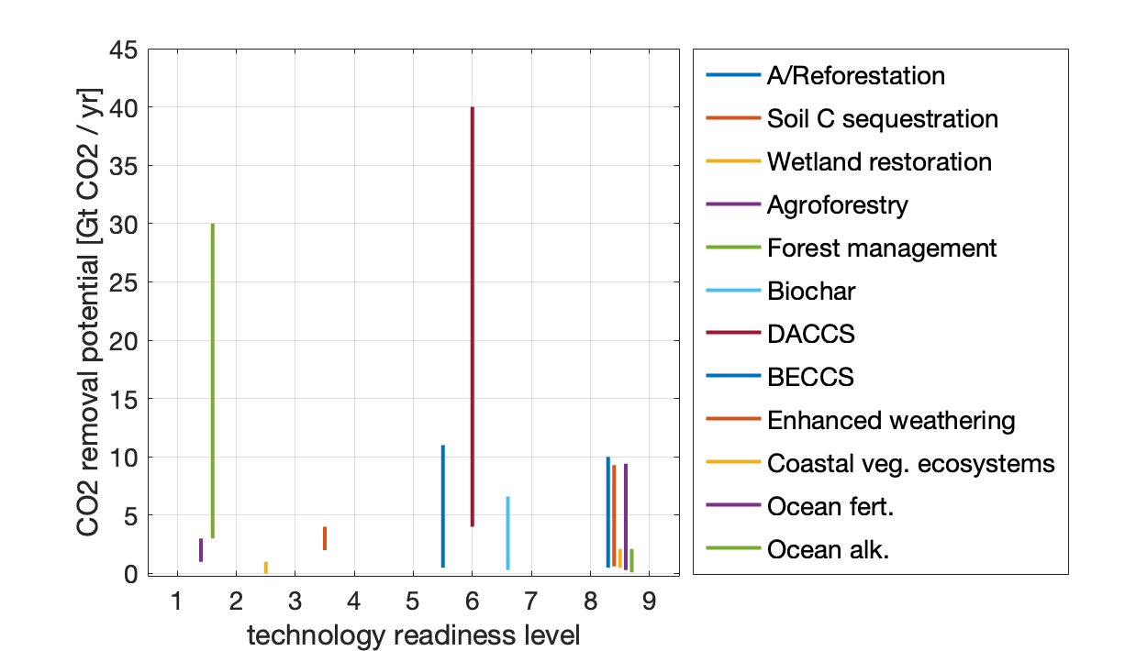
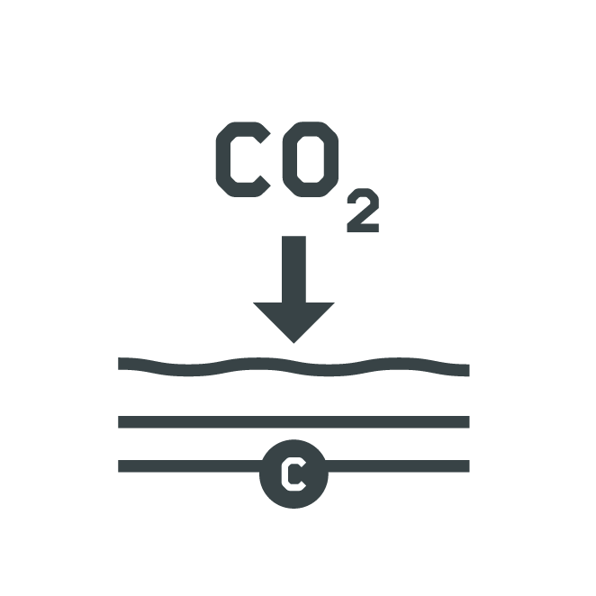
3) Overestimation of carbon dioxide removal capacity
Data source: IPCC, AR6, Cross-sectoral Perspectives, CDR, Table 12.6
requires geological CO2 storage
energy demanding
biomass-competition
area competition
Notes:
sum of global potential 15 - 130 Gt CO2 (40 of which from DACCS; 30 of which from OAE)
40 Gt CO2 DACCS with 1.8 TWh / 1 Mt CO2 would be 72.000 TWh (2.5x global electricity consumption)
30 Gt CO2 OAE with 1.53 TWh / 1 Mt CO2 would be 45.900 TWh (1.6x global electricity consumption)
Total global renewable electricity generation: ~8,500 TWh/year IEA projection for RE energy from wind+solar by 2050 ~ ~55,000 TWh/year

Slide 9
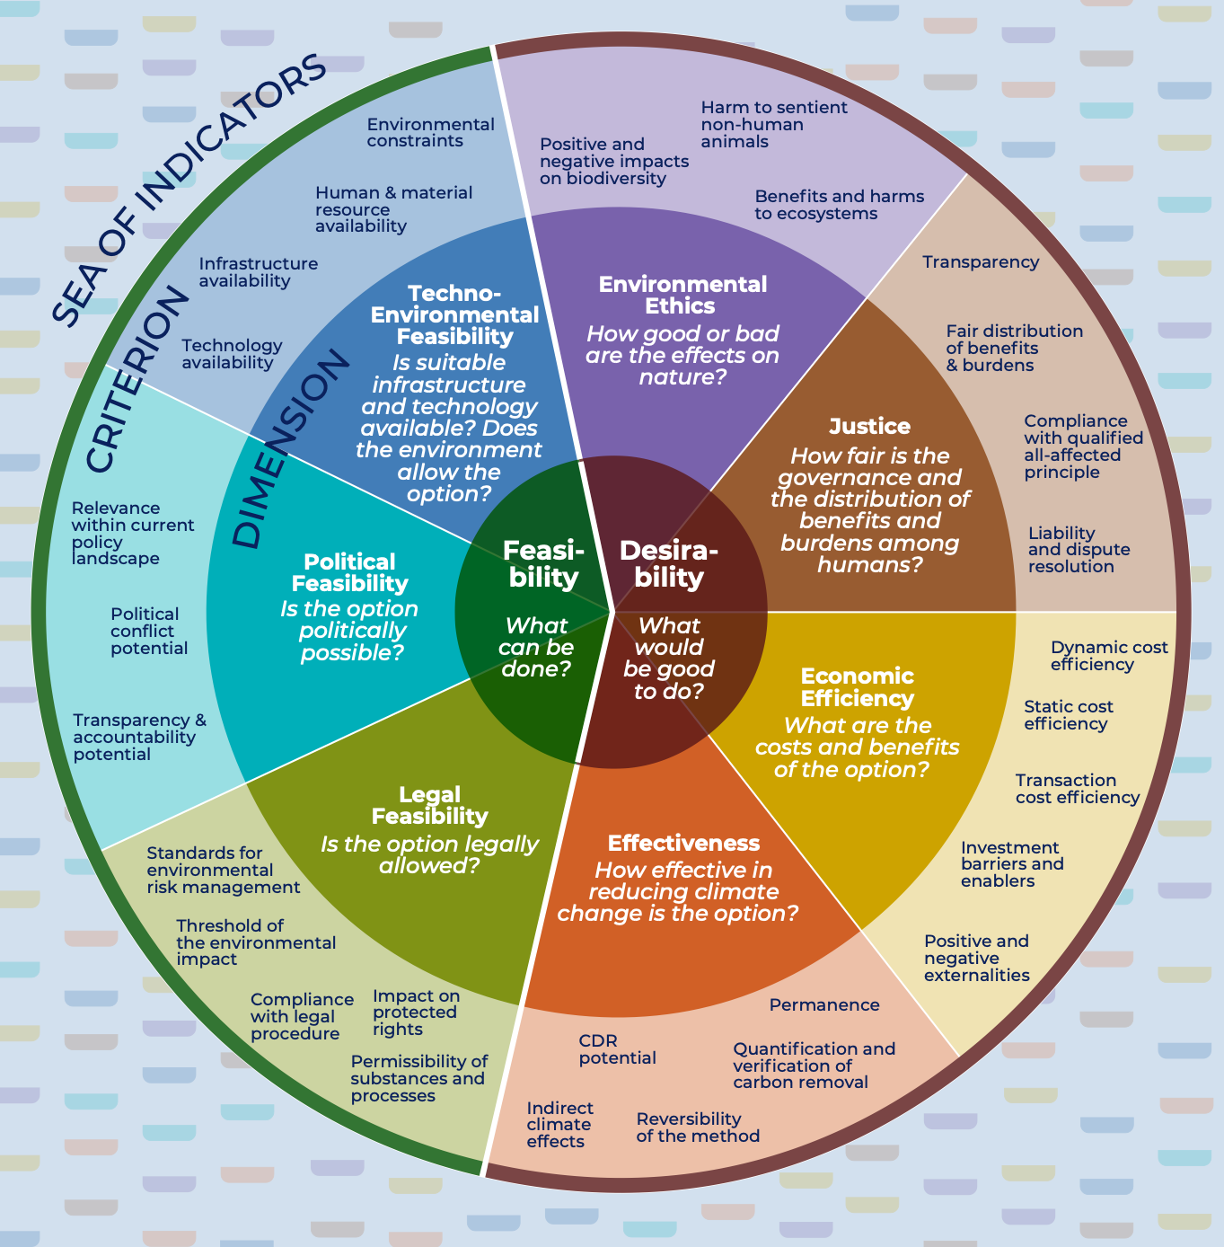
3) Overestimation of carbon dioxide removal capacity
… in need of comprehensive, context-specific & transparent assessment! (Dean et al., 2021)
Source: Tank et al., (2025) Distinguish between feasibility and desirability when assessing climate response options.
Notes:
feasible CDR capacity ≠ desirable CDR capacity —> intentionality for CDR implementation matters —> 2)

Slide 10
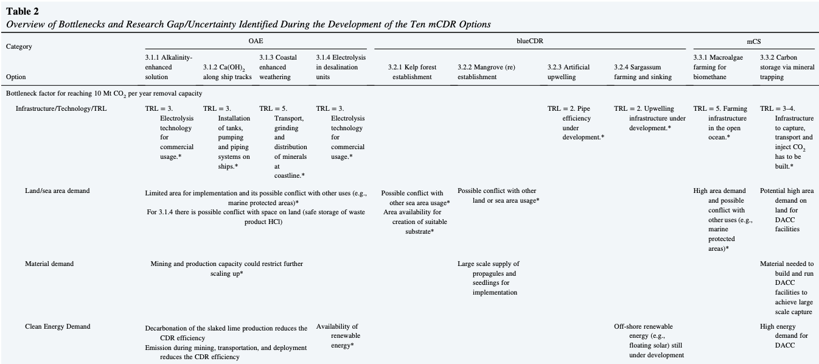
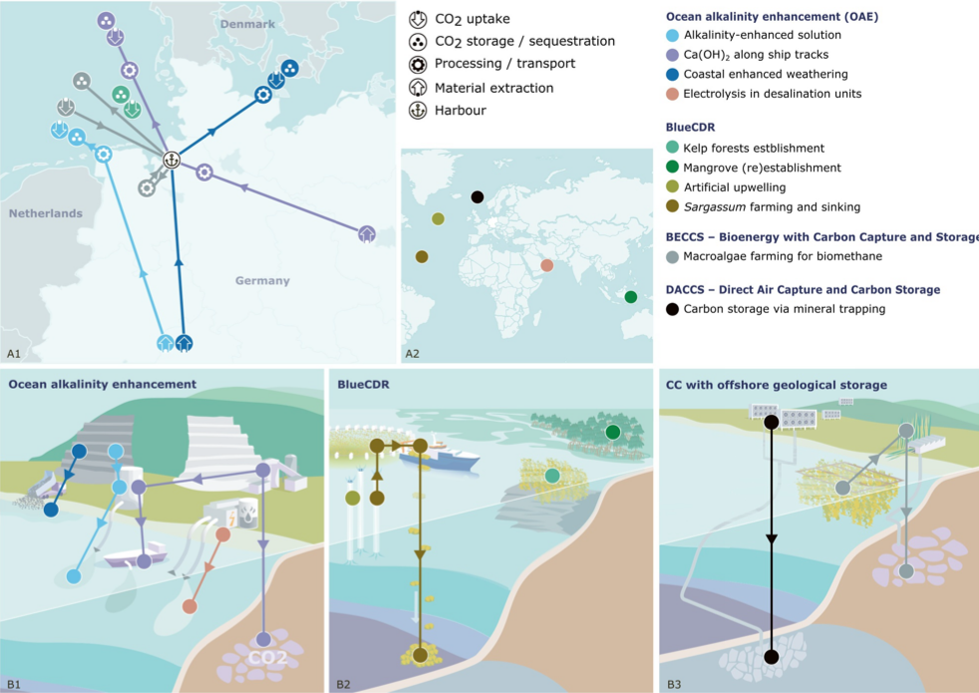
Towards comprehensive, context-specific & transparent assessments
Source: Yao & Morganti, et al. (2025). Exploring site‐specific carbon dioxide removal options with storage or sequestration in the marine environment – the 10 Mt CO2 yr-1 removal challenge for Germany

Slide 11
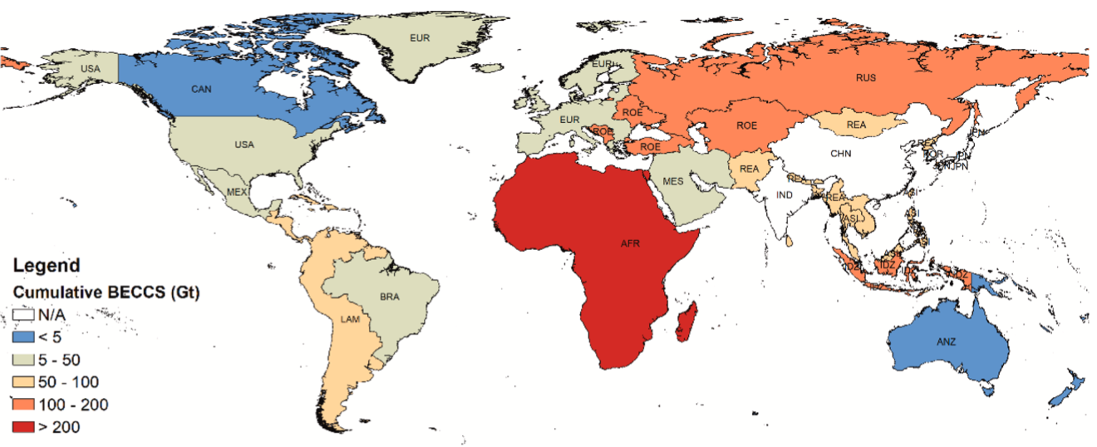
4) Missing governance frameworks to regulate overshoots
“Who decides if and how [net-negative-scale CDR] might ever be used and will benefits be shared evenly?” -> who benefits from CDR and who is carrying the burden ?!
Source: Fajardy et al. (2021) The economics of bioenergy with carbon capture and storage (BECCS) deployment in a 1.5ºC or 2ºC world

Slide 12
4) Missing governance frameworks to regulate overshoots
“Who decides if and how [net-negative-scale CDR] might ever be used and will benefits be shared evenly?” -> who benefits from CDR and who is carrying the burden ?!
“Health, food security, access to water, and prosperity, could all be profoundly affected, with unequal effects between countries and regions" -> net-negative-scale CDR will bring about its own impacts
“[net-negative-scale CDR] could introduce new geopolitical tensions” -> different interests wrt to climate change/level of global warming, implementation of CDR/land-use for CDR, etc. -> who decides if and how [net-negative-scale CDR] is terminated and what is the target atmospheric CO2 level?
modified from: The governance challenges of climate interventions, Center for future generations

Slide 13
5) Mitigation deterrence is real!
The Earth does not know or understand debt-repayment concepts & we do not know the interest rates (Mengis 2024)

Slide 14
Conclusion
insufficient understanding of the reversibility of the climate system #wedontknowtheinterestrates
unknown climate-carbon feedbacks challenges targeted manipulation of atmospheric CO2 concentration #humanhybris
global CDR potentials are meaning-less and need to be re-assessed #down2EarthwithCDR
net-negative CO2 emissions are climate interventions that would need to be governed #ClimateGovernance #ClimateInterventionGovernance
overshoot narratives cause delay/reduced ambition in near term mitigation #mitigationdeterrenceisreal
Notes:
we do not have a good understanding of the reversibility of the climate system - not enough studies or model intercomparisons - are models made for this question?
we will likely not be able to manipulate the atmospheric CO2 concentration as we wish - unknown carbon cycle dynamics + net-zero already causes a reduction in atmospheric CO2 concentrations
I am unsure in how far we would be able to detect significant changes in overshoot

Slide 15
Questions? Answers? Comments?
How Much Attention Should We Give to Overshoot Narratives?
Dr. rer. nat. Nadine Mengis
contact:
nmengis@geomar.de www.geomar.de/nmengis

Slide 16
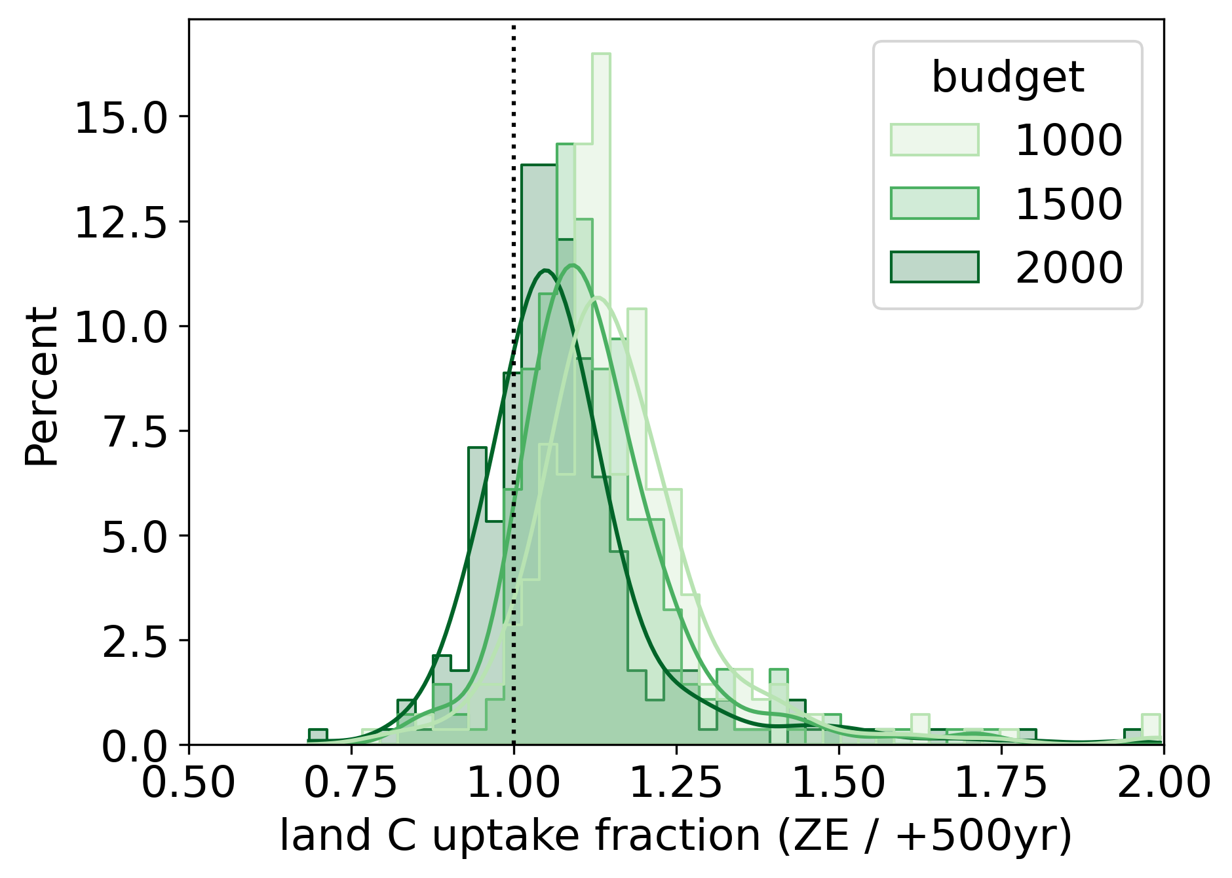
1) Probably! limited potential for (detectable) climate impact reversal
significant difference between overshoot and non-overshoot will be difficult to assess (see also Schleussner et al., 2024, Overconfidence in climate overshoot)
atmospheric CO2 concentration is already going down in net-zero scenarios, with unknown/complex climate-carbon cycle feedbacks
from Hohn et al., EGU General Assembly 2025
Notes:
- where do they come from? - carbon budget overshoot
- net-negative emissions to achieve carbon budget overshoot reversal
- overshoot implies reversibility

Slide 17
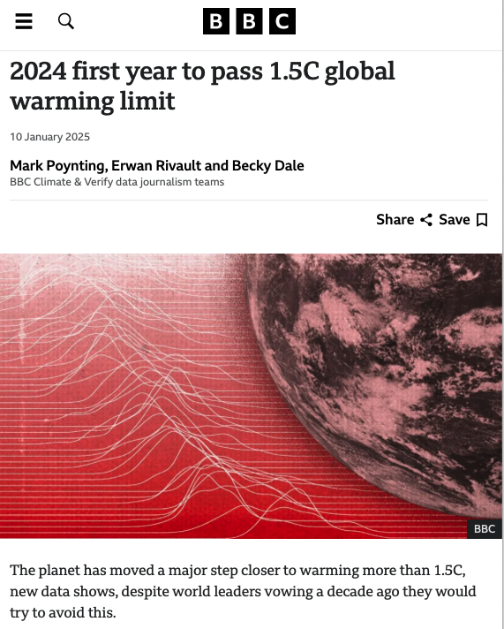
Increasing attention for overshoot pathways
Projected global GHG emissions from NDCs announced prior to COP26 would make it likely that warming will exceed 1.5°C and also make it harder after 2030 to limit warming to below 2°C. (IPCC, AR6, WGIII, 2022, B.6)
2023
Notes:
what are overshoots narratives?
- why are they becoming increasingly talked about ~ 1.5 ºC

Slide 18
1) Overestimation of carbon dioxide removal capacity
CDR/net negative emissions in 1.5 ºC high overshoot scenarios
SR1.5 - removals through BECCS by 2100: 14.9 (16.3,12.1) Gt CO2 / yr (IPCC, 2022, Table 2.4)
AR6 - cumulative net-negative emissions in 1.5 ºC high overshoot scenarios until 2100: 380 (300, 470) Gt CO2 (IPCC, AR6, WG III, Table 3.6)
CDR/net negative emissions in 1.5 ºC no/limited overshoot scenarios
SR1.5 - removals through BECCS by 2100: 12.4 (15.0, 6.4) Gt CO2 / yr (IPCC, 2022, Table 2.4)
AR6 - cumulative net-negative emissions until 2100: 220 (70, 430) Gt CO2 (IPCC, AR6, WG III, Table 3.6)
Notes:
1.5 highOS: 14.9 (16.3,12.1) + 2.4 (1.5, 5.0) Gt CO2 / yr [BECCS + AFOLU]
1.5 noOS: 12.4 (15.0, 6.4) + 2.6 (1.3, 4.2) Gt CO2 / yr [BECCS + AFOLU]

Slide 19
1) Overestimation of carbon dioxide removal capacity
CDR option | Tech. readiness | Mitigation potential (GtCO2 yr⁻¹) | carbon storage time scales (years)
A/Reforestation | 8-9 | 0.5-10 | 10-100s
Soil carbon sequestration | 8-9 | 0.6-9.3 | 10-100s
Wetland restoration | 8-9 | 0.5-2.1 | 10-100s
Agroforestry | 8-9 | 0.3-9.4 | 10-100s
Forest management | 8-9 | 0.1-2.1 | 10-100s
Biochar | 6-7 | 0.3-6.6 | 10-100s
DACCS | 6 | 4-40 | >10.000
BECCS | 5-6 | 0.5-11 | >10.000
Enhanced weathering | 3-4 | 2-4 | >10.000
Coastal vegetated ecosystems | 2-3 | <1 | 10-100s
Ocean fertilisation | 1-2 | 1-3 | 100-1000s
Ocean alkalinisation | 1-2 | 1-100 3-30 | >10.000
Source: IPCC, AR6, Cross-sectoral Perspectives, CDR, Table 12.6
Notes:
sum of global potential 15 - 130 Gt CO2 (40 of which from DACCS; 30 of which from OAE)

Slide 20
1) Overestimation of carbon dioxide removal capacity
Mt CO2 / year
~
~
80
DACCS: HVAC
DACCS: central
CO2 removal potential per year in 2050
60
required amount of negative emission
requires geological CO2 storage
energy demanding
biomass-competition
area competition
enh. terr. weathering
40
BECCS: Pyrolysis
BECCS: Biomasse-CHP
BECCS: Biogas-CHP
20
seagrasses
cover crops
peatlands
crop rotation
reforestation
ecosystem-based & currently in KSG
ecosystem-based
biological + chemical CO2 capture
chemical CO2 capture
Modified from: Netto-Null-2050 Cluster I der Helmholtz-Klima-Initiative, “Netto-Null-2050 Wegweiser - Strategische Handlungsempfehlungen und mögliche Wege für ein CO₂-neutrales Deutschland bis 2050”, 2023

