Slide 1


Climate change impacts on the hydropower potential for the small-scale Pungwe B hydropower scheme in Zimbabwe using a multi-model climate ensemble
FACULTY OF ENGINEERING AND THE BUILT ENVIRONMENT
DEPARTMENT OF CONSTRUCTION AND CIVIL NGINEERING
Moreblessing Muzava
Supervisors
Dr. A. Mhizha
Mr. D. T. Rwasoka

Slide 2


Presentation outline
Introduction (background)
Knowledge gap
Study area and Methodology
Presentation of findings
Conclusion and recommendations
References
Acknowledgement

Slide 3

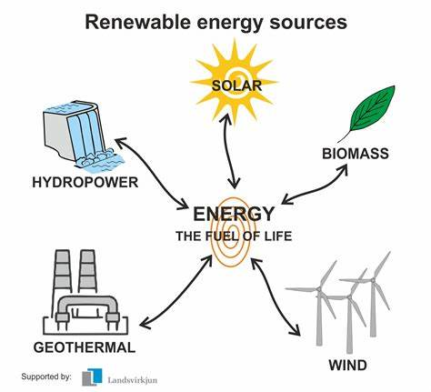

Introduction: Background of study
Climate change, energy security, and electricity access are pressing global issues (Cevik, 2022; Tansel Tugcu and Menegaki, 2024).
Rising temperatures and erratic precipitation patterns may impact:
    ‣ Hydropower generation potential for small schemes
    ‣ Economic viability of small-scale hydropower projects
Most planned projects rarely account for potential climate change impacts
Notes:
Climate change, energy security, and electricity access are pressing global issues.
Approximately 1 billion people worldwide lack access to electricity, with over 620 million in Sub-Saharan Africa alone.
The energy sector is responsible for about two-thirds of global greenhouse gas emissions.
The transition to clean energy relies on solar, wind, and hydropower.
Africa is vulnerable to climate change, with rising temperatures and increased precipitation variability.
Sub-Saharan Africa has experienced significant warming and erratic rainfall patterns.
Climate change impacts will affect all phases of electricity systems, including fuel supply, generation, transmission, distribution, and demand.
Changes in temperature and precipitation patterns will impact hydropower generation, leading to fluctuations in output and water scarcity.
Hydropower is crucial in Africa's energy system, providing approximately 17% of the continent's electricity.
Zimbabwe has significant hydropower potential, but most planned projects rarely account for potential climate consequences.
Small-scale hydroelectric power is critical in addressing energy challenges and fostering sustainable growth.
Small hydropower plants offer a reliable and resilient source of clean energy that can adapt to changing rainfall patterns and water availability.
Climate and hydrological models are essential tools for evaluating climate change's effects on hydroelectric power.
Regional climate models and hydrological models can refine global projections and provide local-level insights.
Process-based, conceptual, and machine-learning models can simulate hydrological processes and predict future responses to climate change.
Coupling climate and hydrological models provides crucial information for determining how hydropower production is affected by climate change.- Assessing climate change impacts on hydroelectric power is essential for sustainable energy strategies, mitigation, and adaptation.
Strategies may include diversifying energy sources, improving water management practices, and upgrading infrastructure.
Understanding potential changes in water resource availability and generation capacity can inform decisions about future investments and infrastructure development.- Small hydropower plants play a crucial role in Zimbabwe's energy landscape, contributing to economic growth and mitigating climate change impacts.- Careful planning and implementation are necessary to ensure a sustainable energy future for Zimbabwe and the wider African continent.

Slide 4


Knowledge Gap
  Quantification of climate change impacts on hydropower potential in Eastern Zimbabwe
Notes:
Southern Africa is projected to experience reduced precipitation amounts and increasing temperatures for the rest of the 21st century. The rising temperatures and erratic precipitation patterns could impact the hydropower generation potential for small projects. Unfortunately, the impact of climate change trends on hydropower generation potential in Eastern Zimbabwe has not been quantified and this is stopping small-scale hydro-project develop climate change adaptation strategies. Therefore, this study seeks to quantify climate change's impacts on the Pungwe River streamflow and quantify the hydropower potential of small hydropower plants like Pungwe B Hydro.

Slide 5
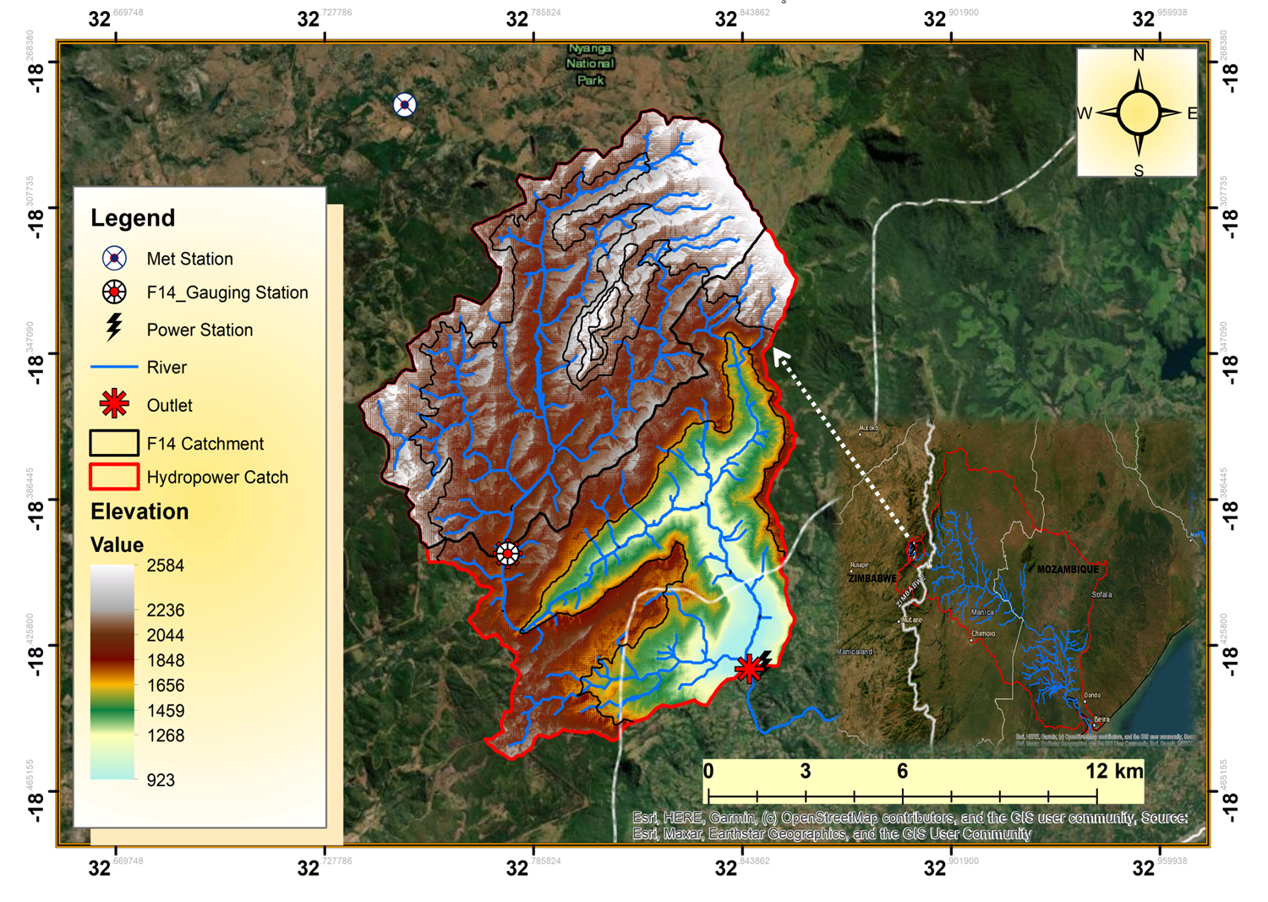
Study Area

Slide 6
Pungwe B Hydropower station
Name | Pungwe B Hydroelectric Power Station
River | Pungwe River, Honde Valley
Installed capacity | 15 MW
Head | 181 metres
Canal length | 2300 m
Canal flow rate | 12m³/s
Penstock size | 4 x 1,200mm diameter
Penstock length | 1,200m
Type | Run-off-river hydropower

Slide 7
Methods
Methods by objectives
Downscaling of the fifteen GCMs
Model Setup, Calibration and Validation
Pt Quantification

Slide 8
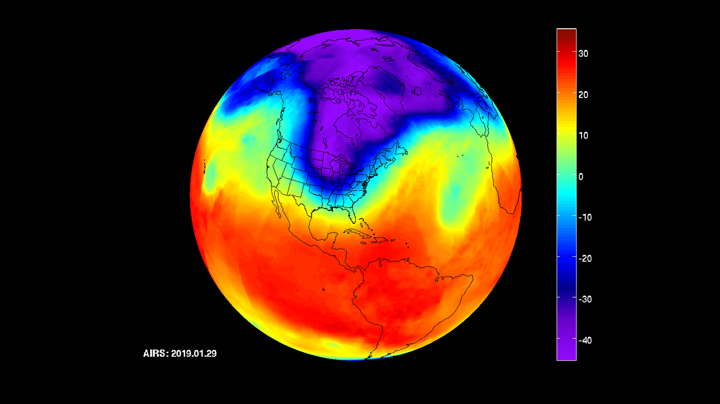
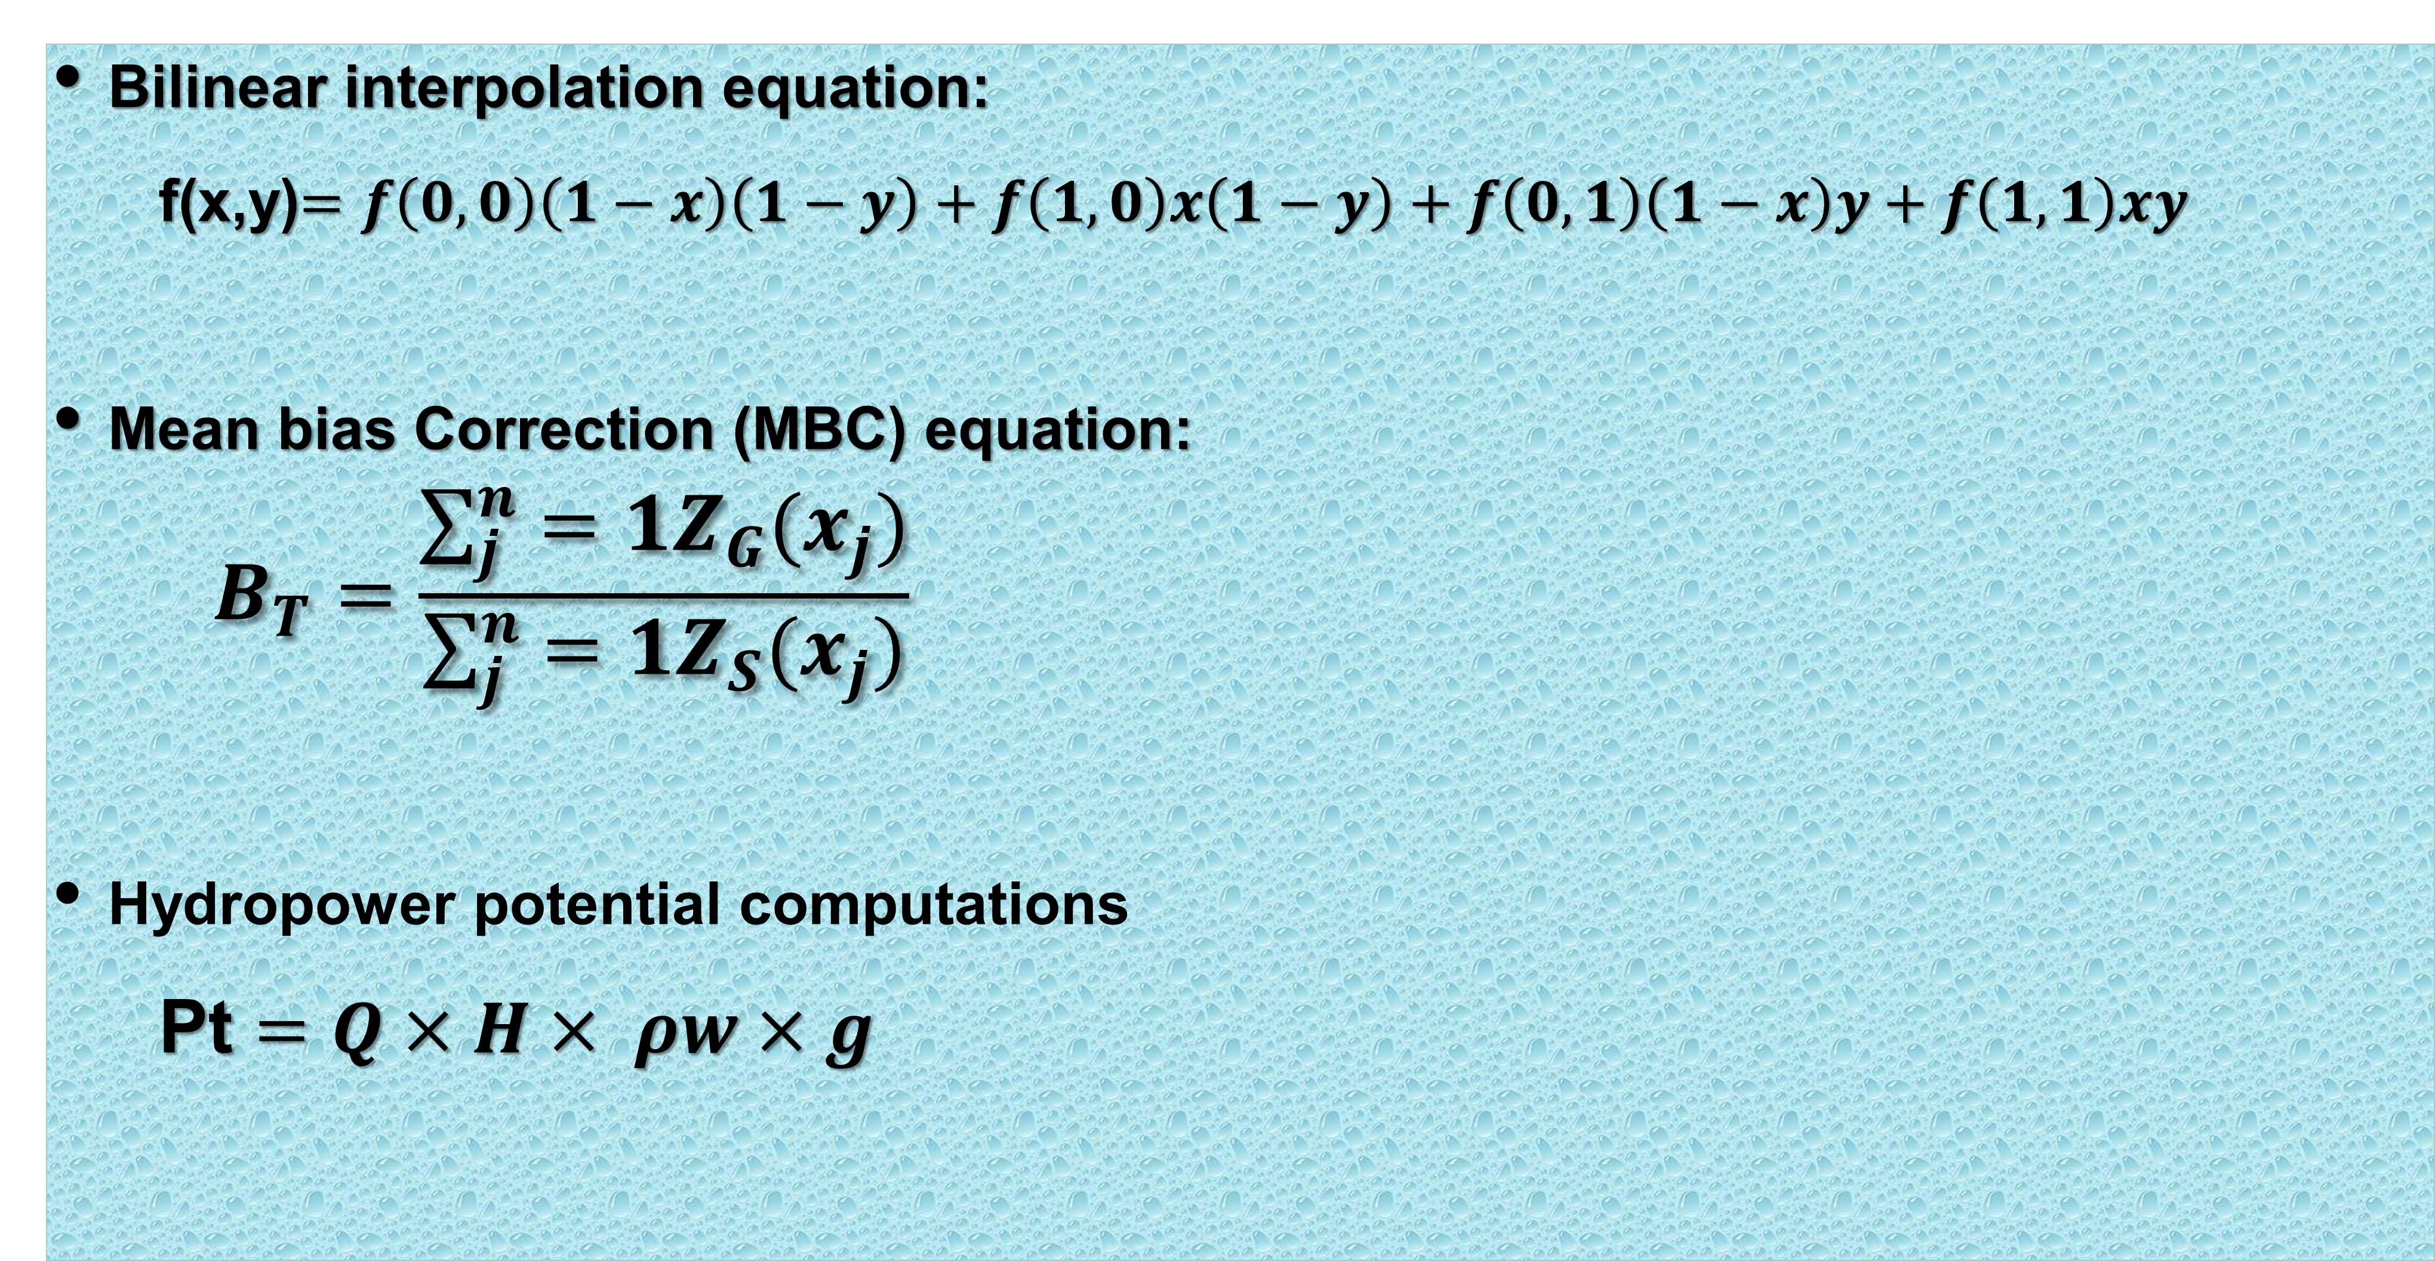
Methods
  Bilinear interpolation equation:
      f(x,y)$=f\left(0,0\right)\left(1−x\right)\left(1−y\right)+f\left(1,0\right)x\left(1−y\right)+f\left(0,1\right)\left(1−x\right)y+f\left(1,1\right)xy$
  Mean bias Correction (MBC) equation:
      $$B_{T}=\frac{\sum_{j}^{n}{=1Z_{G}(x_{j})}}{\sum_{j}^{n}{=1Z_{S}(x_{j})}}$$
  Hydropower potential computations
    Pt $=Q×H× ρw×g$

Slide 9
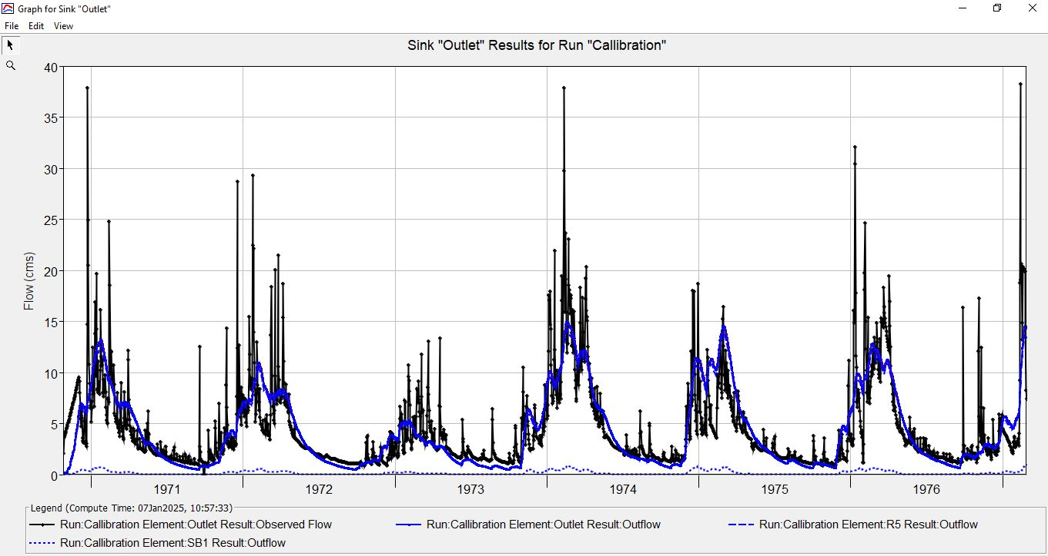
Results :HEC-HMS model Performance
 | Calibration | Validation
Nash-Sutcliffe | 0.52 | 0.42
RMSE Std. Dev | 0.7 | 0.8
Percent Bias (%) | 0.02 | -0.01
R² | 0.66 | 0.53
Notes:
Areal rainfall is a term used in meteorology to describe precipitation in a specific area expressed as an average depth of liquid water over the area. It is calculated on timescales on a storm, seasonal, or annual basis

Slide 10
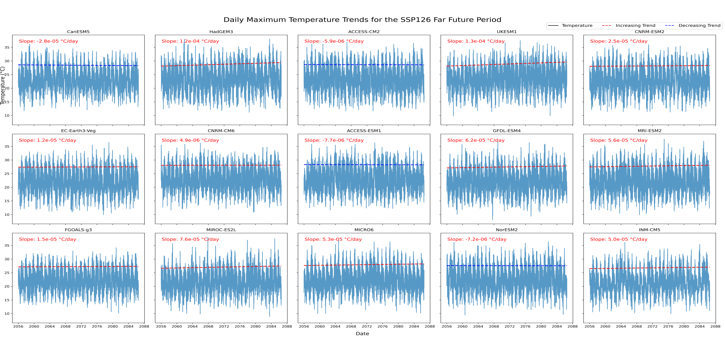
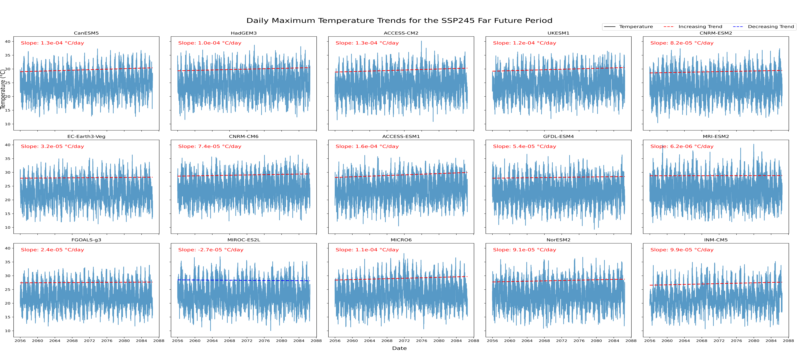
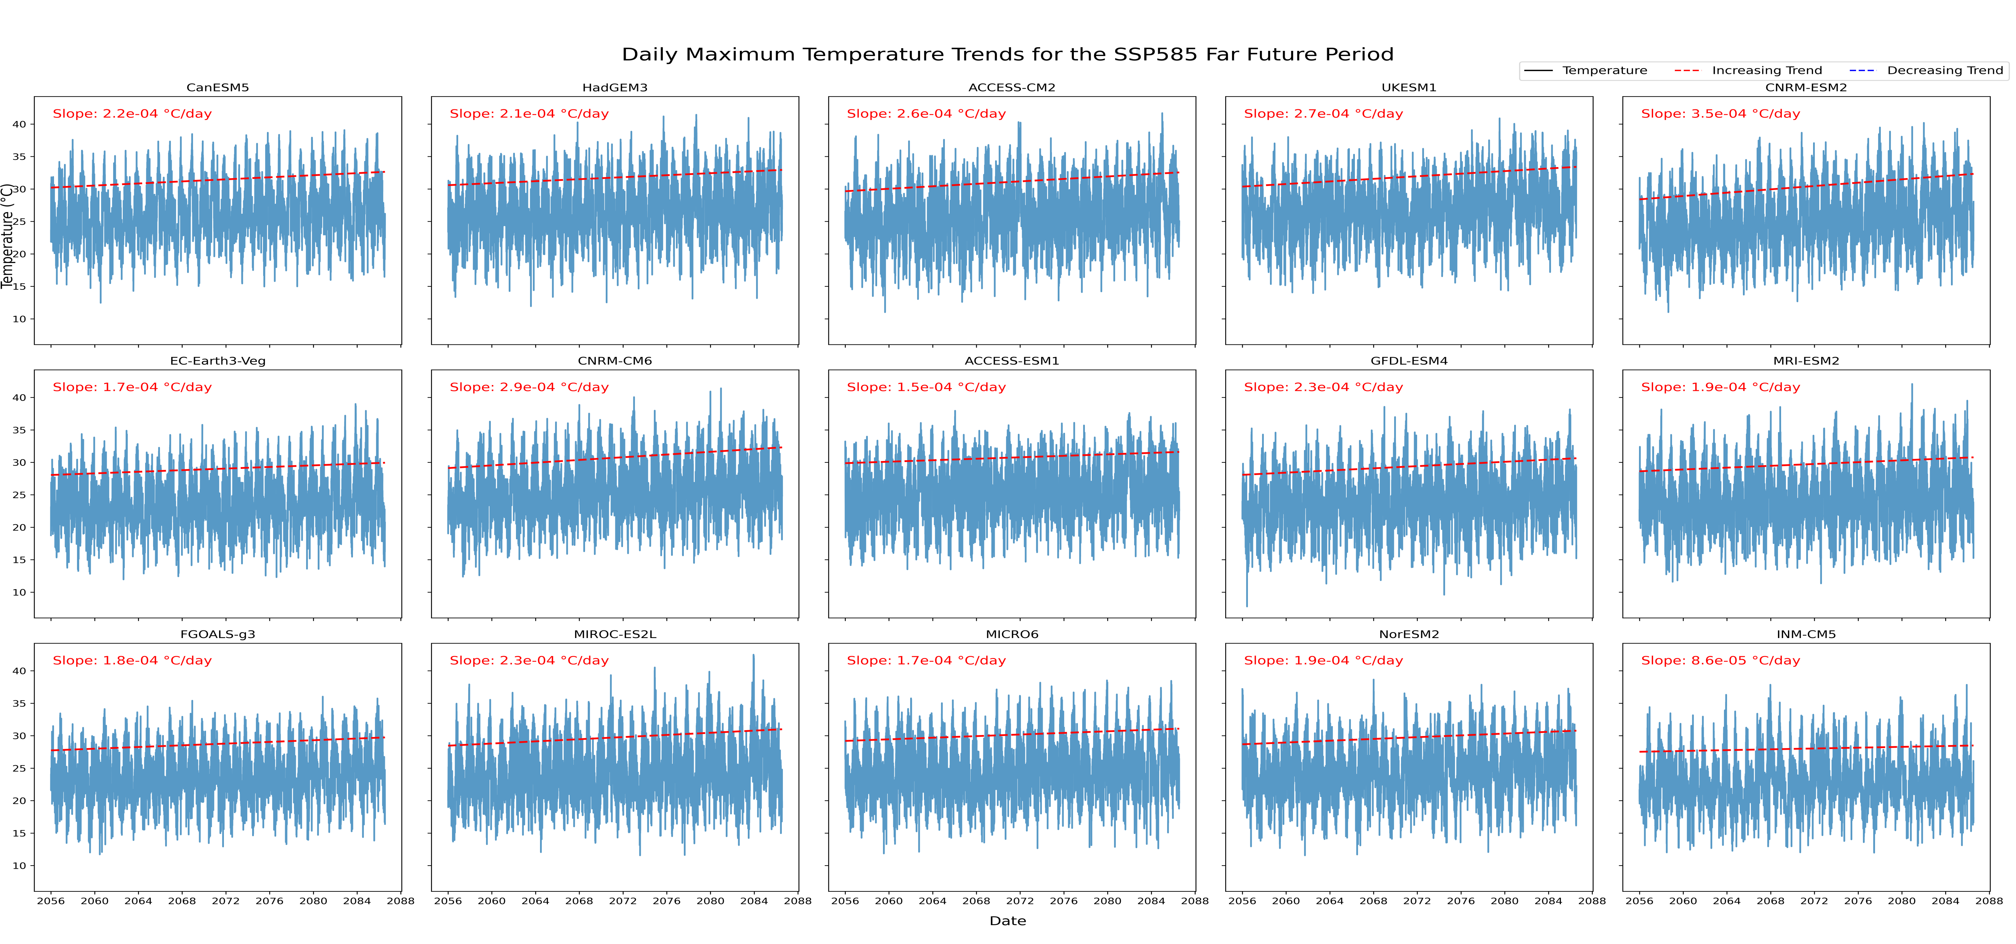
Results : Projections Max Temp. Data Trends
Notes:
Areal rainfall is a term used in meteorology to describe precipitation in a specific area expressed as an average depth of liquid water over the area. It is calculated on timescales on a storm, seasonal, or annual basis

Slide 11
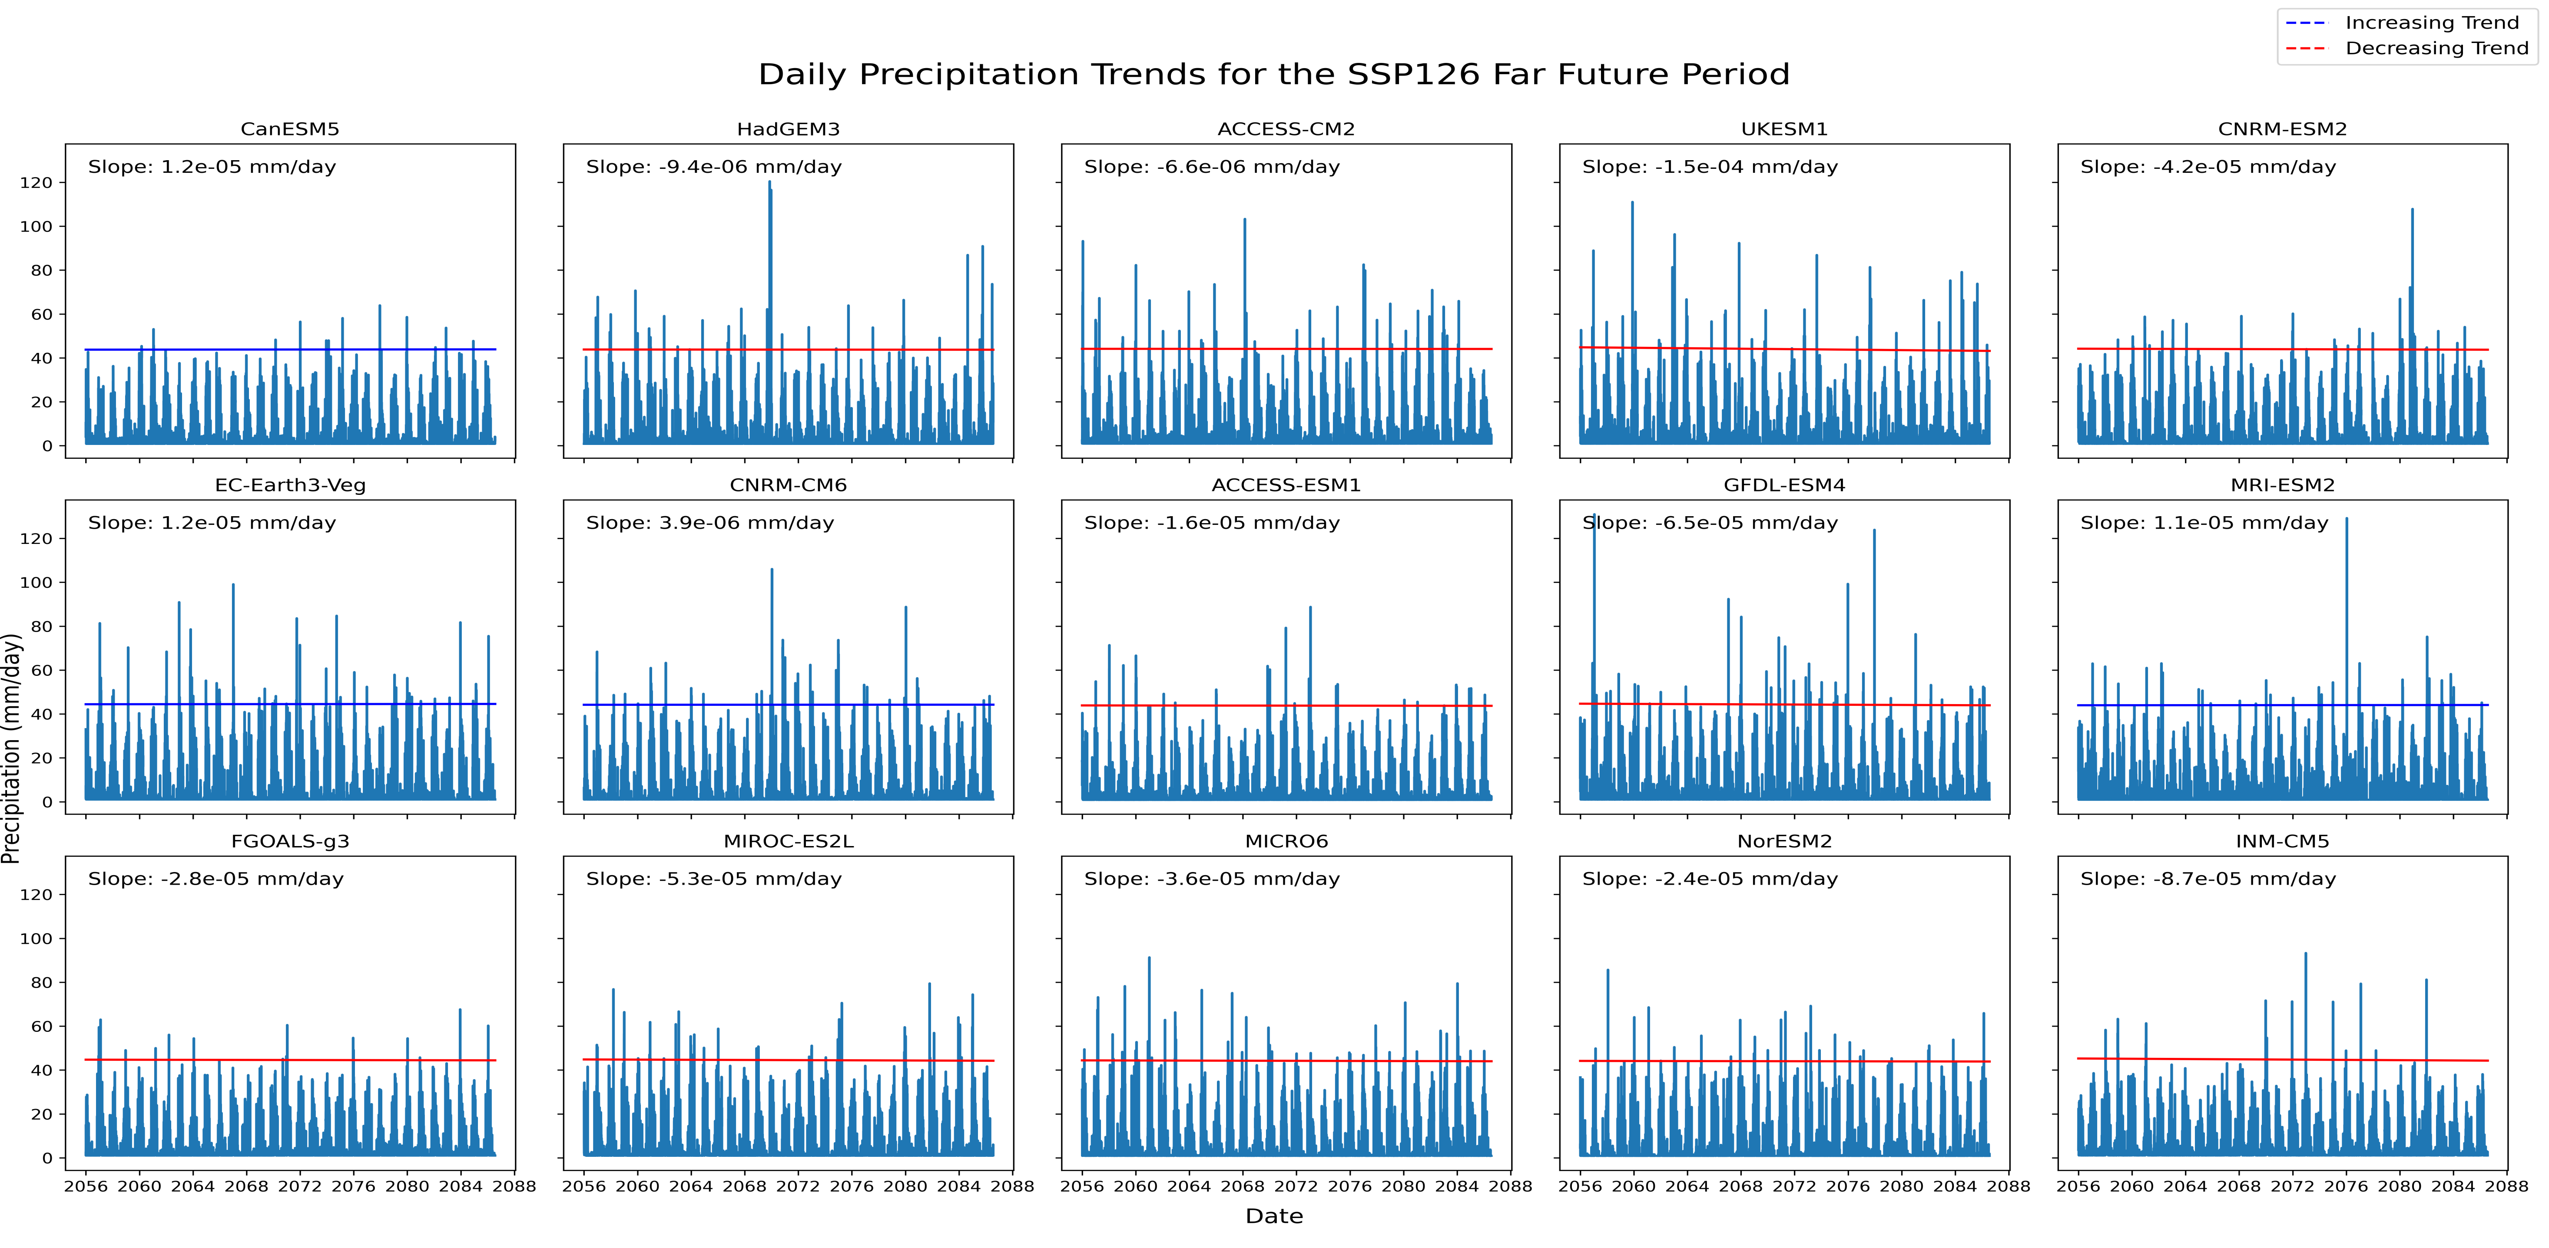
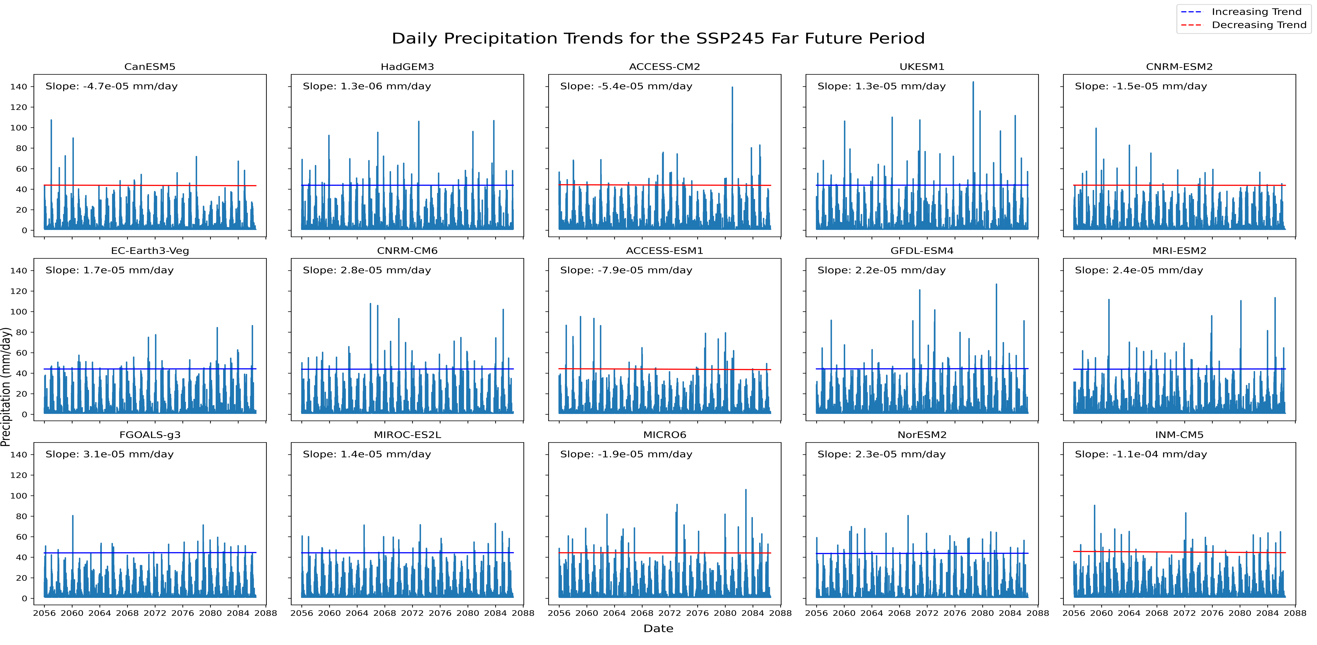
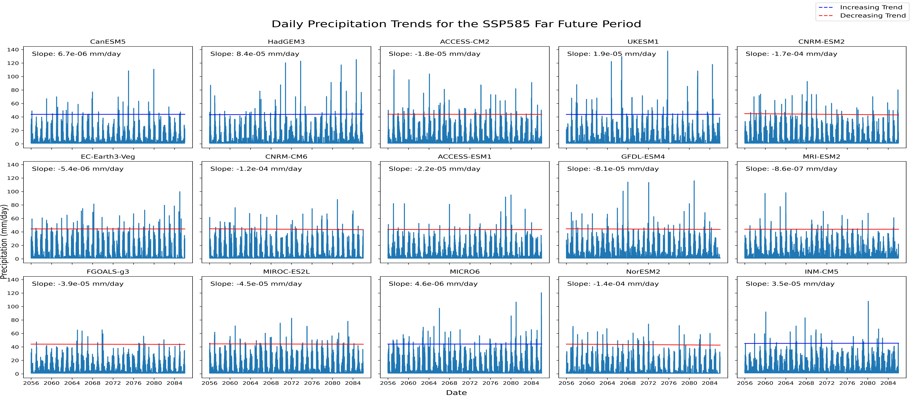
Results : Projections Precipitation Data trends
Notes:
Areal rainfall is a term used in meteorology to describe precipitation in a specific area expressed as an average depth of liquid water over the area. It is calculated on timescales on a storm, seasonal, or annual basis

Slide 12
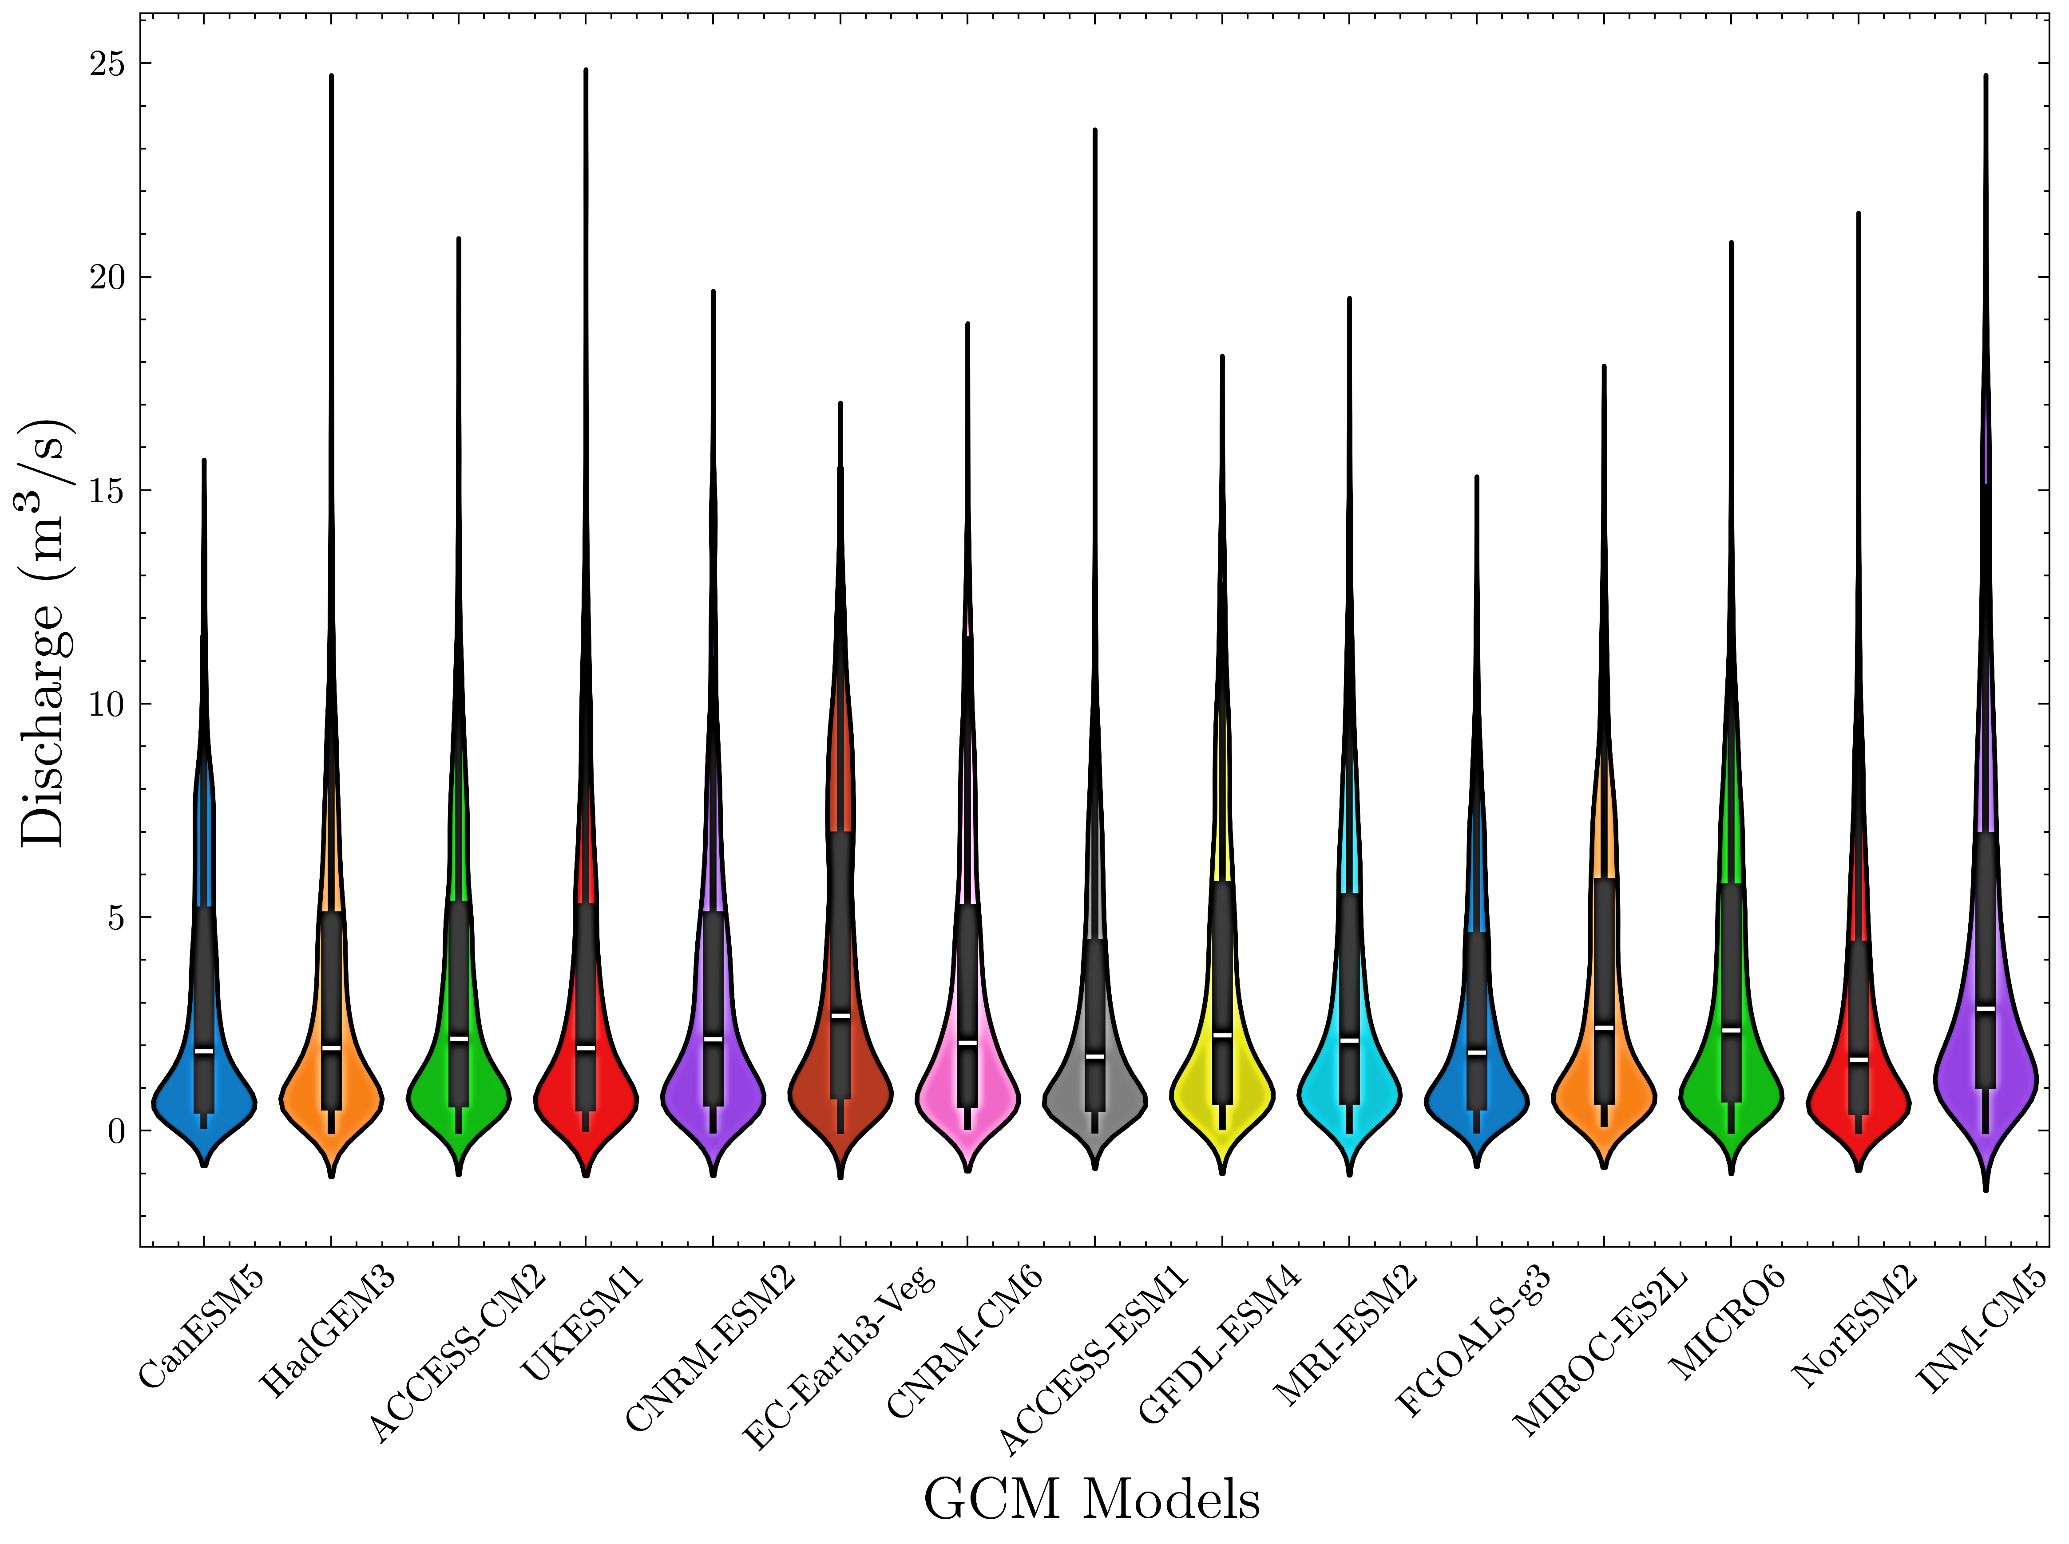
Results : Projections Streamflow Data Distributions
Notes:
Areal rainfall is a term used in meteorology to describe precipitation in a specific area expressed as an average depth of liquid water over the area. It is calculated on timescales on a storm, seasonal, or annual basis

Slide 13
Results : Impacts on Hydropower
Notes:
Areal rainfall is a term used in meteorology to describe precipitation in a specific area expressed as an average depth of liquid water over the area. It is calculated on timescales on a storm, seasonal, or annual basis

Slide 14
Results : Impacts on Pungwe B
Models | Probability of exceeding the Plant’s Daily Maximum Pt (%)
 | Baseline | SSP1-2.6 |  | SSP2-4.5 |  | SSP5-8.5
 |  | MCF | LCF | MCF | LCF | MCF | LCF
CanESM5 | 18.9 | 11.8 | 14.7 | 14.9 | 13.6 | 15.5 | 15
HadGEM3 | 20.9 | 14.7 | 12.8 | 14.7 | 17.4 | 22* | 15.8
ACCESS-CM2 | 23.3 | 19.4 | 18 | 19.2 | 19.1 | 21.1 | 15.8
UKESM1 | 18.9 | 16.1 | 17.2 | 17.2 | 17.2 | 16.1 | 16.7
CNRM-ESM2 | 21.29 | 11.8 | 14.7 | 18.3 | 15.5 | 18 | 17.2
EC-Earth3-Veg | 20.5 | 24.2* | 22.3* | 22* | 20.4 | 23.1* | 26.1*
CNRM-CM6 | 23.3 | 22.3 | 18 | 17.5 | 16.9 | 17.5 | 17.8
ACCESS-ESM1 | 18.1 | 13.2 | 13.4 | 16.3 | 15.3 | 20* | 12.5
GFDL-ESM4 | 20.9 | 20.3 | 19.9 | 20.3 | 21.5* | 25.9* | 21.7*
MRI-ESM2 | 20.5 | 17.2 | 15.5 | 18 | 17.7 | 14.7 | 17.5
FGOALS-g3 | 14.1 | 20.3* | 17.7* | 17.5* | 16.1* | 15.2 | 11.7
MIROC-ES2L | 16.1 | 15.2 | 21.5* | 18.3* | 19.6* | 18.3* | 17.8*
MICRO6 | 16.9 | 19.2* | 17.7* | 17.2* | 20.7* | 21.4* | 18.9*
NorESM2 | 16.9 | 19.4* | 17.4* | 17.8* | 15.5 | 13.5 | 10.6
INM-CM5 | 16.9 | 22.3* | 22.3* | 20.6* | 25.1* | 29.6* | 26.7*
Notes:
Areal rainfall is a term used in meteorology to describe precipitation in a specific area expressed as an average depth of liquid water over the area. It is calculated on timescales on a storm, seasonal, or annual basis

Slide 15
Results : Impacts on Pungwe B
Models | Probability of exceeding Mean Pt (%)
 | Baseline | SSP1-2.6 |  | SSP2-4.5 |  | SSP5-8.5
 |  | MCF | LCF | MCF | LCF | MCF | LCF
CanESM5 | 41 | 38.6 | 40.1 | 39.7 | 38.7 | 39.4 | 38.1
HadGEM3 | 36.6 | 35.8 | 36.8* | 36.3 | 35.4 | 37.8* | 37.2*
ACCESS-CM2 | 40.2 | 35.8 | 39.5 | 40.6* | 38.7 | 39.7 | 38.2
UKESM1 | 40.6 | 37.5 | 38.2 | 39.2 | 38.2 | 39.2 | 36.4
CNRM-ESM2 | 41.4 | 41.4 | 39.8 | 37.8 | 37.9 | 40.6* | 37.5
EC-Earth3-Veg | 39.8 | 40.3* | 39 | 40.3* | 39.2 | 41.7* | 40.8*
CNRM-CM6 | 39.8 | 40* | 39.5 | 41.1* | 39.5 | 35.5 | 37.5
ACCESS-ESM1 | 39.8 | 37.2 | 38.4 | 39.7 | 40.3* | 39.2 | 35.6
GFDL-ESM4 | 44.2 | 41.1 | 40.3 | 40.9 | 38.7 | 42 | 38.6
MRI-ESM2 | 42.6 | 40.9 | 37.9 | 39.7 | 38.4 | 39.2 | 36.9
FGOALS-g3 | 40.5 | 41.1* | 40.6* | 40.9* | 41.7* | 39.2 | 39.2
MIROC-ES2L | 41.8 | 40.6 | 43.3* | 42.5* | 40.9 | 40.3 | 41.7
MICRO6 | 39.8 | 42* | 40.3* | 41.4* | 41.1* | 42* | 40.8*
NorESM2 | 38.6 | 38.9* | 40.1* | 39.2* | 39.2* | 39.7* | 36.9
INM-CM5 | 36.6 | 36.1 | 34.9 | 37.2* | 36.5 | 38* | 37.2*
Notes:
Areal rainfall is a term used in meteorology to describe precipitation in a specific area expressed as an average depth of liquid water over the area. It is calculated on timescales on a storm, seasonal, or annual basis

Slide 16

Conclusion
Climate change:
  To potentially decrease hydropower potential mean 3MW (range: -1 to -7MW)
    SSP2.45, SSP5.85 (67%, & 73%)
    under High and Medium ECS groups
  Potential increase under SSP1.26 and under low ECS groups
  Temperature increase to affect hydropower production at Pungwe B Hydro
Extreme event increases: More frequent, intense floods.
Shifts in seasonal patterns: altered timing.
Climate variability: Natural fluctuations.

Slide 17
Recommendations
Climate Change Adaptation Strategies
Policy Development.
Incorporate Climate Change Projections
Enhance Monitoring and Evaluation
Foster International Cooperation
Further Research

Slide 18
Key References
WMO (World Meteorological Organization) (2020), WMO Statement on the Status of the Global Climate in 2019, https://library.wmo.int/doc_num.php?explnum_id=10211
IEA (International Energy Agency) (2019), World Energy Outlook 2019, https://www.iea.org/topics/world-energy-outlook
Annys, S., Ghebreyohannes, T. and Nyssen, J. (2020) ‘Impact of hydropower dam operation and management on downstream hydrogeomorphology in semi-arid environments (Tekeze, Northern Ethiopia)’, Water (Switzerland), 12(8). Available at: https://doi.org/10.3390/w12082237.
UNIDO (2019) ‘World Small Hydropower Development Report 2019’, World Small Hydropower Development Report, p. 24. Available at: https://www.unido.org/sites/default/files/files/2020-05/Africa Book.pdf.
Karypidou, M.C., Sobolowski, S.P., Sangelantoni, L., Nikulin, G., Katragkou, E., 2023. The impact of lateral boundary forcing in the CORDEX-Africa ensemble over southern Africa. Geosci. Model Dev. 16. https://doi.org/10.5194/gmd-16-1887-2023
Dajuma, A., Sylla, M.B., Tall, M., Almazroui, M., Yassa, N., Diedhiou, A., Giorgi, F., 2023. Projected expansion of hottest climate zones over Africa during the mid and late 21st century. Environ. Res. Clim. 2. https://doi.org/10.1088/2752-5295/acc08a
Sieber, J. and Purkey, D. (2015) ‘Water Evaluation and Planing system (WEAP): User guide for WEAP 2015’, Stockholm Environment Instiute (SEI), U.S.Center [Preprint], (August).

Slide 19

ACKNOWLEDGEMENTS
COWASA

Slide 20
