Slide 1
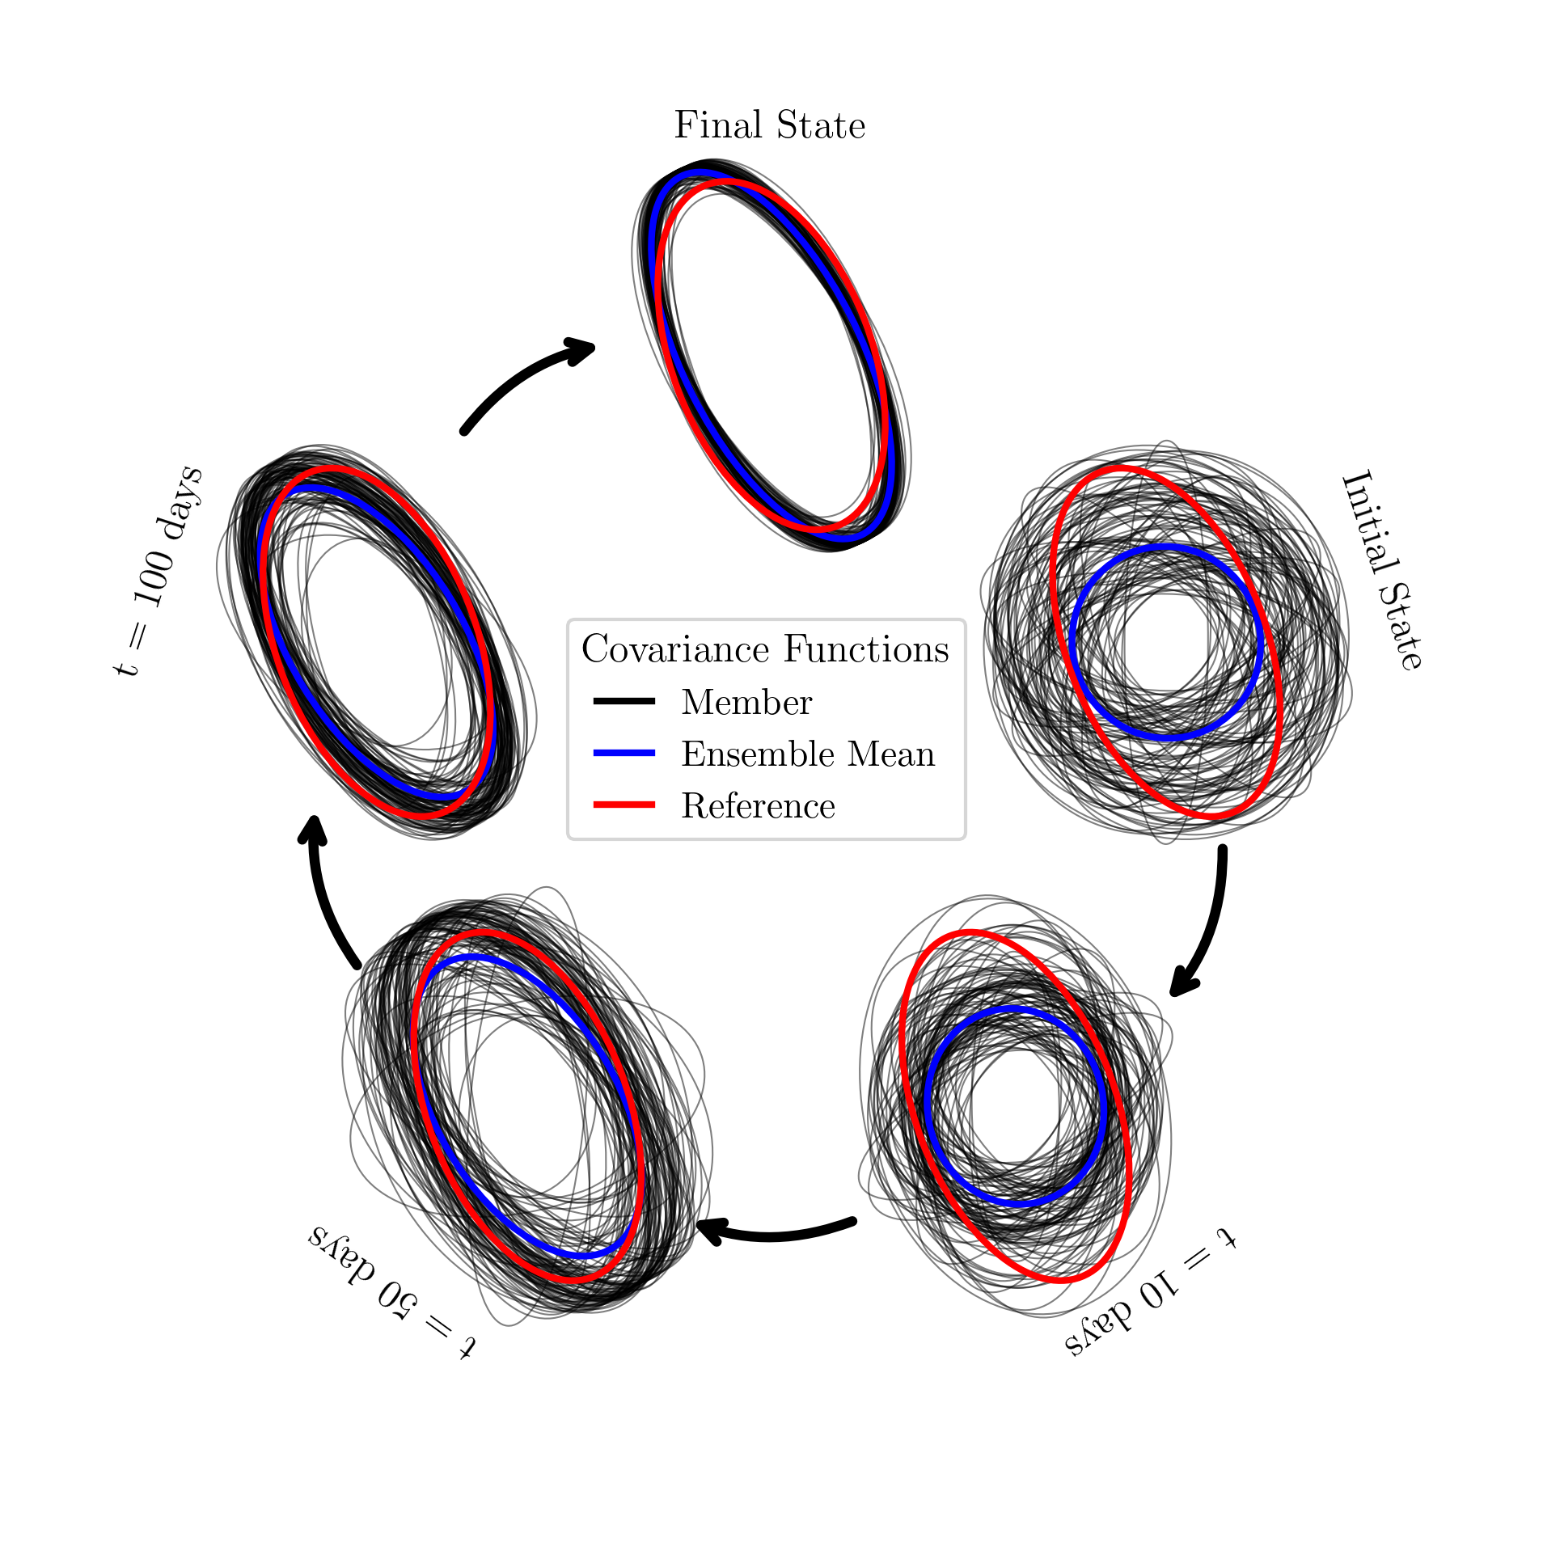
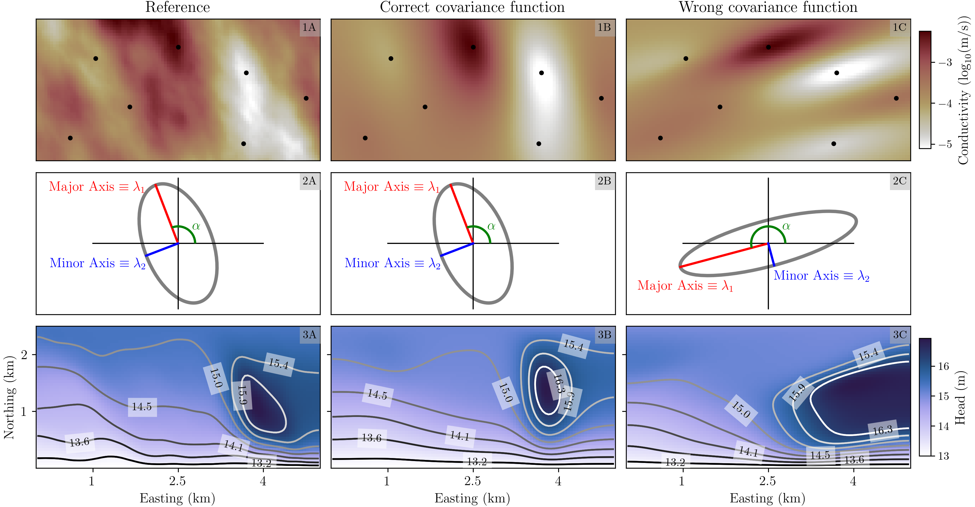
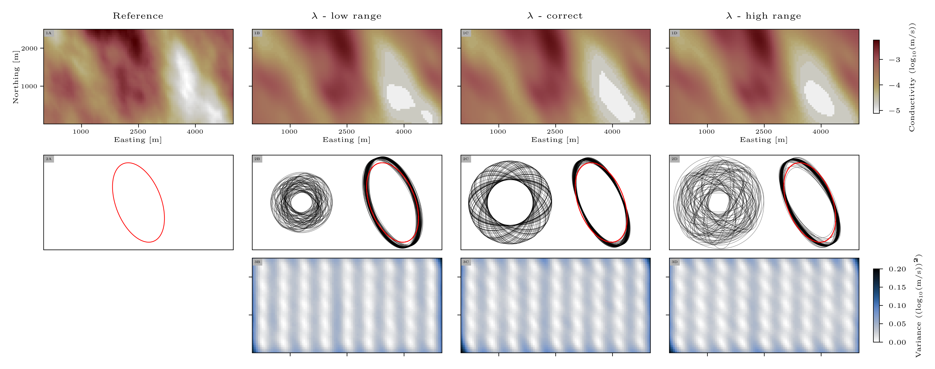
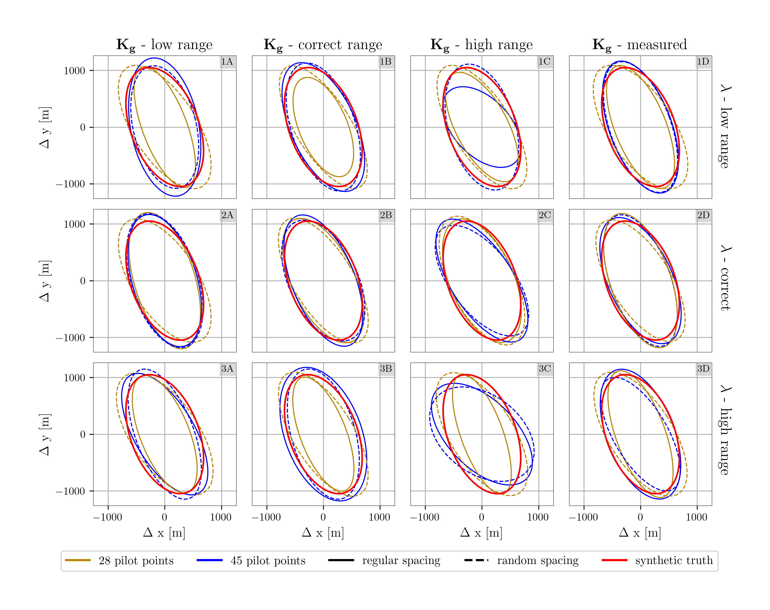
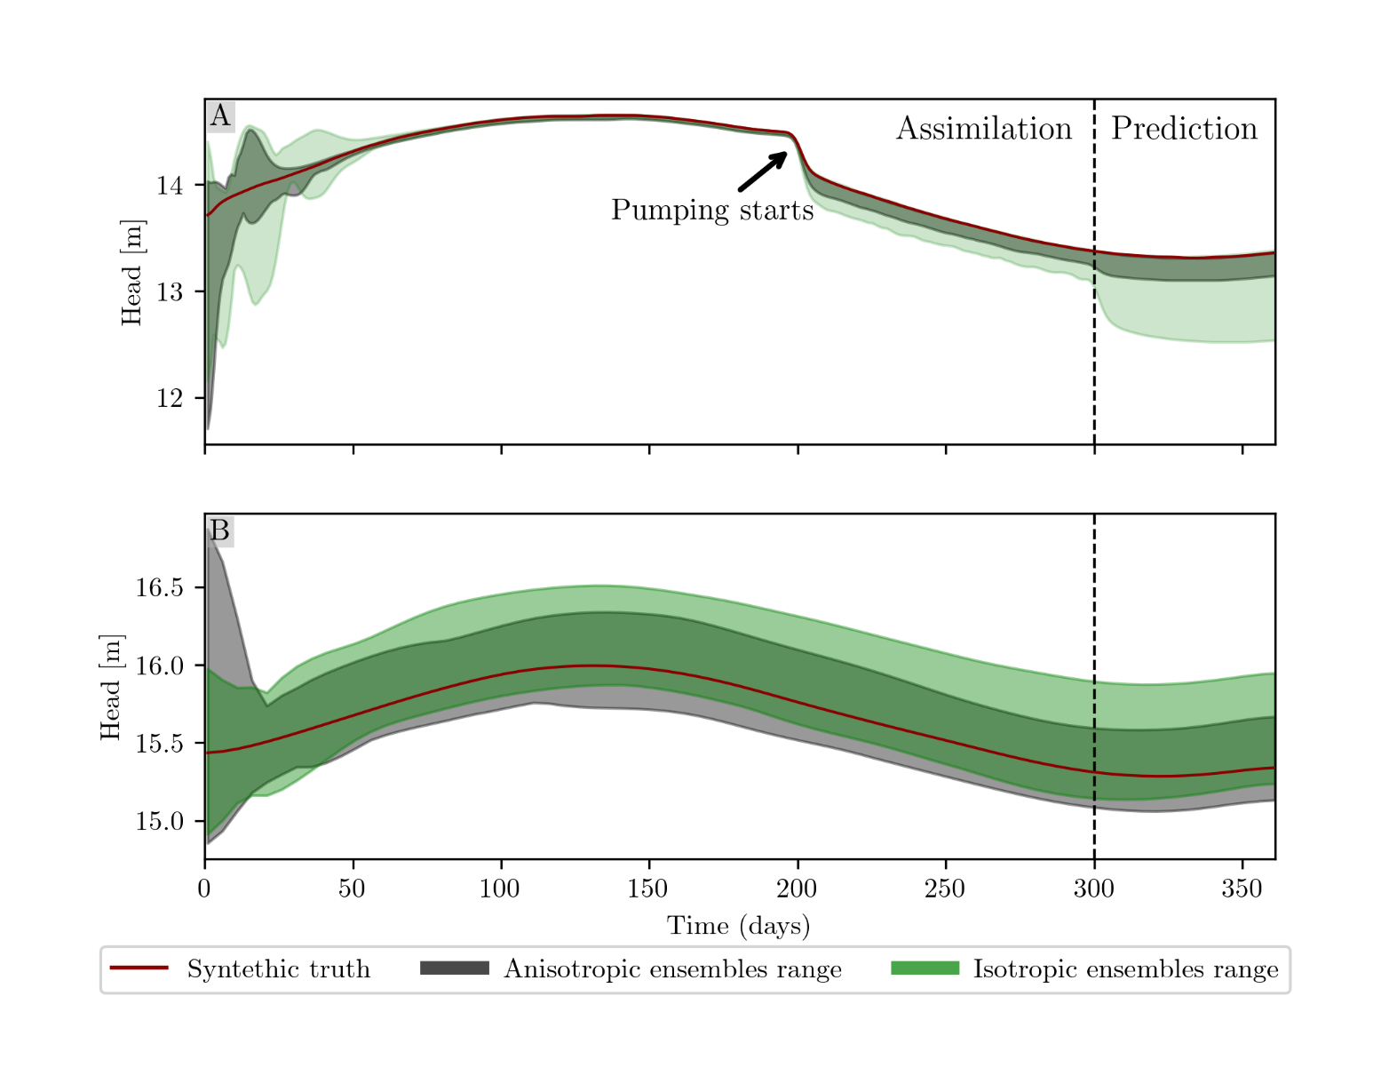
Estimating the Full Anisotropy of the Covariance Function
Janek Geiger, Michael Finkel, Olaf A. Cirpka University of Tübingen janek.geiger@uni-tuebingen.de
Geostatistical Variogram Defines Parameter Field Structure
Synthetic Experiment & Model Initialization
Initial correlation lengths uniformly distributed | $$\text{I}\text{nitial} \text{angle} \text{randomly} \text{drawn} \text{from} \left[0,π\right]$$ | Conditional realizations for small-scale variability
How to obtain a robust parameterization of the covariance function?
Extension of Pilot-Point Ensemble Kalman Filter
Estimating Anisotropy Improves Model
Problem of periodicity
$$R\left(0\right)=R\left(2kπ\right), ∀k∈ℤ$$
Estimating standalone $α$ not possible
Non-unique relationship between covariance function and $[α$, $λ_{i}$]
Consider variogram as ellipse instead
$$d\left(x_{1}{,x}_{2},A\right)=1$$
Estimation of unique elements of A
$λ_{i}$ are eigenvalues of A
$α$≙ orientation of eigenvector of A
Inclusion in PP-EnKF
$$X=[x_{1}…x_{n}]$$
x $∋$ states, parameters, and A
Line search for positive definiteness
Dynamic covariance function
Large number of regularly spaced pilot points show best perfromance
$$\text{Little} \text{prior} \text{knowledge} \text{required}$$
Consideration of anisotropy improves results up to 66 %
Scaled distance d
$$d\left(x_{1}{,x}_{2},A\right)={||x_{1}−x_{2}||}_{A^{−1}}=\sqrt{{(x_{1}−x_{2})}^{T}A^{−1}(x_{1}−x_{2})}$$
Damped, localized Pilot-Point Ensemble Kalman Filter
$$X_{t}|_{y_{0}}= X_{t}+M\left( \left(φ⋅P_{x_{t}, y_{t}}\right) {\left(P_{y_{t}, y_{t}}+ V\right)}^{−1}\left(y_{0,t}− Y_{t}− Ε\right)\right)$$
Scaling matrix A | Diagonal matrix $Λ$ | Rotation matrix R
$$A=RΛR^{T}$$ | $$Λ=\left[\begin{matrix}λ_{1} & 0 \\ 0 & λ_{2}\end{matrix}\right]$$ | $$R= \left[\begin{matrix}\cos{α} & −\sin{α} \\ \sin{α} & \cos{α}\end{matrix}\right]$$
 | length scale $λ_{i}$ | anisotropy angle$α$
State-parameter matrix $X$
Relaxation matrix $M$
Localization matrix $φ$
Cross-covariance matrix $P$
Error covariance 𝑉
Measurements $y_{0}$
Ensemble measurements $Y$
Gaussian noise $Ε$

