Slide 1
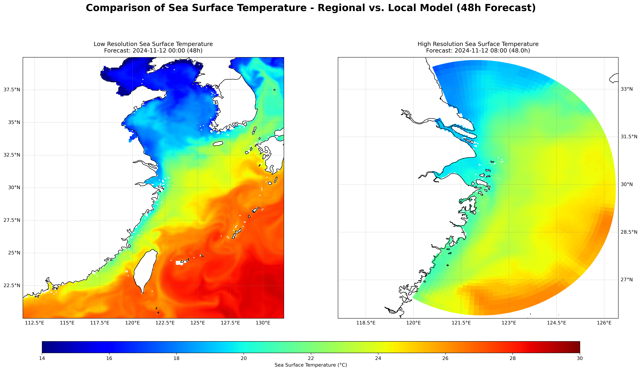
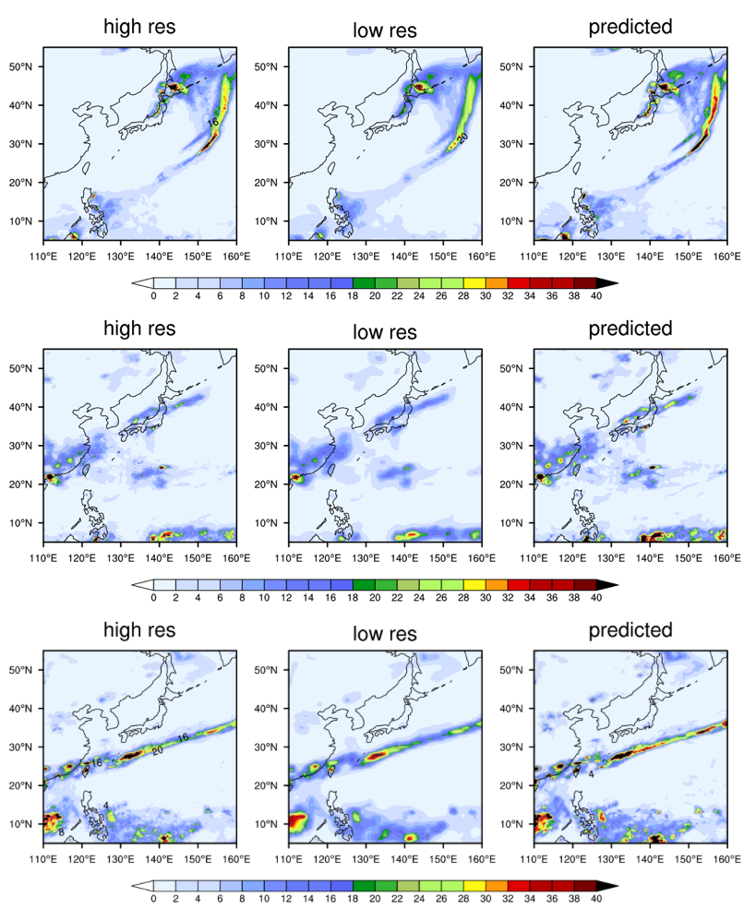
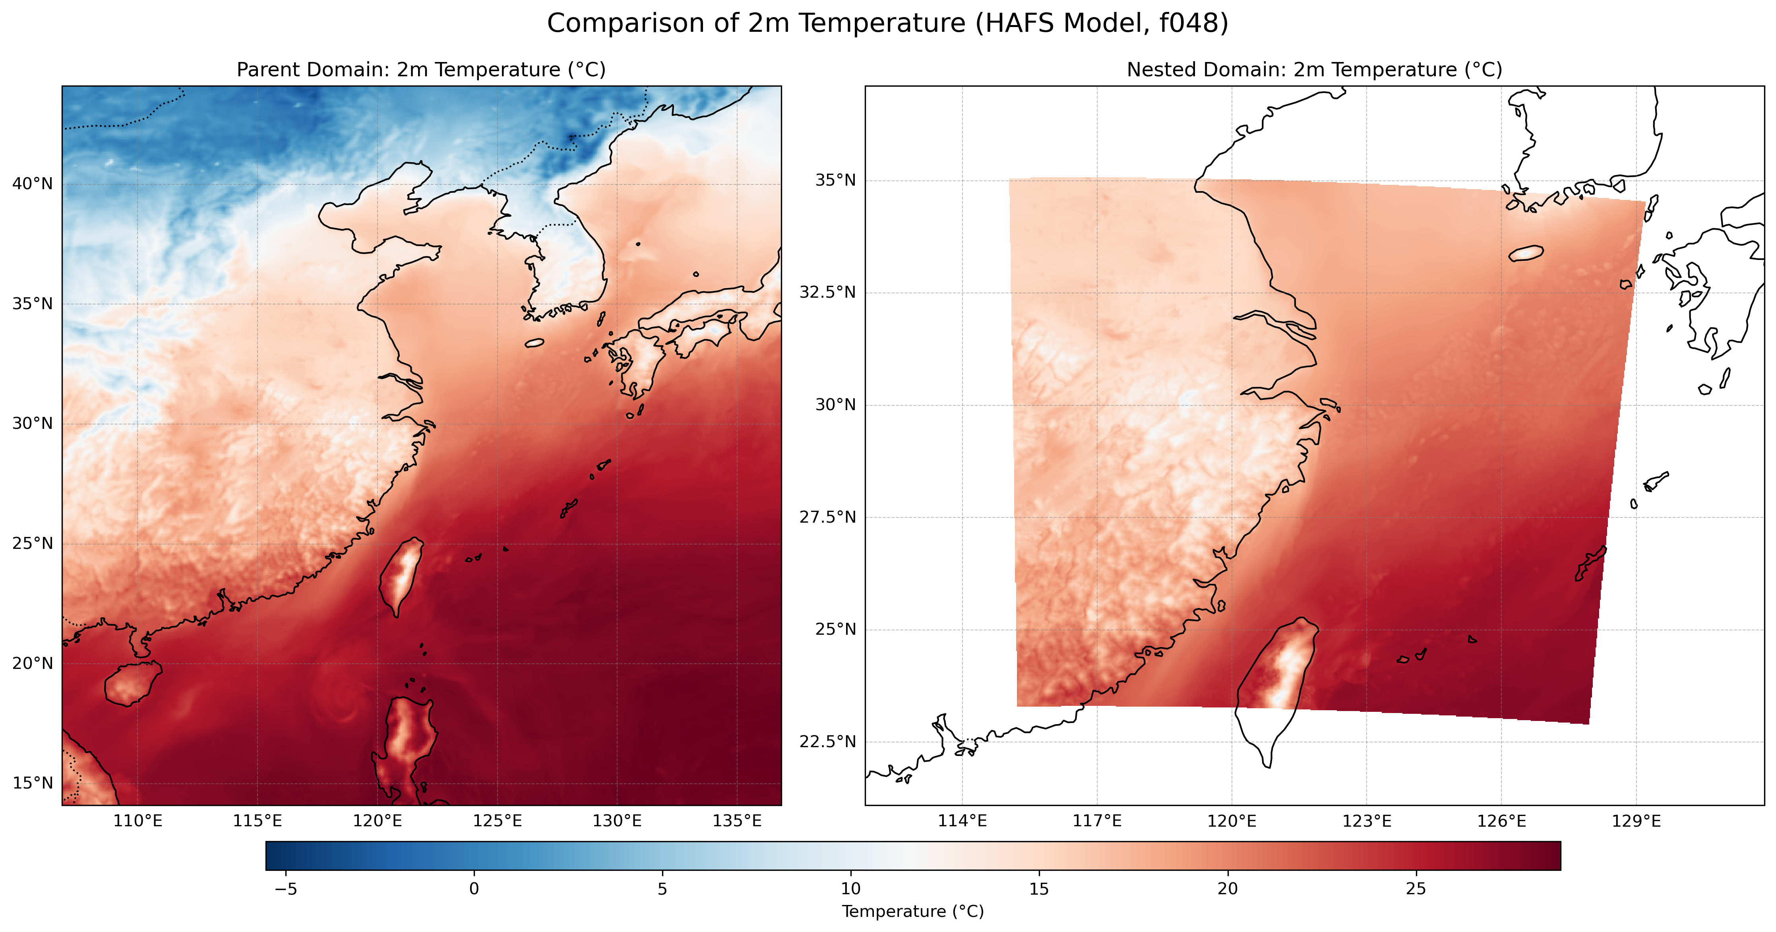
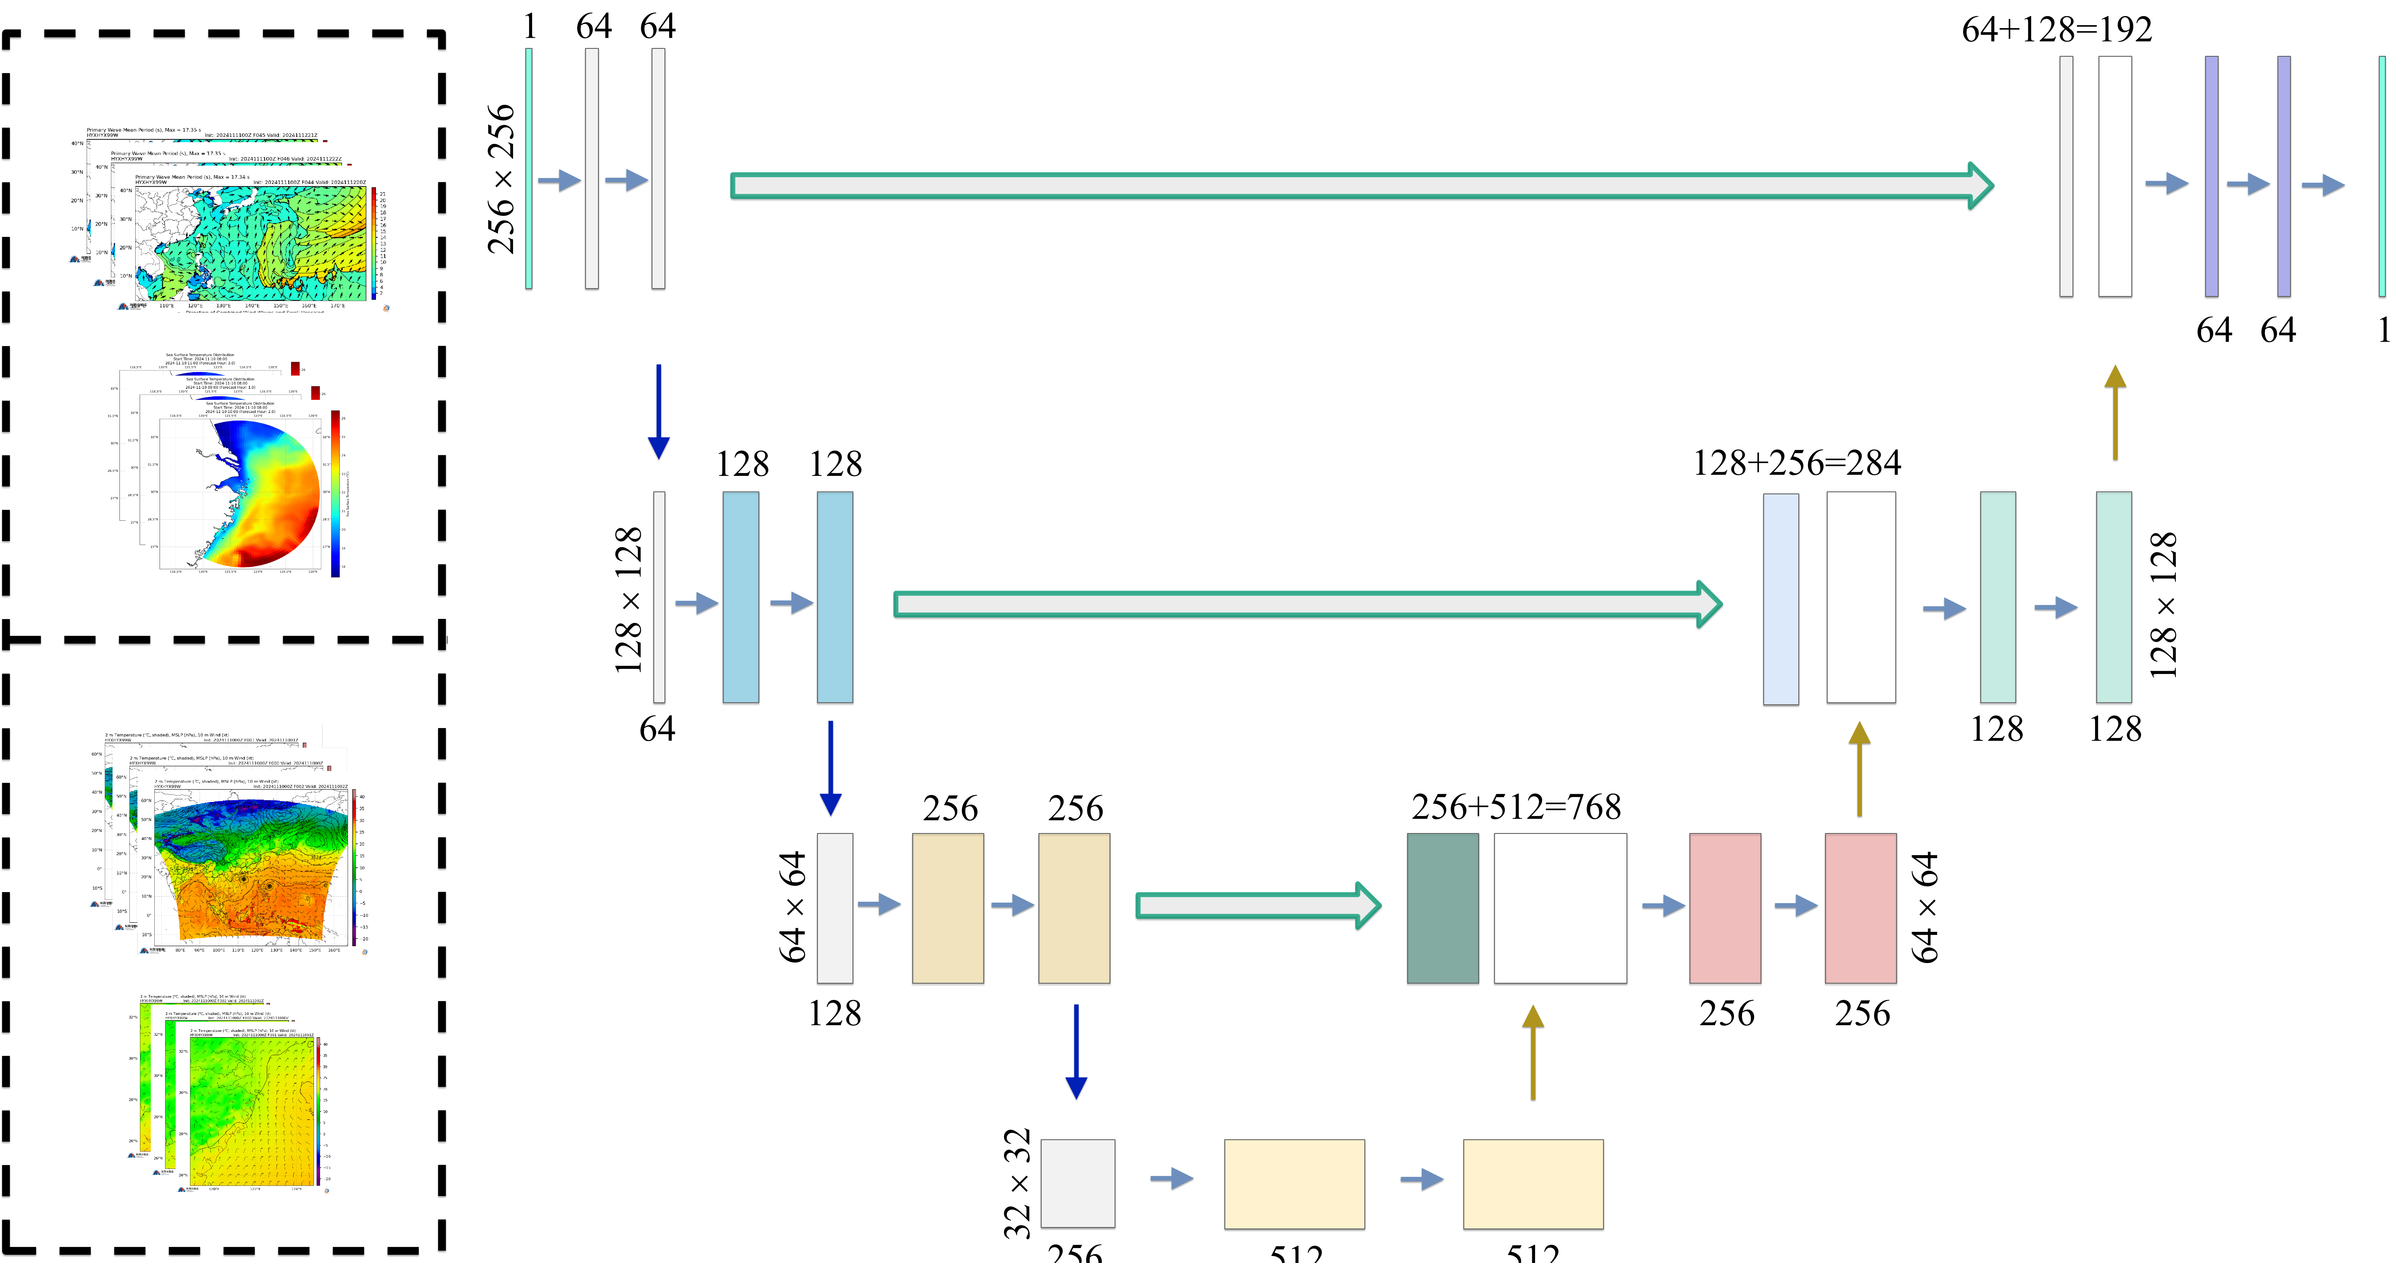
AI-Driven Regional Downscaling for High-Resolution Oceanic and Atmospheric Forecasting
Yuxiang Huang¹，Ruyan Chen¹, Liuqing Ji¹, and Sai Zhang¹
海岸和海洋环境
数字孪生研究所
¹ Donghai Laboratory, Zhoushan, Zhejiang, China
Institute of Digital Twin for
Coastal and Marine Environments
Abstract
Accurate high-resolution forecasting of oceanic and atmospheric states remains a critical challenge. This study introduces an AI-based regional downscaling framework employing a U-Net deep learning architecture, trained on coarse-resolution simulations. By embedding physical constraints, the model effectively bridges scales, capturing fine-grained dynamics unresolved in traditional approaches.
The framework significantly enhances computational efficiency, reducing forecast times from hours to seconds per region while maintaining high accuracy. Its integration with data-parallel computing units enables scalable multi-region applications. Applied within a coupled ocean-atmosphere-wave-tide system, the model excels in reproducing extreme events and mesoscale dynamics.
This work highlights the potential of AI in offering scalable, precise solutions for forecasting, climate science, and disaster management.
Objectives
Develop a U-Net framework for efficient downscaling of coupled ocean-atmosphere model outputs.
Quantify the computational speedup compared to traditional high-resolution numerical simulation.
Assess the U-Net's ability to reproduce key coupled dynamics and features.
U-Net Framework for Emulating Downscaling:
The goal is to train a U-Net model to map Low-Resolution (LR) simulation data to High-Resolution (HR), thereby efficiently emulating computationally expensive HR models. The architecture employed is a standard U-Net featuring an Encoder-Decoder structure with Skip Connections, which processes LR inputs (including simulation data and topography) to generate the desired HR outputs. To ensure physical realism, the training incorporates Physics-Informed Learning by embedding physical constraints through a combined loss function:
$ℒ_{𝓉ℴ𝓉𝒶𝓁}=ℒ_{𝒹𝒶𝓉𝒶}$= $\frac{1}{N}\sum_{i=1}^{N}{{\left(Y_{pred,i}−Y_{ref,i}\right)}^{2}}$
Data Loss ($ℒ_{𝒹𝒶𝓉𝒶}$): Standard regression loss MSE between the U-Net‘s HR output ($Y_{pred}$) and the target HR simulation data ($Y_{ref}$):
Conclusion
We developed an AI (U-Net) regional downscaling framework, significantly boosting computational efficiency for high-resolution forecasting while maintaining accuracy. The atmospheric model yielded excellent results, effectively capturing key dynamics; oceanic model development is ongoing. This physics-informed AI approach offers a scalable, precise tool for forecasting, climate science, and disaster management.
Methodology
Data Generation via Numerical Modeling:
AI training (LR input) & validation (HR target) data generated using HAFS-related numerical models.
Low-Resolution (LR) Input Data:
Atmosphere: FV3-regional (NW Pacific / East China Sea nest) (6 km).
Ocean: HYCOM & WW3 (HAFS components) (8-10 km).
Key Variables: SST, surface winds, currents, sea surface height.
High-Resolution (HR) Target Data (Reference for AI):
Atmosphere: Nested FV3-regional (East China Sea) (2 km).
Ocean: Offline coupled ADCIRC & SWAN (~1 km), forced by LR HAFS ocean/wave outputs.
Static Data:
High-resolution topography/bathymetry data relevant to the HR grid was used as an additional input to the AI model. It serves to define the fixed physical characteristics of the high-resolution domain for the predictions.
Figure 3. Example Low-Resolution (LR) input (left) and High-Resolution (HR) target (right) Sea Surface Temperature (SST) fields used for AI training.
Introduction
High-resolution coupled ocean-atmosphere models are essential for understanding key climate processes, such as fine-scale air-sea interactions and energetic ocean mesoscale eddies. However, the dynamical downscaling required to achieve these resolutions is computationally intensive, limiting the long-term simulations and large ensemble sizes needed for reliable climate prediction and risk assessment. Furthermore, existing models may face inefficiencies when adapting to modern computing architectures. To address this challenge, we propose an AI-based regional downscaling strategy. Crucially, this approach focuses not only on enhancing computational efficiency but, more fundamentally, on enabling the AI model to learn and capture the key physical mechanisms simulated by traditional dynamical downscaling. Through this approach, we aim to efficiently generate physically consistent, high-resolution ocean-atmosphere data, thereby facilitating a better understanding of fine-scale climate system processes and supporting impact assessments, particularly for extreme events.
Figure 5. Comparison of Low-Resolution input (center), AI model predicted (right), and High-Resolution reference (left) 2-meter temperature (°C) for selected cases.
ATM training sets
Acknowledgments
This work is supported by
theScience Foundation of DonghaiLaboratory (DH‐2023QD0002) & the GHfun (ghfund202407032452).
OCN training sets
Contact Info
E-mail: huangyuxiang@gmail.com
Phone/ Wechat: (+86) 15055765758
Figure 1. Overview of the study methodology
Figure 2. Low-Resolution (parent, left) and High-Resolution (nested, right) 2-meter temperature (°C) training data examples.
Figure 4. Architecture of the U-Net model used for downscaling

