Slide 1
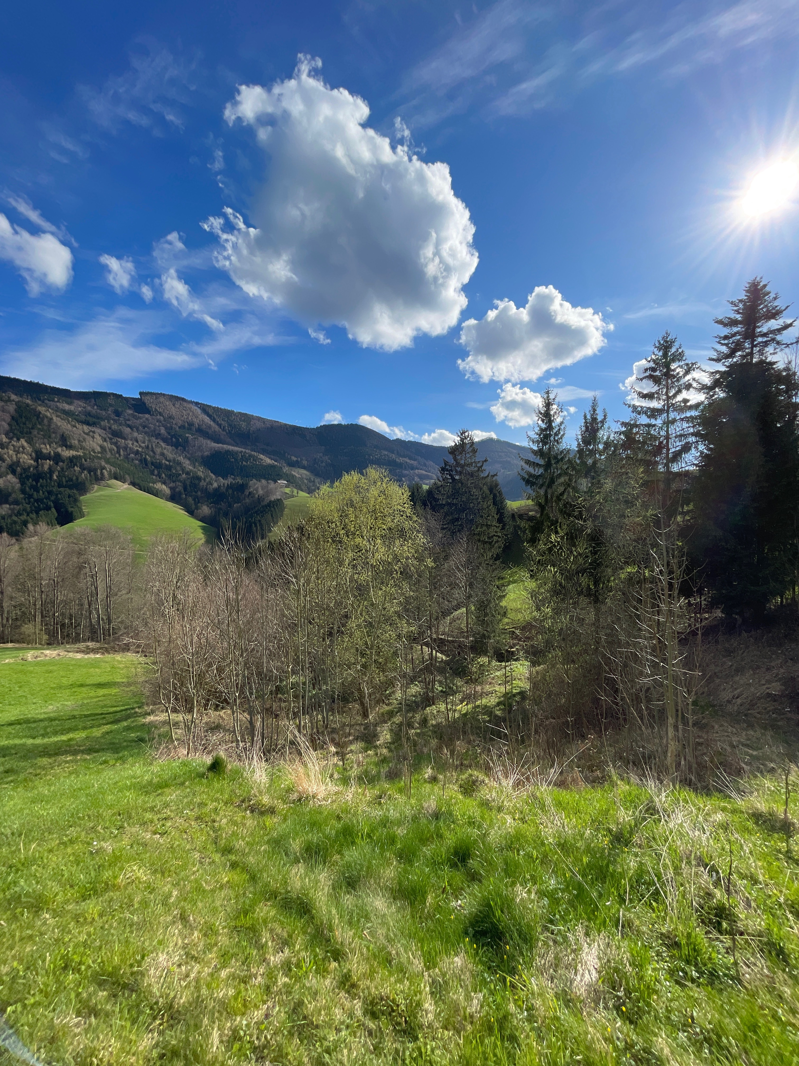
Exploring Slow-Moving Landslides and Greenhouse Gas Emissions
in Pre-Alpine Grassland: from Observations to Modelling
Kirill Grachev, Thomas Glade, and Stephan Glatzel
University of Vienna, Department of Geography and Regional Research, Vienna, Austria
Linking landslide dynamics and greenhouse gas fluxes in Alpine grasslands
Relevance
Research Questions
Methods
Preliminary Results
2025 General Assembly of the European Geosciences Union
Vienna, 28th of April 2025
Notes:
Nitrogen and carbon. CO₂, N₂O, CH₄
Different land: peatlands, croplands, grasslands
However, long-term measurements of GHG emissions from grasslands remain scarce
________

Slide 2
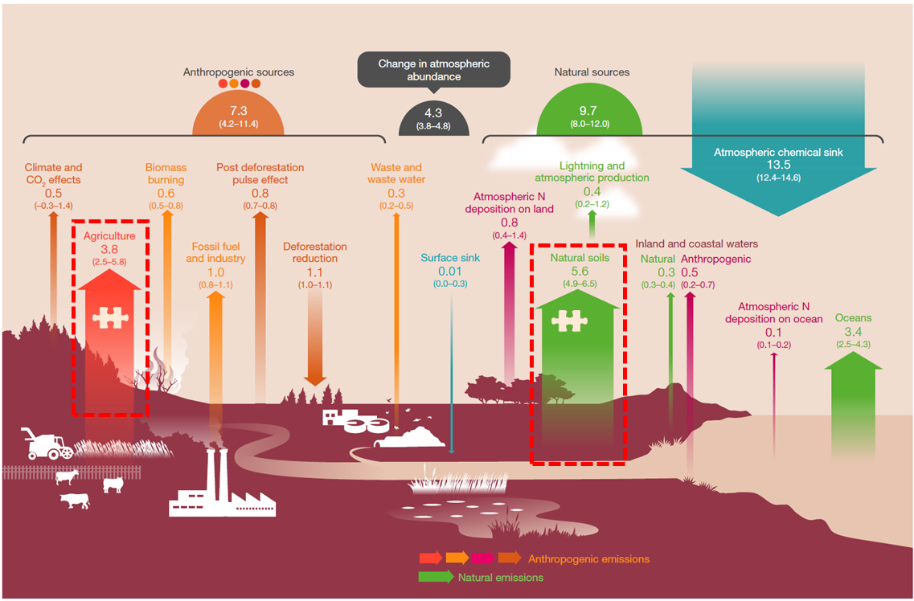
Relevance
Soils pool a considerable amount of greenhouse gases (Yu et al., 2020)
Grasslands emit the largest volume of nitrous oxide (Oertel et al., 2016)
A quarter of Austrian terrestrial surface is dedicated to grassland (Eurostat, 2024)
The complexity of the soil nitrogen cycle requires input from other disciplines (Brevik et al., 2015; Werner et al., 2007)
-> accurate quantification of N₂O is relevant for climate policy
Global N₂O budget for 2007-2016 (Tian et al., 2020)
Menu
Rationale
Research Questions
Methods
Results
Notes:
Nitrogen and carbon. CO₂, N₂O, CH₄
Different land: peatlands, croplands, grasslands
However, long-term measurements of GHG emissions from grasslands remain scarce
________

Slide 3
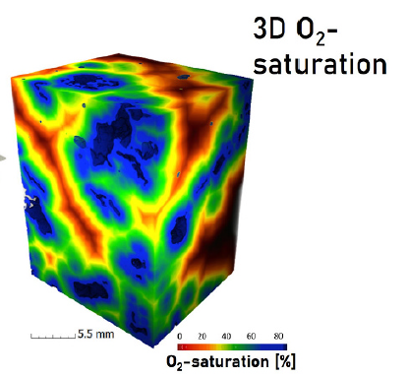
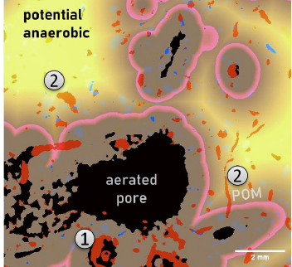
Mechanisms of N₂O Production in Soils
Oxidation of ammonium NH₄⁺ -> NO₂⁻ -> NO₃⁻
Reduction of nitrates NO₃⁻ -> NO₂⁻ -> N₂O↑ -> N₂↑
The horizontal axis represents soil moisture, increasing from left to right (Chen et al., 2021)
1 - hotspots of respiration
2 - hotspots of denitrification
Soil pore modelling and X-ray images of soil (Lucas et al., 2024)
Menu
Rationale
Research Questions
Methods
Results
Notes:
is produced by microbial activities in soils, mainly via nitrification and denitrification processes. Two major processes -> microbiome
Aerobic and anaerobic bacteria
Pores
________

Slide 4
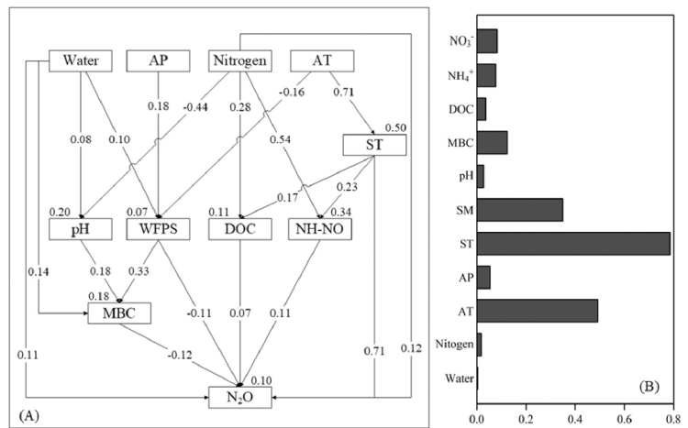
Key Factors Influencing N₂O Emissions
Moisture and temperature (Smith et al., 1998)
Particle size (Syväsalo et al., 2004)
Fertilization types and land use (Yao et al., 2010)
dissolved organic carbon
microbial biomass carbon
soil moisture
soil temperature
ambient precipitation
ambient temperature
Structural equation modelling and variable importance (Guo et al., 2022)
Menu
Rationale
Research Questions
Methods
Results
Notes:
Soil moisture and temperature depend on the meteorological circumstances
________

Slide 5
Key Factors Influencing Landslide Activity
Laboratory studies highlight the role of pore size in landslide rates (Iverson et al., 2000)
Field experiments identify clay content as a key factor (Yalcin, 2007)
Models benefit from integrating wetness indices (Arnone et al., 2011)
Filling, storing, and draining of water explains landslide behaviour (Bogaard and Greco, 2016)
Limited research exists on landslide impacts on soil properties (Comegna et al., 2020)
Gaps:
Research of landslide impacts on soil properties
Focus on deeper layers of soils
Mostly research the rapid processes
Menu
Rationale
Research Questions
Methods
Results
Notes:
…
________

Slide 6
Why is the Research Relevant?
Why Should There be a Connection Between Landslides and N₂O Fluxes?
Because vast grassland areas are prone to landslides, yet there is a lack of research on the mutual factors affecting both phenomena.
Because soil properties, such as moisture content and porosity, are key factors influencing both phenomena.
Menu
Rationale
Research Questions
Methods
Results
Notes:
Nitrogen and carbon. CO₂, N₂O, CH₄
Different land: peatlands, croplands, grasslands
However, long-term measurements of GHG emissions from grasslands remain scarce
________

Slide 7
Research Question 1
Which physico-chemical soil properties impact the most the N₂O, CO₂ and CH₄ fluxes from grassland soils and which of them relate to landslides activity?
Tasks:
1.1. To review existing literature on soil properties’ effect on greenhouse gasses emissions, focusing on nitrous oxide
1.2. To review existing literature on impact of landslides on soil properties, focusing on those which impact greenhouse gasses emissions
1.3. To describe soil properties which on one hand are affected by mass moving and on the other hand modify the dynamics on nitrous oxide emissions in the Alpine grassland environmental context
Menu
Rationale
Research Questions
Methods
Results
Notes:
Objective 1. To identify and synthesize existing knowledge on the relationships between landslides, soil properties, and greenhouse gas emissions.
Tasks to achieve the Objective 1:
Moisture-related properties, such as moisture content and water-filled pore space (WFPS), are hypothesized to predominantly affect N₂O fluxes by altering denitrification processes
Structural soil properties, such as porosity, are also hypothesized to influence N₂O fluxes by modifying redox conditions
Hydrology-related soil properties are hypothesized to contribute to landslide activity, as supported by available scientific findings
________

Slide 8
Research Question 2
What is the role of hydrological soil properties in modulating N₂O fluxes in the landslide-impacted soils in the pre-alpine grassland?
Tasks:
2.1. To collect a 2-years long set of greenhouse gasses fluxes from soils depending on the area of landslide activity
2.2. To carry out laboratory testsof physico-chemical properties of soils in the research area and to calculate supplementary relevant data
2.3. To conduct four 24-hours intensive field campaigns to measure diurnal fluctuations of greenhouse gasses fluxes
2.4. To perform statistical analysis to determine the most significant soil properties greenhouse gasses fluxes including differences in landslide activity
2.5. To build and validate a greenhouse gasses fluxes model
2.6. To test the hypothesis running the model
Menu
Rationale
Research Questions
Methods
Results
Notes:
Objective 2. To understand the annual dynamics of greenhouse gas fluxes in soils affected by landslide activity compared to unaffected soils.
Tasks to achieve the Objective 2:
Higher moisture content and water-filled pore space are hypothesized to increase the variance in the annual N₂O fluxes
Significant difference is hypothesized in the annual N₂O budget between landslide-affected and control sites
________

Slide 9
Research Question 3
How to align landslide monitoring with geoecological research and greenhouse gas flux modelling to achieve complementary benefits?
Tasks:
3.1. To identify similar parameters of both monitoring and methods by which monitoring is carried out
3.2. To compare results of these methods
3.3. To develop recommendations to unify, ease and improve two monitorings
Menu
Rationale
Research Questions
Methods
Results
Notes:
Objective 3. To investigate the role of soil properties, such as moisture content and porosity, in driving differences in N₂O fluxes under varying landslide conditions.
Tasks to achieve the Objective 3:
Monitoring of meteorological and hydrological soil parameters contributes to both: landslide and greenhouse gas monitoring
Vegetation can serve as an indicator for both landslide activity and altered greenhouse gas fluxes
________

Slide 10
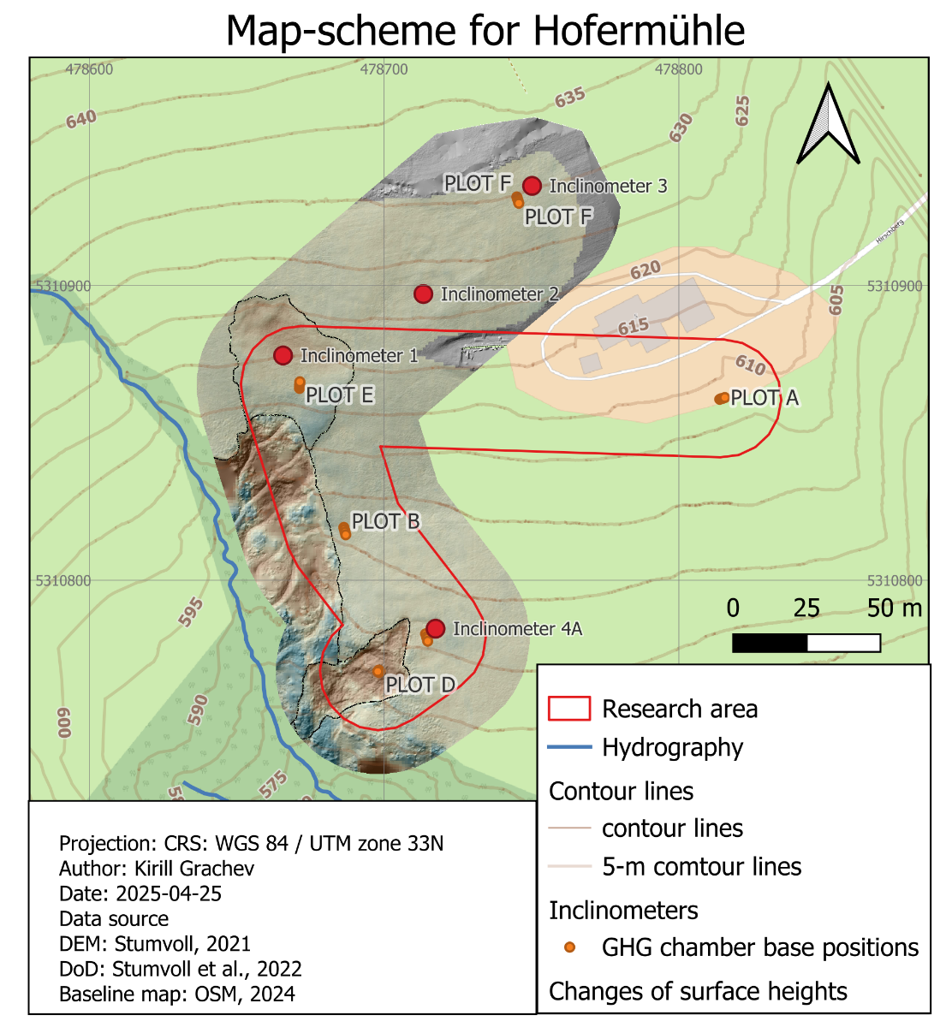
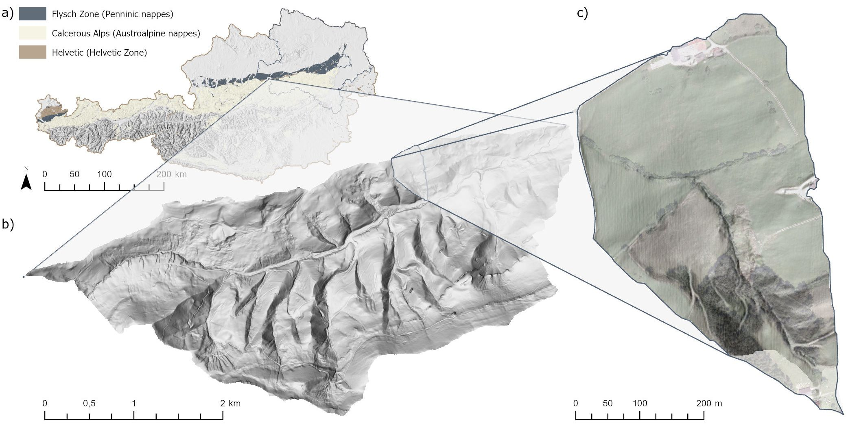
Hofermühle Observatory
Location of study site and areas of investigation (Stumvoll et al., 2021)
Menu
Rationale
Research Questions
Methods
Results
Notes:
FLYSH: Late Cretaceous (критейшос) 100M -> Europe was an archipelago -> deep water sedimentary rocks -> marls (mixture of clay + milestone)
Surface and Subsurface: Meteo, Geomorphological mapping -> two landslide subsystems
Inclinometers
________
1 min

Slide 11
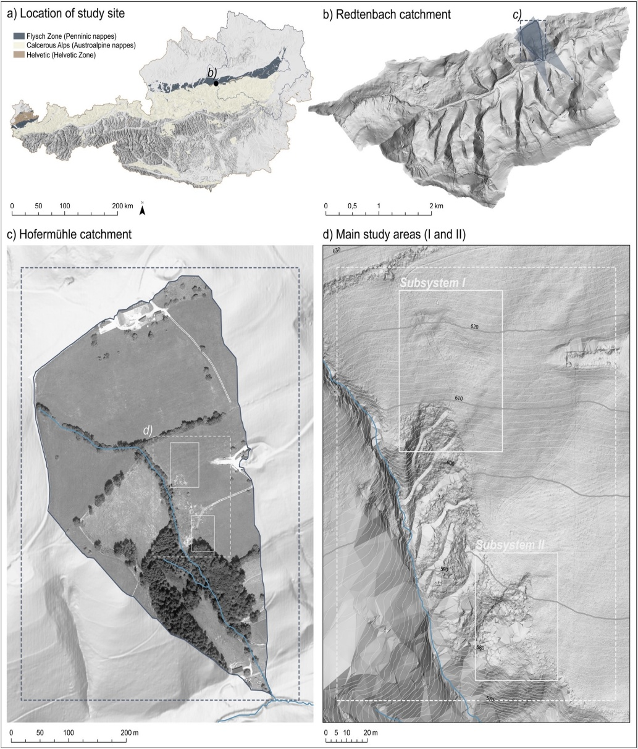
Hofermühle Observatory
Surface monitoring:
● Meteorological station
● Terrestrial laser scanning
● Unmanned aerial vehicle
● Global navigation satellite system measurements
● Geomorphological mapping
Subsurface monitoring:
● Time domain reflectometry probes
● Piezometers
● Automatic and manual inclinometers
Location of study site and areas of investigation (Stumvoll et al., 2021)
Menu
Rationale
Research Questions
Methods
Results
Notes:
FLYSH: Late Cretaceous (критейшос) 100M -> Europe was an archipelago -> deep water sedimentary rocks -> marls (mixture of clay + milestone)
Surface and Subsurface: Meteo, Geomorphological mapping -> two landslide subsystems
Inclinometers
________
1 min

Slide 12
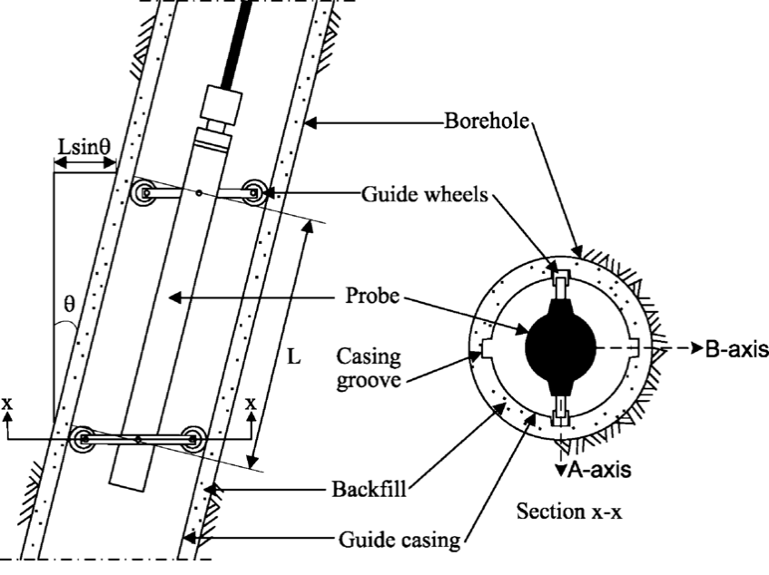
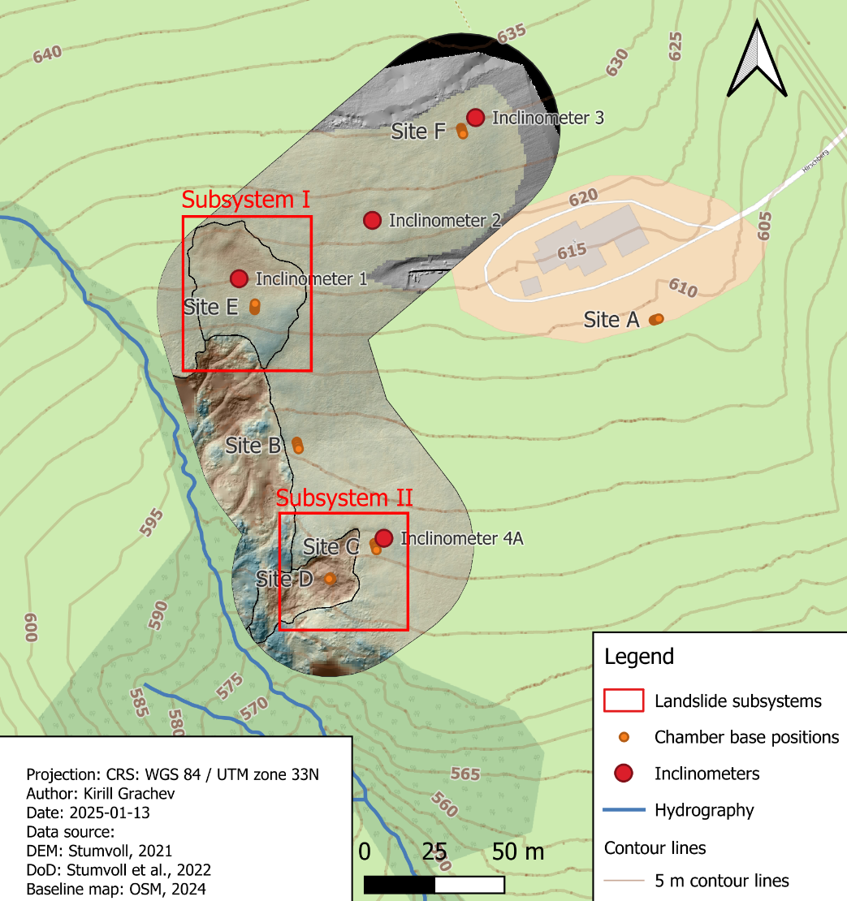
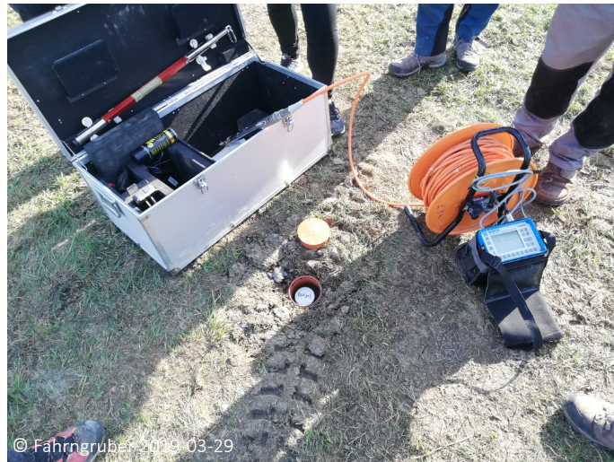
Hofermühle. Inclinometer
Principles of inclinometer (Stark and Choi, 2008)
Locations of inclinometers at Hofermühle
Installation of an inclinometer (NoeSlide, 2019)
Menu
Rationale
Research Questions
Methods
Results
Notes:
Subsystems -> inclinometers -> how they work
Based on the inclinometer locations …
Borehole and Guide Casing:
A borehole is drilled into the ground, and a guide casing with grooves is installed inside it.
The grooves ensure the inclinometer probe stays aligned along specific axes (A-axis and B-axis).
Inclinometer Probe:
The probe is lowered into the guide casing.
It has guide wheels that help it slide smoothly while staying aligned with the grooves.
Angle Measurement (θ):
The probe detects the tilt angle (θ) relative to vertical as it moves down the casing.
This angle represents any displacement or bending in the casing due to ground movement.

Slide 13
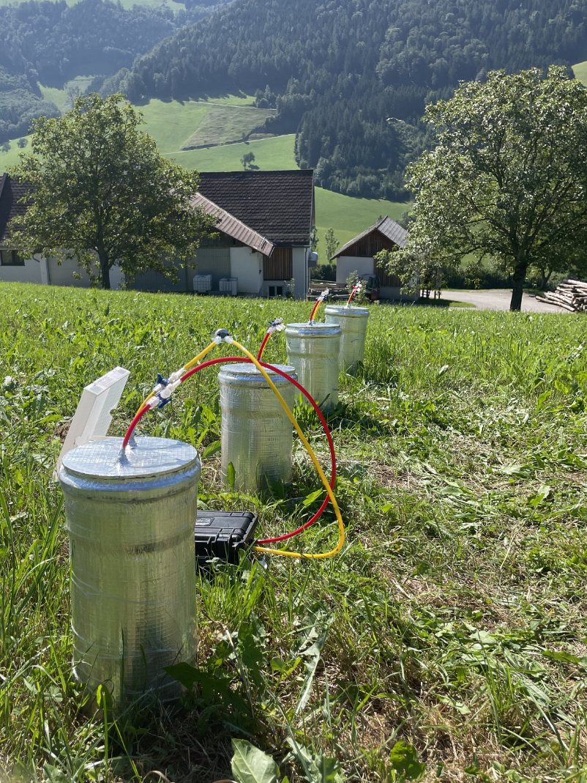
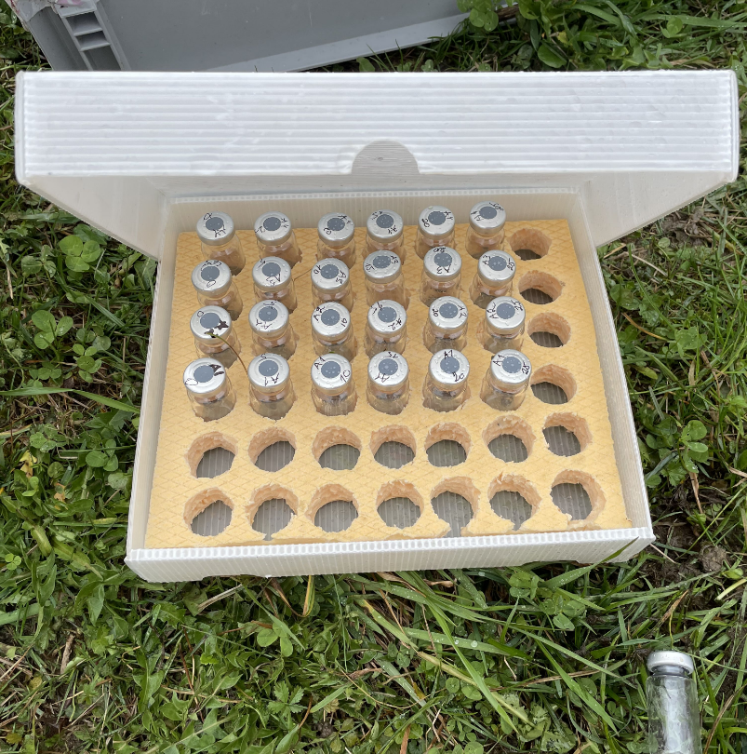
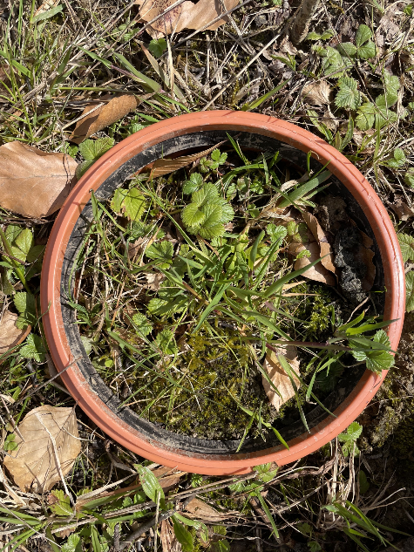
Greenhouse Gas Monitoring
Collected samples
State chamber base
Sampling intervals:
Chamber 1: 0 - 5 - 10 - 15 - 20 - 25 - 30
Chamber 2: 1 - 6 - 11 - 16 - 21 - 26 - 31
Chamber 3: 2 - 7 - 12 - 17 - 22 - 27 - 32
Chamber 4: 3 - 8 - 13 - 18 - 23 - 28 - 33
Installed chambers
Menu
Rationale
Research Questions
Methods
Results
Notes:
Place the chamber base -> 10-15 cm in my case
Not transparent, place the chamber
Take samples
static chamber technique: Measurements of N2O and CH4 were made using the static chamber technique. The gas chambers made of polyvinyl chloride(PVC) pipe consisted of two parts: bottom base comprising of 25 cm high and 15 cm diameter chambers and a lid with a gas sampling port (Jacinthe and Dick, 1997). The chambers were inserted 5 cm into the ground and remained in place during theentire monitoring period except for temporary removal when mechanized farm operations were performed. Three chambers perp lot were installed in three of the four replicates of each tillagetreatment, giving a total of nine chambers per tillage treatment.During air sample collection, chamber lid was used to close thechamber. Air samples from chamber headspace were collected by asyringe (20 mL) at 0, 30 and 60 min and transferred to crimpsealedpre-evacuated (<0.05 kPa) 10 mL vials fitted with butylrubber septa (Wheaton, Millsville, NJ). All chambers were sampledon the same day. Air samples were collected bi-weekly duringgrowing season (spring and summer of 2005) and at 4 weeksinterval during the off season (fall, winter of 2004–2005). Airsamples were collected between 11:00 a.m. and 2:00 p.m. Airtemperature during the time of sampling for each chamber wasused for calculating fluxes.
________
1 min

Slide 14
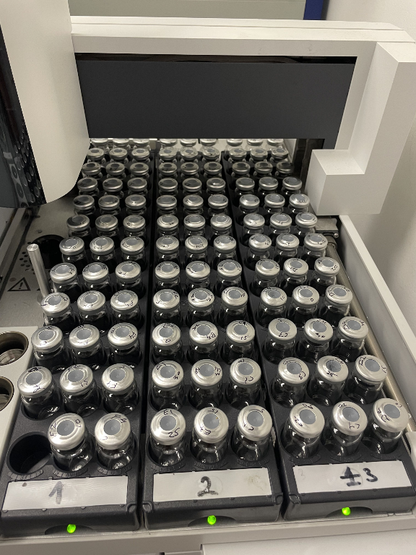
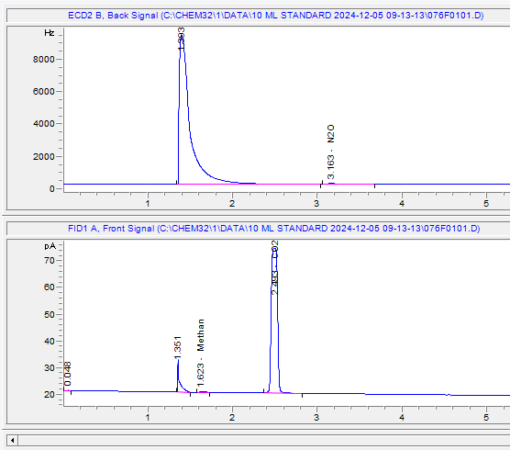
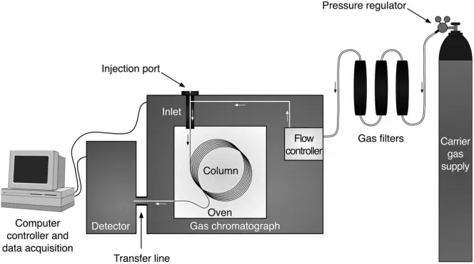
Gas Chromatography
Electron Capture Detector (ECD)
Flame Ionization Detector (FID)
Vials in the GC sampler
Schematic diagram of gas chromatography
(https://www.caretxdigital.com)
Detectors’ signals
Menu
Rationale
Research Questions
Methods
Results
Notes:
24 hours delivery, 1 reck = 6 hours
Sample Injection -> Separation in the Column -> Detection
flame ionization detector: газ подогревается, из-за этого он ионизируется и уменьшает сопротивление. Из-за этого идёт в детекторе ток
Electron Capture Detector При попадании в камеру исследуемого вещества оно начинает захватывать электроны, уменьшая их количество в камере. Образовавшиеся отрицательные ионы гораздо медленнее двигаются к противоположному электроду и потому на некоторое время ток через детектор уменьшится. Это изменение тока трактуется как появление искомого вещества в камере.

Slide 15
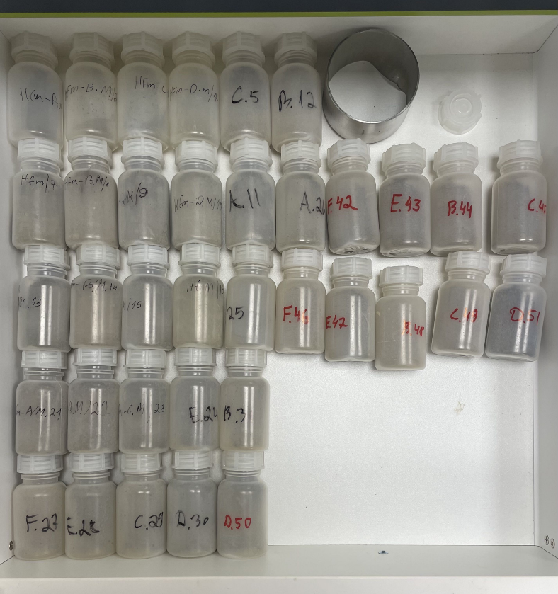
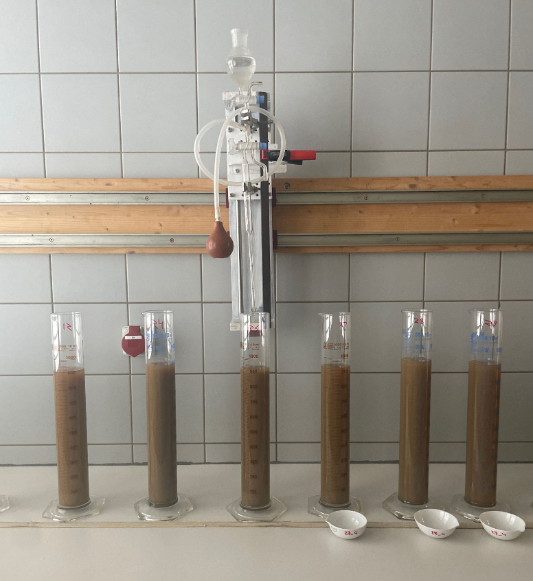
Soil Analysis in the Laboratory
Properties to be measured in the laboratory:
Particle density (𝜌𝑝), g/cm³
Bulk density (𝜌𝑏), g/cm³
Water-filled pore space (WFPS), %
pH
Soil organic carbon (SOC), %
Total nitrogen (TN), %
Spatial distribution
Five sites: F, E, B, C and D
Three depths for each site:
0,0 - 0,1 m
0,1 - 0,2 m
0,2 - 0,3 m
Prepared soil samples
Pipetting
Menu
Rationale
Research Questions
Methods
Results
Notes:
Dried, grindered, sieved -> more than 50
Explain Sieving, Pipetting, Bulk density
________
1 min

Slide 16
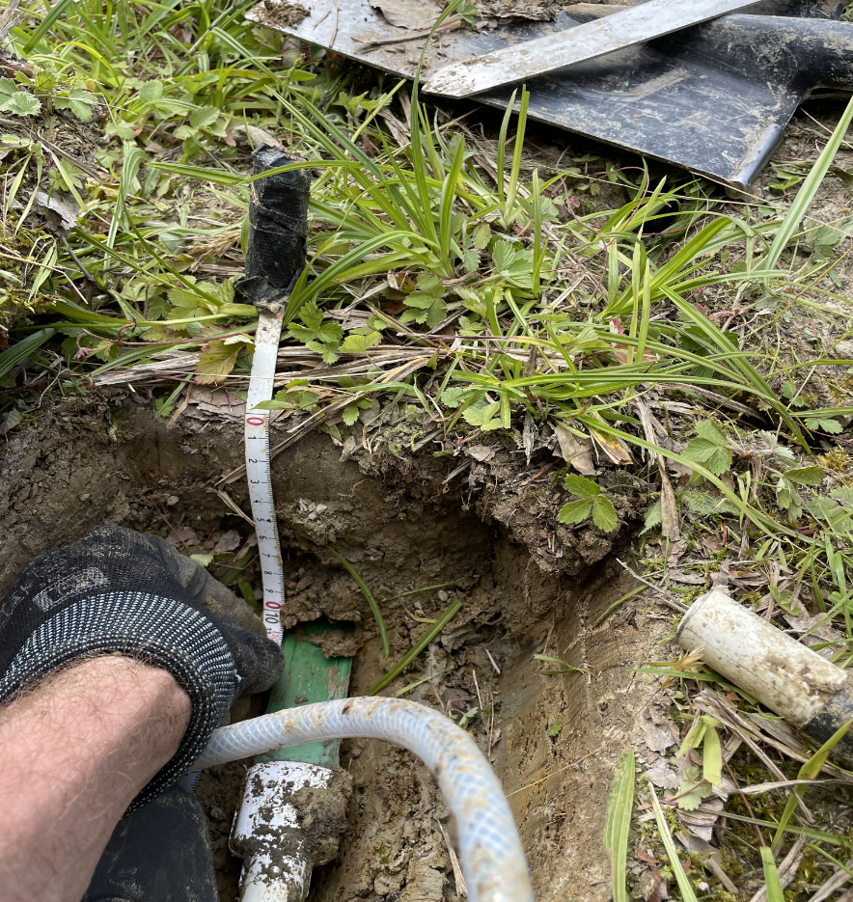
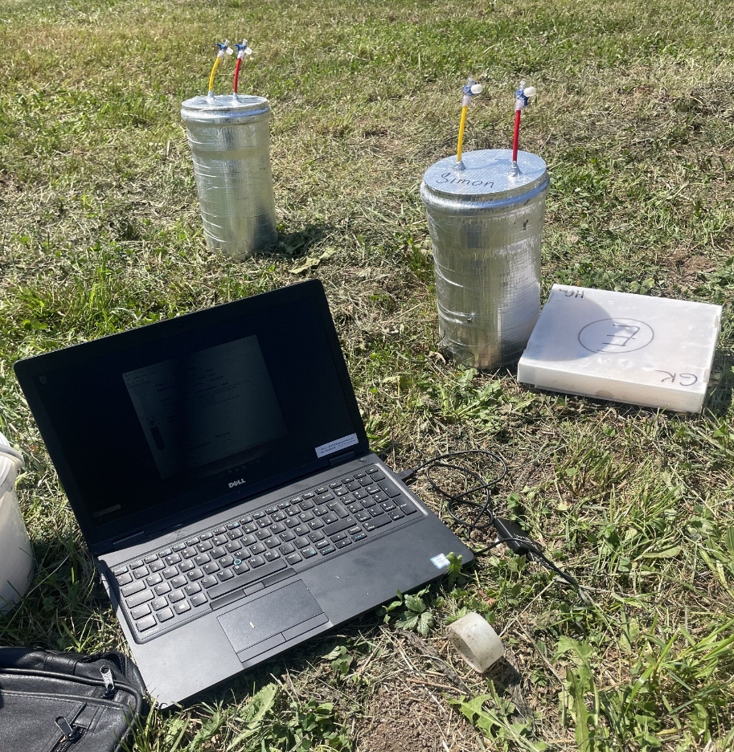
Soil Temperature and Moisture Monitoring
Installed in 5 locations in 10 cm depth
Measures temperature and moisture
Measures every 10 minutes
Installation of The TMS-4 datalogger
TMS-4 data reading
Menu
Rationale
Research Questions
Methods
Results
Notes:
Place the chamber base -> 10-15 cm in my case
________
1 min

Slide 17
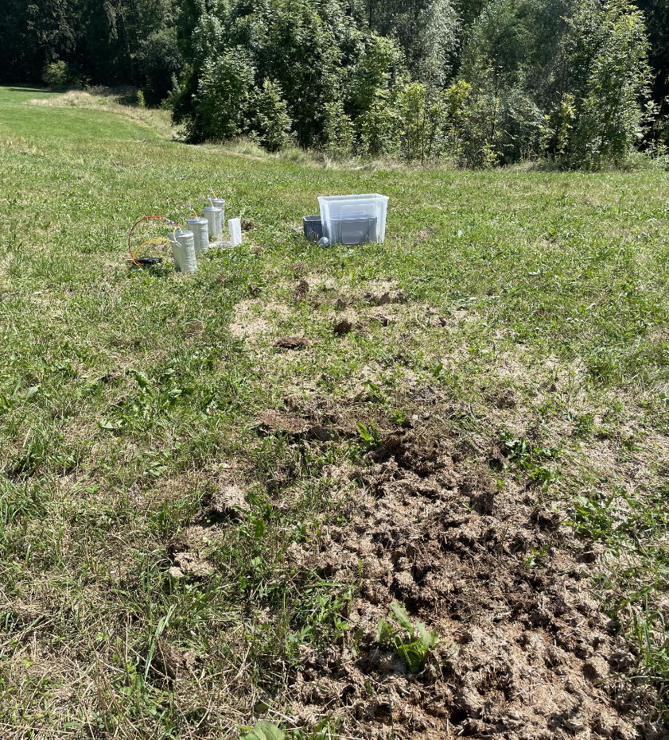
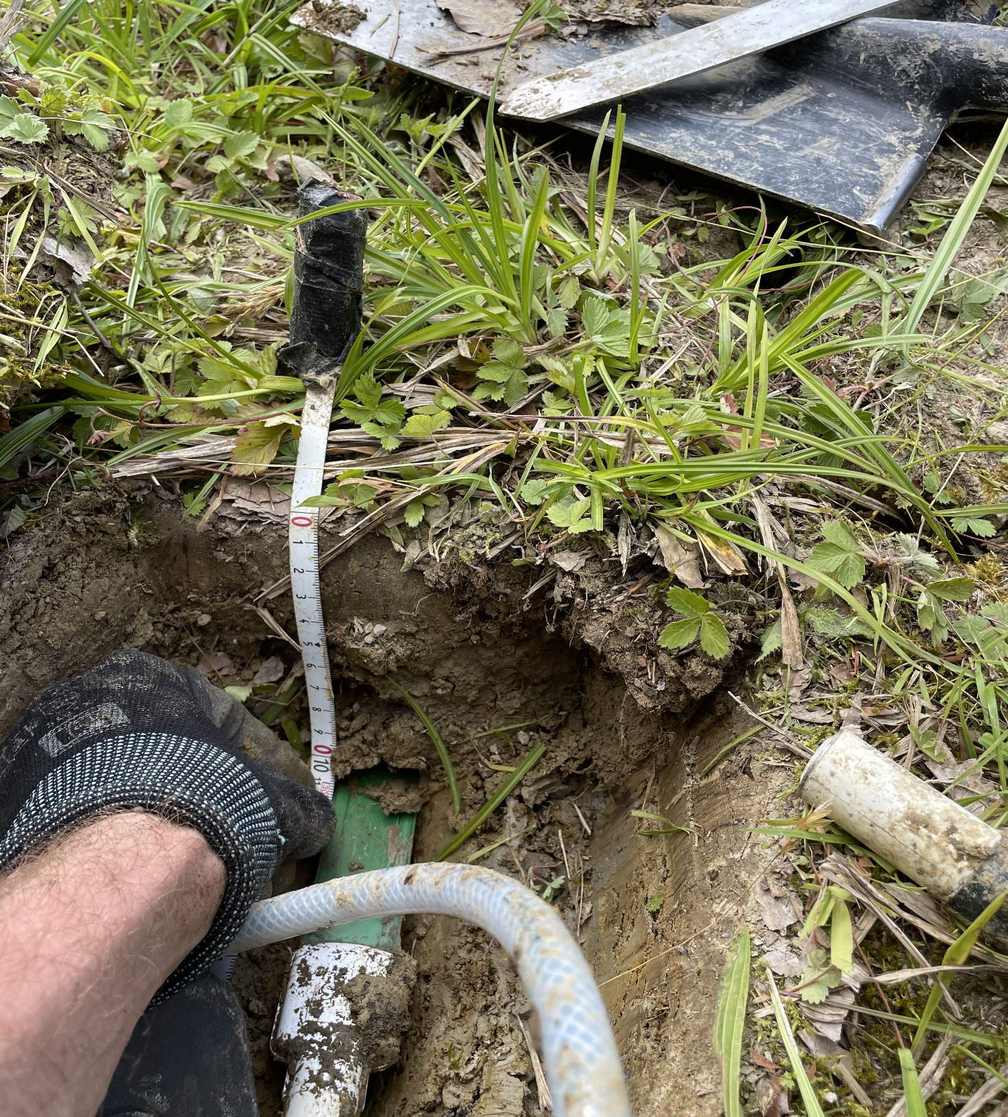
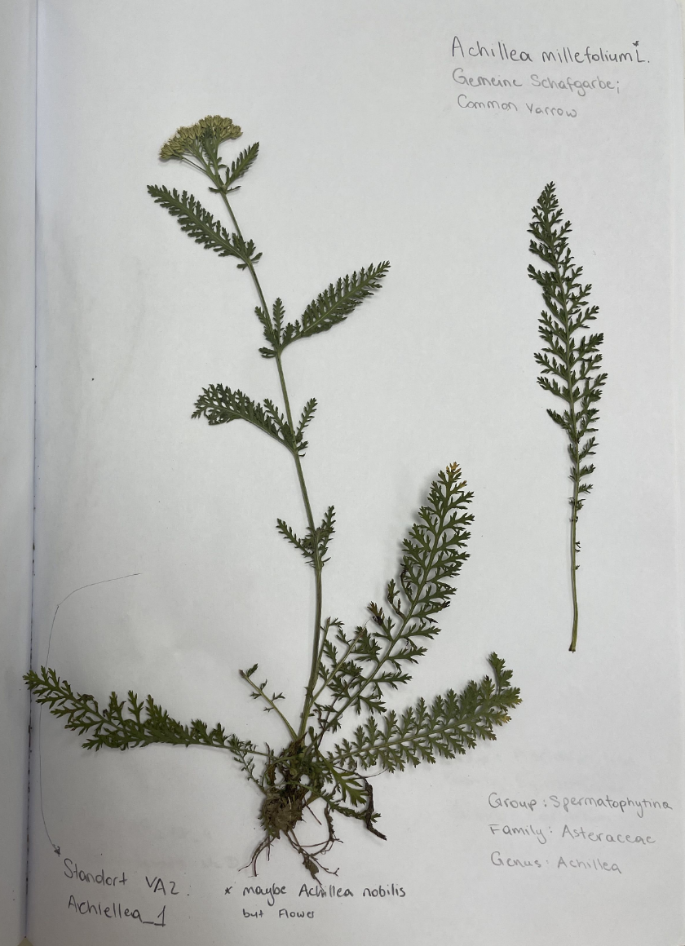
Land Use and Vegetation Monitoring
What is monitored:
Fertilization monitoring (frequency, amount, and composition of fertilizers)
Mowing monitoring (frequency and intensity)
Vegetation monitoring (species diversity and cover percentage)
How monitoring performed:
Web camera installed
Manure sampled
Vegetation height monthly monitoring
Geobotanic description performed
Fertilization with manure
Herbarium
Menu
Rationale
Research Questions
Methods
Results
Notes:
Challenging to find chamber bases -> shit happens
________
1 min

Slide 18
Preliminary Results for 2023: Beginning of the Research
Menu
Rationale
Research Questions
Methods
Results
Notes:
Challenges:
Different time of observation -> intensive campaigns
No clear significant differences so far -> use numerical values, not categorical
________
1 min

Slide 19
Preliminary Results for 2024: Full Year Observed
Menu
Rationale
Research Questions
Methods
Results
Notes:
Challenges:
Different time of observation -> intensive campaigns
No clear significant differences so far -> use numerical values, not categorical
________
1 min

Slide 20
Preliminary Results for 2025: Last Results
Menu
Rationale
Research Questions
Methods
Results
Notes:
Challenges:
Different time of observation -> intensive campaigns
No clear significant differences so far -> use numerical values, not categorical
________
1 min

Slide 21
Planned Papers
1. Literature review paper
“Deciphering the Relationship Between Slow-Moving Landslides and Greenhouse Gas Emissions in Grassland Soils: AI-Assisted Literature Review”
2. Field experiment paper
“Greenhouse Gas Dynamics in Pre-Alpine Grasslands: Common Facets of Landslide and Gas Flux Studies”
3. Laboratory experiment paper
“Laboratory Validation of Field Findings: Exploring Soil Properties and Processes Influencing Greenhouse Gas Dynamics”
Menu
Rationale
Research Questions
Methods
Results
Notes:
Innovate with the AI support,
Paper 2 covers the field experiment
Paper 3 is about the laboratory experiment
________
1 min

Slide 22
References
Bogaard, T. A., & Greco, R. (2015). Landslide hydrology: from hydrology to pore pressure. WIREs Water, 3(3), 439-459. https://doi.org/10.1002/wat2.1126
NoeSLIDE. (2014). Langzeitmonitoring gravitativer Massenbewegungen. Retrieved February 28, 2024, from https://noeslide.at/
Oertel, C., Matschullat, J., Zurba, K., Zimmermann, F., & Erasmi, S. (2016). Greenhouse gas emissions from soils A review. Chemie Der Erde-Geochemistry, 76(3), 327-352. https://doi.org/10.1016/j.chemer.2016.04.002
Smith, K. A., Thomson, P. E., Clayton, H., McTaggart, I. P., & Conen, F. (1998). Effects of temperature, water content and nitrogen fertilisation on emissions of nitrous oxide by soils [Article]. Atmospheric Environment, 32(19), 3301-3309. https://doi.org/10.1016/S1352-2310(97)00492-5
Stumvoll, M. J., Schmaltz, E. M., & Glade, T. (2021). Dynamic characterization of a slow-moving landslide system - Assessing the challenges of small process scales utilizing multi-temporal TLS data. Geomorphology, 389. https://doi.org/10.1016/j.geomorph.2021.107803
Yao, Z., Wu, X., Wolf, B., Dannenmann, M., Butterbach‐Bahl, K., Brüggemann, N., Chen, W., & Zheng, X. (2010). Soil‐atmosphere exchange potential of NO and N2O in different land use types of Inner Mongolia as affected by soil temperature, soil moisture, freeze‐thaw, and drying‐wetting events. Journal of Geophysical Research: Atmospheres, 115(D17). https://doi.org/10.1029/2009jd013528
Notes:
________
1 min

Slide 23
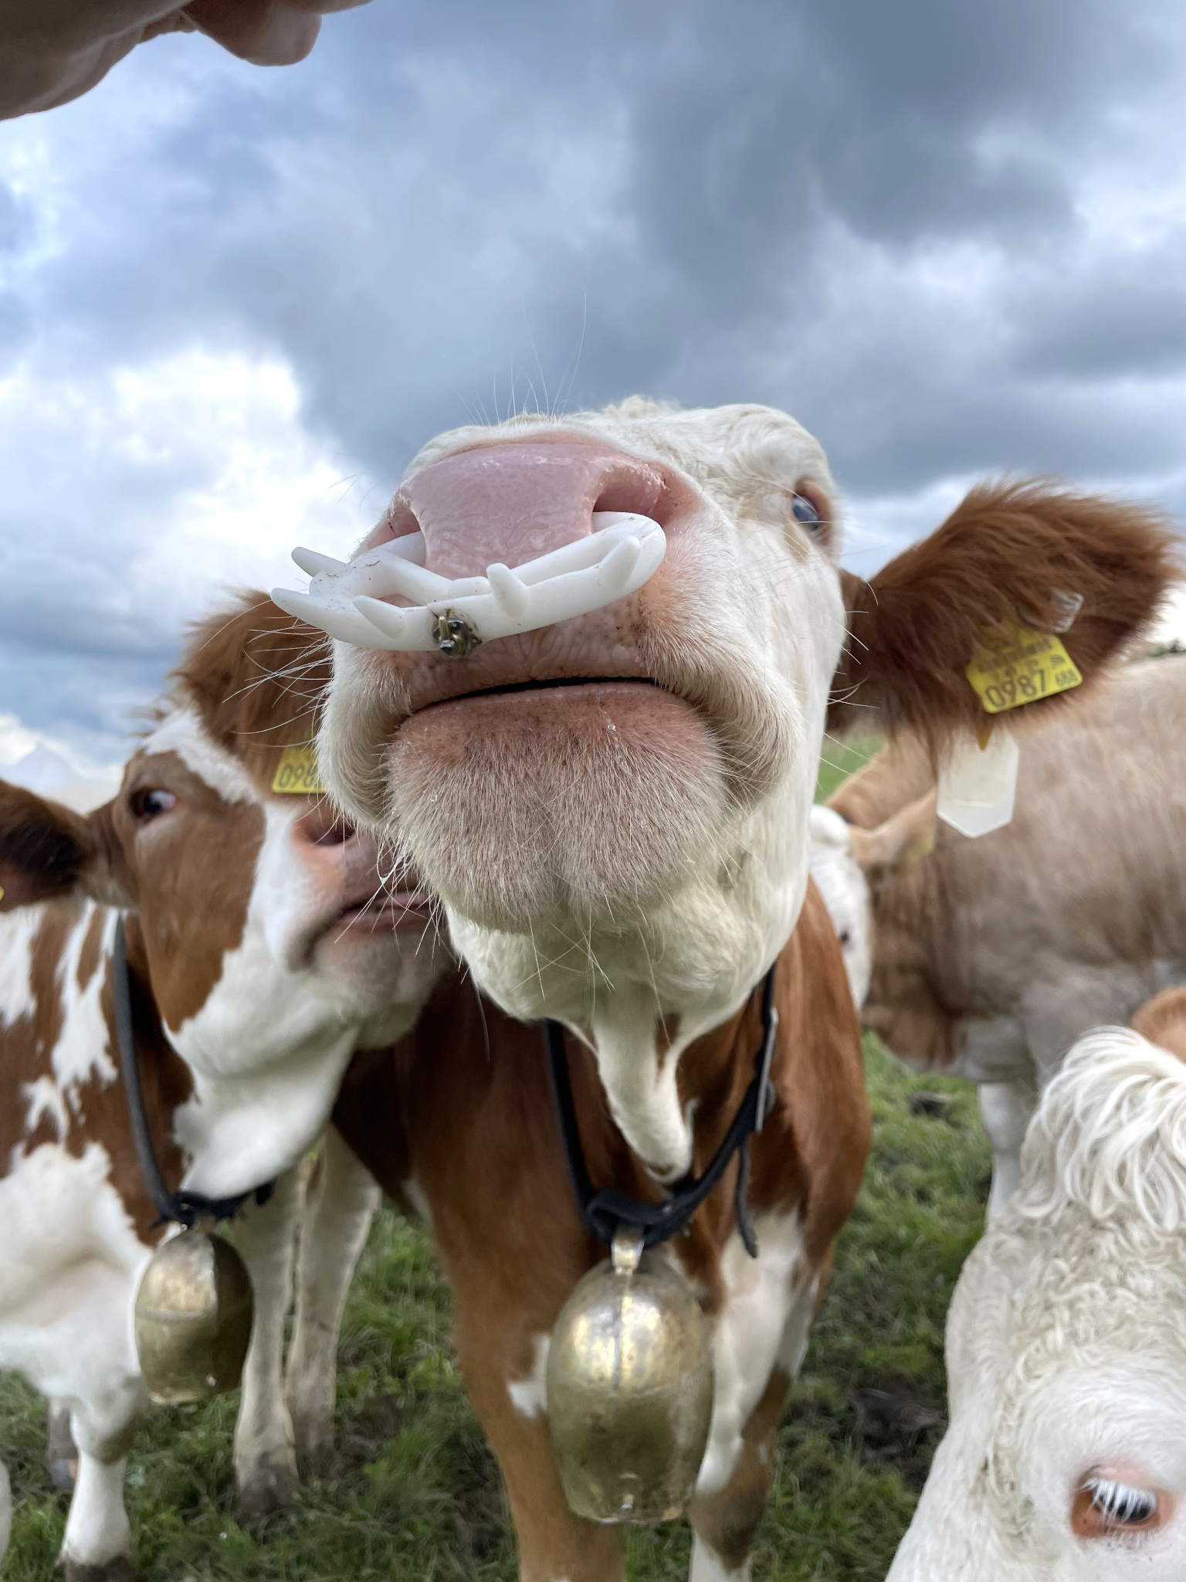
Thank you for exploring the full presentation! I'm happy to answer any questions or hear your feedback
Notes:
Aa
________
1 min

