Slide 1
CHEMICAL IONIZATION MASS SPECTROMETER
Ion source
IMR front
IMR back
Skimmer
Skimmer
Lenses
Detector
Pulser
Quadrupole
Quadrupole
IMR
BSQ
LTOF
Reflector
Organic
Compound
Reagent Ion
${NH}_{4}^{+}$
$$H_{2}O$$

Slide 2
TIME OF FLIGHT MASS DISCRIMINATOR
Detector
Detector
Pulser
Pulser
$$E_{kin}=qU=\frac{1}{2}mv^{2}$$
$$E_{pot}=qU$$
LTOF
LTOF
Reflector
Reflector
Organic
Compound
Reagent Ion
${NH}_{4}^{+}$

Slide 3
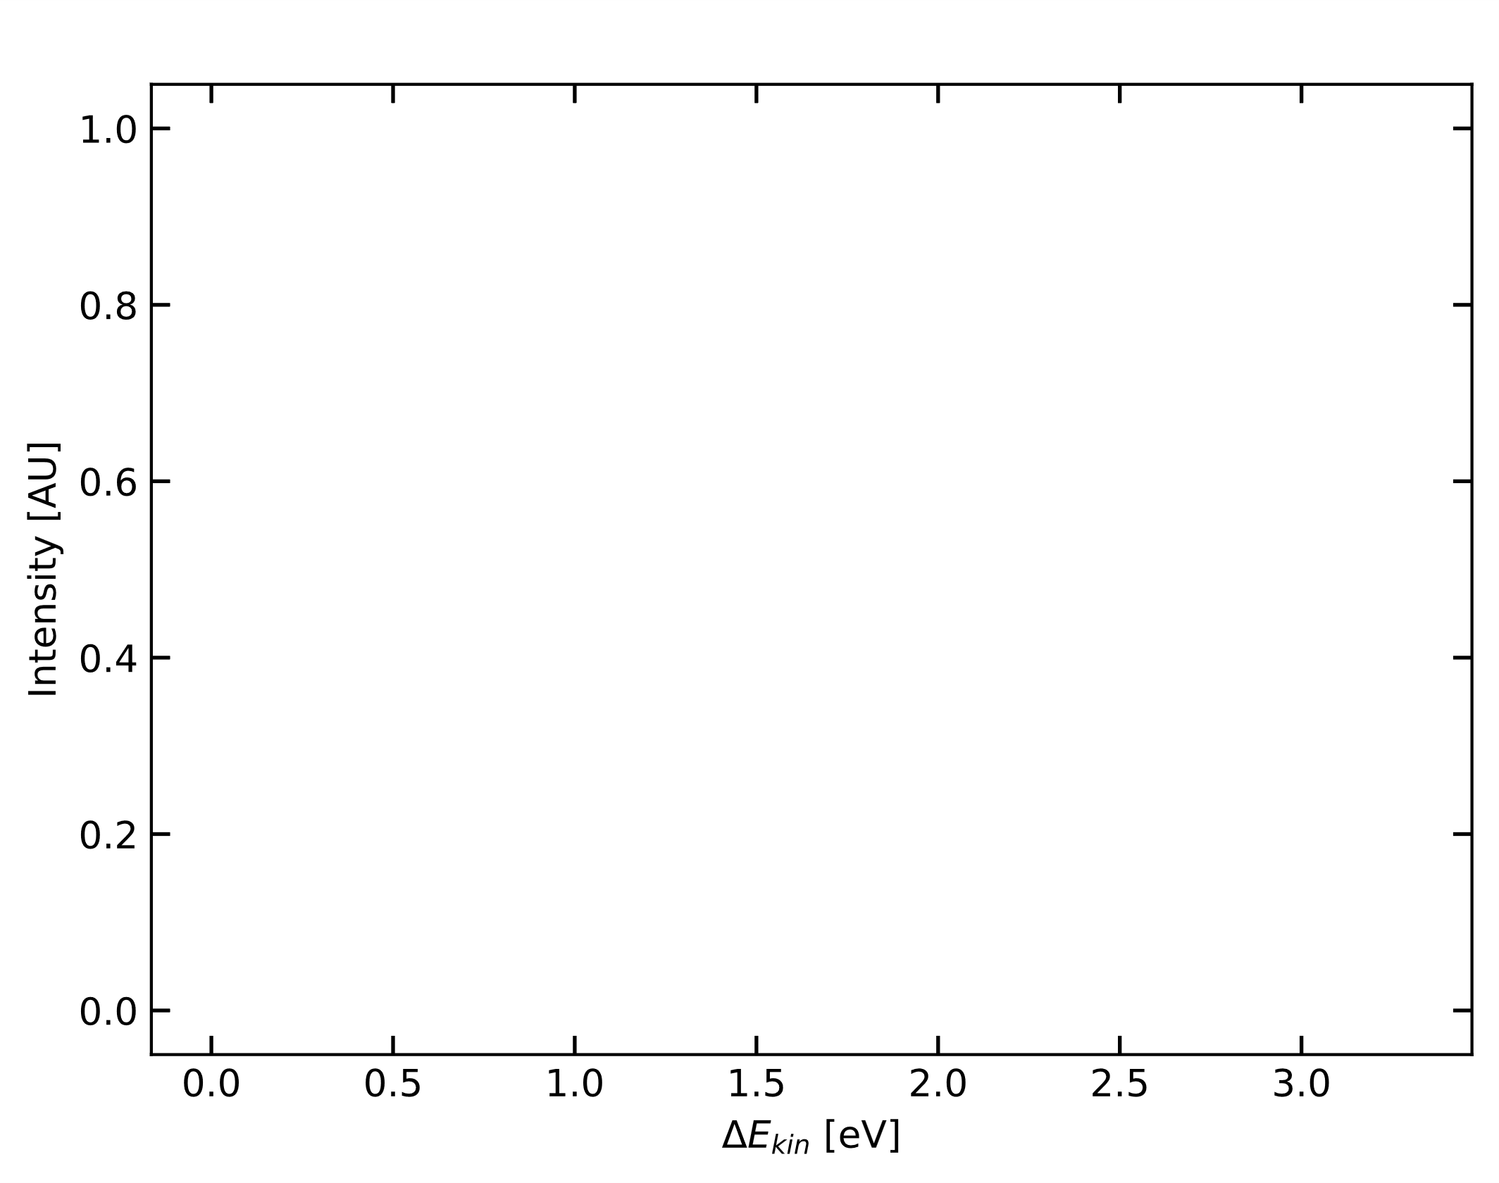
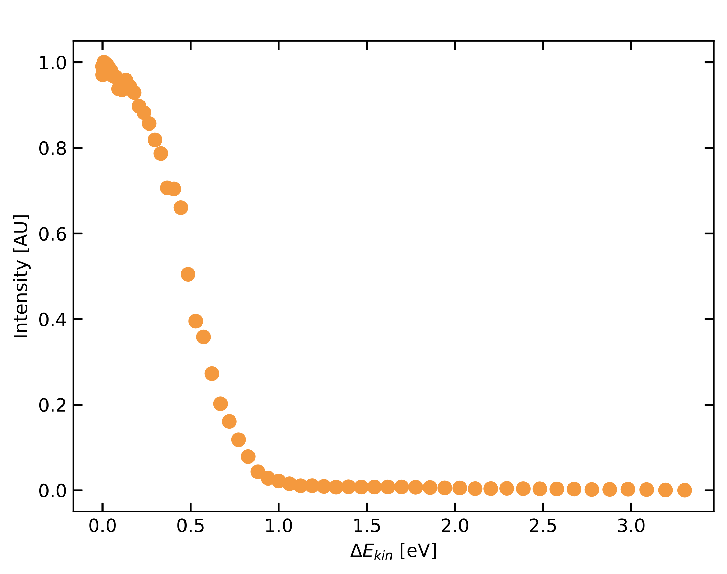
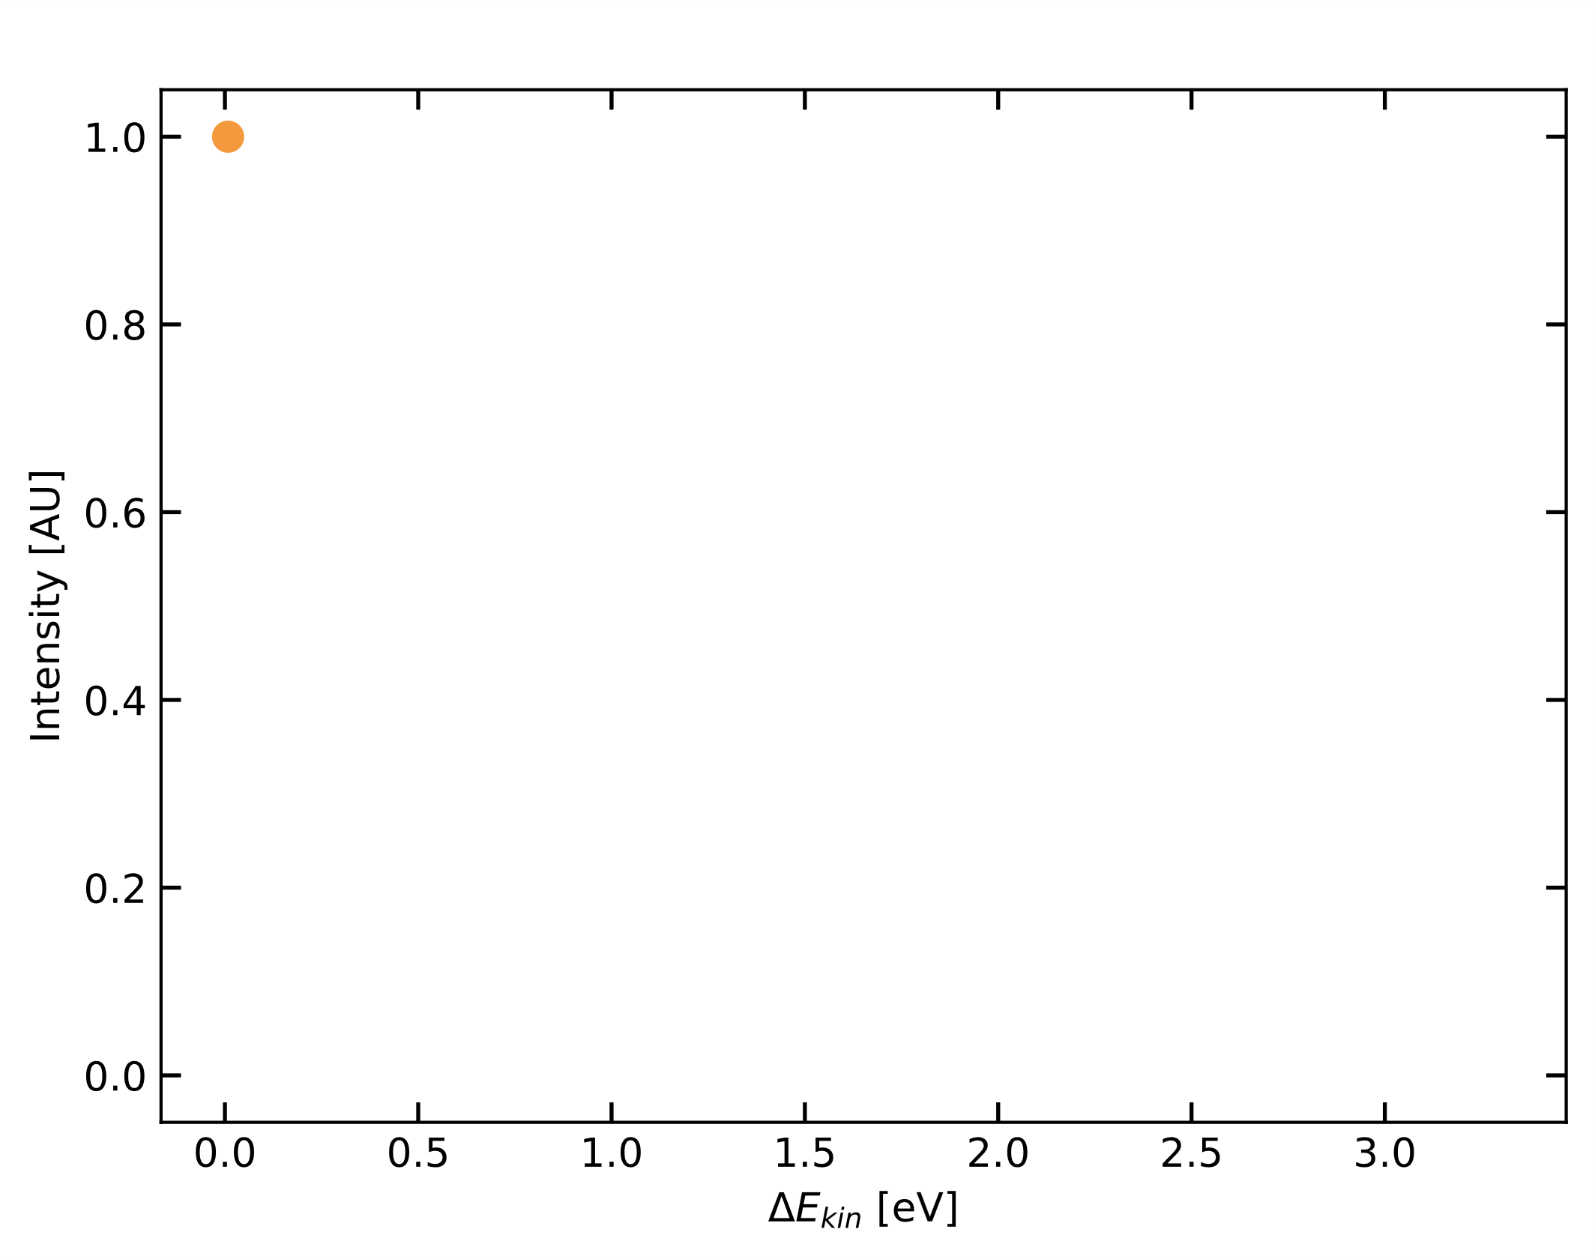
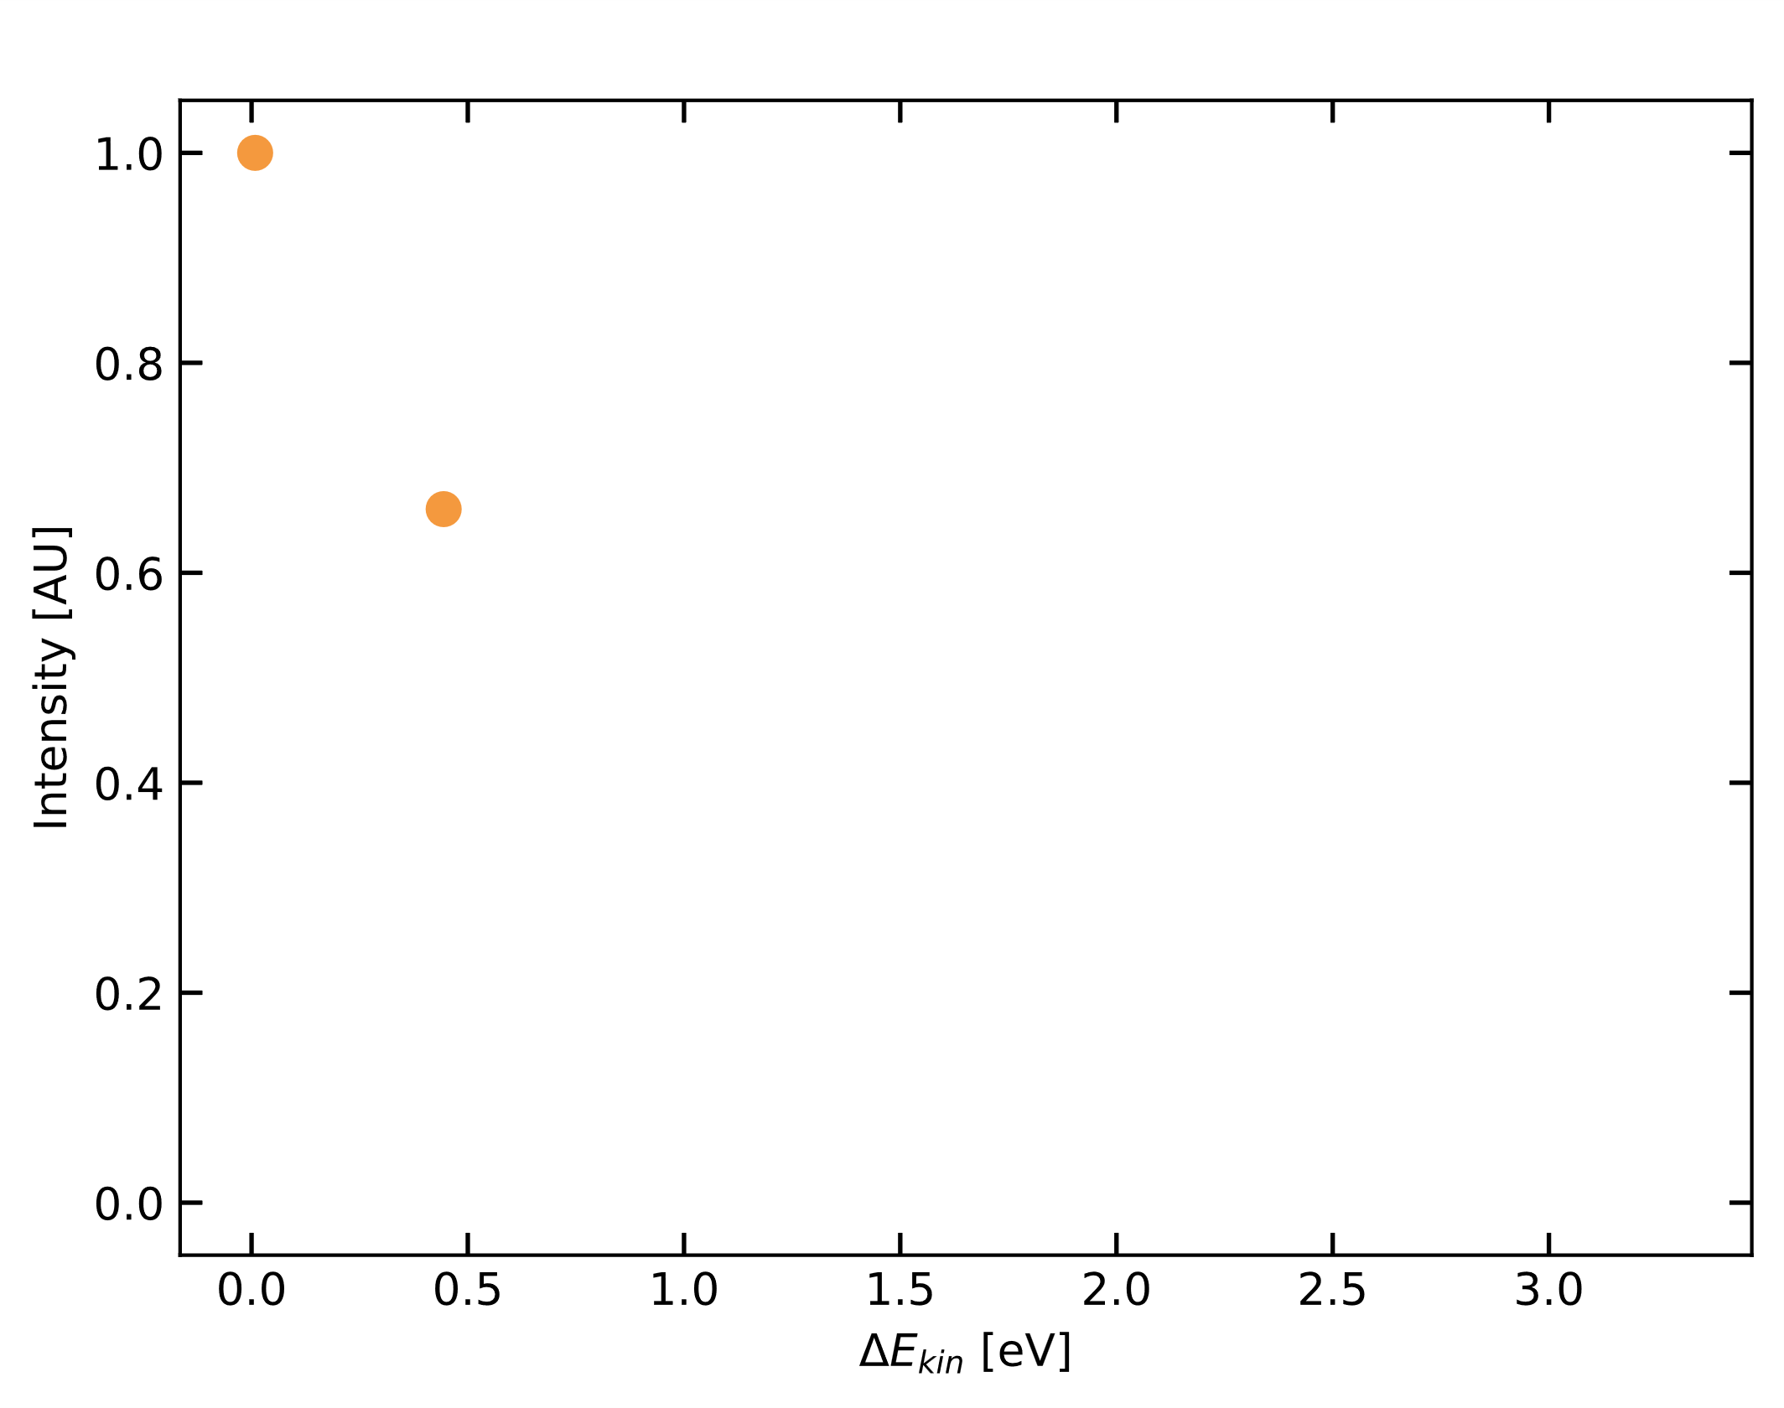
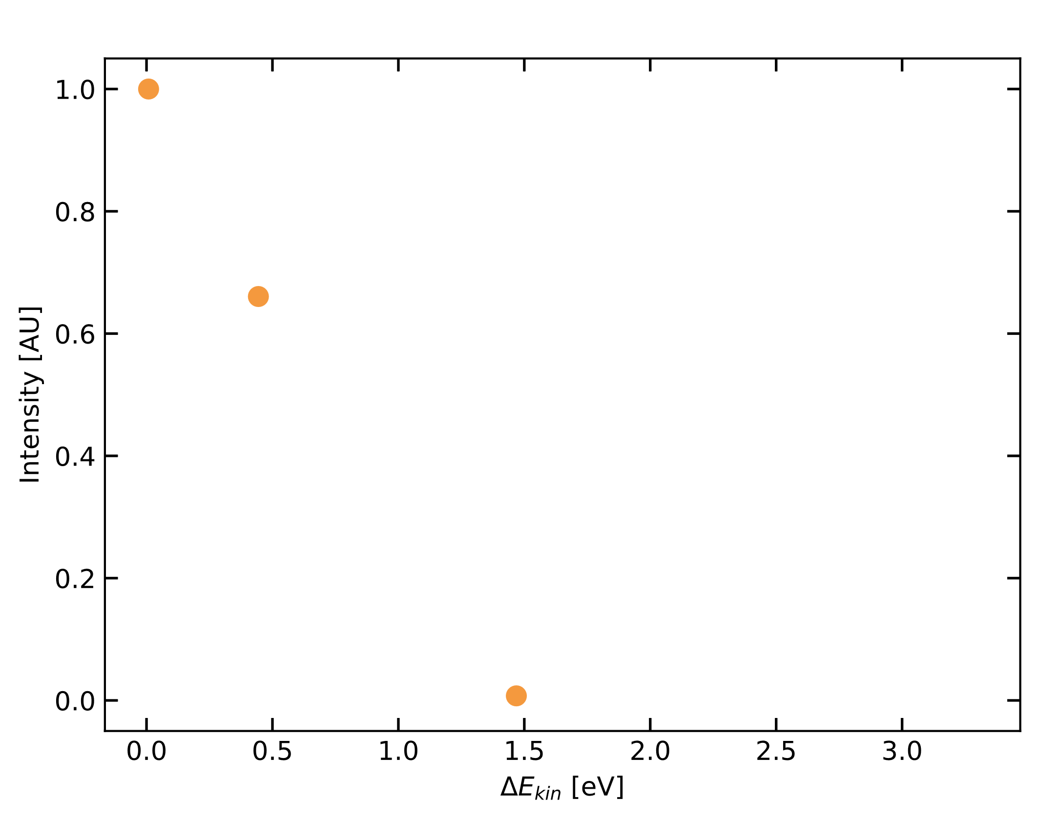
COLLISION-INDUCED-DISSOCIATION
$$\overset{⃑}{E}$$
Ion source
IMR front
IMR back
Skimmer
Skimmer
Lenses
Detector
Pulser
Quadrupole
Quadrupole
IMR
BSQ
LTOF
Reflector
Organic
Compound
Reagent Ion
${NH}_{4}^{+}$
Buffer Gas

