Slide 1
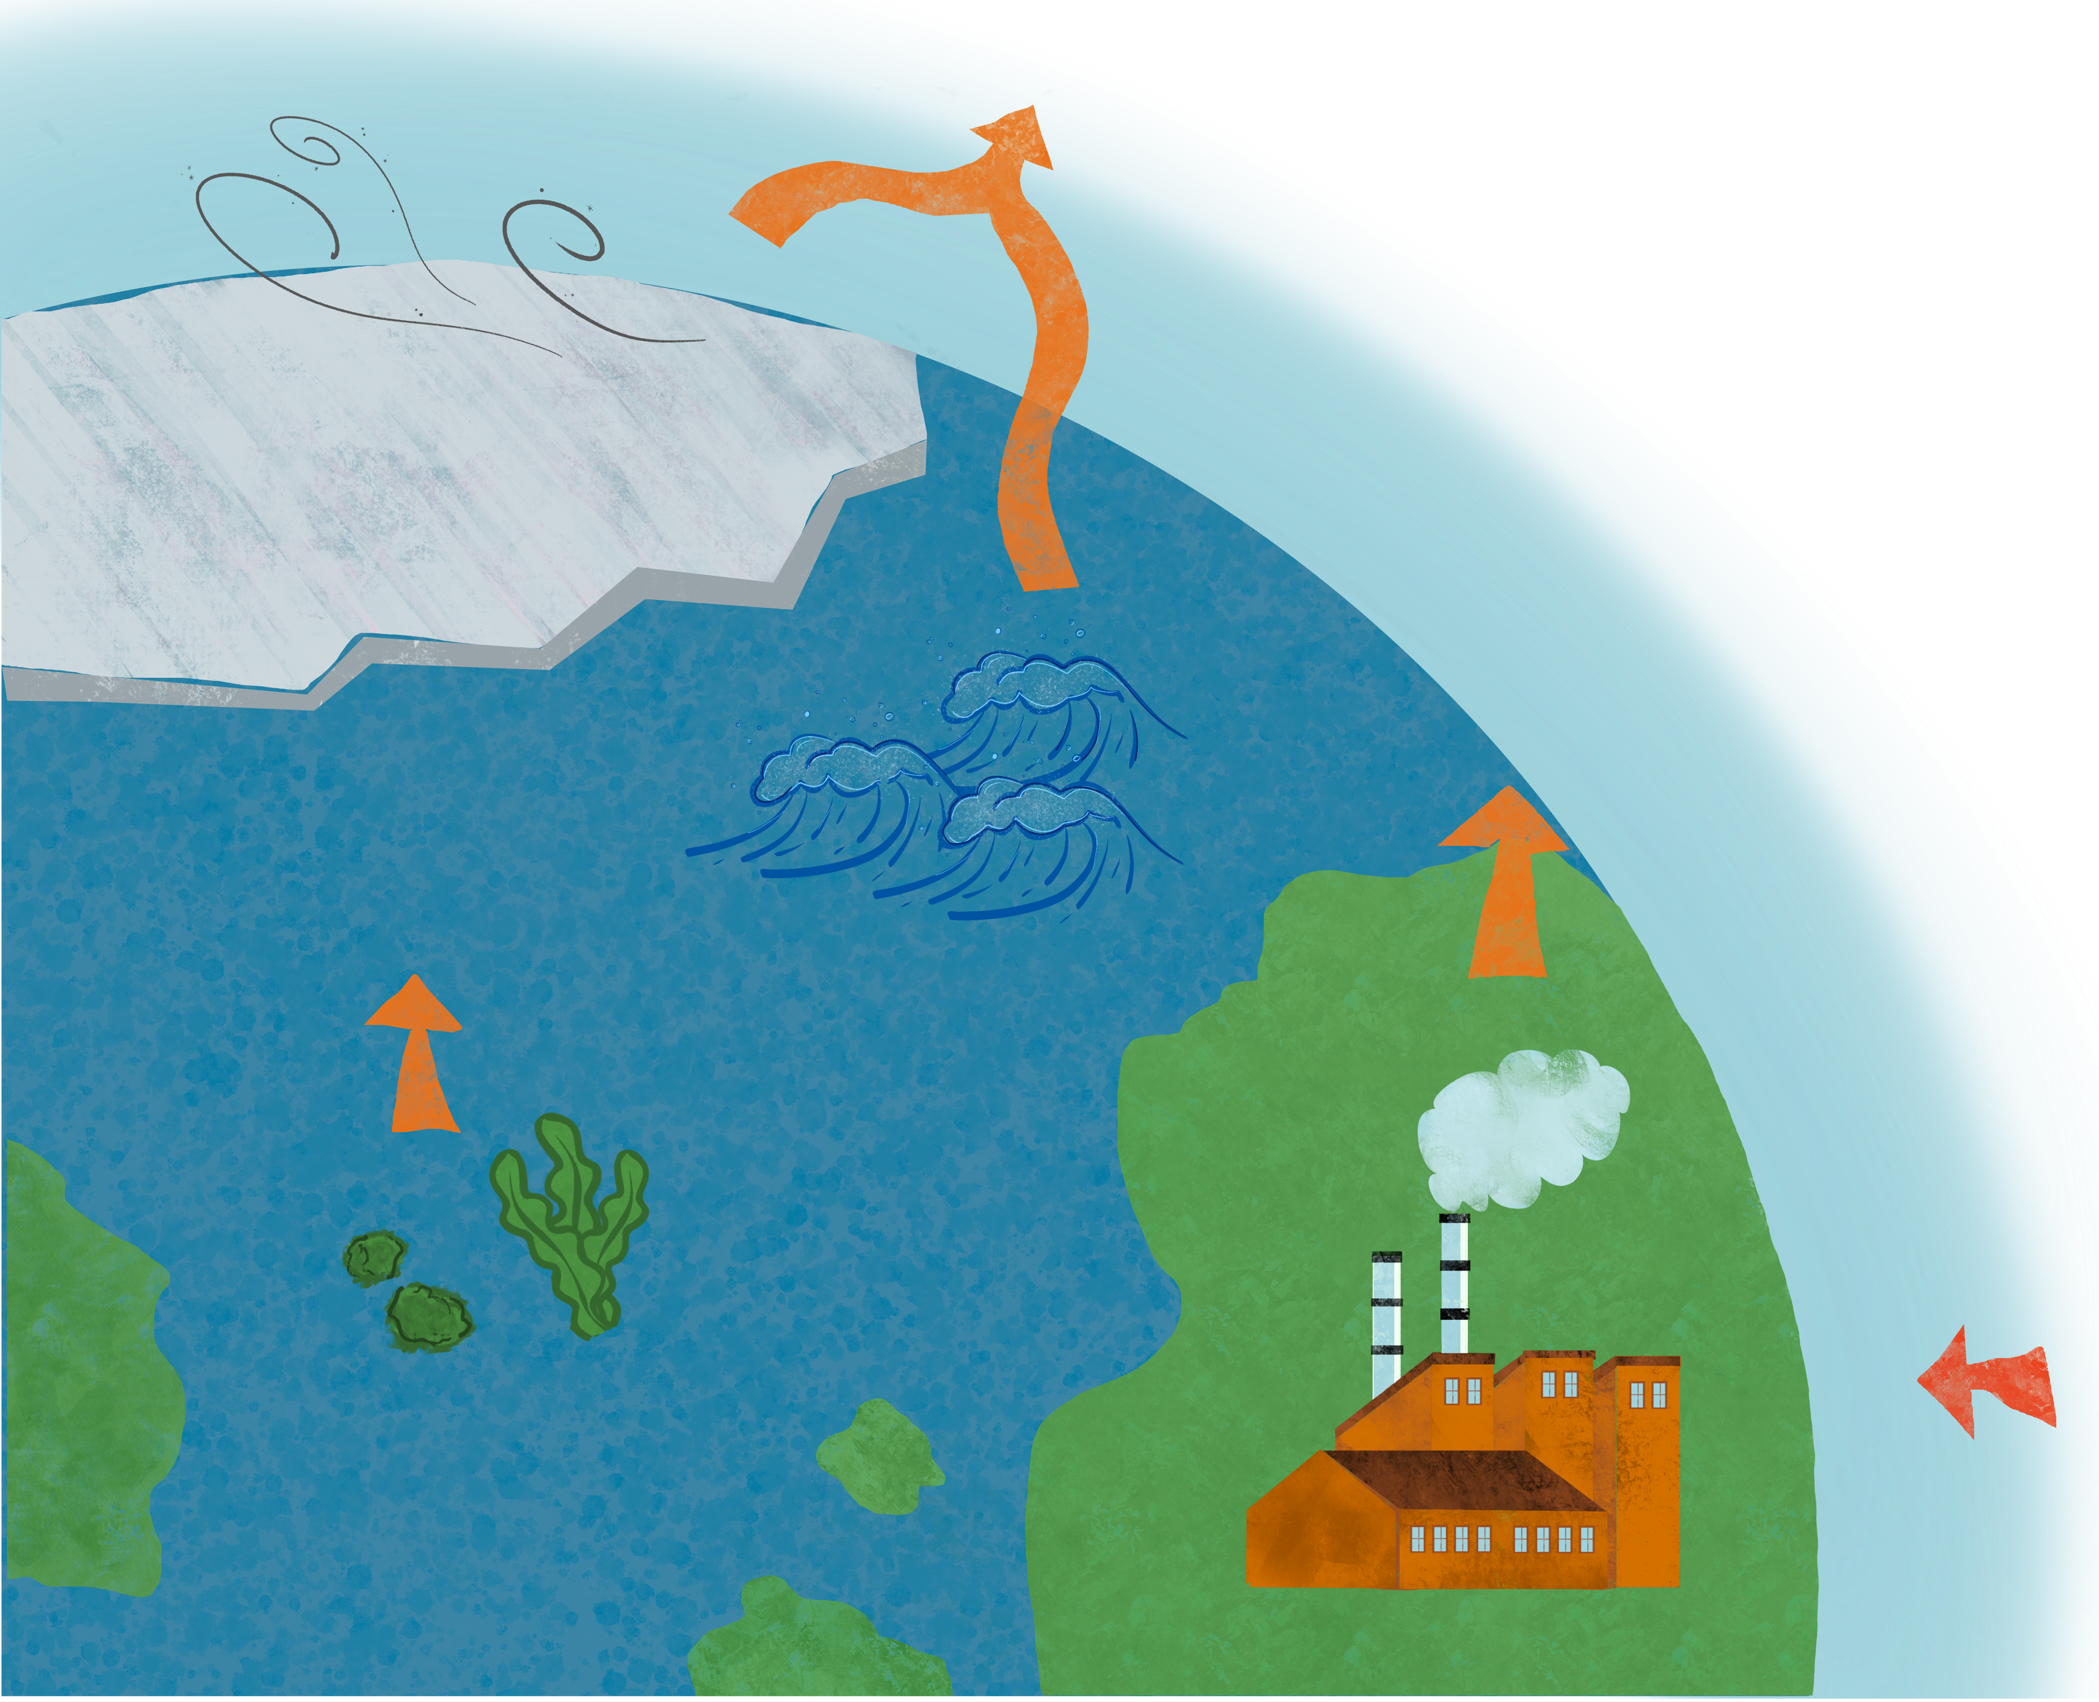




Assessing the Impacts of Bromine and Iodine Chemistry on Tropospheric Composition
Randell, J.¹, Hossaini, R.¹, Wild, O.¹, Mazzeo, A.¹, Hou, X.¹
METHODS
¹ Lancaster University (j.Randell@lancaster.ac.uk)
Br AND I
EVALUATION
IMPACTS
NEXT STEPS
SENSITIVITY STUDIES

Slide 2
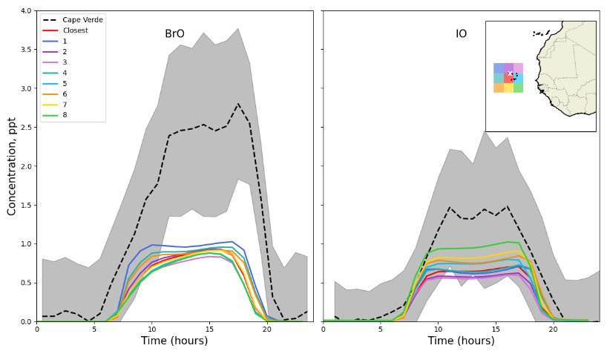
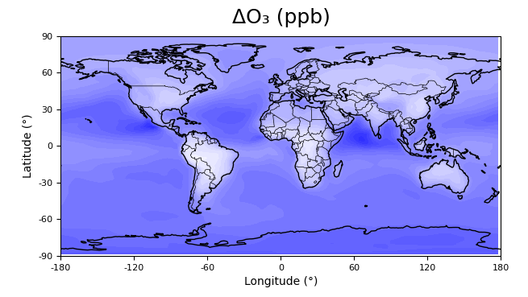
SUMMARY
Model evaluation against observational datasets e.g. Cape Verde observations from Mahajan et al. 2010
Model:
FRSGC/UCI CTM
Key Features:
Added in detailed description of bromine chemistry
  Sources: VSL Bromocarbons, CH₃Br, sea-salt aerosol, transport from the stratosphere
  Gas-phase, photochemical and heterogenous reactions
Updated exisiting iodine chemistry scheme
Experiments:
  Base - no halogen chemistry
  Br + I - added bromine and iodine chemistry
METHODS
Br AND I
EVALUATION
Preliminary
IMPACTS
NEXT STEPS
SENSITIVITY STUDIES
Global decrease in O₃ observed of up to 10ppb
Notes:
WHAT DONE → E.g. added chem
Model validation
Key impacts of this added chemistry are preliminary a global decrease in ozone with the greatest effect seen over the ocean and polar regions. If you’re interested in discussing the results / next stegs then please find me at pico spot XXX

Slide 3
Assessing the Impacts of Bromine and Iodine Chemistry on Tropospheric Composition
Randell, J.¹, Hossaini, R.¹, Wild, O.¹, Mazzeo, A.¹, Hou, X.¹
METHODS
¹ Lancaster University (j.Randell@lancaster.ac.uk)
Br AND I
EVALUATION
IMPACTS
NEXT STEPS
SENSITIVITY STUDIES

Slide 4
MOTIVATION AND OBJECTIVES
Reactive bromine and iodine species influence the oxidative capacity of the troposphere through multiple pathways:
  Directly, via the catalytic destruction of ozone
  Indirectly, by altering the partitioning and cycling of key radical species such as HO_{x} (OH + HO₂) and NO_{x} (NO + NO₂)
While several global modelling studies have demonstrated the significance of halogen chemistry in the troposphere, substantial uncertainties remain—particularly regarding emission sources, reaction pathways, and the magnitude of their impacts.
Our Aims:
  Implement a new representation of bromine chemistry alongside an updated iodine scheme in a global model
  Use this framework to analyse recent observations of tropospheric halogens
  Quantify the impacts of bromine and iodine on tropospheric oxidant chemistry, including ozone and OH
METHODS
Br AND I
EVALUATION
IMPACTS
NEXT STEPS
SENSITIVITY STUDIES

Slide 5
METHODS AND MODEL (1/2)
Model:
FRSGC/UCI CTM
Simulations run at T42 (2.8° × 2.8°) resolution with 57 vertical levels
Fully resolved chemistry
Key Features:
Added in detailed description of bromine chemistry
  Sources
    CHBr₃, CH₂Br₂, CH₂BrCl, CHBr₂Cl, CHBrCl₂
    CH₃Br
    Sea-salt aerosol debromination
    Transport from the stratosphere
  Gas-phase, photochemical and heterogenous chemistry added
    Detailed description of the chemistry added can be found HERE
METHODS
Br AND I
EVALUATION
IMPACTS
NEXT STEPS
SENSITIVITY STUDIES

Slide 6
METHODS AND MODEL (2/2)
Key Features (continued.):
Updated iodine chemistry scheme
  Updated uptake coefficients for heterogeneous reactions
  Sensitivity studies run with different uptake coefficients for HOI → 0.5ICl + 0.5IBr on sea-salt aerosol (Li et al. 2022) - results can be viewed HERE
  Sources:
    CH₃I, CH₂I₂, CH₂ICl, CH₂IBr
    HOI and I₂ released from aqueous iodide reacting with atmospheric ozone at the sea surface
  Gas-phase, photochemical and heterogenous chemistry scheme for iodine can be viewed in detail HERE
Experiments:
Base - no bromine and iodine chemistry
Br + I - with added bromine and iodine chemistry
METHODS
Br AND I
EVALUATION
IMPACTS
NEXT STEPS
SENSITIVITY STUDIES

Slide 7
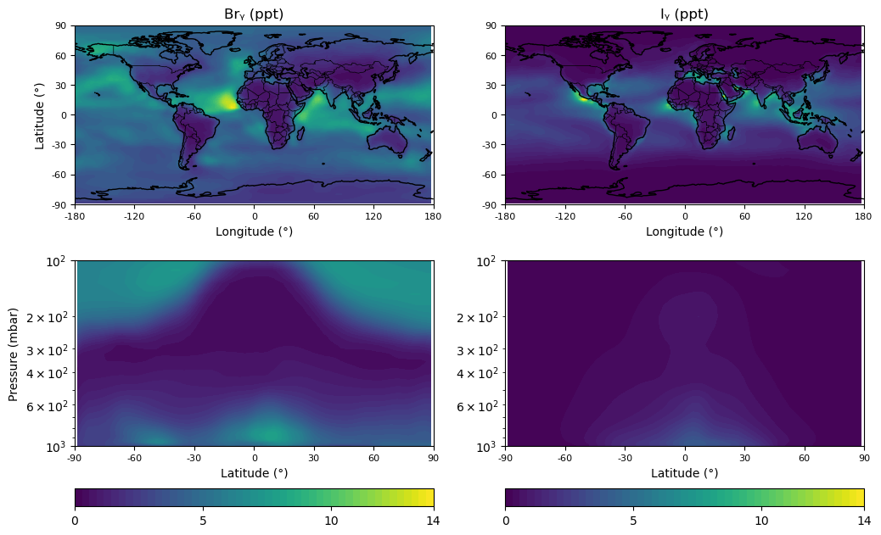
GLOBAL BUDGET AND DISTRIBUTION OF
TROPOSPHERIC Br AND I (1/8)
METHODS
Br AND I
EVALUATION
IMPACTS
NEXT STEPS
SENSITIVITY STUDIES
Highest mixing ratios in the tropics
Notes:
- Surface and zonal concentrations of annual mean Iy and Bry
Surface and zonal concentrations of annual mean IO and BrO
SHERWEN ET AL. 2016

Slide 8
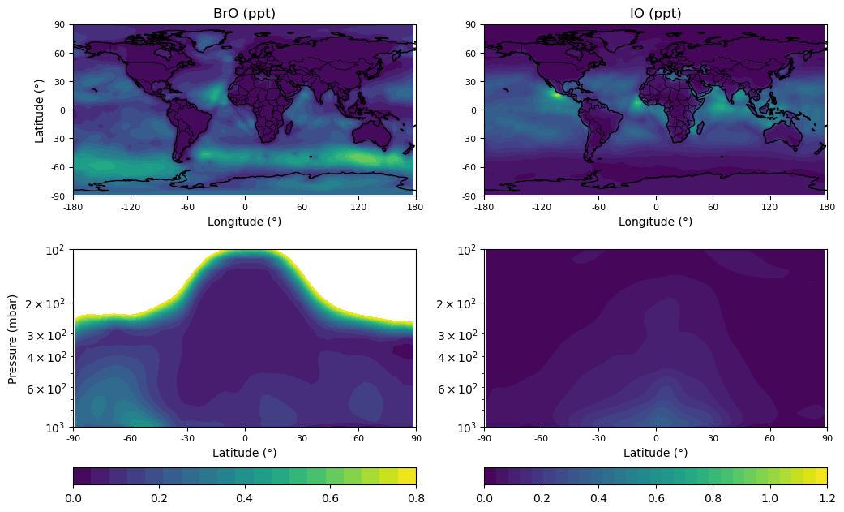
GLOBAL BUDGET AND DISTRIBUTION OF
TROPOSPHERIC Br AND I (2/8)
BrO: Slightly lower mixing ratios compared to other studies. Higher mixing ratios over the Southern Ocean associated with high SSA
IO: Highest mixing ratios over tropical oceans
METHODS
Br AND I
EVALUATION
IMPACTS
NEXT STEPS
SENSITIVITY STUDIES

Slide 9
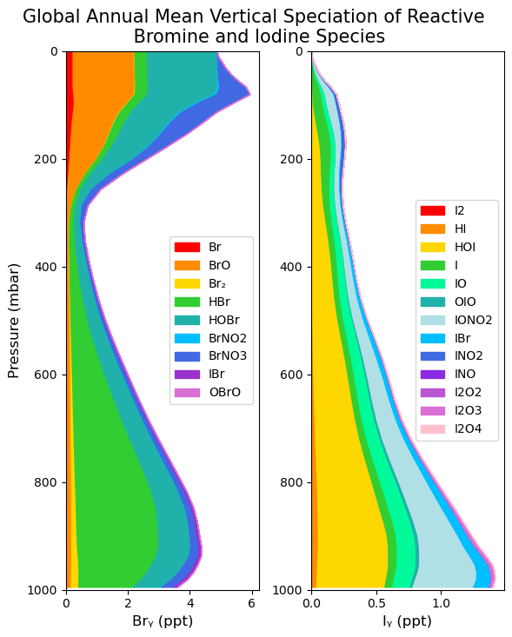
GLOBAL BUDGET AND DISTRIBUTION OF
TROPOSPHERIC Br AND I (3/8)
METHODS
Br AND I
The figure shows the global annual mean vertical speciation of reactive bromine and iodine species
EVALUATION
IMPACTS
NEXT STEPS
SENSITIVITY STUDIES

Slide 10
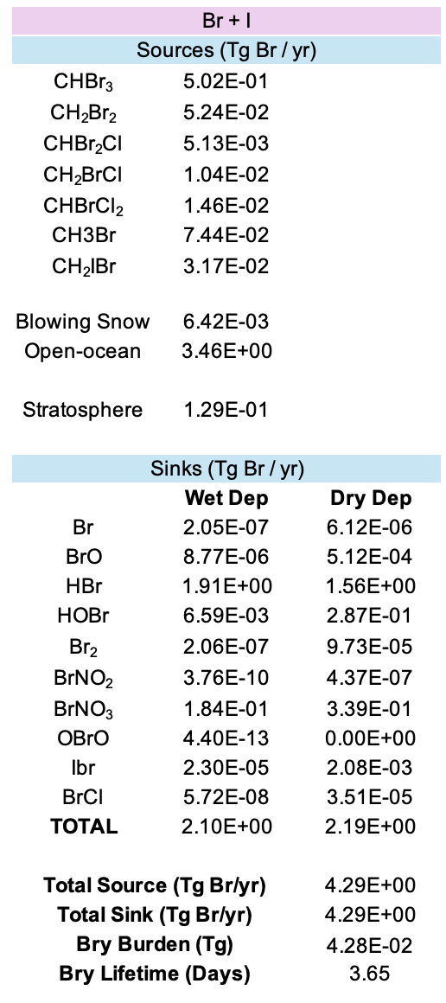
GLOBAL BUDGET AND DISTRIBUTION OF
TROPOSPHERIC Br AND I (4/8)
METHODS
The table lists the global sources and sinks of tropospheric bromine in the FRSGC/UCI CTM
We calculate a tropospheric lifetime of ~3.7 days for Bry
Br AND I
EVALUATION
IMPACTS
NEXT STEPS
SENSITIVITY STUDIES

Slide 11
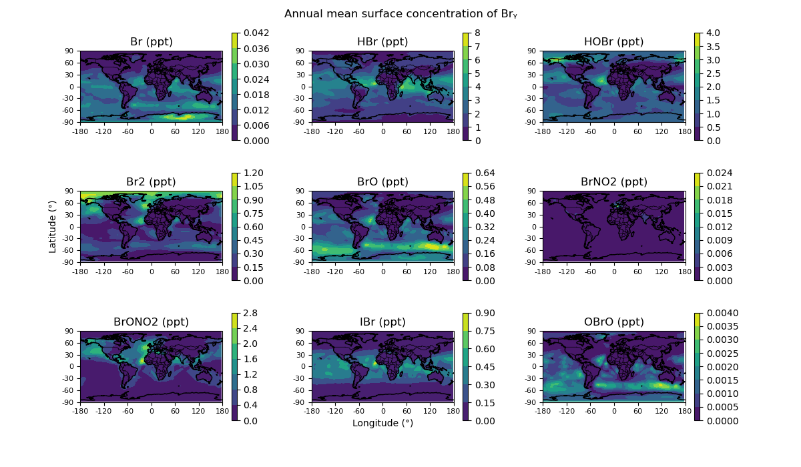
GLOBAL BUDGET AND DISTRIBUTION OF
TROPOSPHERIC Br AND I (5/8)
METHODS
Br AND I
EVALUATION
IMPACTS
NEXT STEPS
SENSITIVITY STUDIES

Slide 12
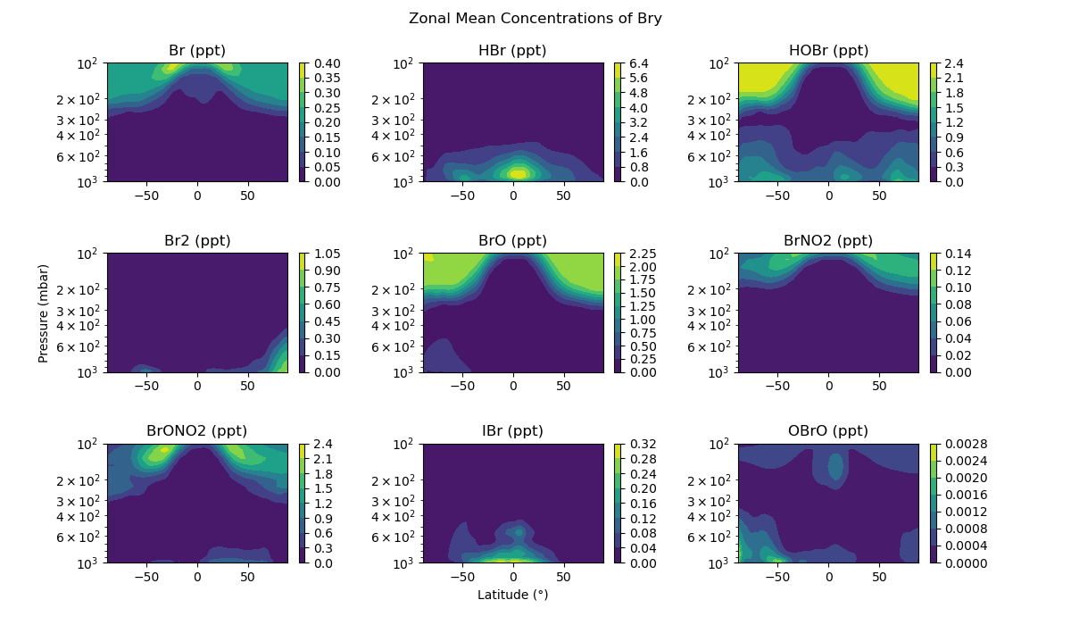
GLOBAL BUDGET AND DISTRIBUTION OF
TROPOSPHERIC Br AND I (6/8)
METHODS
Br AND I
EVALUATION
IMPACTS
NEXT STEPS
SENSITIVITY STUDIES

Slide 13
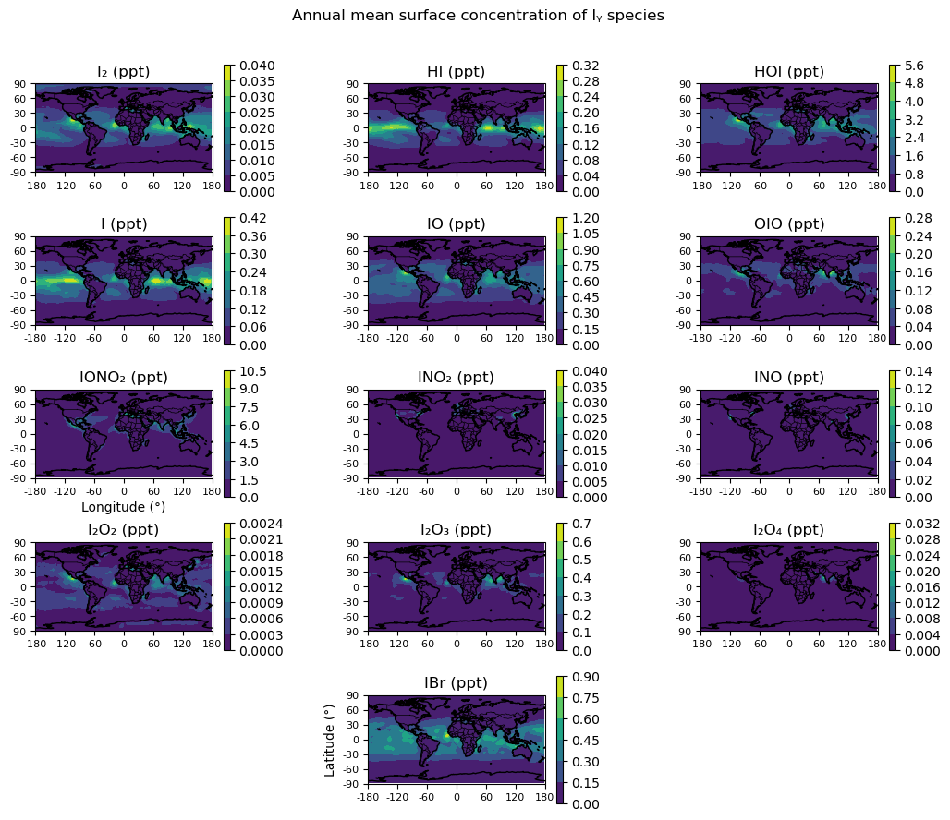
GLOBAL BUDGET AND DISTRIB-UTION (7/8)
METHODS
Br AND I
EVALUATION
IMPACTS
NEXT STEPS
SENSITIVITY STUDIES

Slide 14
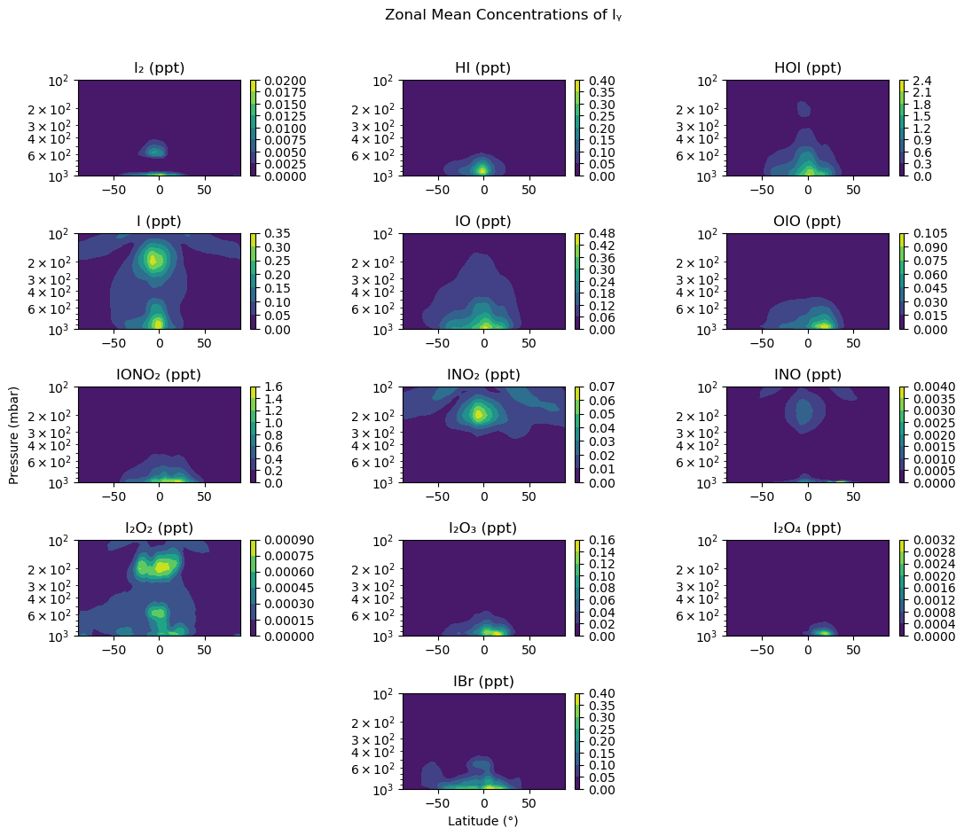
GLOBAL BUDGET AND DISTRIB-UTION (8/8)
METHODS
Br AND I
EVALUATION
IMPACTS
NEXT STEPS
SENSITIVITY STUDIES

Slide 15
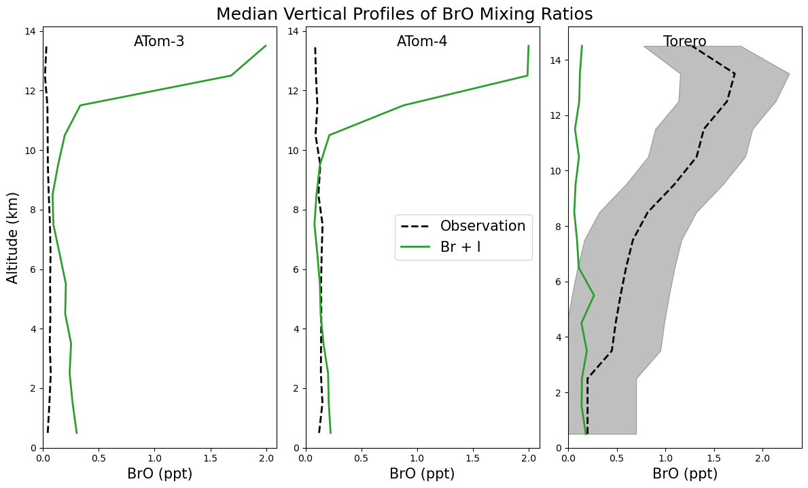
MODEL EVALUATION (1/4)
Modelled BrO reasonably consistent with ATom observations in the MBL but much higher in the upper troposphere where transport from the stratosphere becomes important in the model
In contrast, model much lower than Torero in the upper troposphere
METHODS
Br AND I
EVALUATION
IMPACTS
NEXT STEPS
SENSITIVITY STUDIES

Slide 16
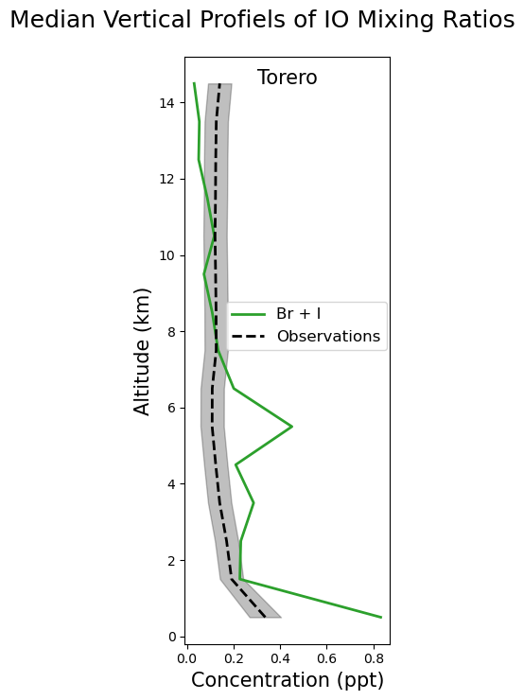
MODEL EVALUATION (2/4)
Comparison of IO against observations from TORERO. Agreement improves for the upper troposphere where there is little IO measured
METHODS
Br AND I
EVALUATION
IMPACTS
NEXT STEPS
SENSITIVITY STUDIES

Slide 17
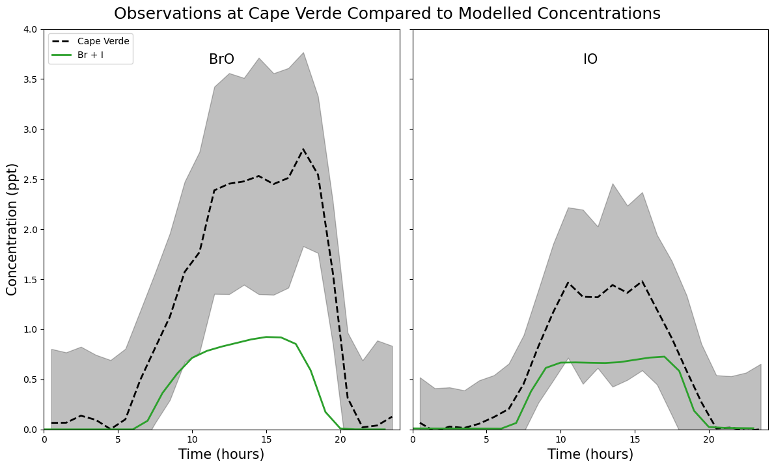
MODEL Evaluation (3/4)
METHODS
Br AND I
EVALUATION
IMPACTS
NEXT STEPS
SENSITIVITY STUDIES
BrO and IO surface observations from Cape Verde (Mahajan et al. 2010 and Read et al. 2008 ) against the “Br + I” simulation
Results from a sensitivity study exploring how sampling the model affects the comparison can be found HERE

Slide 18
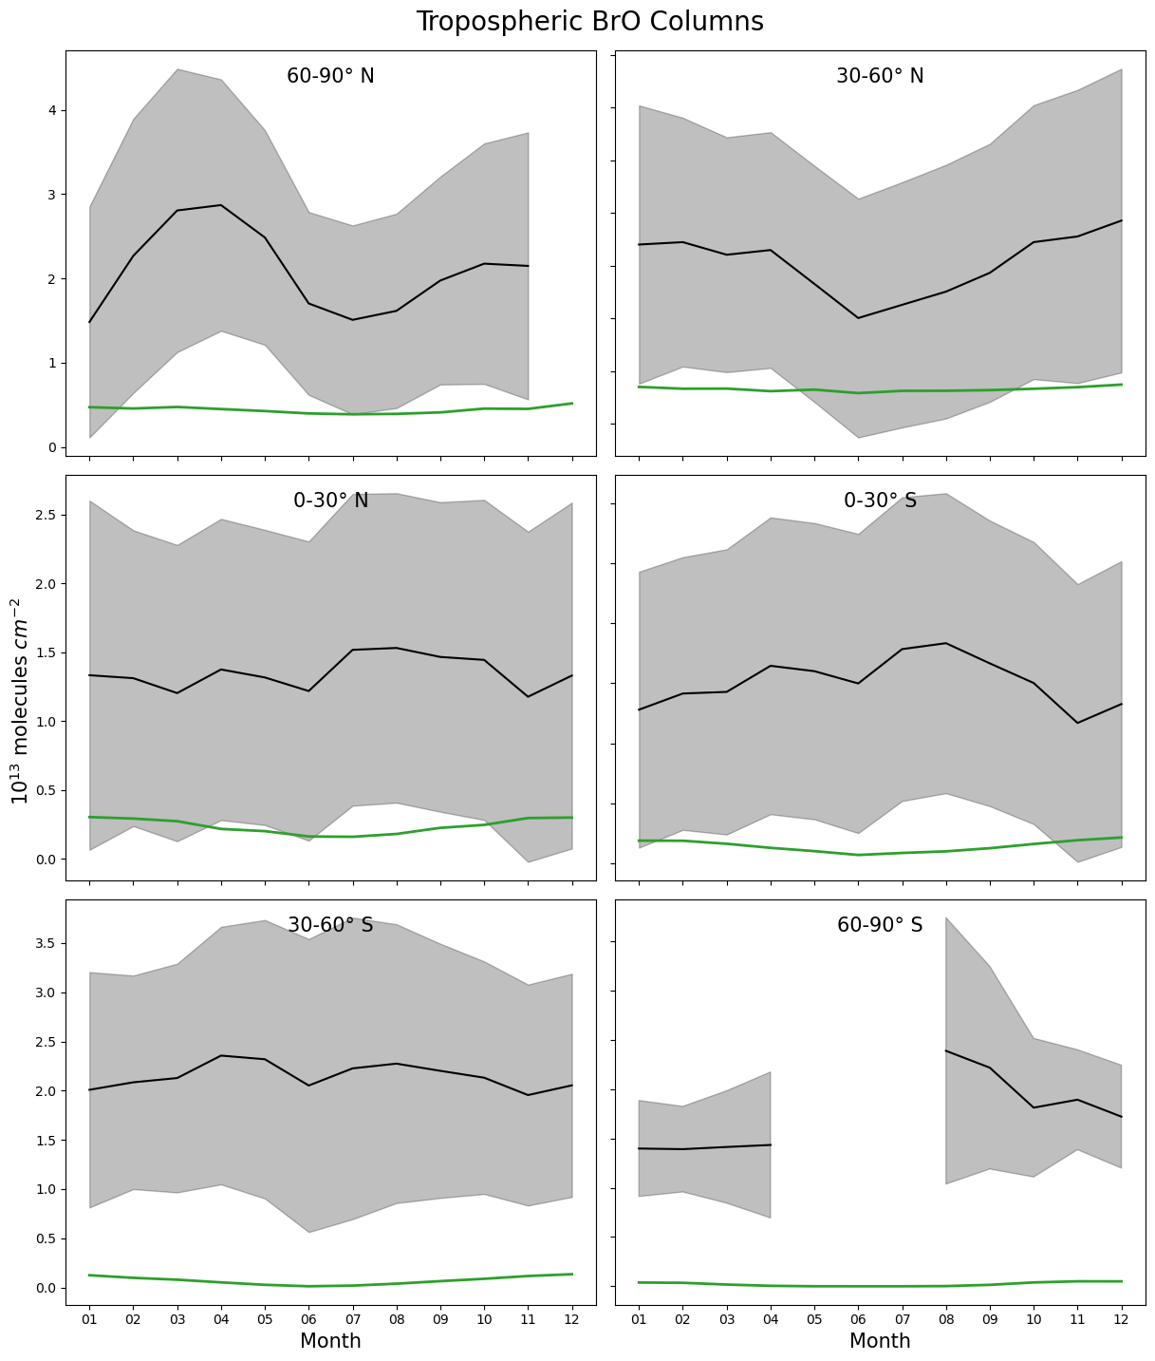
MODEL EVALUATION (4/4)
METHODS
Simulated BrO tropospheric columns compared to GOME-2 satellite data (Theys et al. 2011)
Consistency is poor between the model and observations
Br AND I
EVALUATION
IMPACTS
NEXT STEPS
SENSITIVITY STUDIES

Slide 19
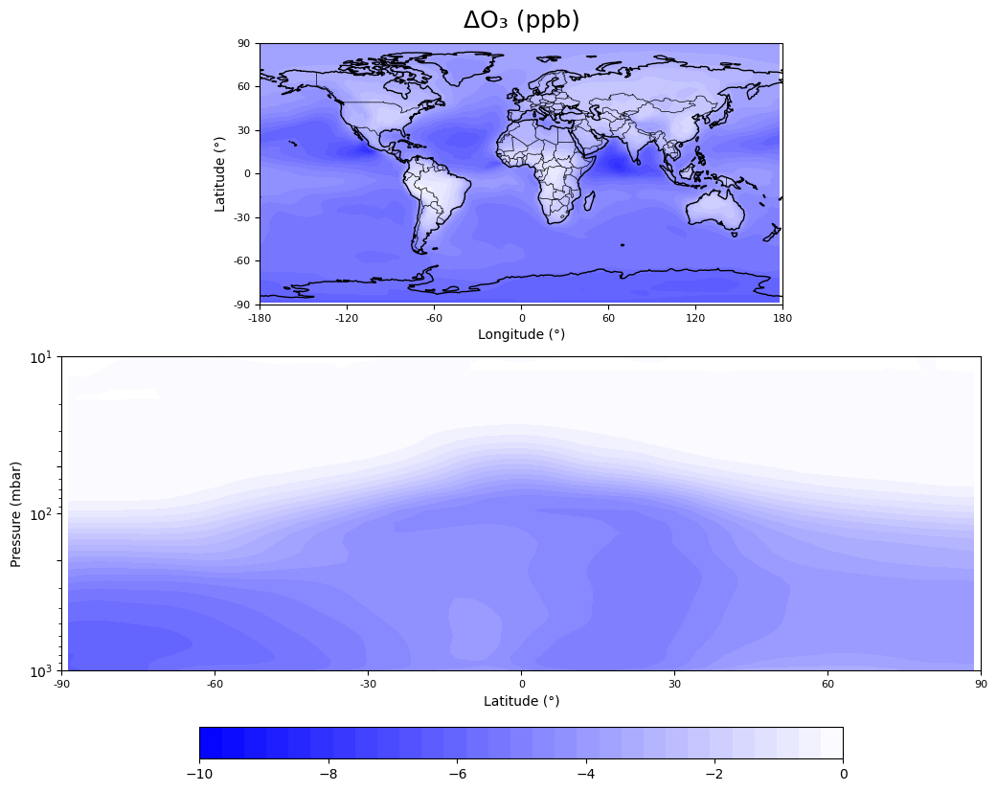
KEY IMPACTS
“Br + I” run compared to BASE run
Adding in bromine and iodine chemistry leads to a global decrease in tropospheric ozone concentrations
Largest effect observed over oceanic and polar regions
METHODS
Br AND I
EVALUATION
IMPACTS
NEXT STEPS
SENSITIVITY STUDIES

Slide 20
MAIN TAKEAWAYS (1/2)
The model incorporates the major known chemical pathways and sources of bromine and iodine.
There is partial agreement with observations, though some discrepancies may indicate issues with Bry speciation in the model
Preliminary results indicate a reduction in tropospheric ozone due to halogen chemistry, consistent with expectations and highlighting the importance of bromine and iodine in oxidant regulation
METHODS
Br AND I
EVALUATION
IMPACTS
NEXT STEPS
SENSITIVITY STUDIES

Slide 21
NEXT STEPS (2/2)
Short Term:
Investigate potential issues in Bry speciation – suggestions and feedback welcome
Quantify the effect of halogen chemistry on tropospheric ozone
Assess impacts on other key oxidants, particularly OH
Perform targeted simulations:
  "I only" and "Br only" runs to isolate and compare their individual contributions
Future Work:
Compare halogen impacts on the ozone budget between the pre-industrial and present-day atmospheres
Conduct a sensitivity analysis to identify key drivers of uncertainty in halogen-related oxidant impacts
METHODS
Br AND I
EVALUATION
IMPACTS
NEXT STEPS
SENSITIVITY STUDIES

Slide 22
CAPE VERDE COMPARISON: SENSITIVITY STUDY
METHODS
Br AND I
EVALUATION
IMPACTS
NEXT STEPS
SENSITIVITY STUDIES
BrO and IO surface observations from Cape Verde (Mahajan et al. 2010 and Read et al. 2008 ) against the “Br + I” simulation
Model sampled in surrounding grid cells to explore variation

Slide 23
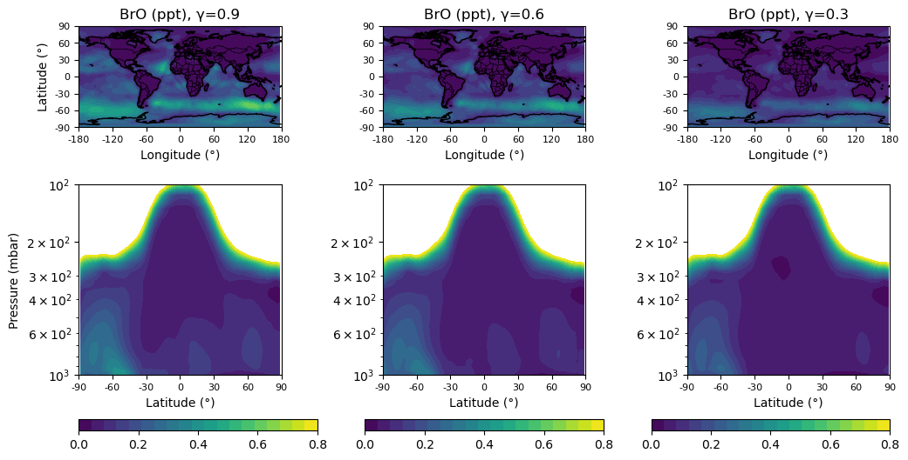
UPTAKE COEFFICIENT: SENSITIVITY STUDY
(1/7)
METHODS
Br AND I
EVALUATION
IMPACTS
NEXT STEPS
Explored the influence of the heterogenous recycling of iodine on SSA on the bromine budget and partitioning
Considered the updated uptake coefficient range (Tham et al. 2021 and Li et al. 2022) for the HOI heterogeneous uptake on SSA
Figures show results for γ=0.3, 0.6 and 0.9
SENSITIVITY STUDIES

Slide 24
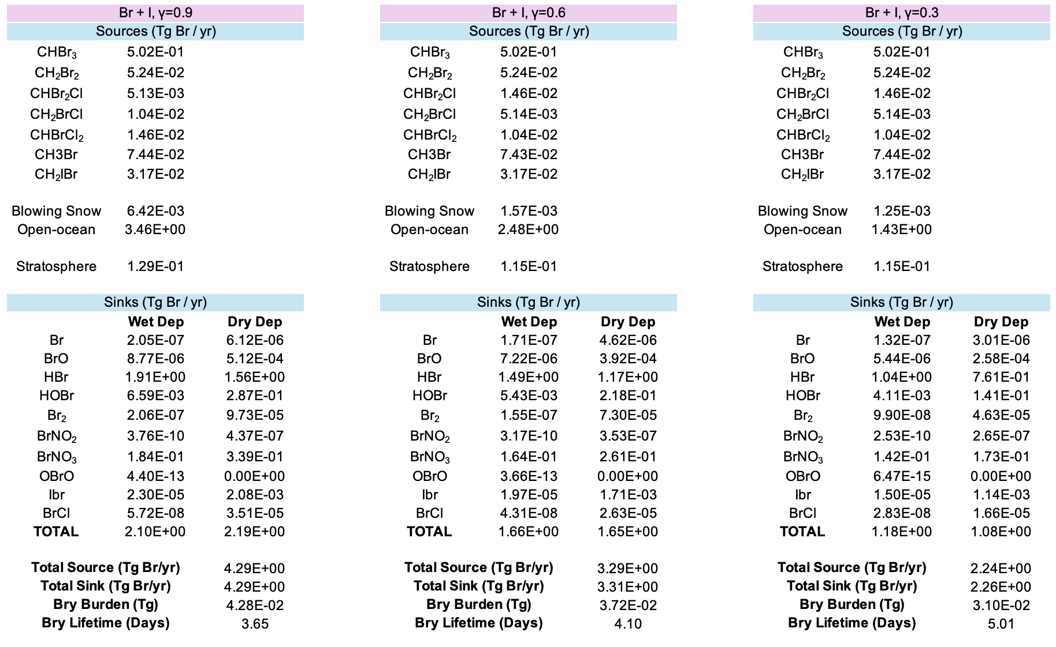
UPTAKE COEFFICIENT: SENSITIVITY STUDY (2/7)
METHODS
Br AND I
EVALUATION
IMPACTS
NEXT STEPS
SENSITIVITY STUDIES
Increase in source from the debromination of SSA and corresponding decrease in Br_{y} lifetime

Slide 25
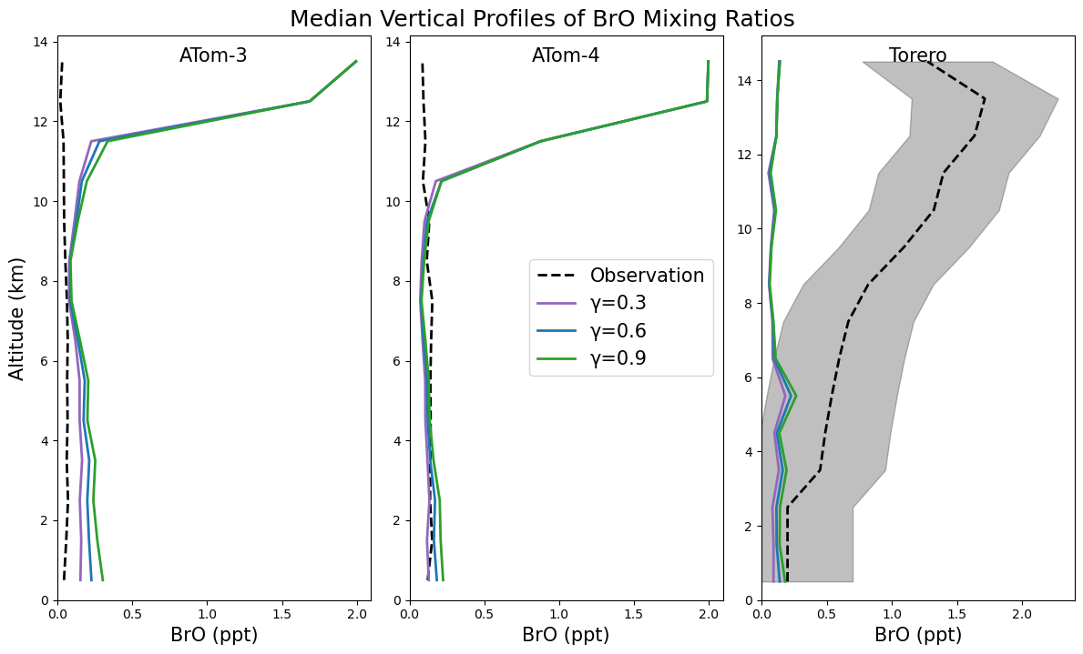
UPTAKE COEFFICIENT: SENSITIVITY STUDY
(3/7)
METHODS
Br AND I
EVALUATION
IMPACTS
NEXT STEPS
SENSITIVITY STUDIES
Slight difference in comparison in the MBL as increased debromination of SSA leads to larger source to the MBL but otherwise comparison is largely unaffected

Slide 26
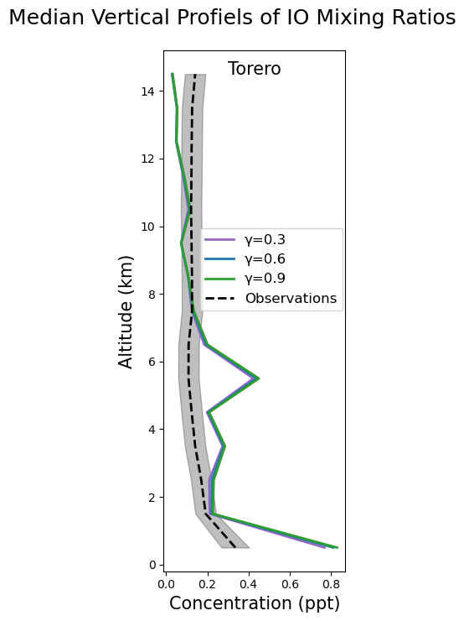
UPTAKE COEFFICIENT:
SENSITIVITY STUDY (4/7)
METHODS
Br AND I
EVALUATION
IMPACTS
NEXT STEPS
SENSITIVITY STUDIES

Slide 27
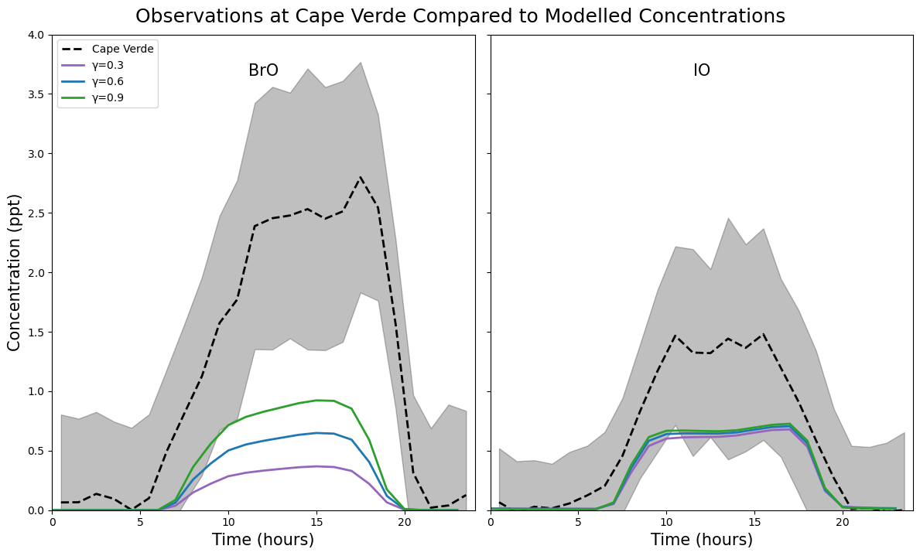
UPTAKE COEFFICIENT:
SENSITIVITY STUDY (5/7)
Increasing uptake coefficient corresponds to an increase in Br_{y} leading to slightly closer agreement
METHODS
Br AND I
EVALUATION
IMPACTS
NEXT STEPS
SENSITIVITY STUDIES

Slide 28
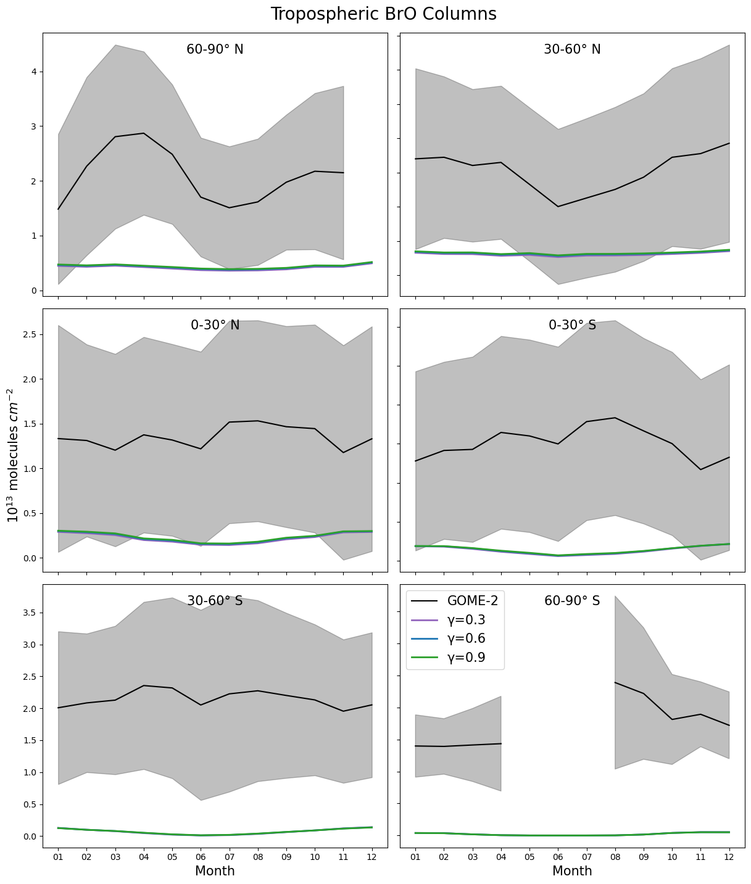
UPTAKE COEFFICIENT:
SENSITIVITY STUDY (6/7)
METHODS
Br AND I
EVALUATION
IMPACTS
NEXT STEPS
SENSITIVITY STUDIES

Slide 29
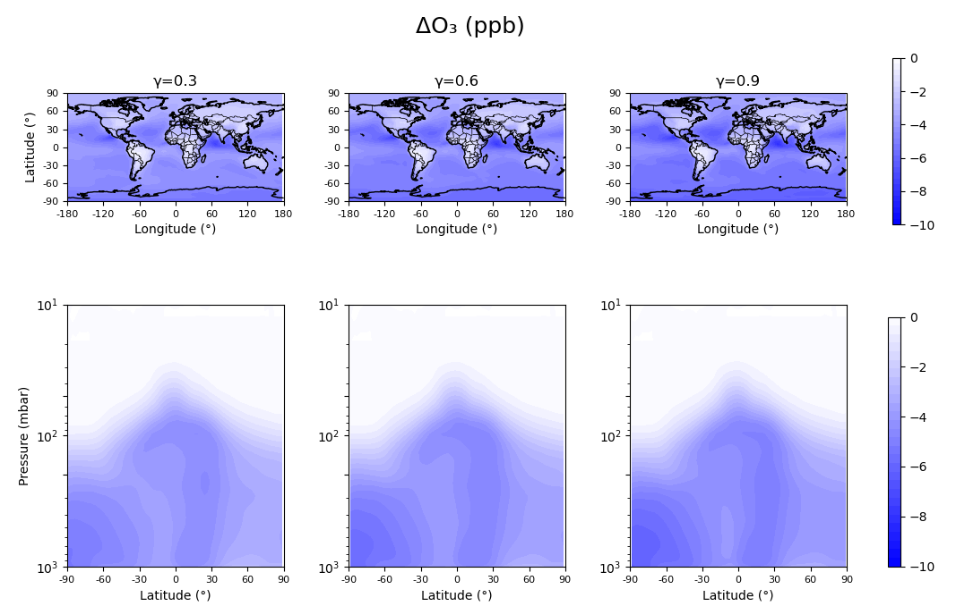
UPTAKE COEFFICIENT: SENSITIVITY STUDY (7/7)
METHODS
Br AND I
EVALUATION
IMPACTS
NEXT STEPS
SENSITIVITY STUDIES
Increase in Br_{y} leads to a larger decrease in ozone globally

Slide 30
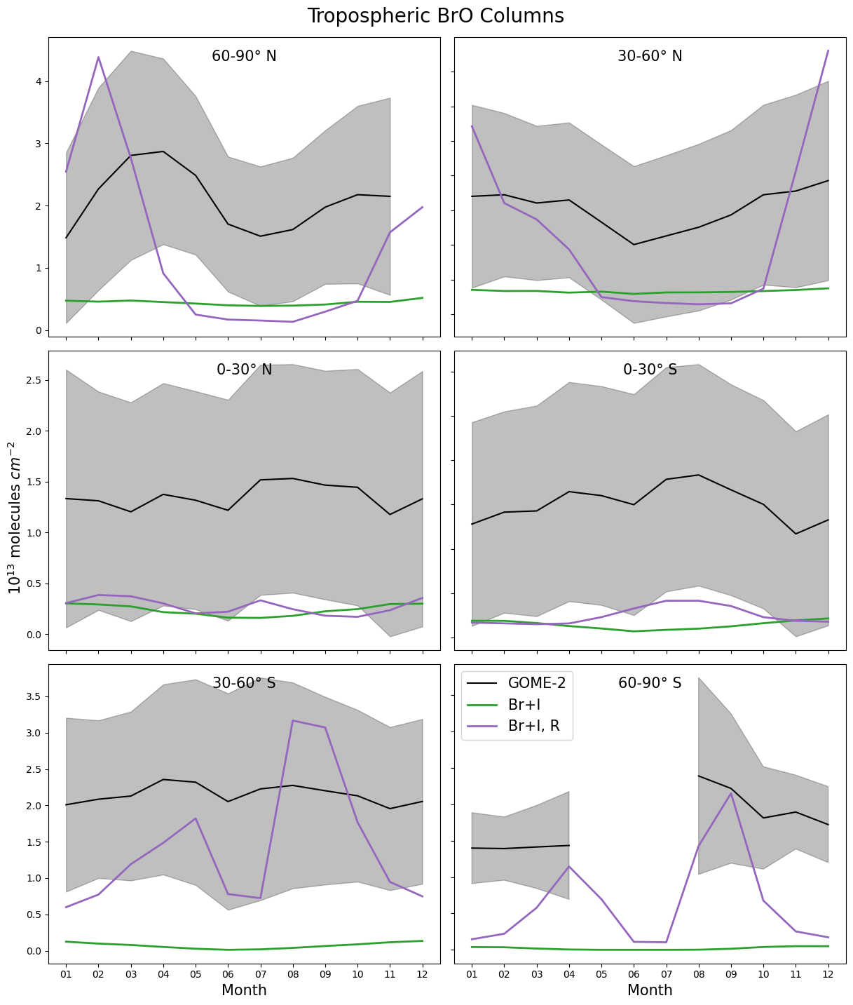
INCLUSION OF HOBr + HBr RECYCLING
HOBr + HBr → Br₂ + H₂O
Highlighted as important pathway for recycling of bromine radicals in the troposphere
Leads to overall increase in tropospheric BrO columns and some seasonal features becoming apparent
METHODS
Br AND I
EVALUATION
IMPACTS
NEXT STEPS
SENSITIVITY STUDIES

Slide 31

Contact Details
Email: j.randell@lancaster.ac.uk
Research Group Website: https://lec-atmos.org/team/jessica-randell/
LinkedIn: www.linkedin.com/in/jessica-randell-703197208
METHODS
Br AND I
EVALUATION
IMPACTS
NEXT STEPS
SENSITIVITY STUDIES

Slide 32
Bimolecular halogen reactions included in scheme
B1: CHBr₃ + OH → 3 Br
B2: CH₃Br + OH → Br + H₂O + HO₂
B3: CH₂Br₂ + OH → 2 Br
B4: CHBr₂Cl + OH → 2 Br
B5: CHBrCl₂ + OH → Br + H₂O
B6: CH₂BrCl + OH → Br + H₂O
B7: Br + O₃ → BrO + O₂
B8: Br + HCHO → HBr + HO₂ + CO
B9: Br + MeCHO → HBr + MeCO₃
B10: Br + HO₂ → HBr + O₂
B11: Br + BrNO₃ → Br₂ + NO₃
B12: Br + NO₃ → BrO + NO₂
B13: BrO + O(³P) → Br + O₂
B14: BrO + HO₂ → HOBr + O₂
B15: BrO + NO → Br + NO₂
B16: BrO + OH → Br + HO₂
B17: BrO + BrO → Br + Br + O₂
B18: BrO + BrO → Br₂ + O₂
B19: BrO + MeOO → HOBr + HCHO
B20: BrO + MeOO → Br + HCHO + HO₂
B21: BrO + MeCO₃ → Br + MeOO
B22: Br₂ + OH → HOBr + Br
B23: BrNO₃ + O(³P) → BrO + NO₃
B24: HBr + O(³P) → Br + OH
B25: HBr + OH → Br + H₂O
B26: HOBr + O(³P) → BrO + OH
B27: CH₃I + OH → I
B28: I + HO₂ → HI + O₂
B29: I + O₃ → IO + O₂
B30: I + BrO → IO + Br
B31: I + NO₃ → IO + NO₂
B32: I + IONO₂ → I₂ + NO₃
B33: IO + HO₂ → HOI + O₂
B34: IO + NO → I + NO₂
B35: IO + IO → I + OIO
B36: IO + IO → I₂O₂
B37: IO + O(³P) → I + O₂
B38: IO + OH → I + HO₂
B39: IO + BrO → Br + OIO
B40: IO + BrO → Br + I + O₂
B41: IO + BrO → IBr + O₂
B42: IO + BrO → I + OBrO
B43: IO + NO₃ → OIO + NO₂
B44: IO + O₃ → OIO + O₂
B45: IO + O₃ → I + 2 O₂
B46: IO + MeOO → HCHO + I + HO₂
METHODS

Slide 33
Heterogeneous halogen reactions included in scheme
H1: I₂O₂ (ss) →
H2: I₂O₃ (ss) →
H3: I₂O₄ (ss) →
H4: IONO₂ (ss) → 0.5ICl + 0.5IBr
H5: INO₂ (ss) → 0.5ICl + 0.5IBr
H6: HOI (ss) → 0.5ICl + 0.5IBr
H7: HI (ice) →
H8: HOI (ice) →
H9: IONO₂ (ice) →
H10: I₂O₂ (ice) →
H11: I₂O₃ (ice) →
H12: I₂O₄ (ice) →
H13: IONO₂ (ice) → HOI + HONO₂
H14: HOI + HI (ice) → I₂ + H₂O
H15: BrNO₃ (ice) → HOBr + HONO₂
H16: HOBr + HBr (ice) → Br₂ + H₂O
H17: HOI + HBr (ice) → IBr + H₂O
H18: BrNO₃ (cwd) → HOBr + HONO₂
H19: BrNO₃ (su) → HOBr + HONO₂
H20: HOBr + HBr (su) → Br₂ + H₂O
H21: BrNO₃ (ss) → 0.5Br₂ + 0.5BrCl
H22: BrNO₂ (ss) → 0.5Br₂ + 0.5BrCl
H23: HOBr (ss) → 0.5Br₂ + 0.5BrCl
METHODS

Slide 34
Photochemical reactions included in scheme
P1: CH₃I + hν → I
P2: CH₂ICl + hν → I + Cl
P3: CH₂IBr + hν → I + Br
P4: CH₂I₂ + hν → 2 I
P5: I₂ + hν → 2 I
P6: IO + hν → I + O(3P)
P7: OIO + hν → I + O₂
P8: HOI + hν → I + OH
P9: IONO₂ + hν → I + NO₃
P10: INO₂ + hν → I + NO₂
P11: INO₂ + hν → IO + NO
P12: INO + hν → I + NO
P13: I₂O₂ + hν → I + OIO
P14: I₂O₃ + hν → IO + OIO
P15: I₂O₄ + hν → 2 OIO
P16: IBr + hν → I + Br
P17: CHBr₃ + hν → 3 Br
P18: BrO + hν → Br + O(3P)
P19: HOBr + hν → Br + OH
P20: Br₂ + hν → 2 Br
P21: BrNO₂ + hν → Br + NO₂
P22: BrNO₃ + hν → Br + NO₃
P23: BrNO₃ + hν → BrO + NO₂
P24: OBrO + hν → Br + O₂
P25: CH₂Br₂ + hν → 2 Br
P26: CHBrCl₂ + hν → Br
P27: CH₂BrCl + hν → Br
P28: CHBr₂Cl + hν → 2 Br
P29: BrCl + hν → Br
P30: CH₃Br + hν → Br
P31: ICl + hν → I + Cl
METHODS

Slide 35
Termolecular reactions included in scheme
T1: Br + NO₂ → BrNO₂
T2: BrO + NO₂ → BrNO₃
T3: I + NO → INO
T4: I + NO₂ → INO₂
T5: IO + NO₂ → IONO₂
T6: I₂O₂ → OIO + I
T7: I₂O₂ → IO + IO
T8: I₂O₄ → OIO + OIO
T9: IONO₂ → IO + NO₂
T10: INO₂ → I + NO₂
METHODS

