Slide 1
Imprint of metamorphic dehydration reactions subsequent to amphibolitization of mafic granulite from Eastern part of Chotanagpur Granite Gneiss Complex (CGGC), India.
Presented by
Shyamolima Banerjee
JRF,IIT(ISM) Dhanbad
Co-authors:-
Vedanta Adak
Upama Dutta(Associate professor,
IIT Dhanbad)

Slide 2
Content
Introduction
Sample types
Textural relation
Thermodynamic modelling
Results
Discussion
References

Slide 3
Introduction
The Super-continental cycle is a fundamental mechanism that has formed Earth's continental crust throughout geological history. Within this cycle, during 1.1-0.8 Ma the Rodinia supercontinent is believed to have developed by amalgamating the scattered continental fragments resulting from the disintegration of the Paleoproterozoic Columbia supercontinent (2.5-1.5 Ma).
In the reconstruction of Rodinia India is positioned adjacent to Antarctica, with the Eastern Ghats Belt (EGB) and the Chotanagpur Granite Gneiss Complex (CGGC) of Peninsular India aligned with the Rayner Complex and the eastern part of the Vestfold Hill in East Antarctica, respectively.

Slide 4
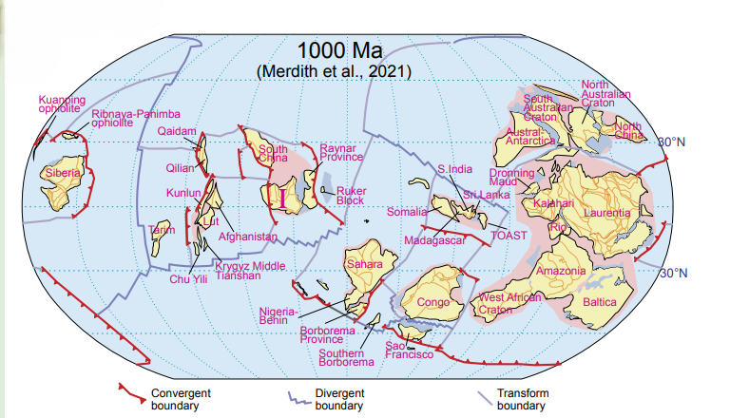
Fig:-Occurrence of different continents during Rodinia period (Merdith et al. 2021)

Slide 5
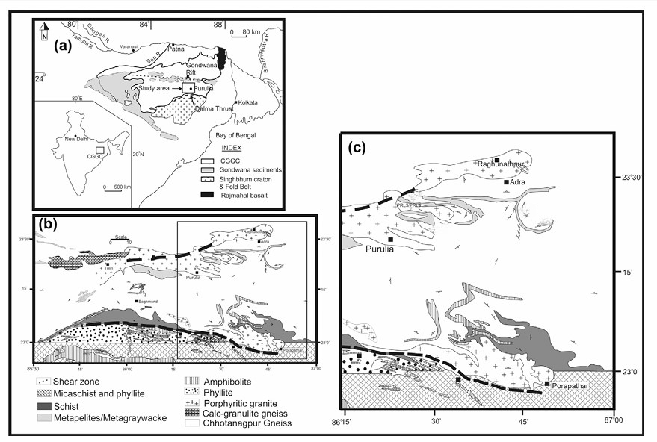
Role of CGGC
Karmakar et.al 2011
To understand the tectonic evolution of India during Meso-Neoproterozoic, detailed study of rocks of CGGC is crucial.
The Proterozoic Chotanagpur Granite Gneiss Complex (CGGC) is an eastern-west trending region in the East Indian Shield, occupying approximately 100,000 km².
But there is a significant lack of exposure in the area due to major weathering and erosion.
Lithologies:-Mostly felsic orthogneisses with enclaves of mafic granulite and metapelites. Local occurrence of alkaline rocks.

Slide 6
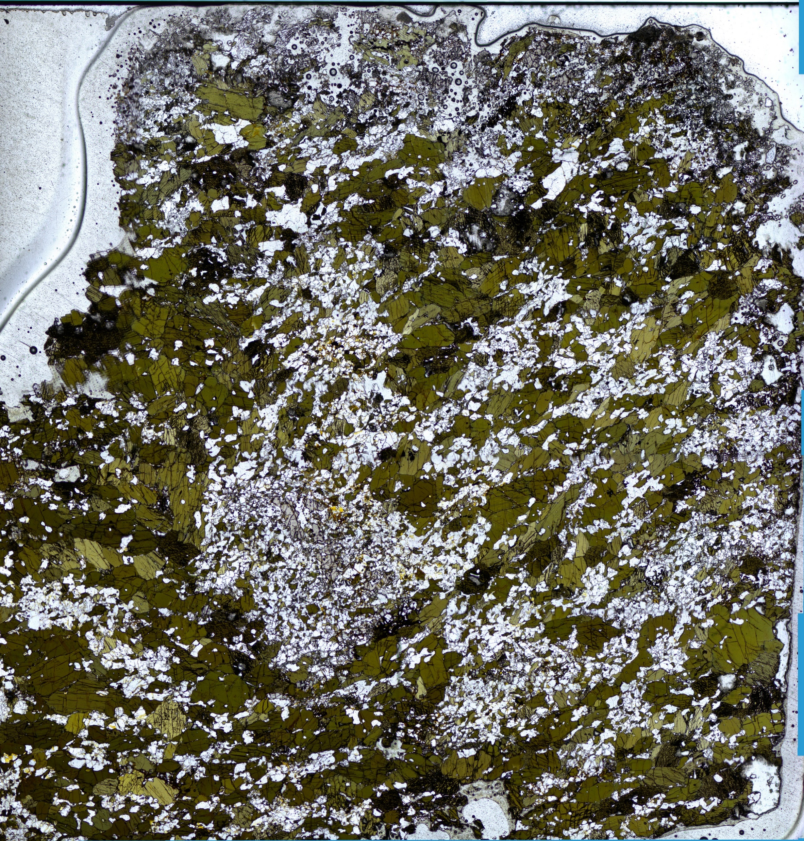
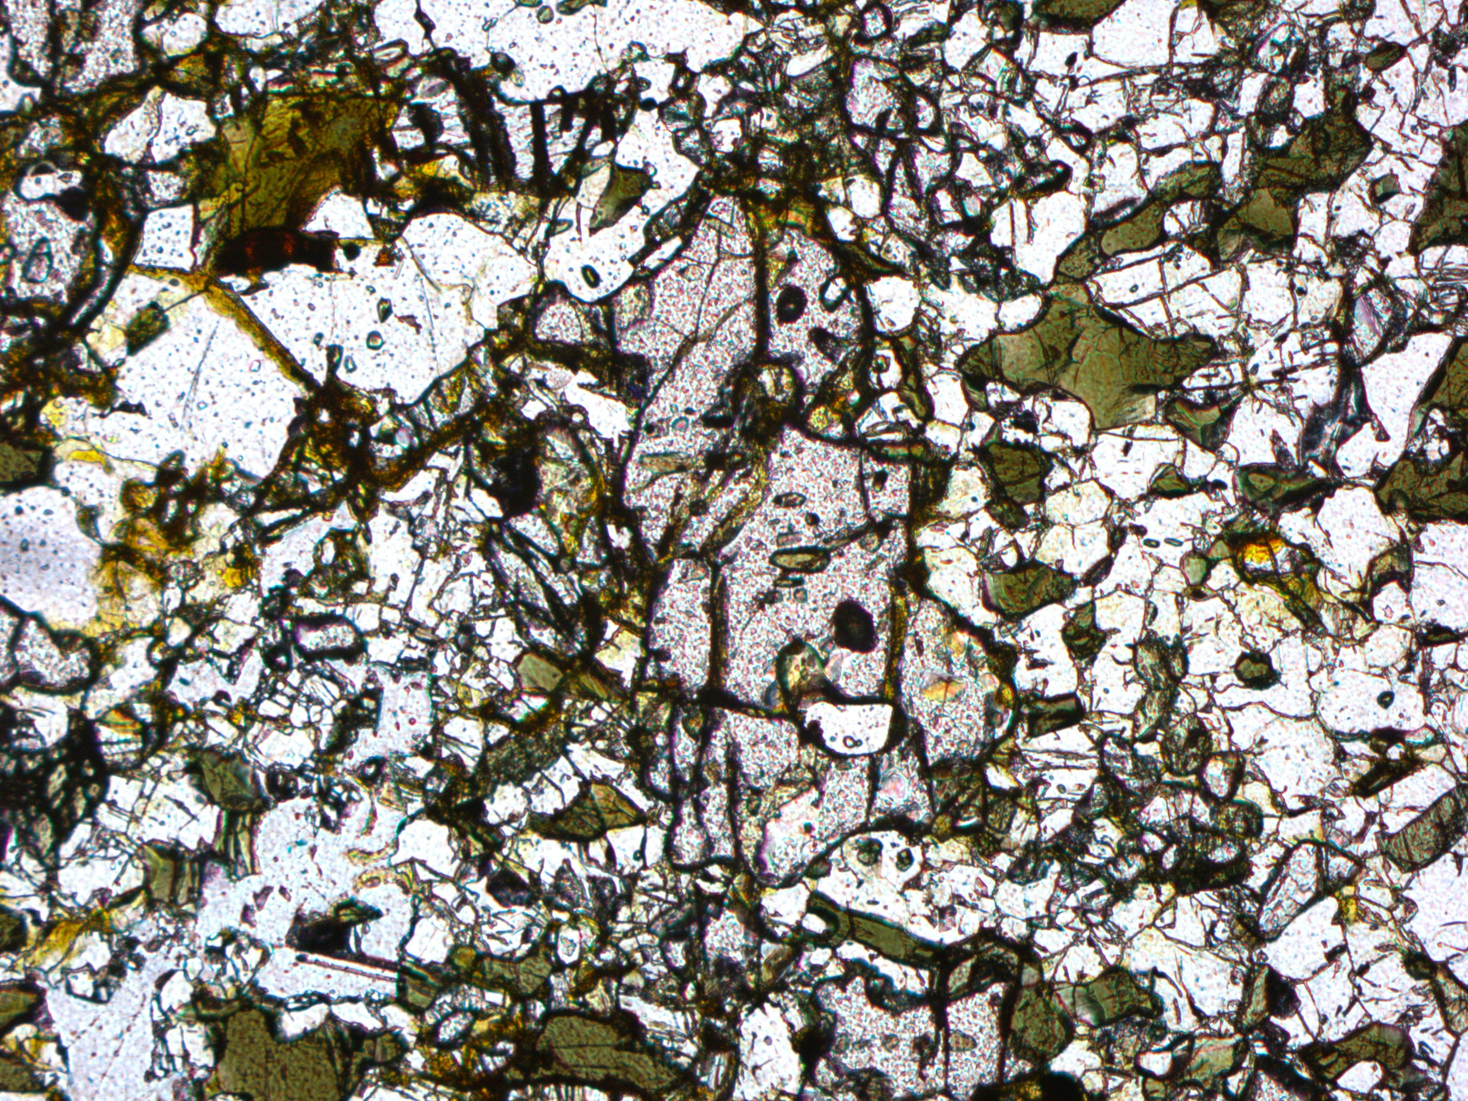
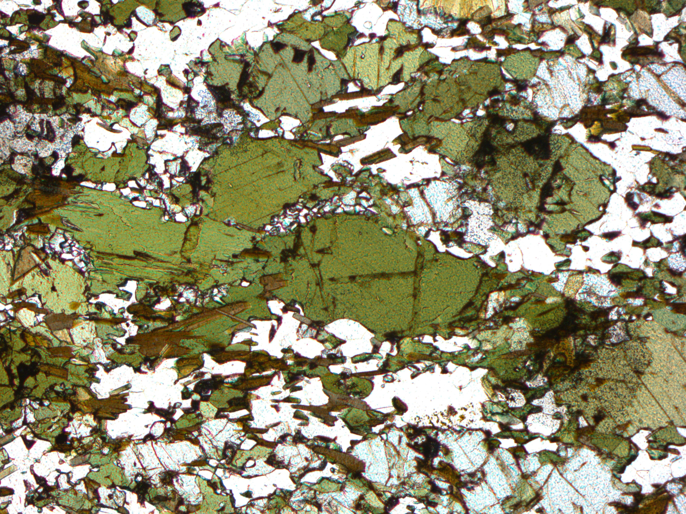
Mafic granulite
Non-garnetiferous mafic granulite
Garnetiferous mafic granulite
Grt
Cpx
Pl
Amph
Amph

Slide 7
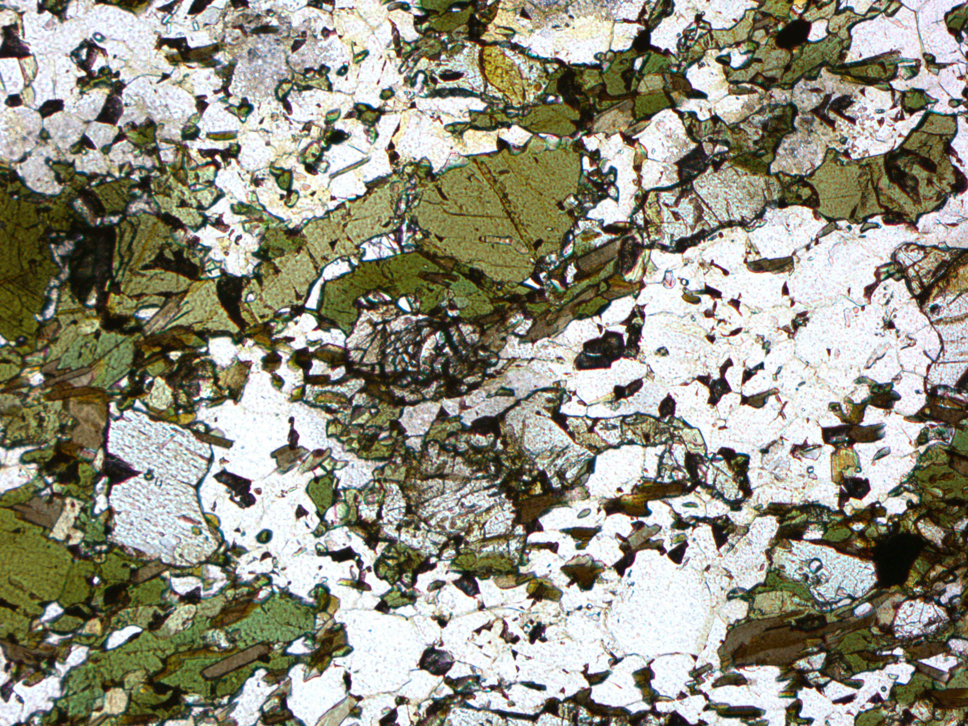
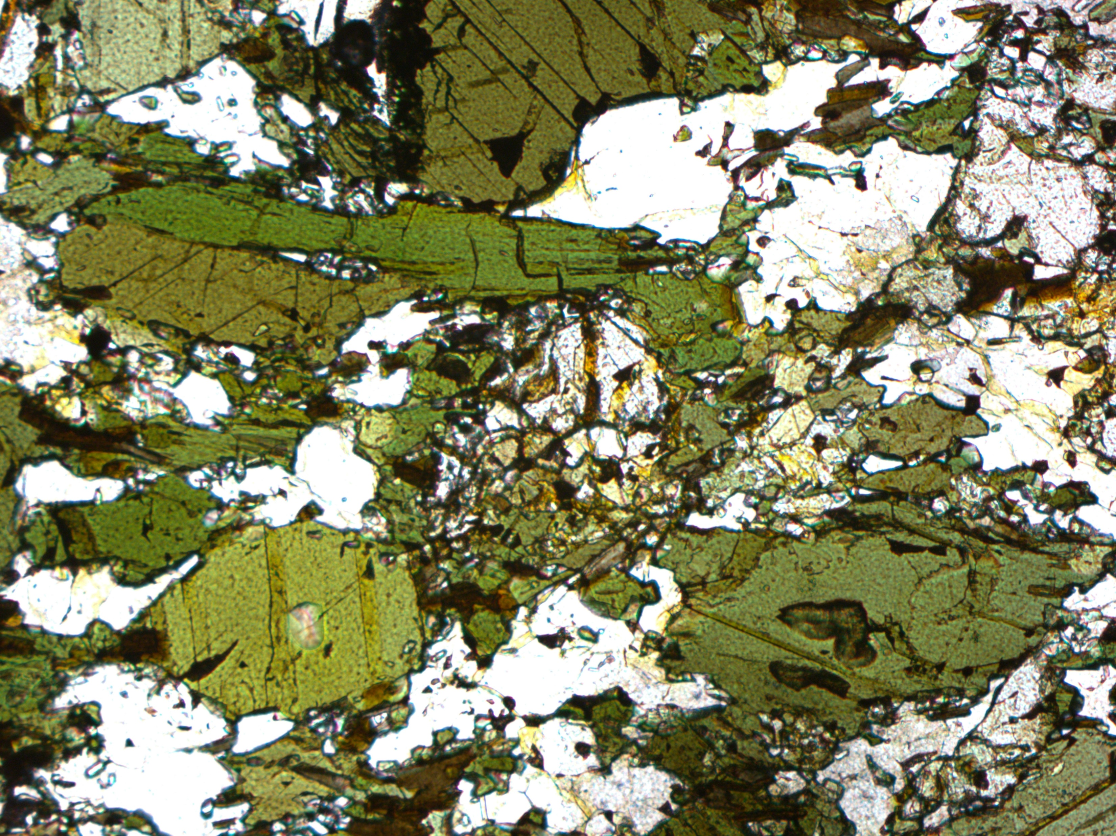
Textural relation(Non-garnetiferous)
The rock contains primary plagioclase, clinopyroxene, orthopyroxene mineral associated with secondary ambhiboles.
Amphibole and pyroxene grains define an overall foliation in the rock.
The grains show granoblastic texture.
Both pyroxenes are replaced by amphiboles
Symplectites of plagioclase and clinopyroxene grown as the periphery of amphibole grains.
Amph
Amph
Pl
Amph
Cpx
Amph
Amph
Opx
Amph
Pl
Cpx
Cpx

Slide 8
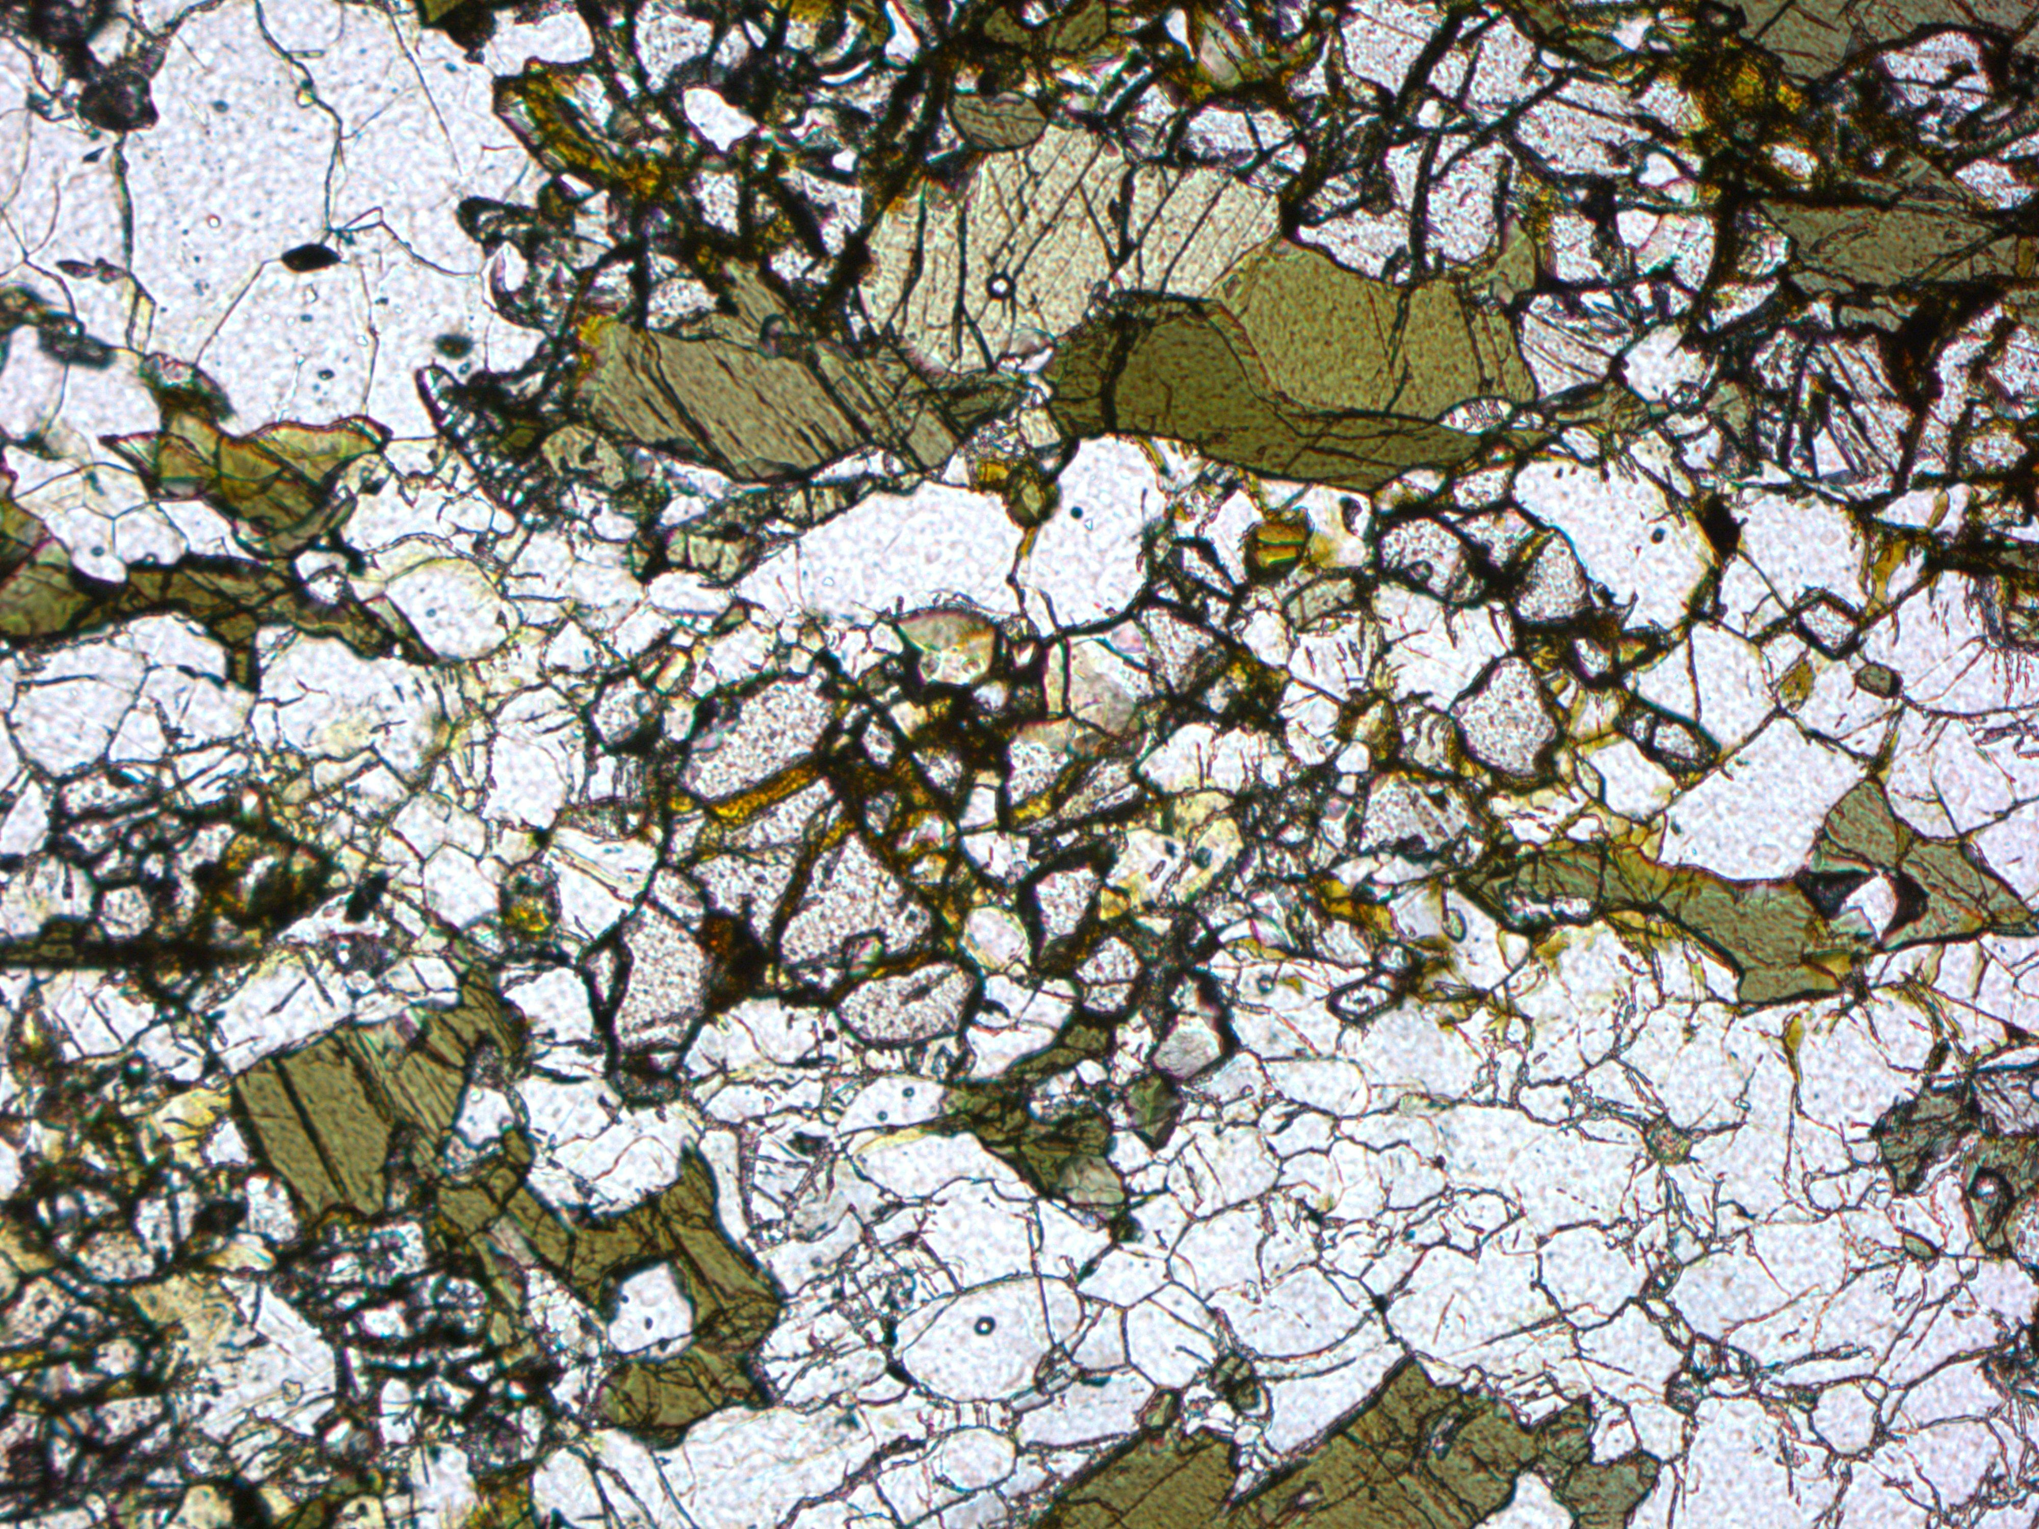
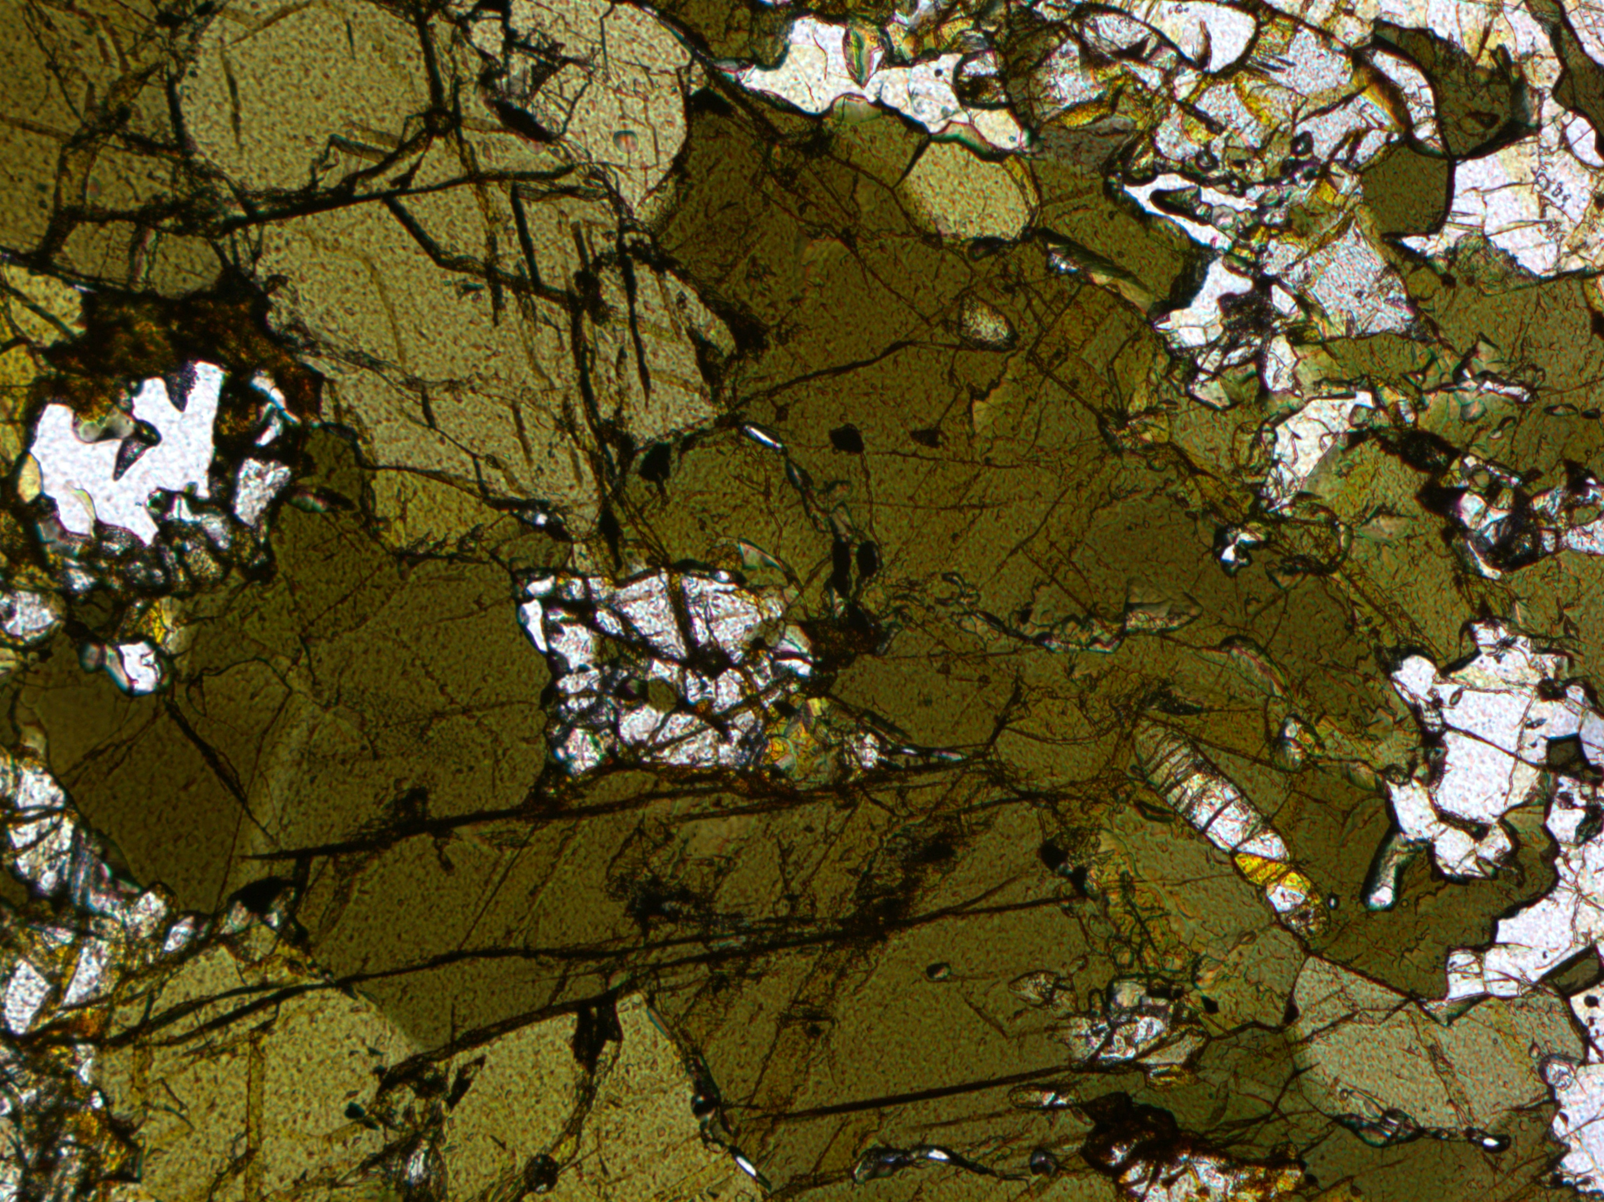
Textural relation(Garnetiferous)
The rock contains primary Clinopyroxene, Orthopyroxene and plagioclase. Pyroxenes got replaced by secondary amphiboles.
Garnet occurs with inclusion of amphibole, orthopyroxene and quartz.
This rock also shows granoblastic texture but it does not have any foliation like the other type.
Grt
Amph
Gt
Cpx
Amph
Opx
Qtz

Slide 9
Textural comparison
Non-garnetiferous rock
Garnetiferous rock
Contains less amphibole.
Clinopyroxene is more than orthopyroxene.
Last metamorphic event denoted by occurrence of symplectites.
Contains more amphibole.
Orthopyroxene is more than clinopyroxene.
Last metamorphic event denoted by occurrence of garnets.

Slide 10
Thermodynamic modeling
In view of the observed mineral assemblage the system NCFMASH (Na2O–CaO–FeO–MgO– Al2O3 –SiO2 –H2O) has been chosen.
This diagram has been computed with PERPLEX_7.1.6(Connolly,2005) using the internally consistent data set of Holland and Powell (1998, updated in 6feb,2012)
For the non garnetiferous rock, we wanted to model the existing physical conditions of the symplectite texture.
So, we took into account a local effective bulk in which the product phases only present.
Amphibole = Clinopyroxene + Plagioclase

Slide 11
Thermodynamic modeling
To estimate the H2O content, we have constructed T-H2O diagrams the water content can not be measured by EPMA.
The estimated water is 0.135 wt%.
The characteristic assemblage in the non-garnetiferous rock clinopyroxene + plagioclase + amphibole that developed in the rock has a wide P-T range.
To narrow the P–T range for the observed assemblages, the clinopyroxene compositional isopleths along with clinopyroxene(XMg = 0.68-0.70) (indicated by blue lines) and plagioclase volume isopleths (Modal proportion ratio 1:2.5) (indicated by pink lines) were plotted in the relevant field of the pseudosection.
From the all given data, we get temperature ~650-700°C and pressure 7±1kbar.

Slide 12
Thermodynamic modeling
For the garnetiferous rock, we made the bulk using whole rock i.e. effective bulk.
Here also to calculate the water content T-H2O modeling has done. The water content is ~ 0.66 wt%.
The distinctive assemblage in garnetiferous rock, comprising amphibole, plagioclase, clinopyroxene, orthopyroxene, and garnet, also exhibits an extensive pressure-temperature range.
To refine the pressure-temperature range for the observed assemblage, here also the compositional isopleths of garnet(XMg = 0.16-0.18 and Xca=0.20-0.22) (indicated by pink lines and blue lines respectively) were plotted within the pertinent area of the pseudosection.
Finally, we get a P-T range which is 750-850 °C and 7.5-8.5kbar.

Slide 13
Results
For the non-garnetiferous rock, we got temperature ranging between 650-700°C and pressure ranging between 7-8kbar.
For the garnetiferous rock, we got temperature ranging between 750-850°C and pressure ranging between 7.5-8.5kbar.
Combining both the sample we can say that the last metamorphic event took place at ~600-800 °C temperature and 7-8kbar pressure.

Slide 14
Discussion
The non garnetiferous rock shows presence of symplectite as the last event of metamorphism. Though this texture has been reported earlier(Maji et.al,2008) but no detailed work has been done as of yet.
The garnetiferous rock shows the presence garnet as last metamorphic event. We have found inclusion of orthopyroxene within the garnets which has not been reported as of yet.
The last stage of metamorphism in both the rock took place at ~600-800 °C temperature and 7-8kbar pressure. This data is slightly different from others(Maji et.al,2008) as the pressure is much higher. However this much high pressure or even higher-pressure conditions have been discussed by other researcher from mafic granulites (Karmakar et. al,2011,Dey et. al,2019,Sanyal and Sengupta 2012). This difference may be because of pyroxenes in the garnetiferous mafic granulite.

Slide 15
Discussion
This rocks are very important in investigation of petrological evolution of CGGC so more study is under process…
These studies will help to corelate the rocks of India with East Antarctica which eventually reconstrain the tectonic evolution of India during the Rodinian period.

Slide 16
Reference
Connolly JA (2005) Computation of phase equilibria by linear programming: a tool for geodynamic modeling and its application to subduction zone decarbonation. Earth and Planetary Science Letters, 236, 524–41.
Dey A, Karmakar S, Mukherjee S, Sanyal S, Dutta U and Sengupta P (2019) High pressure metamorphism of mafic granulites from the Chotanagpur Granite Gneiss Complex, India: Evidence for collisional tectonics during assembly of Rodinia. Journal of Geodynamics 129,24–43.
Karmakar S, BoseS, Sarbadhikari AB and Das K(2011)Evolution of granulite enclaves and associated gneisses from Purulia, Chhotanagpur Granite Gneiss Complex, India: evidence for 990–940 Ma tectonothermal event(s) at the eastern India cratonic fringe zone. Journal of Asian Earth Sciences 41,69–88.
Maji AK, Goon S, Bhattacharya A, Mishra B, Mahato S and Bernhardt HJ (2008) Proterozoic polyphase metamorphism in the Chhotanagpur Gneissic Complex (India), and implication for trans-continental Gondwanaland correlation. Precambrian Research 162, 385–402.
Mukherjee, S., Dey, A., Sanyal, S., & Sengupta, P. (2019). Proterozoic crustal evolution of the Chotanagpur Granite Gneissic Complex, Jharkhand‐ Bihar‐West Bengal, India: Current status and future prospect. In S. Mukherjee (Ed.), Tectonics and structural geology: Indian context (pp. 7–54). Cham: Springer. https://doi.org/10.1007/978‐3‐319‐ 99341‐6_2
Sanyal S and Sengupta P (2012) Metamorphic evolution of the Chotanagpur Granite Gneiss Complex of the East Indian Shield: current status. In Palaeoproterozoic of India (eds R Mazumder and D Saha), pp. 117–45. Geological Society of London, Special Publication no. 365.

