Slide 1
A new methodology for emergency planning in the humanitarian field
Authors: Francesca De Vito, Alessandro Benati, Lorenzo Massucchielli, Daniela Molinari
Taken by PPRD East 3

Slide 2
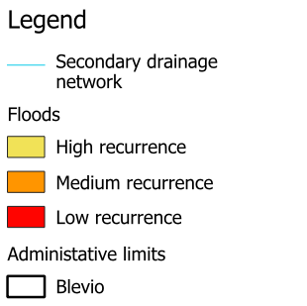
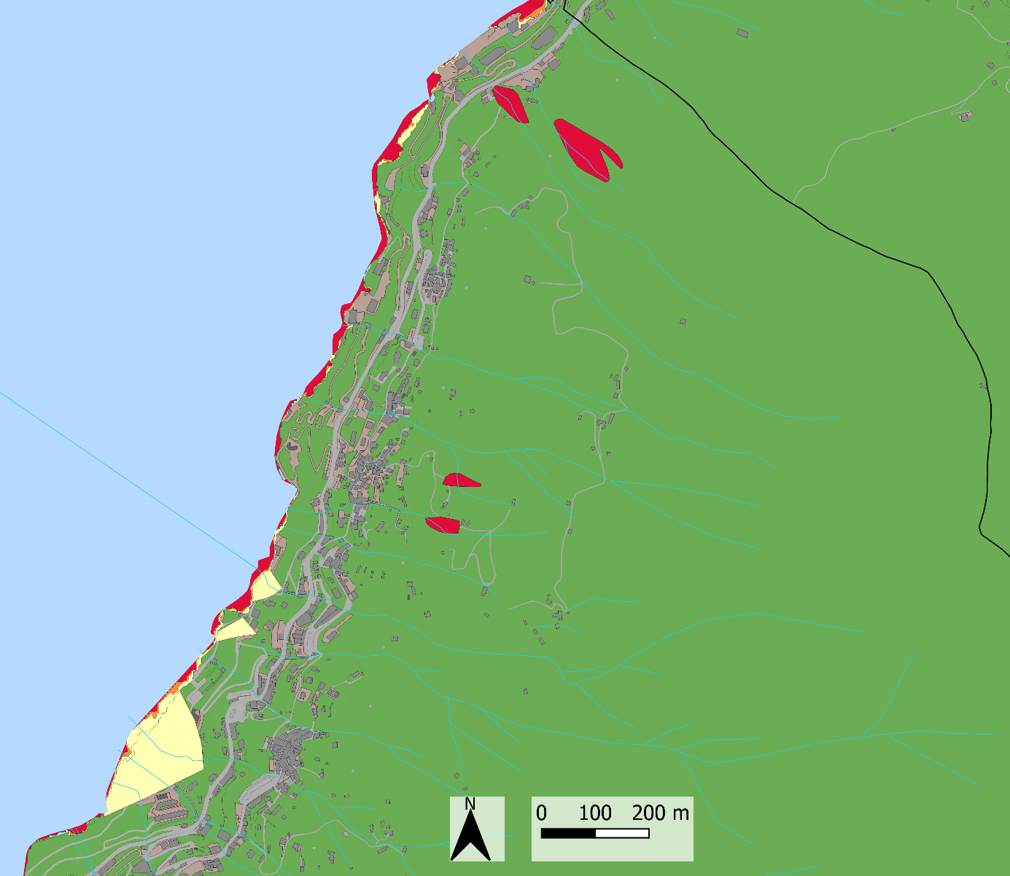
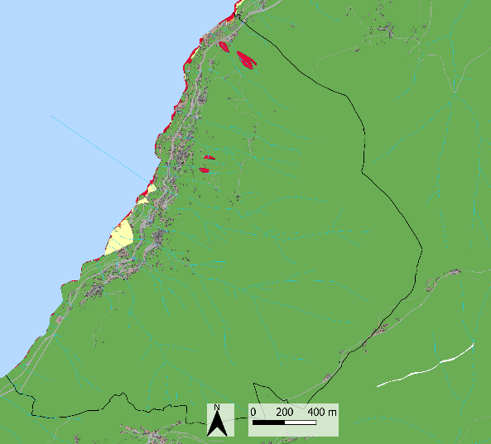
National
Como Branch case study
Regional
Provincial
Local
THE “GOOD PRACTICE”
THE ALTERNATIVE APPROACH
INPUT
INPUT
Civil Protection plan
Available data
Agreements
Civil Protection plan
Available data
Agreements

Slide 3
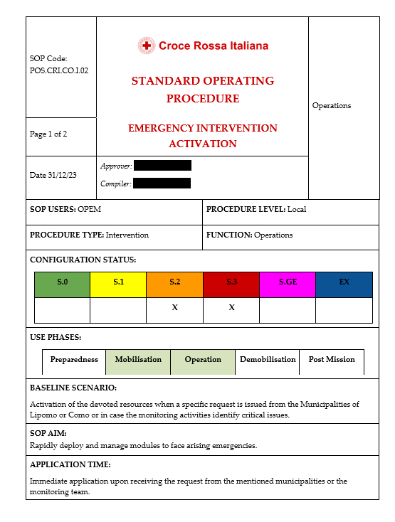
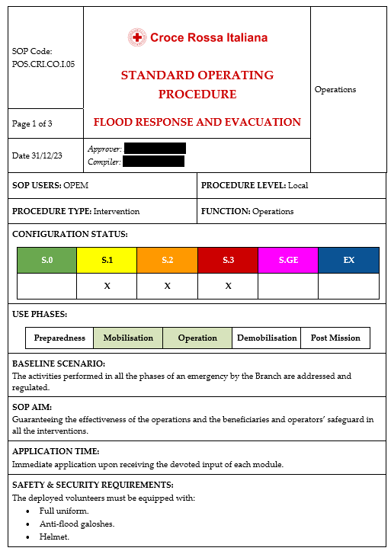
Como Branch case study
THE “GOOD PRACTICE”
THE ALTERNATIVE APPROACH
OUTPUT
OUTPUT
Implementation of models
Creation of SOPs
Exposure assessment
Hypothesis of activities

Slide 4
A new methodology for emergency planning in the humanitarian field
Authors: Francesca De Vito, Alessandro Benati, Lorenzo Massucchielli, Daniela Molinari
Taken by PPRD East 3

Slide 5
Step 3|
Constituted by self-standing cards

Slide 6
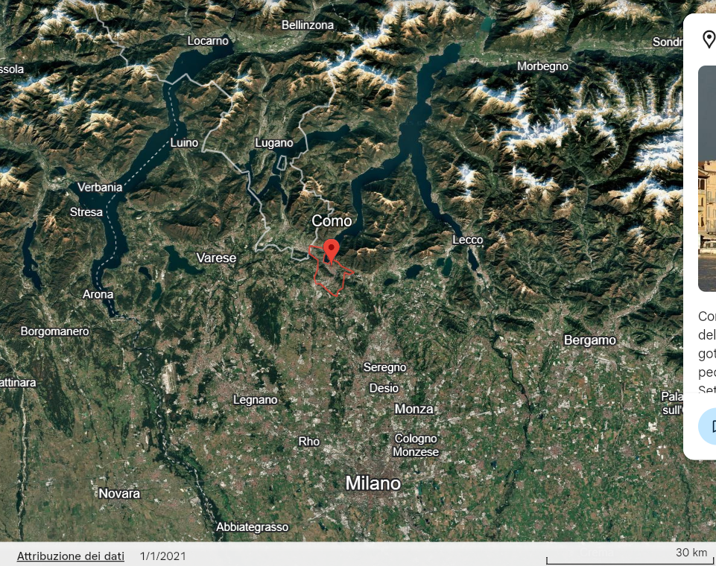
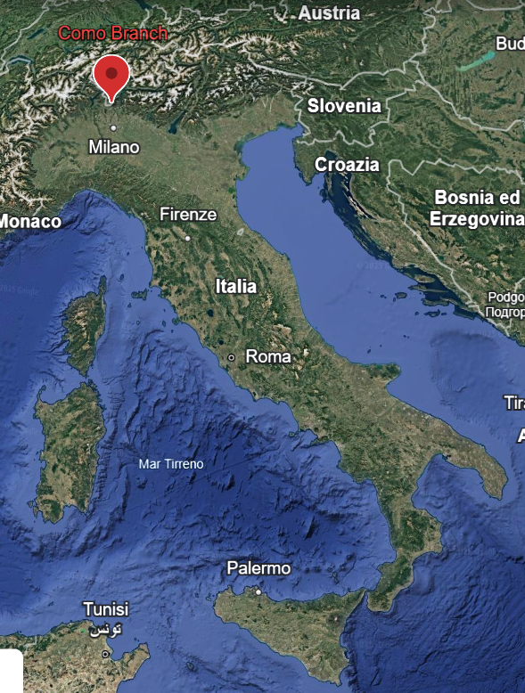
The “good practice”:
The Municipality of Como
REFERENCE SCENARIO:
Lacunar flood of Como Lake with return period of 15 years
04

Slide 7
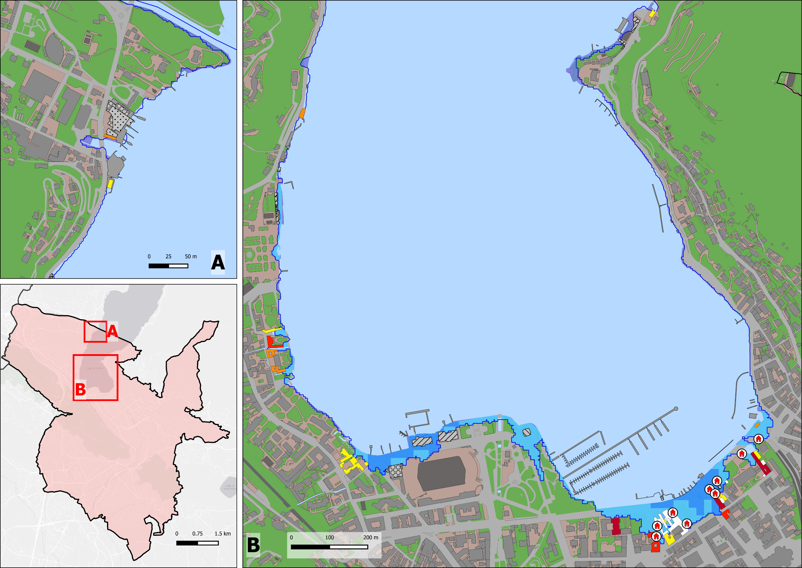
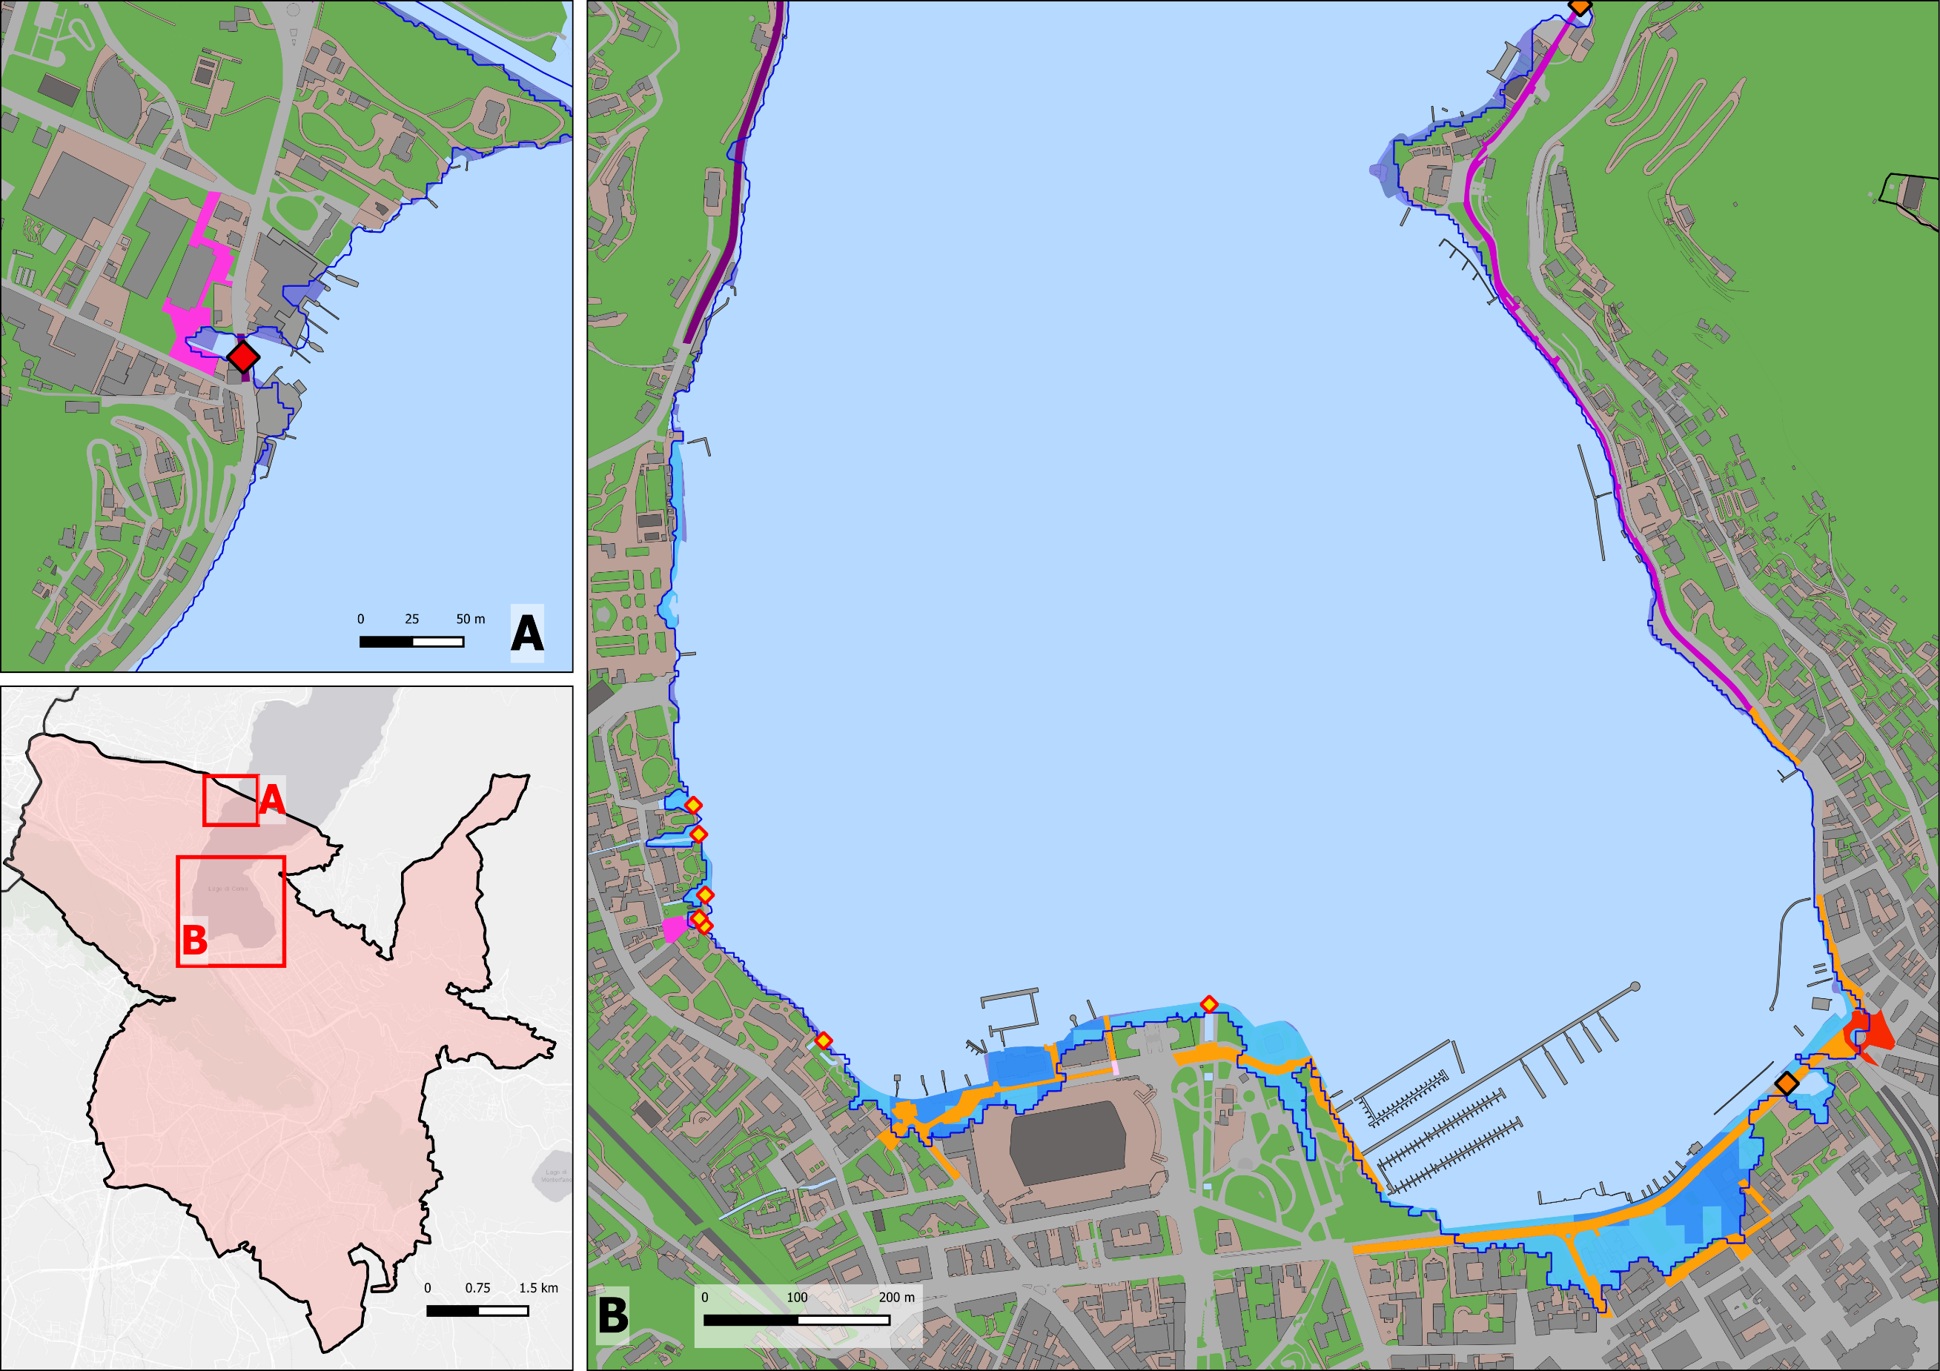
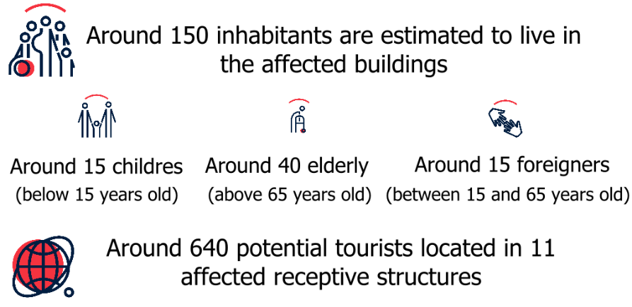
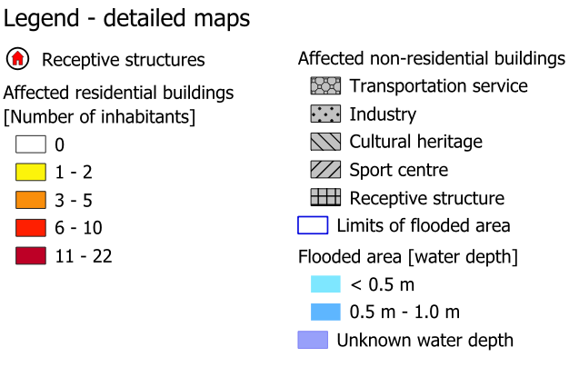
Description of scenario and impact|
Road network
Population
05
MOVIDA model has been adopted to estimate the indirect damage to road network

Slide 8
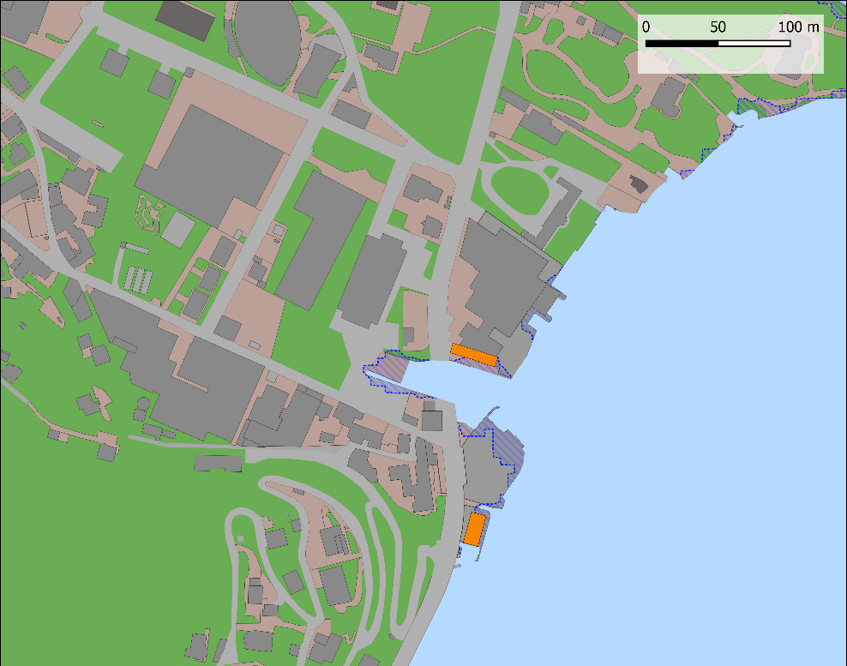
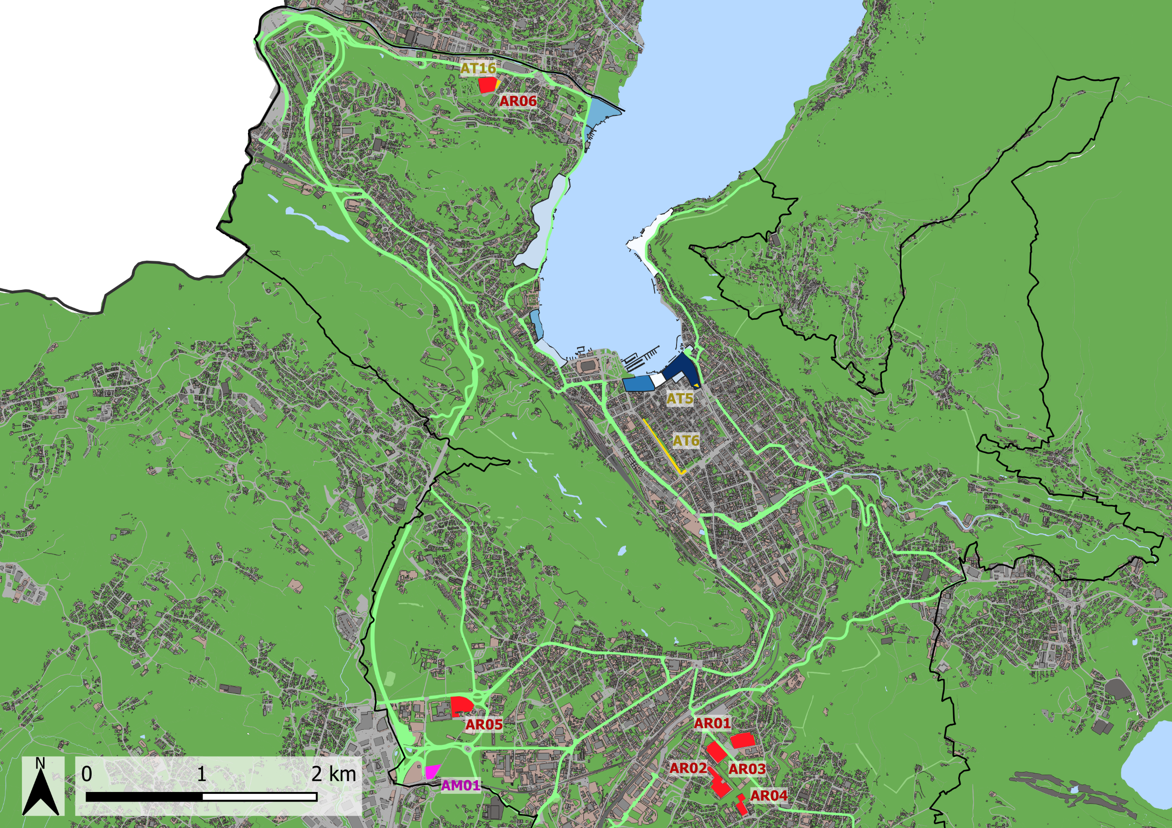
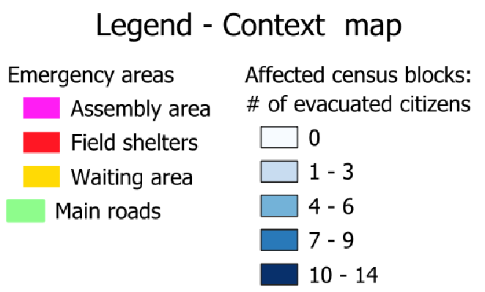
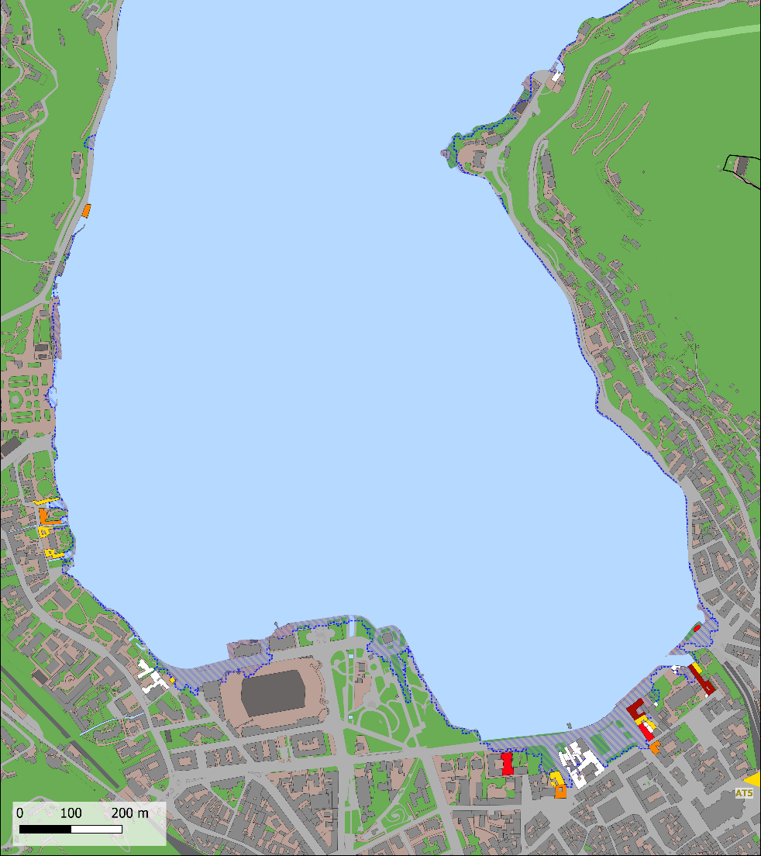
Operations management|
Evacuation
07
SES method has been adopted to estimate the evacuation time

Slide 9
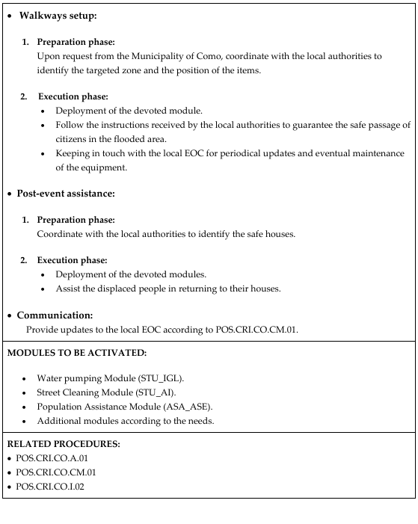
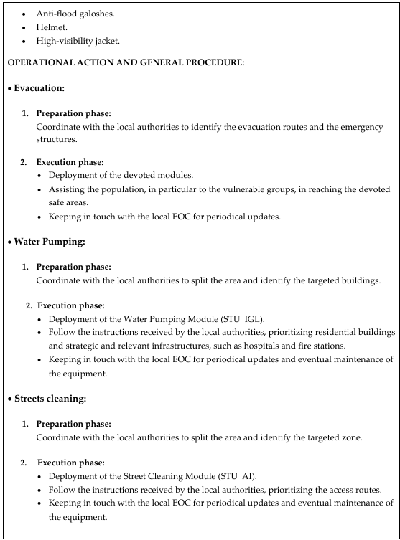
Operations management|
SOPs
Specific standard operating procedures (SOPs) have been created to support all the operations

Slide 10
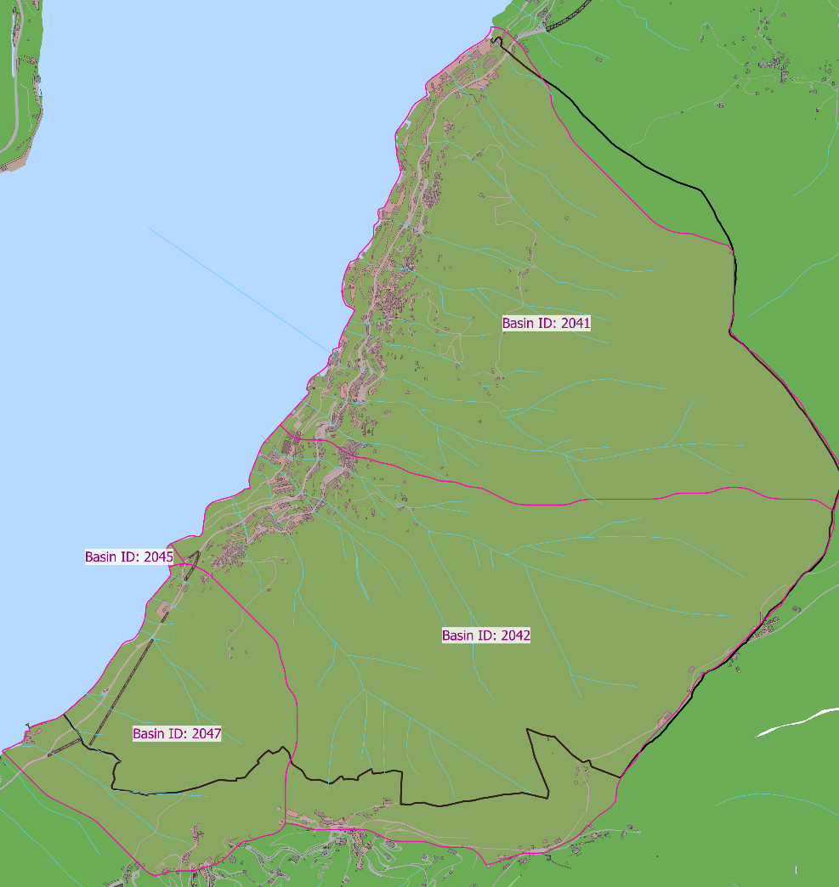
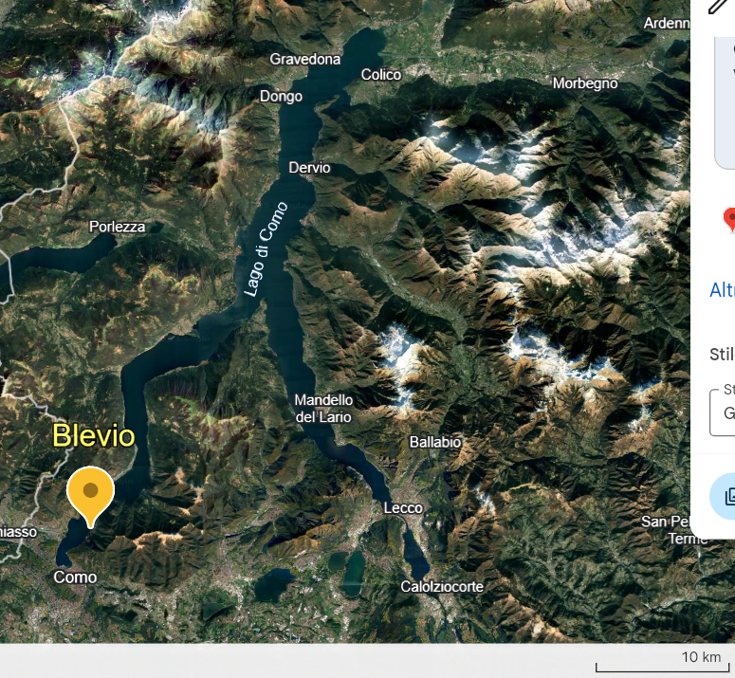
The basin approach:
The Municipality of Blevio
REFERENCE SCENARIO:
Simultaneous overflooding of streams in basin 2042.

Slide 11
Description of scenario and impact|
Road network
Population
<<

Slide 12
Operations management|
Evacuation

Slide 13
Lessons learnt
Some considerations have been produced highlighting the relevant aspects, the spaces of improvement, and the obstacles of the methodology.
These lessons learnt will be integrated into the emergency planning guidelines of the Italian Red Cross.

Slide 14
The complete work is available at the following link

