Slide 1
Cooling from foliar yellowing & plant residue in winter wheat cultivation
(supplementary inforamtion)
Ke Yu
Daniel S. Goll, Yang Su, Philippe Ciais, Ronny Lauerwald, Yi Xi, Haoran Xu, Xianglin Zhang, Nicolas Viovy, David Makowski, Eric Ceschia, Tiphaine Tallec, Amie Pickering, Marie Collard
Le Laboratoire des Sciences du Climat et de l'Environnement, France
ke.yu@lsce.ipsl.fr

Slide 2
Model development

Slide 3
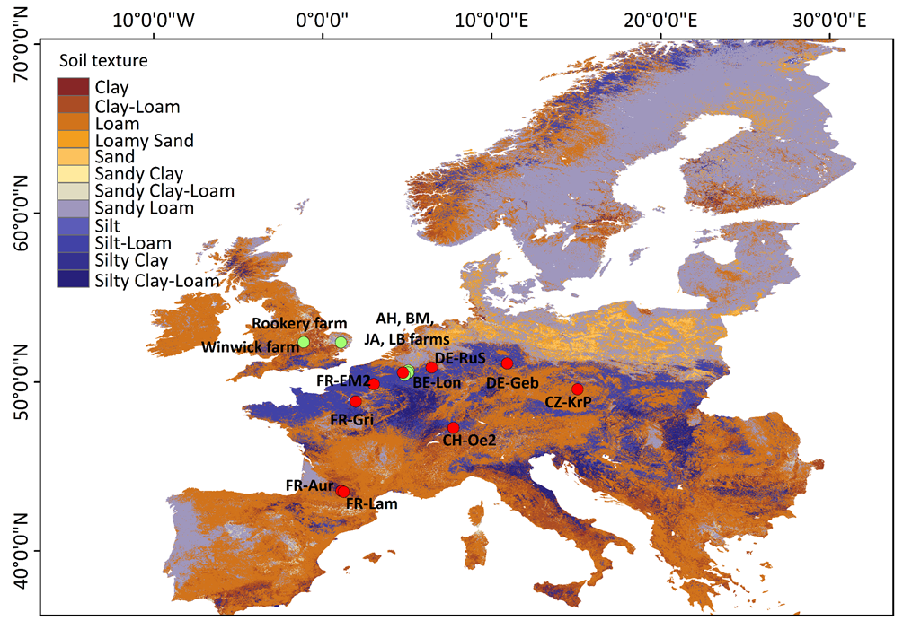
Method 1: albedo / management information from cropland sites
Albedo / management information from 12 cropland sites with 31 winter wheat years
At each cropland site, we obtain:
Daily surface&soil albedo datasets
Daily soil and crop fractions
Management information (sowing and harvest dates, tillage, residue coverage, soil structure….)

Slide 4
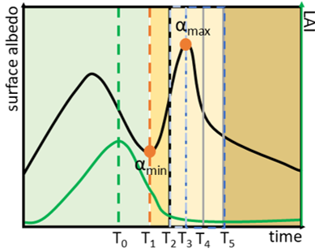
Method 2: characterisation of albedo stages
foliar yellowing period
Harvest
residue covering period
Tillage
LAI_{max}
albedo increase phase
albedo decrease phase
smoothed eddy covariance surface albedo
smoothed LAI
observed harvesting date
start and end of albedo increase

Slide 5
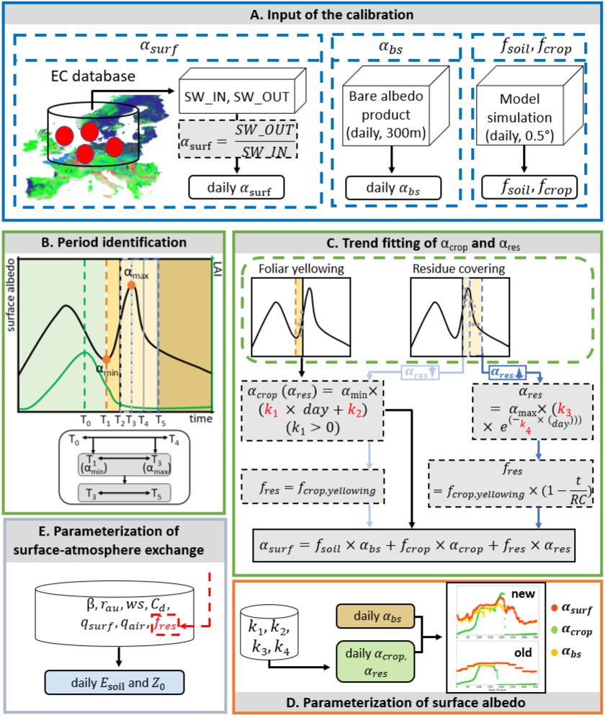
Method 3: new parameterization of surface albedo in ORCHIDEE-CROP model
α_{soil} , α_{crop}, α_{res} :bare soil albedo, crop albedo and
residue albedo;
f_{soil}, f_{crop}(f_{crop,yellowing}), f_{res}: bare soil fraction, crop fraction (during yellowing period), residue fraction in each model grid;
day: days during these two periods
RC: the total days of residue covering periods
k₁, k₂, k₃, k₄: fitting parameters

Slide 6
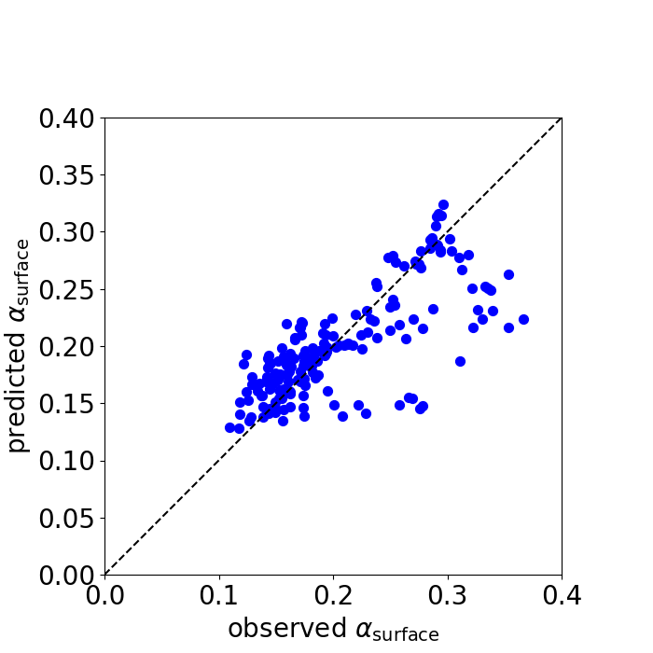
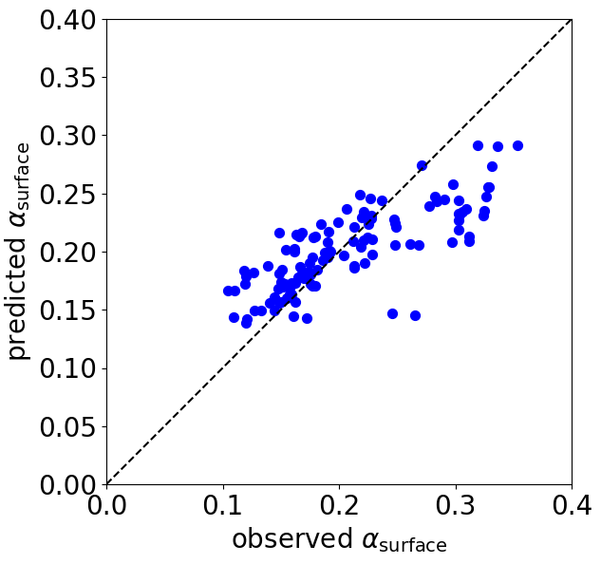
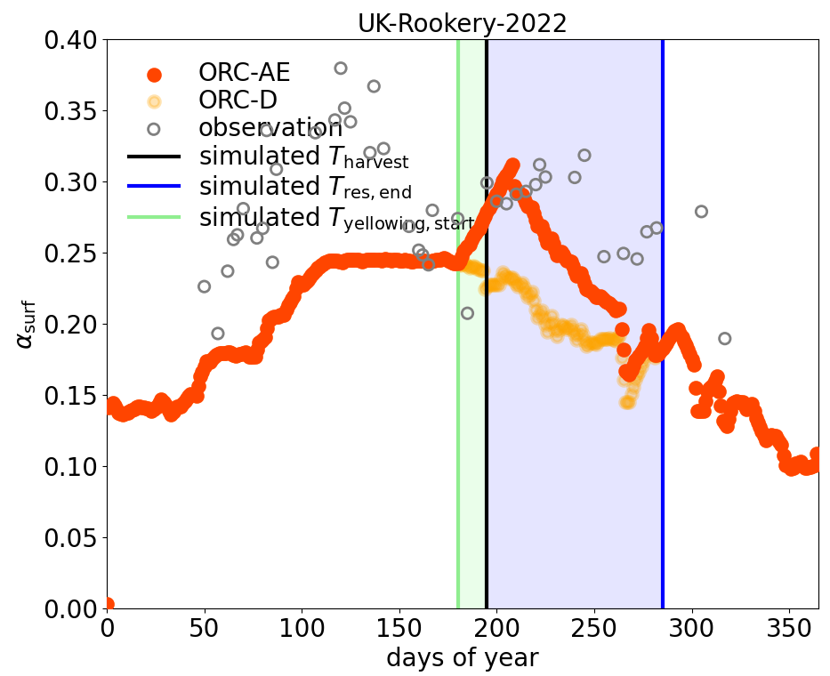
Evaluation: parameter optimization and model simulation
Evaluation of parameter optimization
R² = 0.54
R² = 0.62
RMSE = 0.04
N = 179
RMSE = 0.03
N = 117
Evaluation of modeled surface albedo
ORC-AE: model with refinements
ORC-D: model without refinements
foliar yellowing period
residue covering period

Slide 7
Method 4: modification of soil evaporation and surface roughness
Decrease soil evaporation by change in residue fraction (Zhao et al 2020, Raes et al 2022)
Change plant height from 1.1 m for winter wheat to 0.5 m for crop residues (MacMaster et al 2000)

Slide 8
Regional simulation

Slide 9
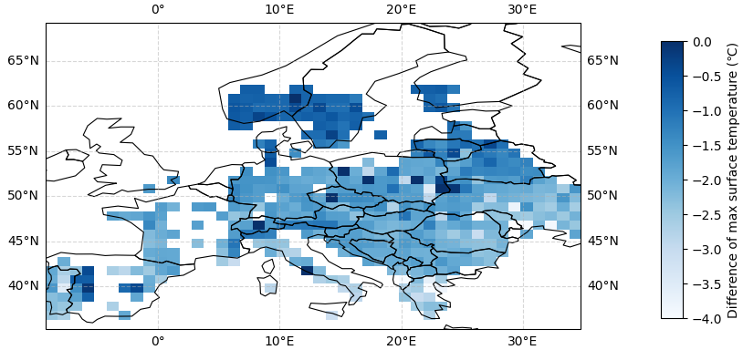
Result 3: Climate mitigation in European scale
- Impact of foliar yellowing and residue covering on surface temperature (average and maximum)
-1.72±0.76℃
residue coverage in 60 days after winter wheat harvest cools the surface in Europe
The cooling effect of residue coverage enhances in the low-latitude regions

Slide 10
Bare soil albedo datasets

Slide 11
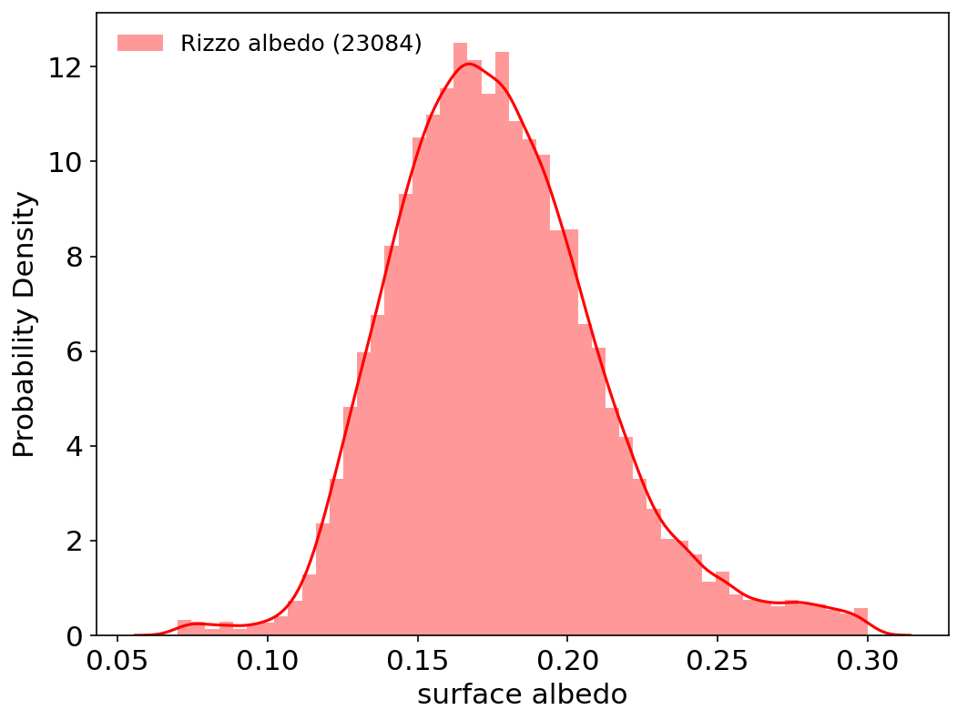
Extract BSA using S2 spectral indices
- Extract bare soil periods and S2 albedo during periods where ‘bare soil conditions’ are met
Spectral indices (Rizzo 2023)
NDVI | (NIR- R) / (NIR + R)
Greenness | (2*green-red-blue)/(green+red+blue)
NBR | (NIR-SWIR2)/(NIR+SWIR2)
NBR2 | (SWIR1-SWIR2)/(SWIR1+SWIR2)
- 0.05< NDVI <0.25 - Greenness <0.65 - NBR > -0.23 - 0.05 < NBR2 < 0.15
132,487 soil samples
mean+std:0.176±0.03
median: 0.174

Slide 12
Build the relationship between bare soil albedo and predictors
- Select features related with bare soil albedo
Features | Labels | Unit | Spatial resolution | Data source | Classification
local solar zenith angle | lsza | ° | 300 m | Sentinel-2 | Satellite properties
sensing orbit number | son | - | 300 m | Sentinel-2
month | month | - | - | Sentinel-2
time of each day | time | - | - | Sentinel-2
soil organic carbon | SOC | g / kg | 250 m | OpenLandMap USDA soil datasets | Soil conditions
sand content | sand_{c} | % | 250 m | OpenLandMap USDA soil datasets
soil bulk density | bulkdens | kg / m³ | 250 m | OpenLandMap USDA soil datasets
soil pH | pH | - | 250 m | OpenLandMap USDA soil datasets
soil moisture | SM | cm³/cm³ | 1000 m | Global Surface Soil Moisture (GSSM1 km)
digital elevation model | DEM | m | 30 m | Shuttle Radar Topography Mission (SRTM) | Topography

Slide 13
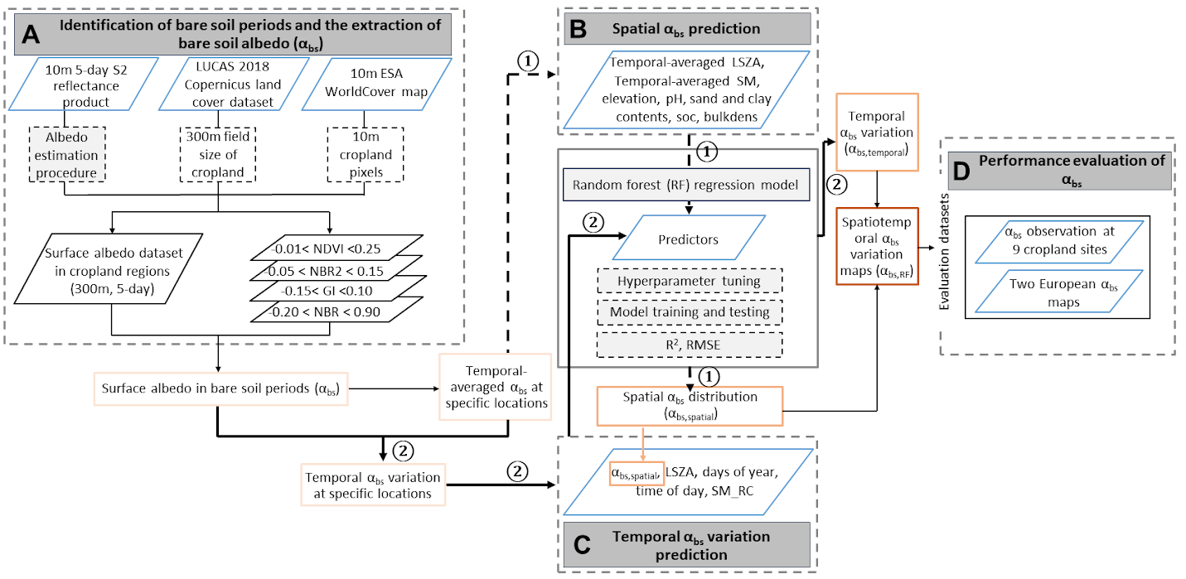
Build the relationship between bare soil albedo and predictors
- Build the random forest model

Slide 14
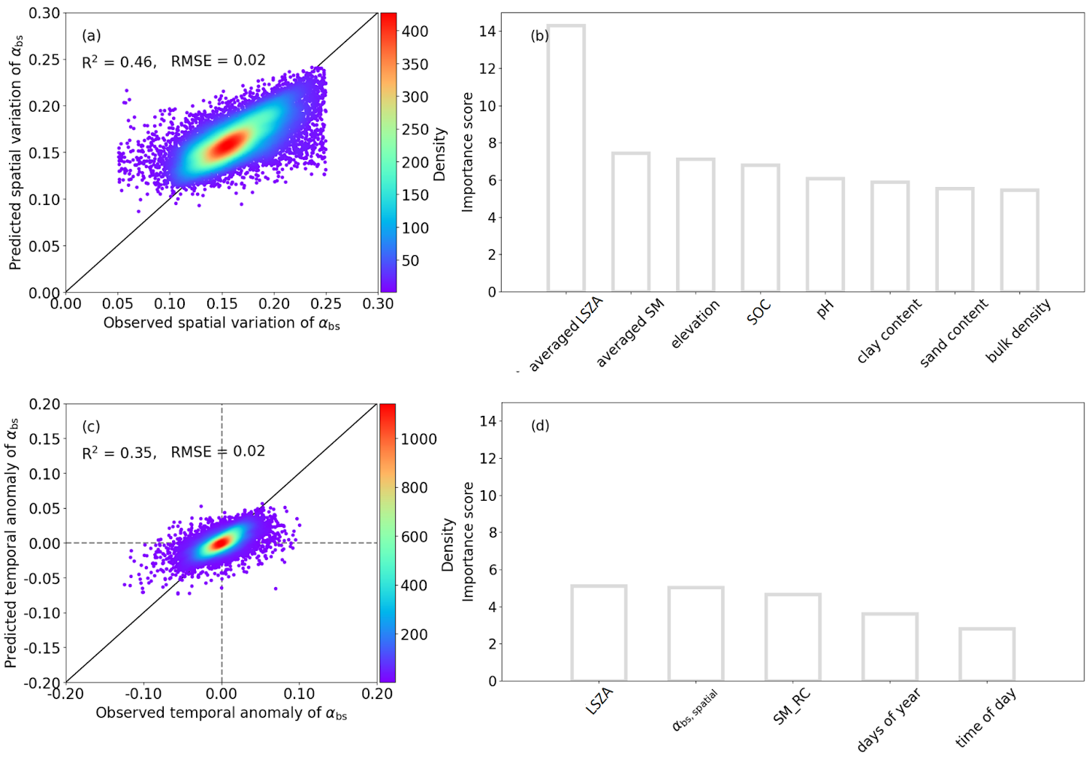
The performance of the random forest models for predicting European bare soil albedo

Slide 15
The spatial distribution of produced bare soil albedo and the comparison with site or S2 observation

