Slide 1
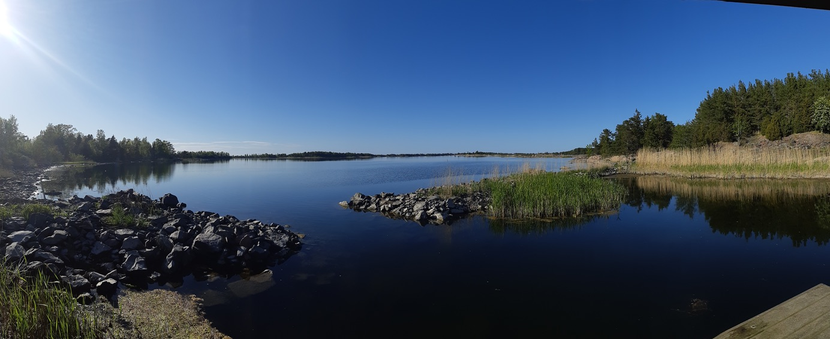




Exploring the effects of nutrients, carbon, and water darkening on coastal phosphorus bioavailability
Mayra P. D. Rulli, Aurélie Garnier, Magnus Huss, Jenny Ask, Olivia Bell, Ryan A. Sponseller, Ann-Kristin Bergström, Martin Berggren
Mayra Rulli
Department of Physical Geography and Ecosystem Science, Lund University, Sweden
Session:
Dissolved and particulate organic matter –
Linking terrestrial and aquatic ecosystems
Photo credit: Aurélie Garnier
Notes:
Good morning! My name is Mayra, and today I will walk you through our study exploring how nutrients, carbon, and water darkening affect coastal phosphorus bioavailability.

Slide 2
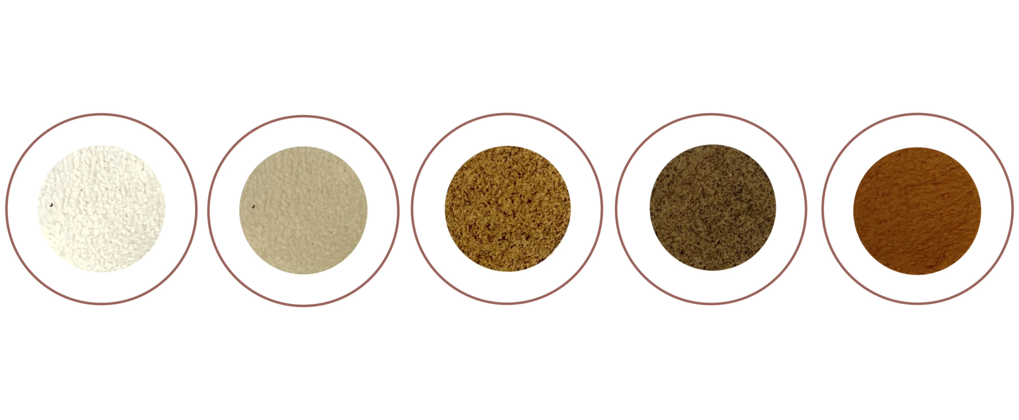
Backgrounds
Increases in DOM input
  Coastal water darkening
Nutrient enrichment
  Eutrophication
Notes:
Coastal ecosystems are facing multiple pressures from human activity and environmental change. Among these, two major trends are reshaping nutrient cycling: increasing inputs of coloured dissolved organic matter, which leads to water darkening, and eutrophication caused by nutrient enrichment.
Water darkening reduces light penetration, affecting primary production and microbial processes. At the same time, terrestrial inputs are also increasing the load of dissolved organic phosphorus — or DOP — a fraction of phosphorus that is less readily available but can still fuel productivity when broken down by microbes.
The bioavailable portion of DOP, or BDOP, is particularly important to understand because it reflects how much of this pool can actually support microbial growth.
Yet we still know little about how darkening, carbon supply, and nutrient inputs interact to influence BDOP dynamics in coastal systems — and that is the gap this study aims to address.

Slide 3
Research Question
How do labile carbon additions, nutrient enrichment, and increased water colour affect the bioavailability of dissolved organic phosphorus (BDOP) in coastal waters?
Notes:
This led us to three primary hypotheses, aimed at understanding how labile carbon additions, nutrient enrichment, and water darkening influence the bioavailability of dissolved organic phosphorus in coastal waters.

Slide 4
Research Question and Hypotheses
How do labile carbon additions, nutrient enrichment, and increased water colour affect the bioavailability of dissolved organic phosphorus (BDOP) in coastal waters?
Light availability regulates BDOP (more BDOP under dark, less under light).
Nutrient enrichment promotes BDOP accumulation by shifting P uptake.
Labile DOC stimulates microbial activity, increasing BDOP.
Notes:
First, that light availability regulates BDOP concentrations, with more accumulation in dark conditions and depletion under light, likely related to increased autotrophic demand.
Second, that nutrient enrichment promotes preferential uptake of inorganic phosphorus, leading to BDOP accumulation.
3. And third, that labile carbon additions stimulates microbial breakdown of organic matter, increasing BDOP
To test these hypotheses, we conducted a fully factorial mesocosm experiment manipulating light, carbon, and nutrient conditions.

Slide 5
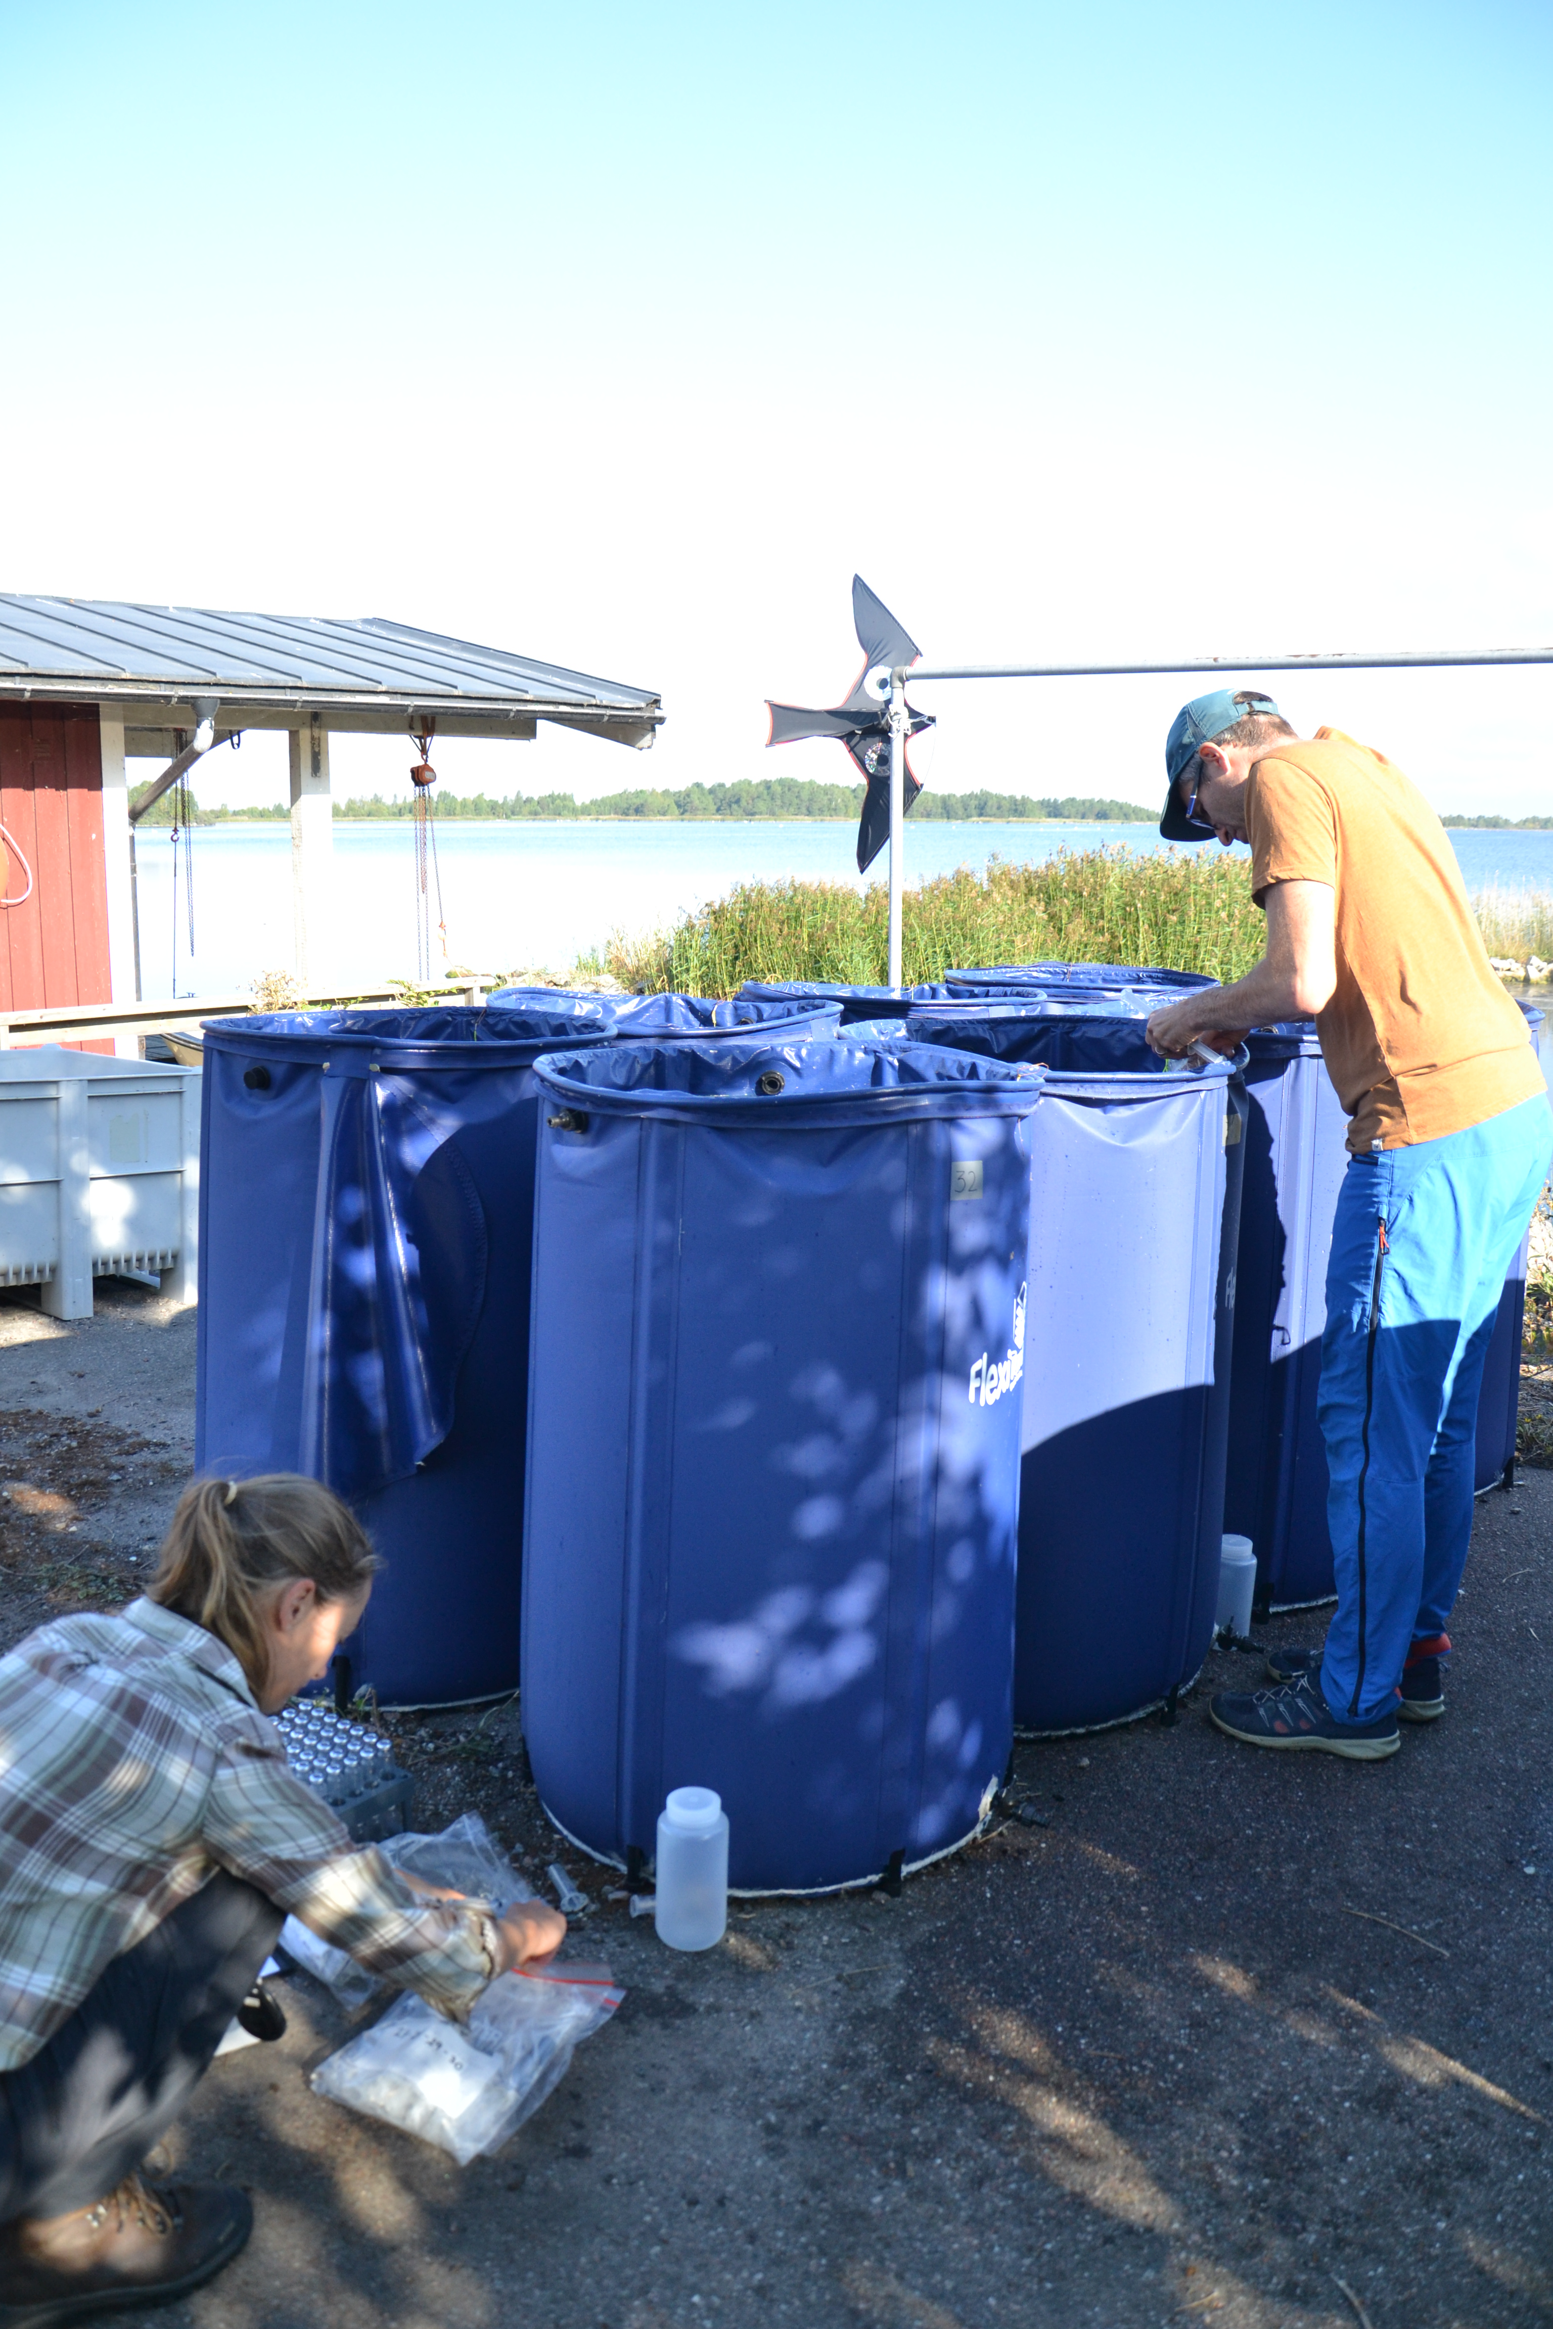
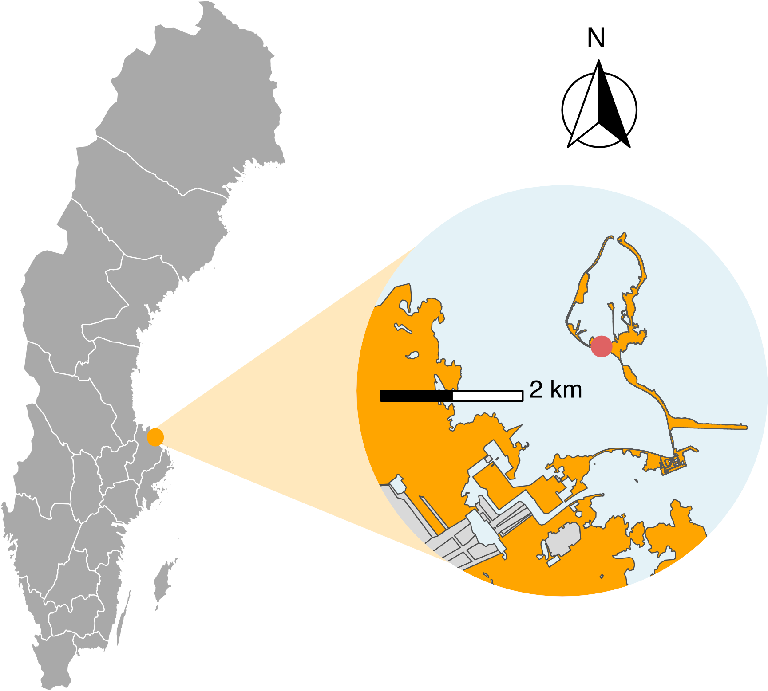
Experimental site and design
Field station in Forsmark at the Swedish coast of the Baltic Sea
Photo credit: Aurélie Garnier
Notes:
We set up 24 outdoor mesocosms at the Forsmark field station on the Swedish Baltic Sea coast, just north of Stockholm.
Each mesocosm consisted of these 400-liter flexible, foldable plastic tank, filled with 350 L of unfiltered seawater from the surrounding area.

Slide 6
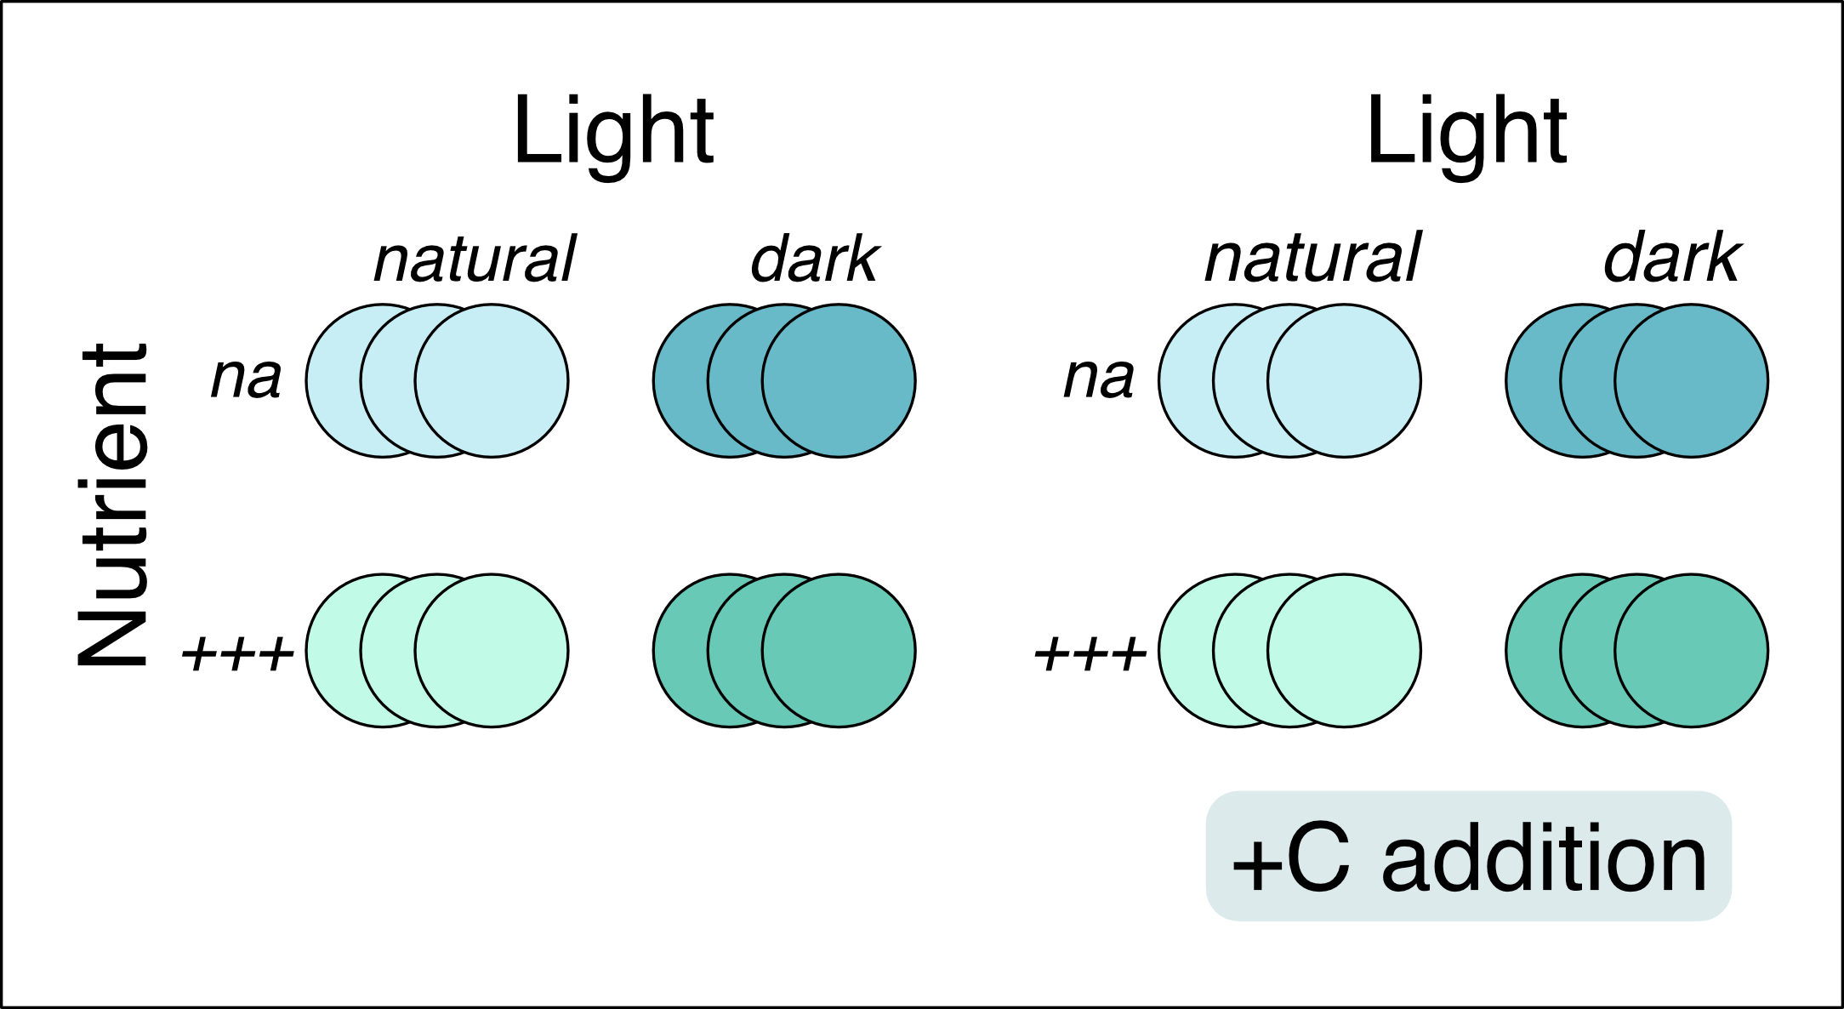
Experimental site and design
Field station in Forsmark at the Swedish coast of the Baltic Sea
Rulli et al., in review, L&O
Notes:
Now, here’s how we set up the experiment.
Our fully factorial design crossed these three treatment factors:
darkening, to simulate reduced light availability from DOM pigmentation;
labile carbon addition using glucose, to isolate the resource effect of DOM without adding colour;
and nutrient enrichment with inorganic nitrogen and phosphorus, mimicking eutrophic conditions typical of high-nutrient regions in the Baltic Sea.
You can see the eight combinations here — from the control with no additions, to the full treatment with all three factors combined.
Each of these three factors was applied individually and in combination, giving us eight treatment groups in total, with three replicates per group.
This design allowed us to disentangle the individual and interactive effects of light, carbon, and nutrient inputs on phosphorus bioavailability.

Slide 7
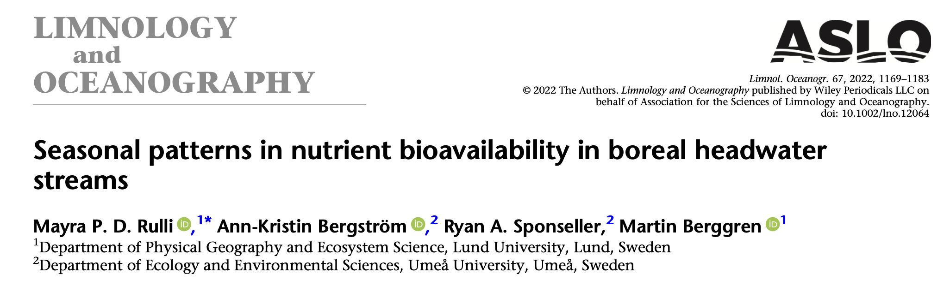
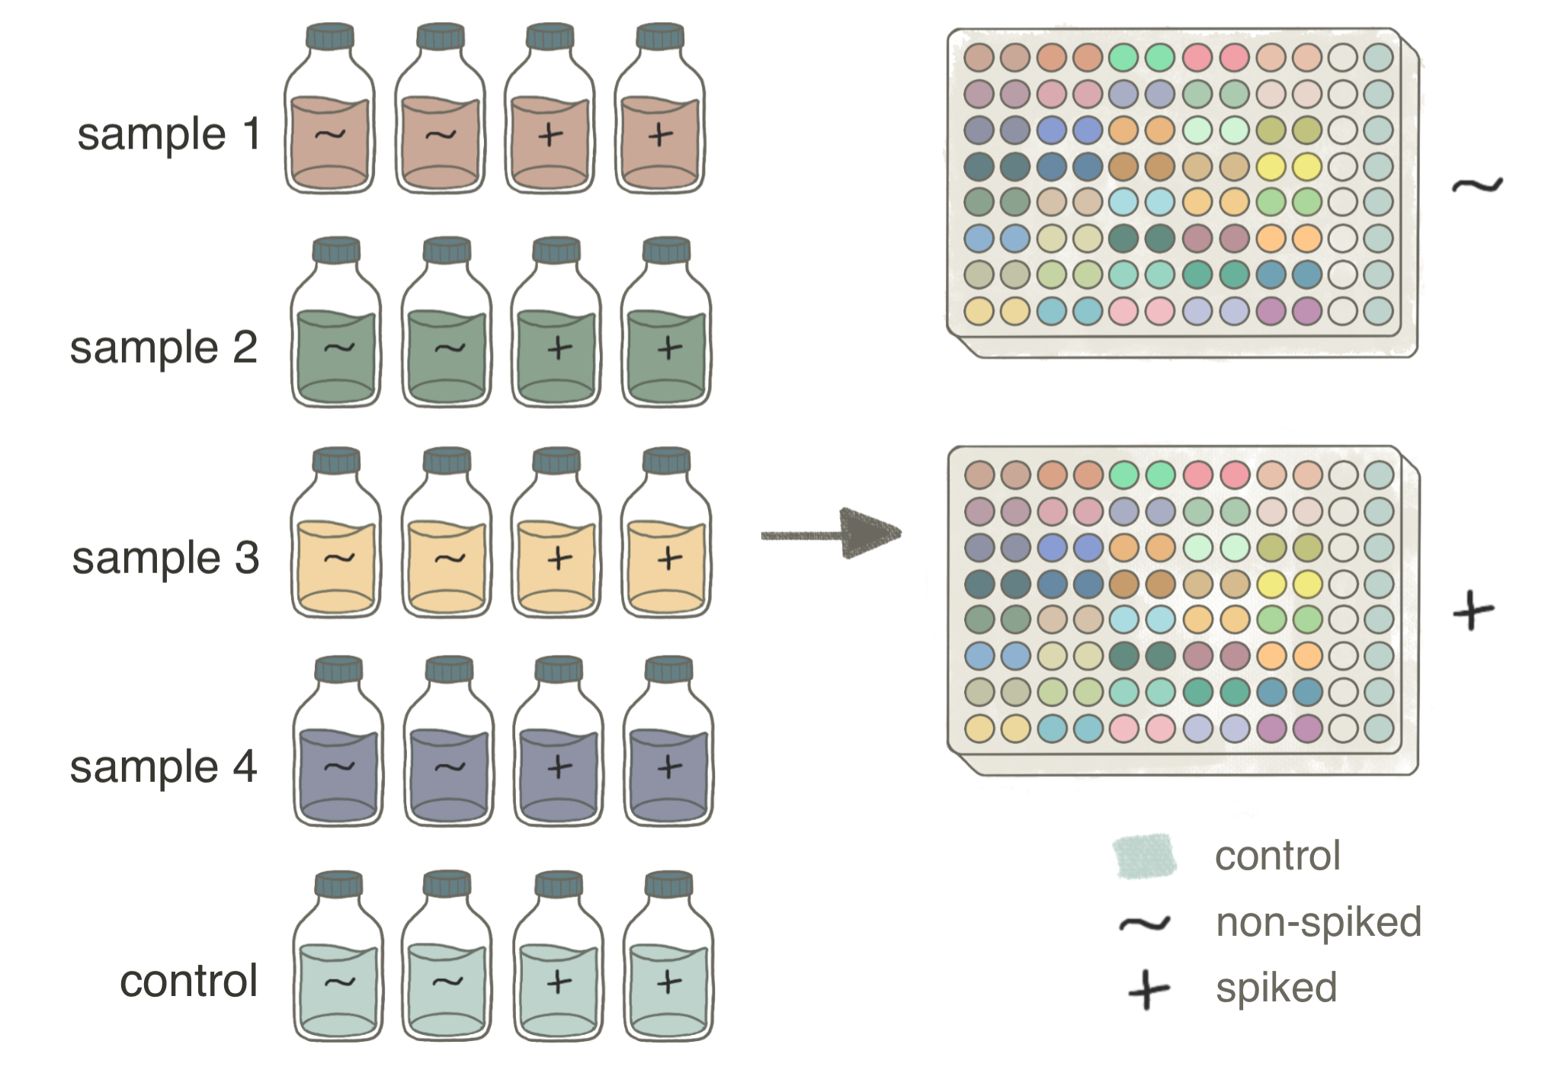

Estimating phosphorus bioavailability
  Short-term bioassays (48 hours)
  Flow cytometry
Rulli et al., in review, L&O
Notes:
To estimate bioavailable phosphorus, we used a short-term bioassay based on bacterial uptake.
This approach provides a more ecologically relevant measure of BDOP than relying on chemical concentrations alone, since it captures the biologically accessible portion of the dissolved P pool.
The method builds on Rulli et al. (2022), but we adapted it for a high-throughput setup to handle large sample numbers while maintaining precision and replication.
We then measured bacterial abundance with flow cytometry, shown on the right, to assess growth responses to dissolved phosphorus, and allowing us to track bacterial growth as a proxy for bioavailable phosphorus.
Let’s start with what we found — beginning with the effect of water colour on BDOP.

Slide 8
Water darkening effects on BDOP
Dark increased BDOP
Suggests light limitation affects phosphorus cycling.
  Competition?
 | F_{df=1} | p
Dark | 8.269 | 0.004 | +
H1✅
Light regulates BDOP
Rulli et al., in review, L&O
Notes:
First, we found that darkened waters had higher BDOP concentrations, suggesting that light limitation under darkened conditions can alter P cycling, possibly by reducing autotrophic uptake and competition for P, which allows more P to accumulate in bioavailable organic forms.

Slide 9
Nutrient effects on BDOP depend on light availability
Nutrient addition increase BDOP.
 | F_{df=1} | p
Dark | 8.269 | 0.004 | +
Nutrient | 4.192 | 0.041 | +
H2✅
Nutrient regulates BDOP
Rulli et al., in review, L&O
Notes:
Next, we tested how nutrient addition influenced BDOP.
Nutrient addition also increased BDOP concentrations significantly
CLICK
Supporting our H2.
→ NEXT

Slide 10
Nutrient effects on BDOP depend on light availability
Nutrient addition increase BDOP.
  but only under clear water conditions?
 | F_{df=1} | p
Dark | 8.269 | 0.004 | +
Nutrient | 4.192 | 0.041 | +
Dark:Nutrient | 4.905 | 0.027 | -
Darkening suppressed the positive effect of nutrient enrichment on BDOP
Rulli et al., in review, L&O
Notes:
However, under darkened conditions, adding nutrients did not lead to a further increase in BDOP. This suggests that darkening modifies the system’s ability to process and transform P, possibly by limiting light-driven microbial or autotrophic activity.

Slide 11
Darkening and nutrients effects on PO₄
 | F_{df=1} | p
Dark | 4.5 | 0.033 | +
Nutrient | 117 | <0.001 | +
PO₄ concentrations increased with both
  nutrient addition
  dark
Rulli et al., in review, L&O
Notes:
When looking at inorganic P concentrations, we found that nutrient enrichment increased PO₄ concentrations, as expected. And dark also have a positive effect on phosphate.
→ Next

Slide 12
Darkening and nutrients effects on PO₄
 | F_{df=1} | p
Dark | 4.5 | 0.033 | +
Nutrient | 117 | <0.001 | +
Dark modifies P processing dynamics
Rulli et al., in review, L&O
Notes:
However, under darkened conditions, PO₄ concentrations were even higher after nutrient addition, indicating that darkening further limited the conversion of inorganic phosphorus into bioavailable organic forms.
The added inorganic P did not contribute to BDOP but seems to have mainly persisted in its inorganic form. This result reinforces the idea that water colour strongly modifies P processing dynamics.

Slide 13
Limited effect of labile carbon addition
 | F_{df=1} | p
Carbon | 0.7 | 0.4 | +
Dark:Carbon | 1.8 | 0.2 | -
Nutrient:Carbon | 0.4 | 0.5 | +
Adding labile C no significant effect on BDOP concentrations.
H3❌
C addition had little effect
Rulli et al., in review, L&O
Notes:
Finally, we tested whether labile carbon additions influenced BDOP concentrations, both alone and in combination with darkening and nutrient enrichment. Across all contexts, we observed limited effects of labile C, and none of the differences were statistically significant.

Slide 14
Conclusion and implications
Water darkening increased BDOP but constrained nutrient-driven transformations.
Managing both nutrient loads and DOM-driven darkening is essential to reduce total bioavailable P and support coastal ecosystem resilience.
Notes:
To conclude, we found that water darkening increased BDOP concentrations but also constrained the system’s ability to process added inorganic nutrients.
Nutrient enrichment enhanced BDOP under clear water conditions, but this effect disappeared under darkening.
These results suggest that reversing coastal darkening could enhance algal uptake of excess inorganic phosphorus. However, total bioavailable P would shift from inorganic to organic forms, rather than simply decreasing.
Therefore, mitigating both coastal darkening and eutrophication is essential to reduce total bioavailable P and support ecological balance and functionality in coastal ecosystems.

Slide 15

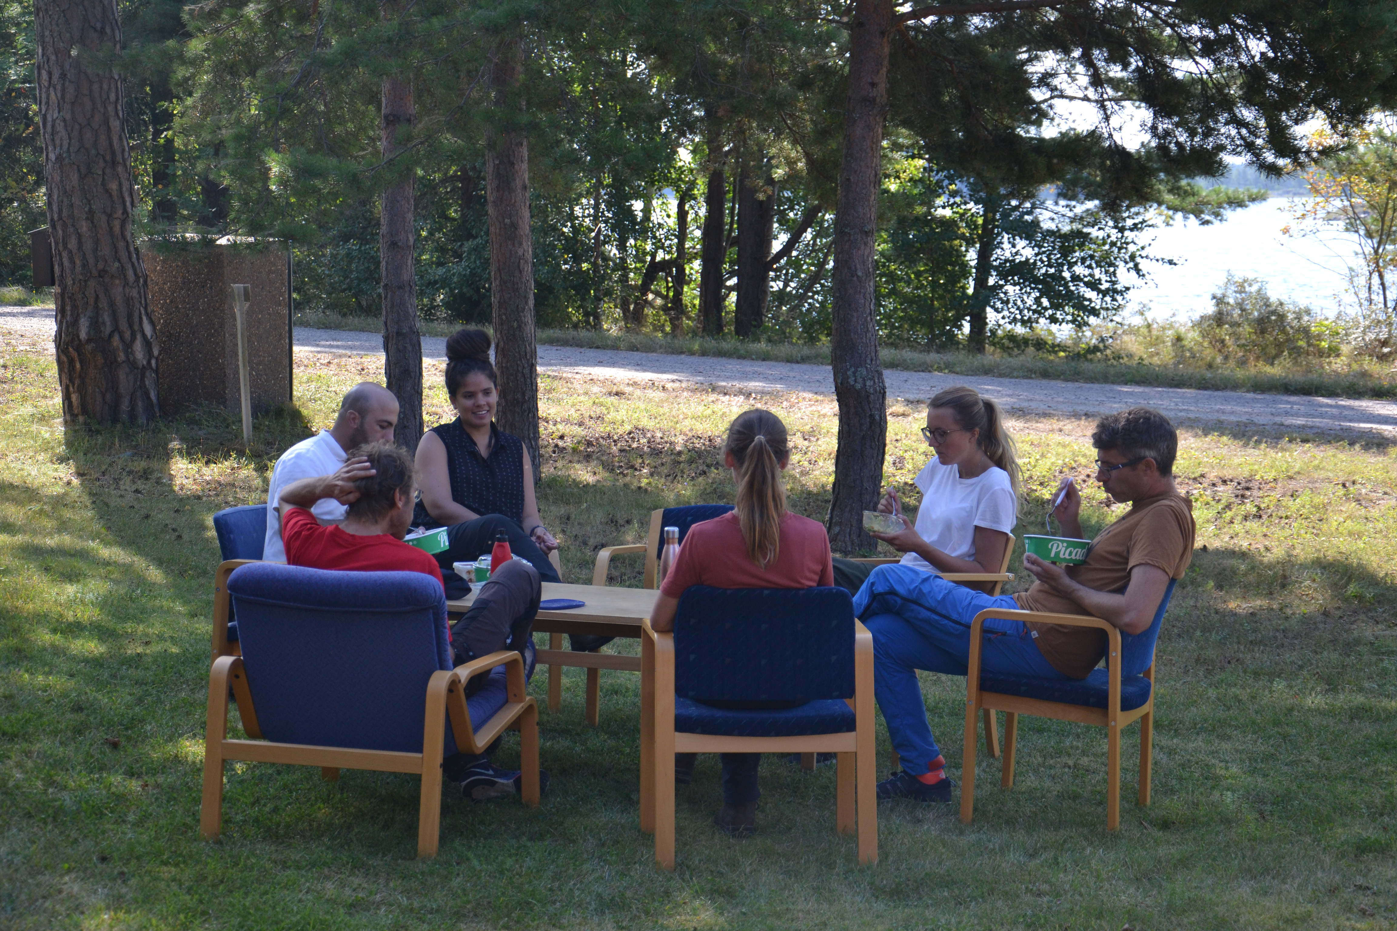

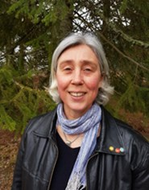




Vielen Dank!
Thank you for your attention.
mayra.rulli@nateko.lu.se
Mesocosm study:
Supervisors:
Funding:

