Slide 1
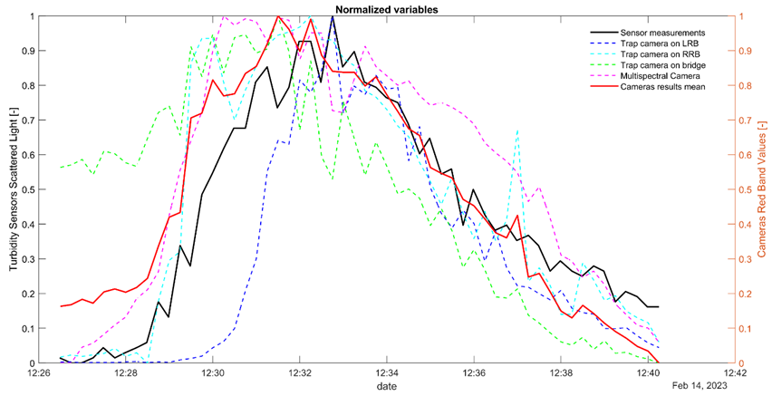
Supplementary materials: Comparability of different camera results
Within the figure, the mean of all the normalized camera red bands values is also reported in red. The normalization made it easier to assess camera performances in relation to the measurements of turbidity.
Additionally, it enables a consistent comparison among different camera types, avoiding the issue of the Bayer pattern, used in digital cameras, that provides us RGB values already interpolated, unlike the multispectral camera that measures pure bands.

Slide 2
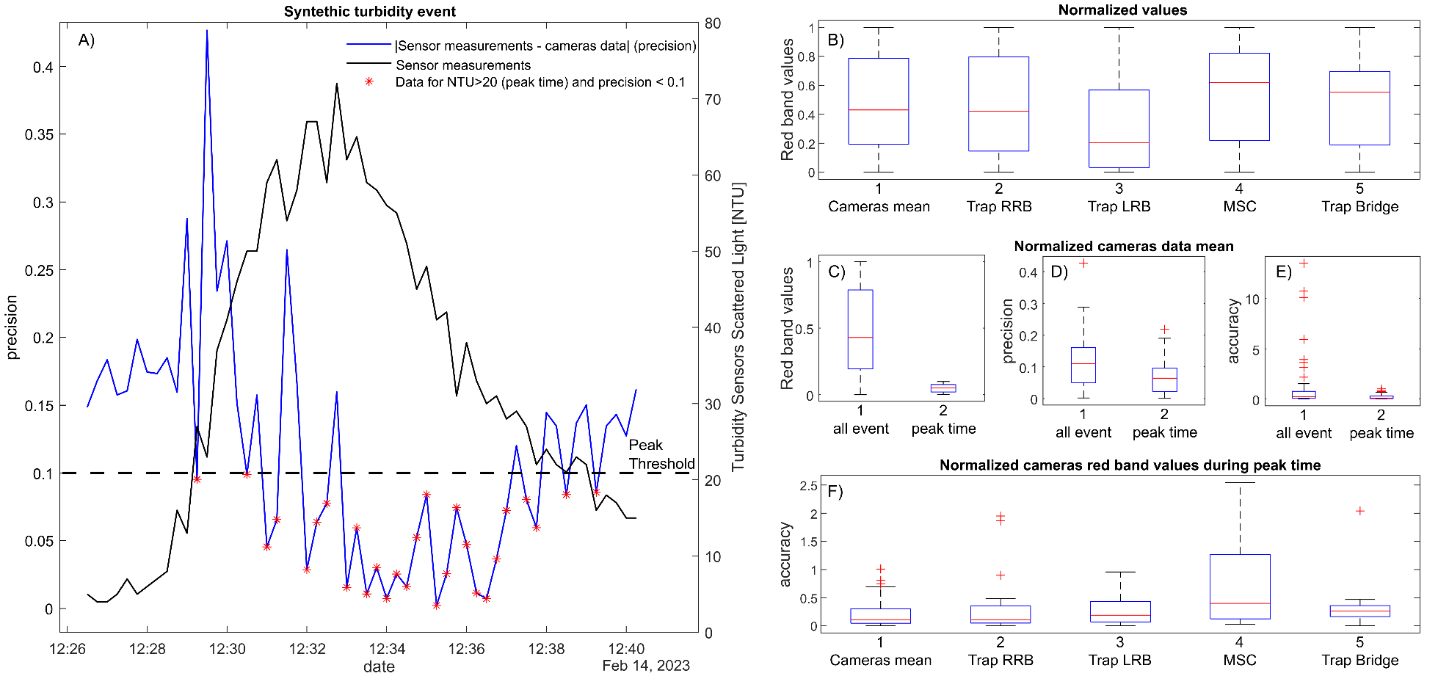
Supplementary materials: Sensitivity analysis
/ 42
Significant variations in illumination cause notable differences in spectral signatures across days and seasons.
Changing illumination direction and resulting shadows alter the scene during the day.
Flow conditions and ripples may affect the
spectral signature.
Suspended sediment colour variations can also impact the camera signal.
Wind, human activity, or animal presence might disrupt camera positioning or even induce vibrations.
Higher the turbidity, more reliable the procedure, in the range investigated.
Plots of results precision (A, D) and accuracy (E, F) for each camera (B), considering the entire turbidity event and only the peak time (C, D, E, F).

Slide 3
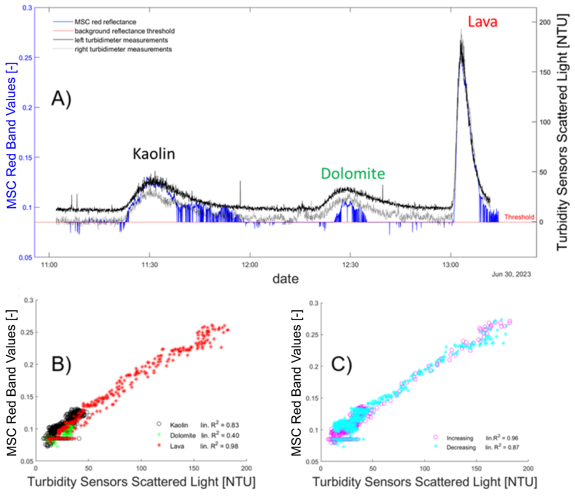
Supplementary materials: Range of applications
Figure. Comparison of turbidimeter measurements and all the cameras’ data, in terms of red band values (A) and red band increments (B), starting from a clear water condition (Red0), during the first experiment of February 2023.
Figure. A) Comparison of turbidimeter measurements and the MSC red band data, considering the three consecutive turbidity events generated by different tracers (kaolin, dolomite and lava flours); B) Scatter plots of the three turbidity events, taken individually; C) Scatter plots of the turbidity events, separated by turbidity level increasing and decreasing curves

Slide 4
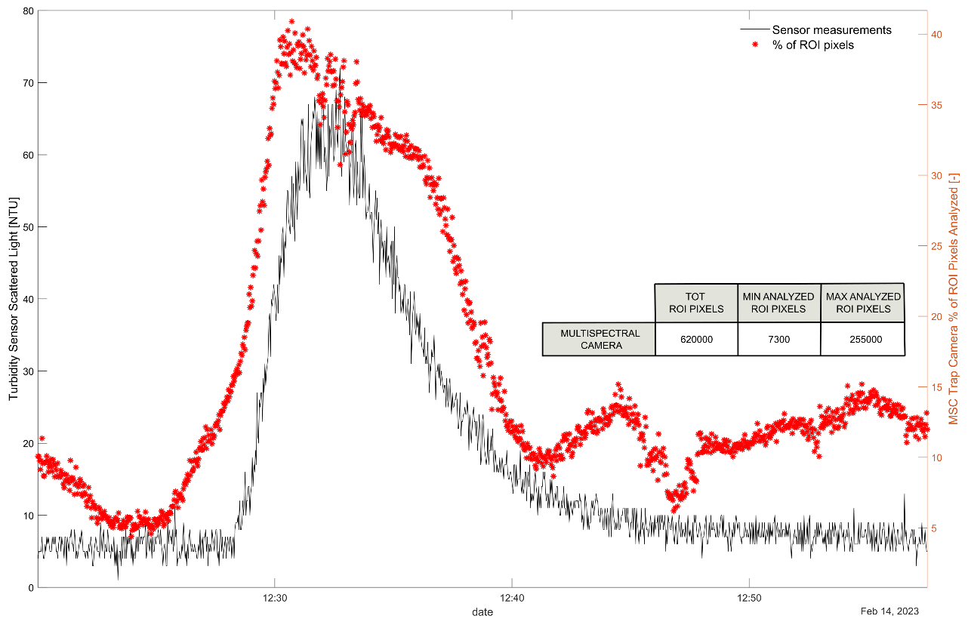
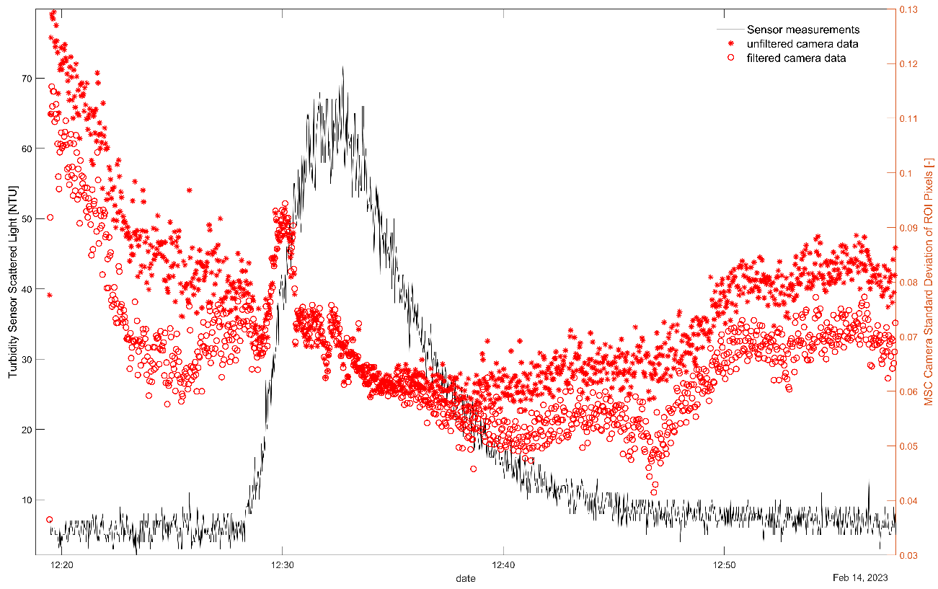
Supplementary materials: Spatial variability and active pixel count within the region of interest
Figure. Comparison of turbidimeter measurements (in black) and number of analyzed ROI pixels in MSC data (in red) during the short-term experiment of February 2023
Figure. Comparison of turbidimeter measurements (in black) and the standard deviation of ROI pixels intensity in multispectral camera red band (in red), during the short-term experiment of February 2023

Slide 5
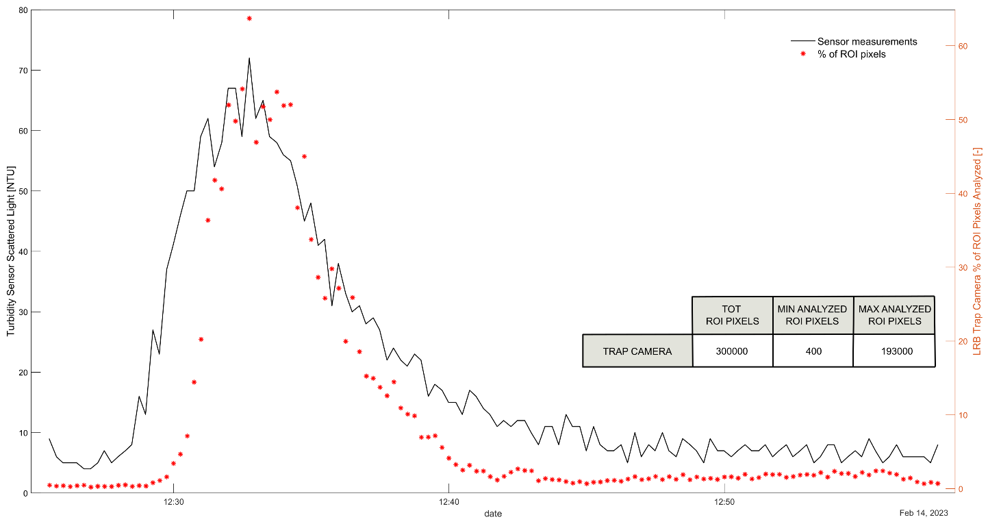
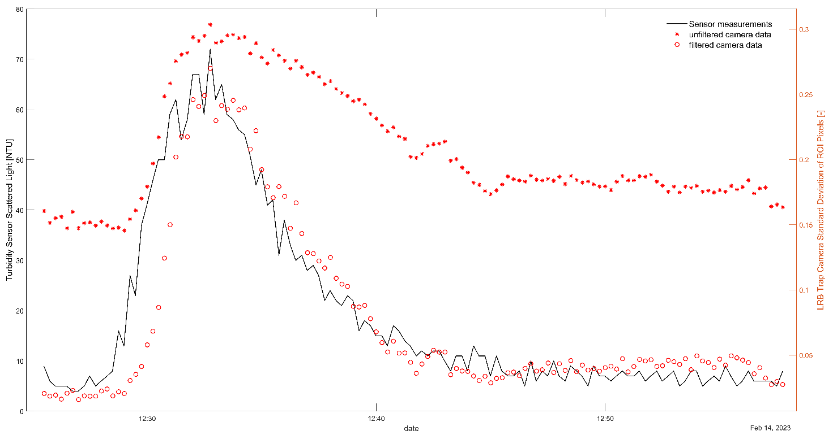
Supplementary materials: Spatial variability and active pixel count within the region of interest
Figure. Comparison of turbidimeter measurements (in black) and number of analyzed ROI pixels in LRB trap camera data (in red) during the short-term experiment of February 2023
Figure. Comparison of turbidimeter measurements (in black) and the standard deviation of ROI pixels intensity in LRB trap camera red band (in red), during the short-term experiment of February 2023

