Slide 1
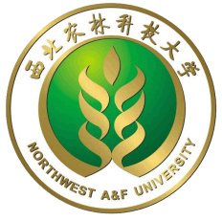
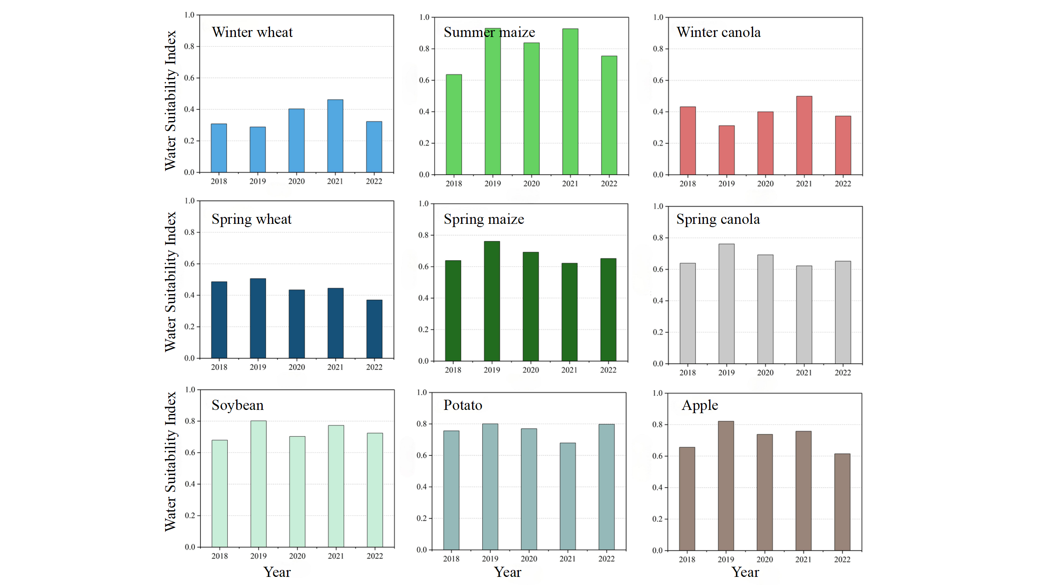
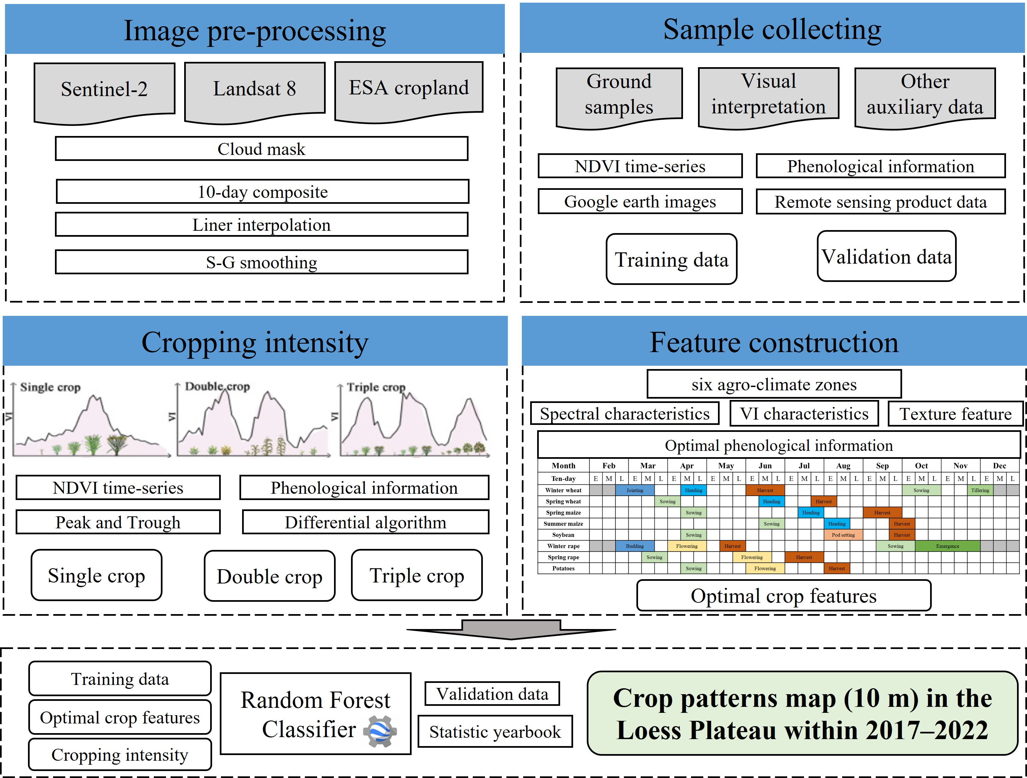
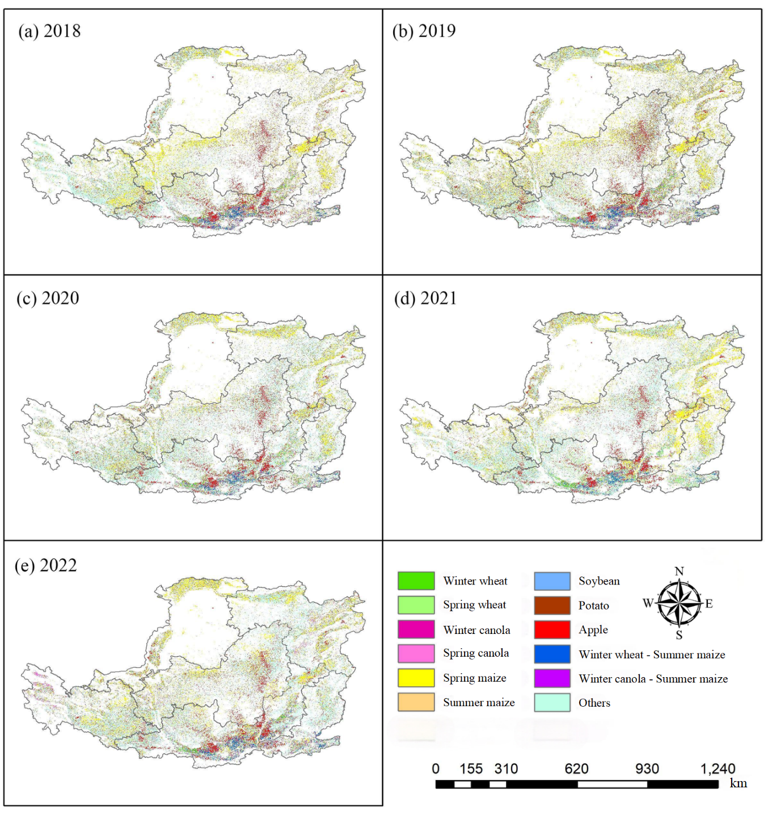
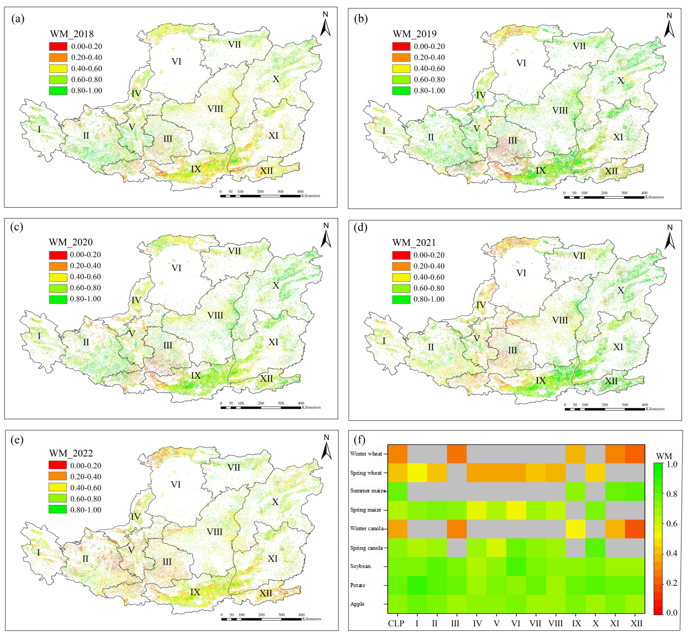
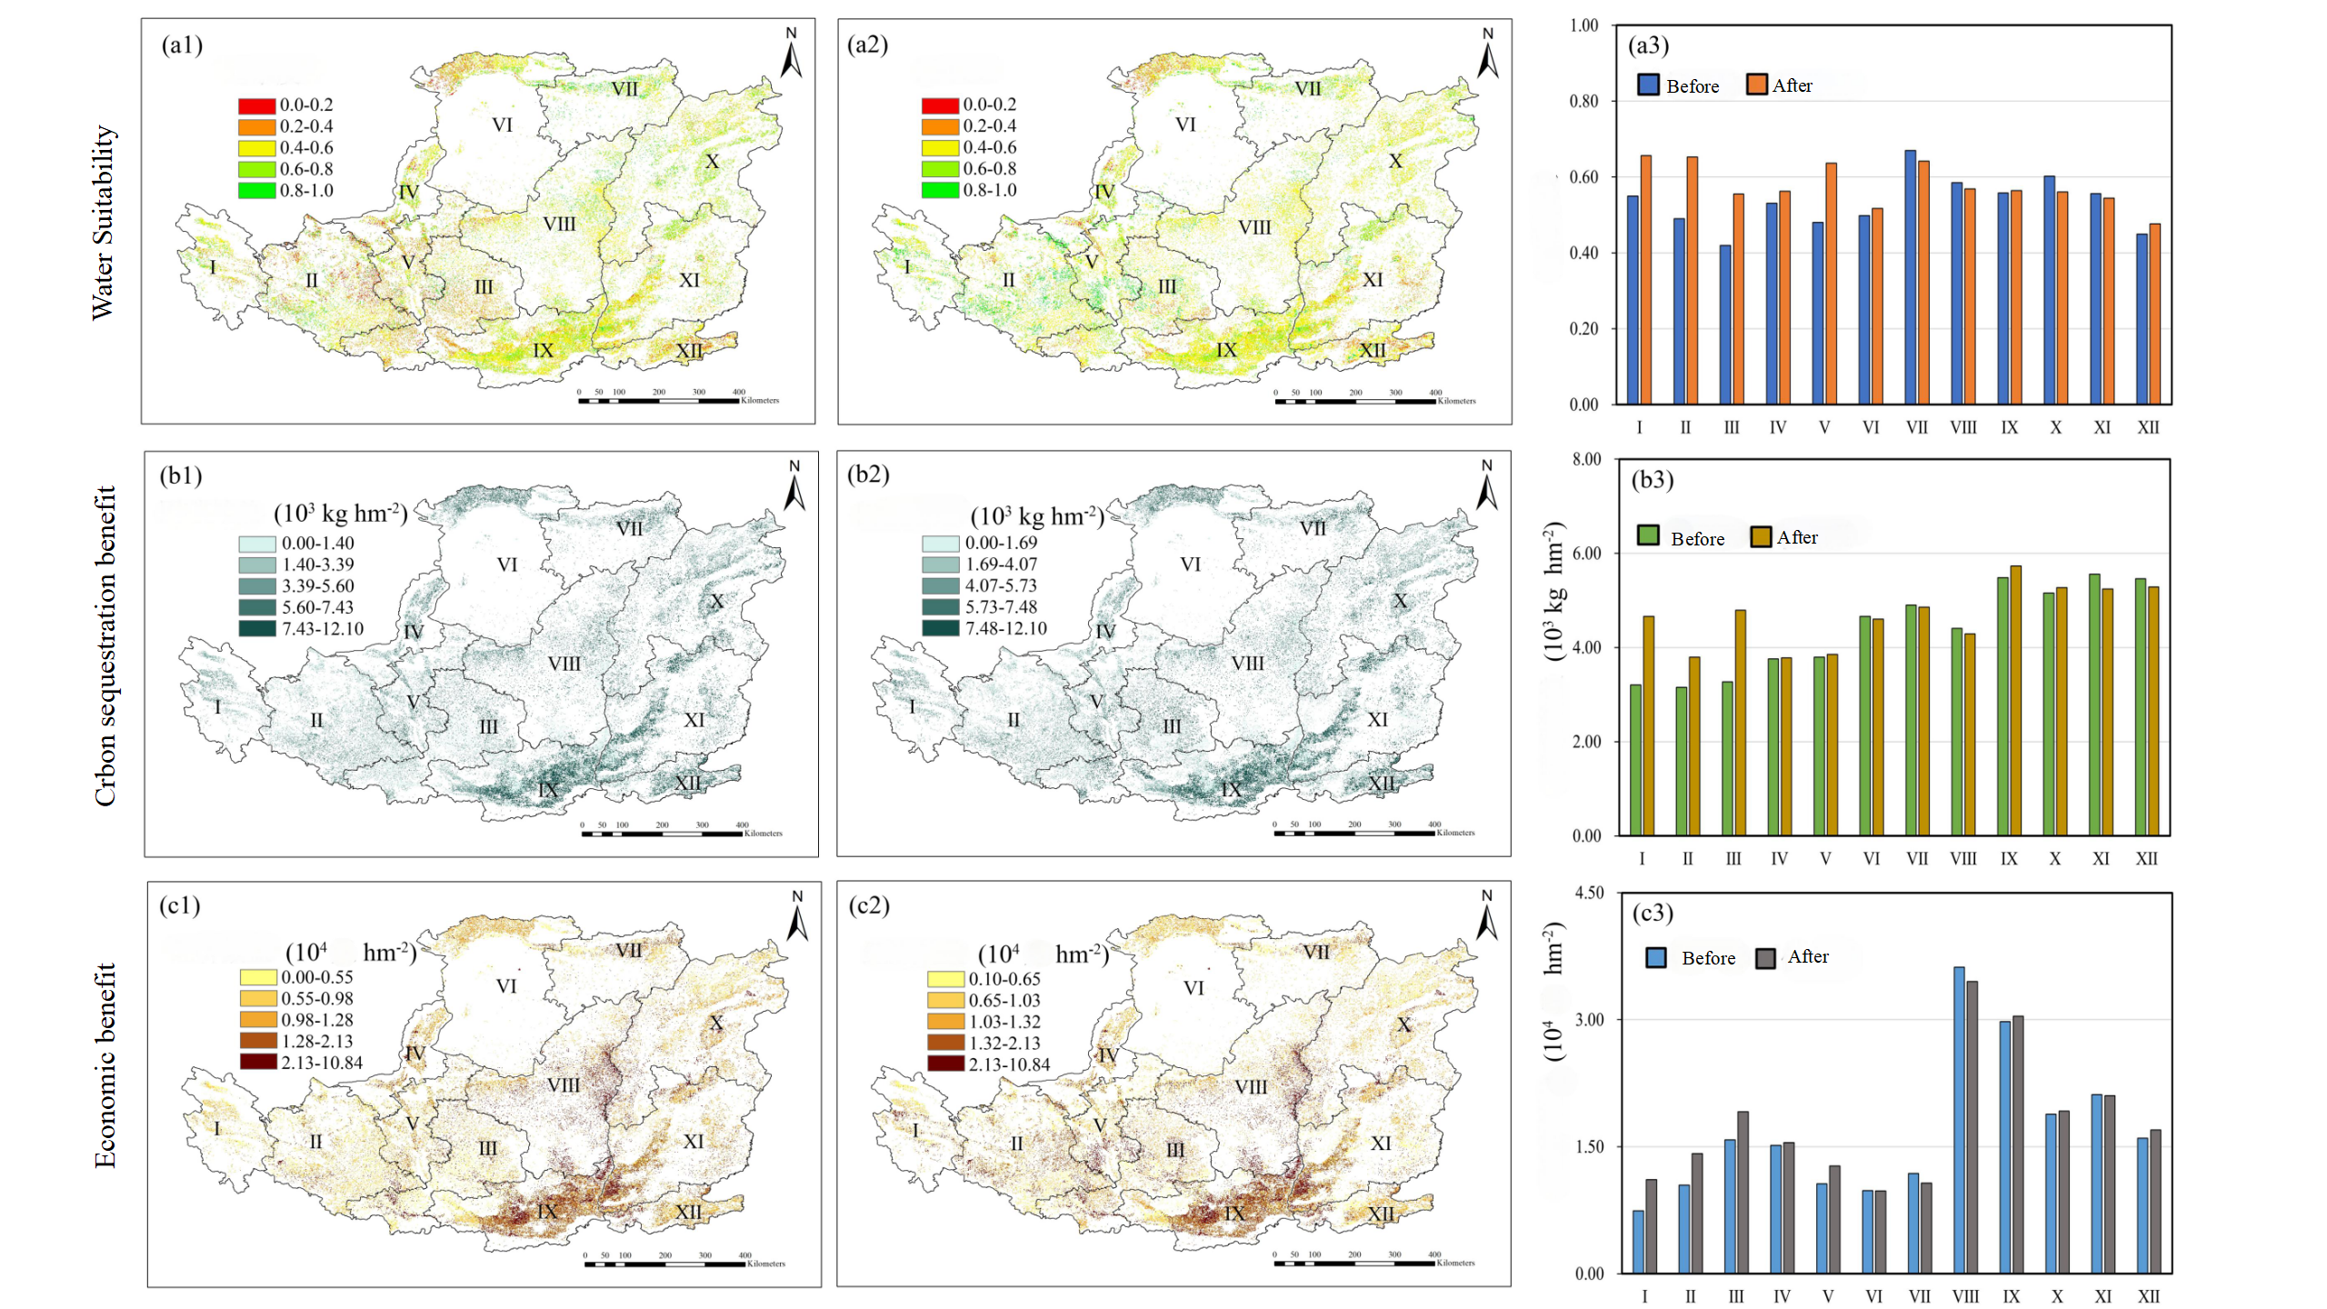
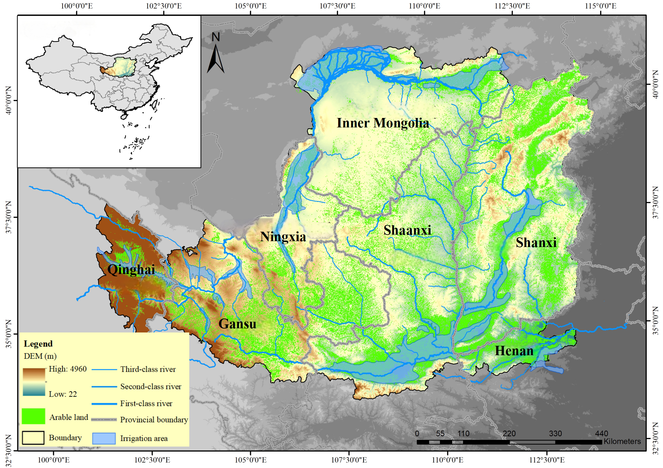
Evaluation of crop-water mutual suitability and optimization of water-adaptive cropping for dryland farming in Loess Plateau
Xining Zhao, Jichao Wang, Xiaodong Gao, Qi Liu, Changjian Li, Xuerui Gao*
Institute of Soil and Water Conservation, Northwest A & F University, China
Introduction
Under global climate change, both food production and water resource systems face increasing uncertainty and instability, particularly in arid and semi-arid regions. As a key base for grain and specialty agricultural products in Northwest China, the Loess Plateau is dominated by rainfed dryland farming. However, the region suffers from severe water scarcity, low water use efficiency, and a mismatch between current cropping patterns and local water–soil resources. Promoting water-adaptive dryland agriculture, improving resource matching, and enhancing green water (precipitation) use efficiency are crucial to breaking development bottlenecks and achieving high-quality agricultural development in this area.
The structure of this study is as follows:
a) By integrating phenological and spectral information, large-scale remote sensing interpretation of cropping patterns was achieved using sample augmentation techniques.
b) A novel farmland water suitability index was developed, revealing the spatial-temporal patterns of water suitability on the Loess Plateau.
c) Based on model-optimization integration, an optimized strategy was proposed to enhance the synergy of “water suitability–carbon sequestration–income increase” in dryland farming systems on the Loess Plateau.
Study Area and Data
The Loess Plateau, located between 33°43′ – 41°16′N and 100°54′ – 114°33′E, spans 624,000 km² across seven provinces in northern China.
Methods
Results analysis
Remote sensing identification of high-resolution crop planting structure on the Loess Plateau
Based on field samples and remote sensing data, phenological information and spectral features were integrated, and the DTW algorithm was used to expand sample data and construct standard phenological curves. NDVI growth curves were extracted from Sentinel-2A imagery to obtain crop planting intensity. A regionally optimized random forest classifier was then developed to map rainfed crop distribution on the Loess Plateau at 10 m resolution from 2018 to 2022.
In the central hilly region (Gansu, Ningxia, and parts of Shaanxi), crops generally had low water suitability. It is recommended to select high-suitability, economically viable crops based on local conditions to optimize planting structures and improve the efficiency and sustainability of rainfed agriculture.
Crop identification process
The crop identification process is shown in the right figure: Sentinel-2 data preprocessing and orchard/cultivated land mask extraction are performed, combined with field samples and the DTW algorithm to enhance phenological information.
Optimization and regulation of planting structure for multi-objective improvement of "Water Suitability – Carbon Sequestration –Increased Income"
Based on soil, terrain, and meteorological factors, the spatial suitability of rainfed crops was assessed, and a suitable crop set for the region was selected. By combining the RWBAT_EPIC model with the NSGA-II intelligent optimization algorithm, an optimized planting structure scheme for "water suitability-carbon sequestration-increased income" synergistic goals in rainfed agriculture on the Loess Plateau was developed. The optimization results showed a 6.55% improvement in water suitability benefits, a 5.26% increase in carbon sequestration benefits, and a 2.67% rise in economic benefits, with significant improvements in yield and water use efficiency, especially in the central and western regions. This scheme provides scientific support for promoting high-quality development of rainfed agriculture on the Loess Plateau.
Based on the phenological curve, planting intensity is identified, and a random forest classifier is trained for each zone, ultimately generating the 10m crop planting structure map of the Loess Plateau for 2018–2022.
Crop water suitability index construction
This study replaces effective precipitation with root zone water, considers CO₂ concentration effects on evapotranspiration, and introduces a new water suitability index with growth stage-specific weights. The algorithm is as follows:
Results showed classification accuracy ranged from 81.08% to 84.54%, with Kappa coefficients between 78.35 and 82.26. Wheat and maize were well identified (R² > 0.84), and the results aligned well with municipal statistical yearbooks (R² > 0.64). The region is mainly dominated by spring maize, with double-cropping areas concentrated in the Fenwei Basin and the hilly areas of eastern Shanxi and western Henan.
(1)
Where WM is the comprehensive water suitability index for the entire crop growth period, while WM_{ini}, WM_{dev}, WM_{mid}, and WM_{end} represent the indices for each growth stage, with α, β, γ, and δ as the water sensitivity indices for these stages.
Construction of a multi-objective optimization model
By integrating the RWBAT_EPIC model with intelligent optimization algorithms, three objective functions and five constraints are set to optimize the spatial distribution of major crops.
Three Objective Functions: Maximize the Water Matching Index (WM); Maximize Net Carbon Sequestration (CN); Maximize Economic Benefits (EB)
Five Constraints: Crop Uniqueness: Only one crop is planted per grid per cycle; Suitability Constraint: Only the top two most suitable crops are selected; Arable Land Area Constraint: Total cultivated area is maintained between 90% and 100% of the current level; Structure Change Constraint: The area change for each crop does not exceed 30%; Regional Practice Constraint: Optimized crops must be selected from those already cultivated in the zone
Calculation of Crop Carbon Sequestration
Where CN is the net carbon sequestration of crops, C_{a} is the carbon absorption, C_{e} is the carbon emissions, Unit: kg·CO₂·hm⁻²
Crop Economic Benefit
In the equation, EB represents the economic benefit per unit grid (yuan·hm⁻²); P_{k} is the price of crop k (yuan·kg⁻¹); Y_{k} is the yield per unit area of crop k (kg·hm⁻²); and C_{k} is the cost of crop k.
It features diverse terrain, soil, and vegetation, with a temperate continental monsoon climate and water scarcity. Agriculture plays a key role in its uneven socioeconomic development.
Data collection
Historical Meteorological Data: From the CLDAS-V2.0 dataset provided by the China Meteorological Administration, offering high-resolution precipitation and temperature data.
Historical CO₂ Data: From the NASA OCO-2 satellite mission, which provides global coverage and high spatiotemporal resolution.
Land Use Data: From Tsinghua University's FROM-GLC10 and the 2018 30m resolution land use data for the Loess Plateau released by the Nanjing Soil Institute.
Soil Data: From the National Qinghai-Tibet Plateau Science Data Center, covering various soil properties with a spatial resolution of 1 km.
Topographic Data: From the 90m resolution DEM provided by the China Geospatial Data Cloud, resampled to a 1 km resolution.
Assessment of water-suitable spatial patterns for dryland agriculture on the Loess Plateau
Based on the RWBAT_EPIC model and the Penman-Monteith method, this study systematically assessed the spatiotemporal matching of water supply and demand for major rainfed crops on the Loess Plateau, and developed a water suitability index considering crop water sensitivity during different growth stages.
Results showed both water supply and optimal water demand during the growing season followed a southeast-high to northwest-low pattern. Due to overlap with the rainy season, summer maize had the highest water supply, while apples also had relatively high supply due to their long growth cycle.
The water suitability ranking was: summer maize (0.82) > potato (0.76) > soybean (0.74) > apple (0.72) > spring rapeseed (0.71) > spring maize (0.67) > spring wheat (0.45) > winter rapeseed (0.40) > winter wheat (0.36).
Conclusion
Water suitability on the Loess Plateau follows a "southeast high, northwest low" pattern, with summer maize showing the highest suitability and winter wheat the lowest.
After optimizing the planting structure, water suitability, carbon sequestration, and economic benefits increased by 6.55%, 5.26%, and 2.67%, respectively, supporting the sustainability of dryland agriculture.
Contact
Dr. Xining Zhao: zxn@nwsuaf.edu.cn
Dr. Xuerui Gao: gaoxuerui666@163.com;
gaoxr@nwsuaf.edu. cn
(2)
(3)

