Slide 1
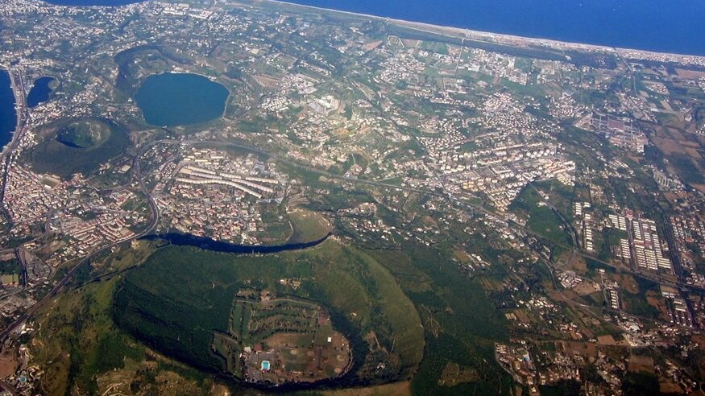
The Role of Urban Planning Law in Volcanic Risk Management
Dr. Marco Francesco Errico
PhD Student University of Campania L. Vanvitelli
Questa foto di Autore sconosciuto è concesso in licenza da CC BY-NC

Slide 2
Introduction
This research originates from the observation that the Italian territory is rich in active volcanoes. In fact, there are about 70 volcanoes, many of these are underwater.
For this reason, the scientific community has long investigated how to manage volcanic risk.

Slide 3
The Volcanic risk
Volcanic risk is defined as "the product of the probability of an eruptive event and the damage that could follow"
Is expressed by the formula
R = P × V × E

Slide 4
The Volcanic risk
P → Hazard (the probability of an eruption occurring within a certain time frame in a given area)
V → Vulnerability (the susceptibility of people, infrastructure, and economic activities to damage from a volcanic eruption)
R = P × V × E
E → Exposure or Exposed Value (the number or value of units at risk, such as people or buildings in a specific area)

Slide 5
How Can Volcanic Risk Be Managed?
While there is no definitive answer to this question, it is widely accepted that prediction and prevention are essential tools in volcanic risk management.
Questa foto di Autore sconosciuto è concesso in licenza da CC BY

Slide 6
The role of Public administration
An essential role in risk management is played by Public Administration. Specifically, the place in which volcanic risk can be concretely assessed is that of urban planning.
The problem is that the structure of urban planning is rigid and, moreover, requires very long times for the formation of plans, by definition irreconcilable with the management of emergency situations.

Slide 7
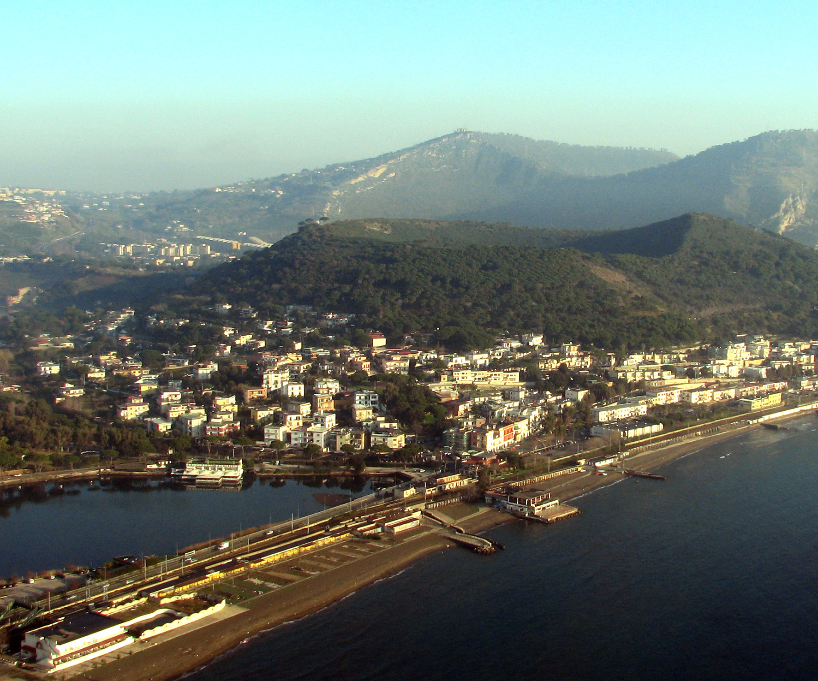
…
In addition to these structural issues, on the other hand, the excessive anthropization of the territories at risk and the high number of illegal building even in red areas also contributes to aggravating the current context.
Questa foto di Autore sconosciuto è concesso in licenza da CC BY

Slide 8
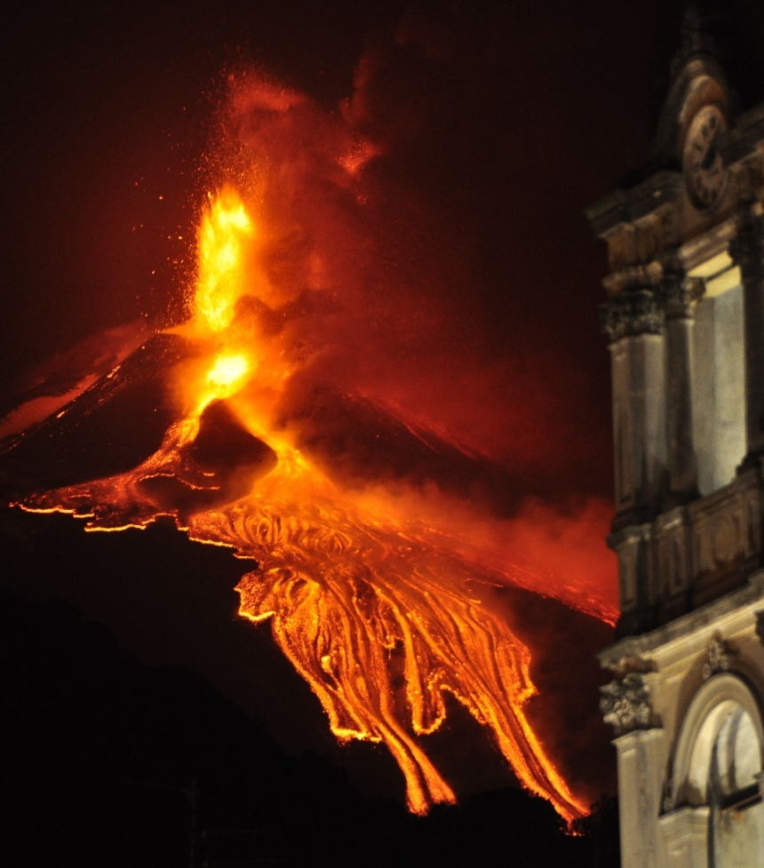
…
From another perspective, there is a lack of coordination between different administrative levels. For instance, while the central government seeks to implement policies aimed at reducing exposure in red zones (e.g., through financial incentives for relocation), local municipalities often continue to issue building permits, including amnesties, even in high-risk zones.
This contradiction creates a systemic failure in the effective management of volcanic risk.
Questa foto di Autore sconosciuto è concesso in licenza da CC BY

Slide 9
The Research
The research firstly, analyzed the tools currently available for managing volcanic risk.
In this context, both urban planning and volcanic risk planning are crucial.
For example, the Vesuvius Volcanic Risk Plan outlines a complex system of roles coordinated at the national level
Municipalities are responsible for supporting evacuation efforts, which are managed through partnerships with other municipalities.

Slide 10
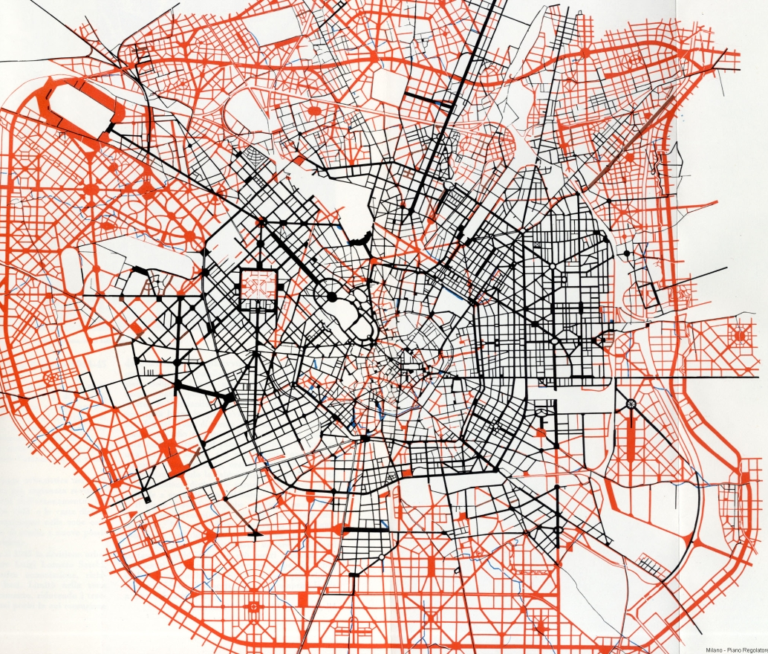
The Role of Urban Planning Law
Returning, however, to urban planning, we must start from a general consideration.
In the current system, urban planning is defined as a cascade and is divided into several interconnected levels.
It is, therefore, a matter of understanding within the planning system what would be the optimal plan for volcanic risk management.
Questa foto di Autore sconosciuto è concesso in licenza da CC BY-NC-ND

Slide 11
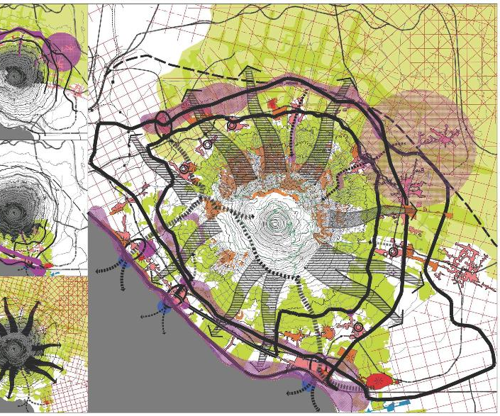
The Role of Urban Planning Law
A case in point is the Campania Region, where Regional Law no. 21 of 2003 introduced long-term planning measures aimed at reducing the population’s exposure to volcanic risk. The Strategic and Operational Plan (PSO) for the Vesuvius area, under provincial jurisdiction, includes tools for improving safety and reducing population density. It also promotes the conversion of residential properties to other uses.

Slide 12
The Role of Urban Planning Law
Another significant example is the Sicily Region, where volcanic risk is also addressed in landscape planning.

Slide 13
The Role of Urban Planning Law
These examples demonstrate that volcanic risk must be managed primarily through first-level planning (i.e., provincial or regional), for two main reasons:
Volcanic areas typically span multiple municipalities;
Municipal master plans have a narrower, local focus.
→ Nevertheless, municipal planning still plays a crucial role in implementing the directives and prescriptions issued by higher-level plans, with special attention to local specificity.

Slide 14
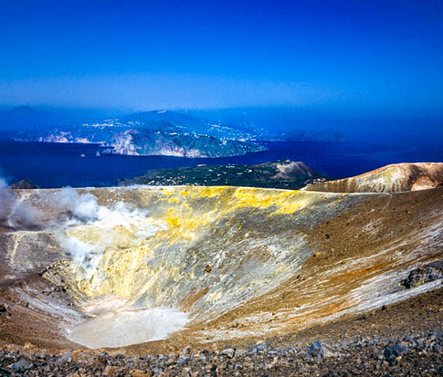
Conclusions
Given the crucial role of first-level planning, it is vital to develop planning processes that are integrated across disciplines—urban planning, geology, and environmental science. This calls for enhanced institutional cooperation, potentially supported by new technologies, such as GIS (Geographic Information Systems).
Questa foto di Autore sconosciuto è concesso in licenza da CC BY-SA-NC

Slide 15
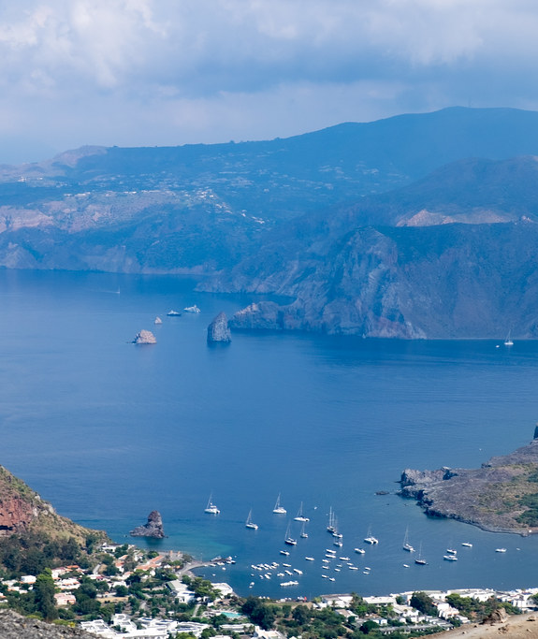
Conclusions
Ultimately, the establishment of a new, interdisciplinary regulatory framework is needed - one that incorporates risk management and emergency preparedness - to ensure a more integrated, participatory, and effective approach to territorial planning.
Questa foto di Autore sconosciuto è concesso in licenza da CC BY

