Slide 1
Gray versus Green Coastal Infrastructure in Promoting Flood Resilience: A Literature Review
Supplemental Materials
Click on a box below for more information!
In-depth results table
Search strings used
Green infrastructure examples
References
Gray infrastructure examples
Author information
I’m seeking a PhD position in applied ecology or nature-based/green solutions!
Please feel free to chat with me about your open positions or contact me at maddy.cicha@ru.nl .

Slide 2
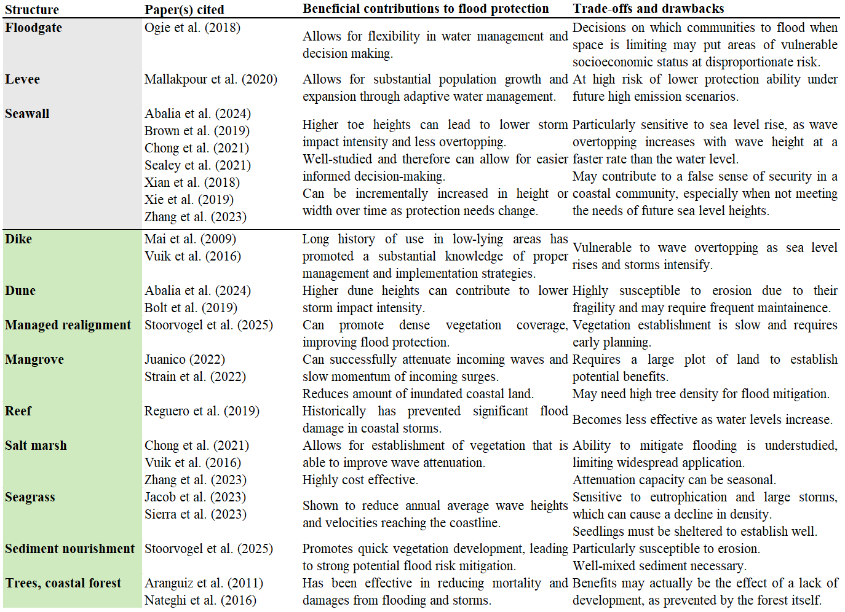
return to home

Slide 3
We conducted two different searches of literature published in the Web of Science database. During both, the following search string was used:
TS=(coast* OR shore* OR beach* OR dune* OR seacoast OR seaside) AND TS=("flood resilience" OR "flood protection" OR "flood resistance" OR "flood risk" OR "flooding risk" OR "flooding resilience" OR "flooding protection" OR "flooding") AND TS=(develop* OR implement* OR creat* OR engineer*)
For each of the gray or green searches, one of the following search strings were also added, respectively:
AND TS=("groyne" OR "groynes" or groin or groins OR seawall OR seawalls OR breakwater OR breakwaters OR dam OR dams OR concrete OR levee OR levees OR gray OR grey)
AND TS=(salt marsh* OR oyster reef* OR coral reef* OR mangrove* OR coastal forest* OR nourishment* OR dike* OR dyke* OR “green infrastructure” OR “nature infrastructure” OR "nature based")
return to home

Slide 4
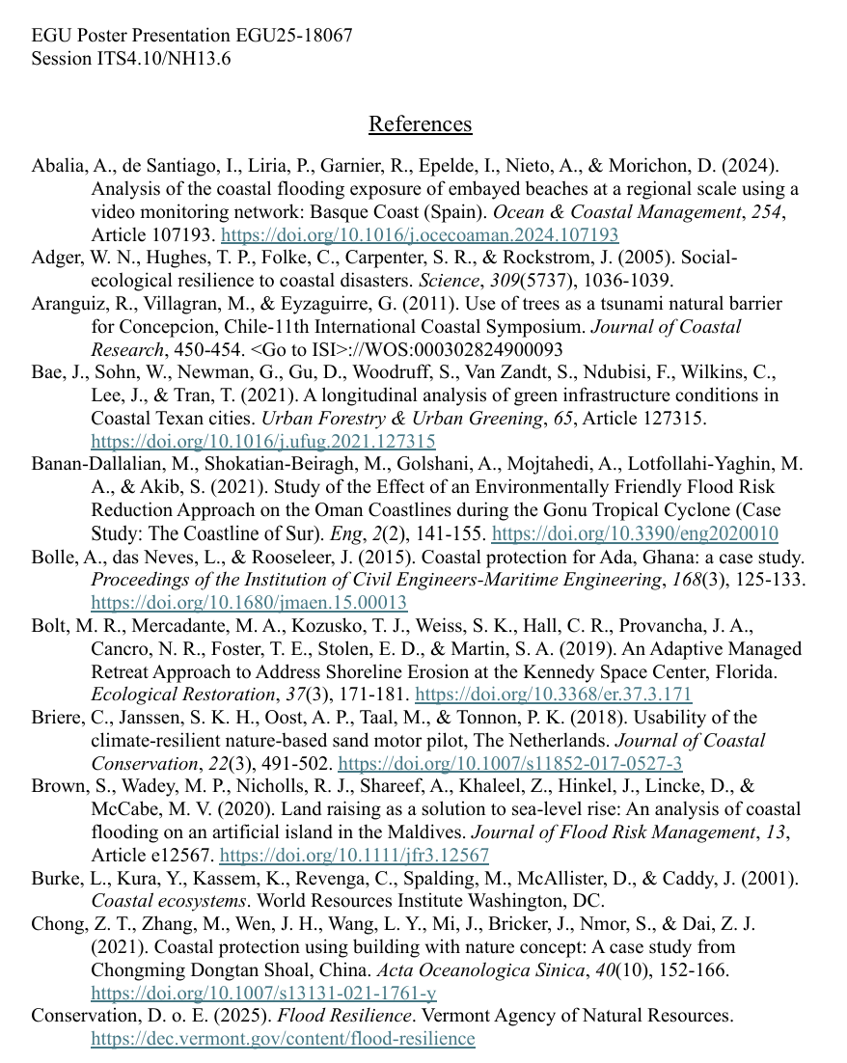
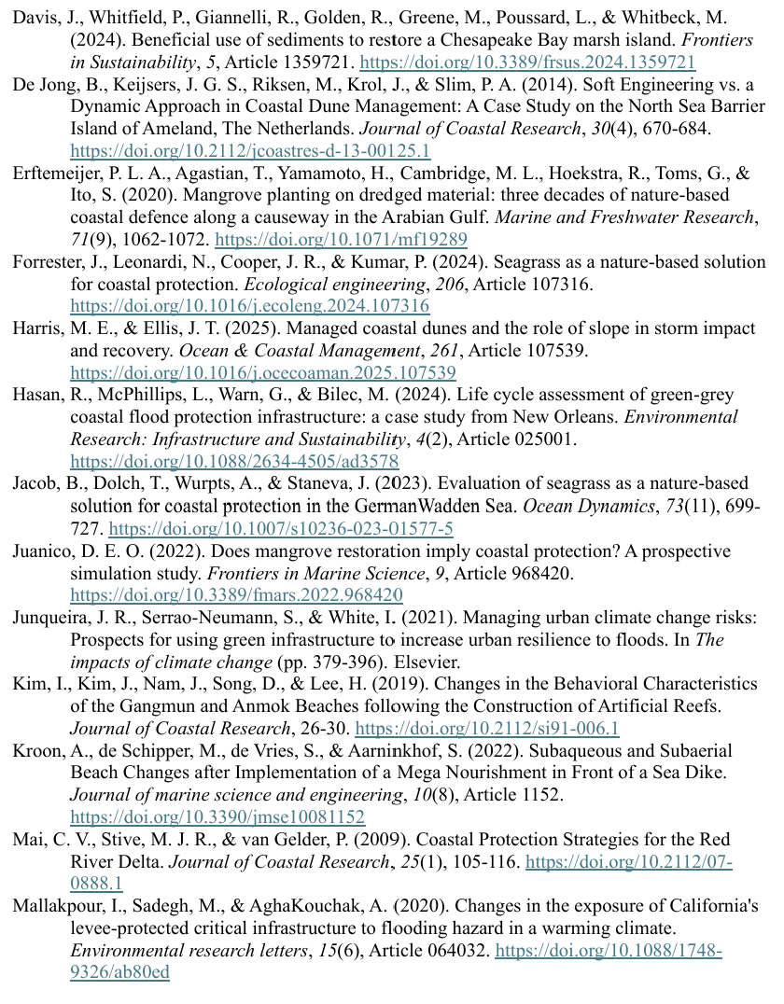
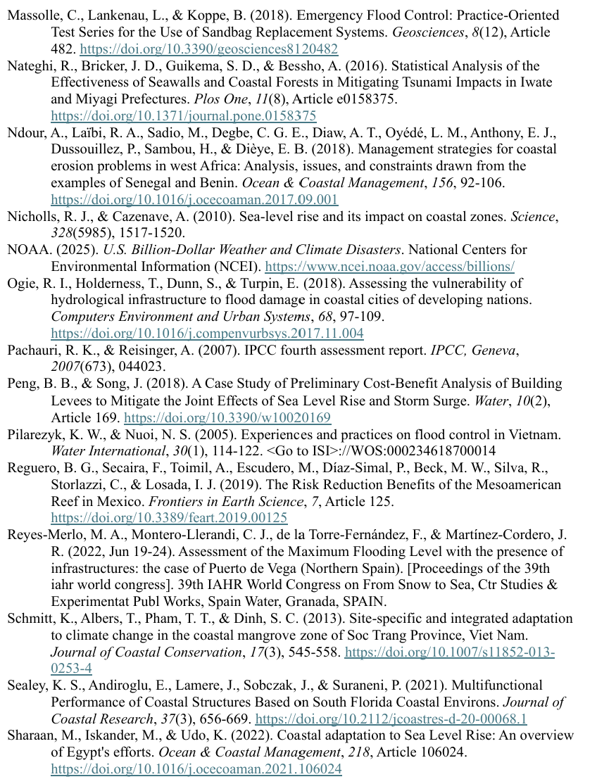
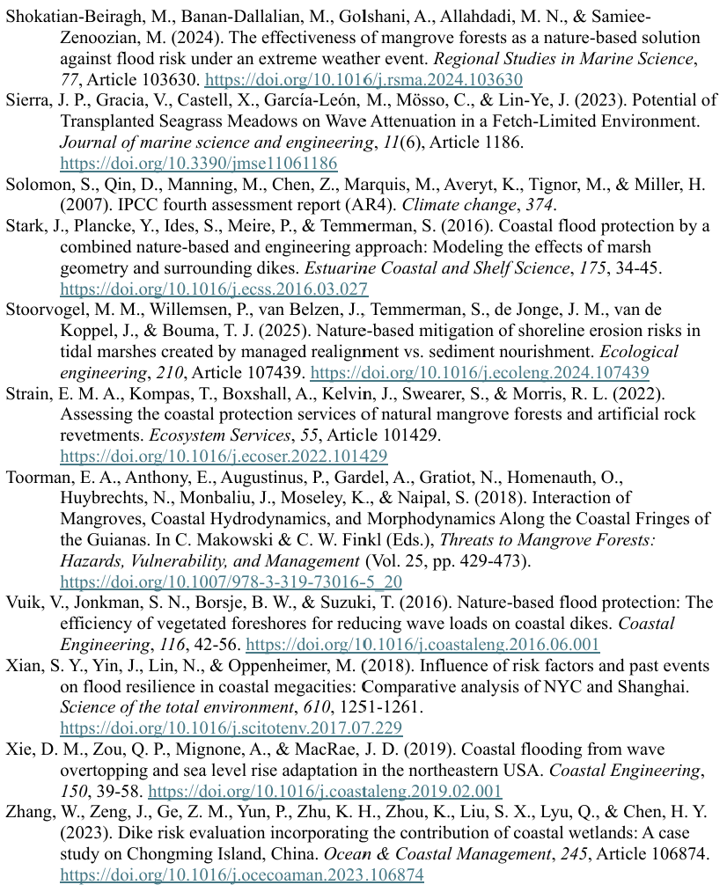
Alternatively, download a PDF of my sources here:
return to home

Slide 5
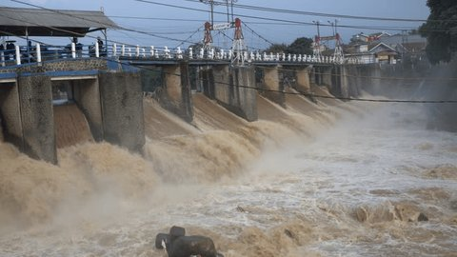
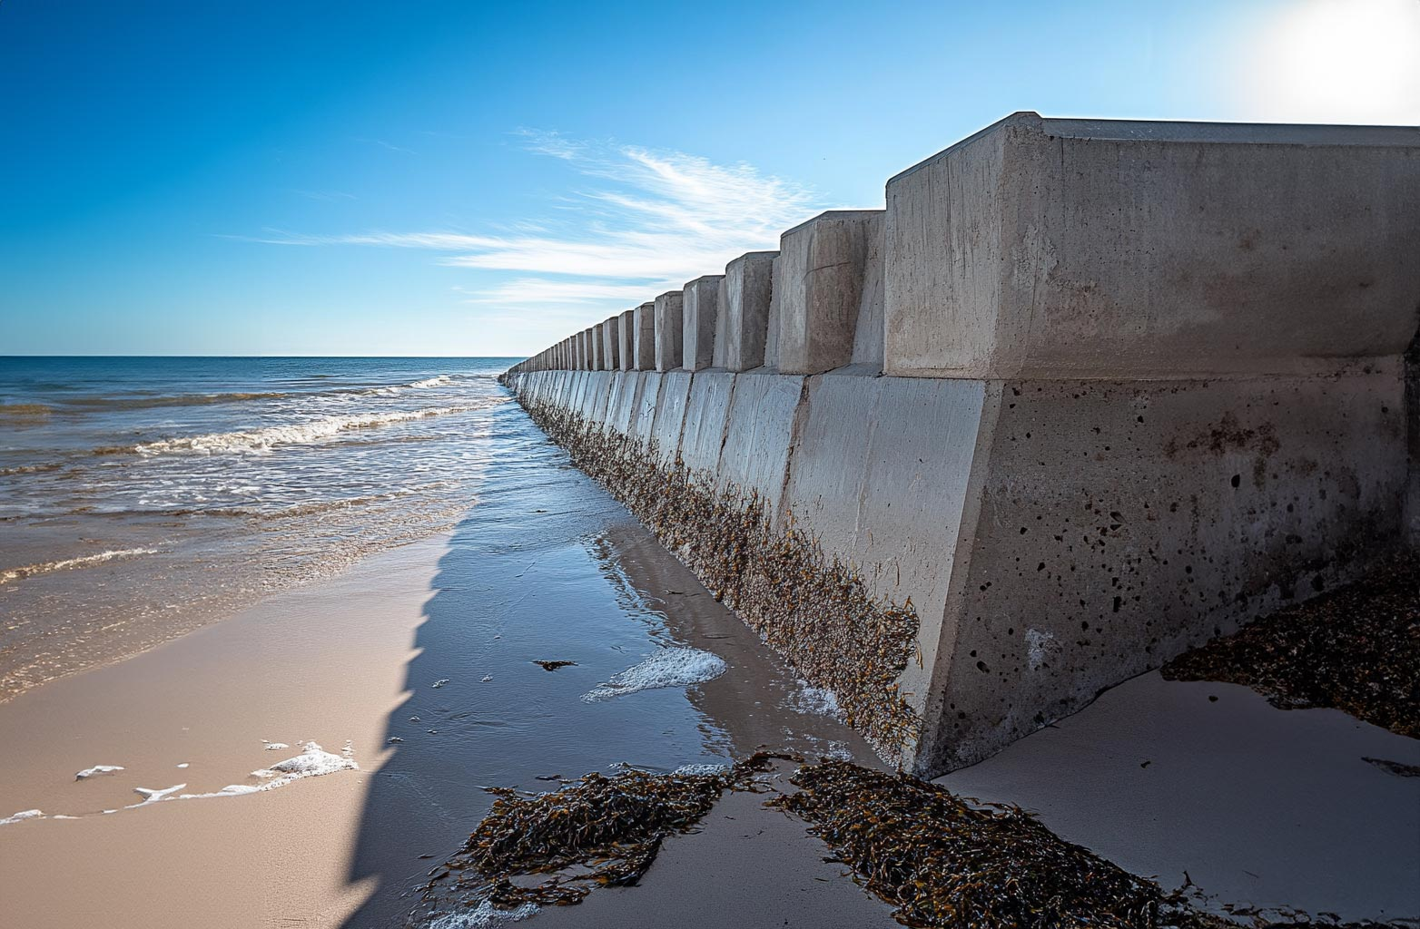
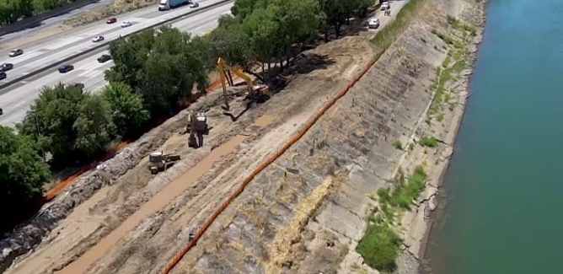
Floodgate
Seawall
Arif Prabawa via Shutterstock
LB Engineering
Levee
return to home
US Army Corps of Engineers

Slide 6
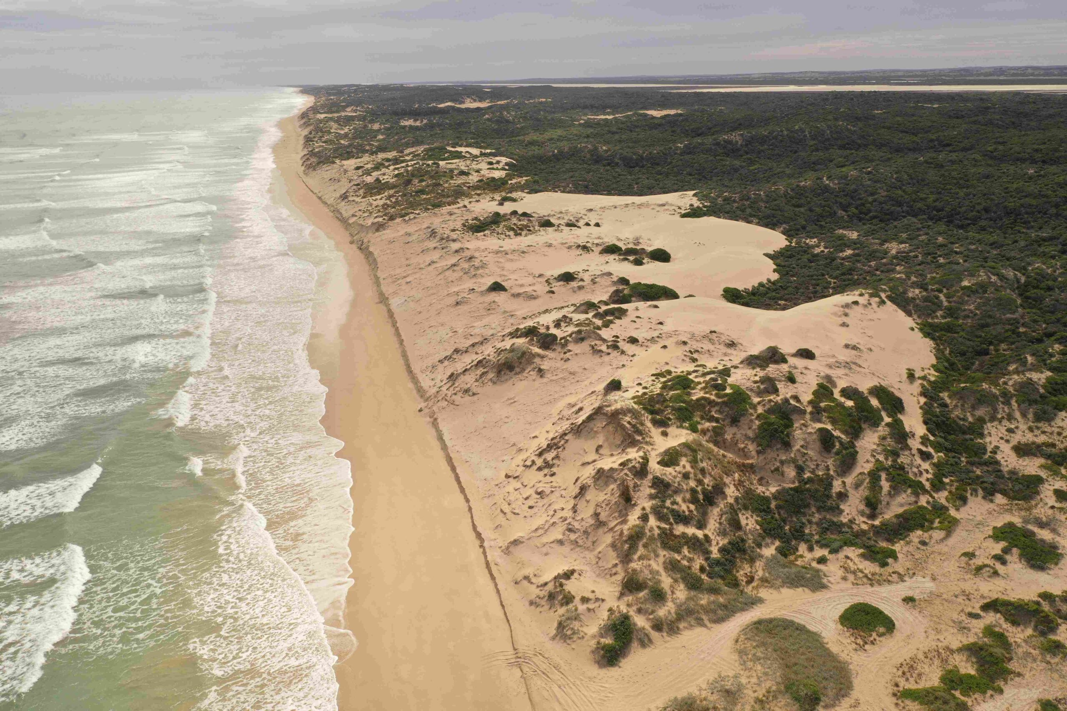
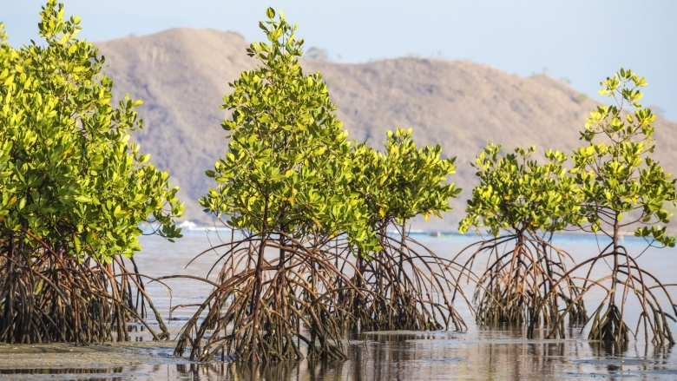
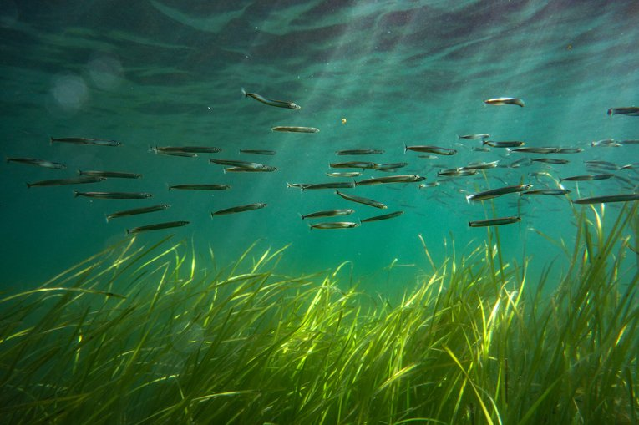
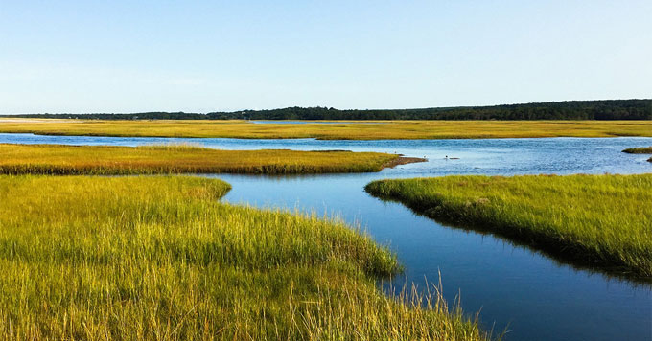
Dunes
Mangrove
Flinders University
World Bank
Seagrass meadow
Saltmarsh
return to home
Yale Climate Connections
Marine Conservation Society

Slide 7
Contact me!
Maddy Cicha
MSc Student of Biology
Specializing in Conservation and Restoration Ecology
maddy.cicha@ru.nl
Scan for my CV, LinkedIn, and other research information!
return to home

