Slide 1



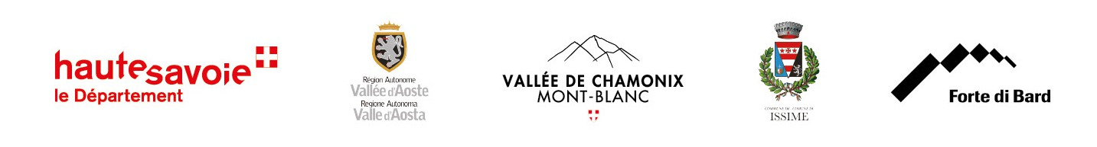
Geology and landscape controls over Middle to Modern Age human frequentation in mountain environments: preliminary results from the Western European Alps
Mariani GS, Viani C, Pintaldi E, D’Amico ME, Garbarino M,
Domanico M, Druscovic N, Idone A, Sartorio G, Freppaz M.

Slide 2
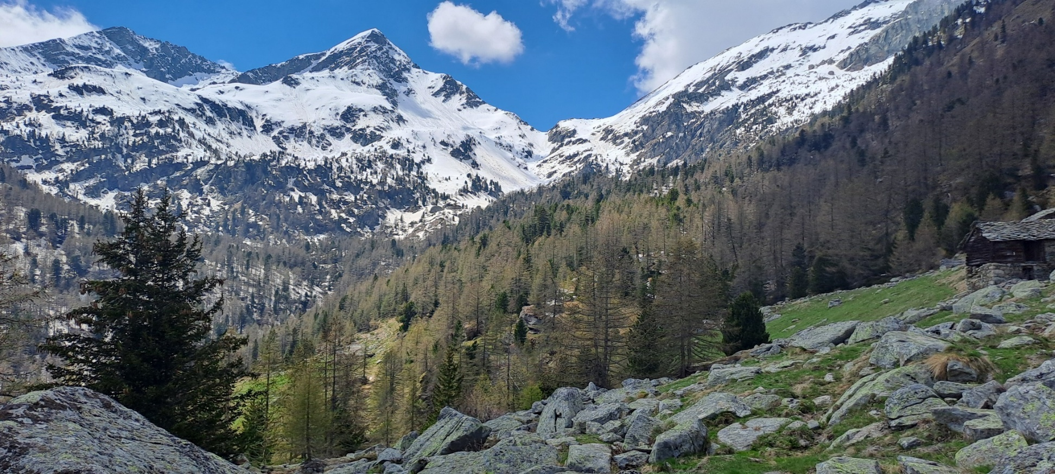
DAHU Project
Programme INTERREG VI-A France-Italia ALCOTRA 2021-2027, n. 20108
Mountains are one of the best environments for the observation of the interaction between geology, landscape, and human sustenance strategies.
The project integrates geomorphological and soil surveys, paleoenvironmental reconstructions, and archaeological evidence to provide insights on how human frequentation throughout the Middle and Modern Age was influenced by landscape factors and the underlying geological setting.

Slide 3
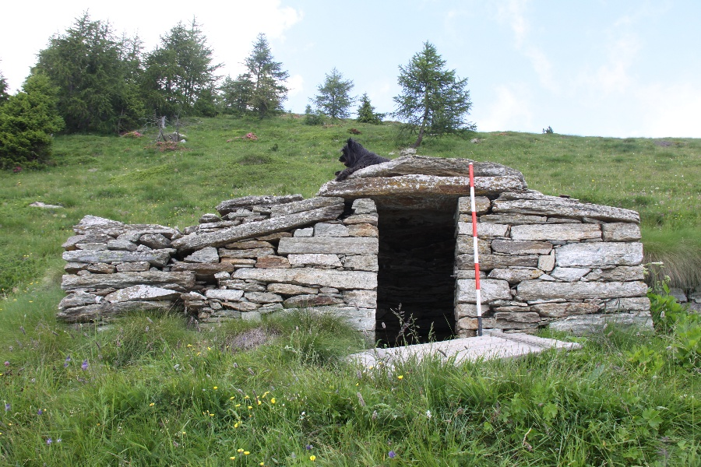
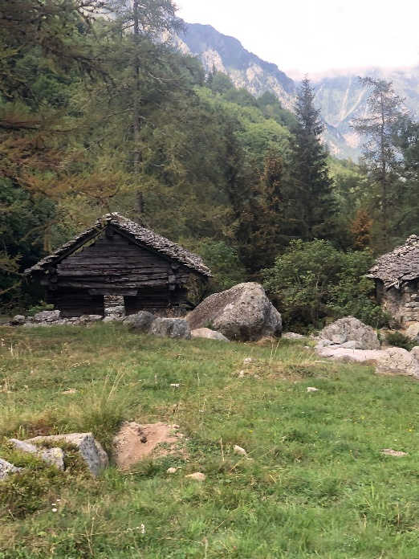
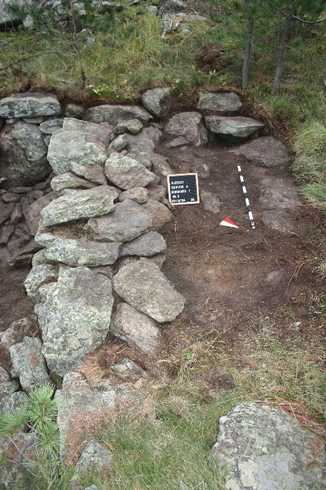
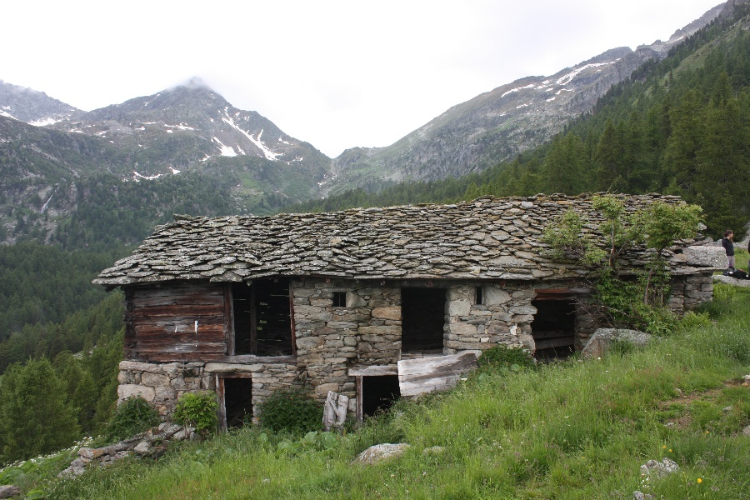
Archaeological context
The complex alpine communities within the closed valley of the Vallone di San Grato (Valle d'Aosta region, NW Italian Alps) have been well established since the Middle Ages - at least since the colonisation of the Walser populations in the 13th-14th Centuries - and expanded over the centuries before their decline and disappearance, which became more and more evident from the 18th Century onwards. This frequentation left many traces in the form of built structures and settlements, as well as profound land modifications for cultivation, forestry, and pastoral activity.

Slide 4
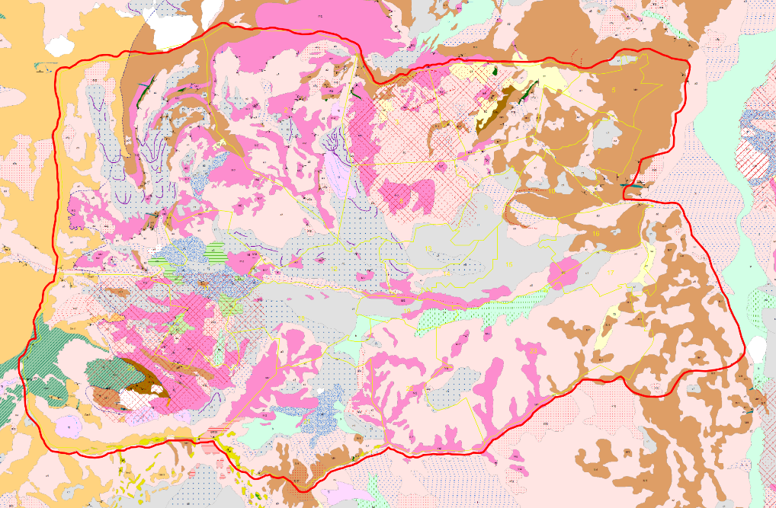
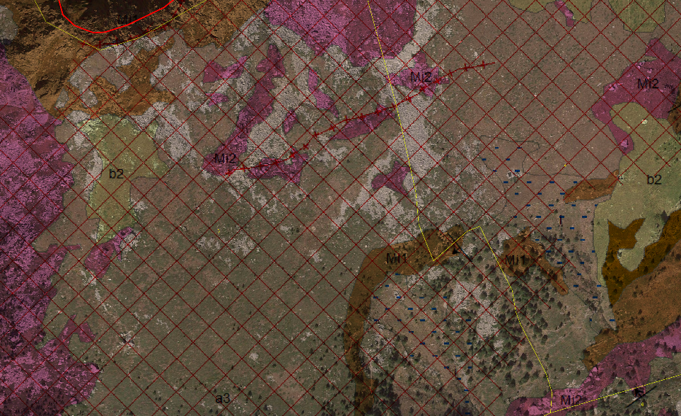
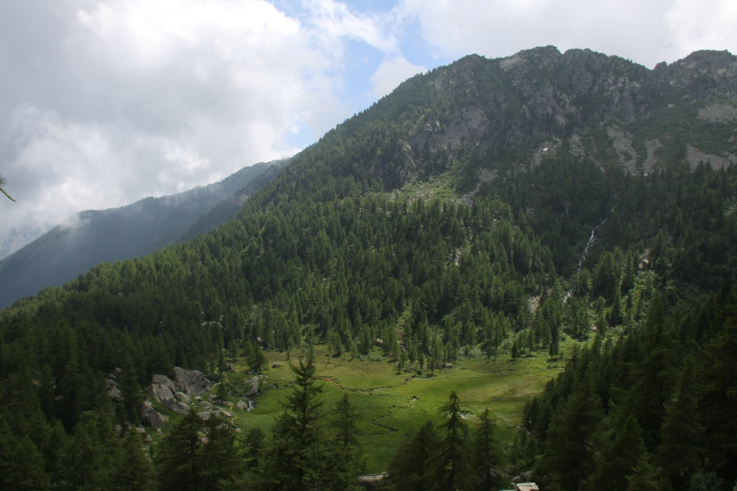
Quaternary deposits and stability
The deposits in the area are mostly stable, but with a tendency for reactivation on both the northern and southern slopes of the valley. In contrast, the central portion and the moraine deposits are generally much more stable. In particular, the observation of aerial photos and the study of historical landslides compared with field observations clearly highlight the influence of slope stability in the choice of the most suitable positions for settlements.

Slide 5
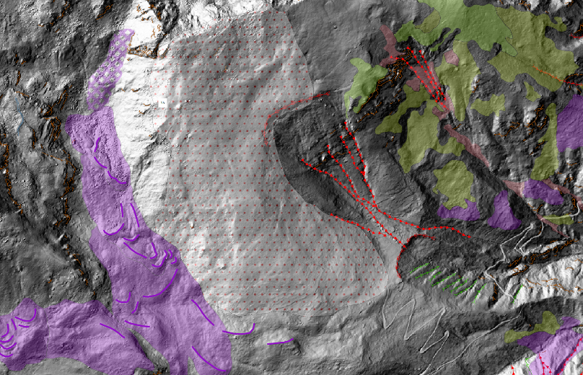
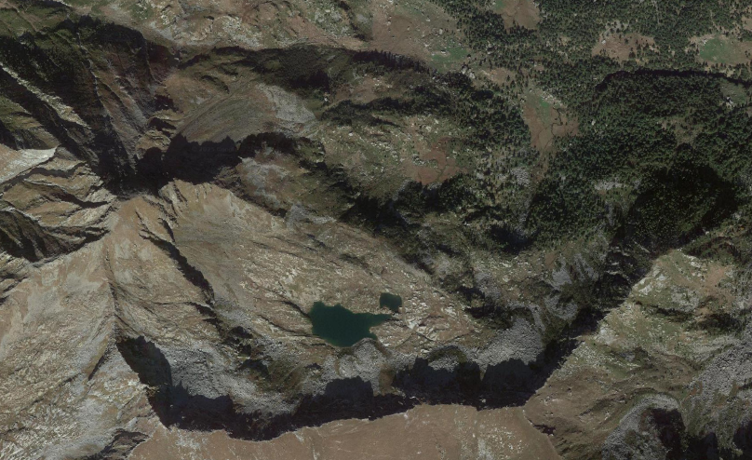
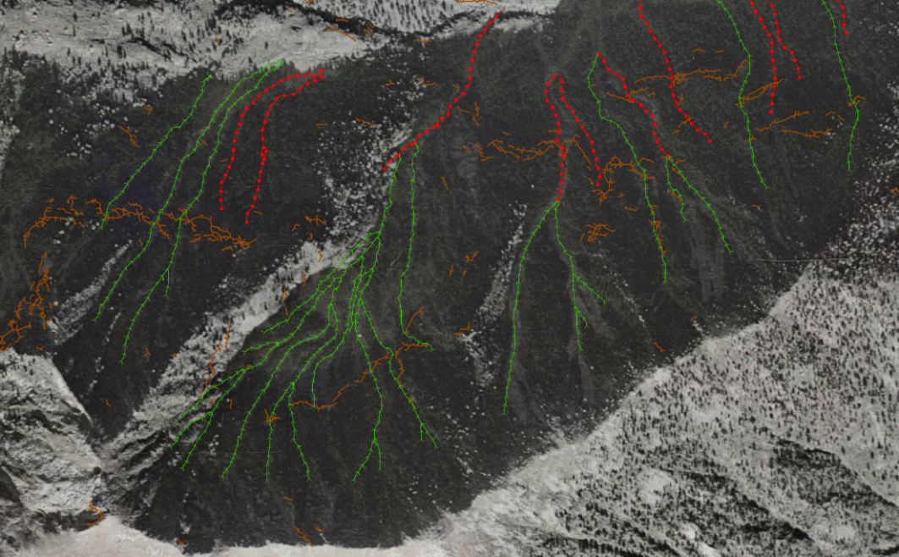
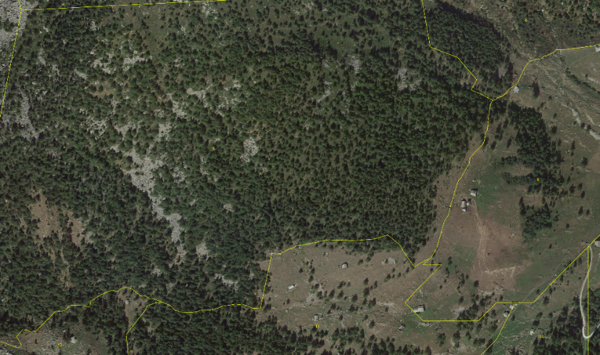
Geomorphology and Hazards
Surveys highlight how the valley is shaped by different processes which prevail in separate areas (glacial and periglacial at higher elevations, structural on the upper southern slope, gravitational on the northern and lower southern slope). The upper slopes are mainly stable and have not seen remarkable changes since glacial retreat.
In the areas free from glacial deposits, significant active runoff is noticeable, especially visible in the lower southern slope. The start of this instability phase is likely "recent", possibly in terms of centuries: comparisons with historical aerial photos suggest a reactivation in the last 70 years. It remains to be verified whether the causes are attributable to climatic-environmental agents (i.e., the Little Ice Age) or whether human activity may have played a role.

Slide 6
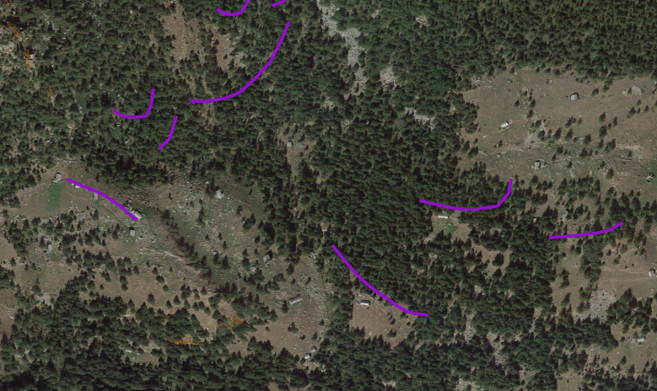
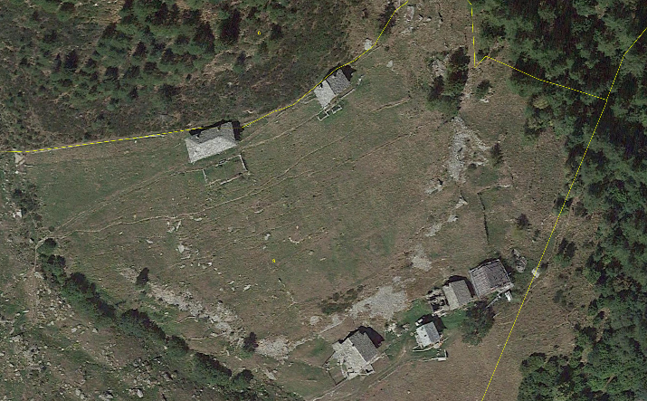
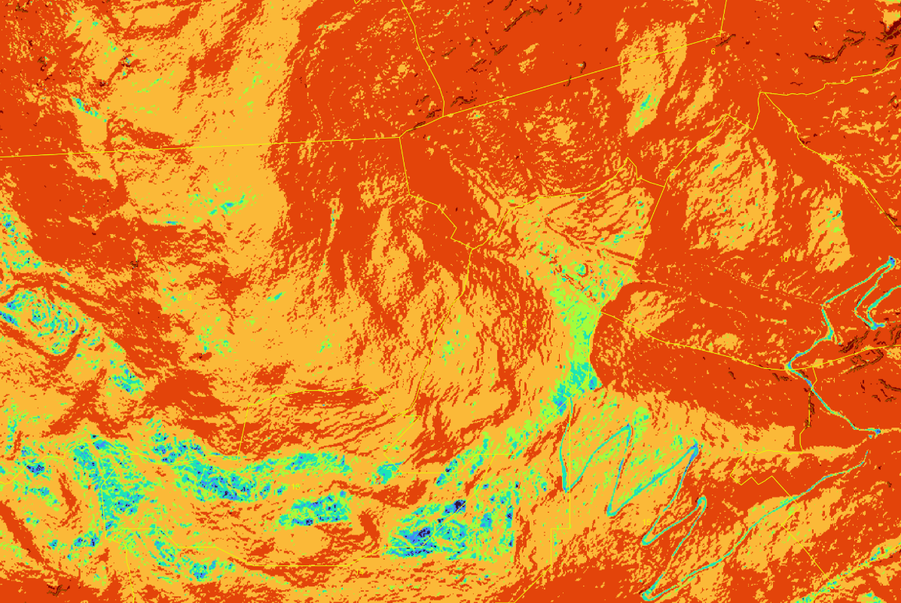
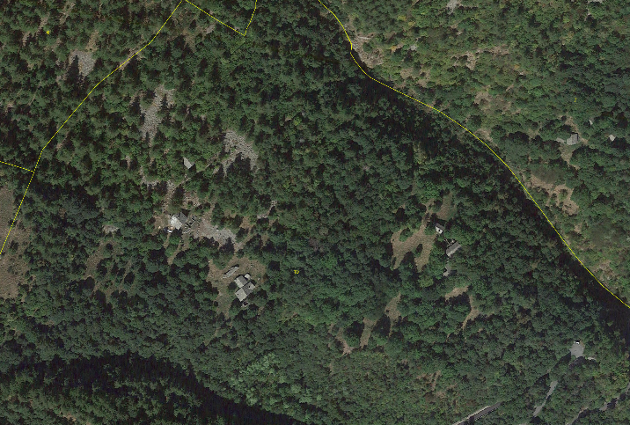
Geomorphology and Human-Landscape interactions
The anthropogenic structures present in the area and observable from aerial photos are often distributed in correspondence with glacial and slope deposits, particularly on lateral moraines.
Slope shows how the structures do not concentrate in sub-plain areas but rather prefer positions with low to medium slope angle. In several settlement areas, the impact of land use on the surfaces is clearly visible, with the transformation of slopes and the development of clear traces on the landscape features, such as terraces and creeping.

Slide 7
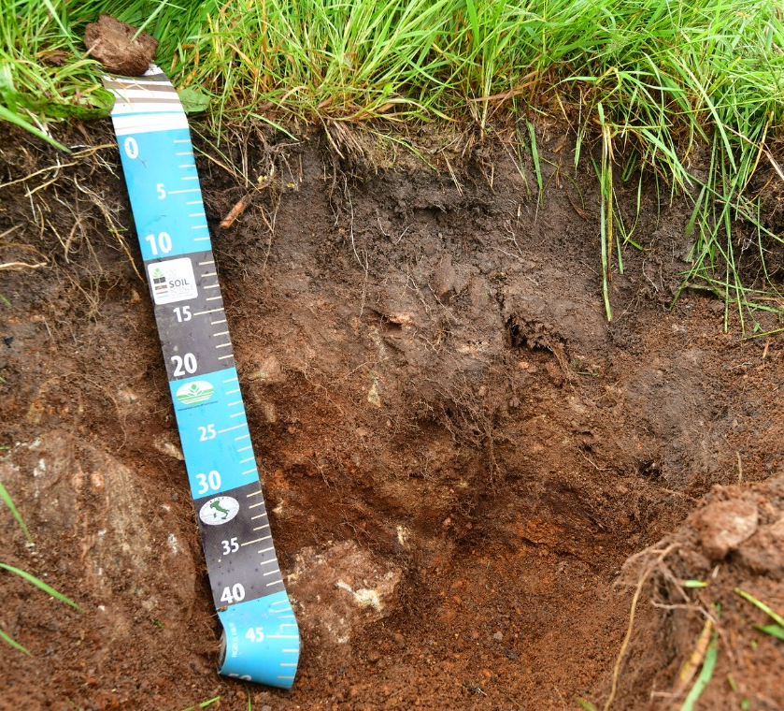
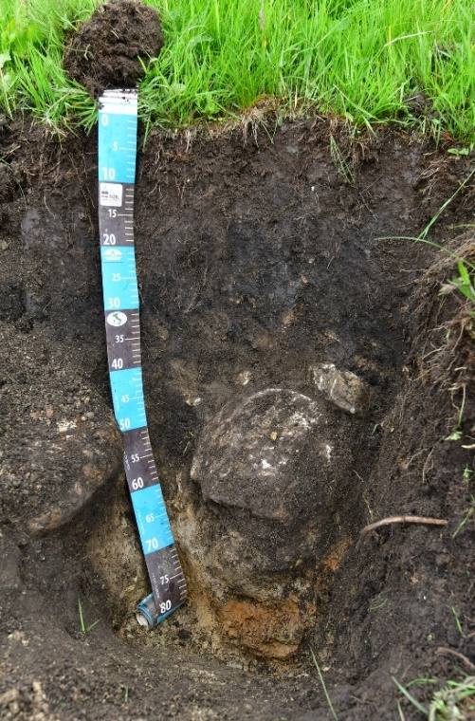
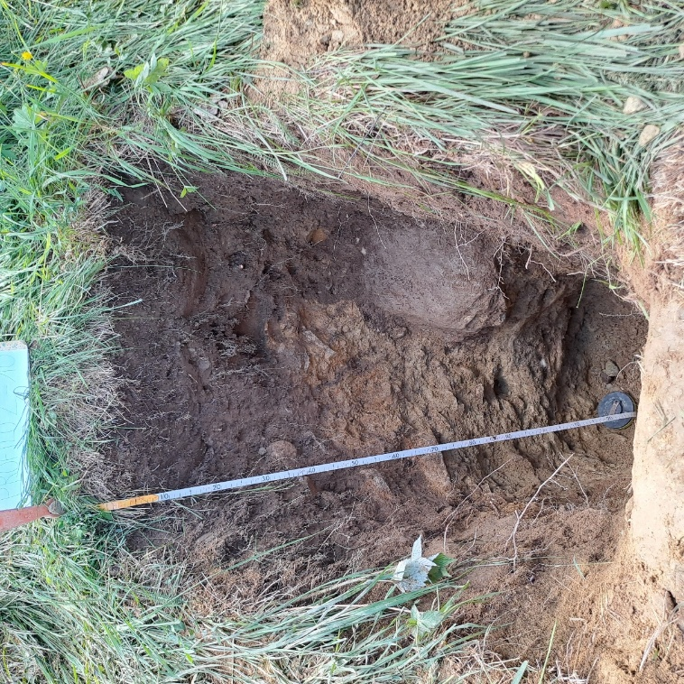
Soil features and evolution
Investigated soil profiles show the occurrence of different soil types throughout the area. At higher quotas, most soils relate to grasslands and to a land use likely influenced by pastures. Down along the bottom of the valley, appear podzols oftentimes associated to moraine deposits, as well as many polysequences showing evidence of land use change. Oftentimes, redder and more developed paleosols are buried under a shallower layer of darker and humifies soil material, possibly colluvial in origin, suggesting phases of abandonment and instability as well as a change in vegetation, all possibly climate-driven.
Many of the investigated soil profiles, especially the buried layers, also bear anthropogenic materials such as bone and charcoal, which are being dated to provide a suitable timeframe for the changes in soil diversity and in landscape dynamics.

Slide 8
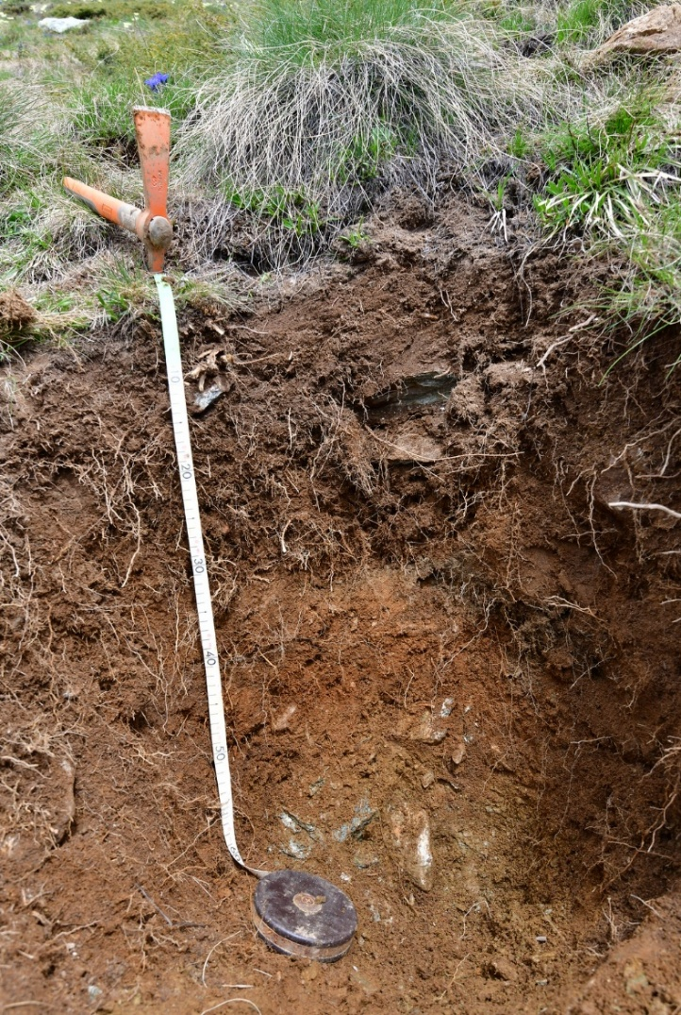
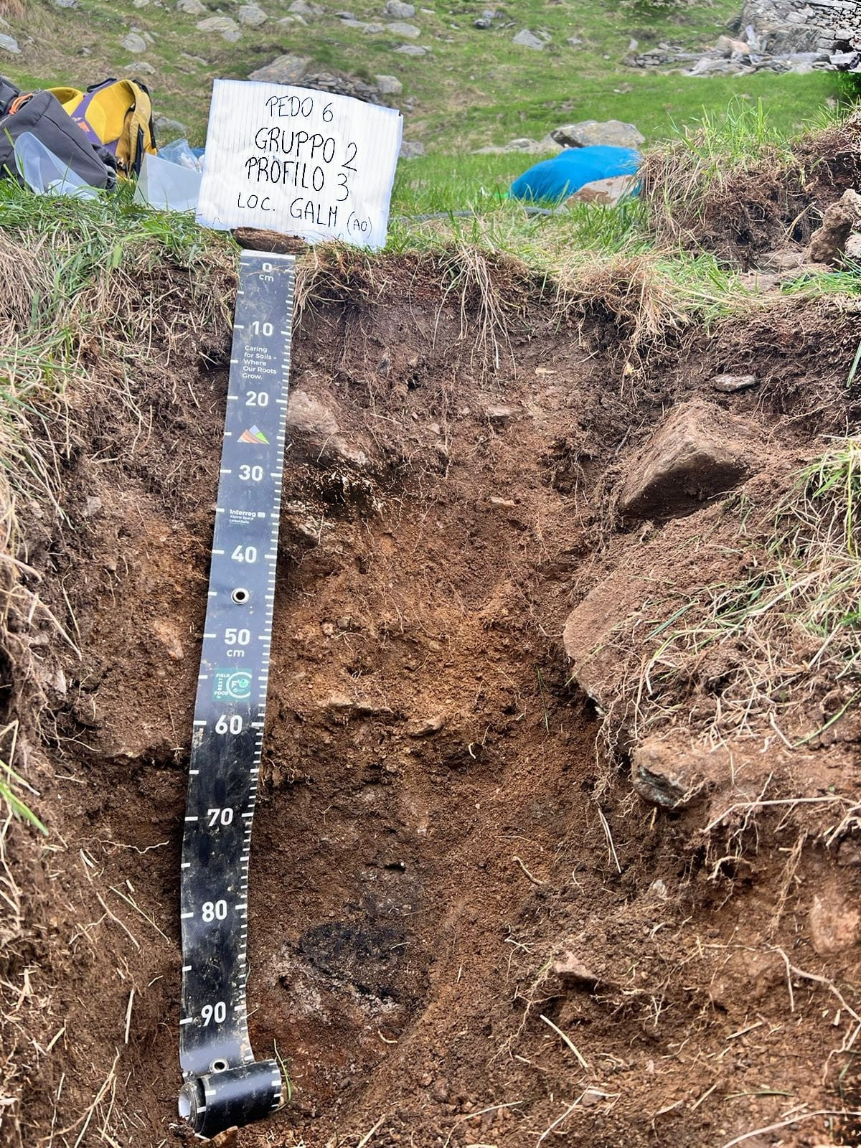
Soil features and evolution

Slide 9
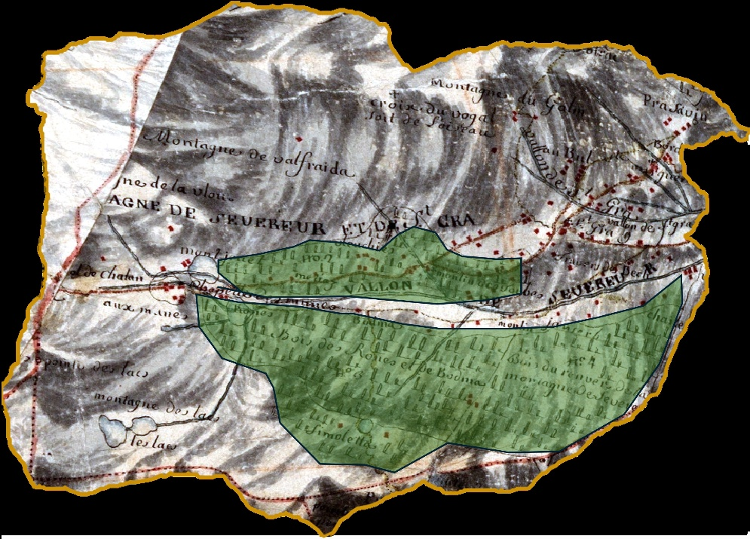
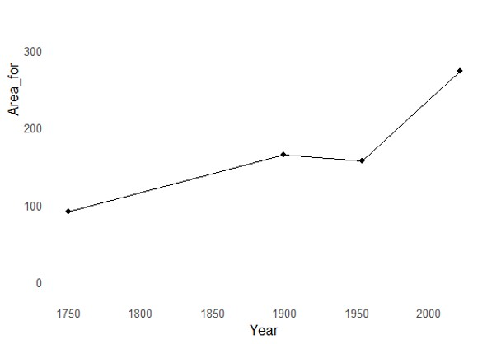
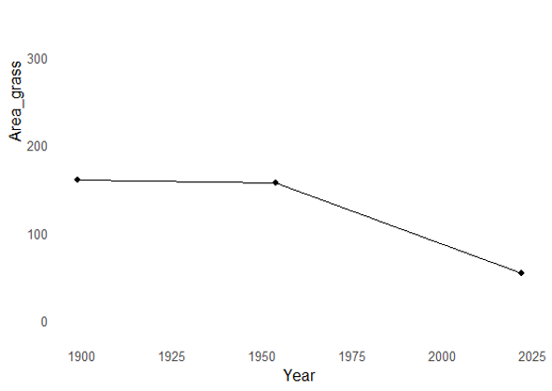
Forest dynamics
The main dynamics of forest expansion in the valley is being investigated through the comparison with cadastral maps and historical imagery. Preliminary results show a progressive expansion of wooded areas at least since 1750 (Map of the Grand Duchy of Aosta, circa 1755), with periods of faster and slower spread of trees. The distribution of woodlands through time is also not random. In the Eighteenth Century, forested space was limited to the least favourable terrain in the southern slope, where high slope angles and lack of suitable soils would have impeded agriculture and impaired pasture exploitation.
Pastures are also decreasing since the beginning of the Twentieth Century, with a clear acceleration starting in post-war times.

Slide 10
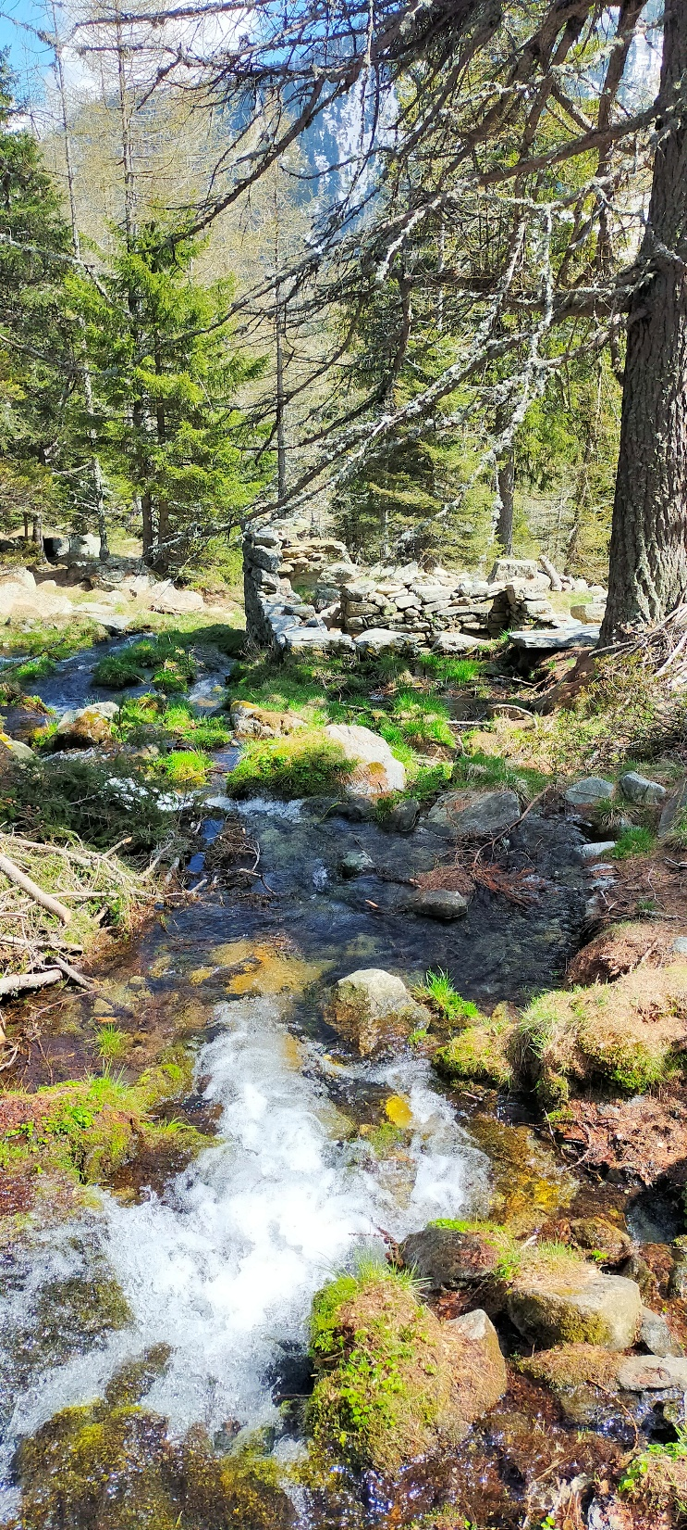
Conclusions
Preliminary results allow to draw a first contextualization of the available archaeological and paleoenvironmental evidence inside their geological and geomorphological context.
Medieval and modern communities were able to consume natural resources and deal with the many geological and landscape constraints on the territory, adapting settlement patterns, construction methods, and resource management accordingly. Above all, past glacial dynamics strongly dictated settlement choices, with most settlements located on moraine deposits and exploiting the soils in the less steep areas for cultivation and leaving deep modifications in their morphology and chemical properties.
Examples of land use are manifold and distributed throughout the valley, where only the steepest bare slopes were not utilized. Human impact also brought substantial land modifications through the centuries, especially on the higher slopes exploited for forestry, where the recent reactivation of slope processes hints at overexploitation-driven instability episodes.
This dynamic interaction offers insights into the resilience of medieval to modern alpine societies in responding to environmental challenges, with implications for cultural heritage preservation and sustainable development in similar landscapes.

