Slide 1
Characterization of the Atmospheric Microbiome in a Semi-Rural Area of Central Europe Using Flow Cytometry
Ernest Abboud¹, Pierre Rossi², Benoit Crouzy³, Athanasios Nenes^{1,4}, Kalliopi Violaki¹
Email: ernest.abboud@epfl.ch
¹Laboratory of Atmospheric Processes and their Impacts, School of Architecture, Civil & Environmental Engineering, École Polytechnique Fédérale de Lausanne, Lausanne 1015, Switzerland
²Central Environmental Laboratory, School of Architecture, Civil & Environmental Engineering, École Polytechnique Fédérale de Lausanne, Lausanne, 1015, Switzerland
³Federal Office of Meteorology and Climatology MeteoSwiss, Chemin de l’Aérologie, CH-1530, Payerne, Switzerland
⁴Center of Studies on Air Quality and Climate Change (C-STACC), Institute of Chemical Engineering Sciences, Foundation for Research and Technology, Hellas, Patras, Greece

Slide 2
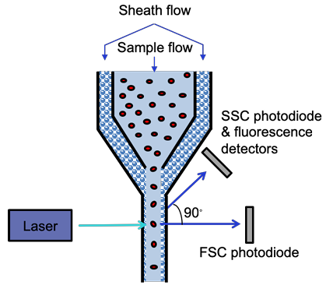
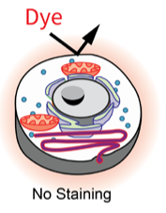
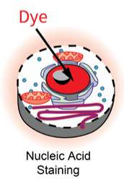
Flow cytometry: a promising tool to characterize and quantify bioaerosols rapidly
Flow cytometry (FCM)
Principle of the live/dead experiment
FSC for particle size
SSC for particle complexity
Fluorescence detected by either particle autofluorescence or/and by fluorescence dyes
Syto13
PI
PI
Modified from Gonzalez et al.,
FCM platform from Melbourne, AU

Slide 3
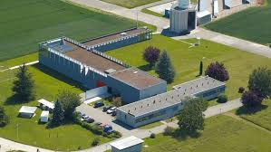
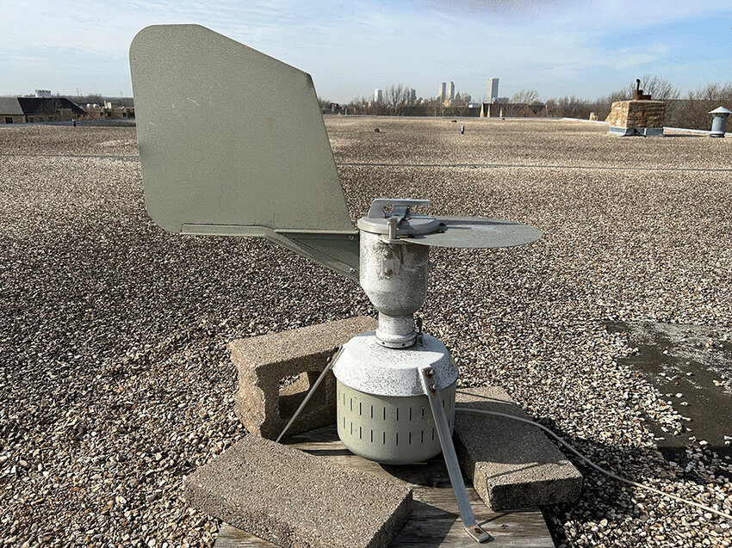
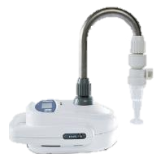
Payerne field campaign
Typical city of central European
Semi-rural site
March 25th, 2024 to August 26th, 2024: 2 samples per week (n = 41)
Samplers used:
Hirst (only for pollen quantification)
Coriolis µ sampler
Flow rate (L min⁻¹):
300 with Coriolis µ
10 with the Hirst
Coriolis efficiency:
Coriolis: 0.8 μm: 7 ± 0.3%, 1 μm: 50 ± 2%, and 3 μm: 91 ± 11%
Bøifot et al., 2024 Environmental Monitoring and Assessment
Notes:
In parallel Marseille campaignDifferent air masses pass by (continental, marine, and dust)
In the FT depending on the day and season (capture of long range transported bioaerosols)

Slide 4
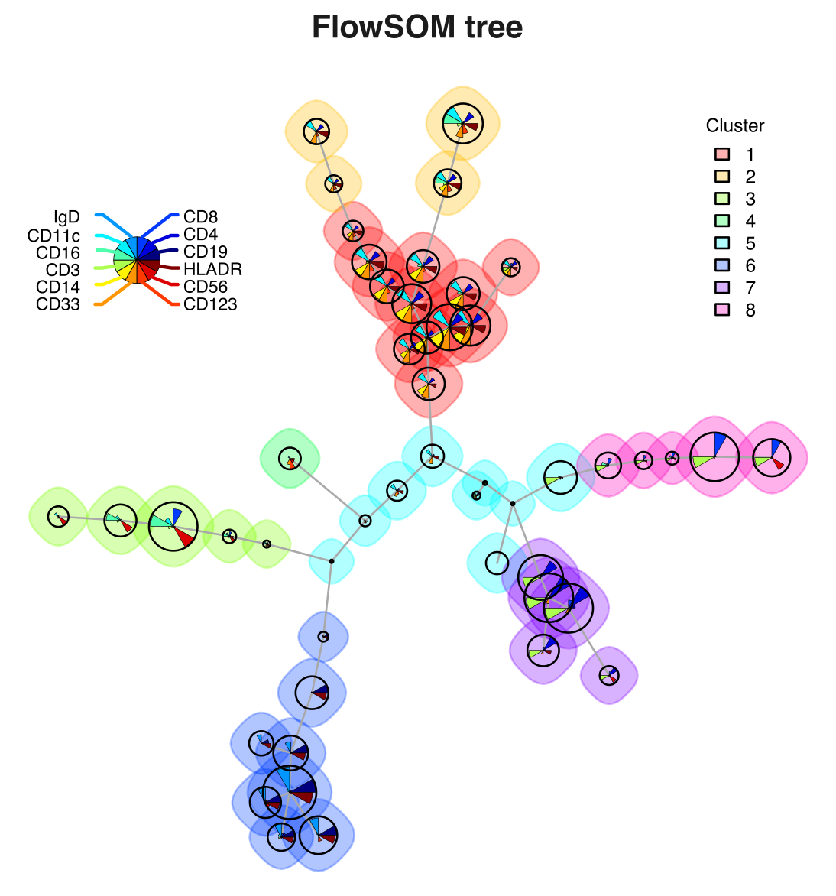
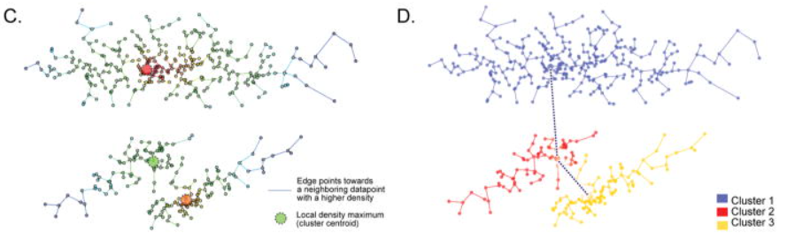
Clustering algorithm used in flow cytometry
Weber et al., 2016 identified 3 clustering algorithms producing results similar to manual clustering (i.e. reproducible) and are computing fast
Flow Self Organized Maps (FlowSOM)
PhenoGraph
XShift
Self organizing map (i.e. neural network) to reduce dimension based on the particle’s fluorescence
Construct cluster via the number of nearest-neighbor or K mean
K mean coupled with the detection the particle autofluorescence within the population
systemsbiology.columbia.edu
biosurf.org
Samusik et al., 2016
Van Gassen et al., 2015 Journal of Quantitative Cell Science; Samusik et al., 2016 Nature methods
Notes:
Based on… 3 algorithm are suitable for processing FCM data. Pros of FlowSOM: fastest of all the algorithm and suitable for high dimensional data
PhenoGraph: no dimension reduction but is depending (sensitive) of the value of K mean which must be optimized for every sample, is computationally intensive
Xshift: reduce dimension into t-SNE and depend on the K mean value entered

Slide 5
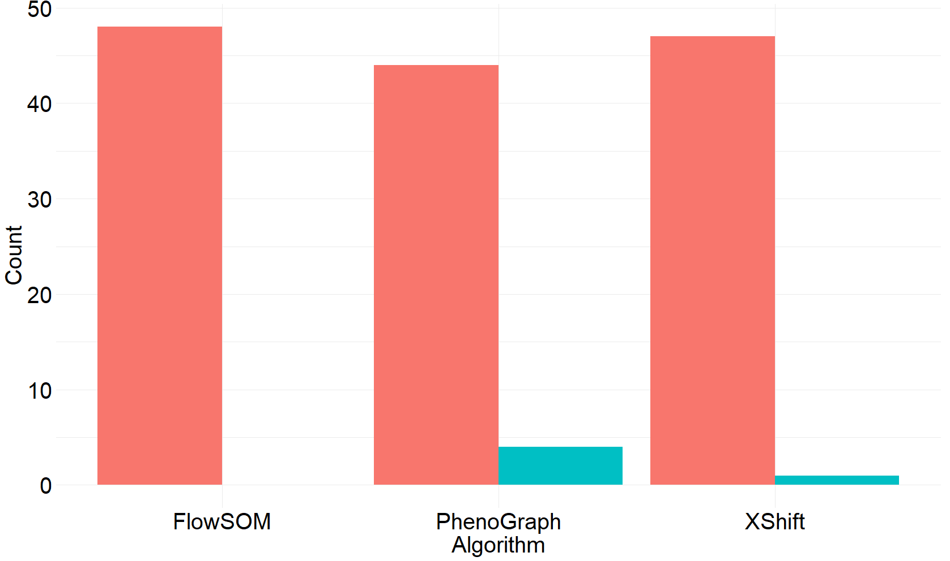
FlowSOM is the unique algorithm that did not fail to return clusters for all the samples
Application of FlowSOM (6 dimensions) on the 41 samples collected in Payerne
41
40
37
Phenograph did not give results with the samples having more than 150 000 cells
Xshift did not give results with the sample having more than 200 000 cells
4
0
1
Notes:
Applied the three algo on all the samples from Payerne (6 dimensions) and followed the recommendation of Weber et al., 2016. Number of output cluster for FlowSOM is 40 (optimal to discrimination between all the population), keep the automatic value of PhenoGraph and Xshift for the K mean.
Problems with K mean: needs optimization and for Xshift, it does not more than 280. So we have decided to keep

Slide 6
LNA and HNA populations identification within a bacterial and fungal mixture
- dyes
+ dyes

Slide 7
Pollen population identification
- dyes
+ dyes

Slide 8
LNA, HNA, and pollen populations identification containing different airborne microorganisms
- dyes
+ dyes

Slide 9
Confirmation of the workflow on atmospheric samples
Geometrical mean of 10 samples consecutively collected
Syto13
PI
Jun
Jul
Jun
Jul
Jun
Jul
Jun
Jul
Jun
Jul
IC
PI
IC
PI
IC
PI
IC
PI
Size
Syto13
Size
IC
PI
Size
Size
Syto13
Size
Syto13
Syto13
Syto13
IC = Internal Complexity
The centroids of the different population are normally distributed among all parameters
Notes:
Shapiro-Wilk use for a population of less than 50 samples

Slide 10
The HNA and intact populations are characterized by a narrower size distribution in Payerne
HNA population dominated by particles 2-5 µm
LNA population dominated by particles 1.5-3 µm
Intact population dominated by particles 2-5 µm
Dead population dominated by particles 1.5-2.5 µm
The LNA and dead populations are sharing the same particles size distributions

Slide 11
Pearson correlation matrix between the different populations and the atmospheric pollutants and variables
The dead population is a subpopulation of the LNA population

Slide 12
Fraction contribution of bioaerosols to PM_{2.5} and PM₁₀
Low contribution of the different population to PM_{2.5} and PM₁₀.
The bioaerosols fraction is not dominant in the atmosphere of Payerne

Slide 13
qPCR principle
qPCR = quantitative Polymerase Chain Reaction
Prokaryotic genome
Modified from Fukuda et al., 2016
Eukaryotic genome
Modified from Rajendran et al., 2013
Notes:
A part of the liquid collected from the wet cyclone was preserved at -80° and the DNA was extracted from. qPCR is a way of amplifying DNA in vitro and quantify the amount of DNA amplified. This amount is representative of the population present. To cover the majority of the Kingdoms present, we want a gene conserved across evolution (16S in prokaryotes and 18S in eukaryotes), a component of an organelle called ribosome, which “makes” proteins. To amplify this genes, we try to design small fragments of DNA called primers that are specific for every Kingdom. For exemple, bacteria and archaea primers are well known in the literature, which is not the case for eukaryotes because of their diversity

Slide 14
Quantification of the rRNA region by qPCR in the different Kingdoms
Bacteria, protists, and fungi are the most abundant bioaerosols in Payerne

Slide 15
Pearson correlation matrix between the different populations, the qPCRs amplicons, and the atmospheric pollutants and variables
The dead population is a subpopulation of the LNA population

Slide 16
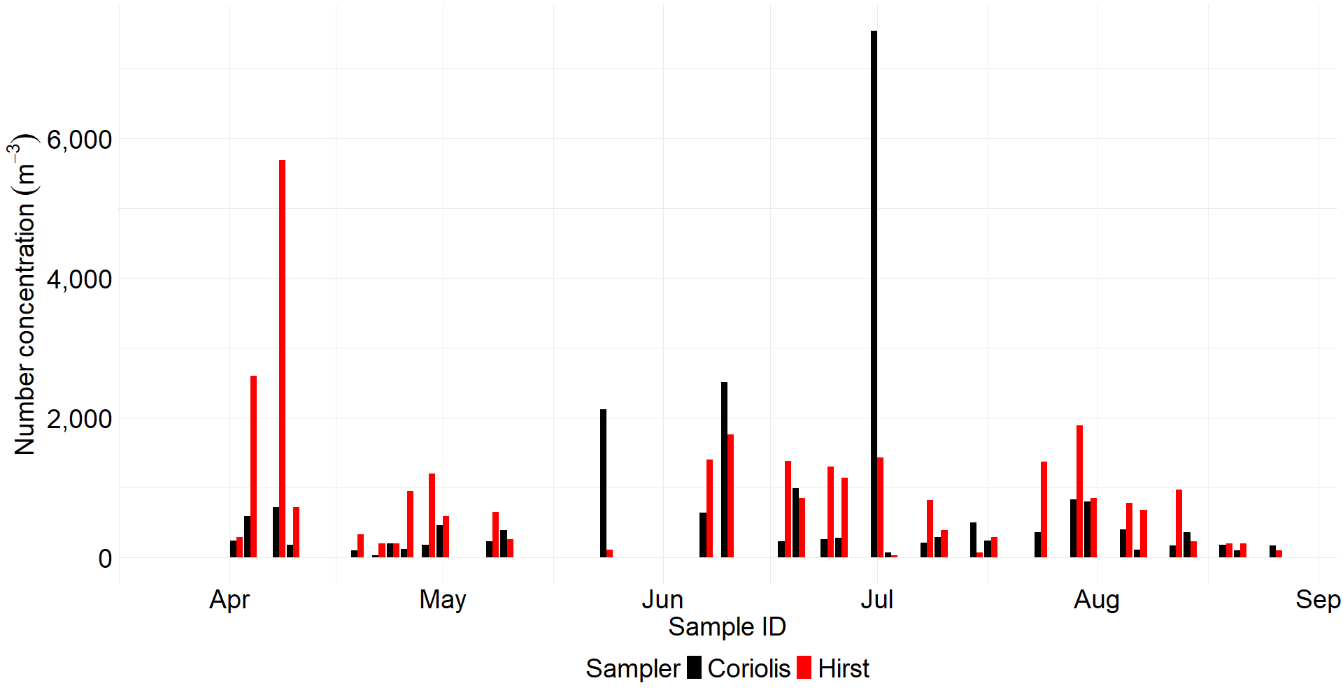
Statistical difference for pollen identified between Coriolis and the Hirst samplers
p-value = 0.03
Only the pollen cluster was taken into consideration
Bursted pollen may cause a decrease in to quantification of the total pollen collected
In agreement with Gómez-Domenech et al., (2010) and in contradiction with Carvalho et al., (2008) (both studies compared Coriolis with Hirst)
Gómez-Domenech et al., 2010 Aerobiologia; Carvalho et al., 2008 Aerobiologia
Notes:
26,3% of Coriolis samples collected more pollen than the Hirst
No statistical difference p val = 0.03315. Mean of collected pollen by Coriolis is 600 and by Hirst is 840
This is a bit tricky because it confirms a study published in 2008 where the authors stated that Coriolis is more efficience to capture pollen compare to the Hirst while in 2009 another study proved the opposite. This difference can be explained by the type of pollen present and their collection efficiency by every machine, which is not established in the litterature

Slide 17
Take home messages
Flow cytometry allows a fast characterization and quantification of bioaerosols
The flow cytometry workflow established identified correctly the different populations targeted, supported by the different pictures taken by the integrated camera
The HNA population is dominant in Payerne, is composed of all the Kingdoms, and mainly fungi and protists as suggested by the qPCRs results
The dead population is a subset of the LNA population leading
to its increase when precipitation is absent

Slide 18
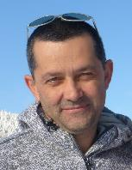
Acknowledgments
Dr. Kalliopi Violaki
Pr. Athanasios Nenes
Dr. Benoit Crouzy - MétéoSuisse
LAPI members
MétéoSuisse member
Acknowledgment: This work was supported by the SNSF project LIPIC-Air (No 215416) and the CleanCloud project funded by the EC Horizon Europe Call “Improved knowledge in cloud-aerosol interaction” (HORIZON-CL5-2023-D1-01-04)
Dr. Pierre Rossi – CEMBL EPFL platform
Dr. Francesco Palumbo – Flow cytometry platform

