Slide 1
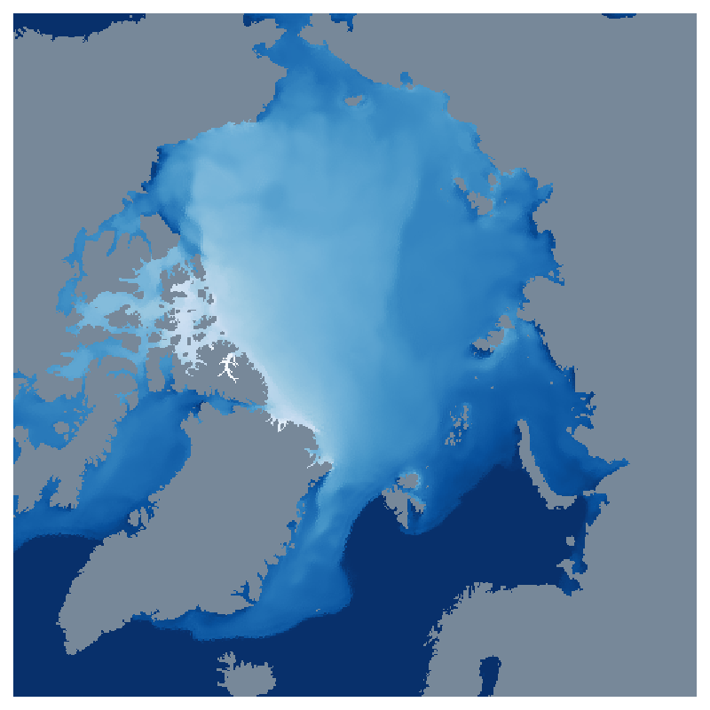



On emulating sea ice in FESOM
Animations
Florent Birrien, Nils Hutter and Nikolay Koldunov

Slide 2
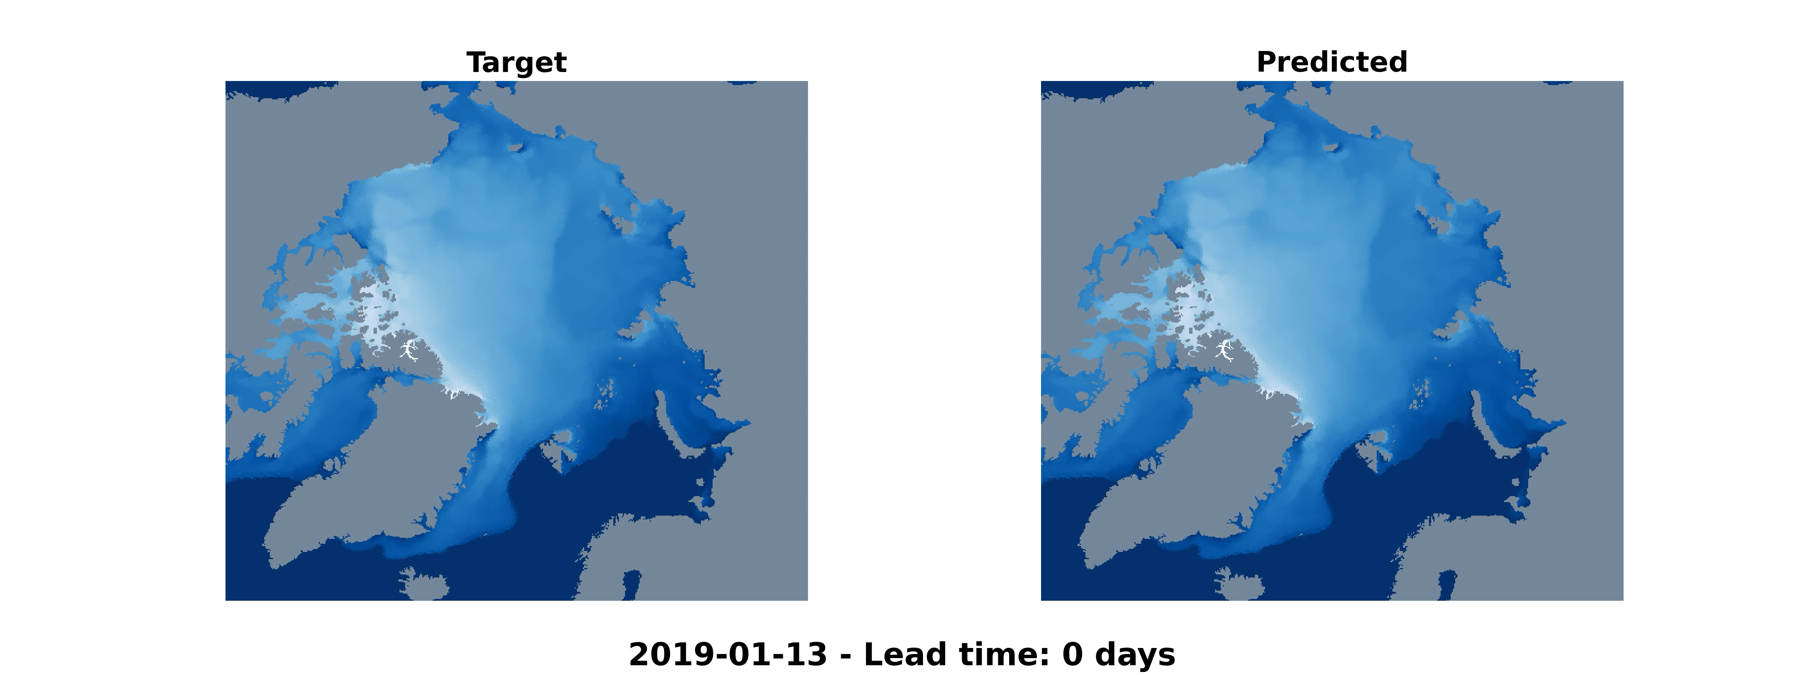

Sea ice thickness prediction with a 100-days rollout: January 13th → April 23rd

Slide 3
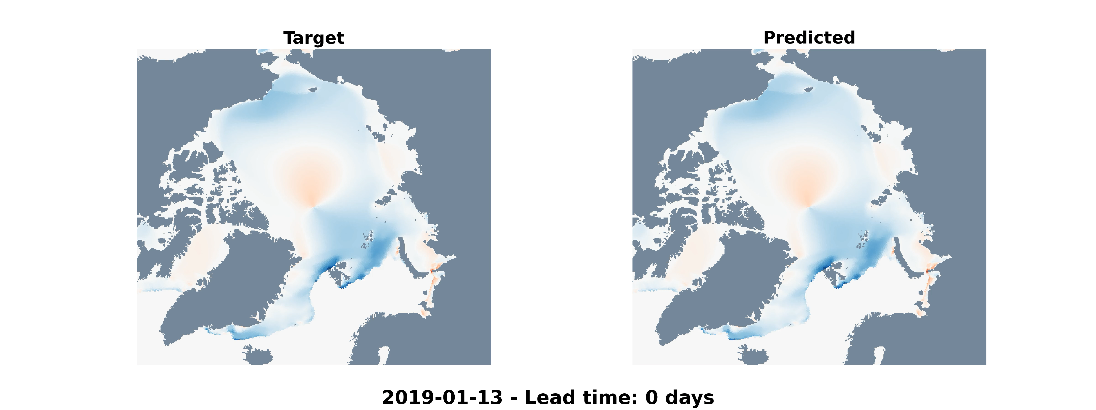
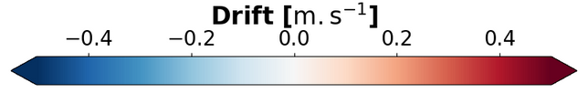
Sea ice drift prediction with a 100-days rollout: January 13th → April 23rd

Slide 4
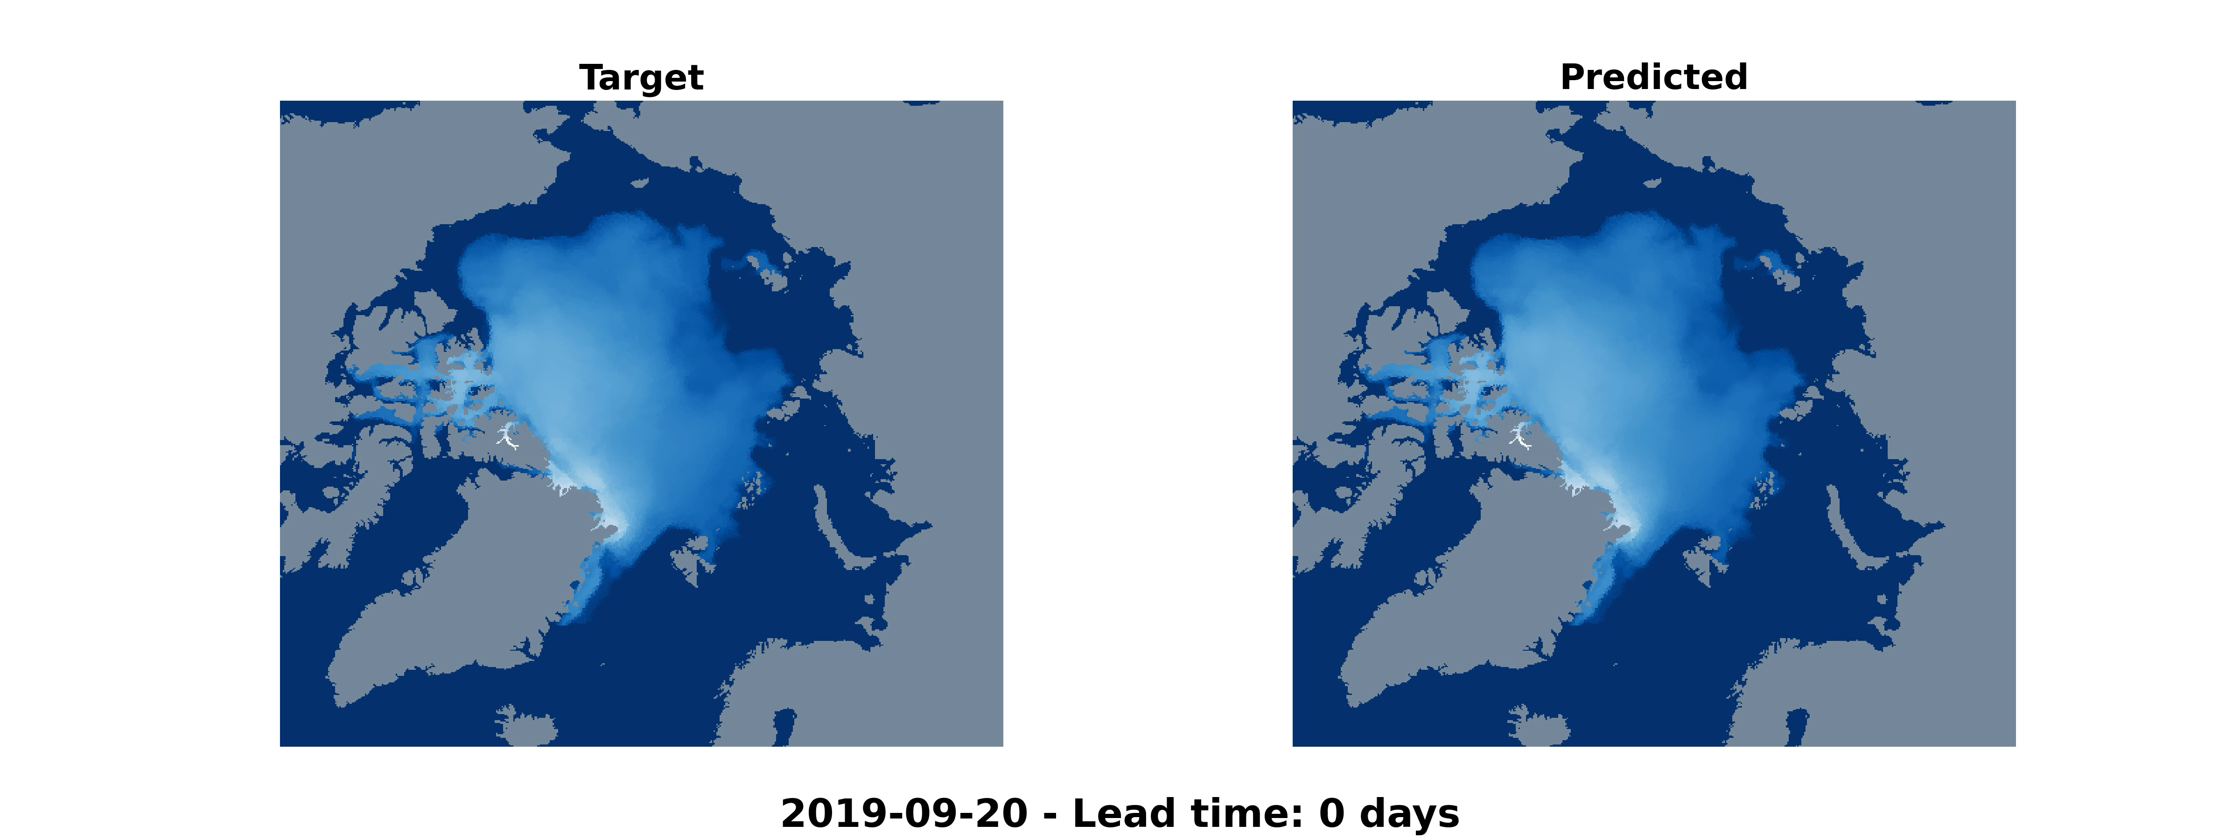
Sea ice thickness prediction with a 100-days rollout: September 20th → December 29th

Slide 5
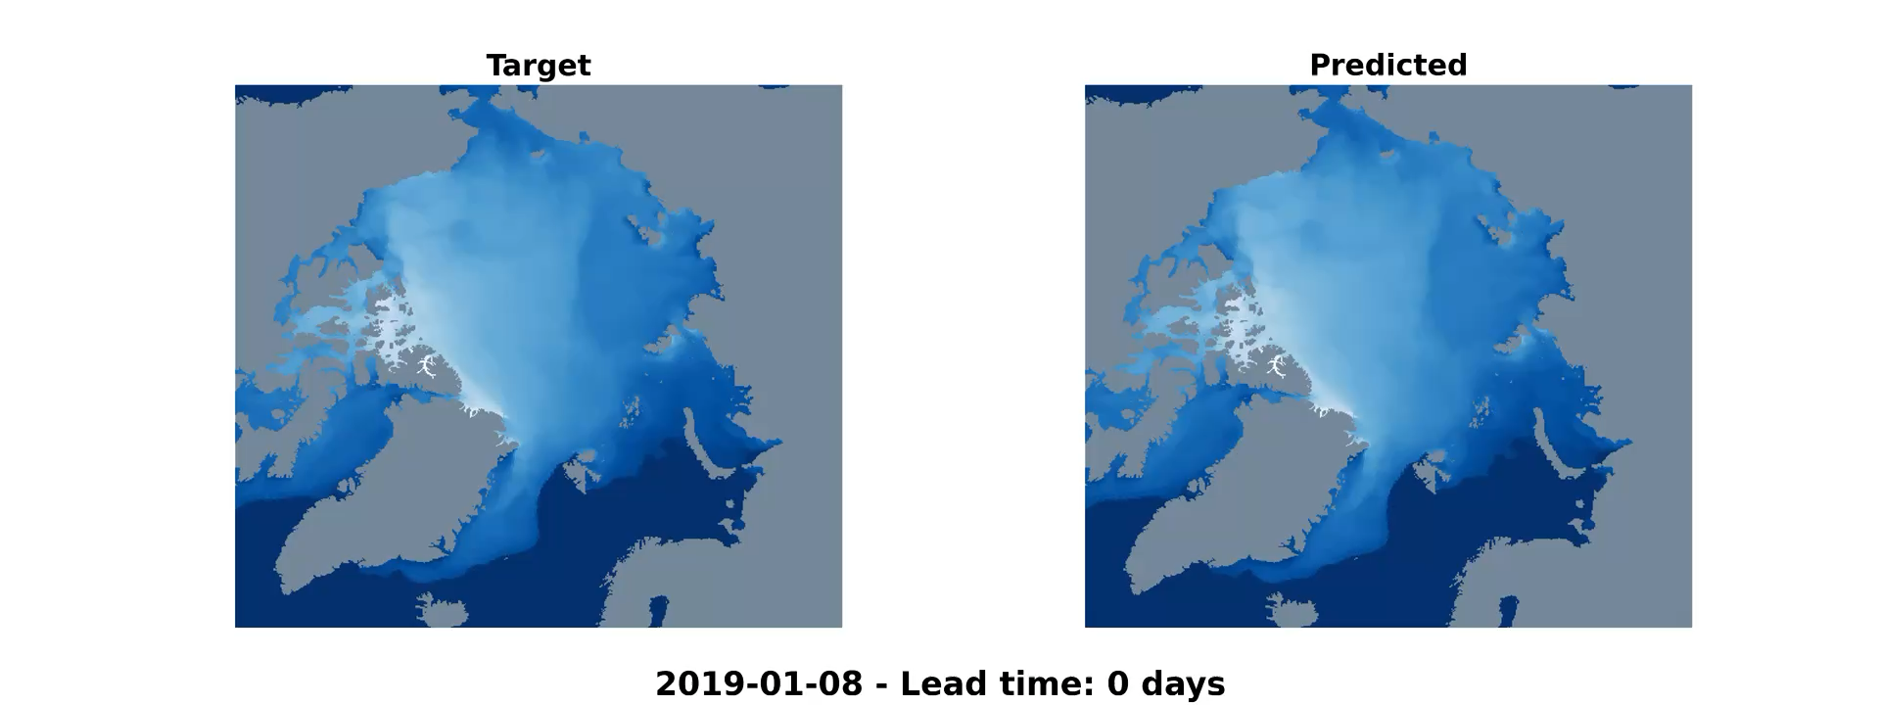
Sea ice thickness prediction with a 350-days rollout: January 8th → December 24th

