Slide 1
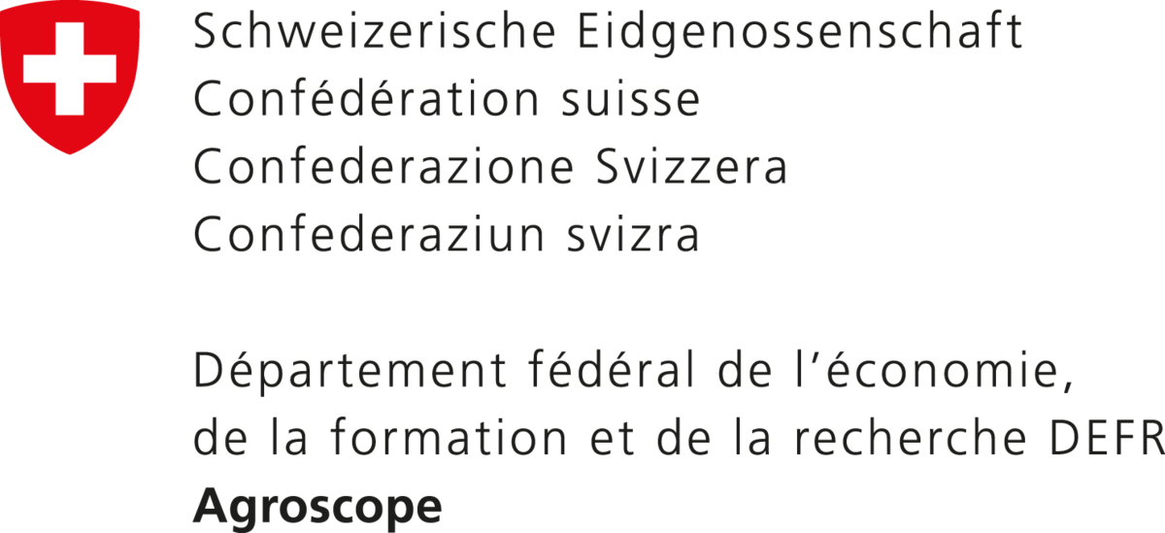
From Field to Catchment: Evaluating the Hydrological Effects of Soil Organic Carbon Increases
${\text{Malve} \text{Heinz}}^{1,2,3}$, ${ \text{Annelie} \text{Holzk}\text{ä}\text{mper}}^{1,2}$, ${ \text{S}\text{é}\text{l}\text{è}\text{ne} \text{Ledain}}^{1}, {\text{Pascal} \text{Horton}}^{2,3}, {Rohini Kumar}^{4}$, ${\text{Bettina} \text{Schaefli}}^{2,3}$
Assumption: Management adaptation leads to change in soil hydraulic properties
Expectation: Impact on states, fluxes, discharge and water balance
Soil organic carbon
Bulk density
Sat. hydraulic conductivity
Plant available water
1 Agroscope Reckenholz, Water Protection and Substance Flows , Zürich, Switzerland
2 Oeschger Centre for Climate Change Research , University of Bern, Switzerland
3 Institute of Geography, University of Bern, Switzerland
4 Hydrosystem modeling, UFZ Helmholtz-Centre for Environmental Research Leipzig, Germany
PICO
A.13
Notes:
Agricultural management can be adapted to increase resilience towards the increasing droughts, organic amendment, cover cropping or conservational tillage can lead to changes in soil hydraulic properties that can increase water retention to make more water longer available for crops. Given that such measures would be taken up on a large scale, we wanted to investigate the impacts on catchment scale hydrological processes.

Slide 2
From Field to Catchment: Evaluating the Hydrological Effects of Soil Organic Carbon Increases
${\text{Malve} \text{Heinz}}^{1,2,3}$, ${ \text{Annelie} \text{Holzk}\text{ä}\text{mper}}^{1,2}$, ${ \text{S}\text{é}\text{l}\text{è}\text{ne} \text{Ledain}}^{1}, {\text{Pascal} \text{Horton}}^{2,3}, {Rohini Kumar}^{4}$, ${\text{Bettina} \text{Schaefli}}^{2,3}$
Assumption: Management adaptation leads to change in soil hydraulic properties
Results: Impacts on states, fluxes, discharge and water balance:
Actual evapotranspiration
Soil water content
Groundwater storage
Total runoff & discharge
Peak flows
Low flows
Soil organic carbon
Bulk density
Sat. hydraulic conductivity
Plant available water
1 Agroscope Reckenholz, Water Protection and Substance Flows , Zürich, Switzerland
2 Oeschger Centre for Climate Change Research , University of Bern, Switzerland
3 Institute of Geography, University of Bern, Switzerland
4 Hydrosystem modeling, UFZ Helmholtz-Centre for Environmental Research Leipzig, Germany
PICO
A.13
Notes:
We therefore implemented the changes in the mesoscale hydrologic model and first results indicate, that water retention is increased, also actual Evapotranspiration is, and that percolation, groundwater recharge and overall total runoff are decreased, leading to a generally mildly decreased discharge aner therefore affected peak and low flows. Please come to Pico spot A13 to discuss further.

Slide 3
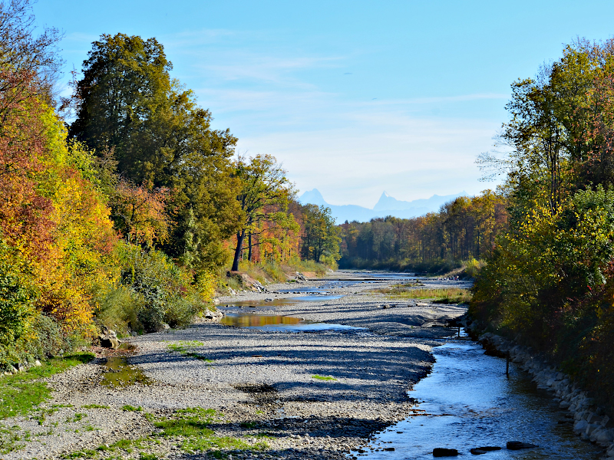
Context
Increasing duration and magnitude of agricultural and hydrological droughts
Declining yields and reduced irrigation possibilities
Management measures increasing soil organic carbon (SOC) can
enhance soil water retention
@Agroscope
How would a large scale implementation of such measures affect hydrological processes at catchment scale ?
@FOEN

Slide 4
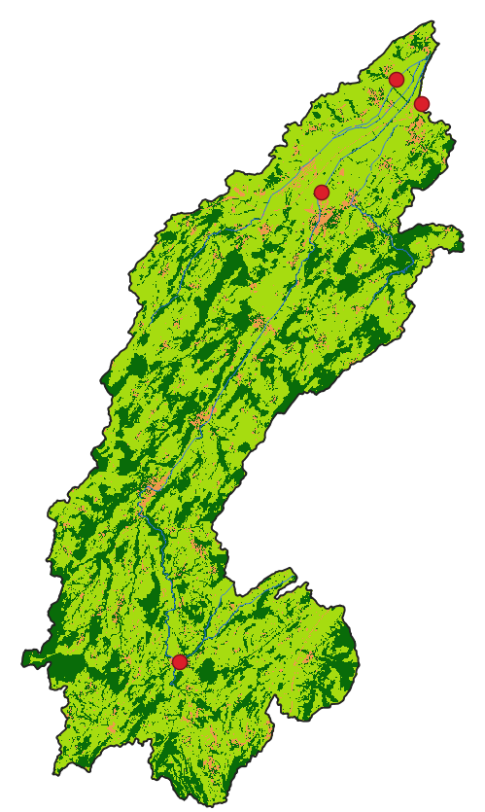
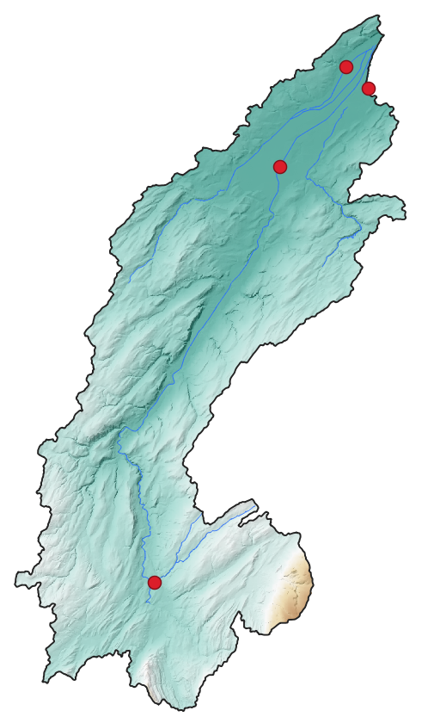
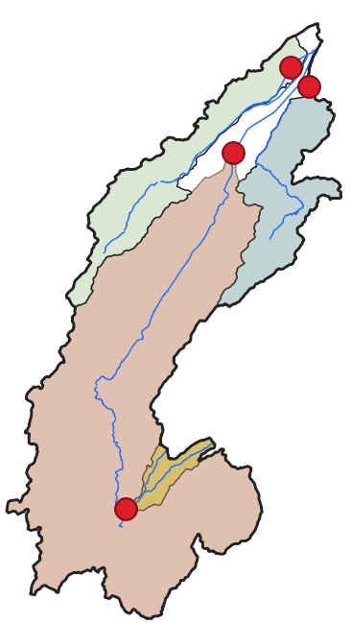
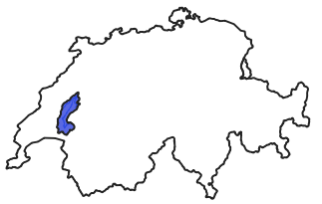
Case study and model
Broye catchment: lowland, mid-sized (~600${km}^{2}$) with large share of agricultural use (~70%)
Mesoscale hydrological model mHM (Samaniego et al. 2010)
Open-source, process-based distributed, rainfall-runoff model.
Petit Glane
Arbogne Avenches
Broye Payerne
Flon Aval
1482m
pervious
forest
impervious
gauging station
429m
KGE: 0.87 NSE: 0.84 pbias: -6.1

Slide 5
Literature review: management
Management adaptations such as cover crops or organic amendments can lead to changes in soil hydraulic properties:
+ 0.65 to 1 % mass Soil organic carbon SOC or increase by 7 to 220%
(Haruna et al. 2020, Hao et la. 2023, Blanco-Canqui et al 2009 , Blanco-Canqui et al 2023 & Shi et al. 2016)
10 to 20 % decrease in bulk density BD
(Haruna et al. 2020, Veetil et al. 2024, Hao et al. 2023, Blanco-Canqui et al 2009 , Blanco-Canqui et al 2023 & Shi et al. 2016)
40 to 360 % increase in saturated hydraulic conductivity Ksat
(Rawls et al. 2004, Haruna et al. 2020, Veetil et al. 2024, Hao et al. 2023, Blanco-Canqui et al 2009 , Blanco-Canqui et al 2023)
4 to 65 % increase in plant available water PAW
(Haruna et al. 2020, Hao et al. 2023, Blanco-Canqui et al 2009 , Blanco-Canqui et al 2023 & Shi et al. 2016)

Slide 6
Implementation of management in the model (mHM)
„pervious“ landcover cells (e.g. cropland)
Required input for each cell: soil texture and bulk density
Management scenario run: +1% SOC (mass) for all pervious landcover cells
Default model run (no management)
SOC
BD
Δ SOC
Δ BD
PTF: Manrique & Jones 1991
PTF: Manrique & Jones 1991

Slide 7
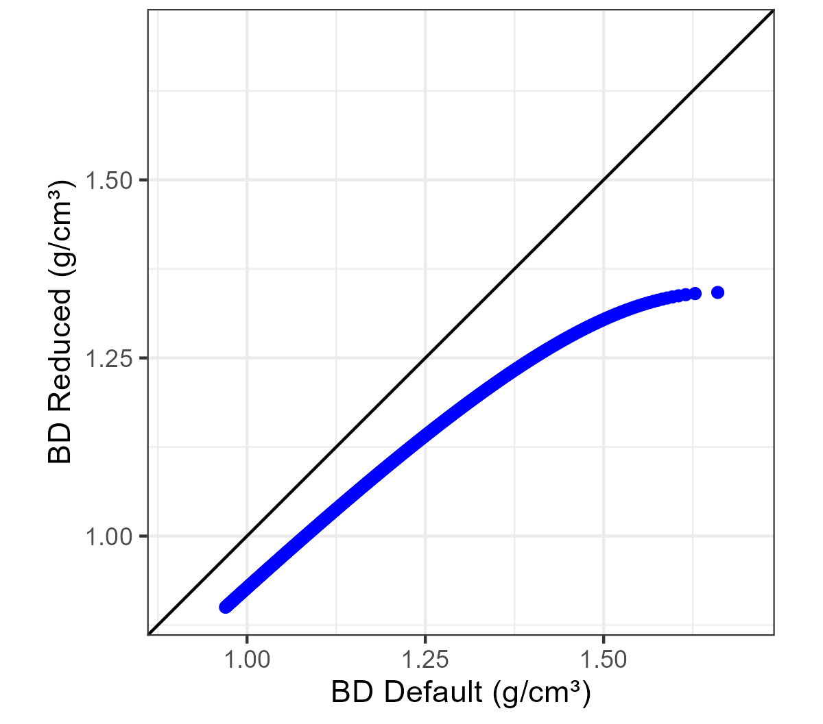
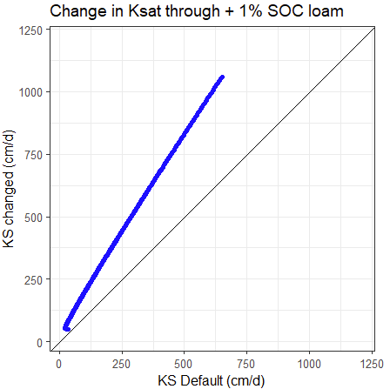
Implementation of management in the model (mHM)
Impact of +1% SOC (mass) on key parameters:
BD (g/${cm}^{3}$)
Assuming an inital range of 0-5% SOC for an example soil (loam)
simulated (scenario)
Δ SOC
Δ BD
PAW (%)
PTF: Manrique & Jones 1991
$$\text{Δ}$$
~
-10%
simulated (default)
simulated (scenario)
$K_{sat}$ (cm/day)
$$\text{Δ}$$
+5%
~
Sand
Clay
Δ SOC
Δ BD
$$\text{Δ} K_{sat}$$
simulated (scenario)
simulated (default)
→ Magnitude of changes is consistent with reported changes from literature
PTF: Vereecken et al. 1990
$$\text{Δ}$$
~
+115%
simulated (default)

Slide 8
Impact on states and fluxes
(weekly aggregation for example cropland cell)
actual ET
% difference in states and fluxes of
management scenario run relative to default run
(→ positive: increased under management)
Seasonal pattern, larger effect in summer
increased aET
higher soil water content
lower groundwater storage
decreased total runoff
Soil water content (0-30cm)
Soil water storage total
Groundwater storage
Total runoff (interflow + baseflow)
Average temperature (°C)
Precipitation (mm)
Notes:
Overall: seasonal differences: in winter soils are anyway more saturated and there is less ET, less room for differences.
Increased water content at layer 1= wegen soil conditions. Overall soil water storage: eher increased, aber auch limited wegen aET, im winter teilweise decreased: higher ksat : more percolation = infiltration from last layer ? Overall groundwater is reduced, but in summer the difference is almost 0, because there is a bit more percolation

Slide 9
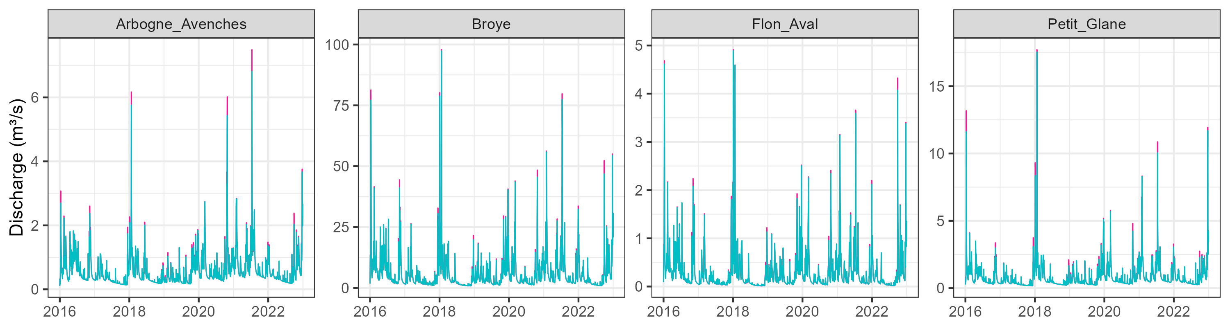
Impact on discharge
simulated (default)
simulated (scenario)
Overall slightly reduced
Seasonal pattern: biggest impact in winter
Peak flows are reduced
Petit Glane
Arbogne Avenches
Broye Payerne
Flon Aval
% difference of simulated scenario relative to default scenario

Slide 10
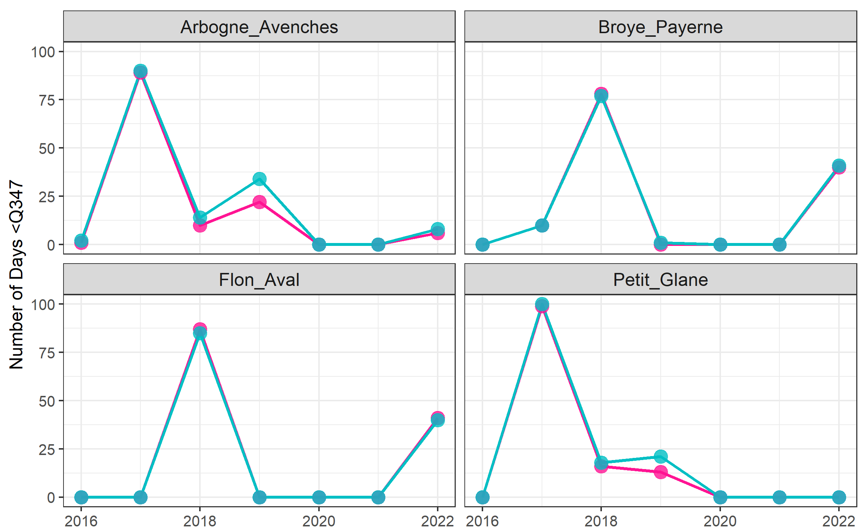
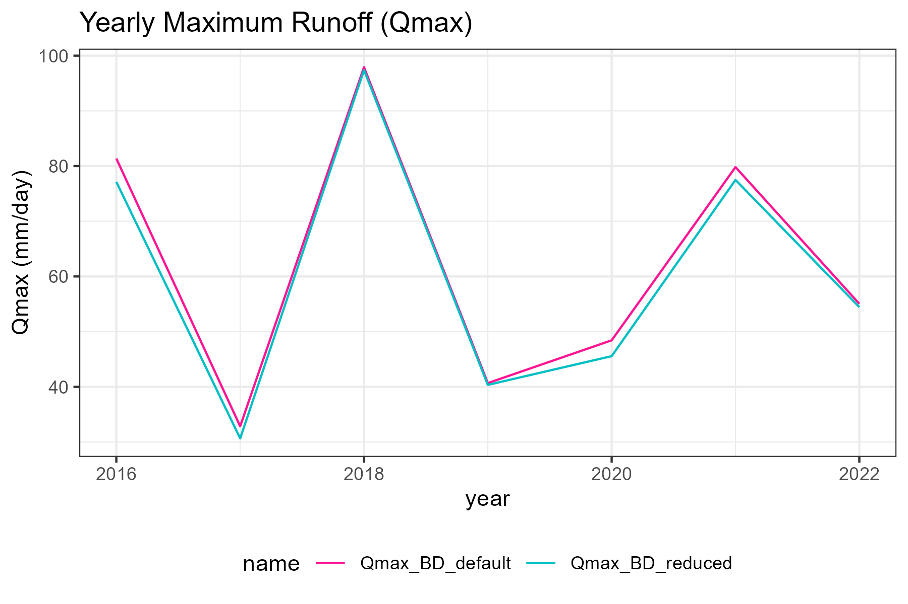
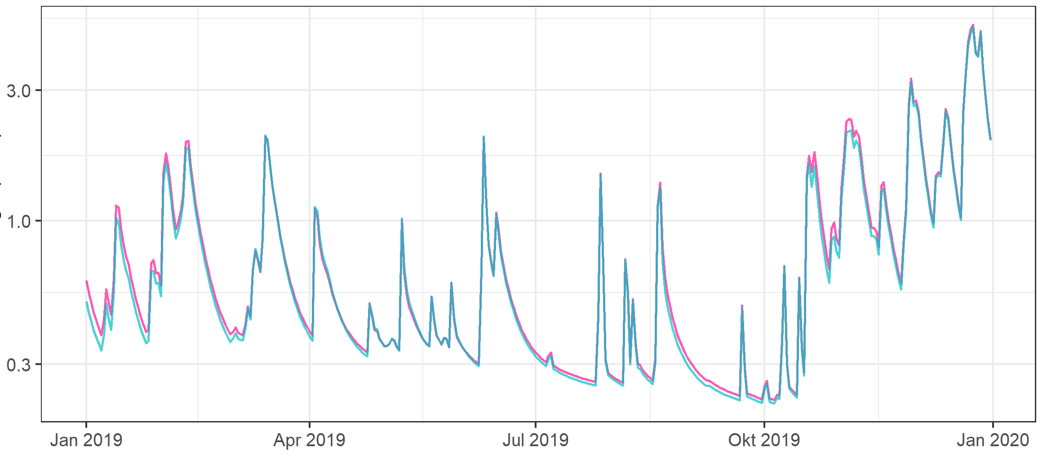
Impact on peak and low flows
Yearly${ Q}_{max}$ and peak flows are mostly reduced under management scenario
Low flows
Days with flow < ${95}^{th}$ percentile are mostly increasing under the management scenario
Peak flows
observed
simulated (default)
simulated (scenario)
Petit Glane 2019
Broye Payerne 2022

Slide 11
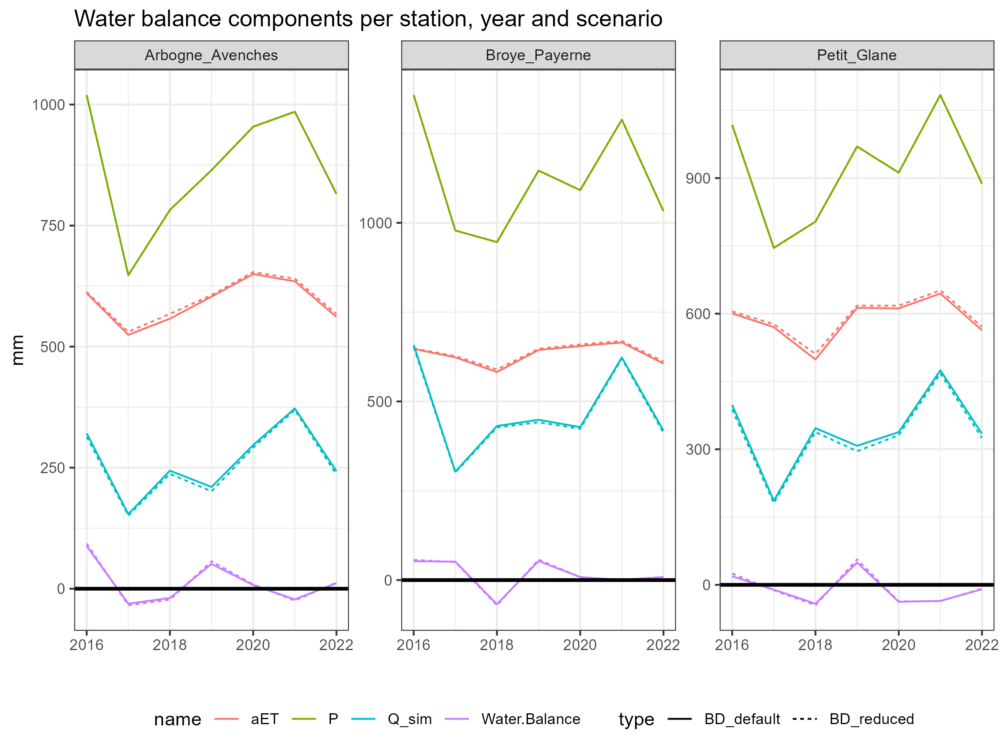
Impact on water balance:
Absolute impacts are in general quite marginal, water partitioning is changed:
aET is increased
discharge is reduced
simulated (default)
simulated (scenario)

Slide 12
Summary & Conclusion
Assumption: Management adaptation leads to change in soil hydraulic properties
Results: Impacts on states, fluxes, discharge and water balance:
Soil organic carbon
Bulk density
Sat. hydraulic conductivity
Plant available water
Actual evapotranspiration
Soil water content
Groundwater storage
Total runoff & discharge
Peak flows
Low flows
Overall: rather minor impacts although assumption is optimistic
Positive side effect: reduced peak flows
Tradeoff: even more low flows in water scarce summer month

