Slide 1

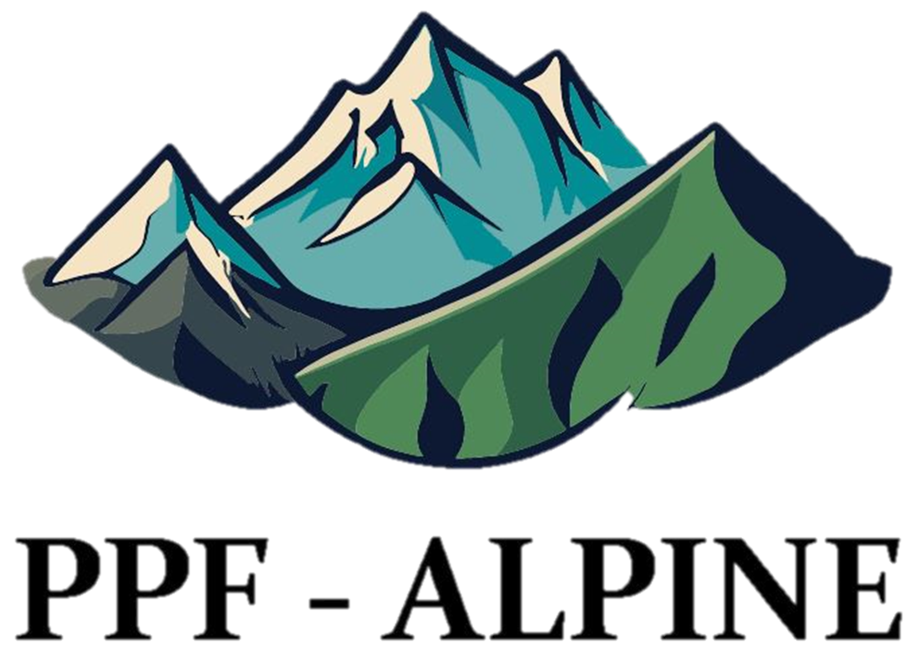
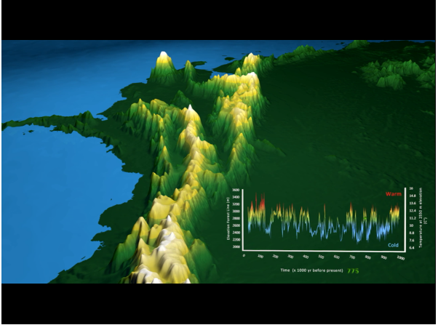





A 3D visualization of the elevational dance of the Andean high mountain biome in the Pleistocene arena
Suzette Flantua, Catalina Giraldo, Henry Hooghiemstra
@catalhina11
@SuzetteFlantua

Slide 2
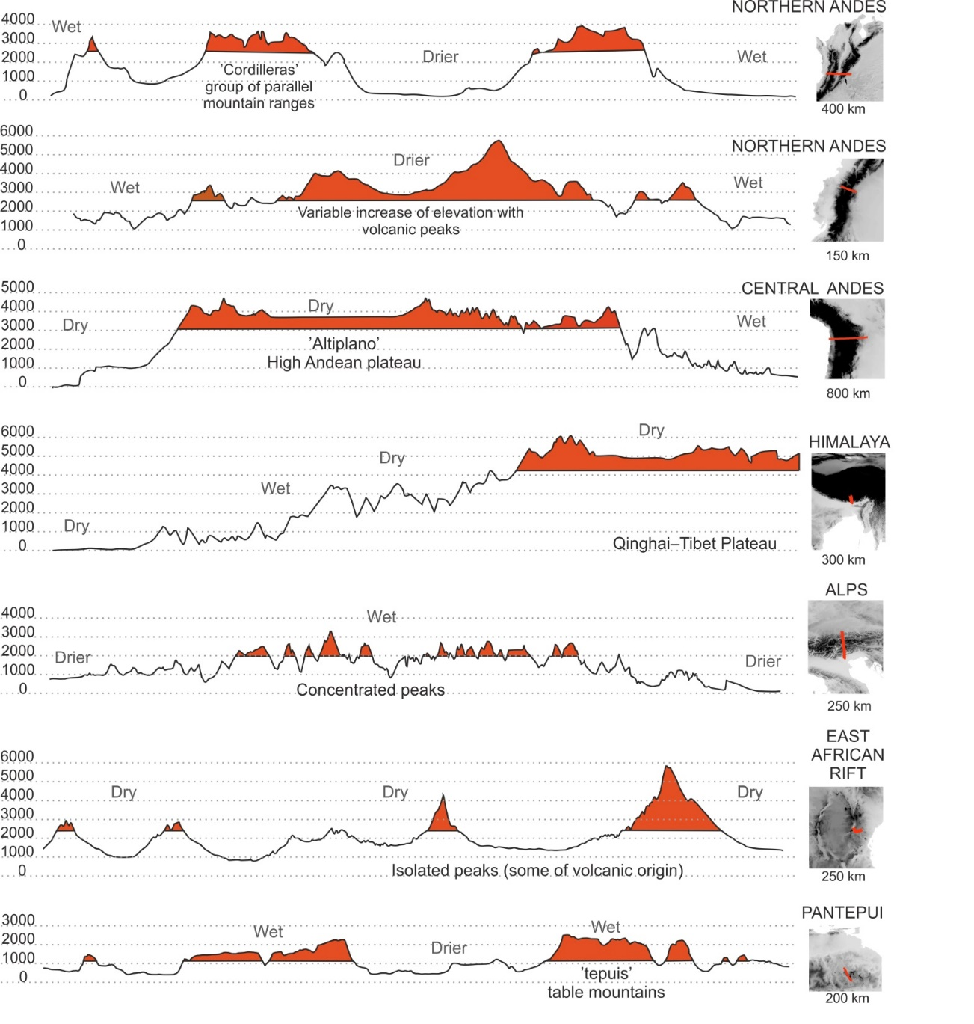
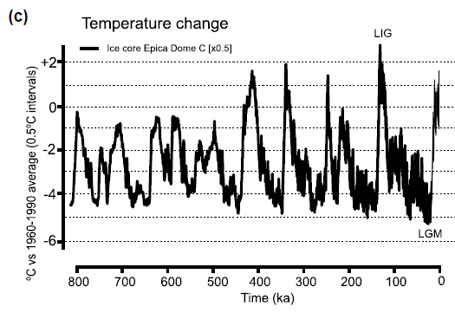
Sky islands
Flantua 2017 PhD Thesis
Flantua et al. 2020 Global Ecology & Biogeography

Slide 3
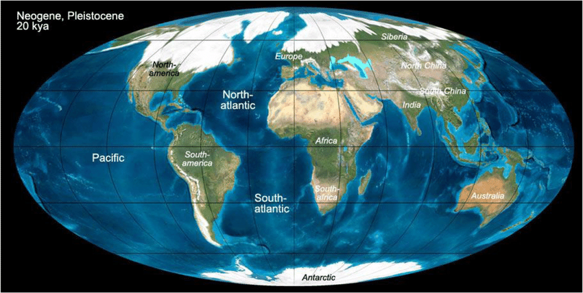
Parallels between true islands and sky islands
1. Quaternary climate fluctuations influenced true islands and alpine islands substantially
Surface area and connectivity of true and sky islands changed constantly

Slide 4
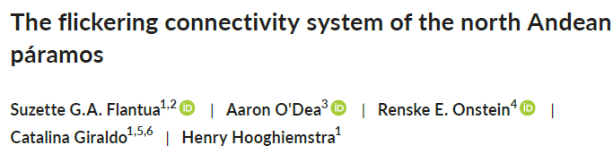

@SuzetteFlantua
@catalhina11

Slide 5
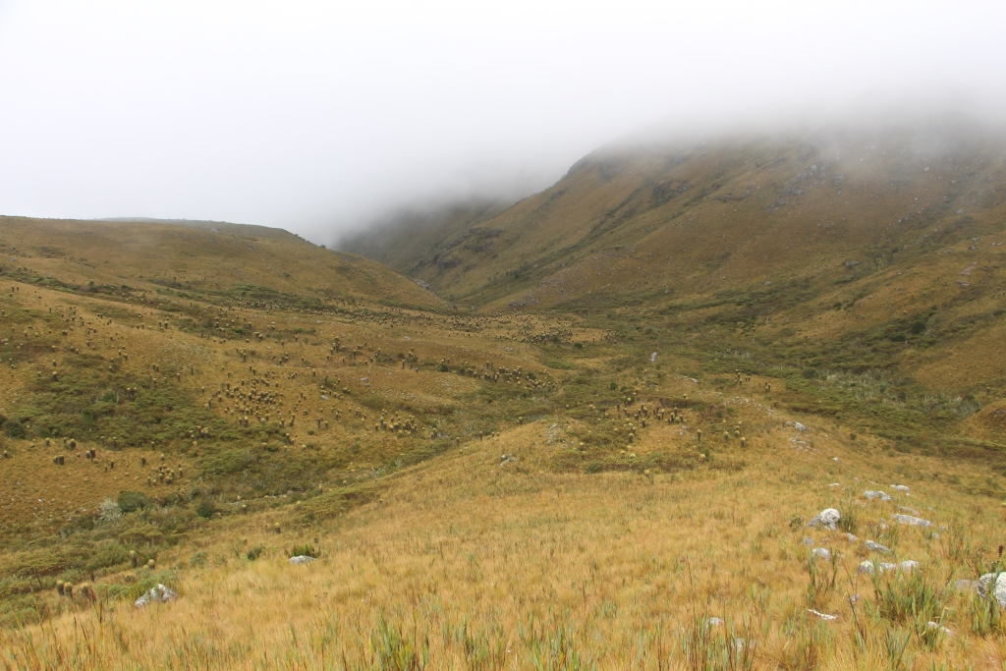
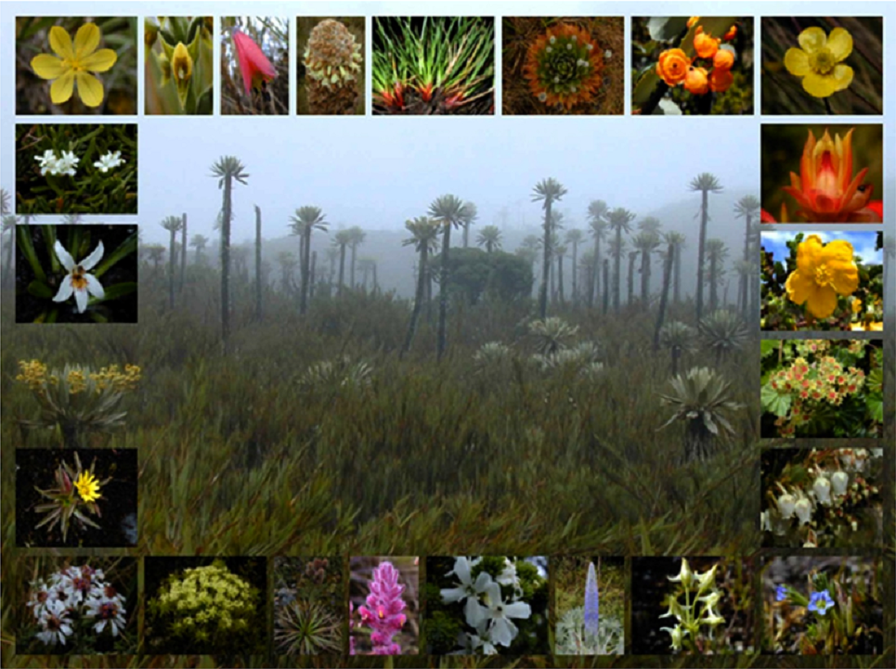
Páramo richness
The richest alpine ecosystem in the world:
c. 4700 plant species, much more than any other tropical alpine flora (e.g., 371 in East-Africa highlands, 1118 in New Guinea highlands, Sklenář et al. 2011; 2014).
Madriñan et al. 2013

Slide 6
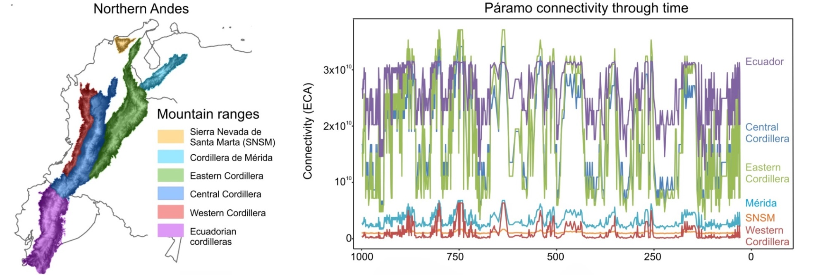
@SuzetteFlantua
@catalhina11

Slide 7
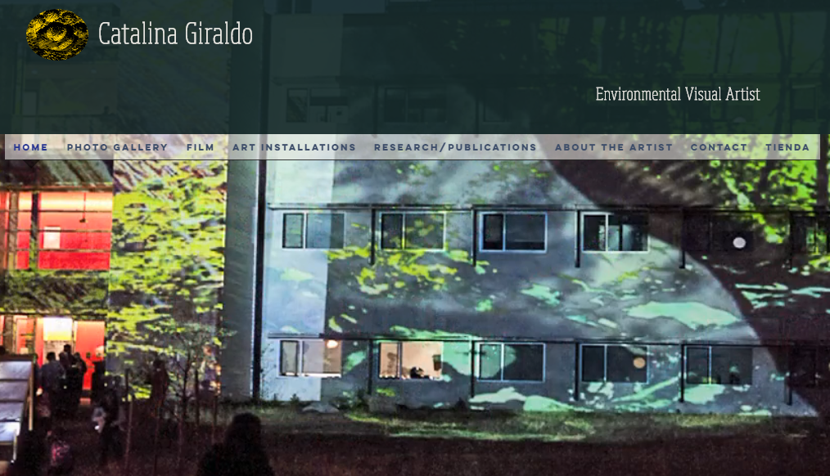
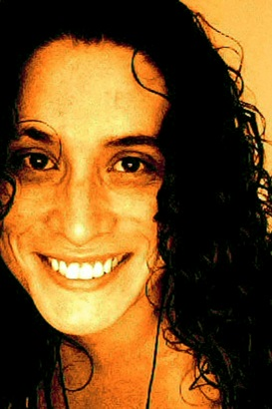
https://www.catalhinagiraldo.com/
@SuzetteFlantua
@catalhina11

Slide 8


Slide 9
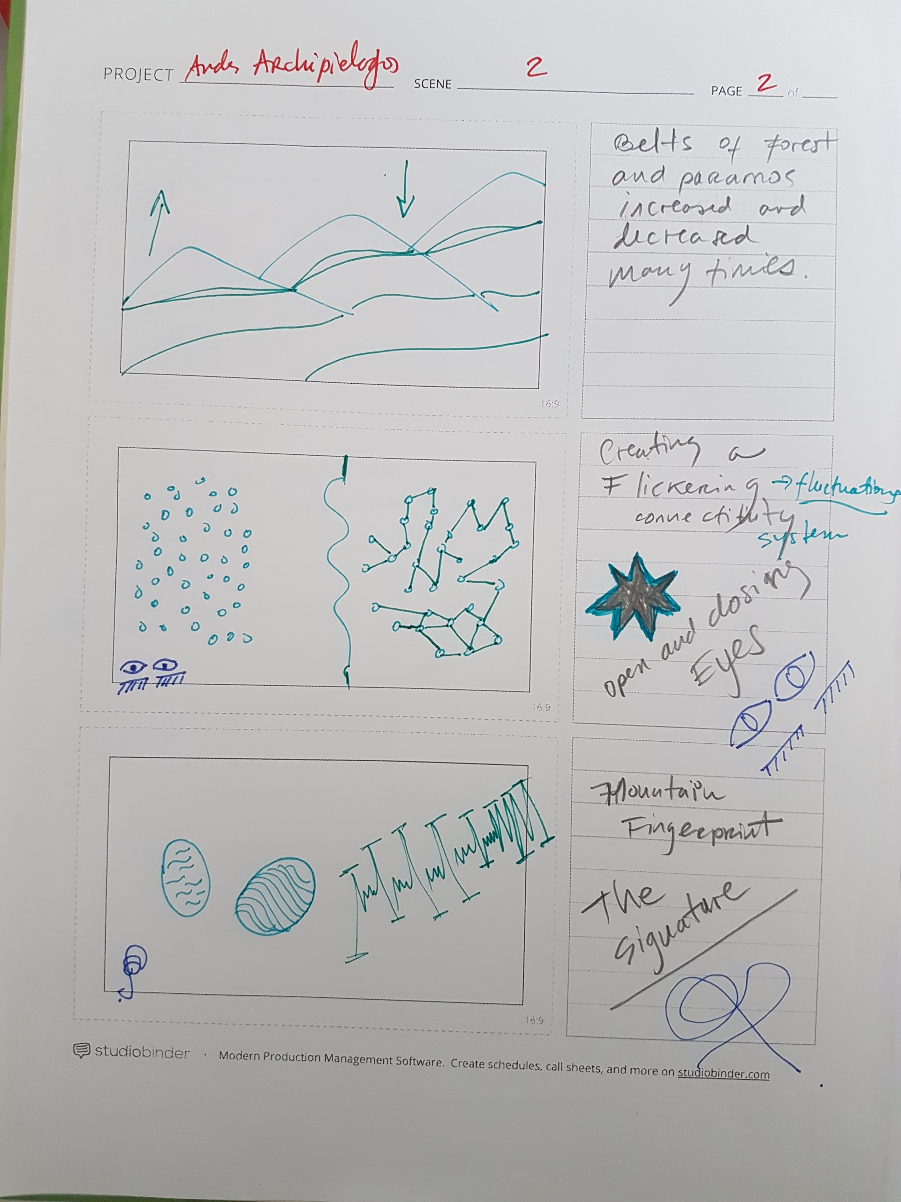
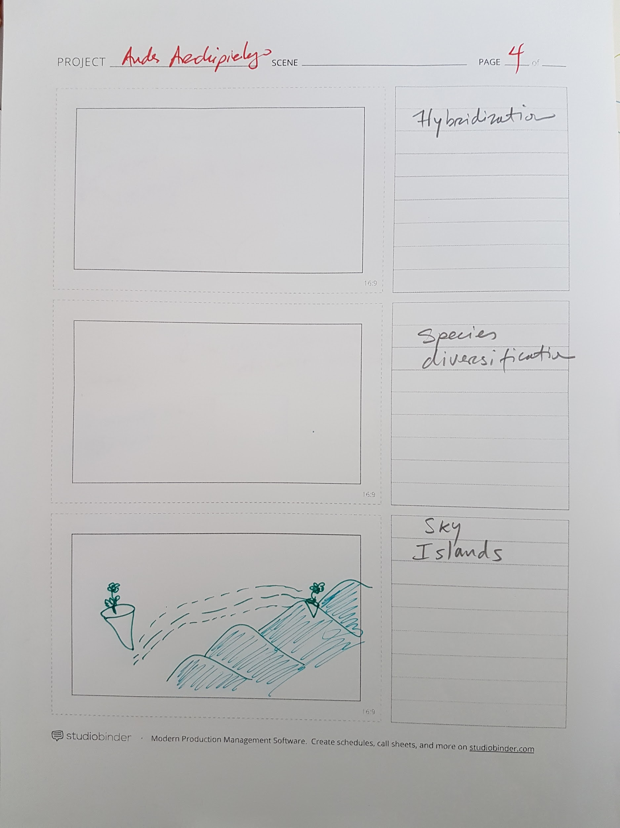
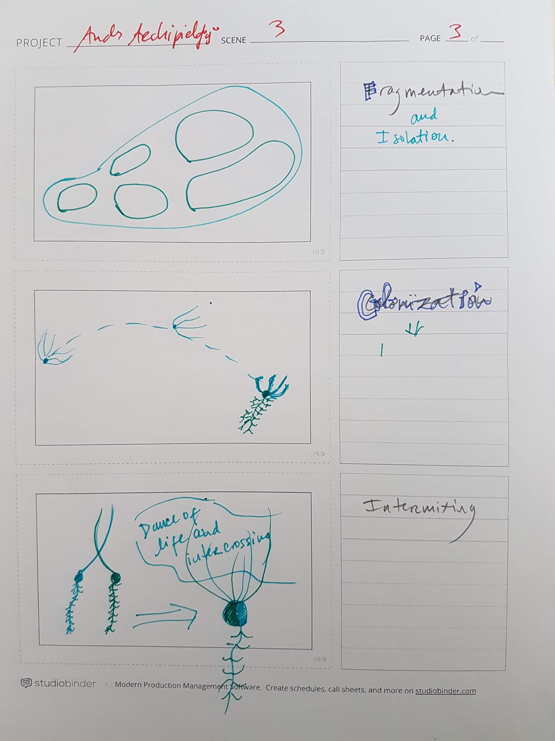
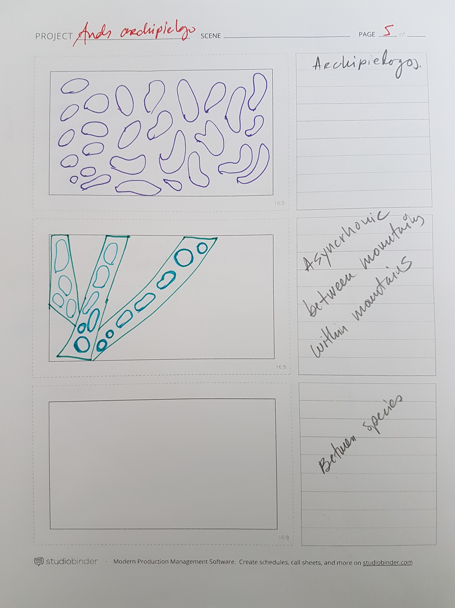
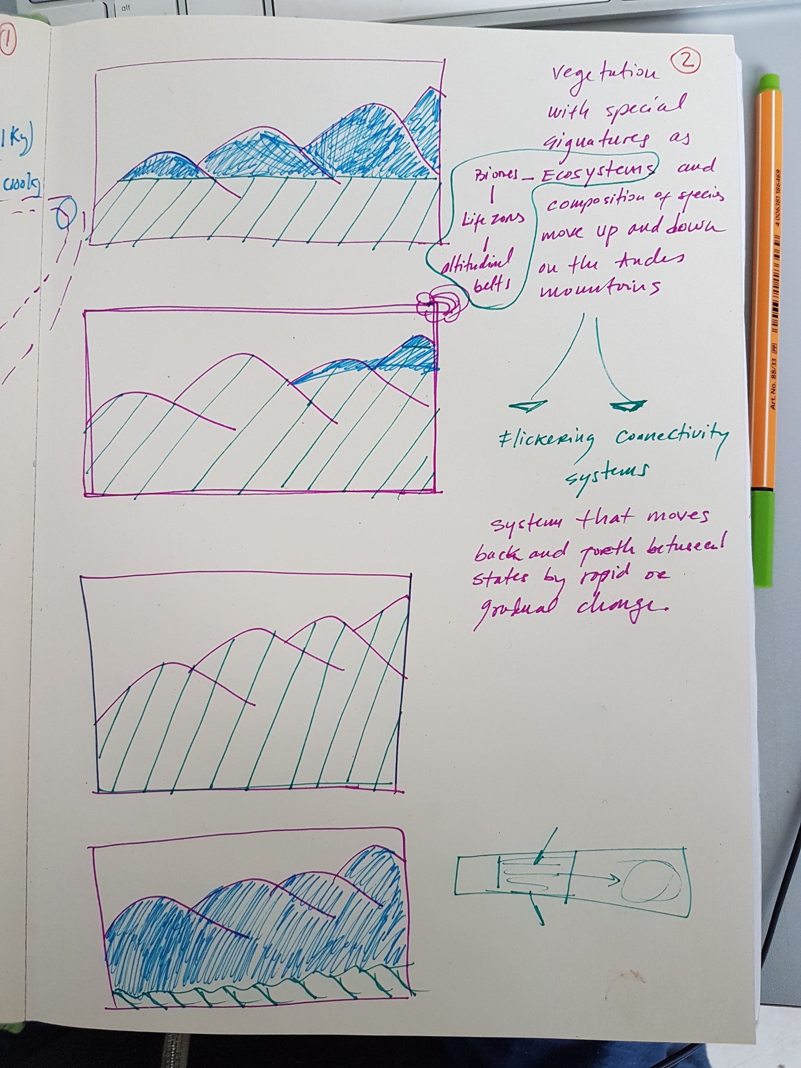
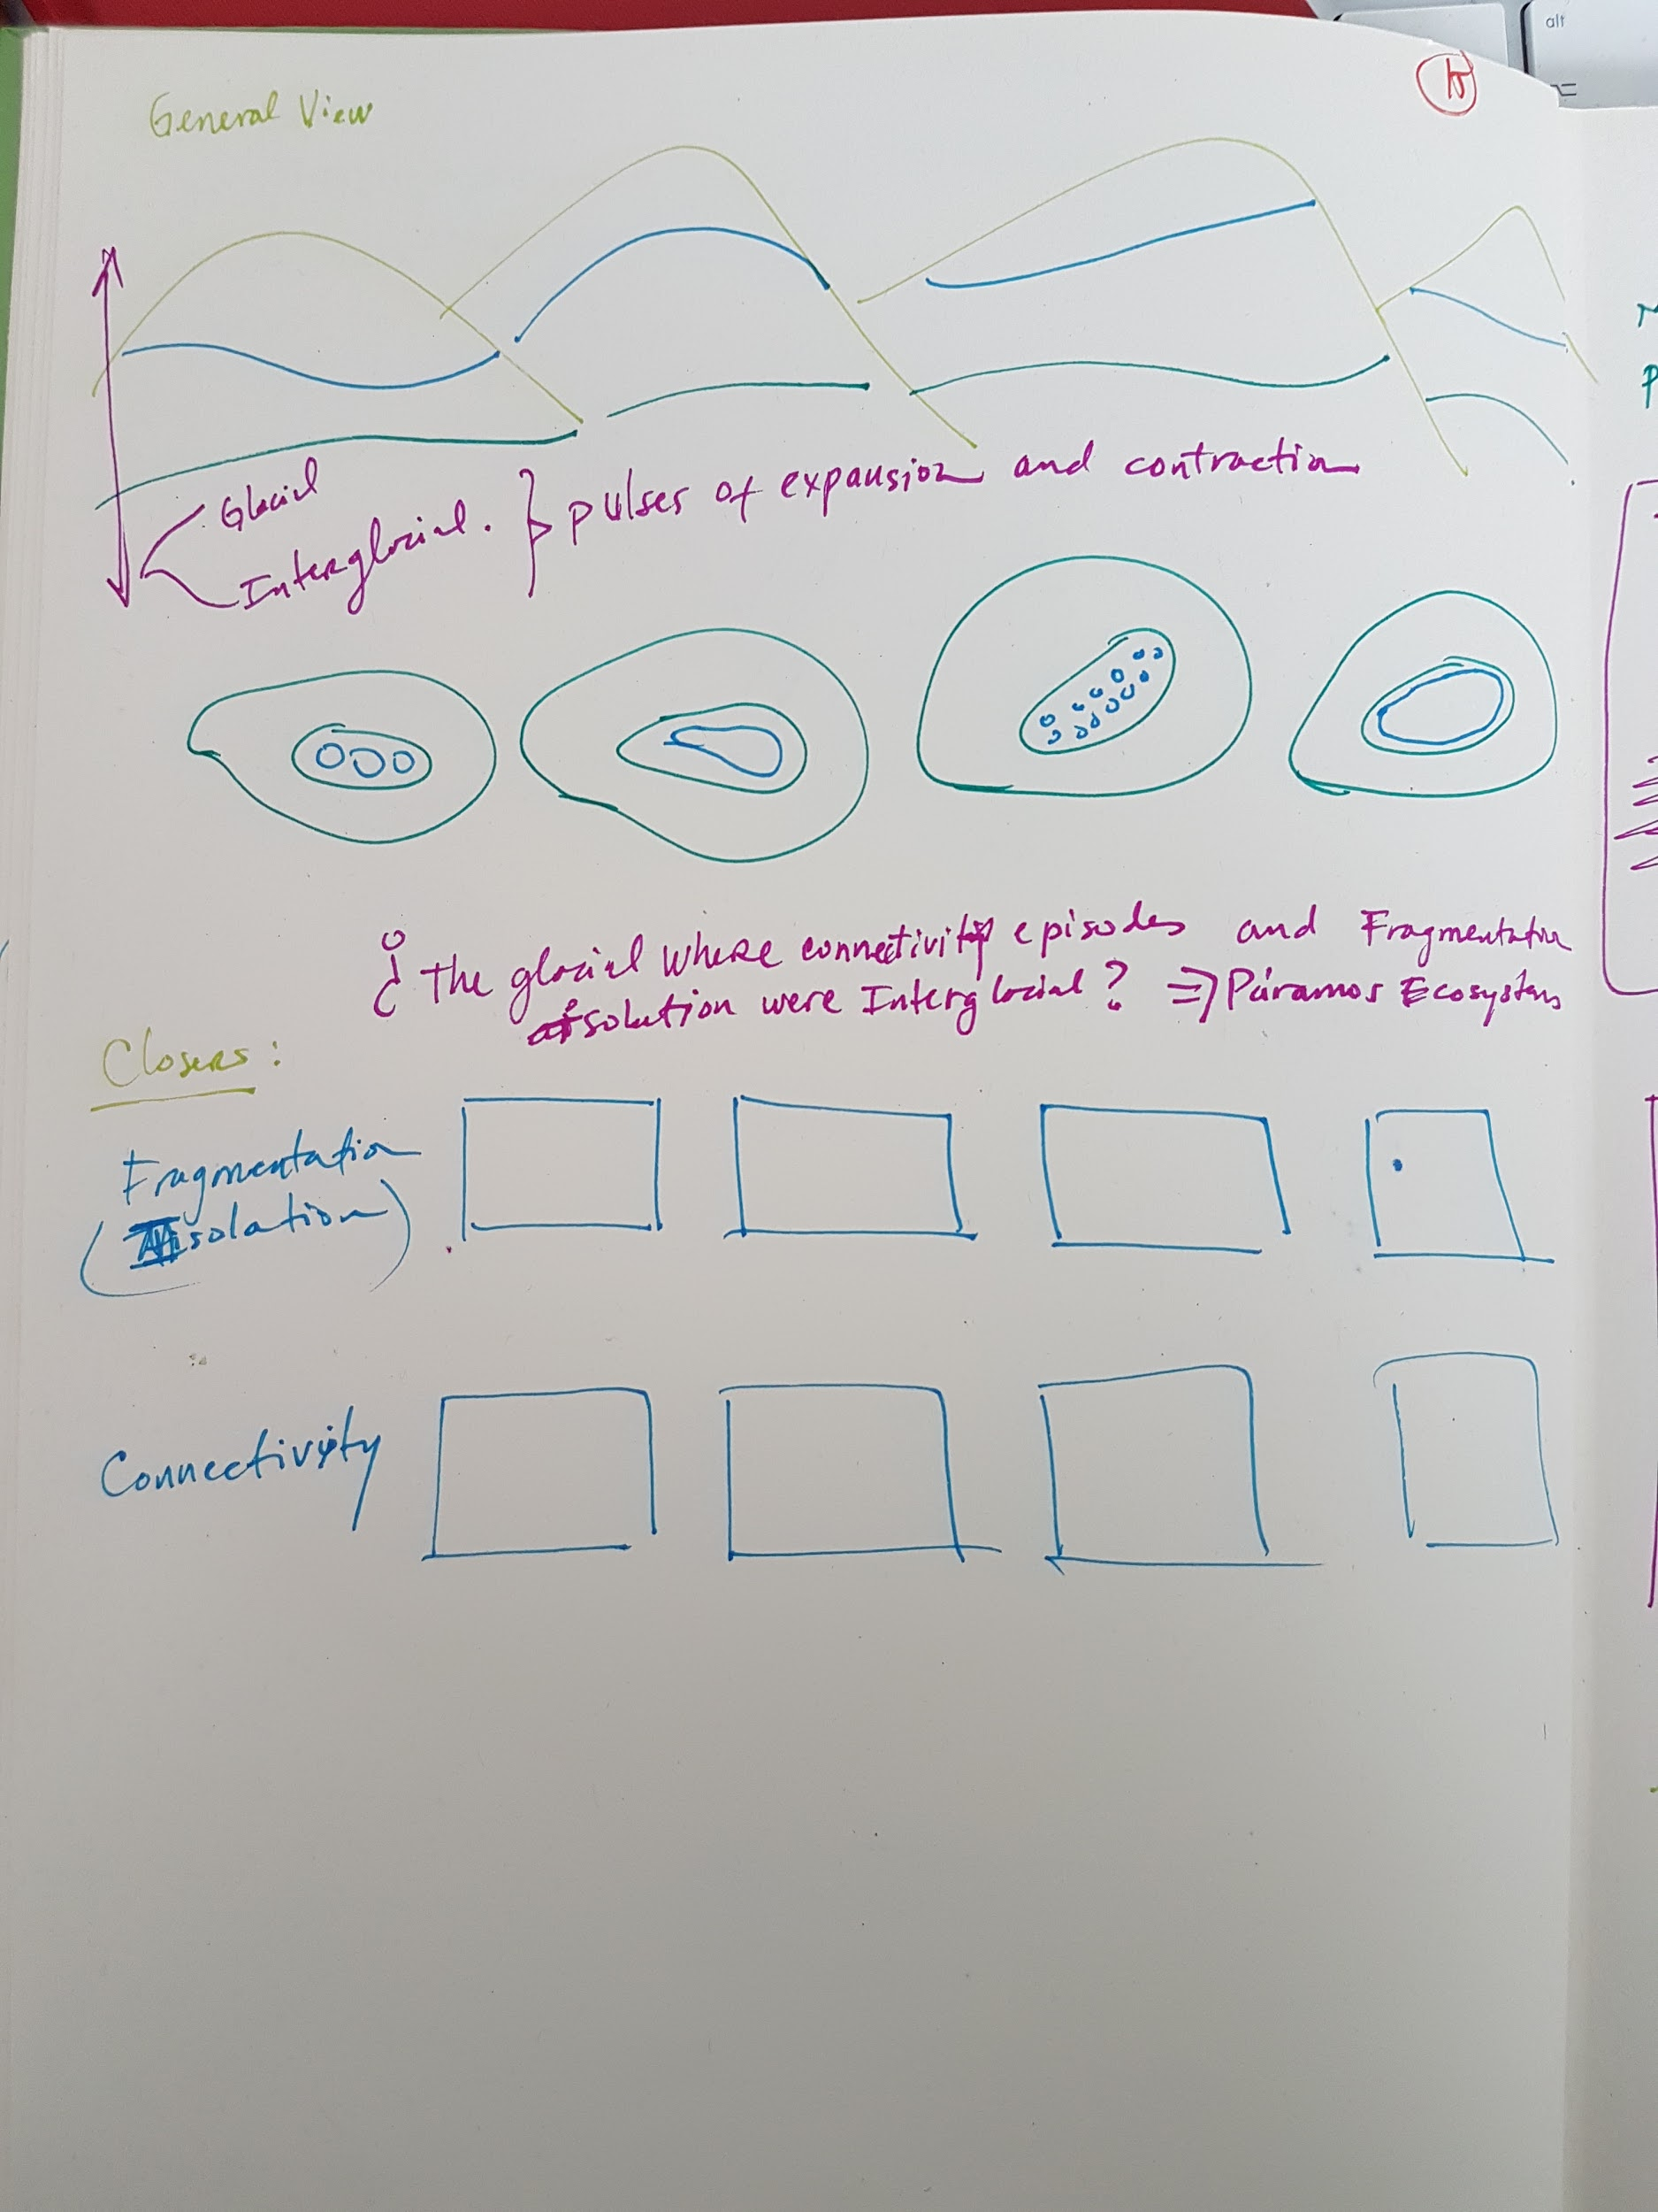
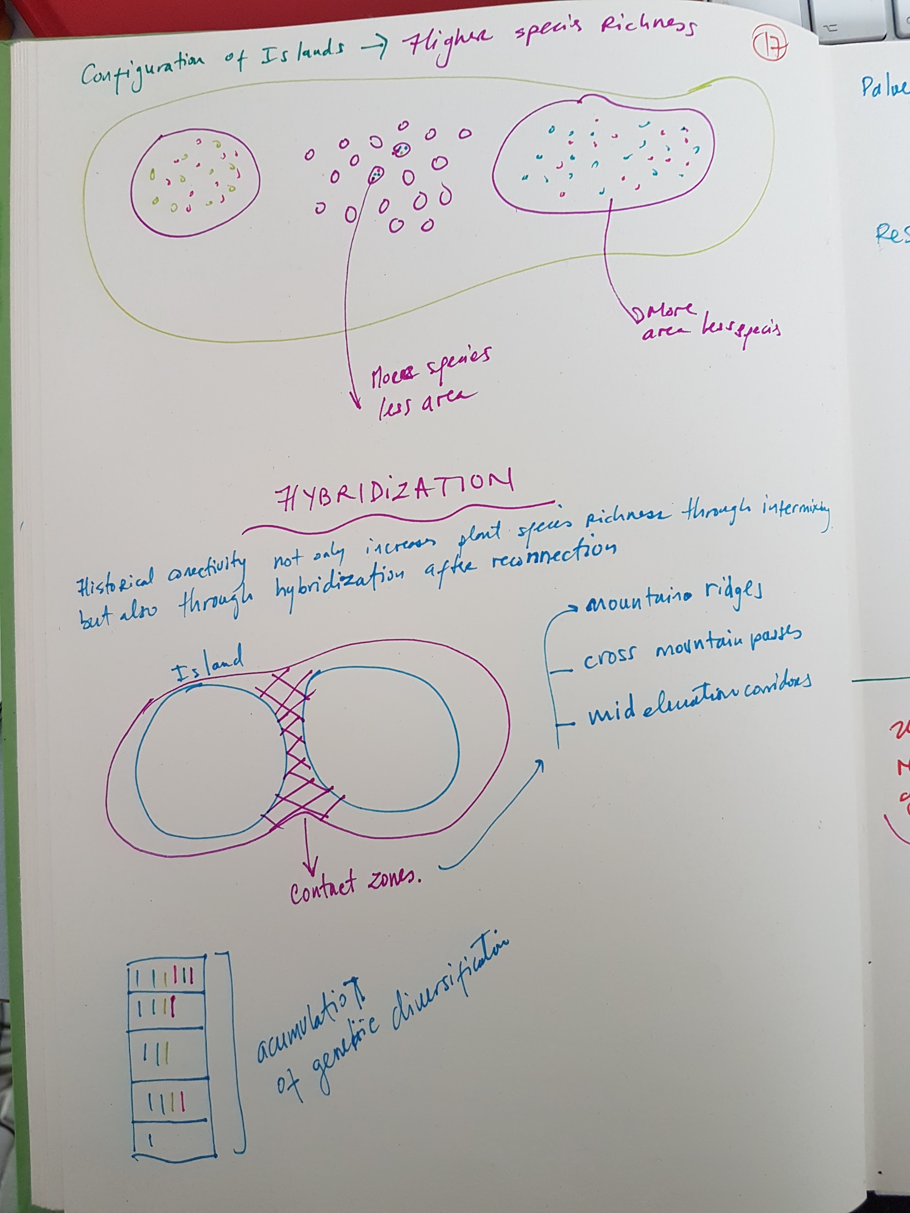
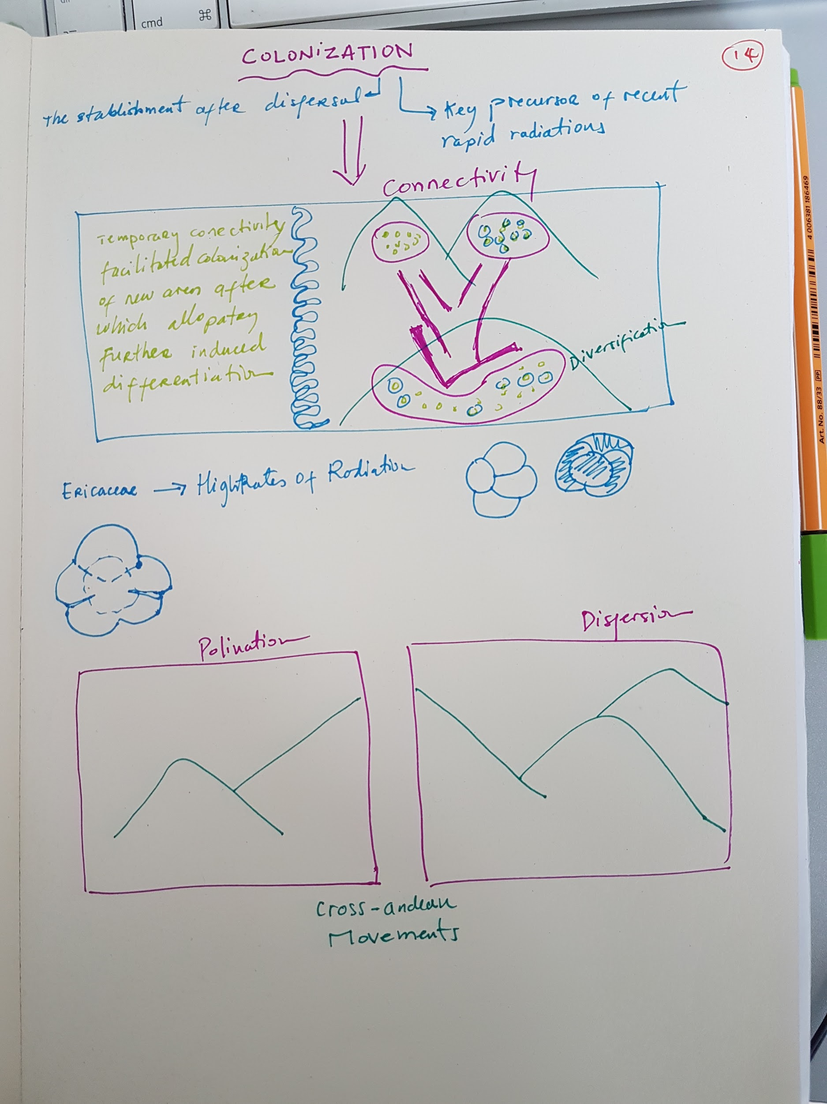
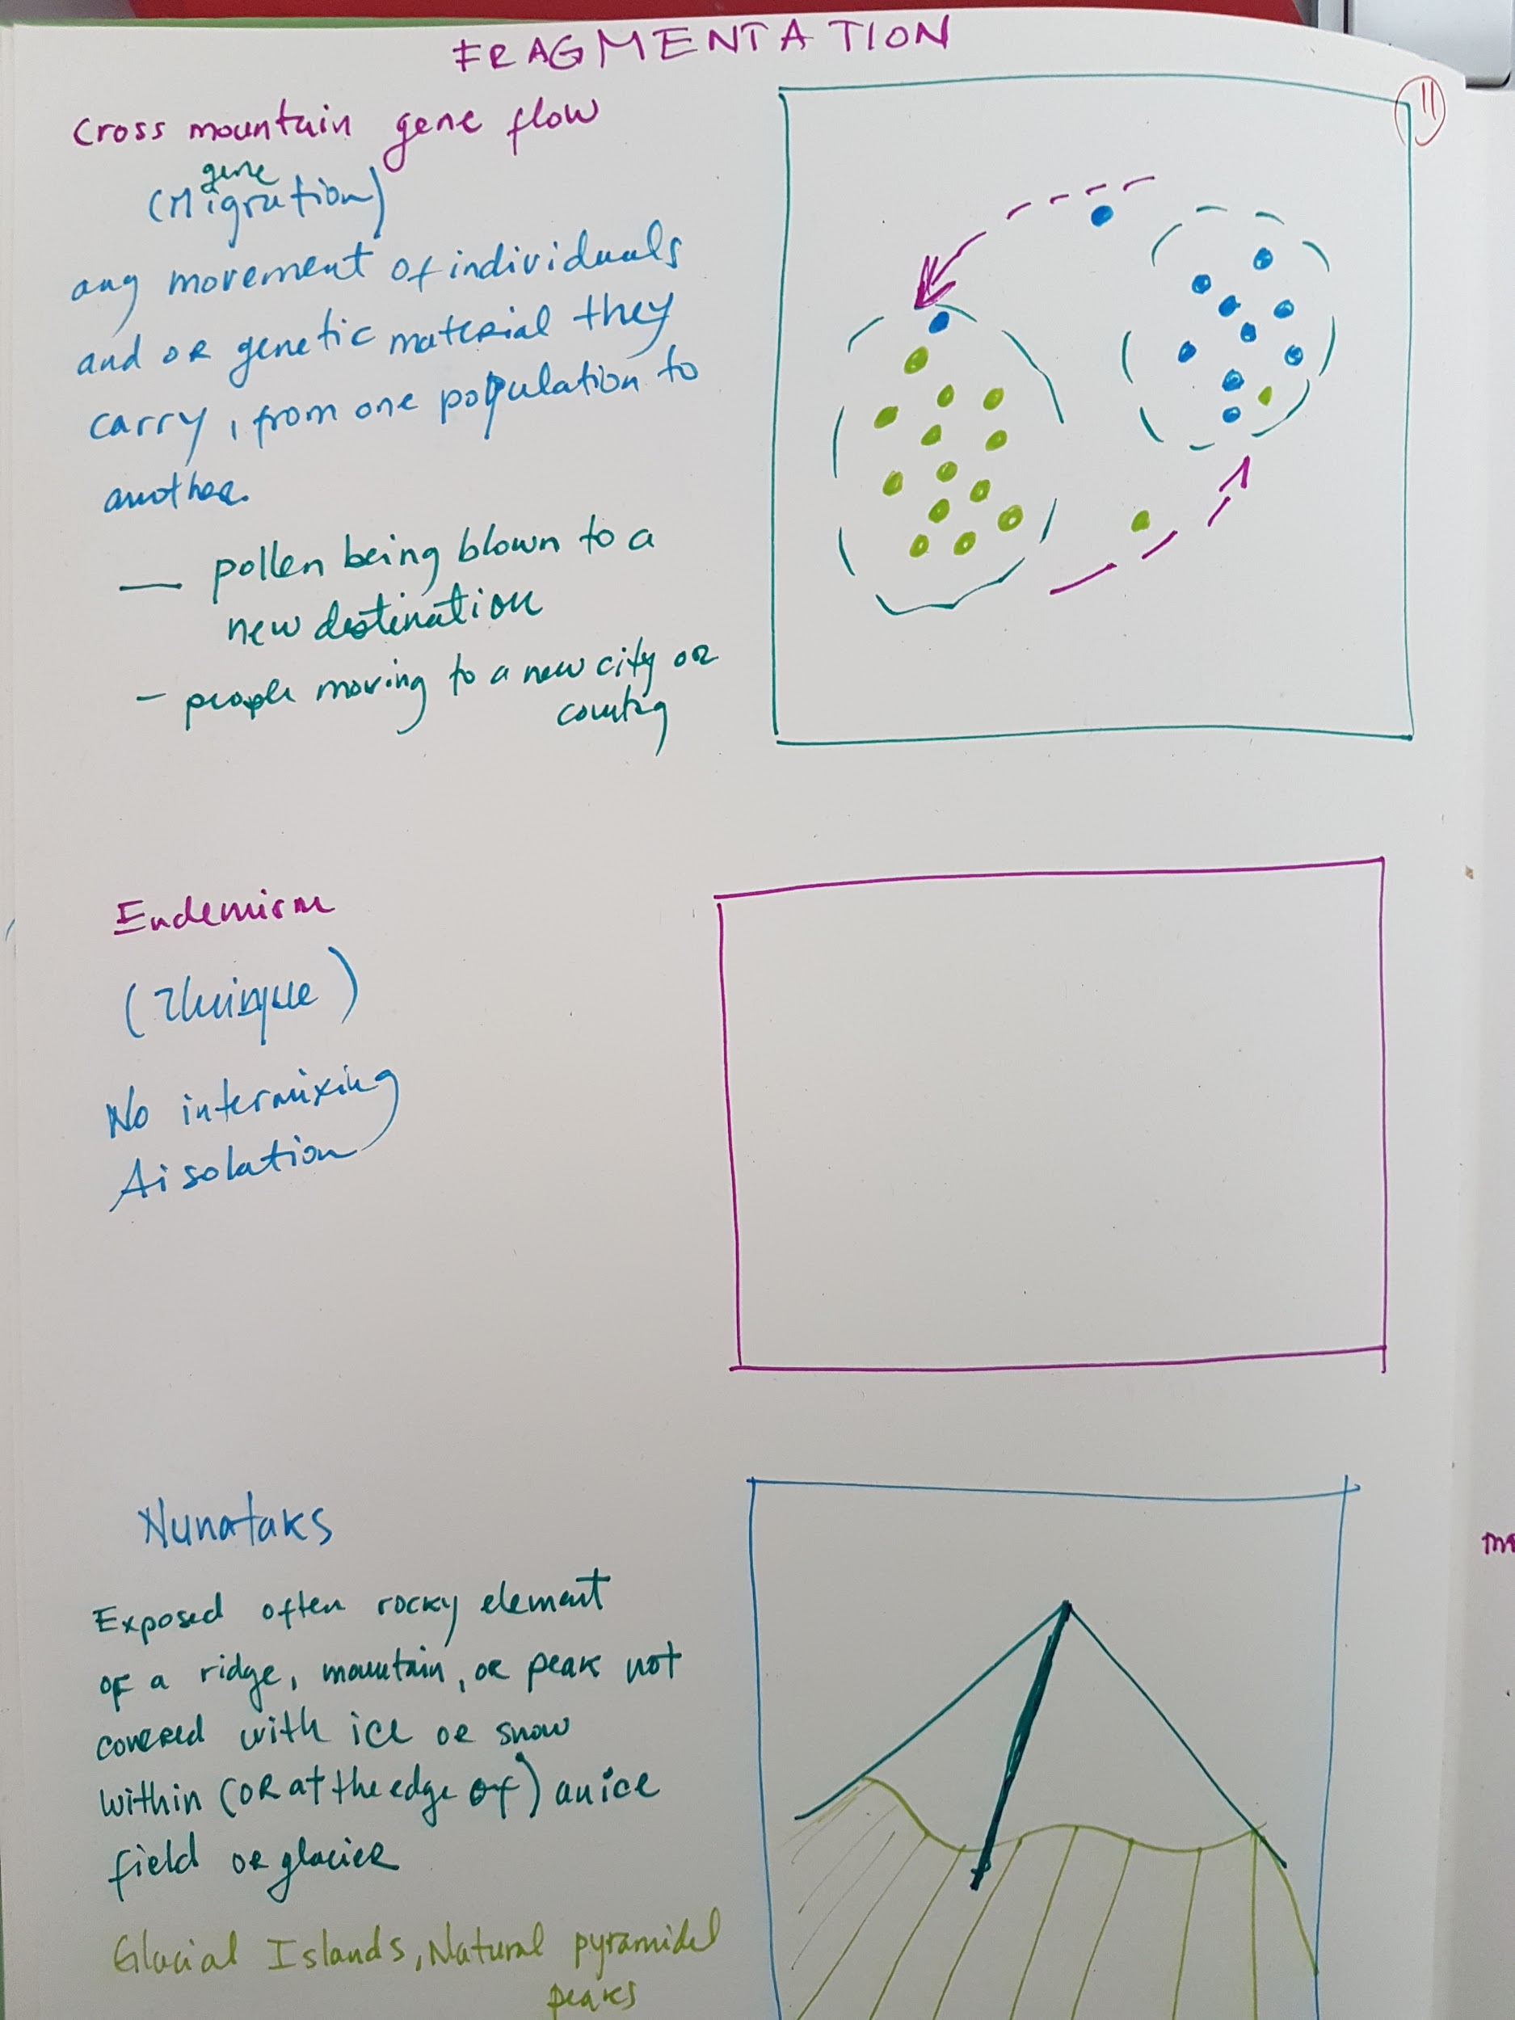
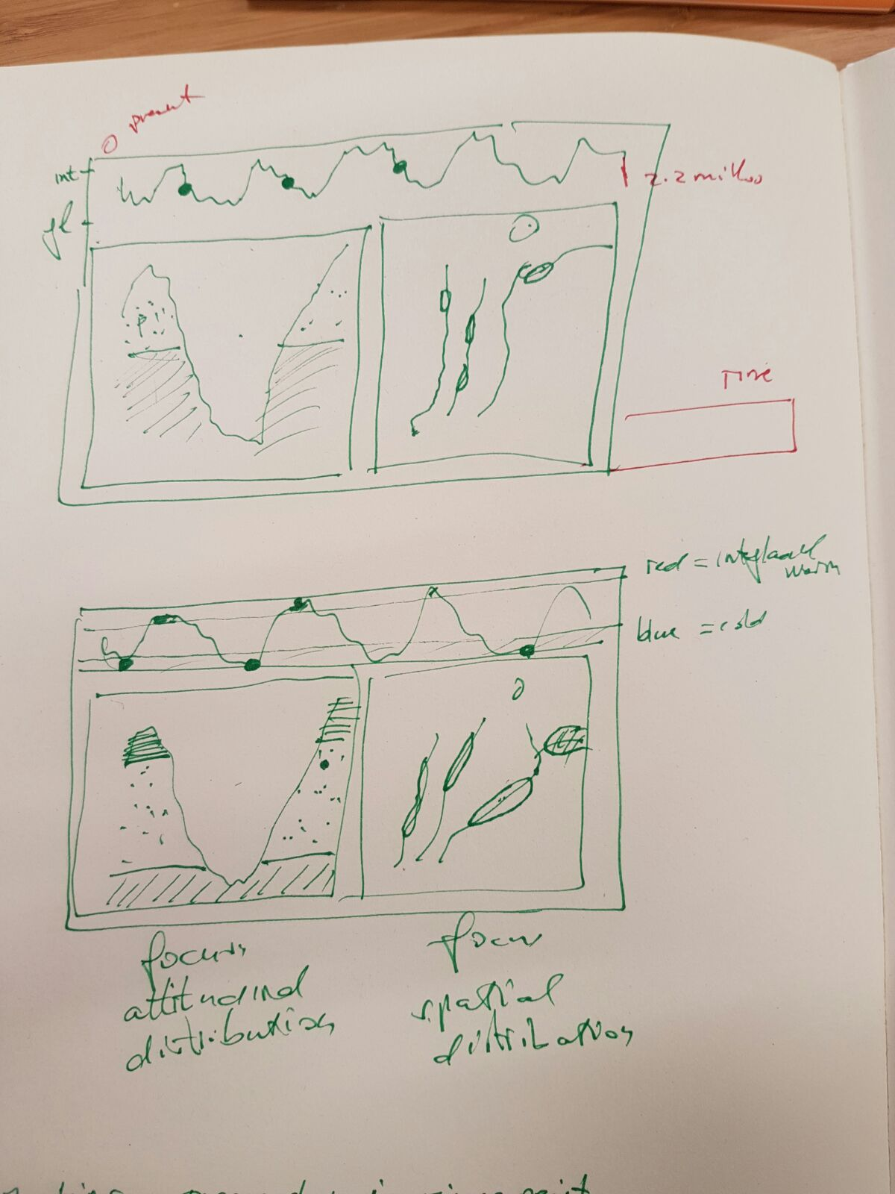
First drafts…

Slide 10
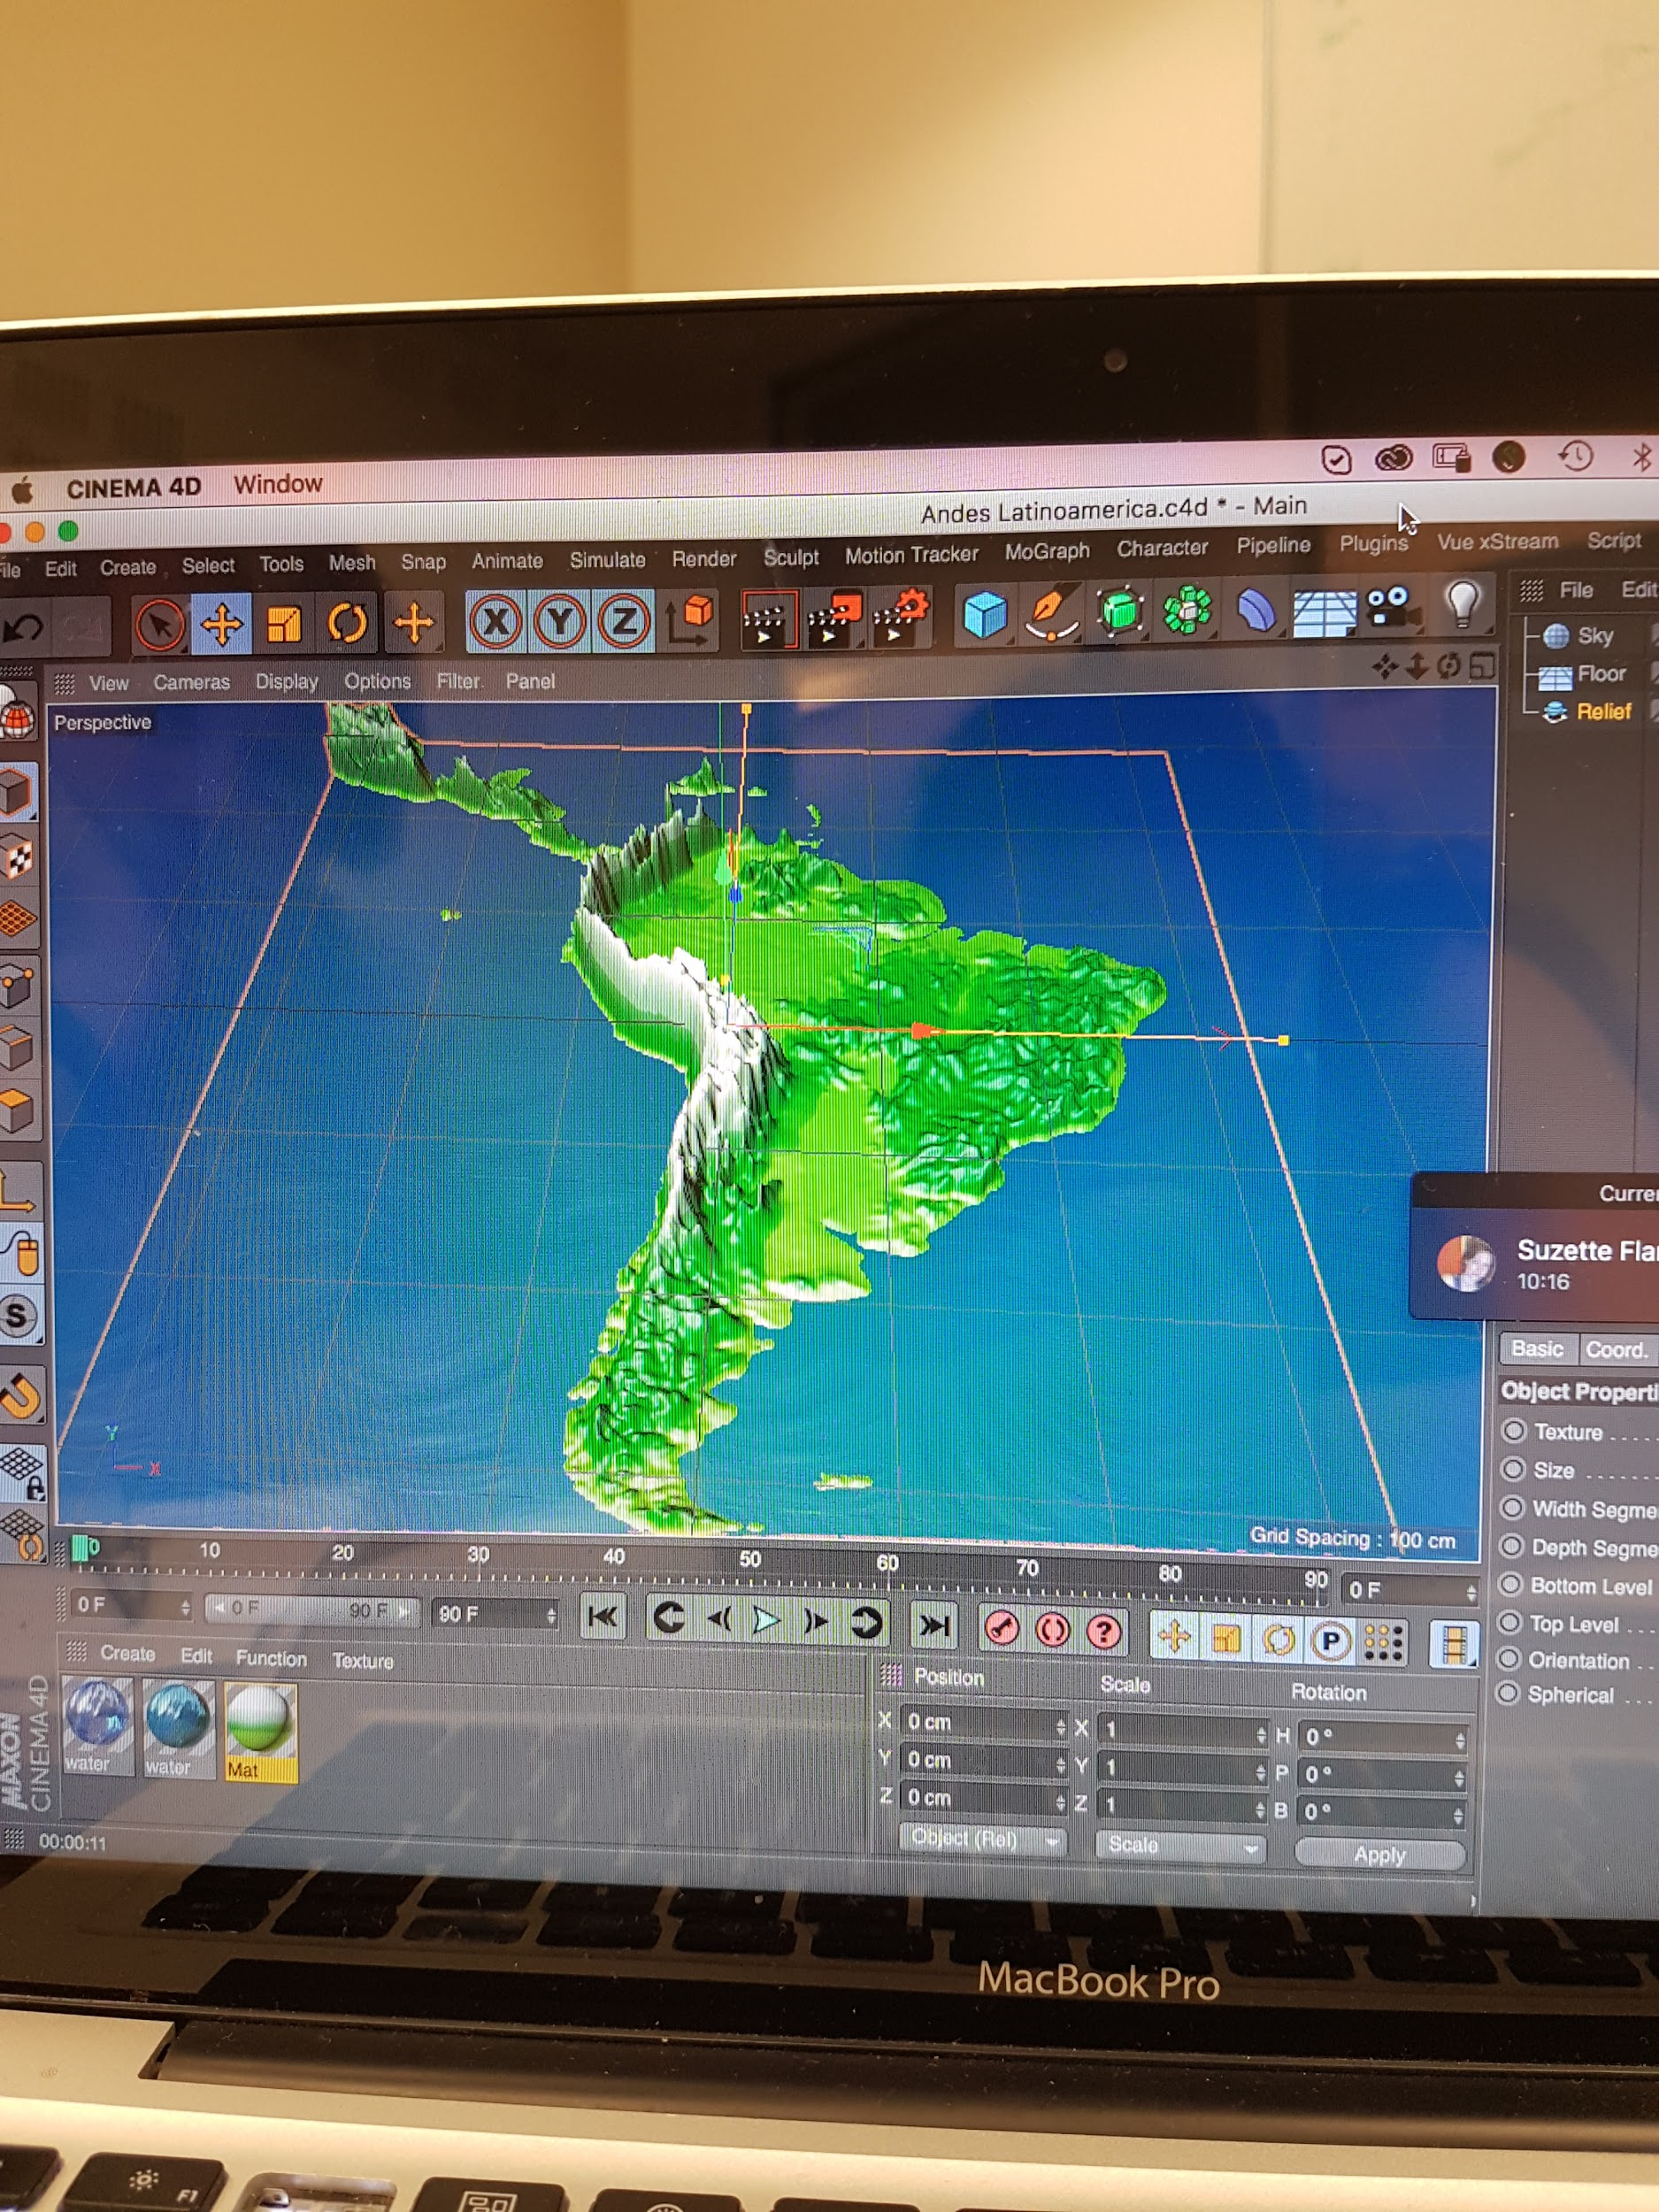
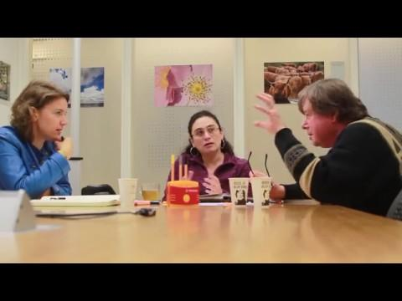
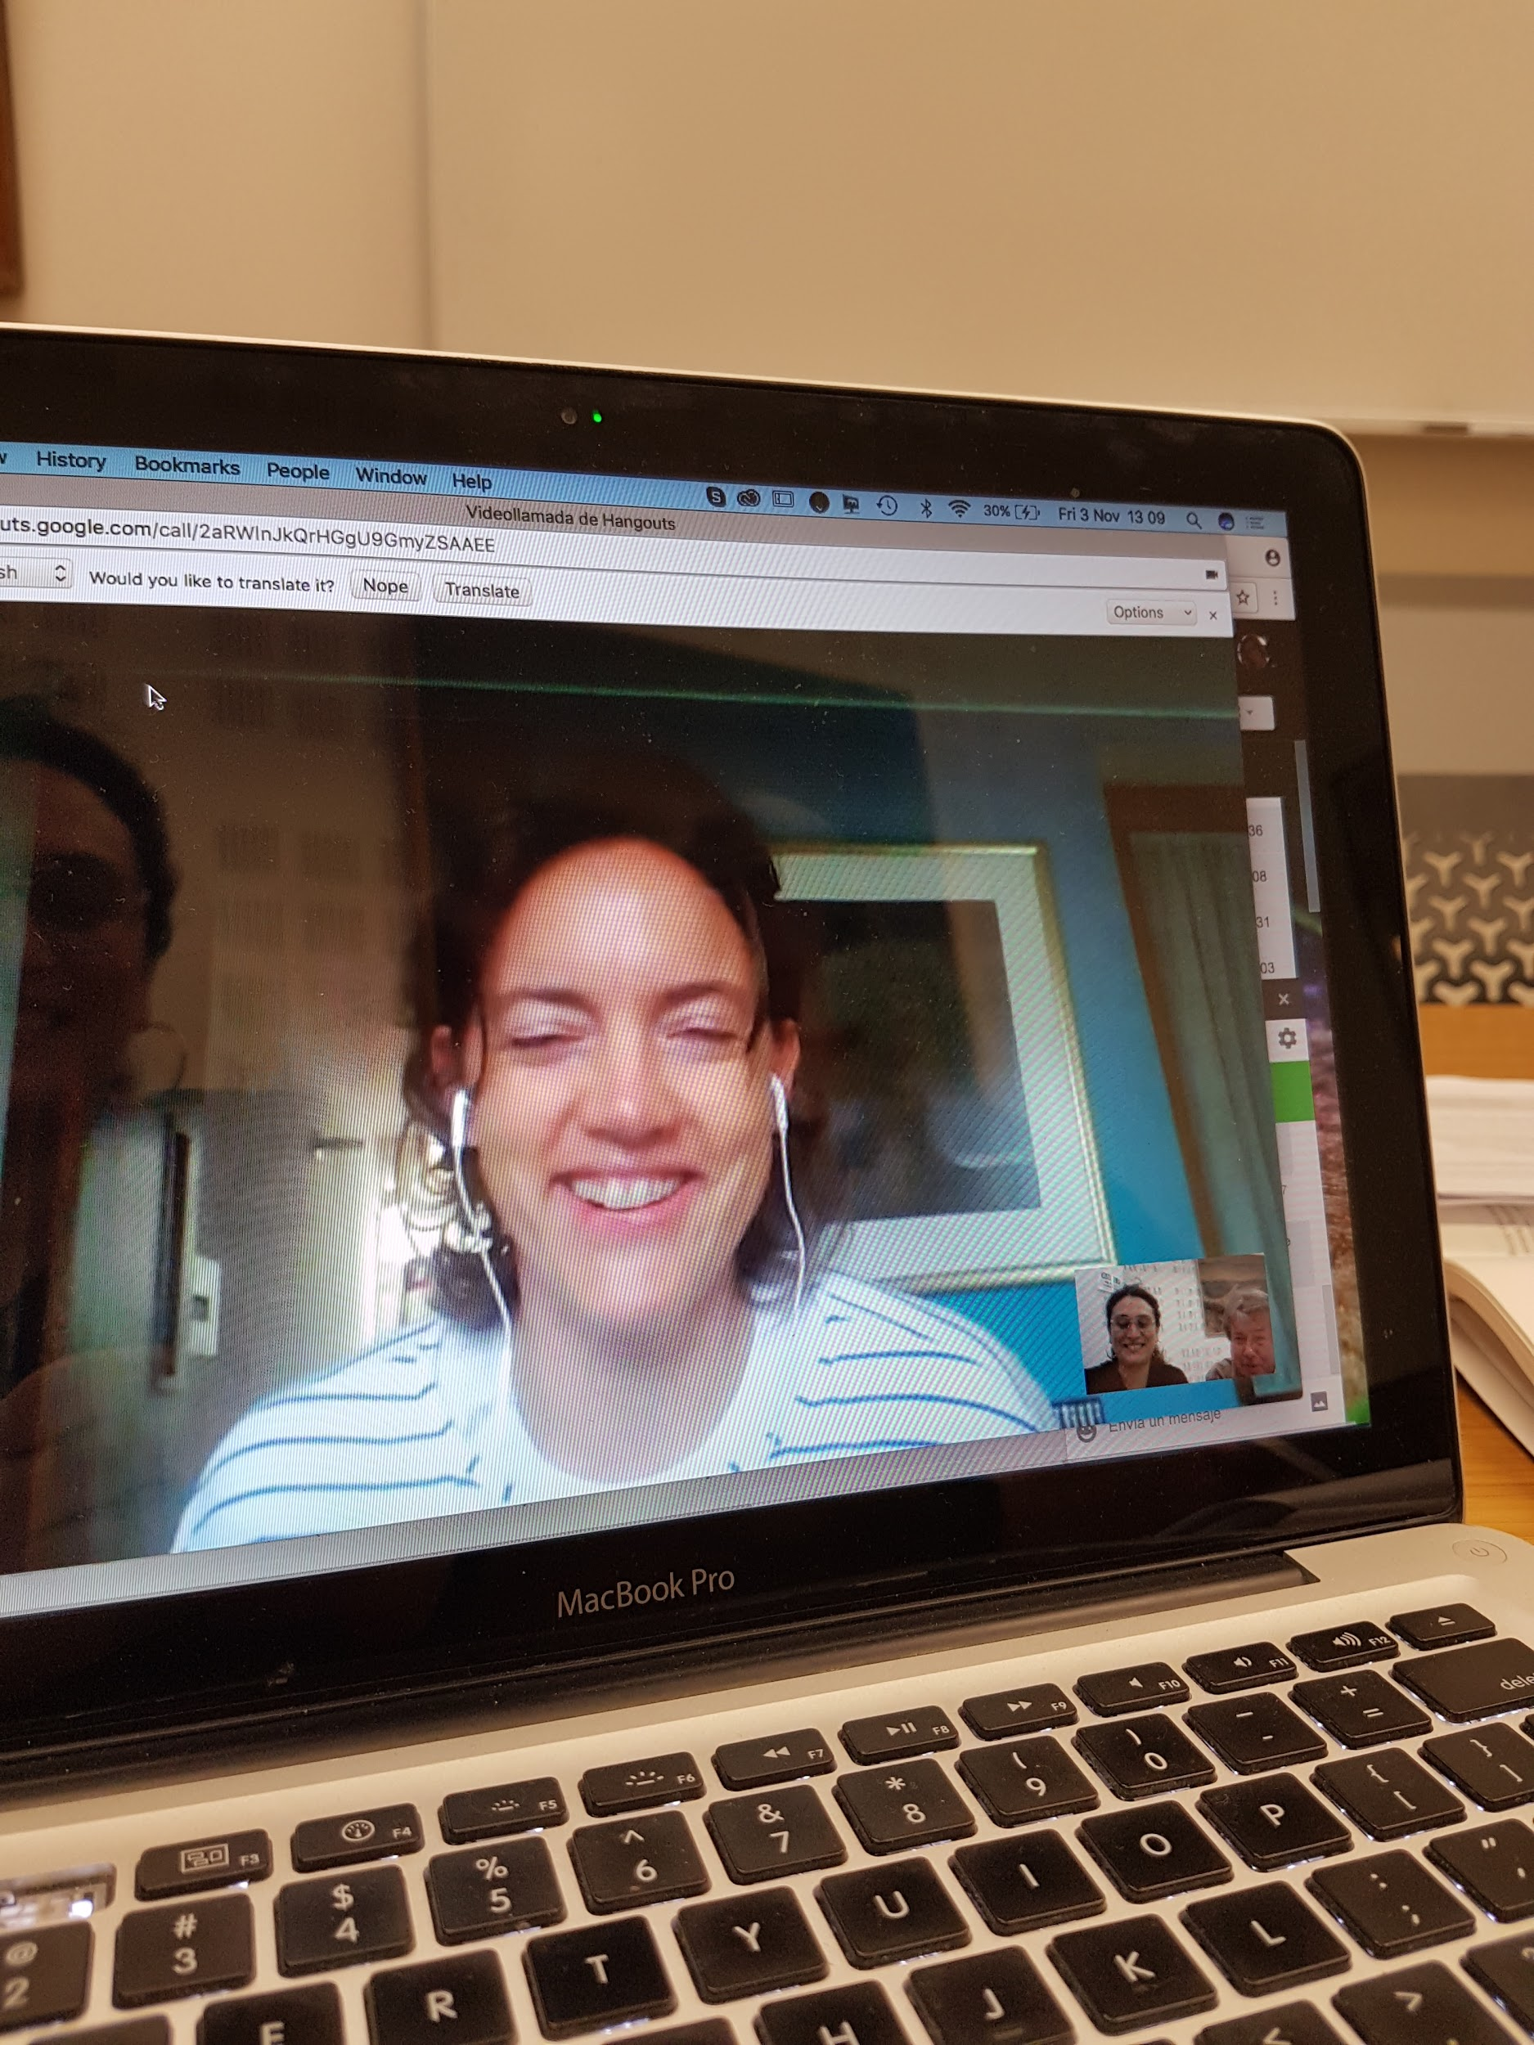
Our MANY meetings…
@SuzetteFlantua
@catalhina11

Slide 11
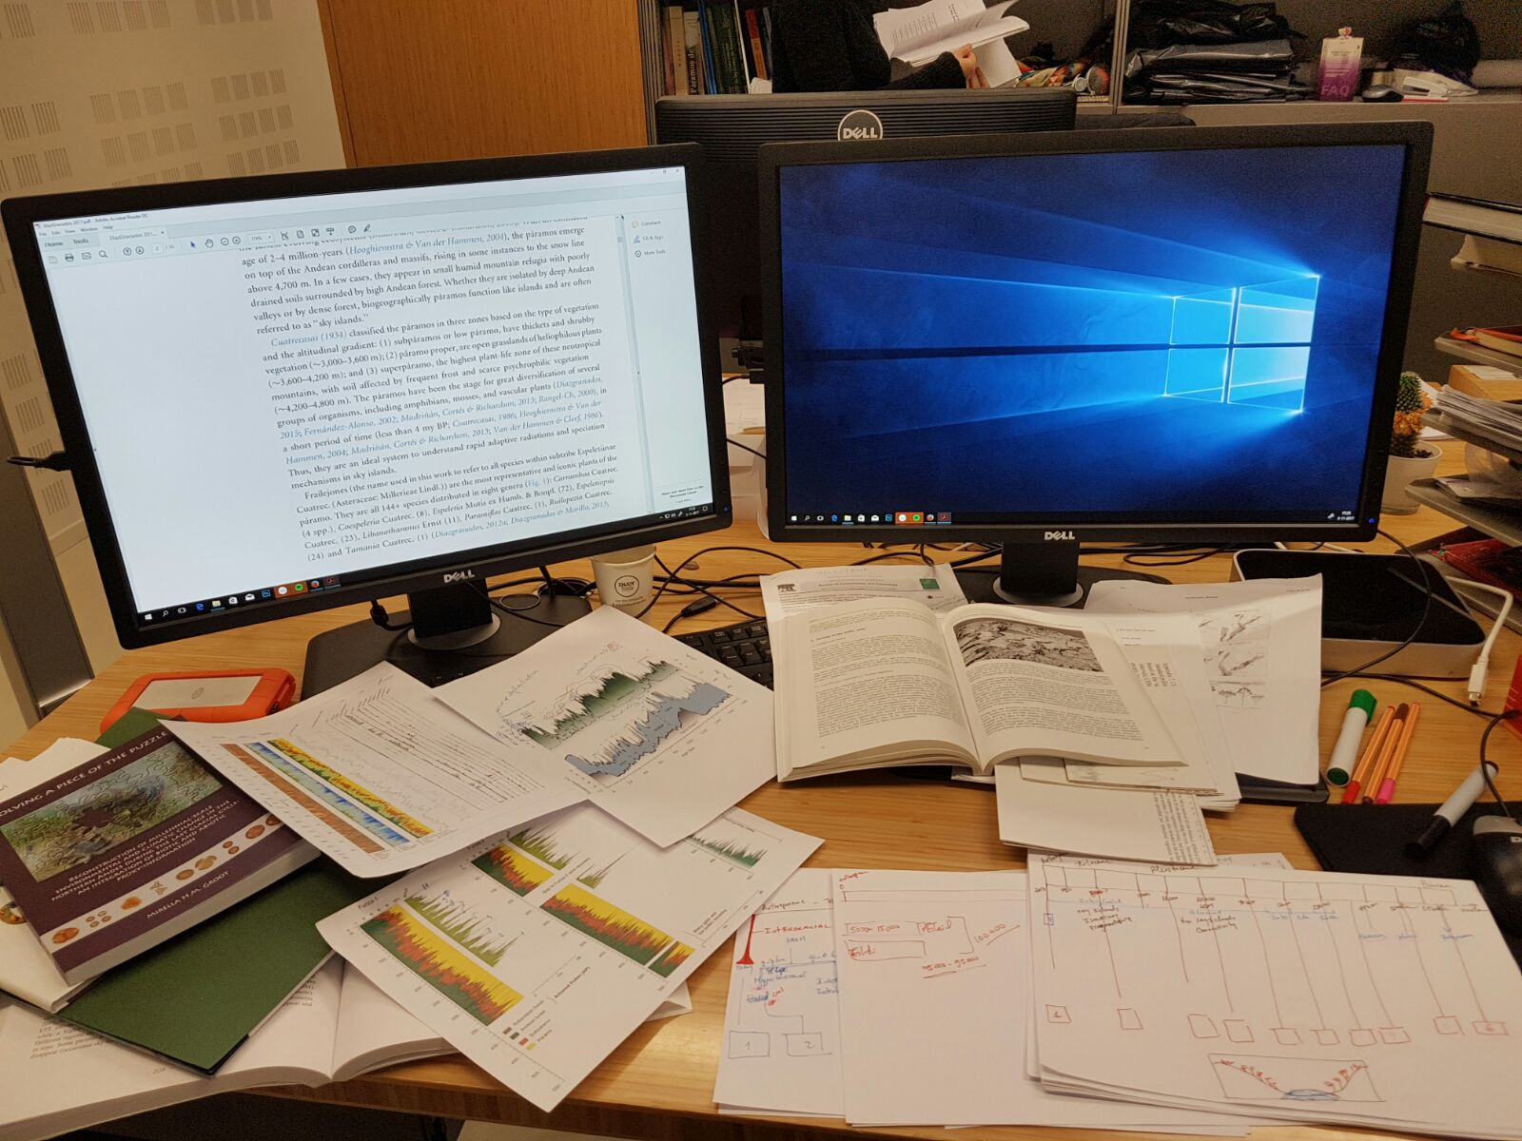
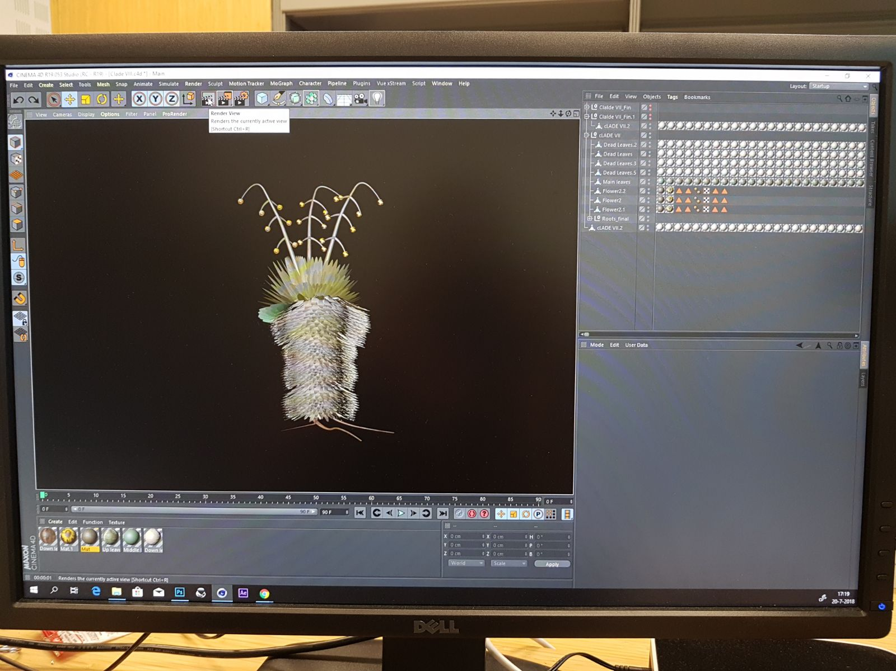
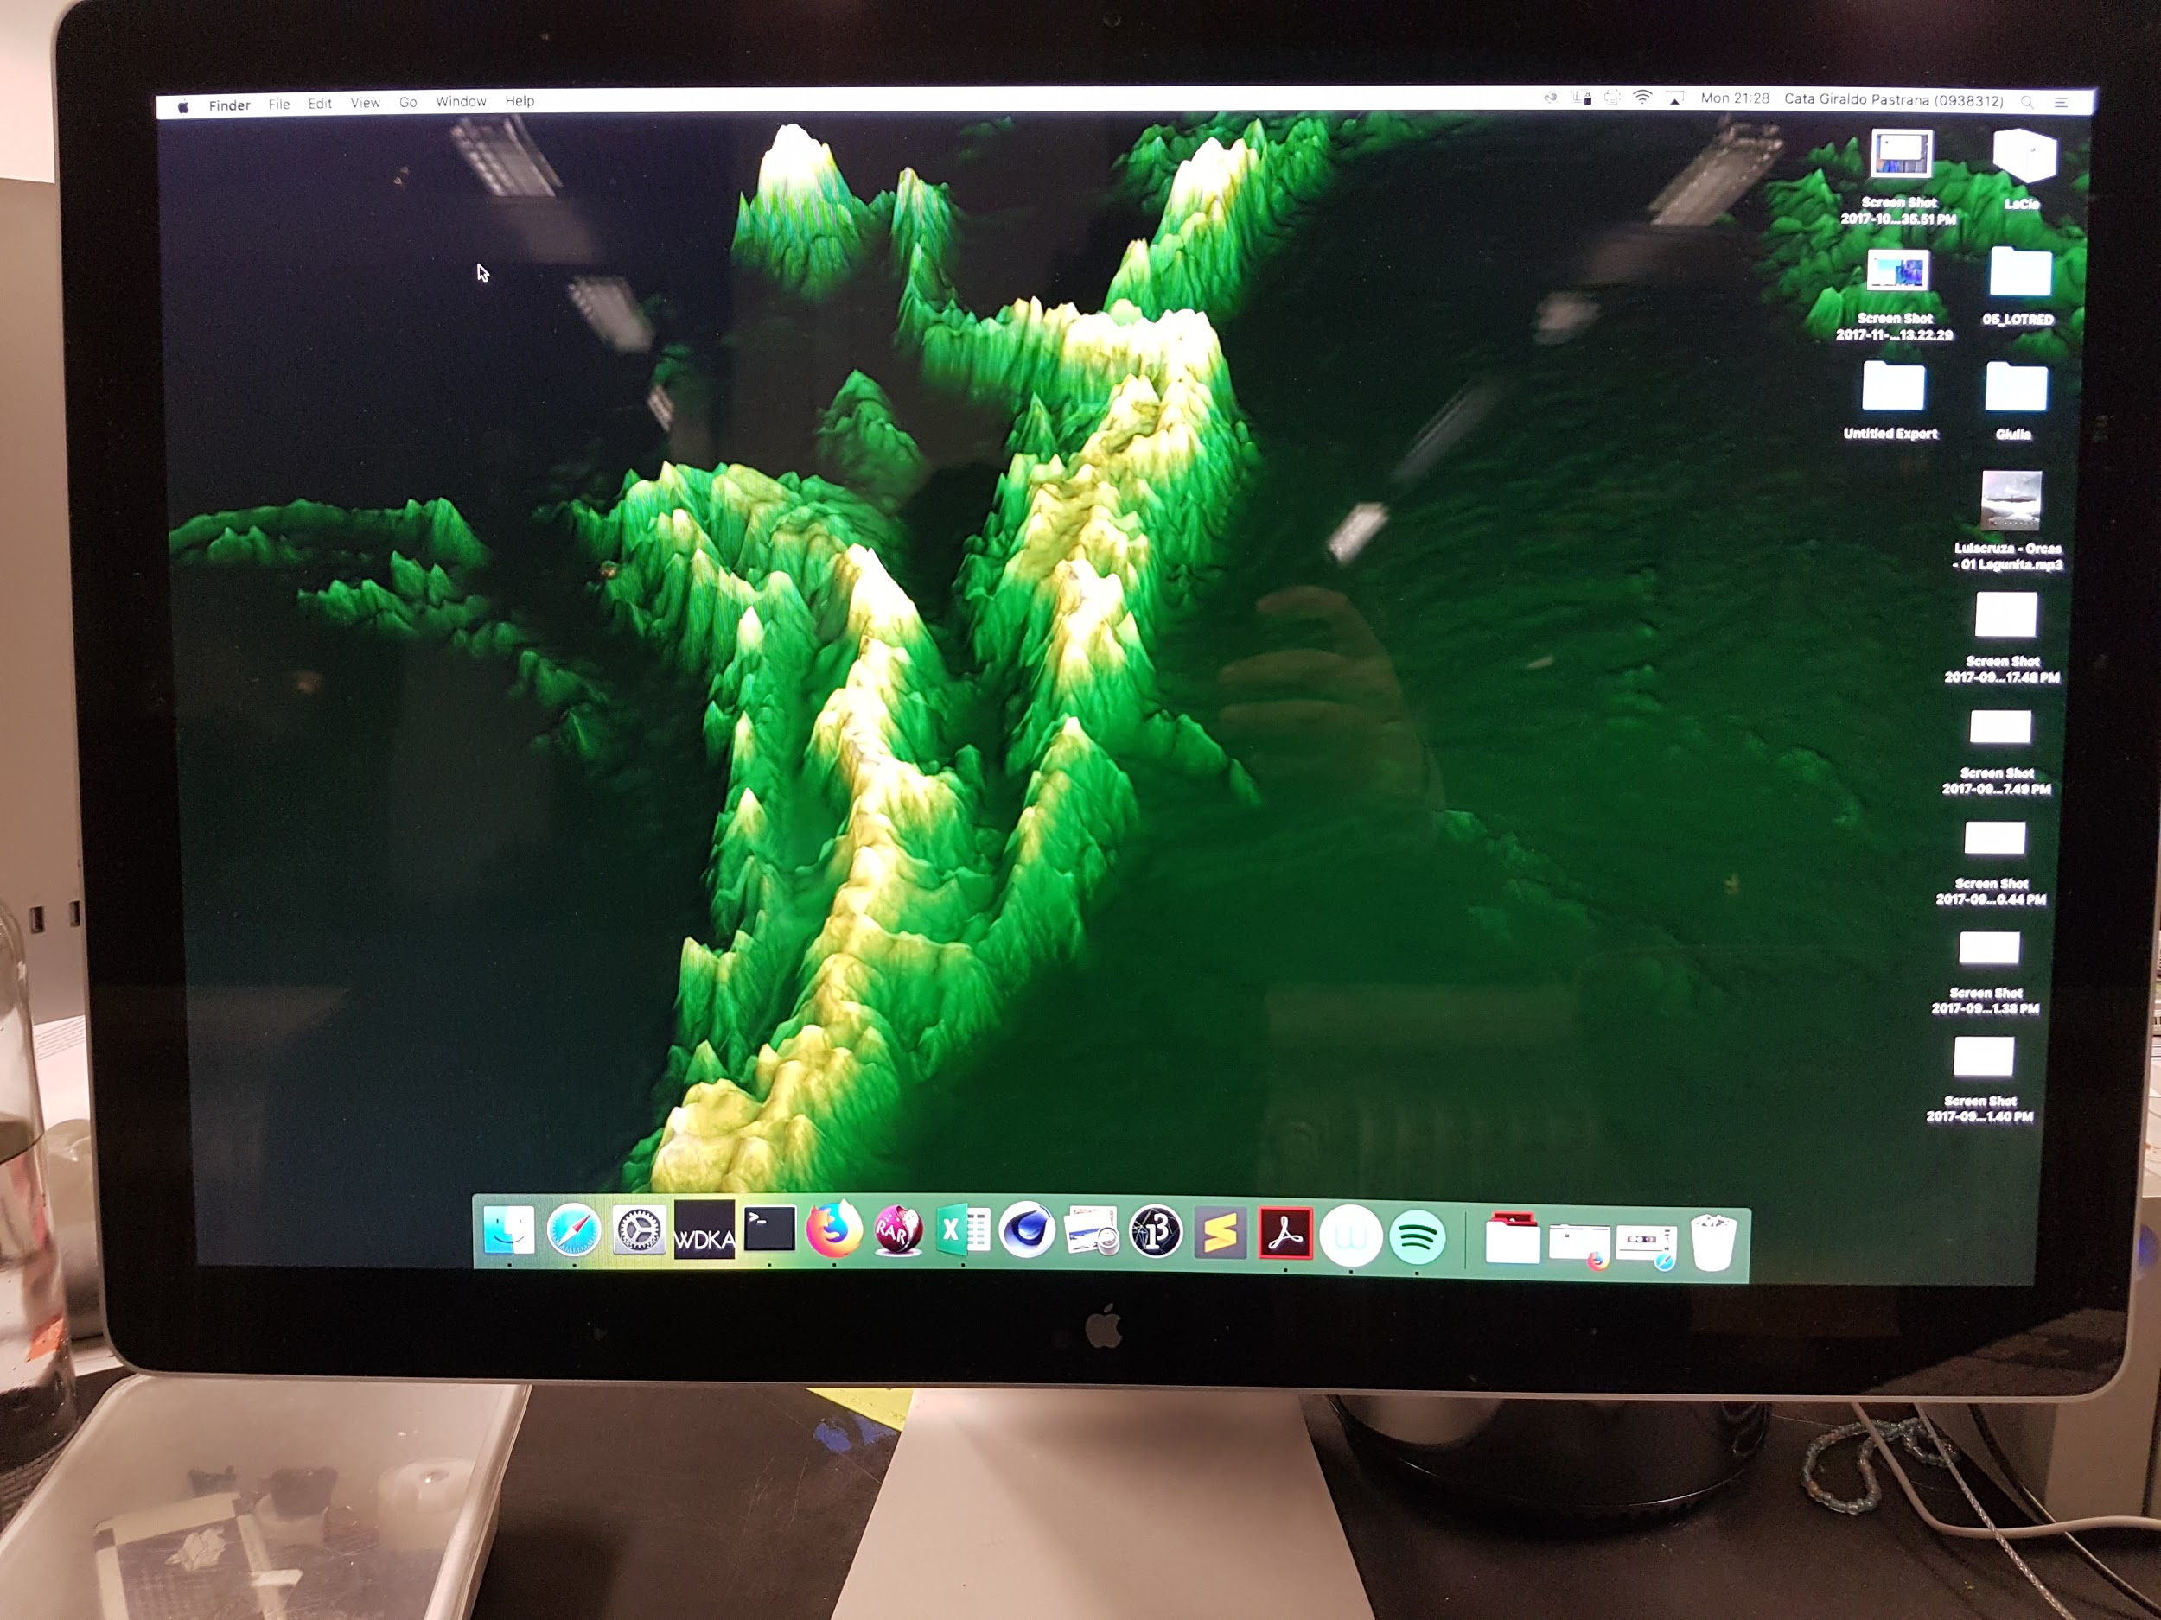
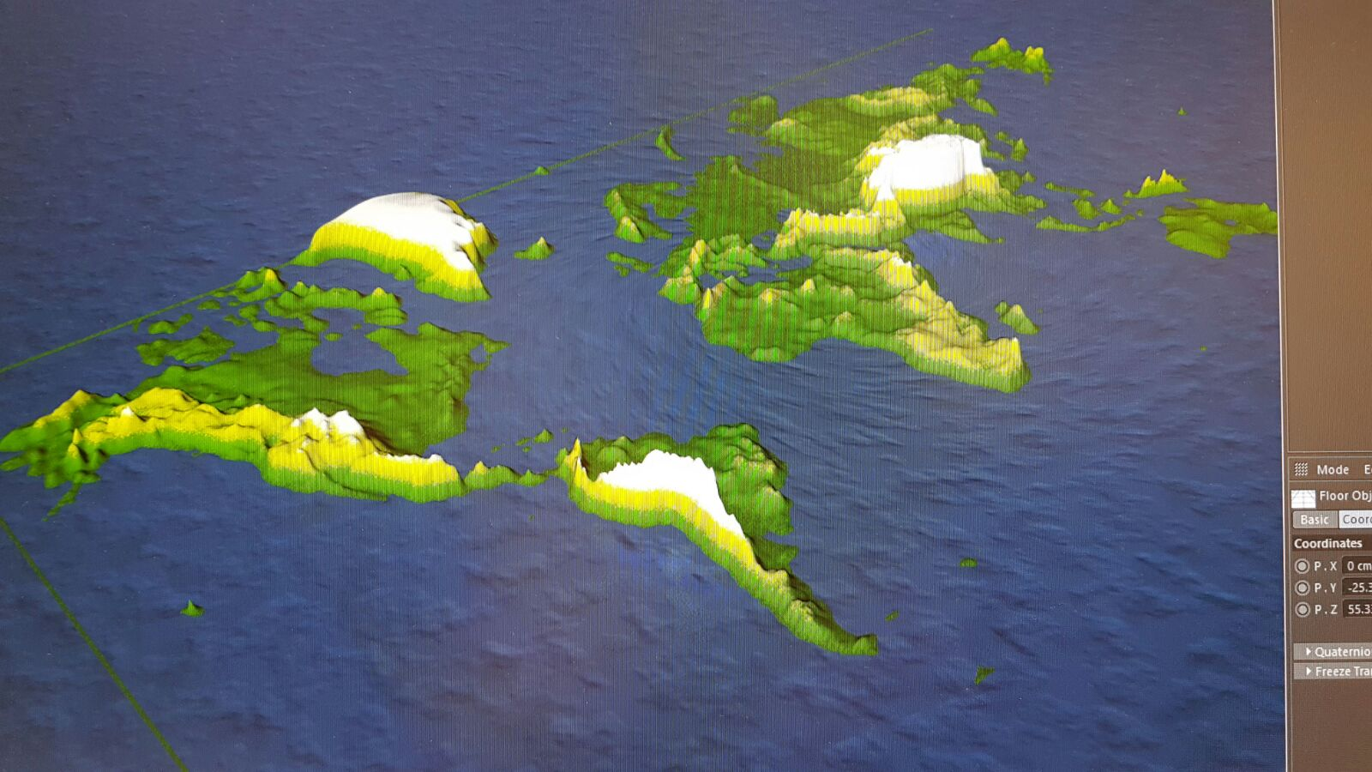
A lot of drafting and reading…
@SuzetteFlantua
@catalhina11

Slide 12
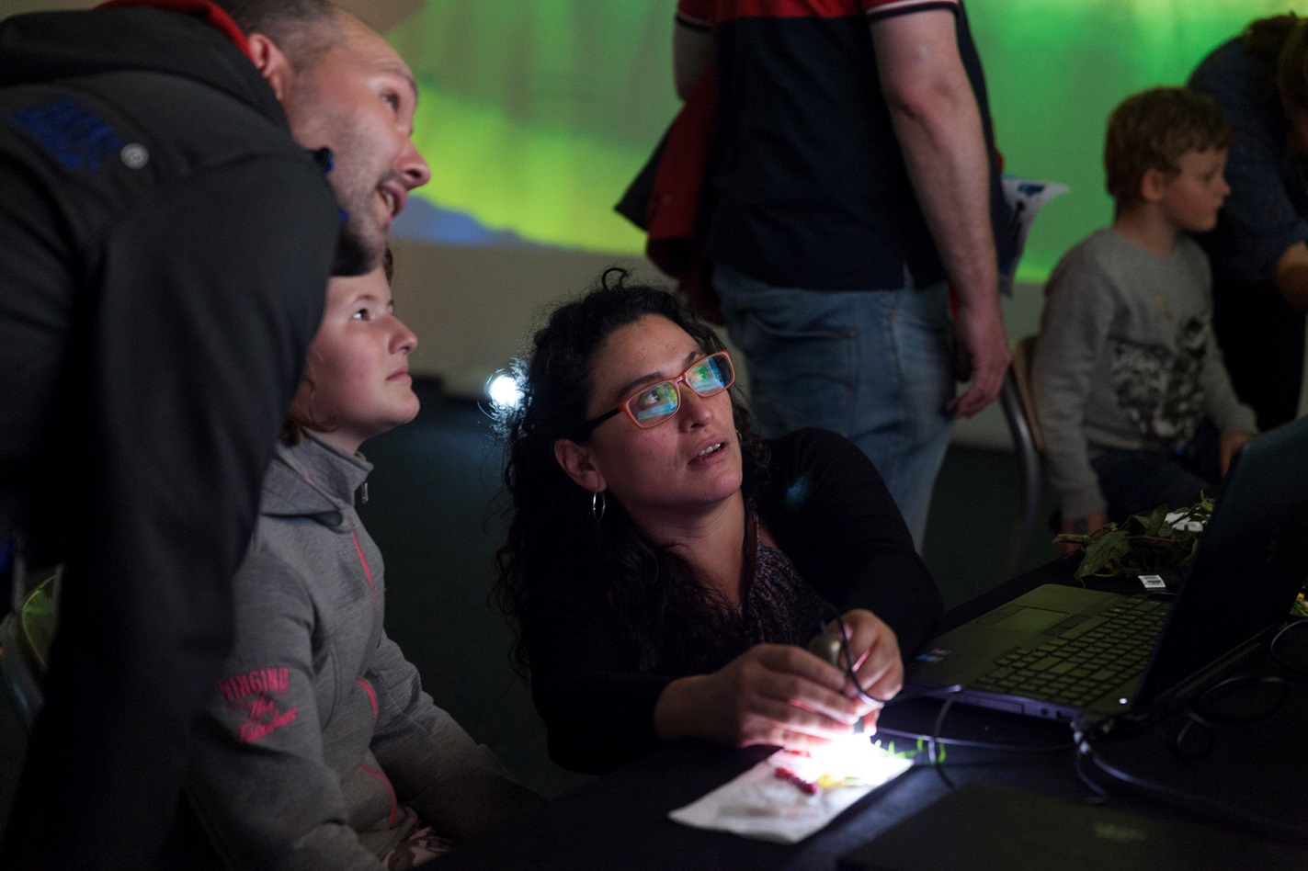
University of Amsterdam
Open Day
@SuzetteFlantua
@catalhina11
Oct-2018

Slide 13
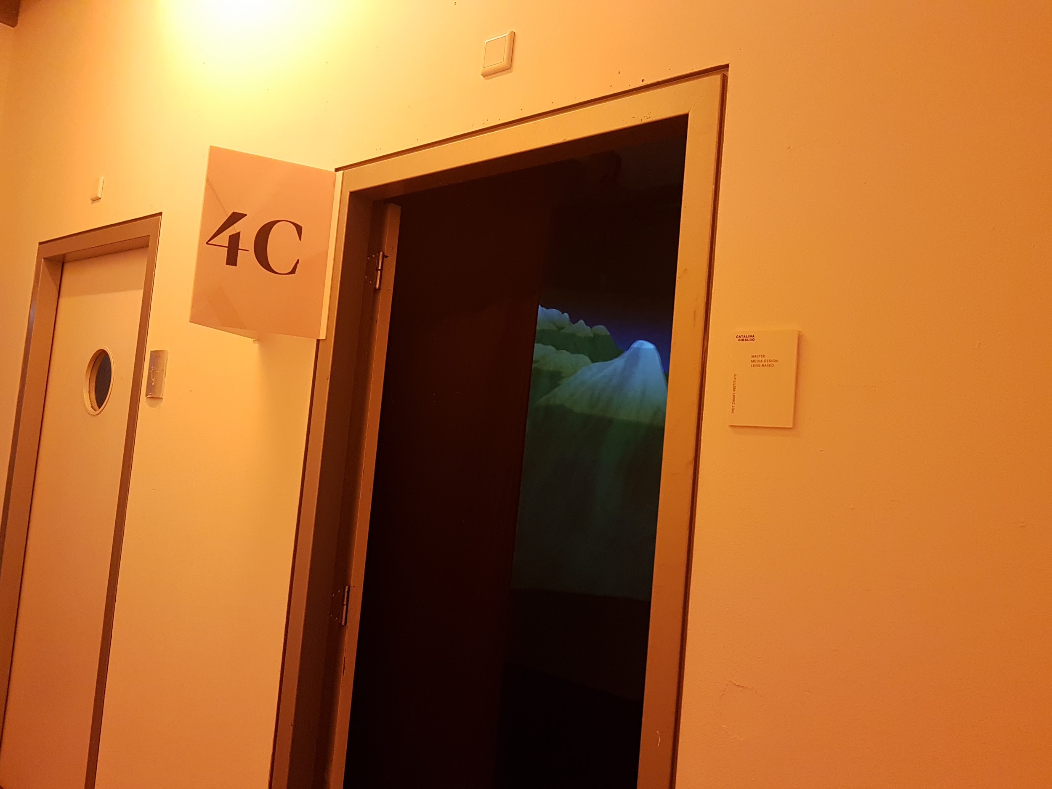
VIDEO- INSTALLATION
180 DEGREES SCREEN
PIET ZWART INSTITUTE- WILLEM DE KOONING ACADEMY,
JULY 2018

Slide 14
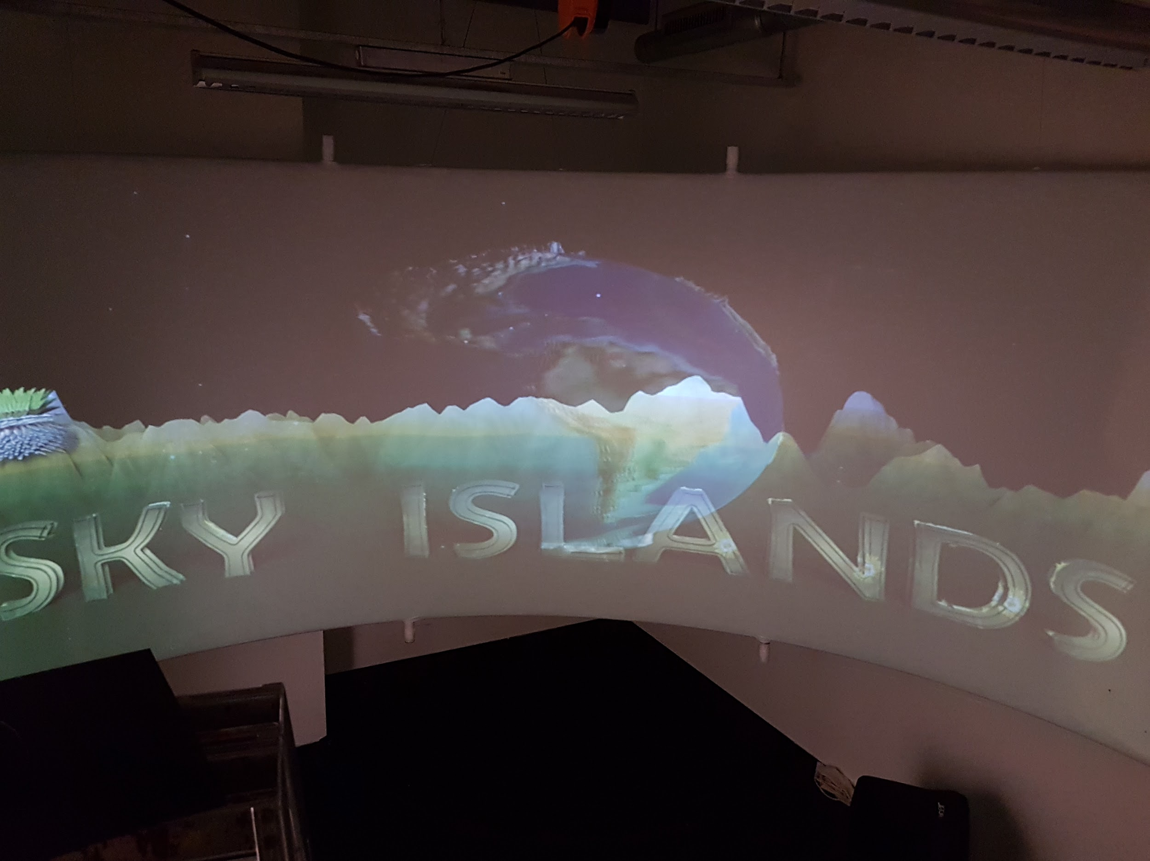
@SuzetteFlantua
@catalhina11

Slide 15
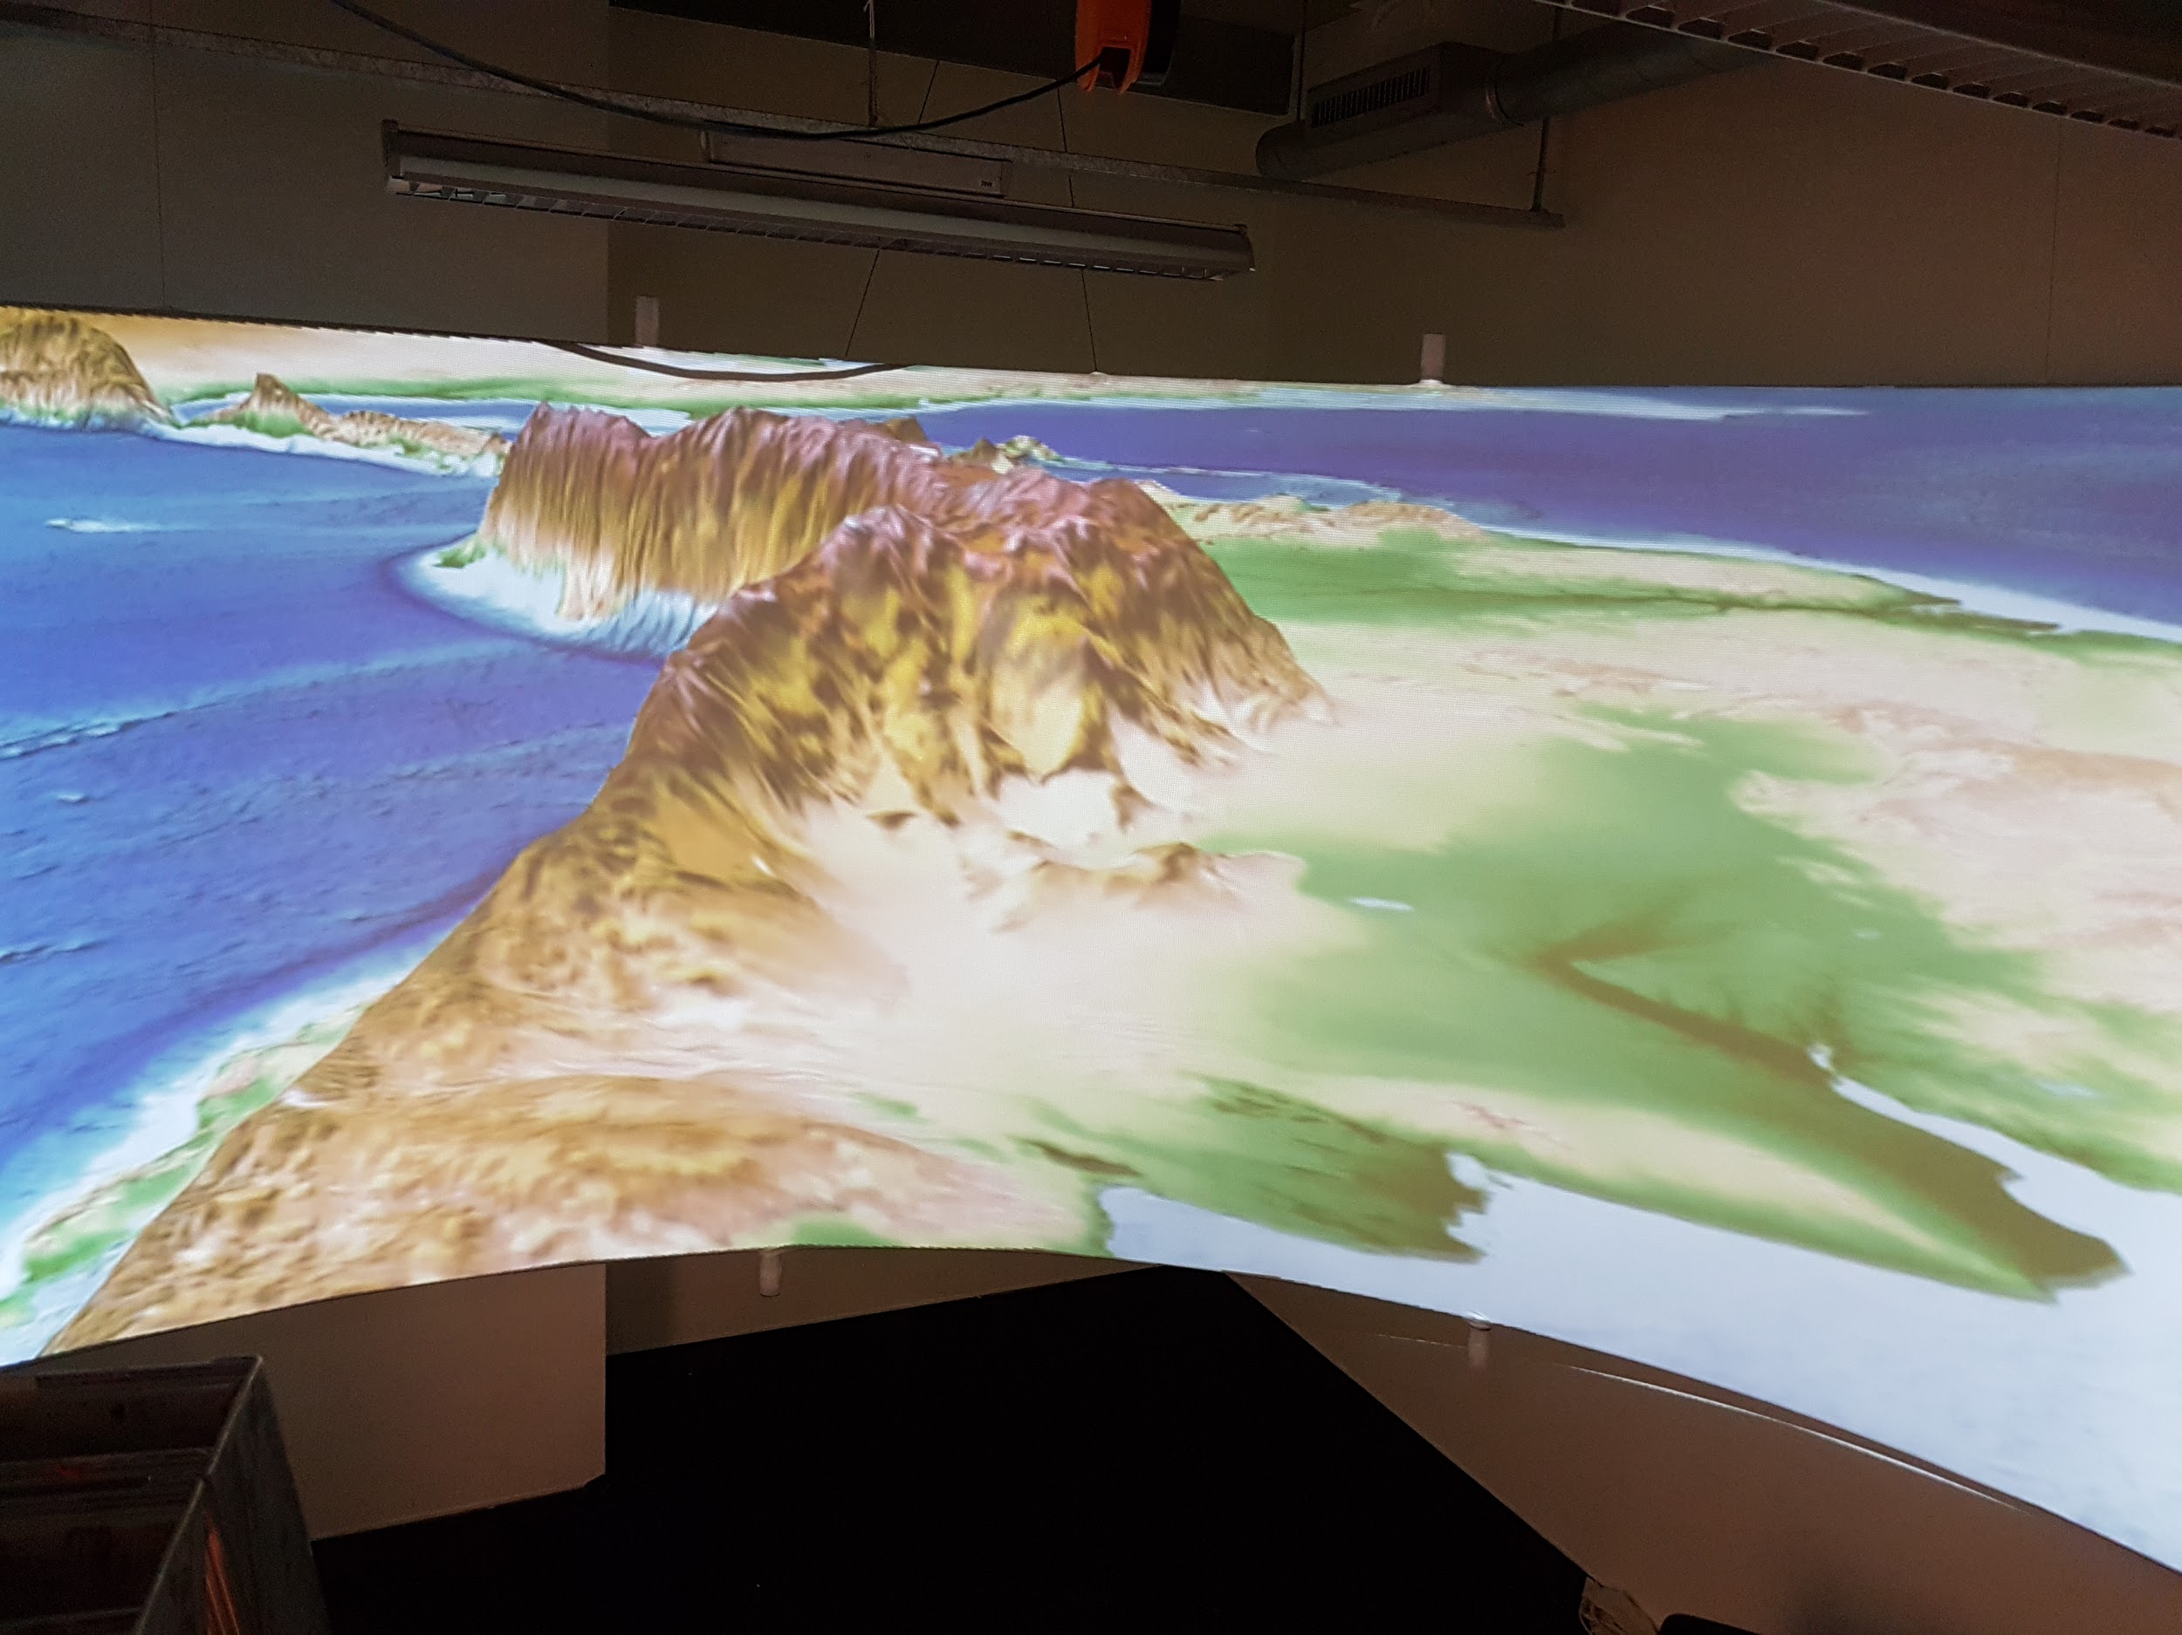
@SuzetteFlantua
@catalhina11

Slide 16
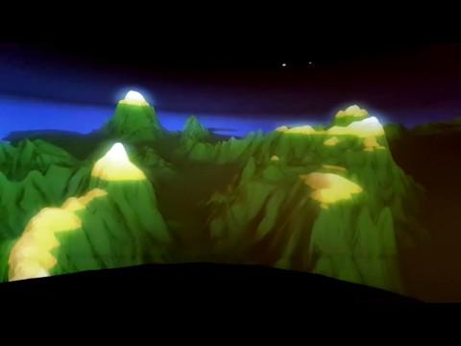
@SuzetteFlantua
@catalhina11

Slide 17
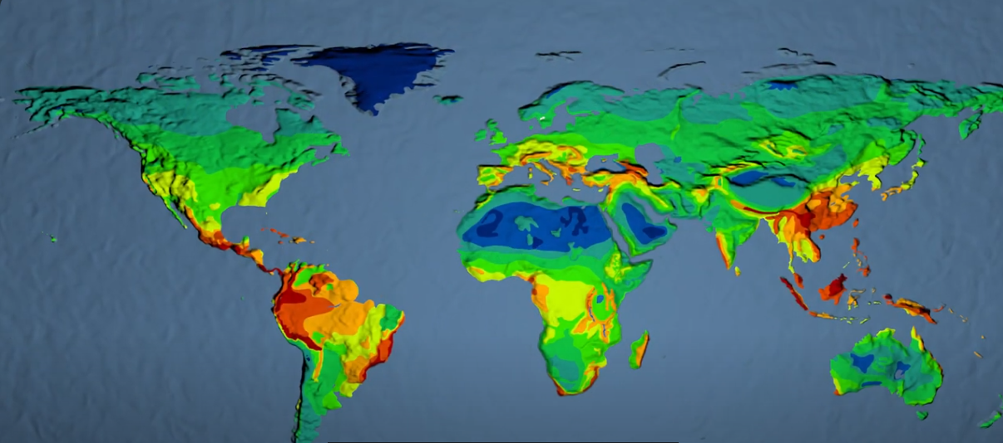
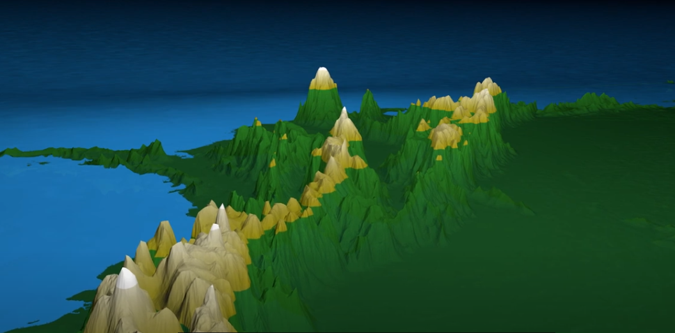
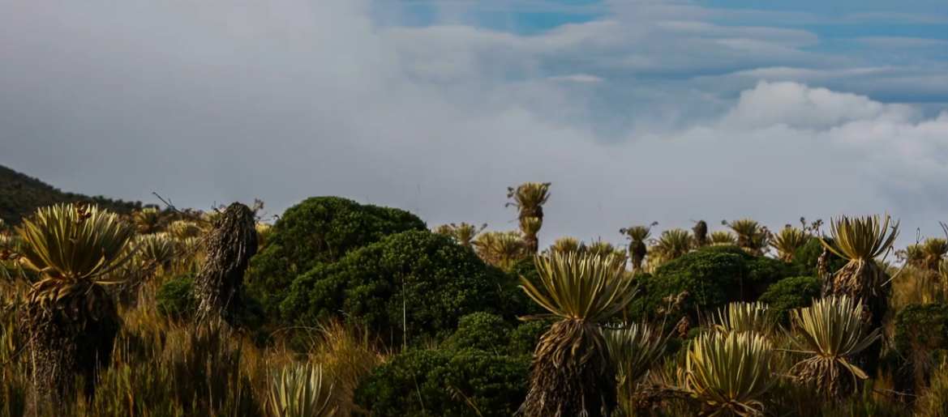
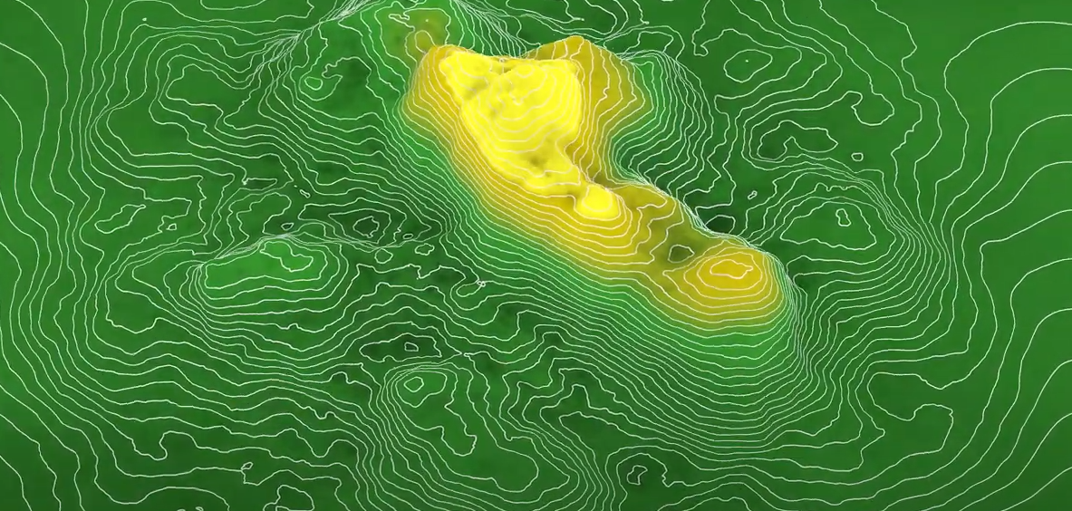
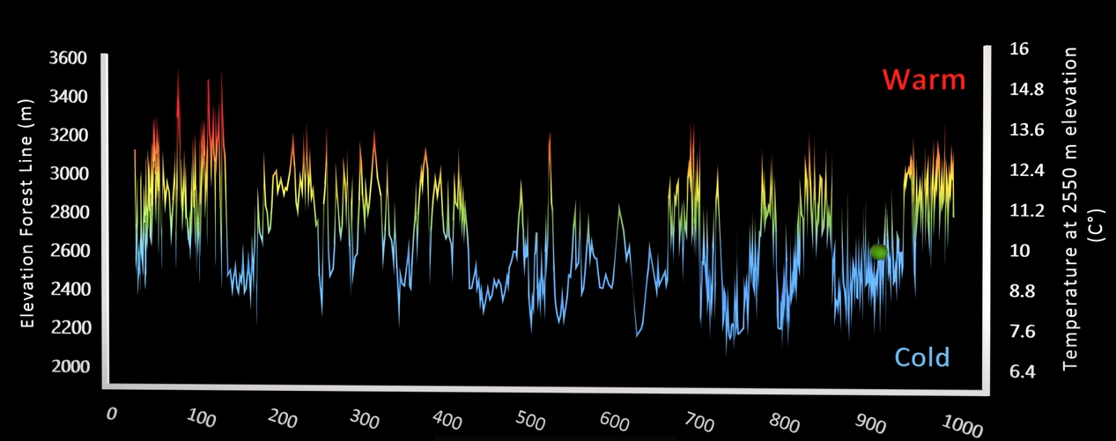
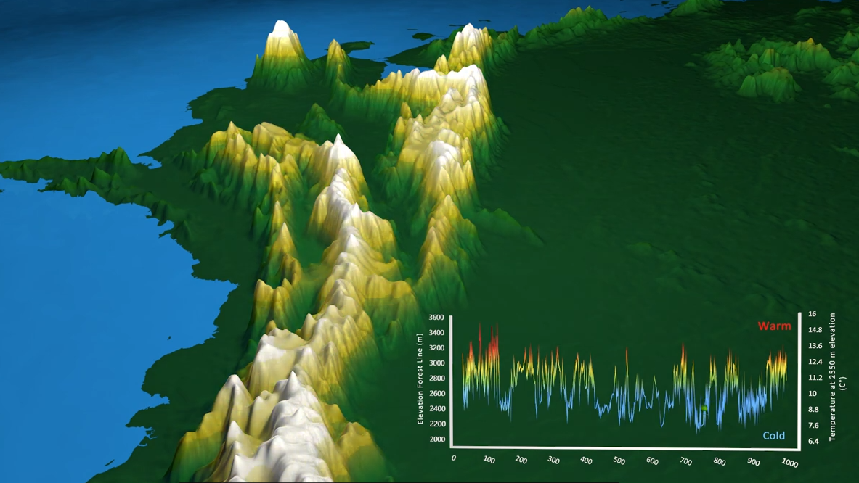
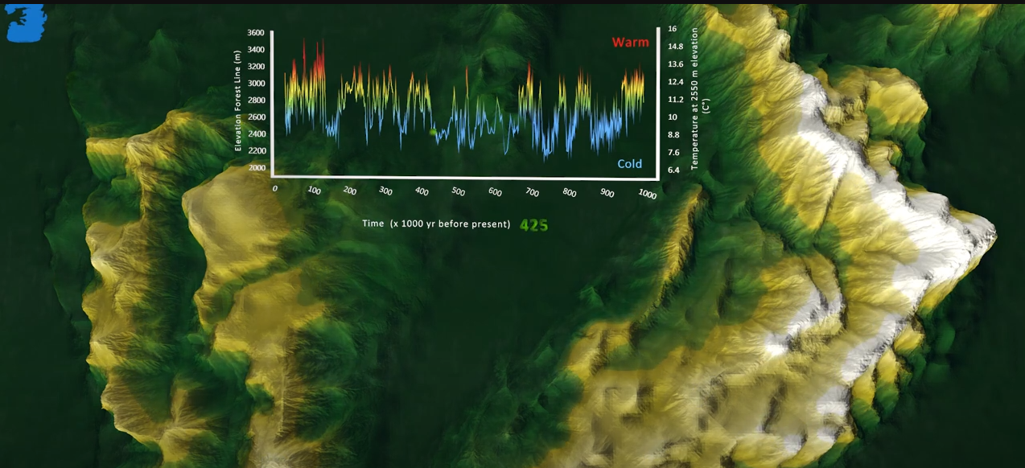
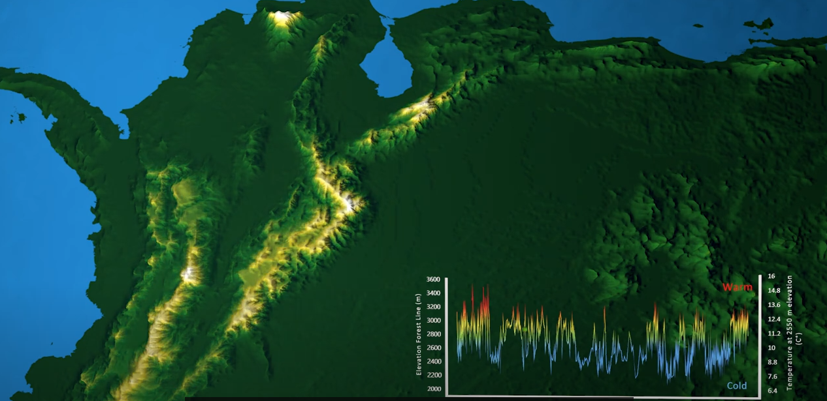
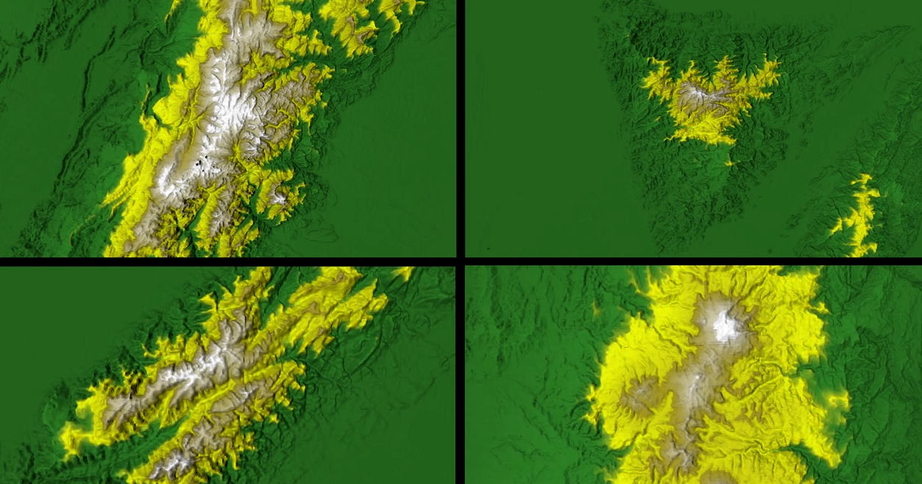
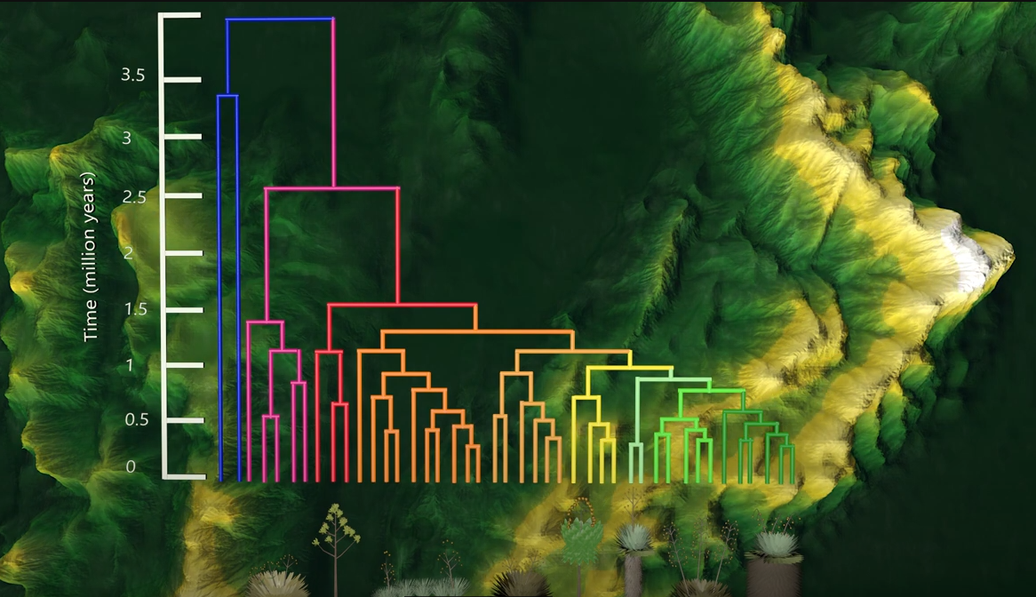
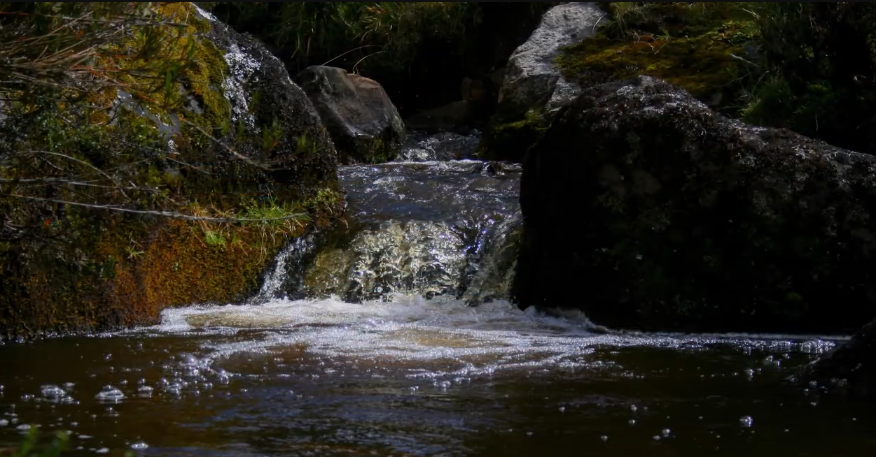
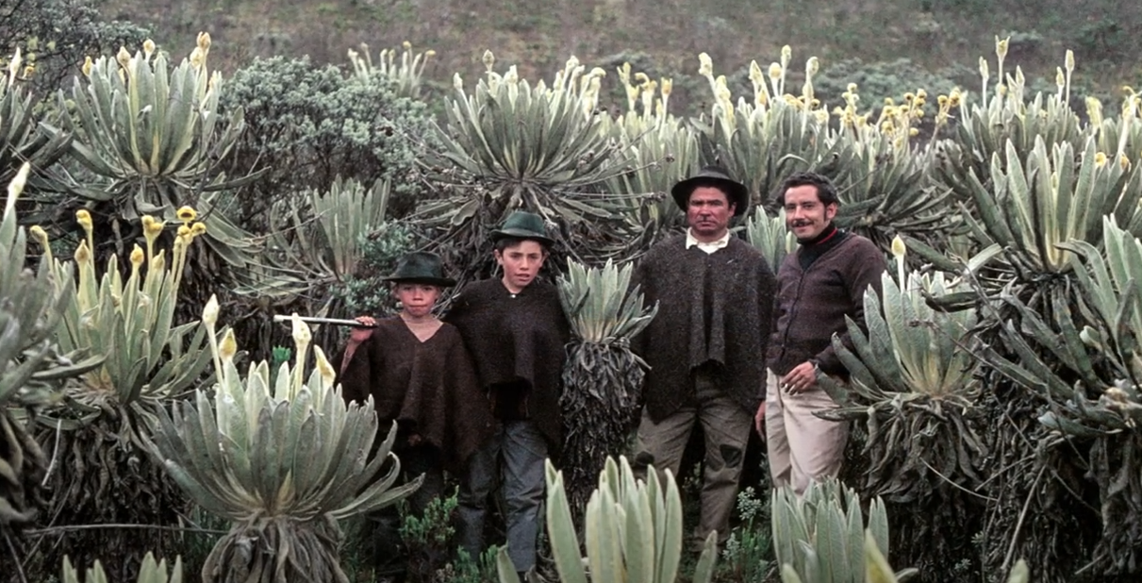

Slide 18

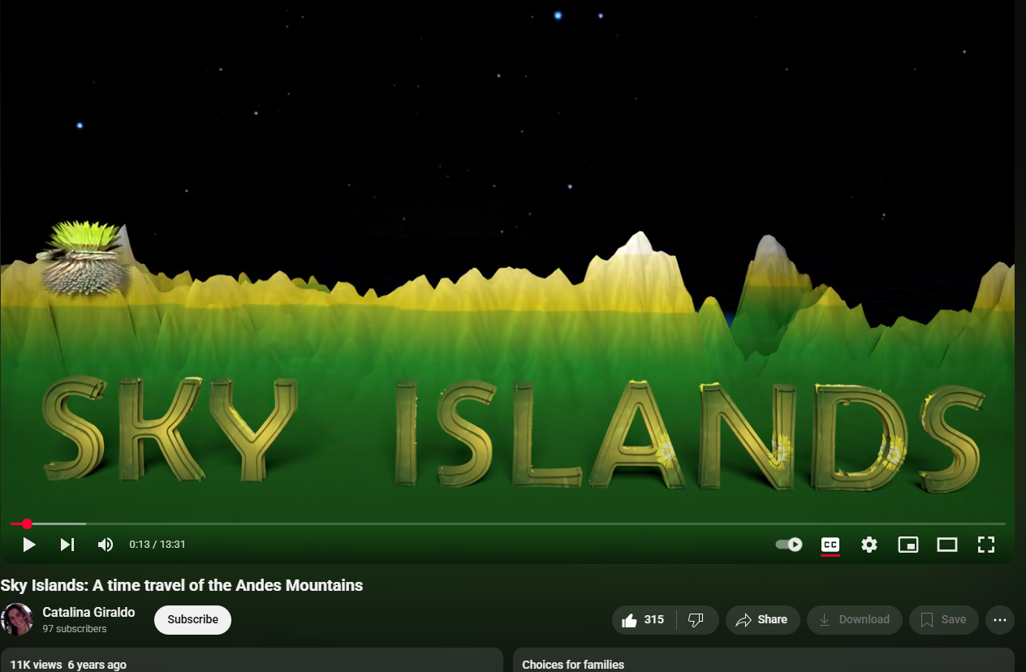

Slide 19







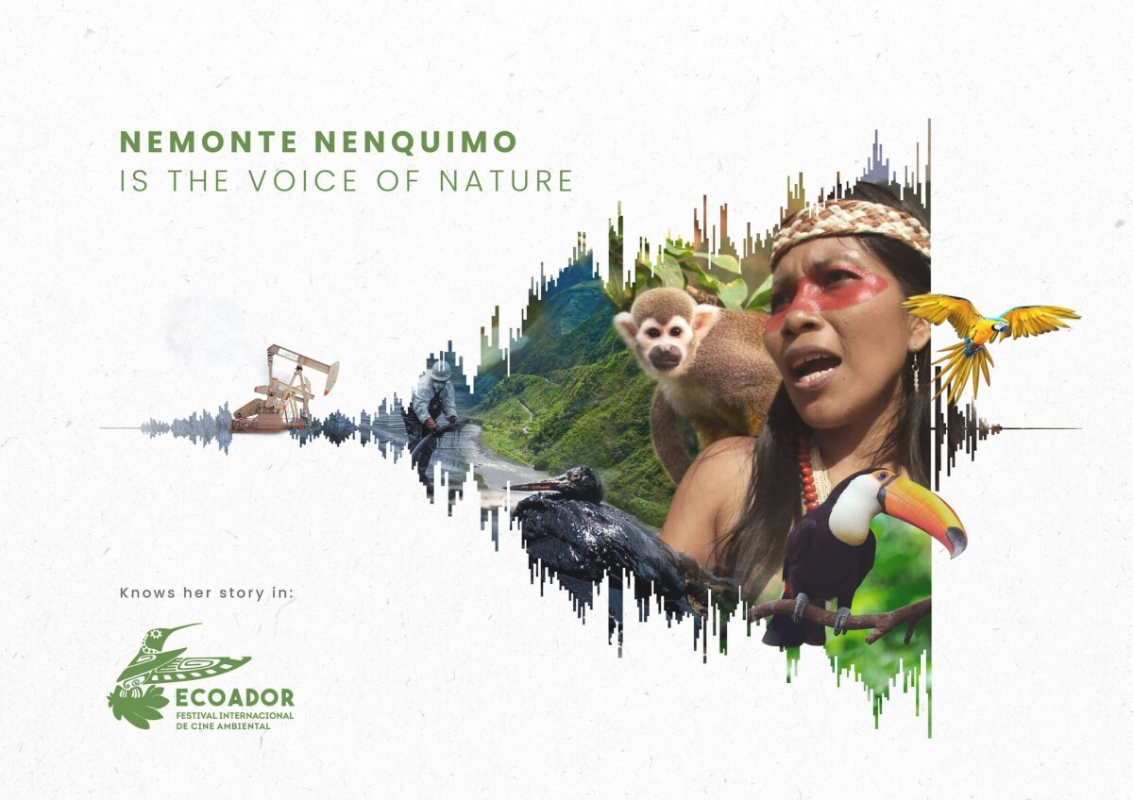









Then the pandemic hit….
So we applied to all the relevant
environmental film festivals we could find….

Slide 20
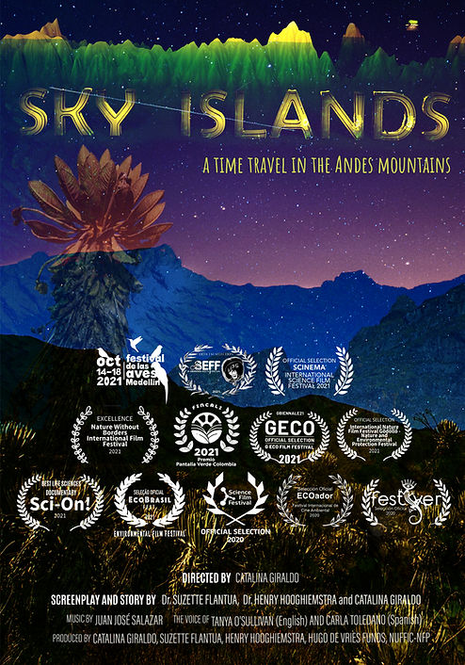

Official Selection in the 13 film festivals and 17 countries
Colombia, Ecuador, Brazil, United States, Croatia, Hungary, Angola, Burkina Faso, Ethiopia, Kenya, Namibia, Rwanda, South Africa, Malaysia, Philippines, Australia, and India
Winner of awards in
different categories
Original music
English & Spanish version

Slide 21

https://youtu.be/-Wcp18vBDK4?t=337

Slide 22

A 3D visualization of the elevational dance of the Andean high mountain biome in the Pleistocene arena
Suzette Flantua, Catalina Giraldo, Henry Hooghiemstra
@catalhina11
@SuzetteFlantua

