Slide 1
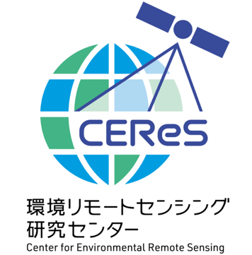
2025/04/30
EGU2025, EGU25-18265
A hyper-temporal monitoring of terrestrial GPP and ET across Asia-Oceania using third generation geostationary satellites, Himawari-8/9 (Supplemental File)
Kazuhito Ichii, Y. Yamamoto, B. Zhang, W. Li, S. Sumii
Center for Environmental Remote Sensing (CEReS)
Chiba University, Japan

Slide 2
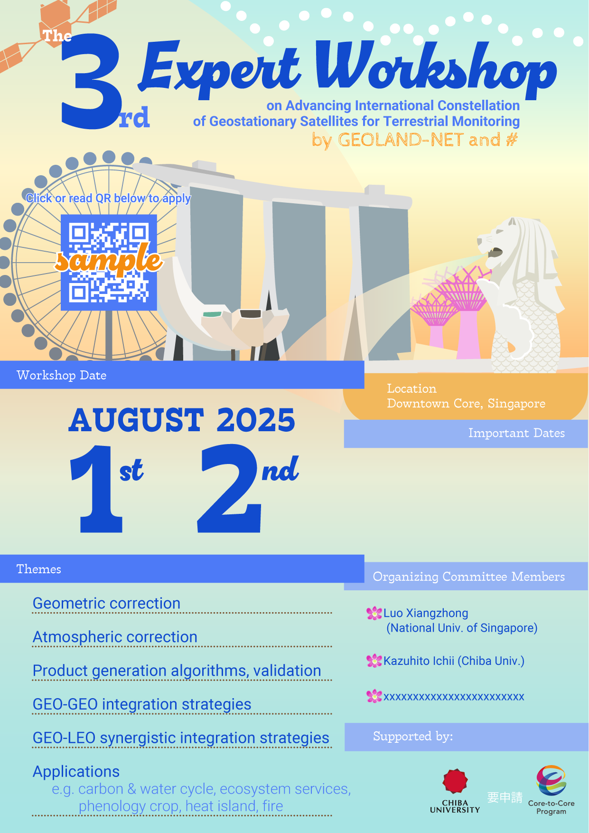
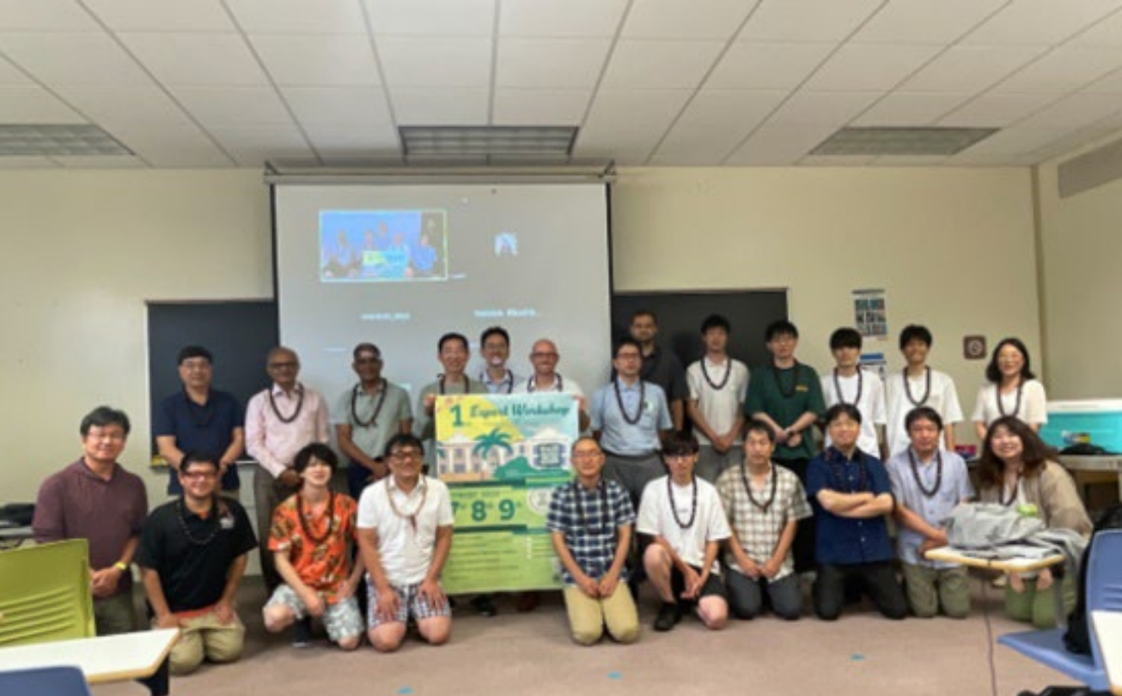
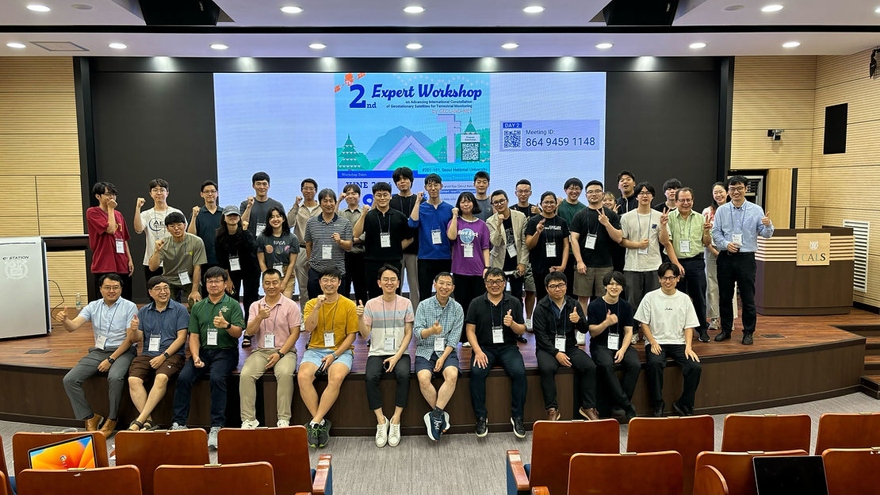
3rd GEO Workshop in Aug 1-2, Singapore
3rd GEO Workshop (Singapore)
1st GEO Workshop (Univ Hawaii)
2nd GEO Workshop (Seoul Natl Univ)
Organized by:
Xiangzhong (Remi) Luo
National Univ of Singapore
Kazuhito Ichii
Chiba University
Contact; Ichii@chiba-u.jp

Slide 3
Toward Global-scale Hyper-temporal Land Monitoring
https://ceres.chiba-u.jp/geoland/

Slide 4
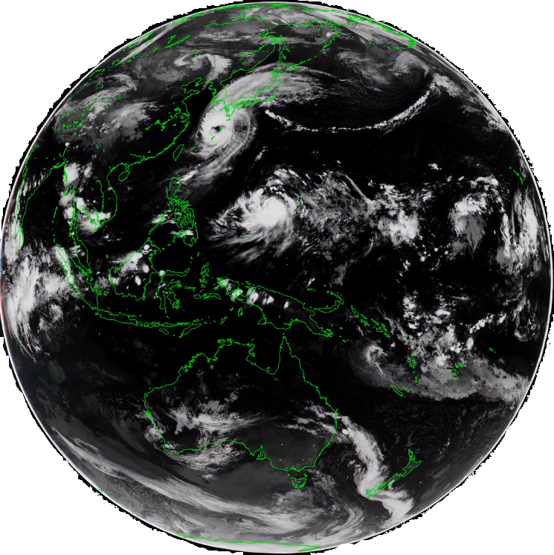
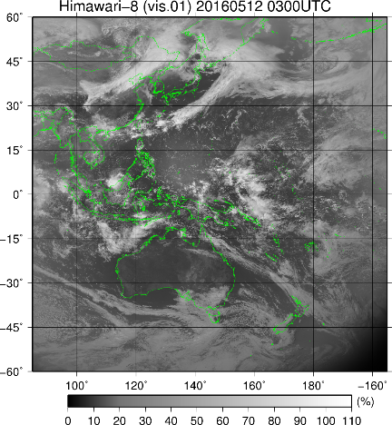
Himawari-8/9 Data Processing
JMA to CEReS/ChibaUniv
CEReS/CU data -> Products
CEReS
(lon-lat)
Org Data
(Full-disk)
Calibration
Info (JMA)
L-1
Geometric Correction
Atmospheric
Correction
Cloud Detection
Land Surface Temp Retrieval
[Li et al. 2025]
[Zhang et al. 2025]
✓
✓
✓
JMA, (NICT)
(Full-disk)
Surface
Reflectance
Cloud Mask
LST
Implement
Higuchi
Takenaka
L-2
[Yamamoto et al. 2018]
[Yamamoto et al. 2018, 22]
CEReS Geo-Corr
+ Reprojection
[Takenaka et al. 2020]
[Yamamoto et al. 2020]
BRDF
Correction
Datasets Available:
https://ichiilab.weebly.com/
datasets.html
✓
Evaluate
Yamamoto
✓
Surface
Reflectance
(BRDF)
CEReS
(lon-lat)
[Li et al. in prep]
L-3
Further Processing
TOA Reflectance
TOA Brightness Temperature
✓
✓
✓
✓
Albedo
Solar
Rad.
GPP, ET
FPAR
LAI
Fire
ftp://hmwr829gr.cr.chiba-u.ac.jp/
gridded/FD/V20190123/
[GPP: Yamamoto et al. in review]
[ET: Zhang et al. in prep]

Slide 5
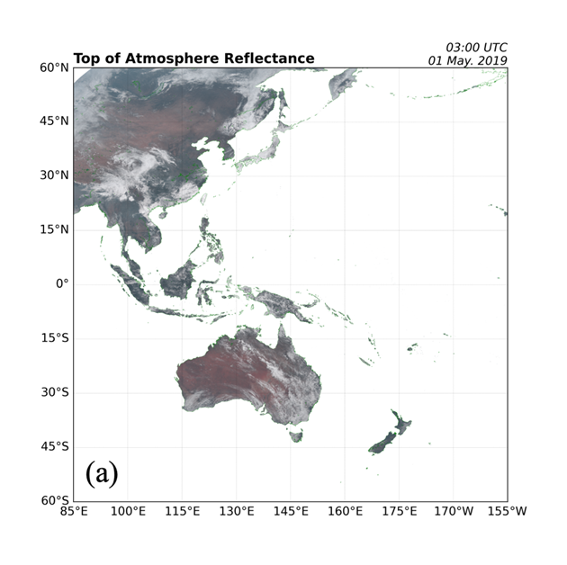
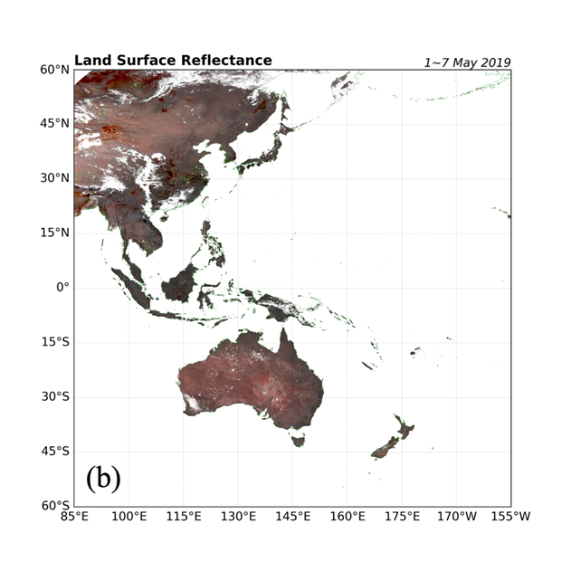
Land Surface Reflectance
Atm Corr
Our system (open software) is flexible to apply other GEO sensors.
[Li et al. 2025; JMSJ, Zhang et al. 2025; RSE]

