Slide 1
This research (PHDF-19-559) has been supported by Shota Rustaveli National Science Foundation of Georgia (SRNSFG)
Geophysical Analysis of Soil Properties for Engineering-Geological Studies and Urban Planning
Dimitri Akubardia
INSTITUTE OF EARTH SCIENCES AND NATIONAL SEISMIC MONITORING CENTRE _ ILIA STATE UNIVERSITY

Slide 2
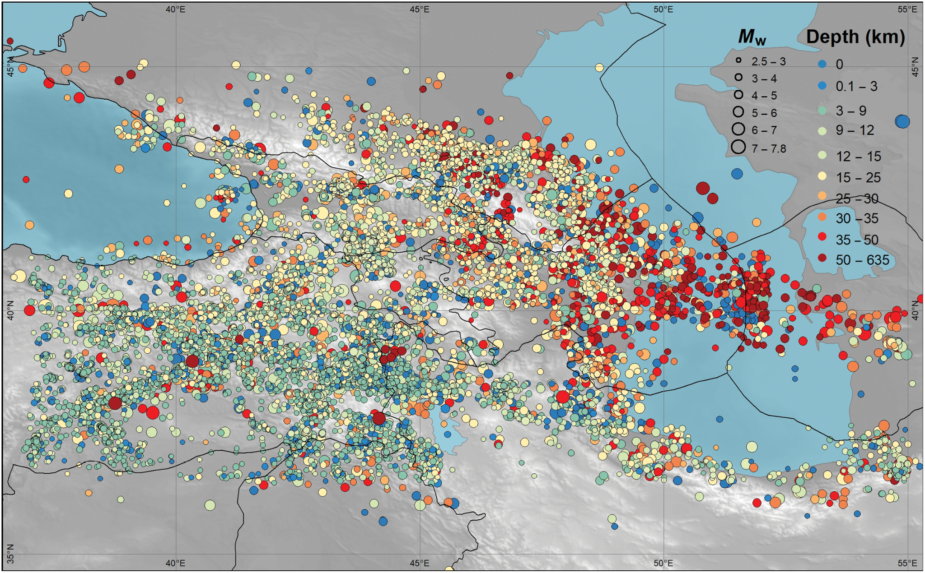
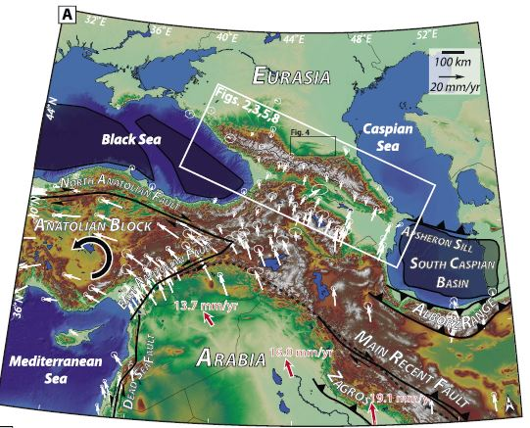
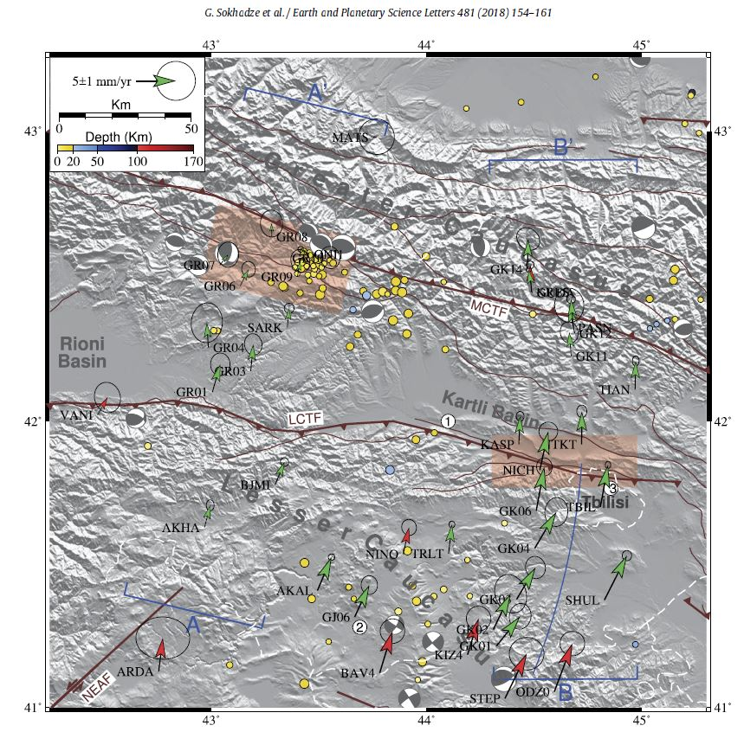
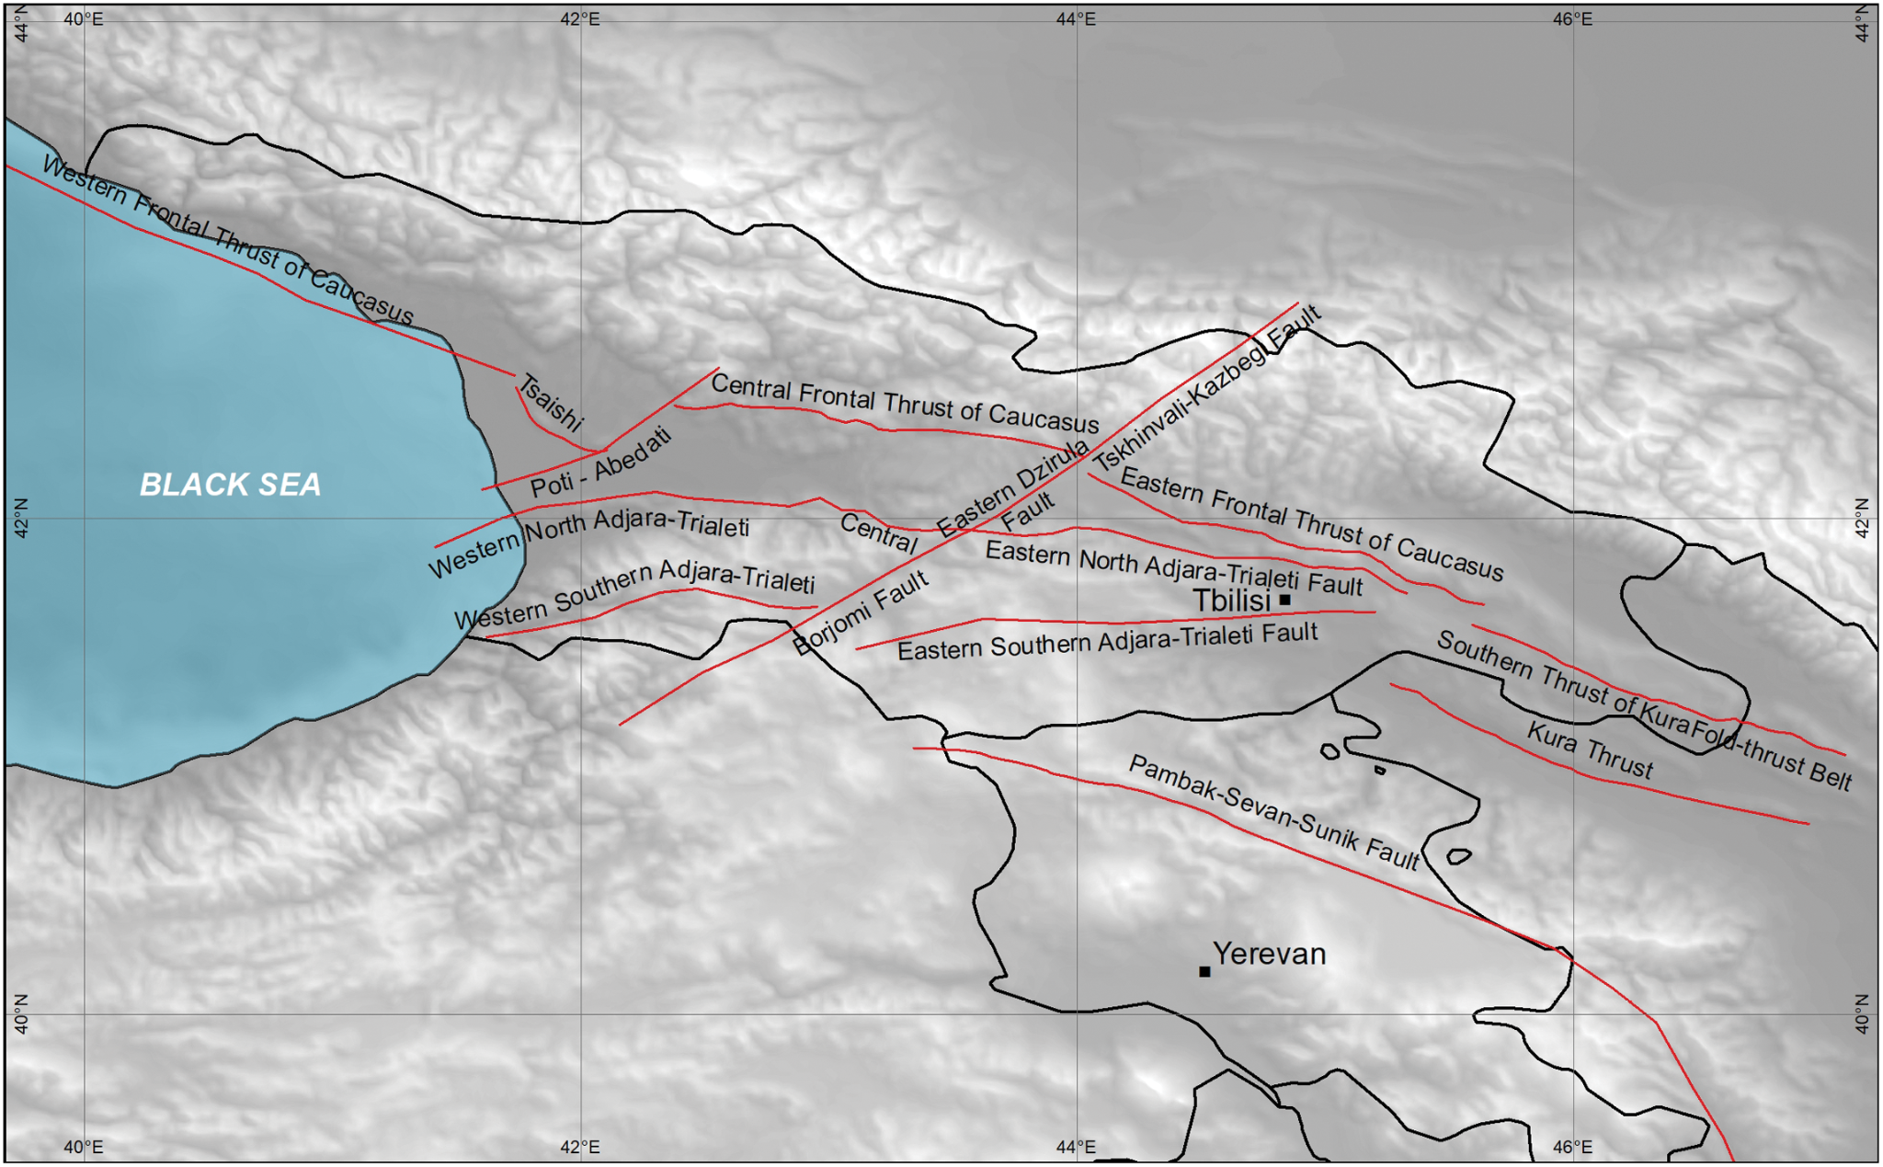
Regional Tectonics
Seismicity
GPS Velocities
(Onur et al, 2020)
(Sokhadze et al, 2018)
TBILISI
(Onur et al, 2020)
(Forte et al, 2014)

Slide 3
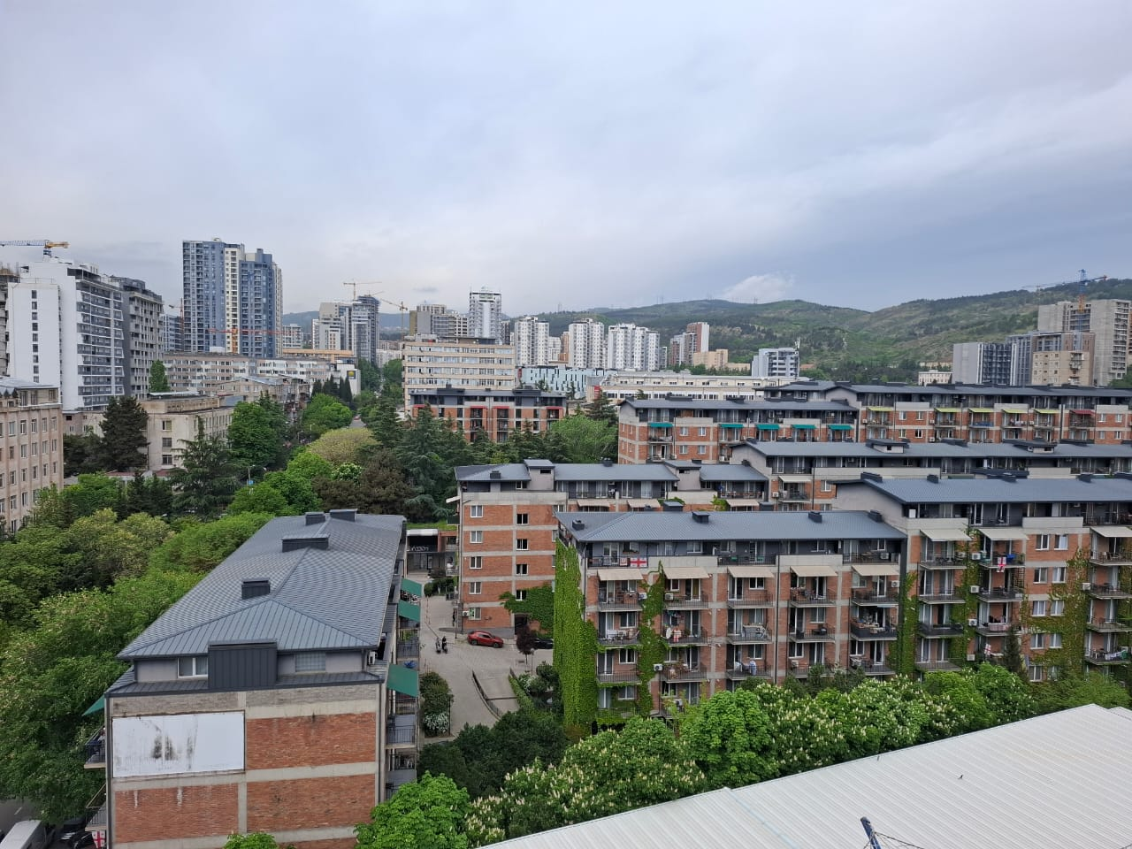
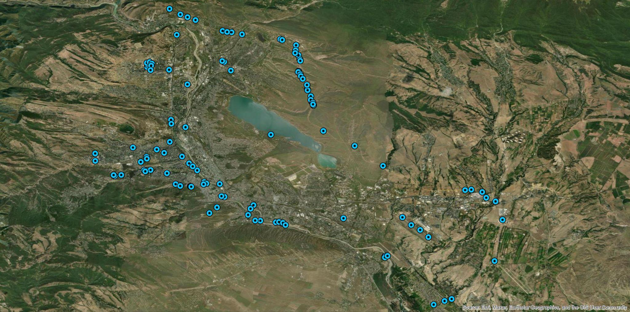
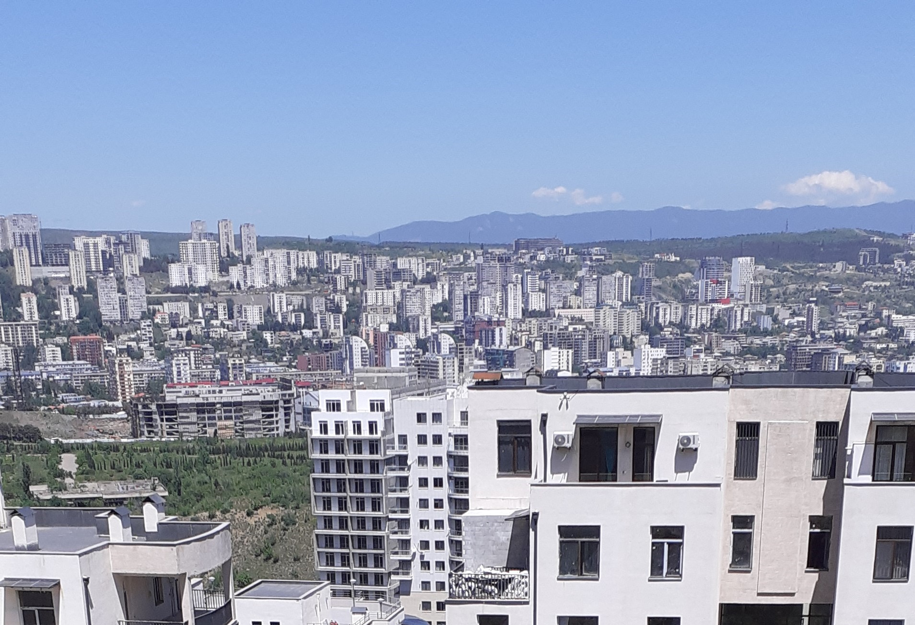
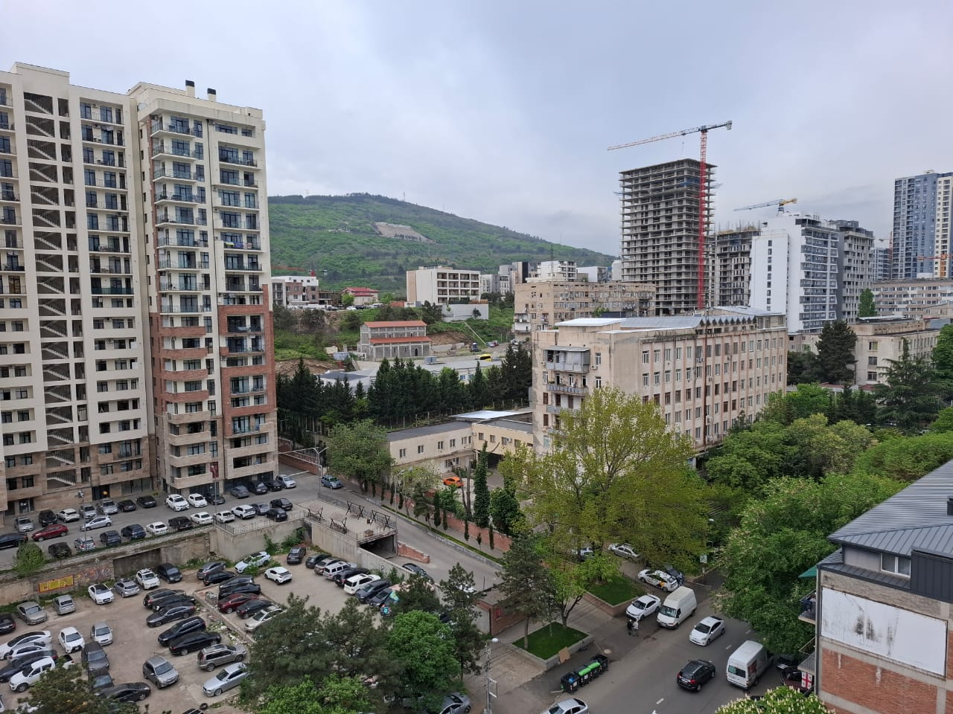
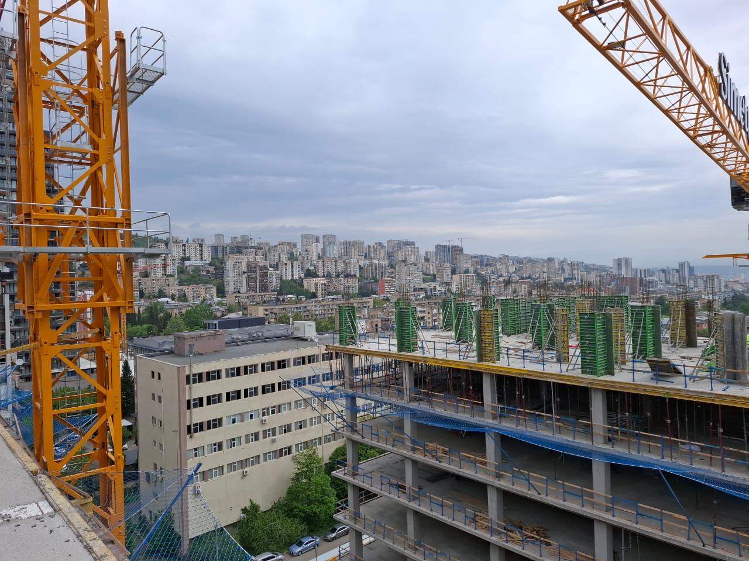
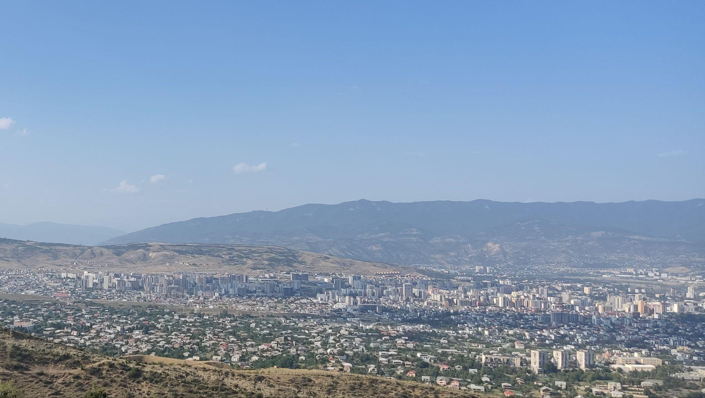
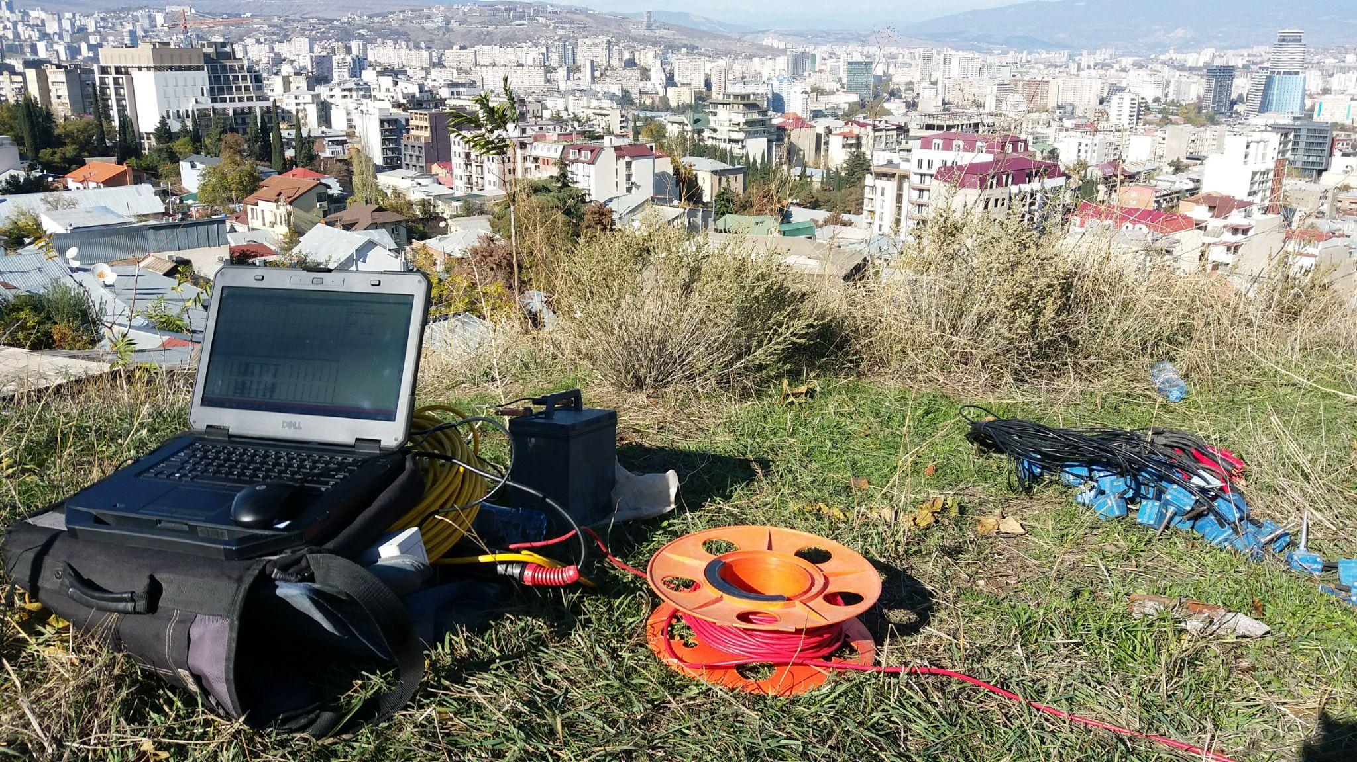
Geophysical survey points in the Tbilisi area
Surveys were conducted and ground categories were estimated at over 100 locations within urban areas.

Slide 4
Geophysical survey methods for site classification - Vs30
Methods
Seismic Refraction Survey
Multi-channel Analysis of Surface Waves (MASW)
Used Standards
Field data collection, processing, and interpretation were carried out in accordance with the ASTM standard and EuroCode 8
Survey Kit
Geode 24 Ch with seismic cable
Sensors: 4.5 Hz and 10 Hz V/H
Seismic Source: 8 kg sledgehammer or weight-drop
Software Packages
SeisImager/2D
Rayfract®
ParkSeisAUTO

Slide 5
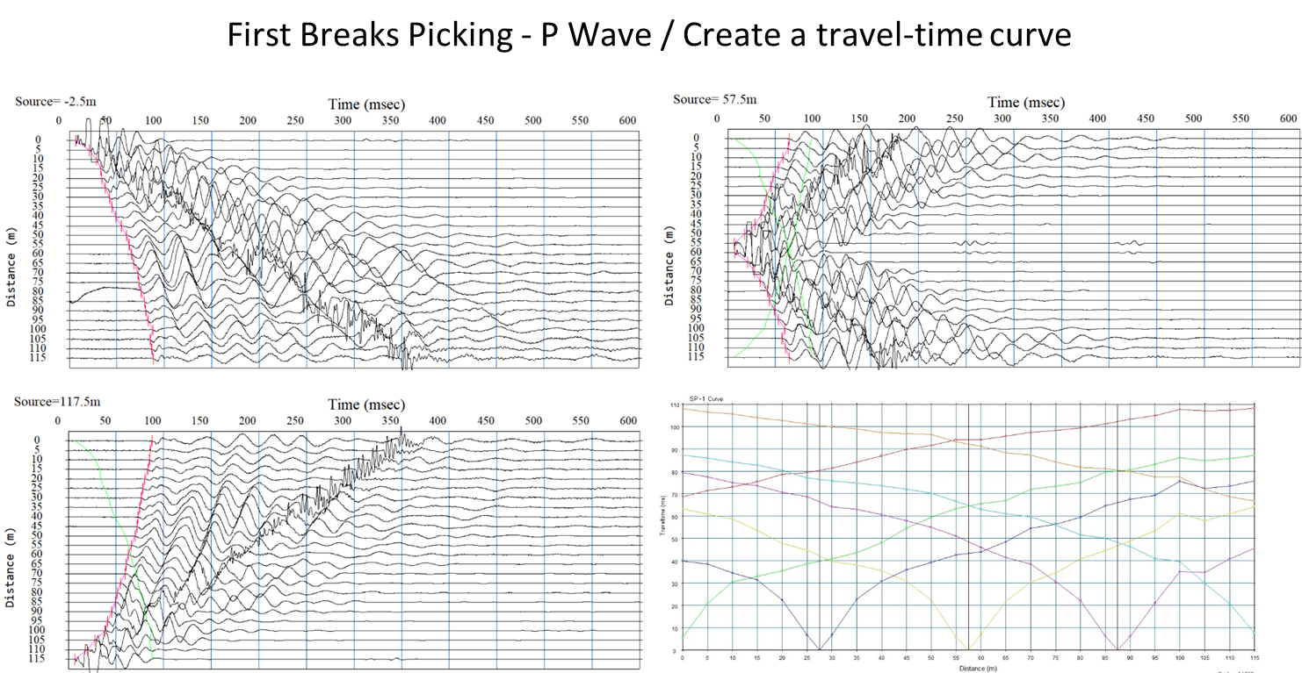
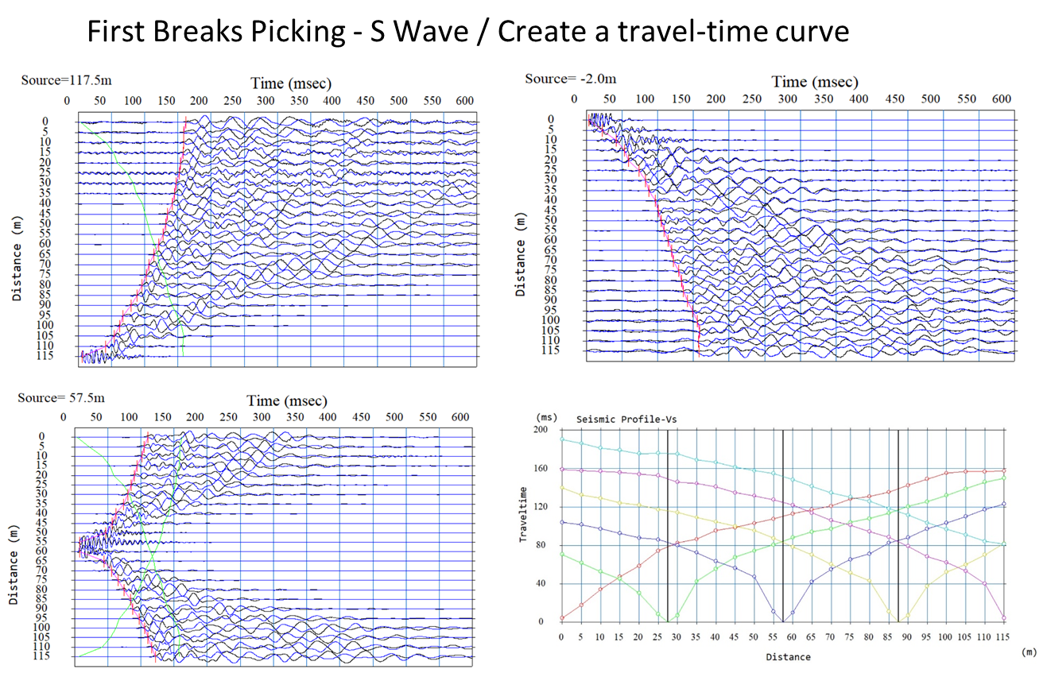
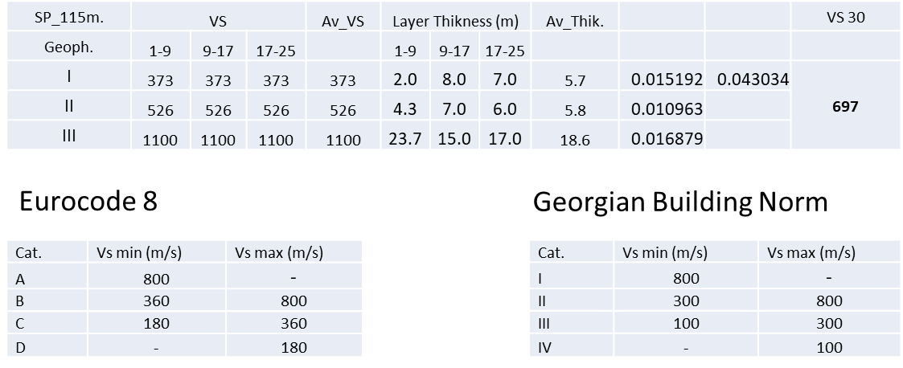
Seismic Refraction Survey for Site Classification

Slide 6
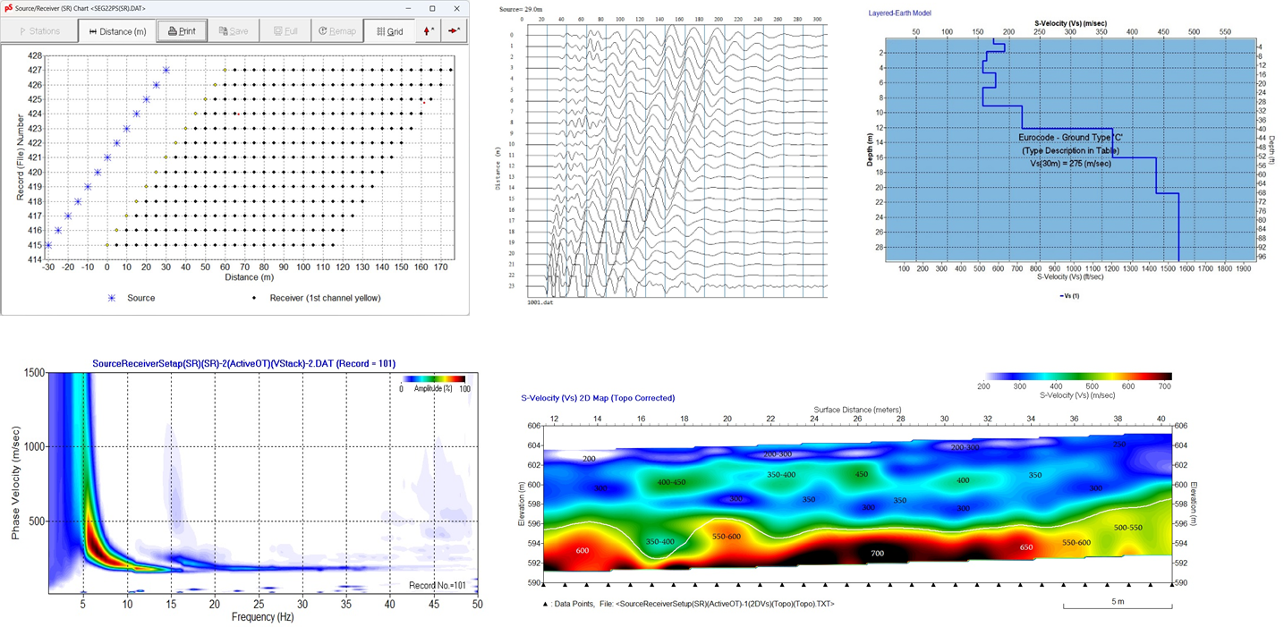
MASW Survey for Site Classification

Slide 8
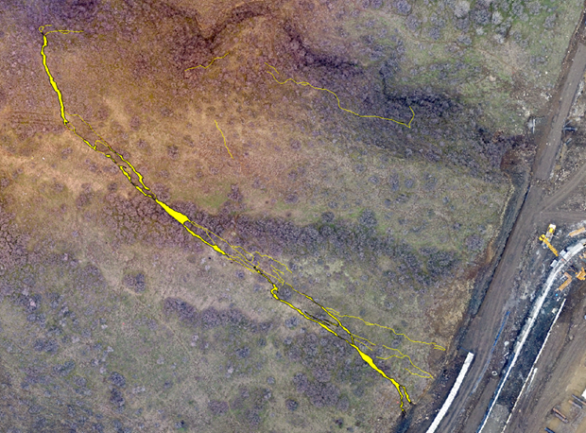
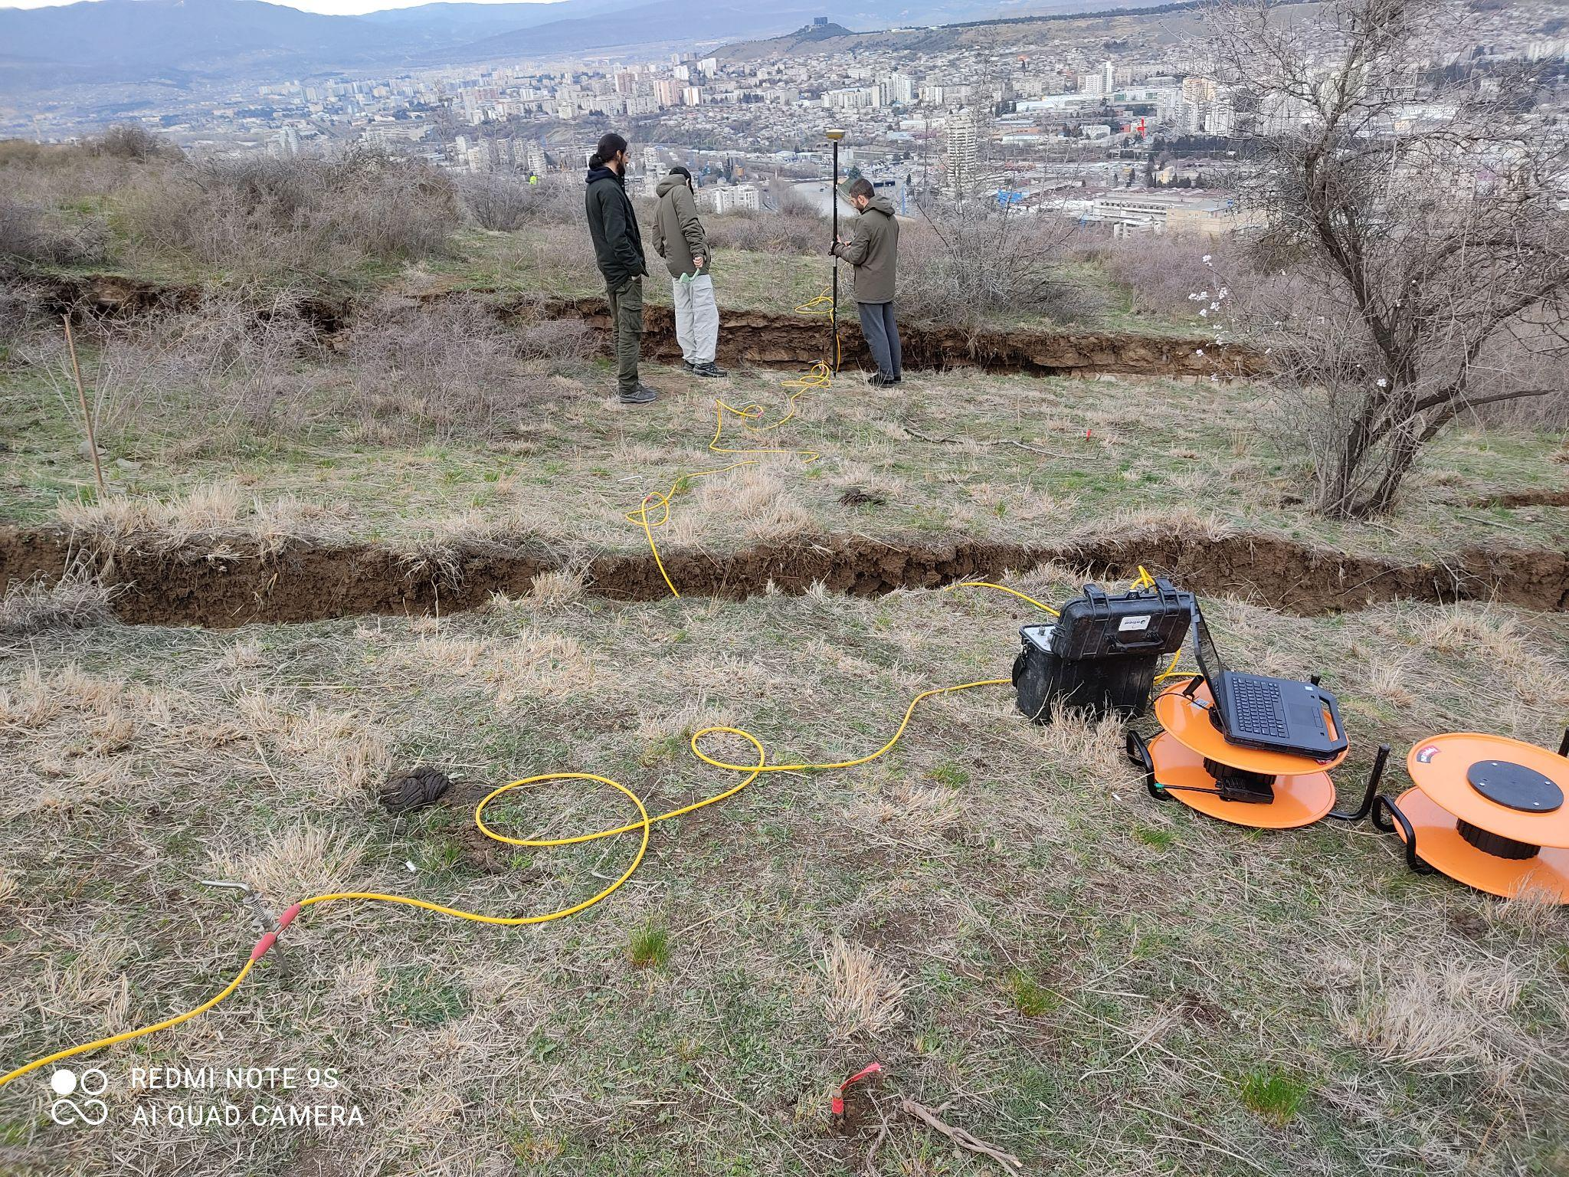
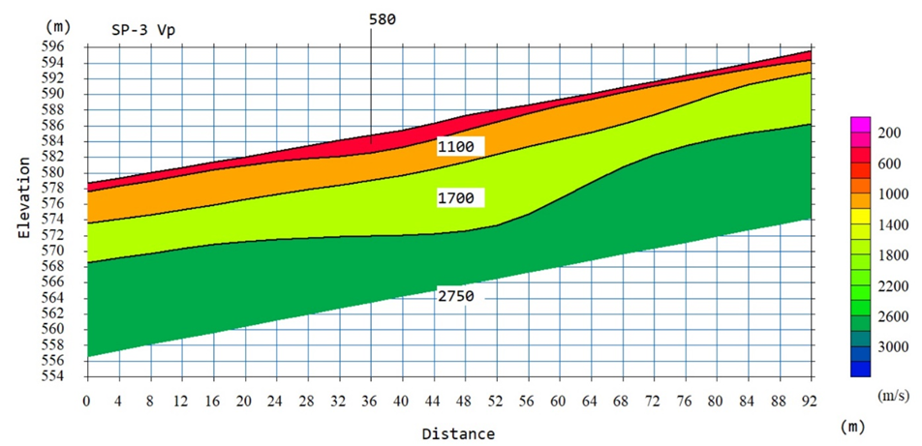
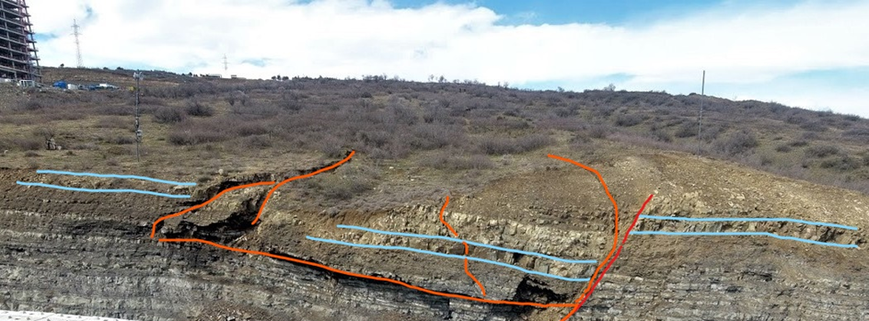
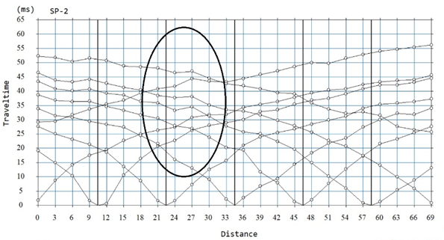
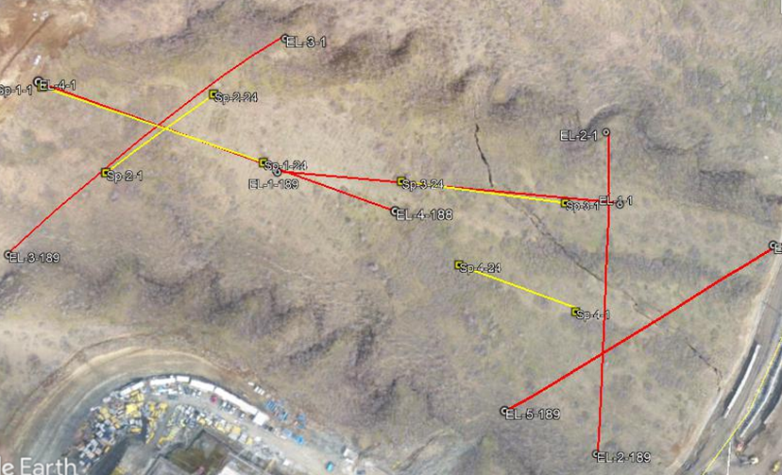
Landslide Volume Estimation in the Tbilisi Area

Slide 9
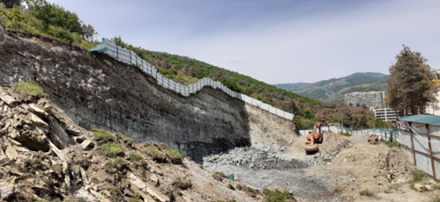
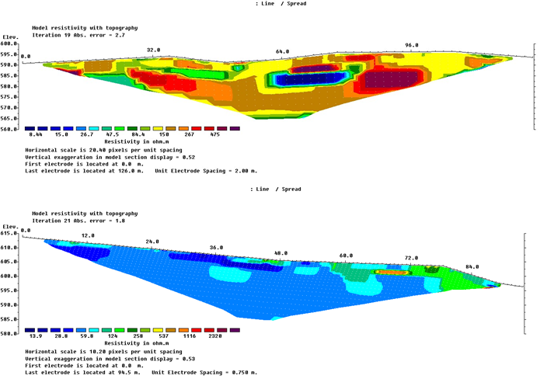
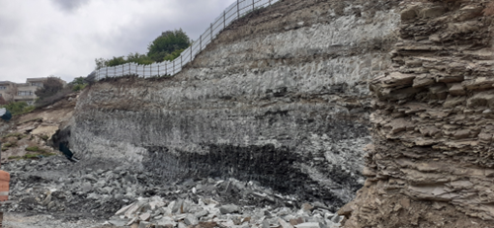
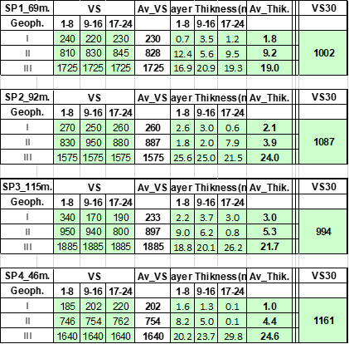
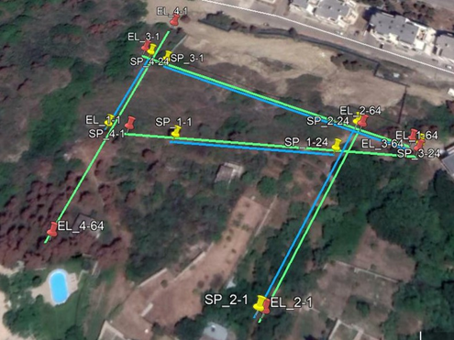
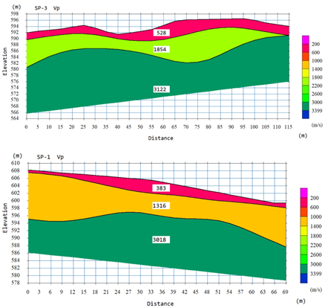
Study of Construction Site – Tbilisi Area

Slide 10
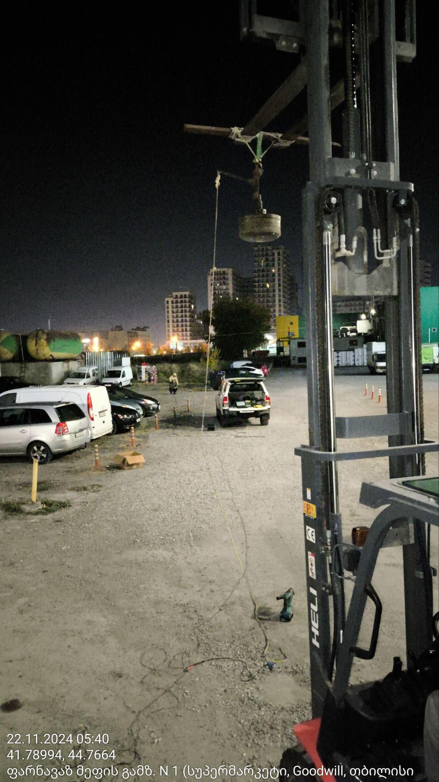
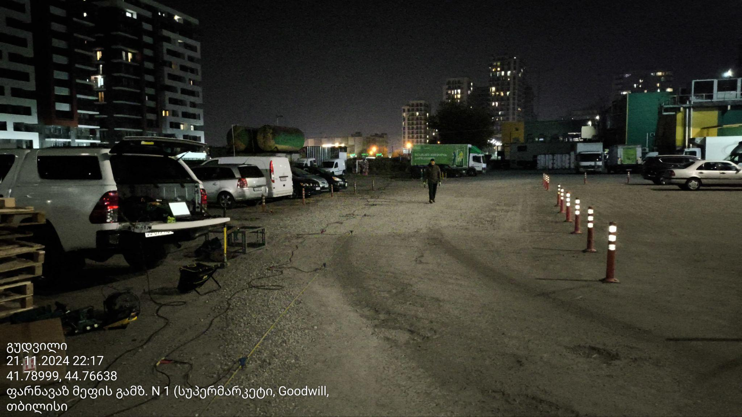
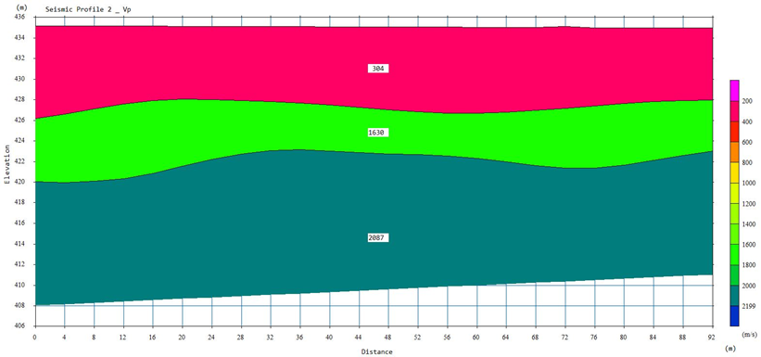
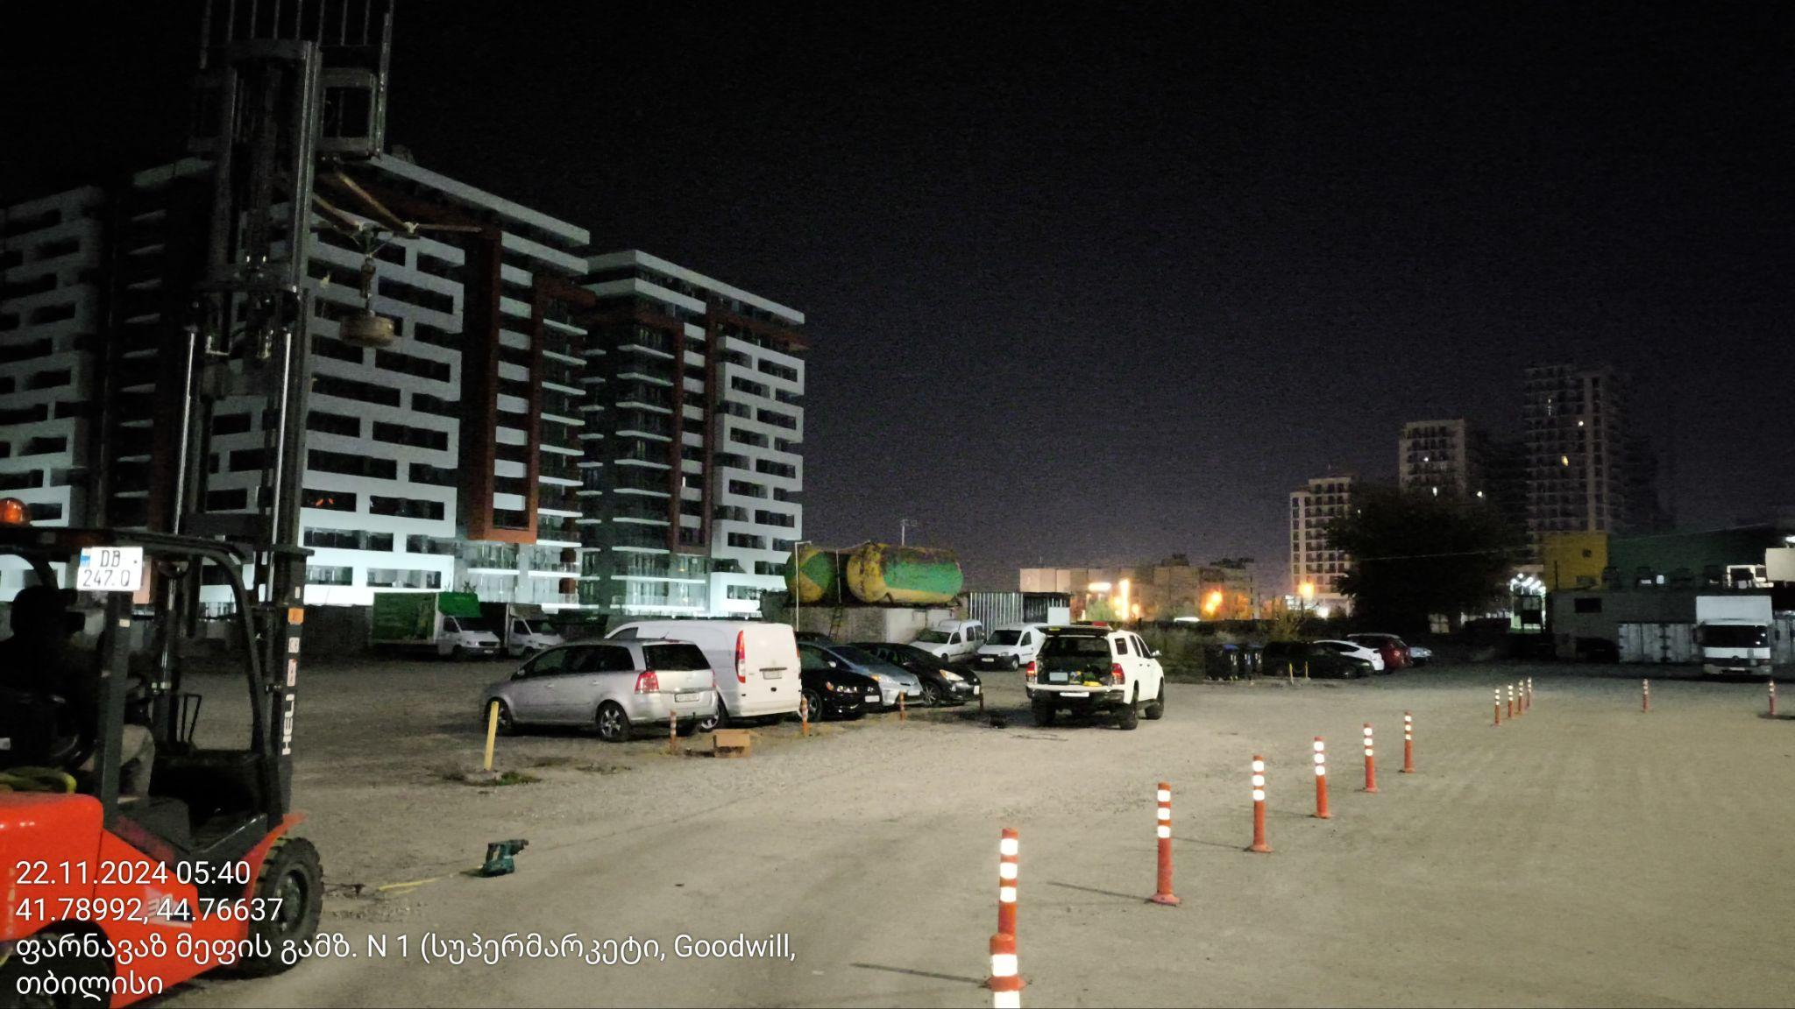
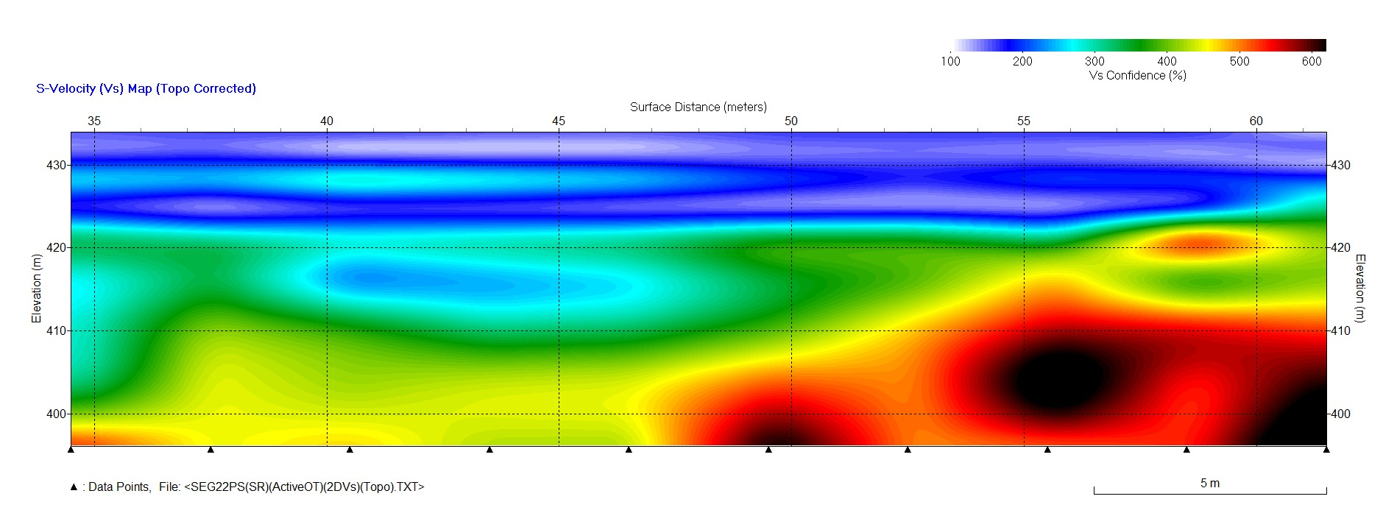
Study of Construction Site
Seismic Refraction and MASW Survey Using Weight-Drop

Slide 11
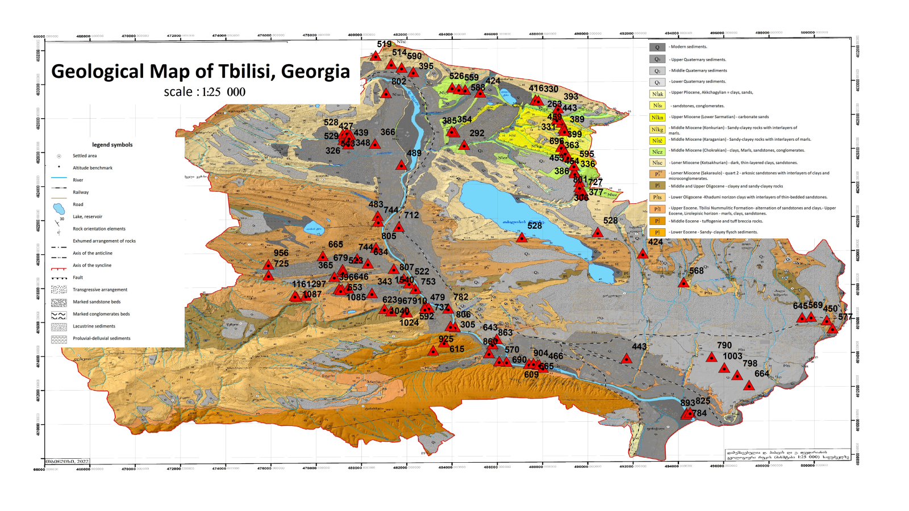
Geological Map of Tbilisi
Seismic Site Classification - Vs30
scale 1:25000

Slide 12
Geological Map of Tbilisi
Seismic Site Classification
According to EuroCode 8
scale 1:25000

Slide 13
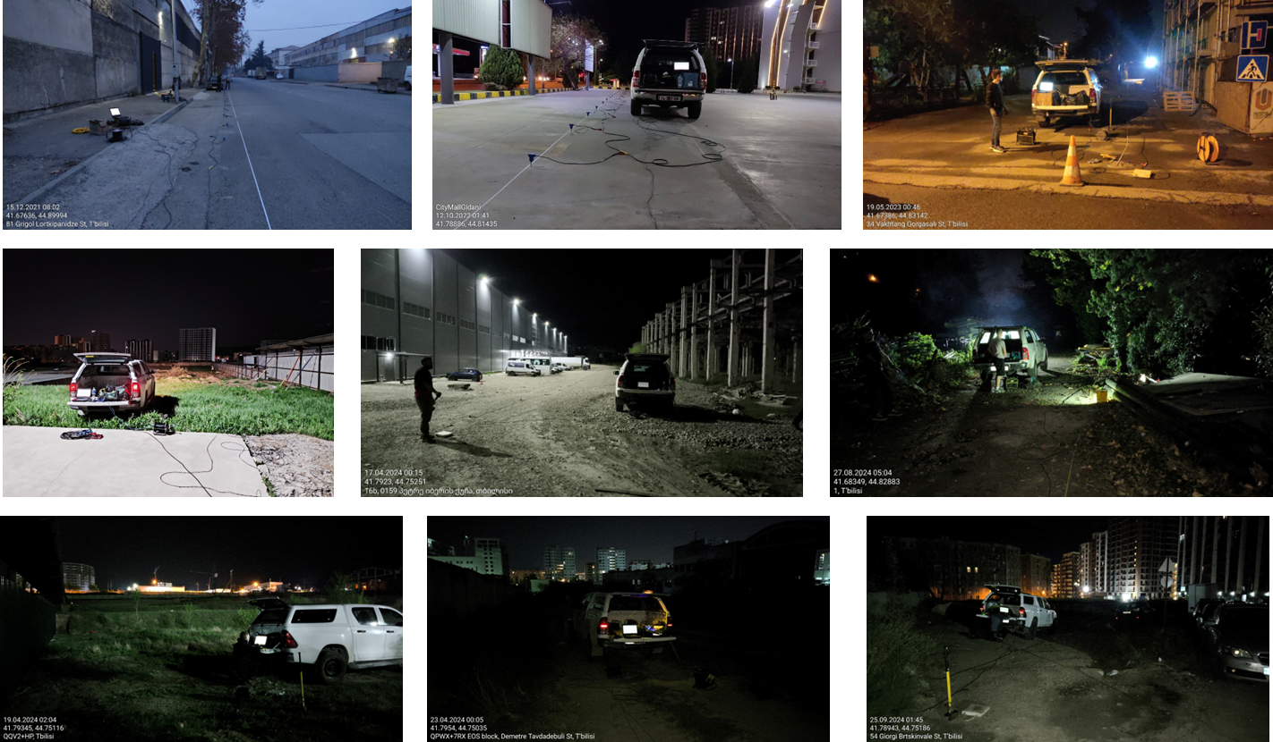
Study of Construction Sites in the Tbilisi Area
Collecting data at night to avoid urban noise

Slide 14
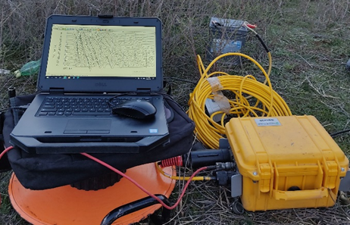
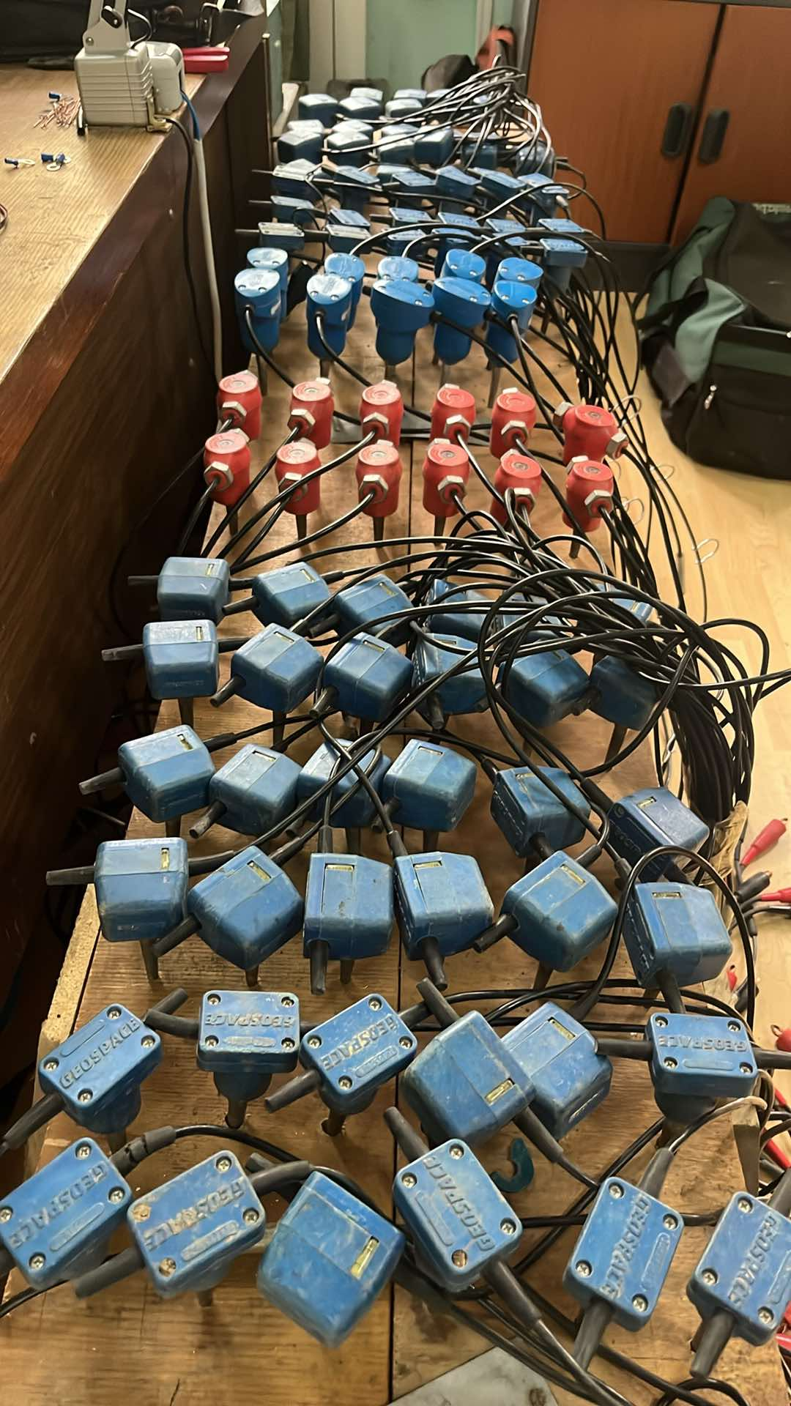
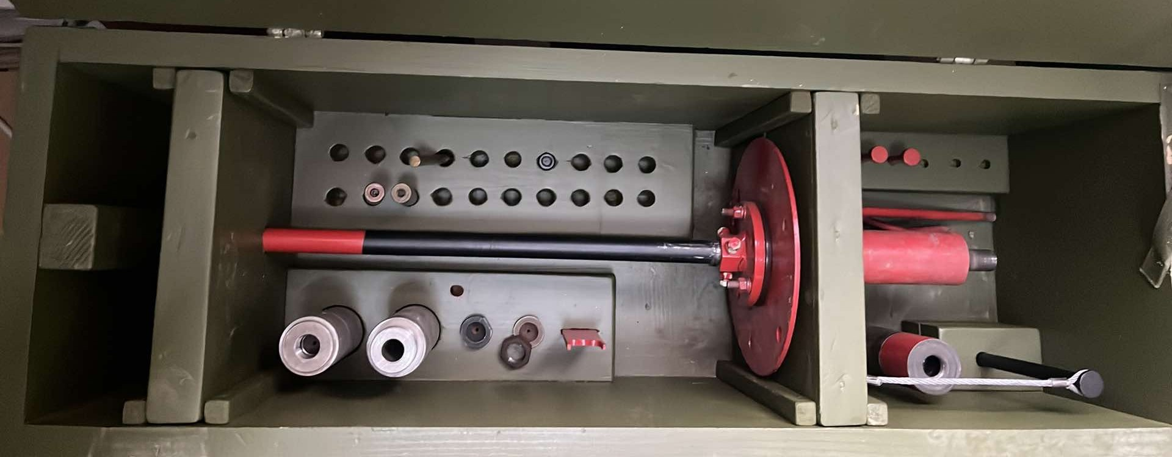
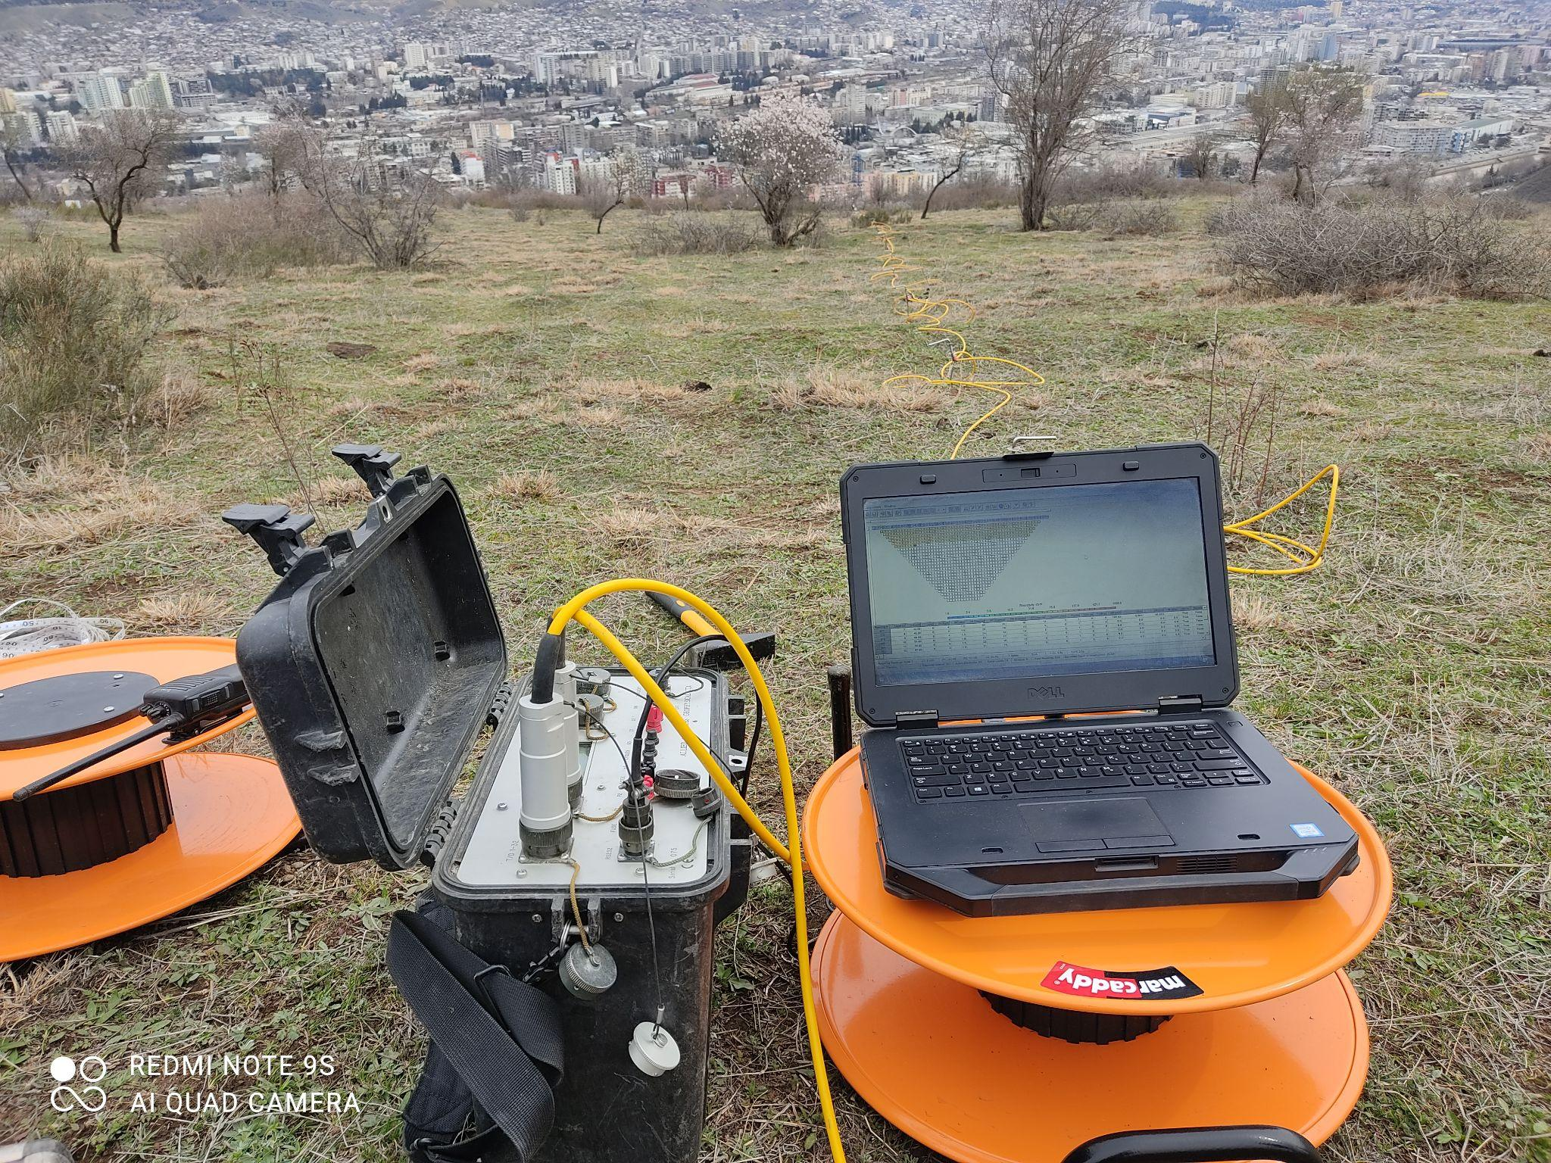
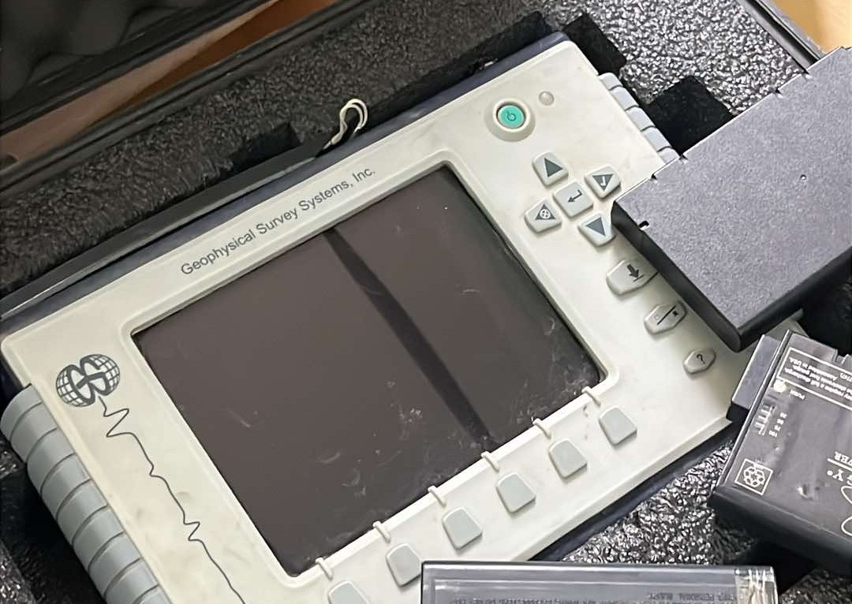
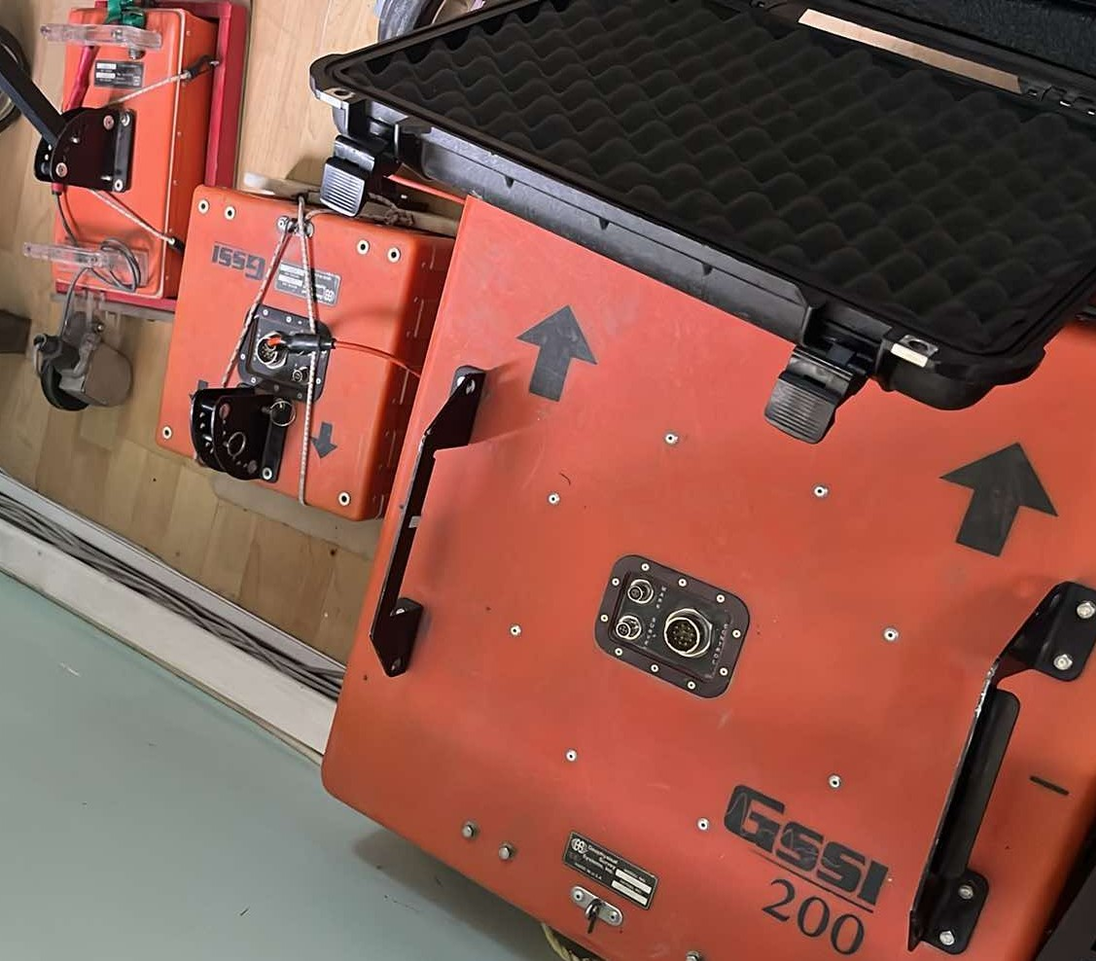
Geophysical Field Survey Kits

Slide 15
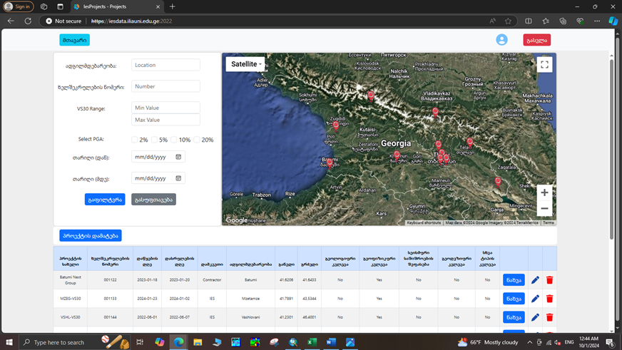
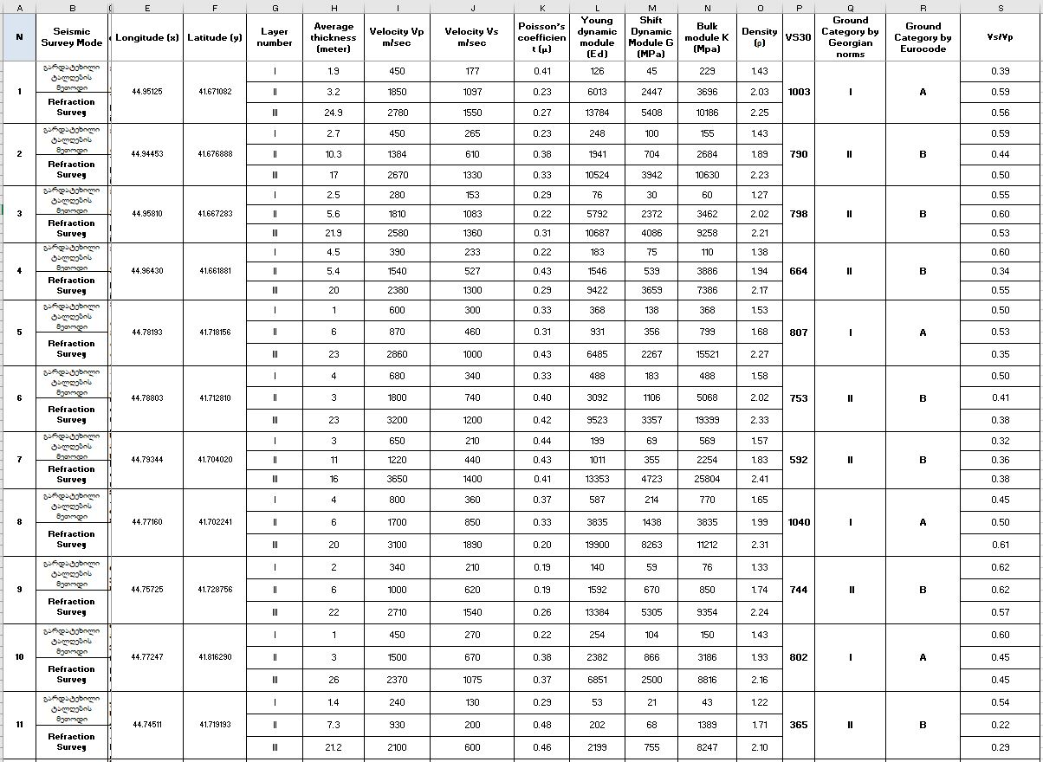
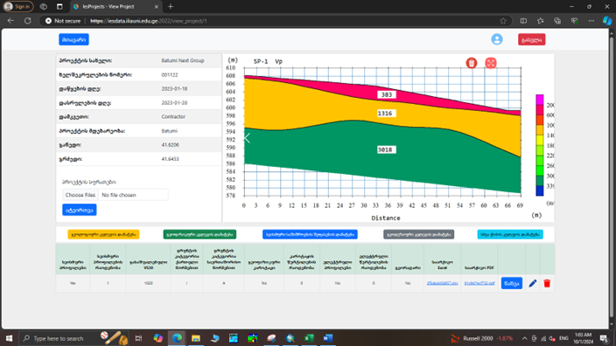
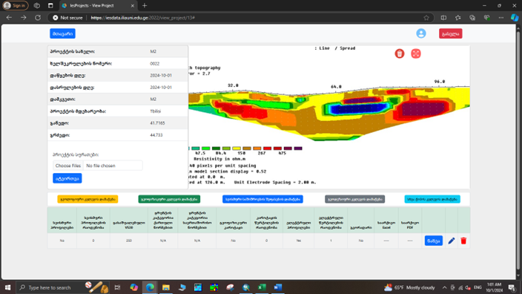
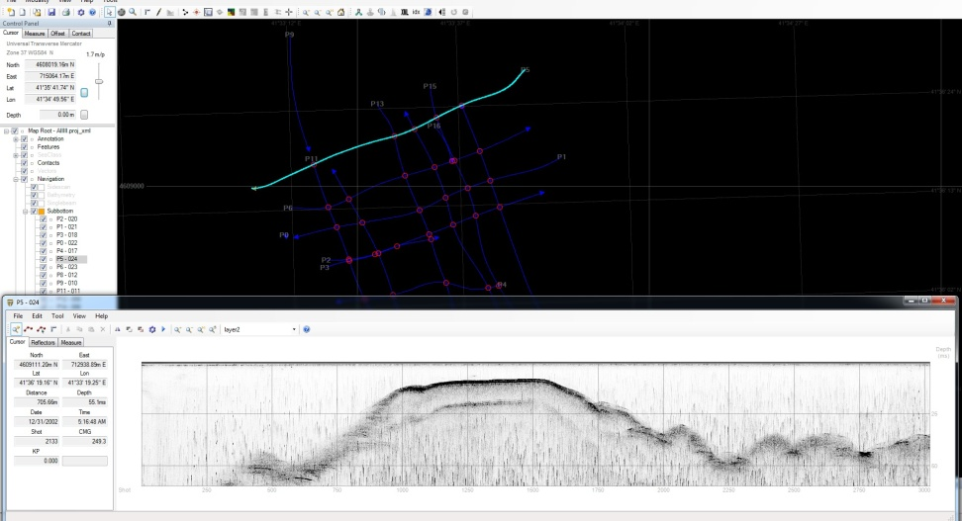
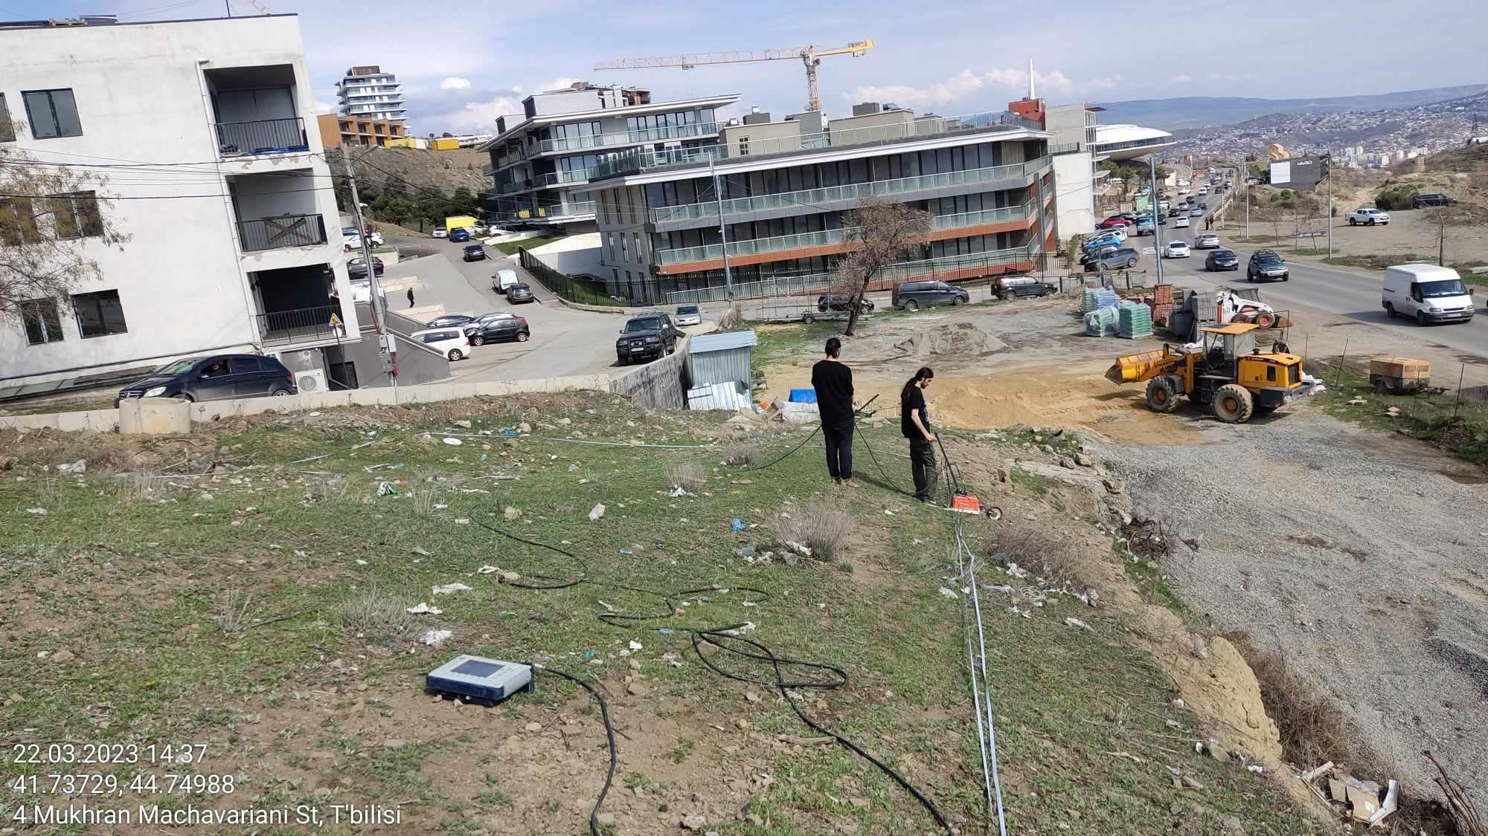
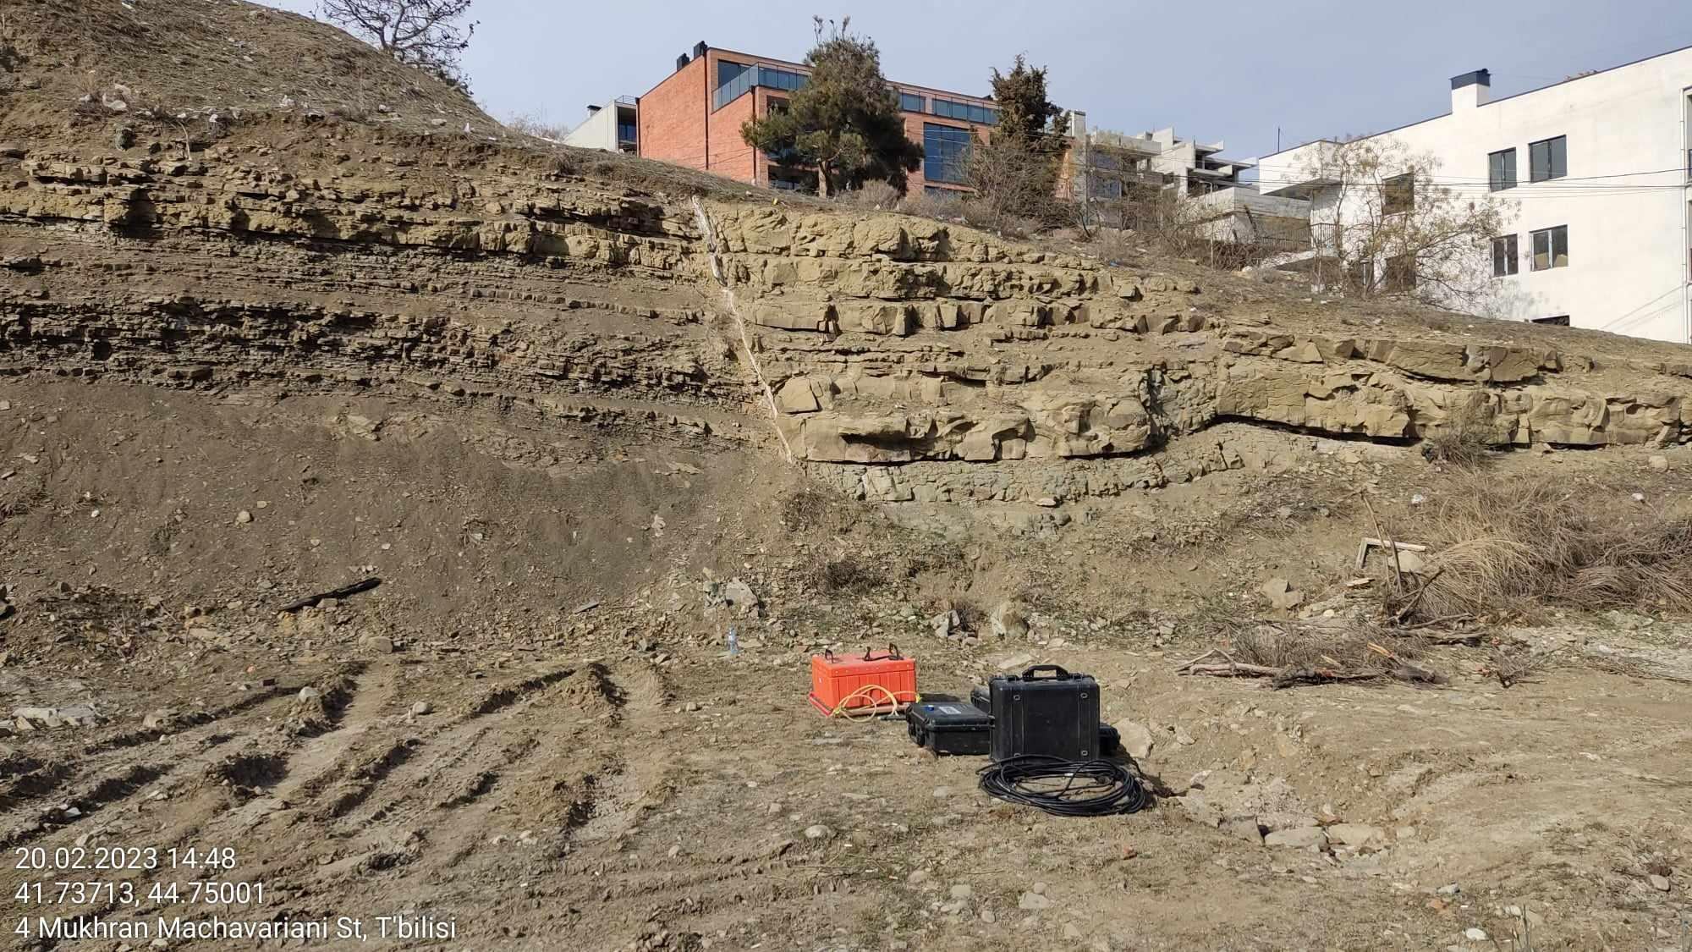
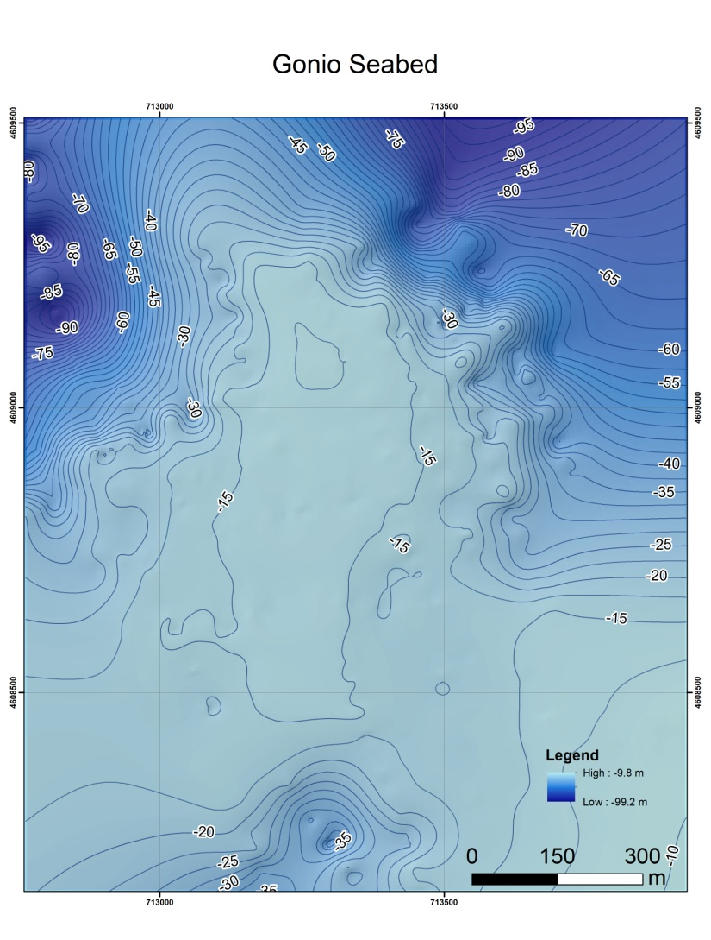
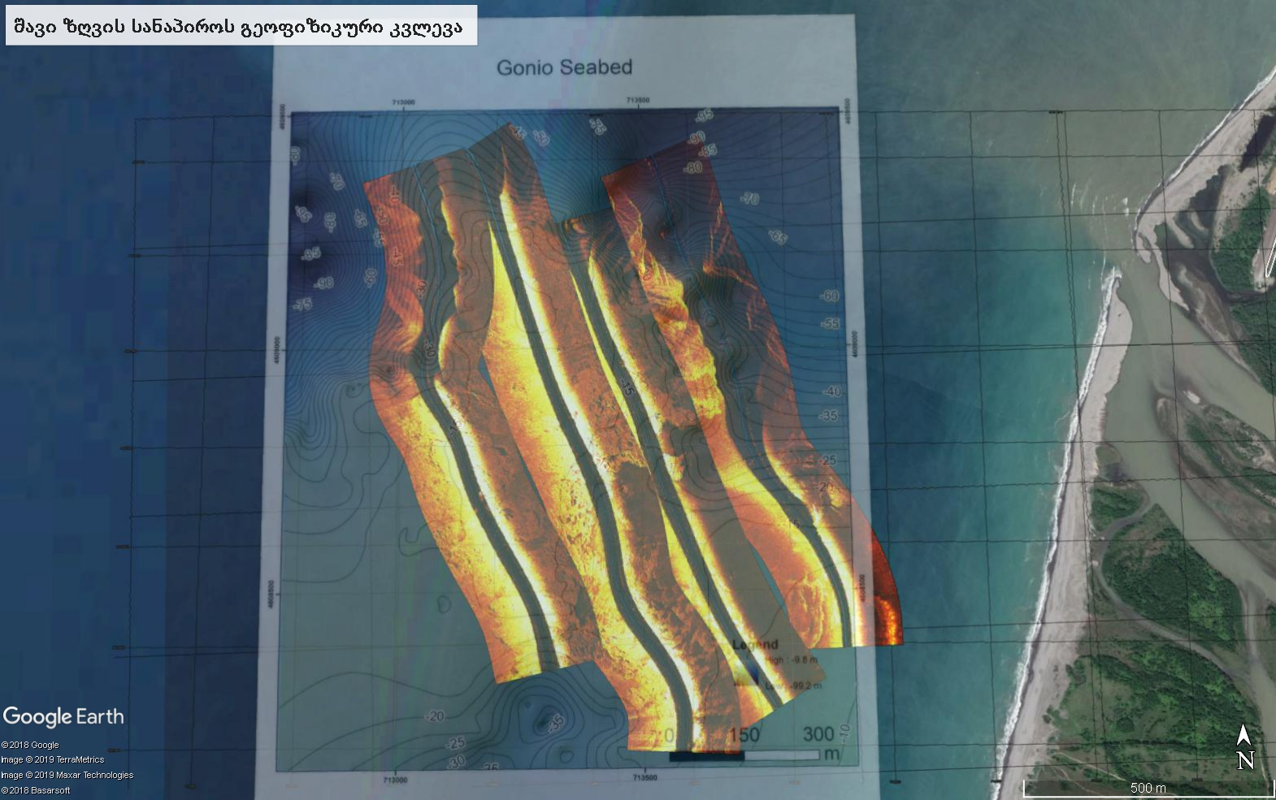
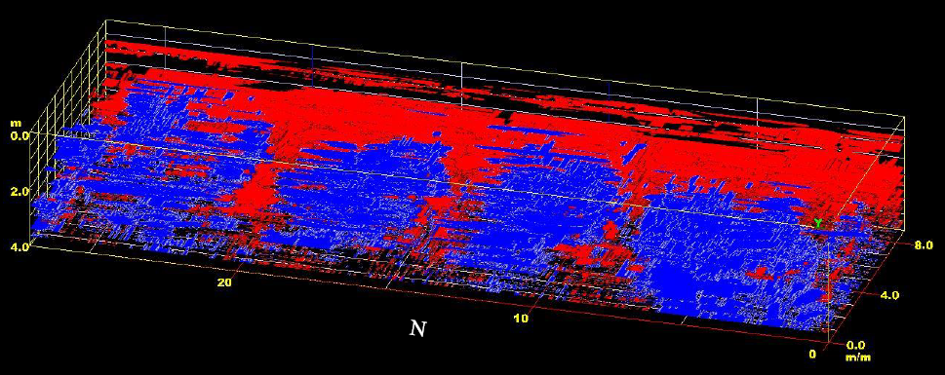
Institute of Earth Sciences and National Seismic Monitoring Centre - Online Database
Evaluation of Soil Physical Properties and Dynamic Modulus

