Slide 1



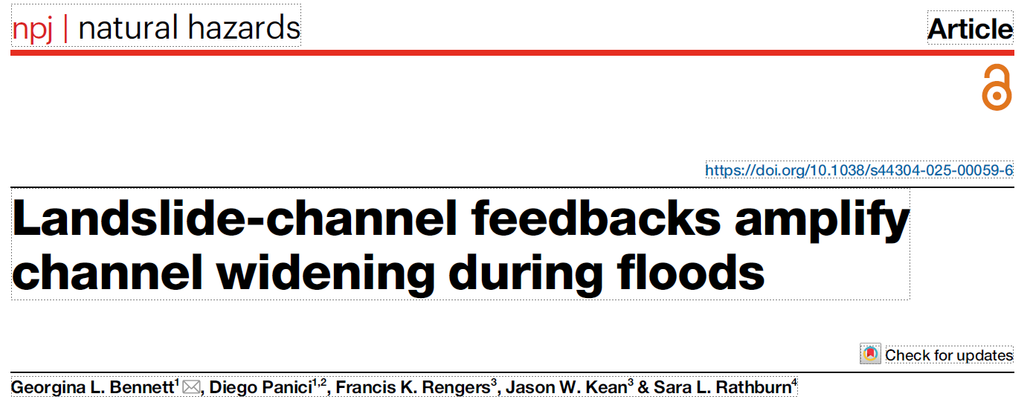
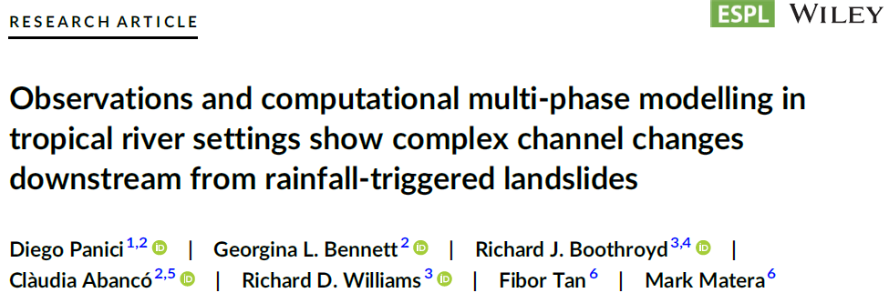


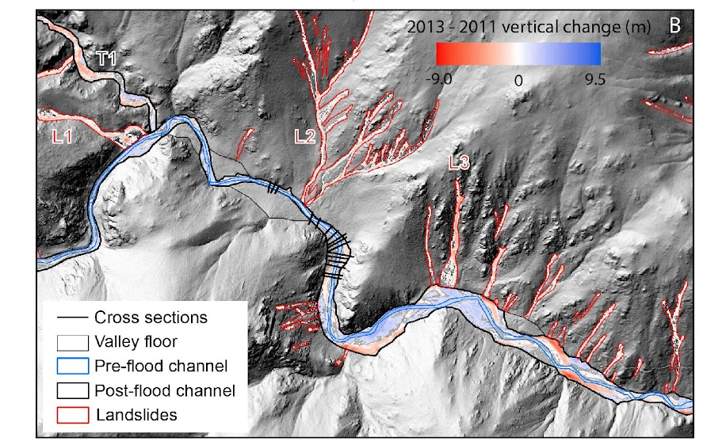
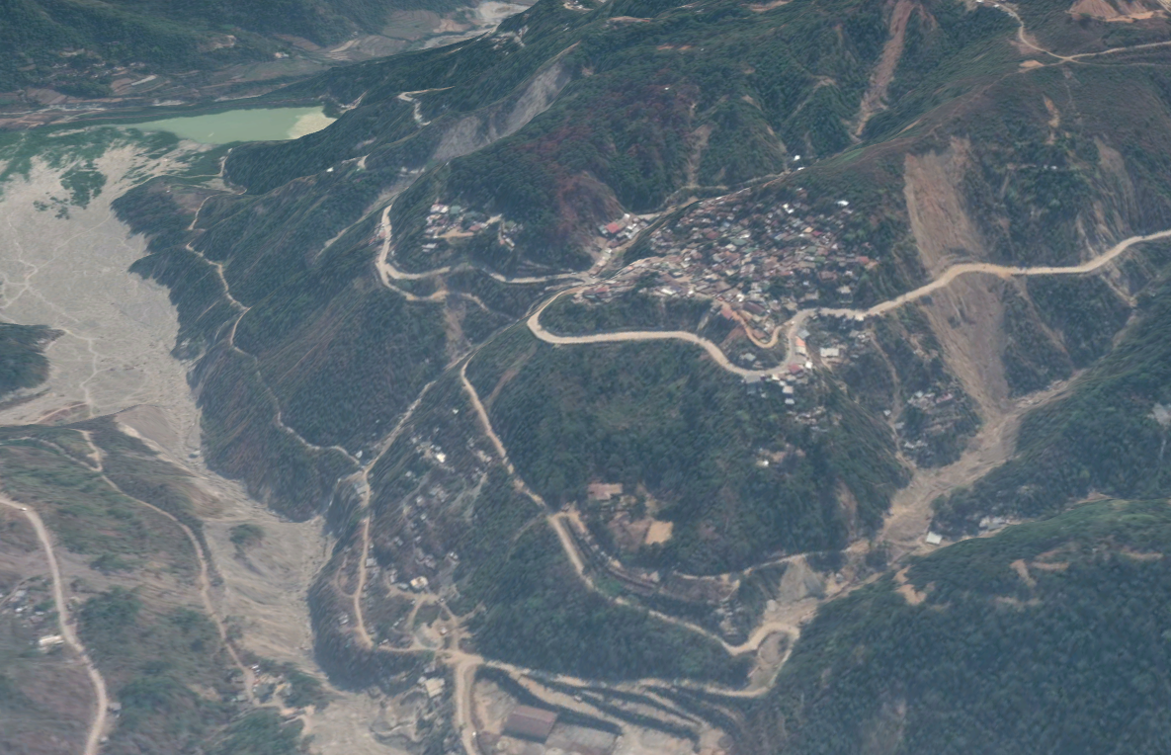
Landslide-channel feedbacks amplify channel widening during floods
Dr Georgie Bennett
EGU attendance supported by a BSG carers support grant
Bennett et al., 2025

Slide 2
Landslide hazard cascades
Landslides kill at least 5000 per year (Froude and Petley, 2018) 2024 is an exceptional year for landslides (LandslideBlog)
Landslide sediment delivery may also amplify flood hazard during and after an event causing a cascade of hazards
How do landslides impact flooding?
We lack tools to monitor and model the dynamics of landslide hazard cascades
Cascading landslide hazards in Typhoon Mangkhut, Philippines 2019
Deadly Itogon landslide
Sedimentation in Antamok river
Image credit: Google Earth

Slide 3
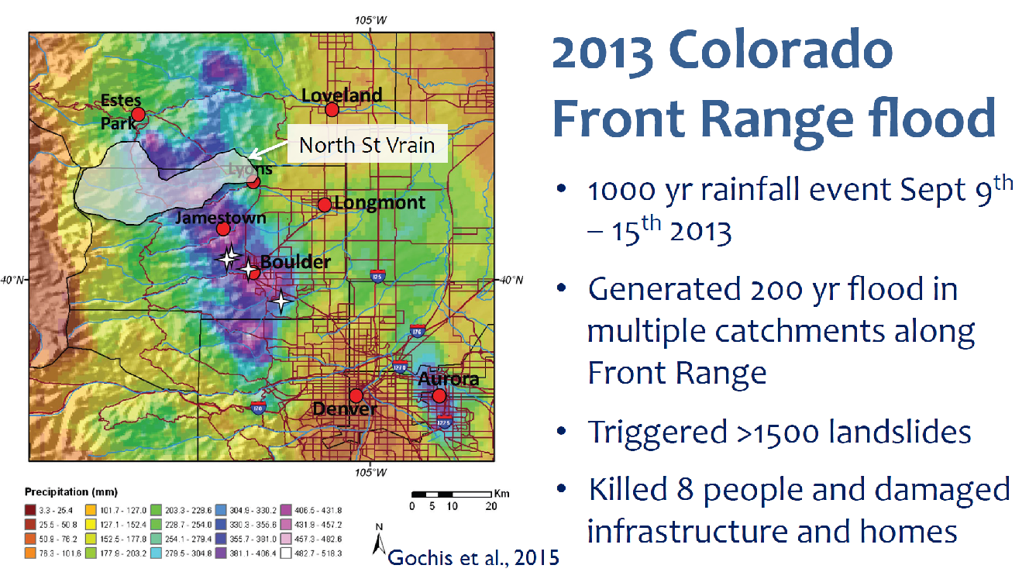

Slide 4
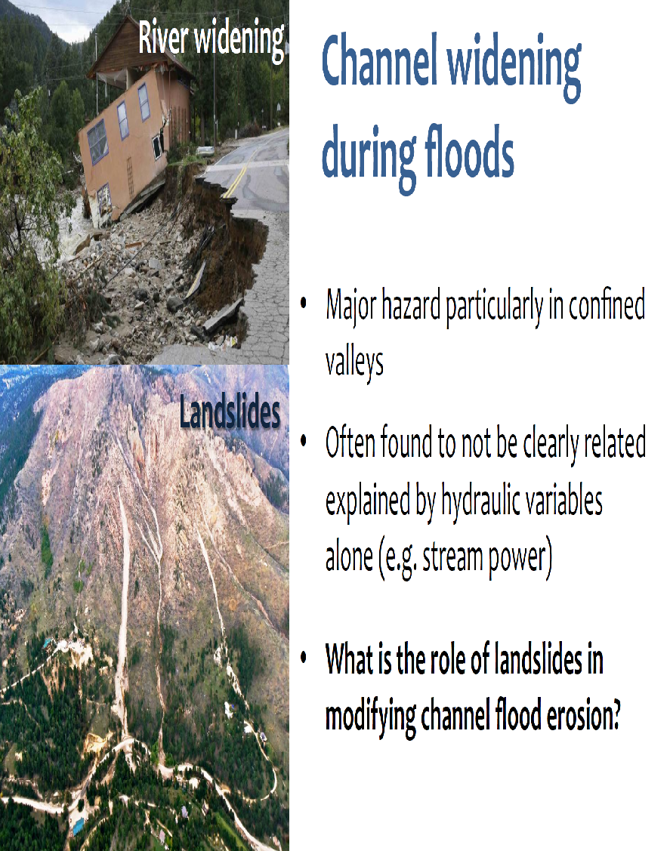
Channel widening during floods
Major hazard particularly in confined valleys where rivers compete for space with roads
Often found to not be clearly explained by hydraulic variables alone (e.g. stream power)
What is the role of landslides in modifying channel erosion during floods?

Slide 5
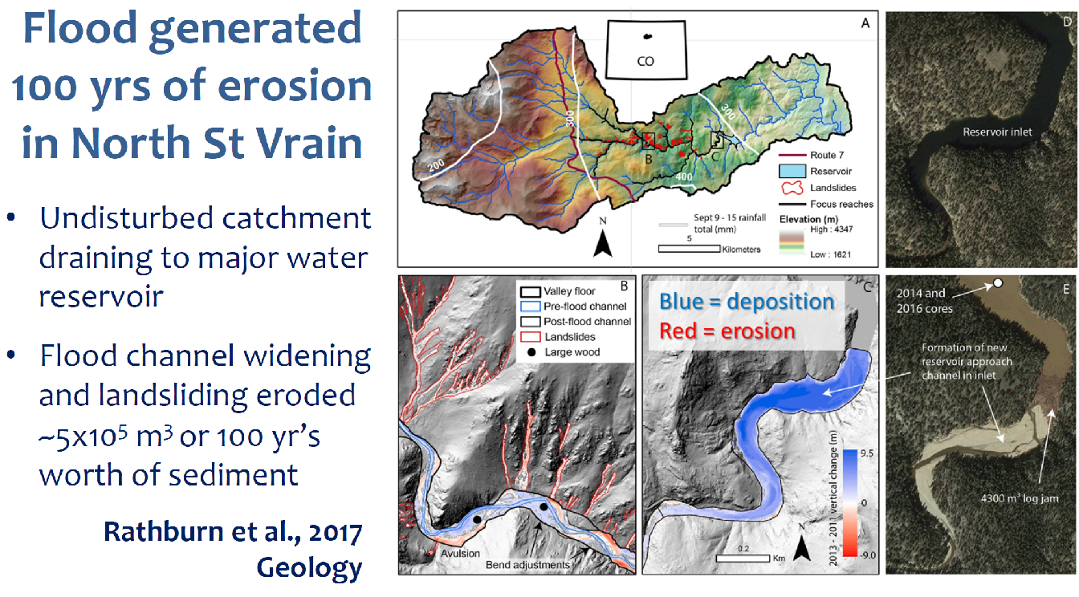


Slide 6
Stream power alone does not explain sudden increase in erosion
- What about the role of landslides e.g. through damming and/or bulking the flow?
- Can multiphase flow models be used to simulate landslide-flood interaction?

Slide 8

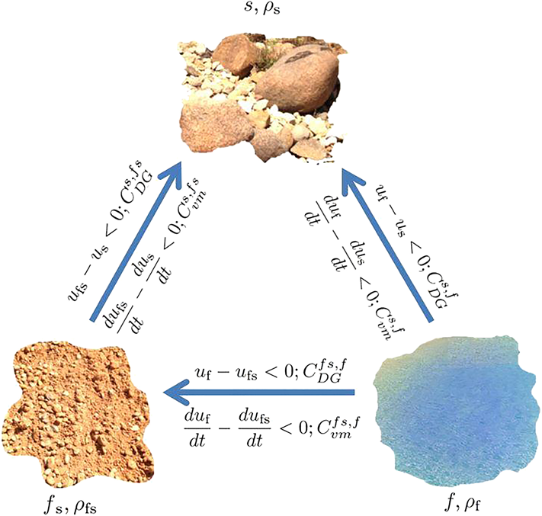

Testing hypothesised dam burst with r.avaflow
https://www.landslidemodels.org/r.avaflow/
Mergili, M., Pudasaini, S.P.
Traditional flood models don’t include lateral sediment input
Open source, multi-phase model
  Solid (coarse sediment – friction dominated)
  Fine solid (fine sediment – viscous and friction dominated)
  Fluid
Based on conservation of energy and momentum between phases
First application of r.avaflow to landslide-flood interaction
Diego Panici

Slide 9
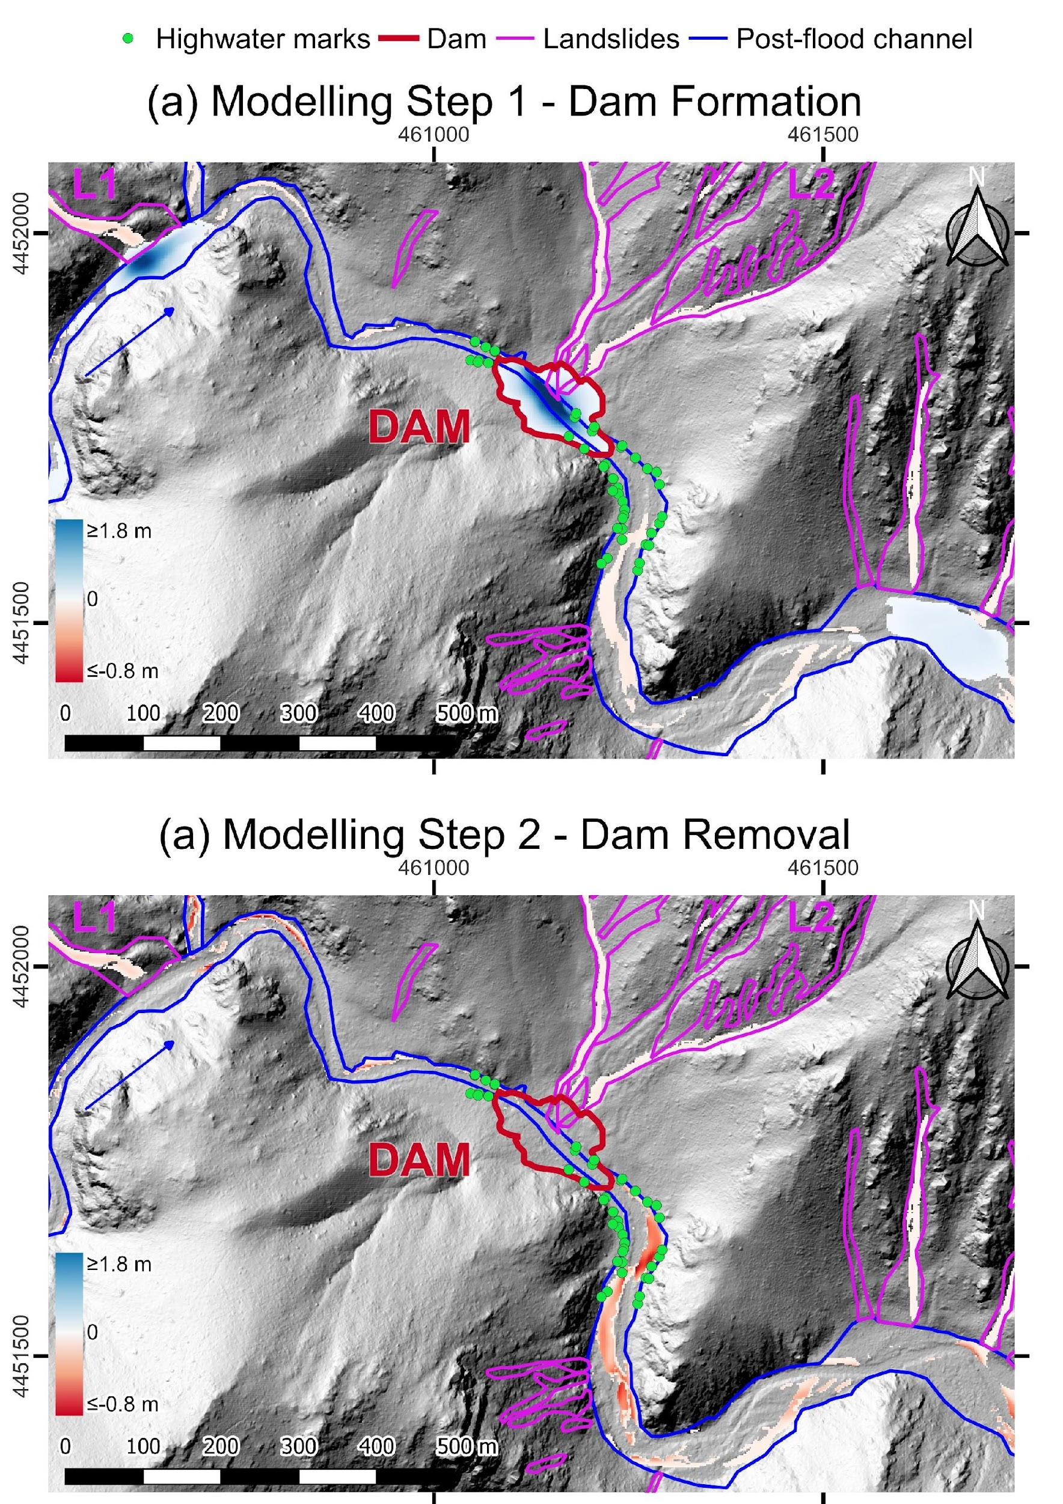
Modelling confirms formation and failure of a dam

Slide 10
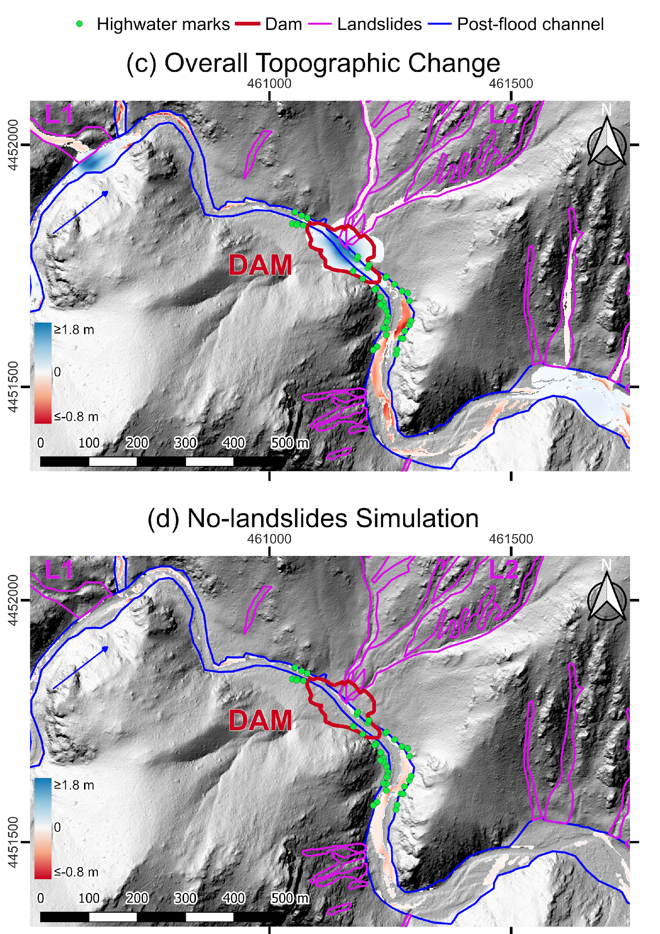
Landslides are required to generate the observed pattern of channel erosion
Bennett et al., 2025

Slide 11
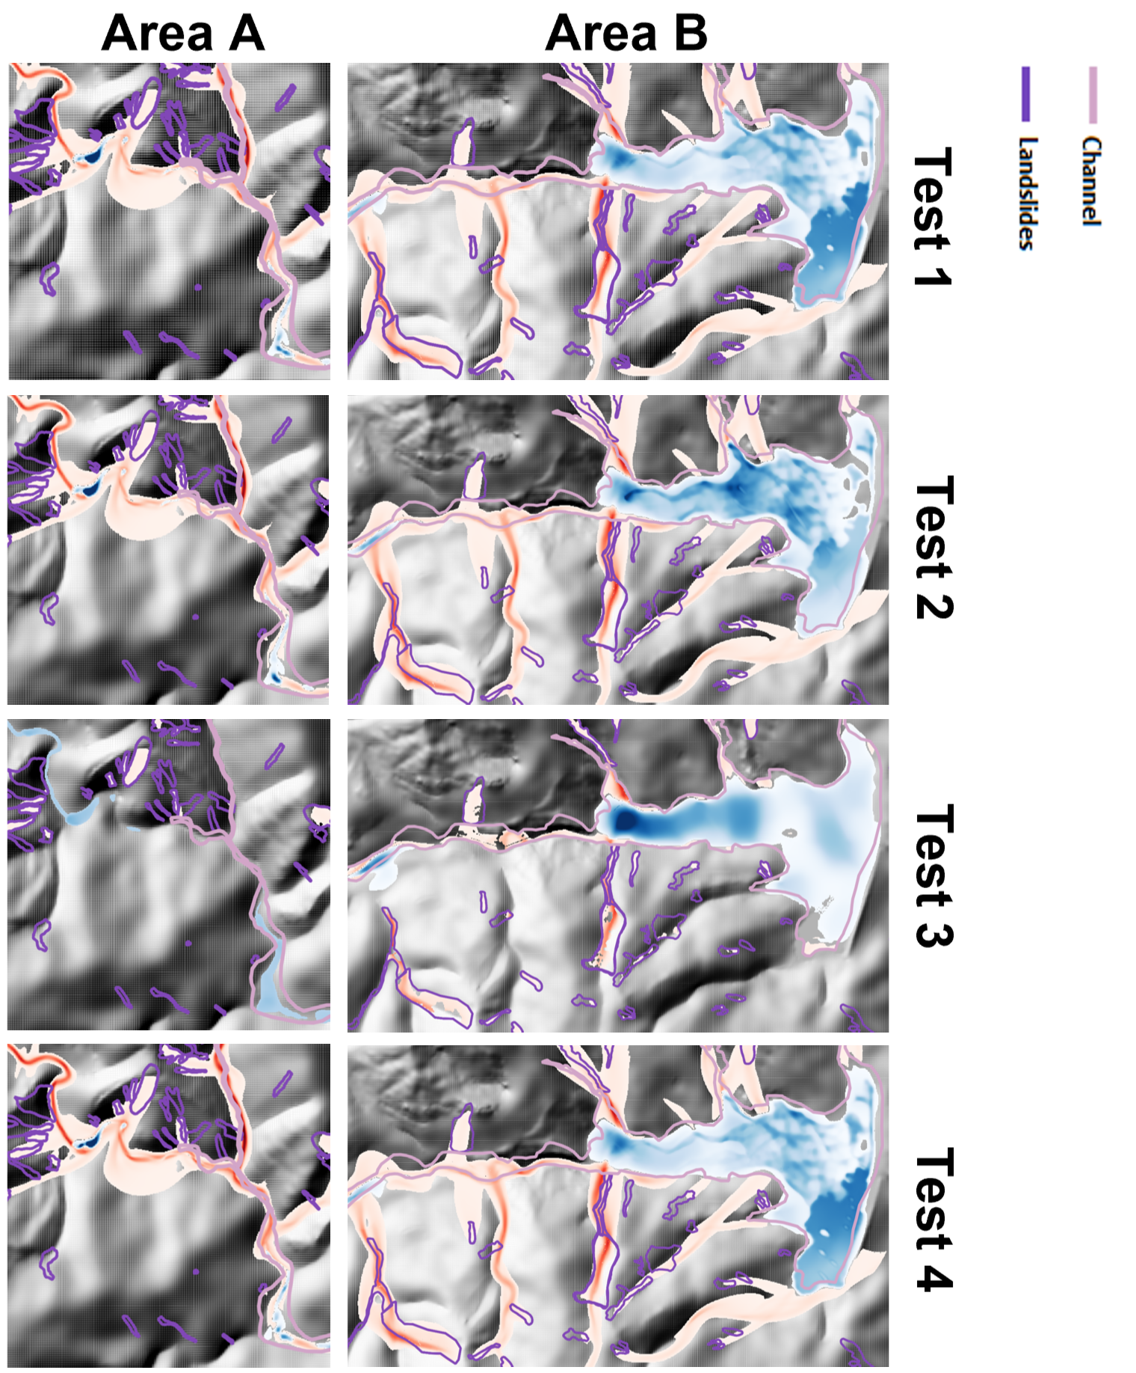
Some extra observations from landslide-flood modelling in Philippines
Control
Drag coefficient
Fine sediment fraction needed to simulate pattern of erosion observed along Antamok river catchment, Philippines (left). Only coarse sediment needed in Colorado study.
Model not sensitive to +/- 20% discharge highlighting role of phase interactions in simulating geomorphic change.
Links between landslides and channel widening less clear than in Colorado study due to mining activity in the catchment
Panici et al., 2024
Rheology
Internal Friction
Further 4 tests, not shown here.

Slide 12
Conclusions
EGU attendance supported by a BSG carers support grant
First applications of the multi-phase flow model, r.avaflow, to landslide-flood interaction
Landslide sediment delivery was critical to simulate patterns of channel erosion during flooding
Ephemeral landslide dam build up and removal bulks flow with sediment, making this more erosive
Fine sediment along with coarse sediment was necessary in Philippines simulation
We suggest that landslide-channel interactions are a crucial factor in flood risk assessment in confined mountain catchments
Bennett et al., 2025
Panici et al., 2024

Slide 13
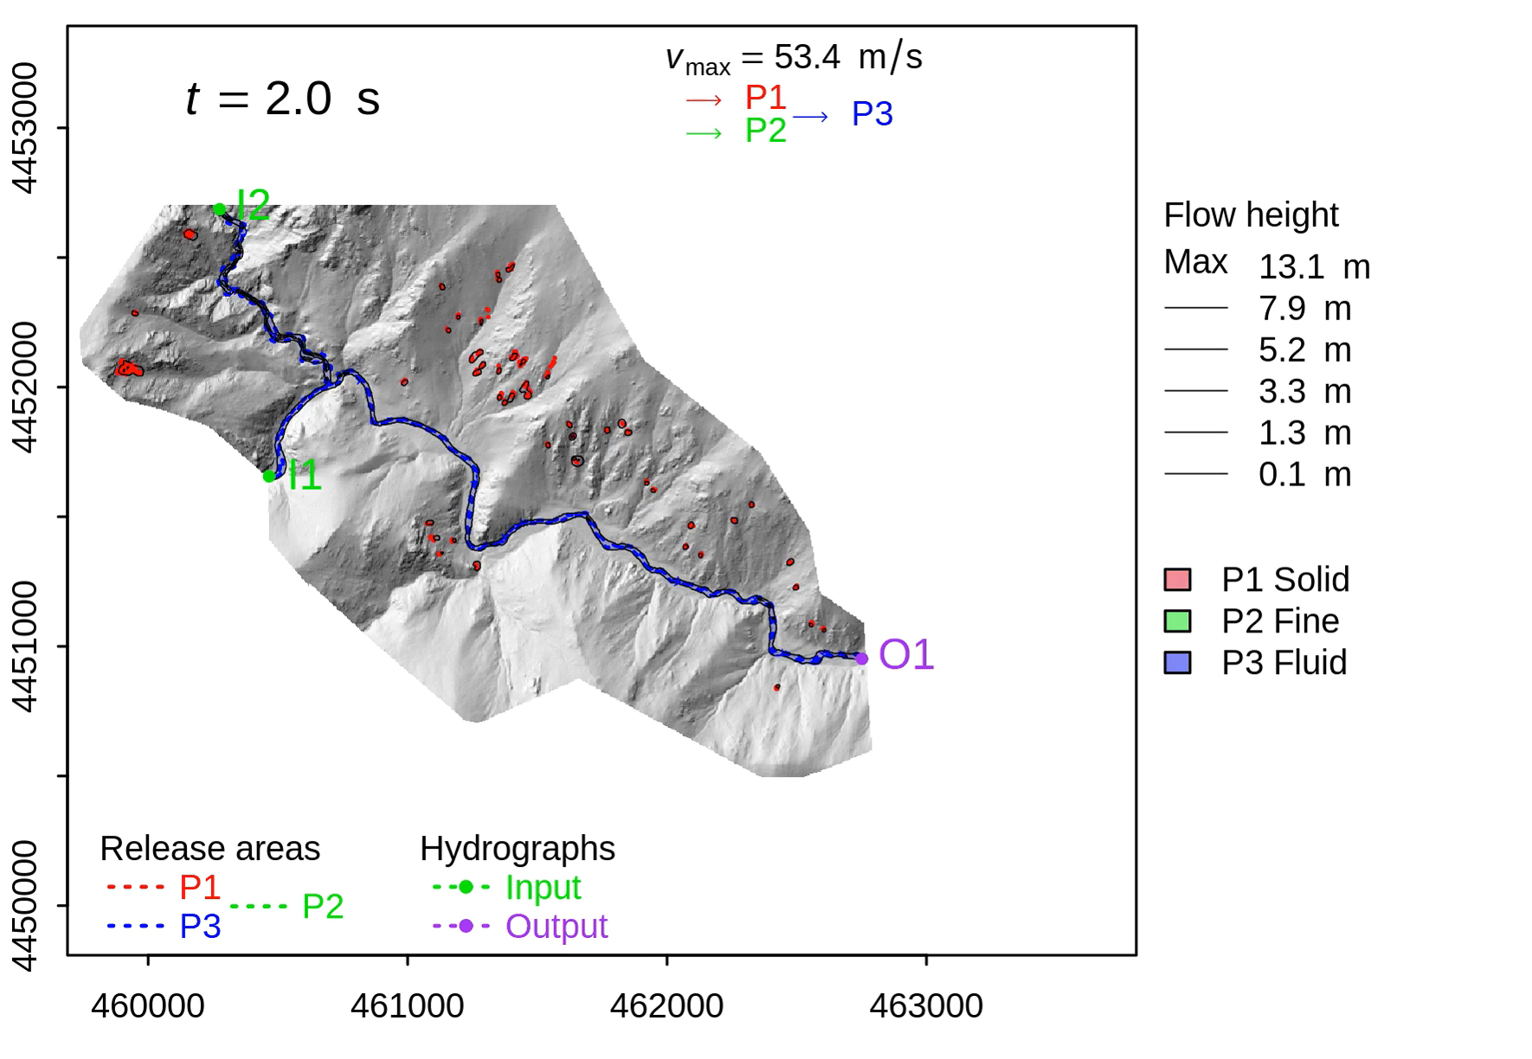
Modelling confirms the formation of a dam
Simulation shows flow height of solid and fluid phases (no fine phase in the simulation)
One major dam of ~1.8 m depth and and two additional smaller dams

Slide 14
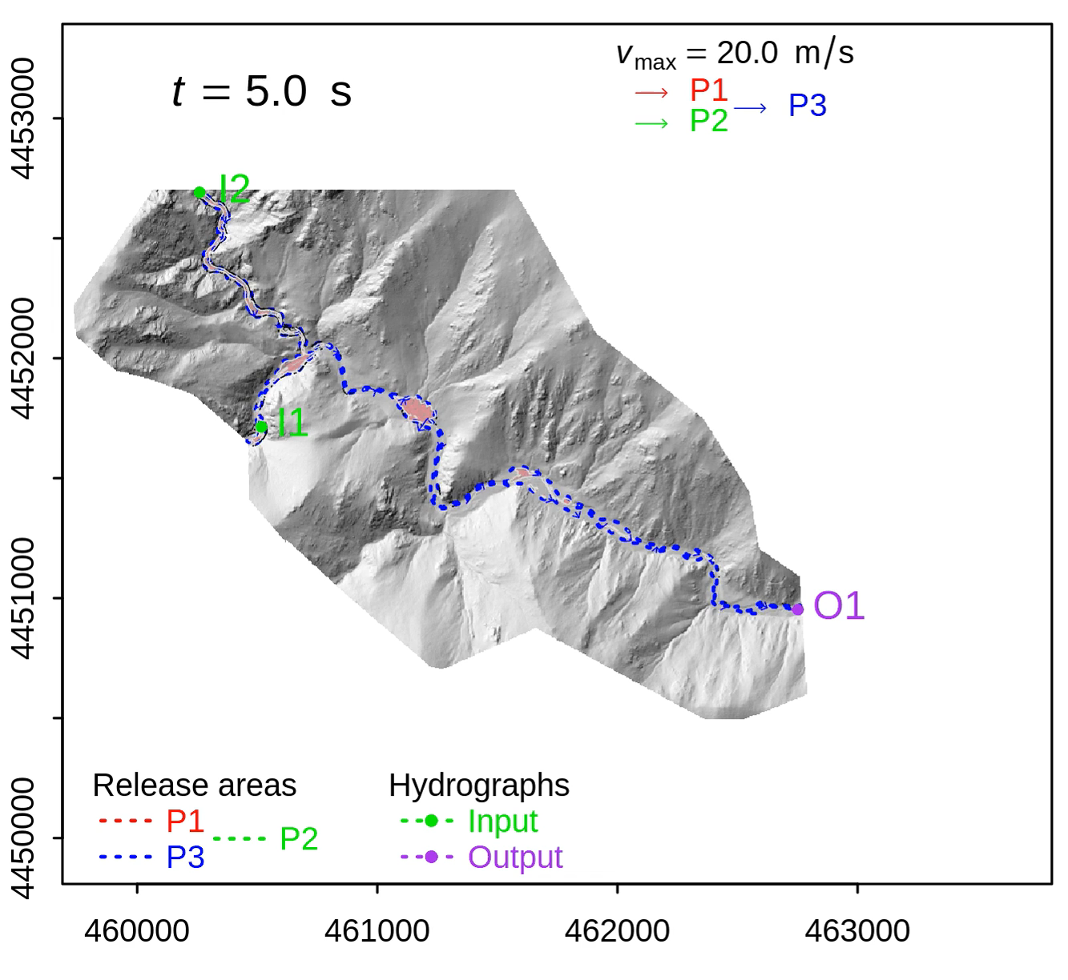
Dam removal and downstream erosion
Simulation shows erosion in red
The most superficial strata (~10mm) are removed quickly, and then a slower but constant deeper erosion of the dam occurs over ~5 minutes
This feeds the flow with sediment and drives erosion of the channel downstream, related to bulking of the flow by sediment

Slide 15
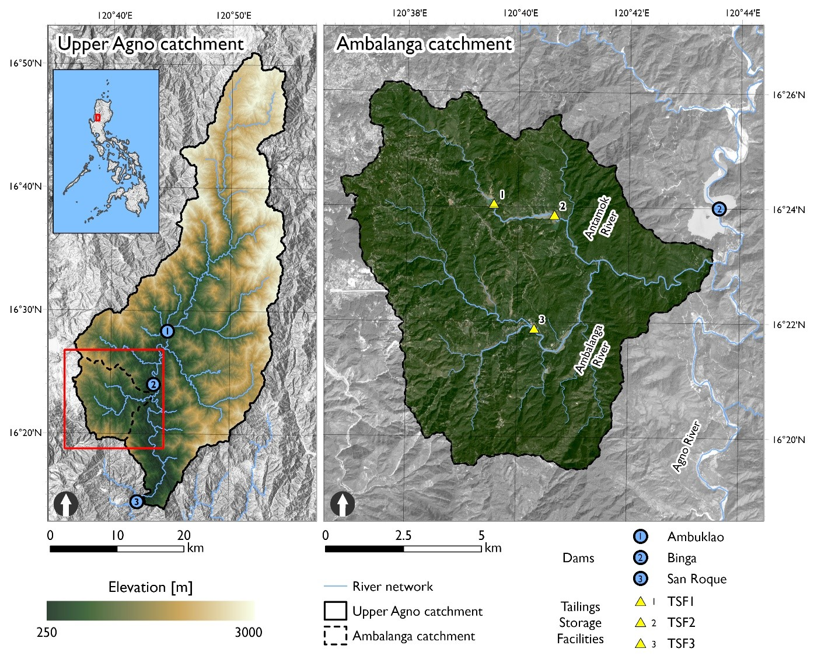
Modelling cascading landslide hazard in Typhoon Mangkhut, Philippines, 2019

Slide 16
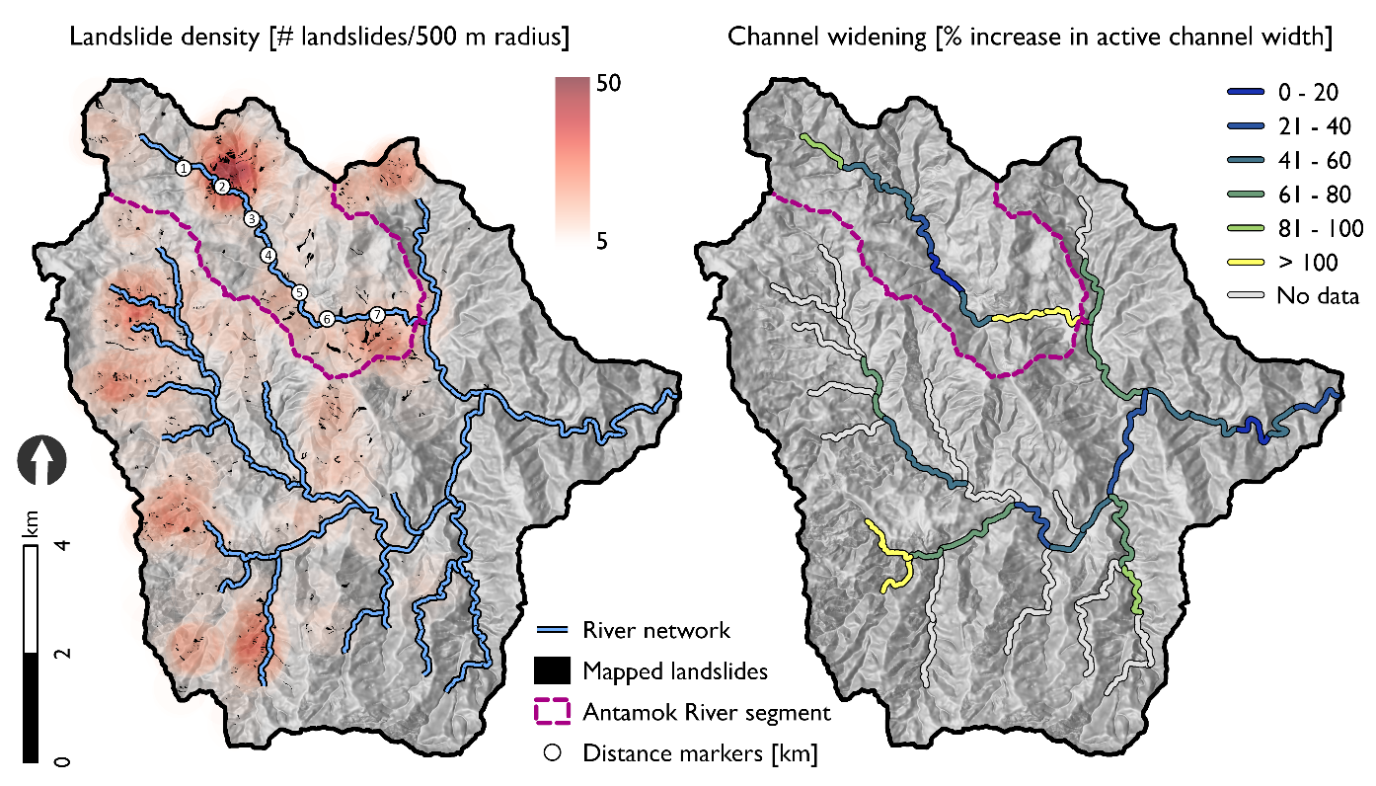
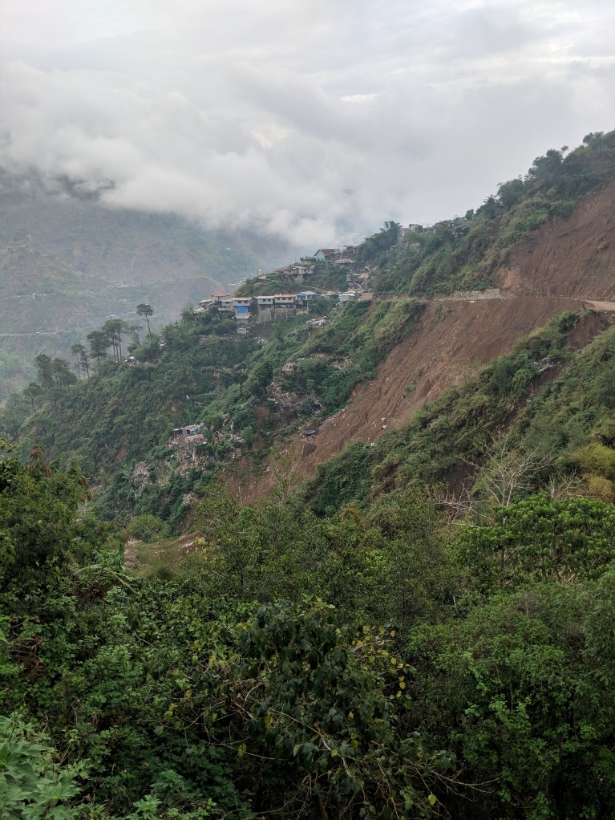

Mapping of landslides and channel widening
Landslide mapping by Abanco et al., NHESS 2021

Slide 17
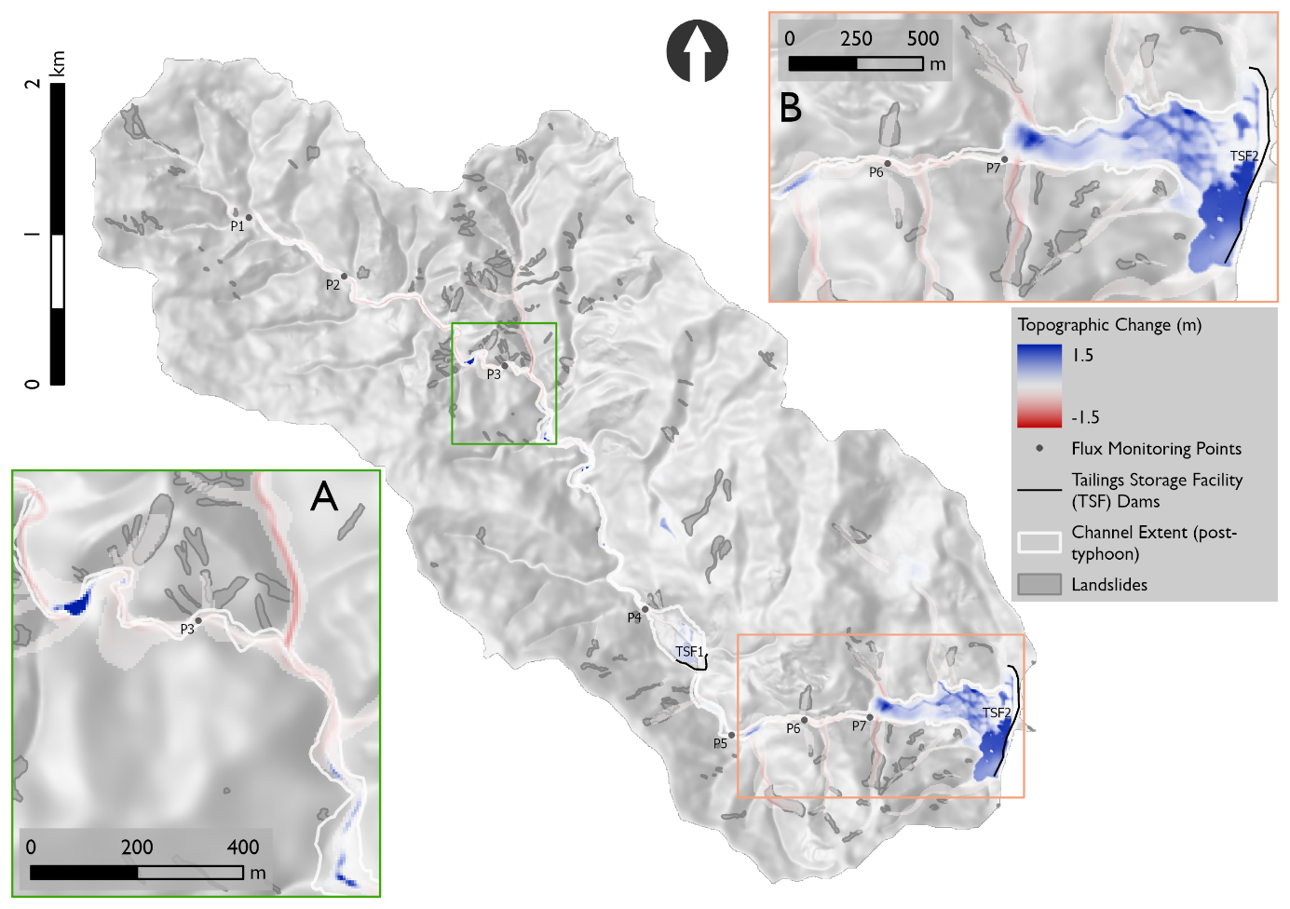
R.avaflow model results
Small ephemeral dam simulated in upper catchment, similar to Colorado study

