Slide 1
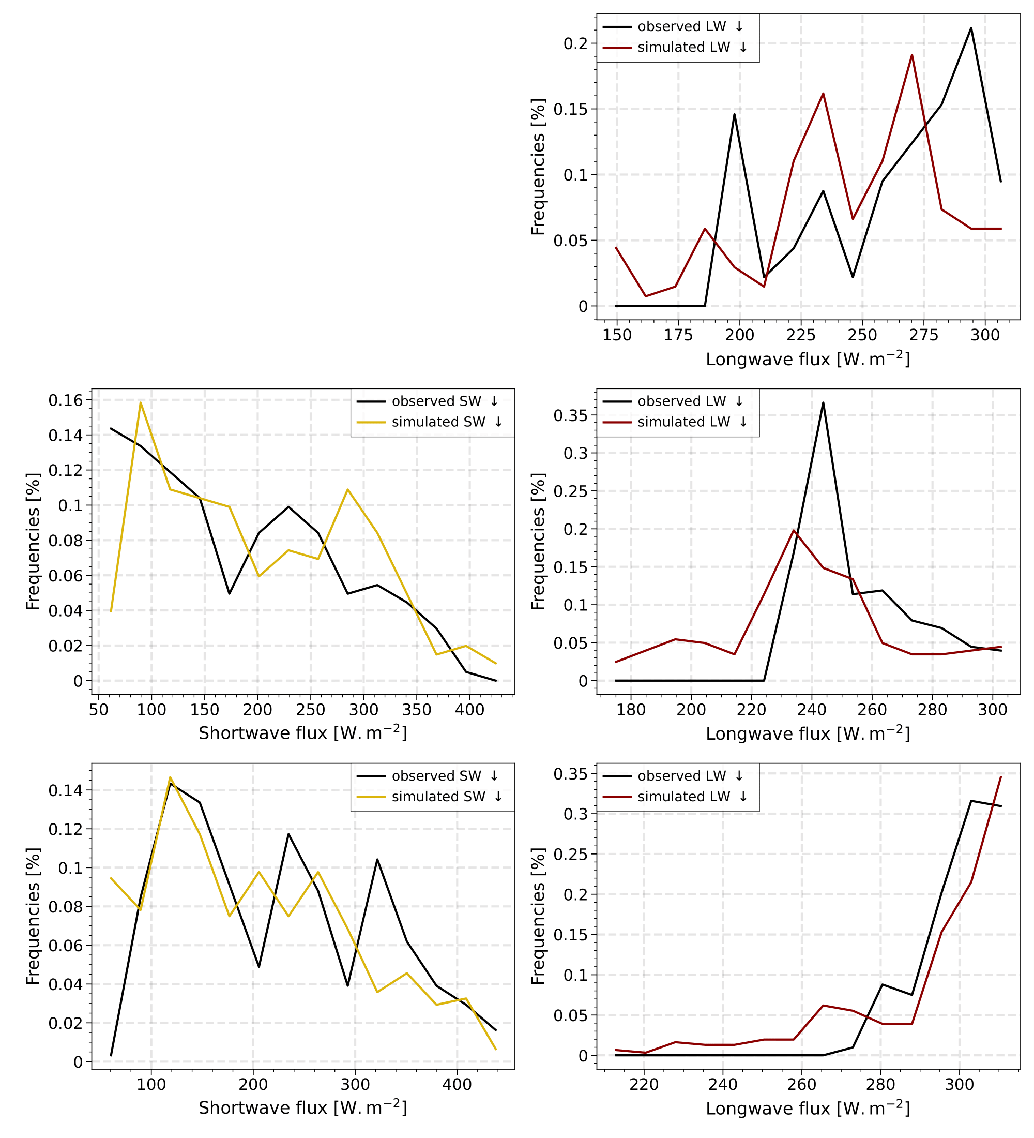

Yaël Le Gars - Modeling cloud phase and radiative effects in the European Arctic
Supplementary materials
Winter : model underestimates frequent situations of high LW↓.
Spring : The distribution for LW is ~ retrieved but with a shift in the peak. Model overestimates SW↓ (underestimates cloud optical depth).
Summer : SW↓ underestimated. The model overestimates cloud optical depth.
Figure S1 : Statistical distribution of observed and simulated downward SW (LW) fluxes values

Slide 2
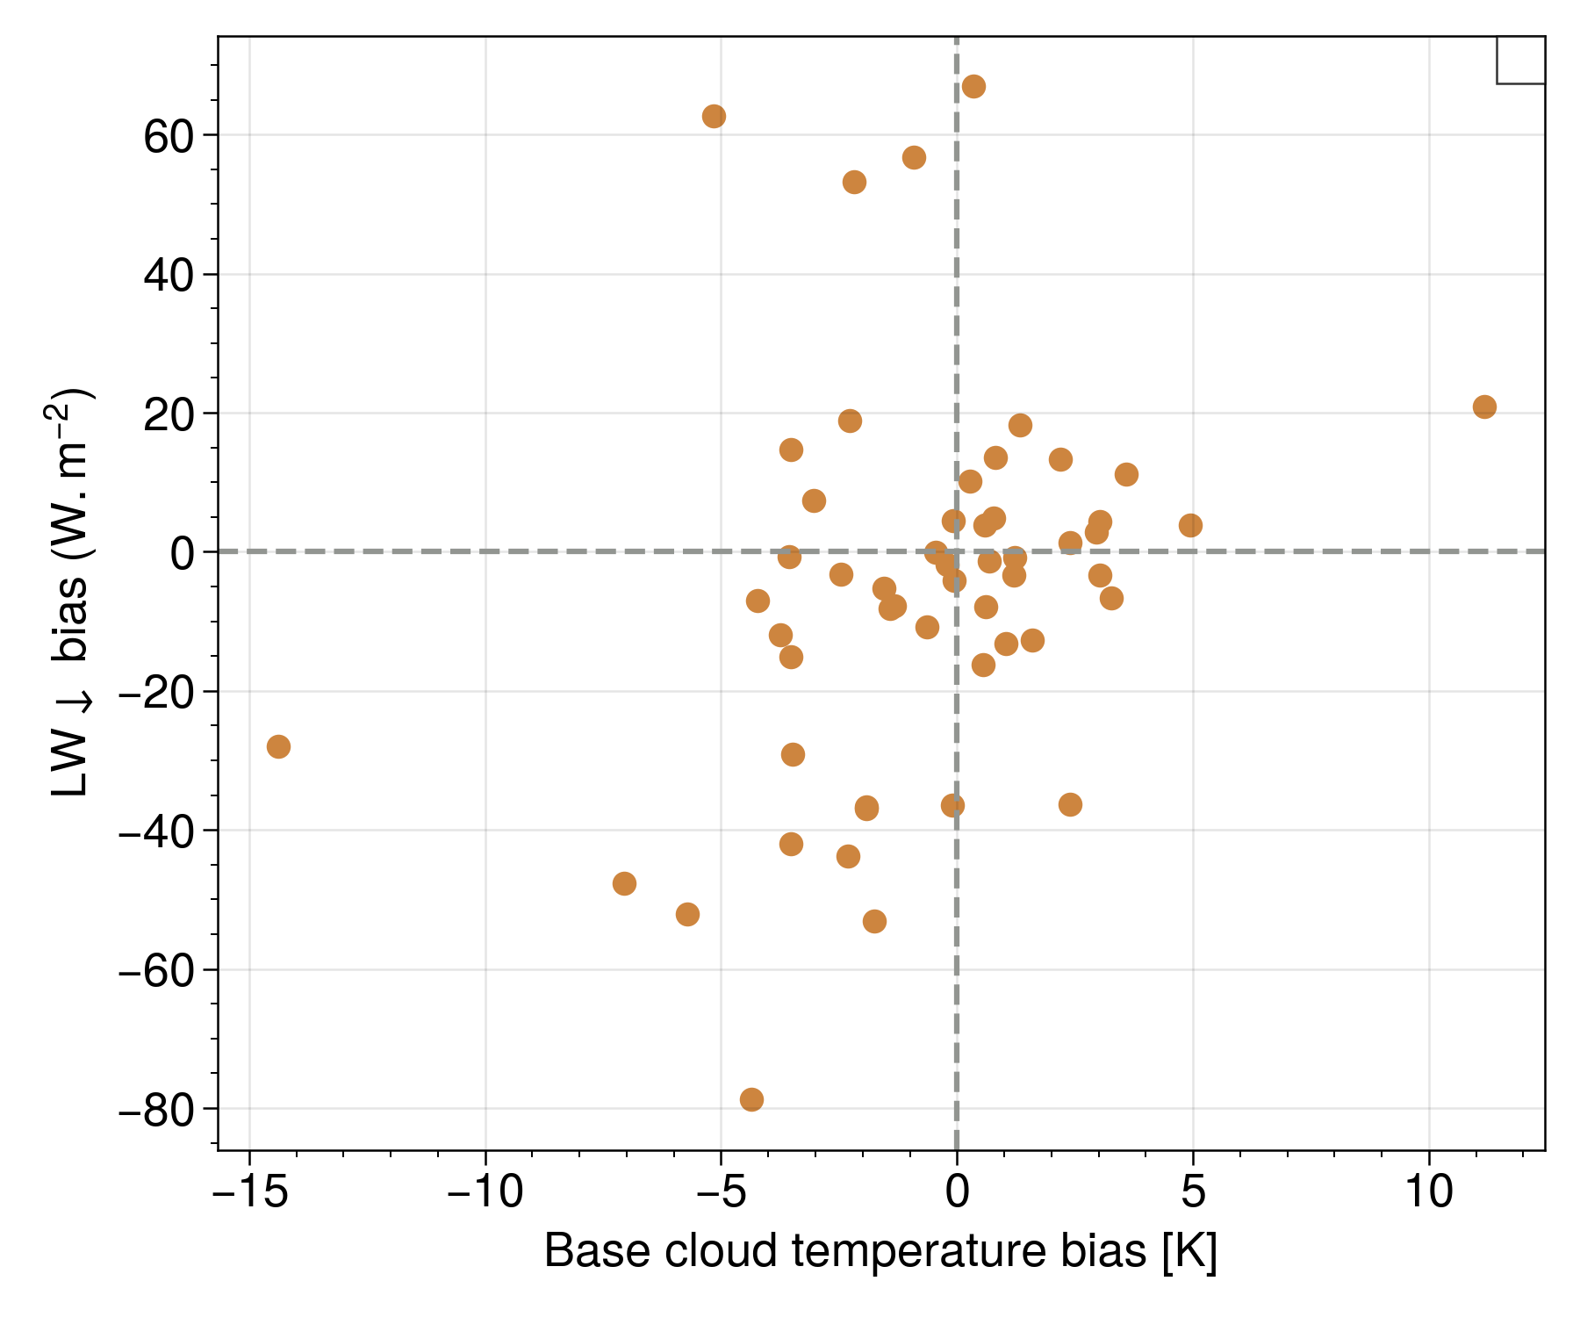
Yaël Le Gars - Modeling cloud phase and radiative effects in the European Arctic
Supplementary materials
No evident correlation between the $${LW}_{↓}$$ radiative biases and the base cloud temperature biases (r² = 0.18).
$${LW}_{↓}$$ are dominated by emissivity biases.
Figure S2 - $${LW}_{↓}$$ biases as a function of Base cloud temperature biases

Slide 3
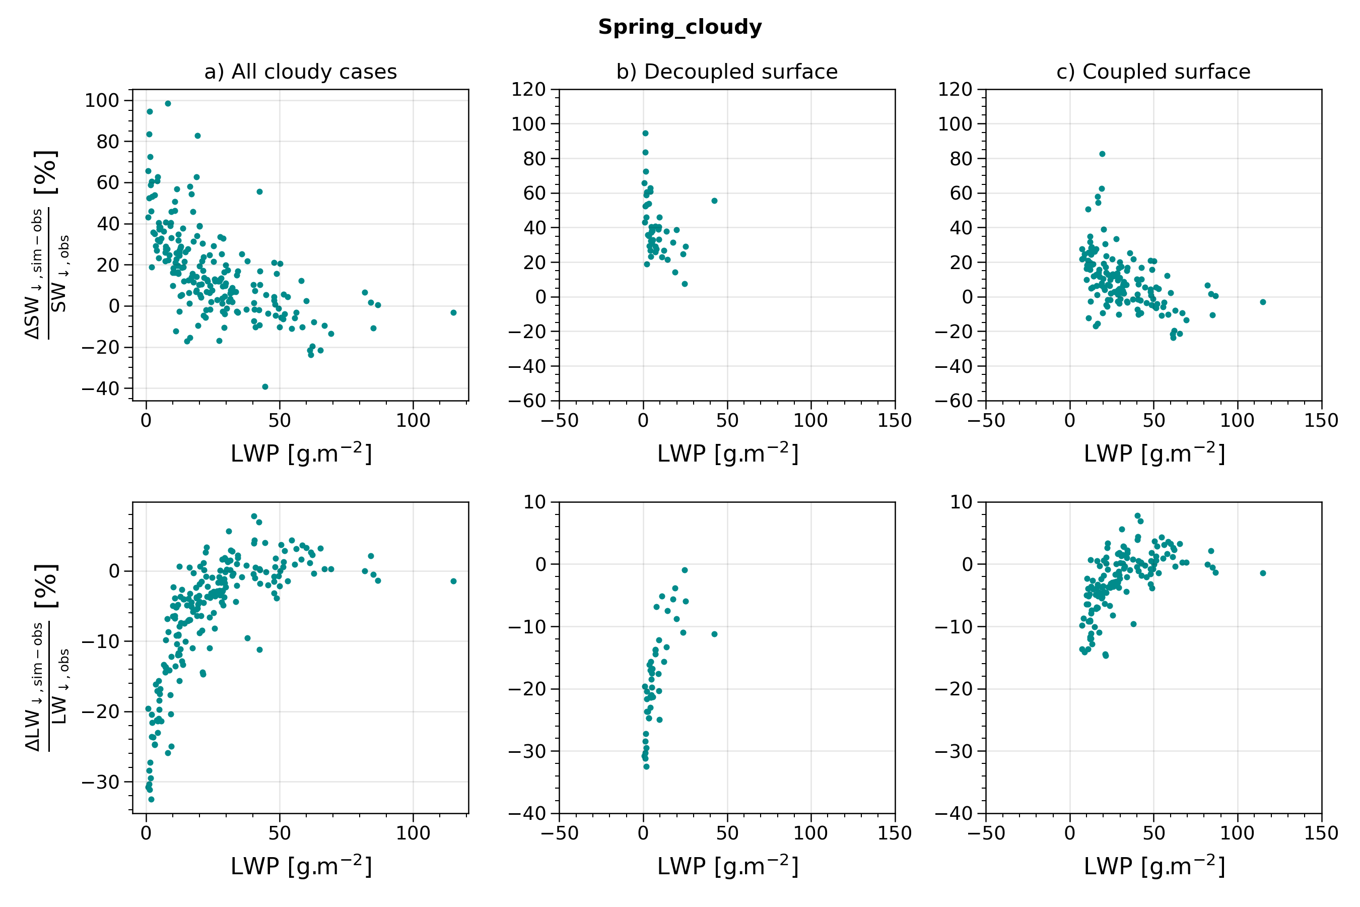
Yaël Le Gars - Modeling cloud phase and radiative effects in the European Arctic
Supplementary materials
The results show clear dependance depending on wether the surface is coupled / decoupled in spring.
The lowest values of LWP, associated with higher biases are occuring over decoupled surface.
The model struggles to create / maintain liquid water over decoupled surface without the surface coupling and surface turbulent fluxes

