Slide 1
Characterizing Sedimentary Facies of Meandering Paleochannel and Floodplain Deposits using Multi-Frequency Ground Penetrating Radar: A Case Study from the Western Part of Bengal Basin
Supplementary File
Ankit Dipta Dutta ¹, Hemen Gogoi ¹, Oindrila Bose ¹, Tridip Bhowmik ², Probal Sengupta ¹, Abhijit Mukherjee ^{1,2}
¹ Department of Geology and Geophysics, Indian Institute of Technology Kharagpur
² School of Environmental Science and Engineering, Indian Institute of Technology Kharagpur
2025

Slide 2
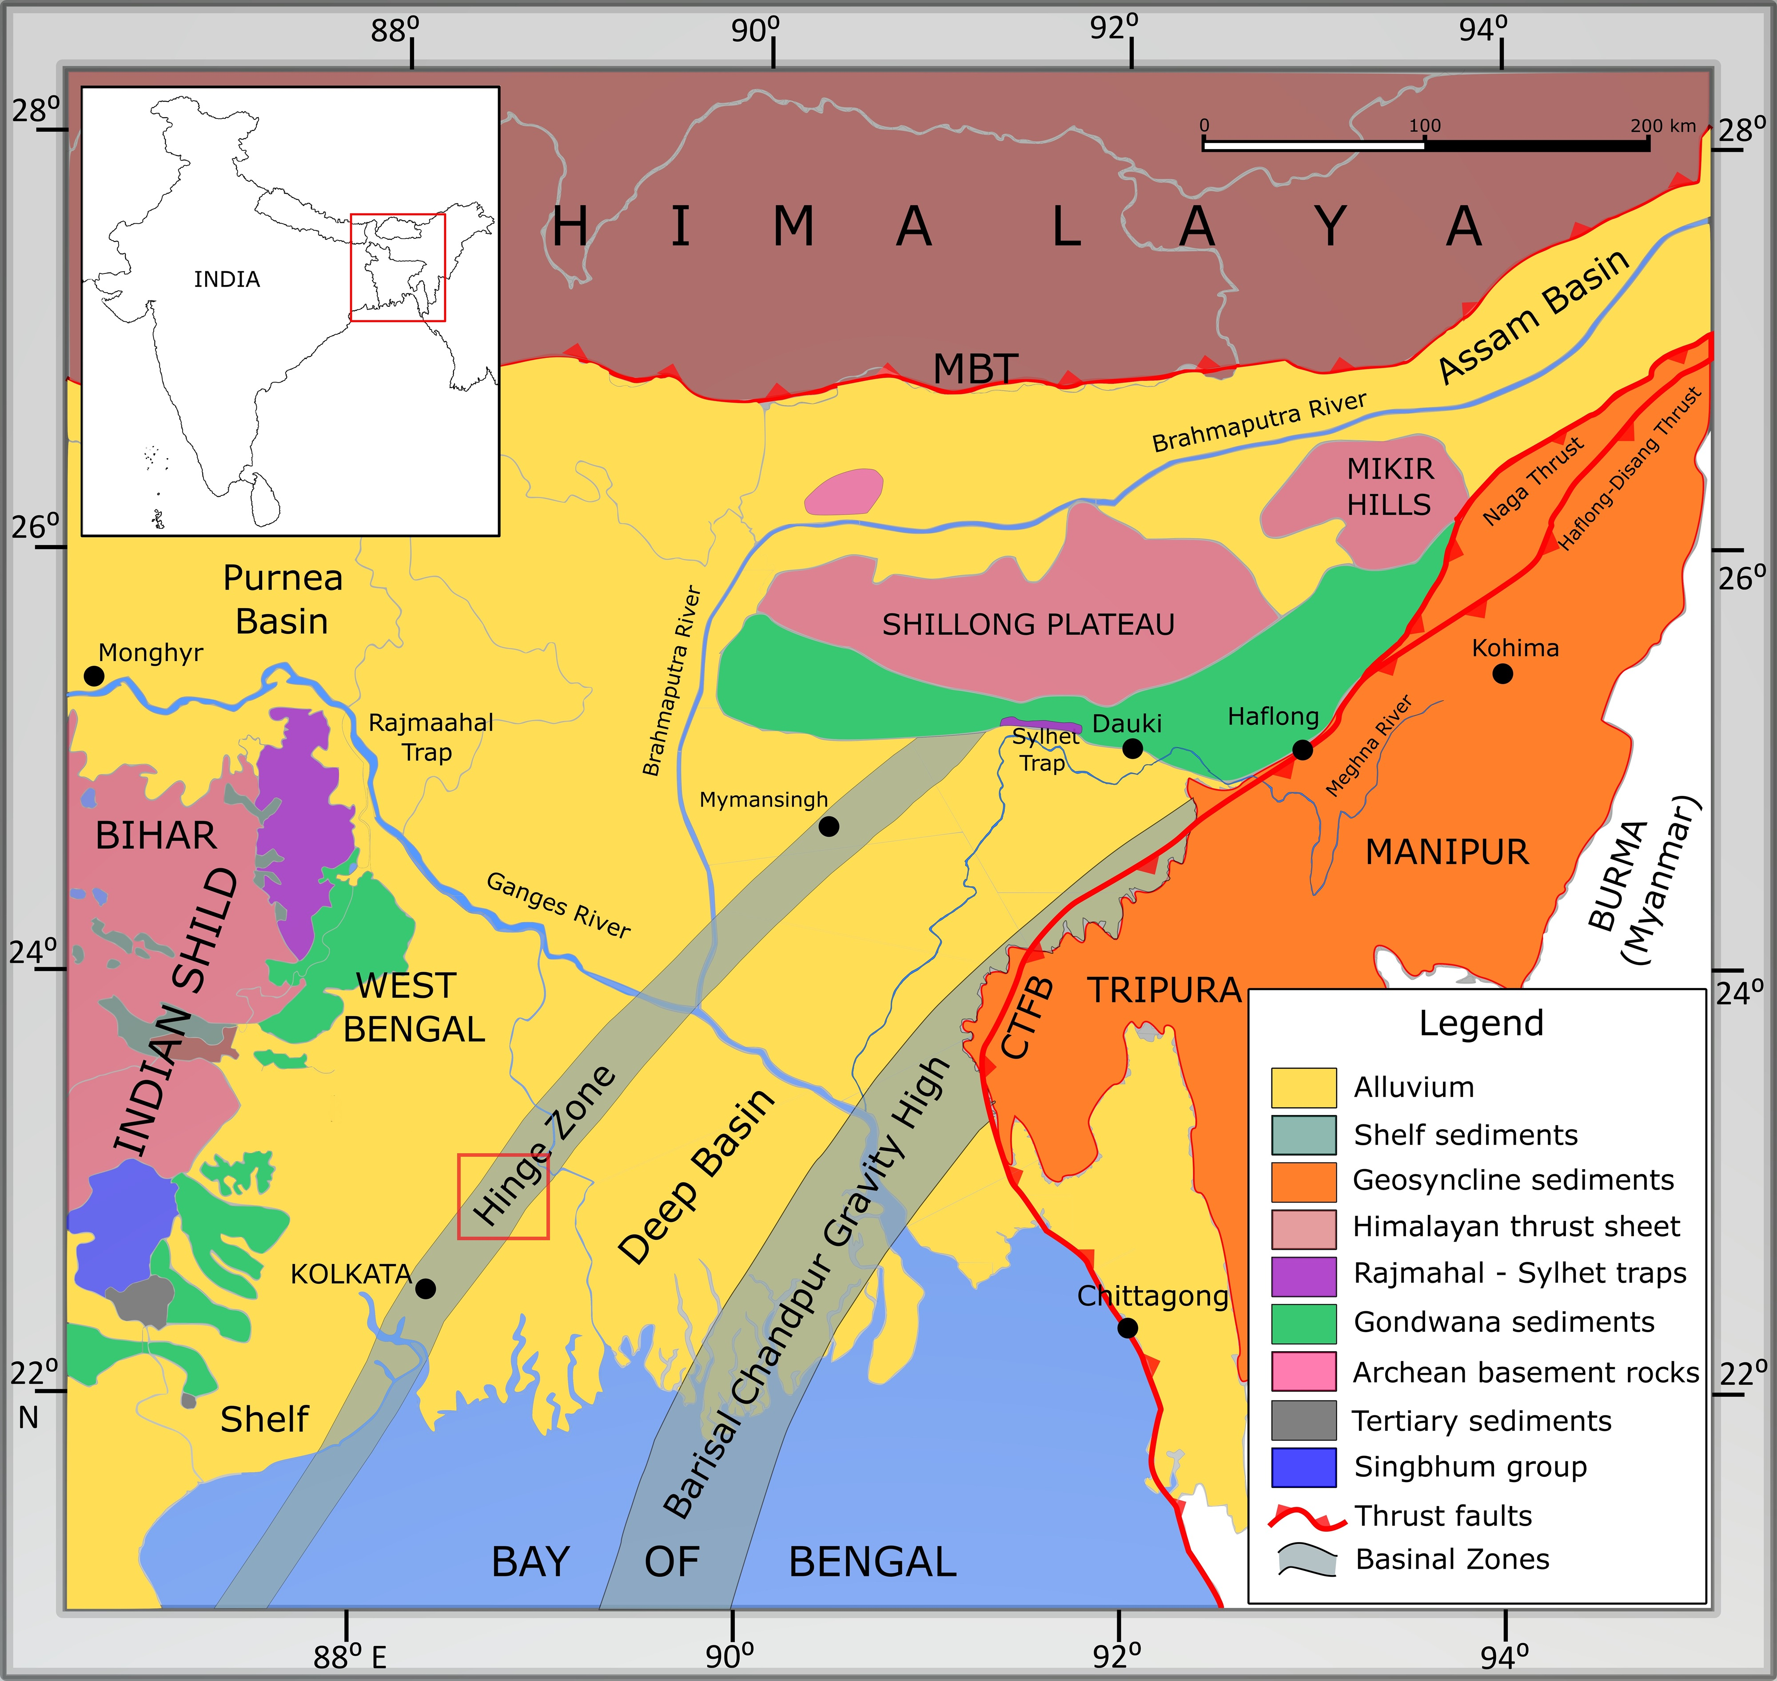
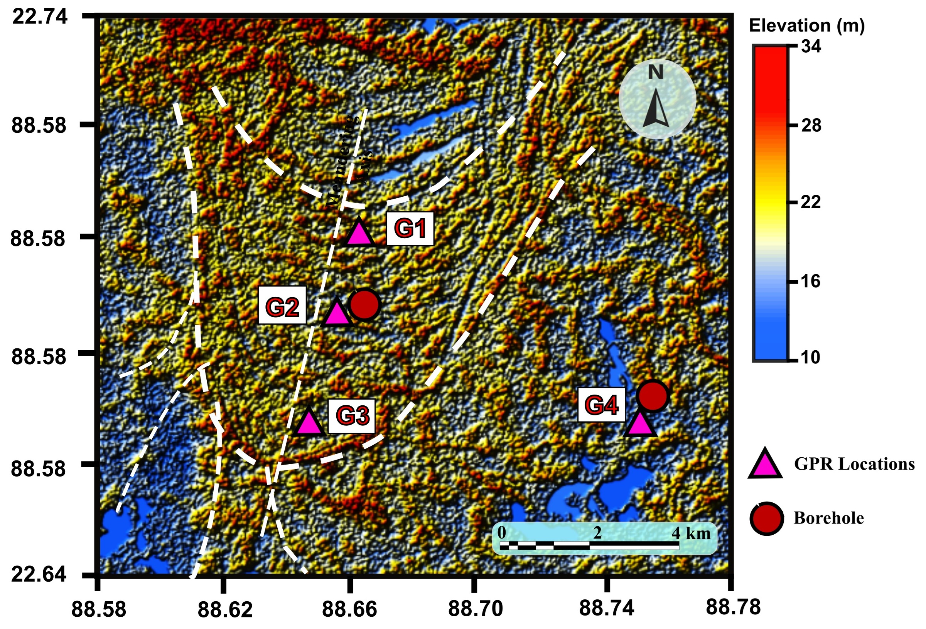
Figure 1: The geological map of the broader study area (left) highlights the local extent of the study site within the Bengal Alluvium, marked by a red rectangle. A digital elevation model (DEM in the left) of the paleochannels and floodplains in North 24 Parganas illustrates geomorphological features and the locations of GPR survey sites: G1, G2, and G3 along the meandering axis, and G4 within the associated floodplain region.

Slide 3
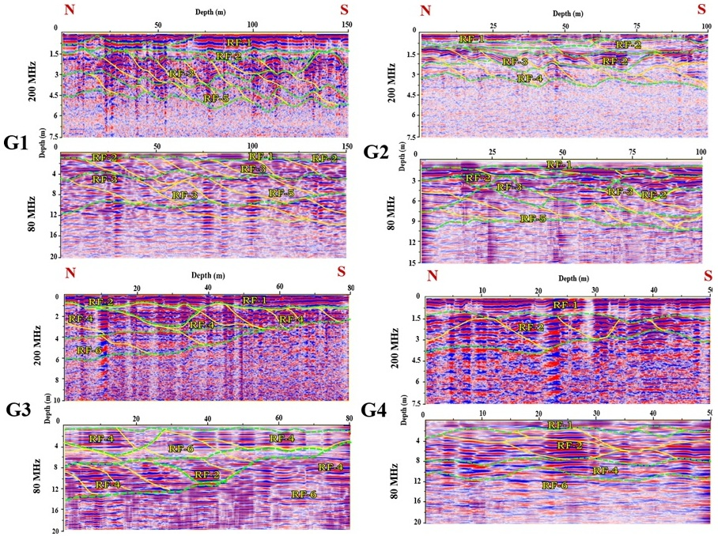
Figure 2: Ground-penetrating radar (GPR) profiles at sites G1, G2, G3 and G4 obtained using 200 MHz and 80 MHz antennas.

