Slide 1
Assessment of flash flood discharges in Madagascar using videos: methodological simplification, sensitivity analysis and feedback
19 JApril 28, 2025
Ambinikasinirina - Tahinandriambelonandro
Thesis Advisor: Eric GAUME Co-Advisor: Aimé Richard HAJALALAINA Supervisor: Andry RAZAKAMANANTSOA Co-Supervisor: Hasina RAKOTONIRAINY

Slide 2
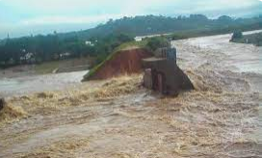
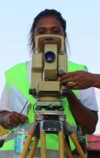
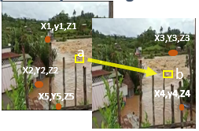
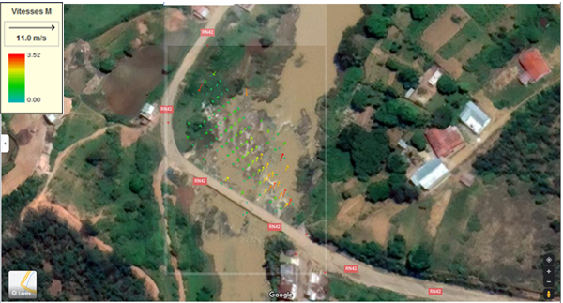
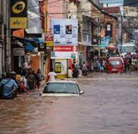
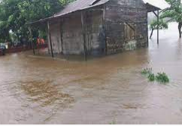
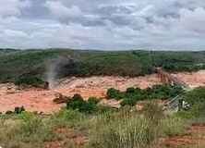
Flood Documentation : LSPIV (Large Scale Particle Image Velocimetry)
A method developed for measuring flow velocity and discharge in rivers using image analysis
LSPIV Method
Several videos of flooding
Terrain topographic measurements
Image matching by correlation
velocity along a transect
Alternative to field surveys : GRPs extracted from online geospatial databases.
Discharges
Uncertainty in velocity and discharge ?
Capability for generating reference points and transects from alternative sources?
Identification and generation of hydraulic reference points for flood event characterization.
Assessment of the relevance and sensitivity of using amateur videos as an alternative data source.

Slide 3
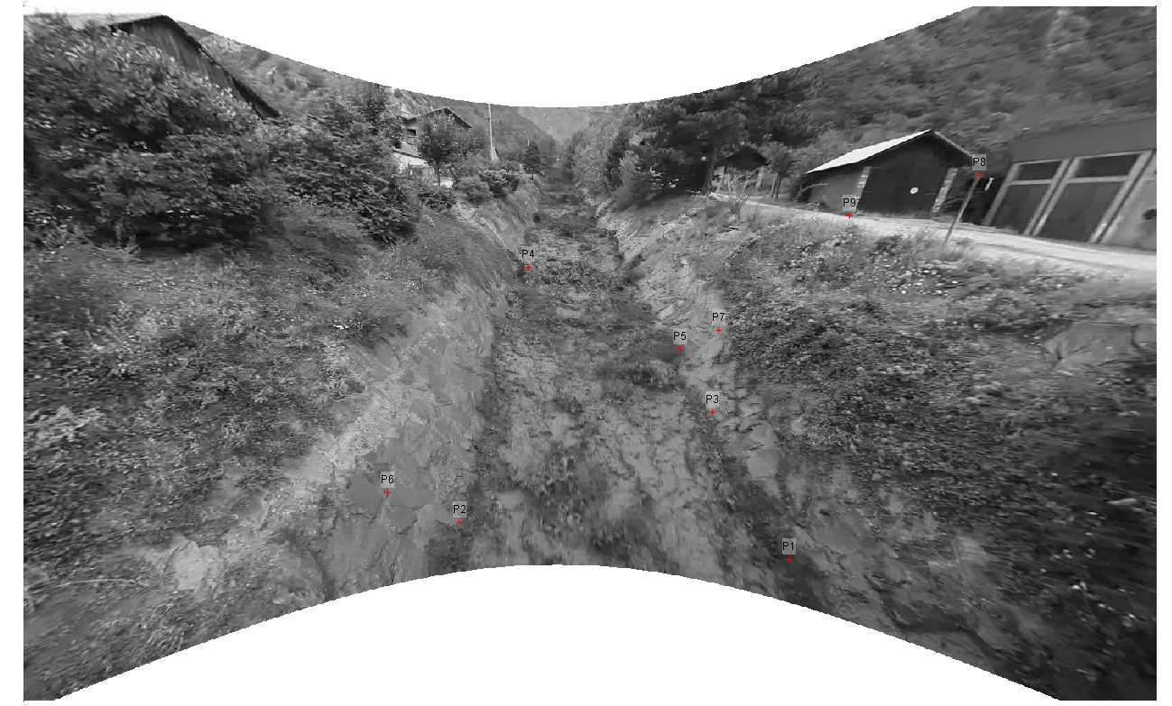
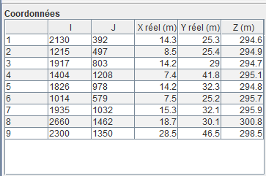
Uncertainty in velocity and discharge : LSPIV (Large Scale Particle Image Velocimetry)
I. Sensitivity analysis of Google Maps reference points relative to a thoroughly documented case study.
1. Based on the study conducted by Le Boursicaud et al. (2016) :
Accurately stabilized image
Resolution : 0,03m/pixel
Orthorectification: 9 Ground Reference Points (GRPs) with well-known x, y, z coordinates.
Times interval : 0.04 s
p8
Number of frames per second: 25 images
p9
Data source: field survey (total station)
p4
p7
p5
p3
p6
p2
p1
Reference points from field survey (total station)
LSPIV Analysis
Post-processing: no filtering applied to instantaneous results.

Slide 4
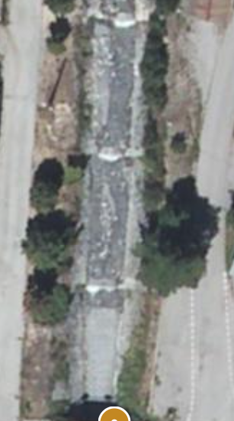
Uncertainty in velocity and discharge : LSPIV (Large Scale Particle Image Velocimetry)
I. Sensitivity analysis of Google Maps reference points relative to a thoroughly documented case study.
2. Change the source GRP points from Le Boursicaud et al., 2016:
Image import: as in the article.
Calculation of the distance between all the reference points.
Horizontally, diagonally, and vertically
Measurement in Geoportail: Coordinates: 45.257253, 6.402508.
20 m
https://www.geoportail.gouv.fr/carte
Selection of reference points with coordinates x, y.
Measuring the distance between points on Google maps.
P1 (7.4 , 41.8)
Deduction of the coordinates for all other reference points starting from P1 by measuring the distance to P2 more easily.
Linear interpolation.
https://www.geogebra.org/classic?lang=fr

Slide 5
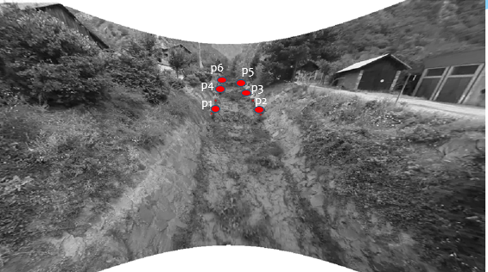
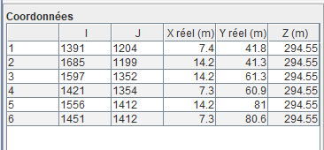
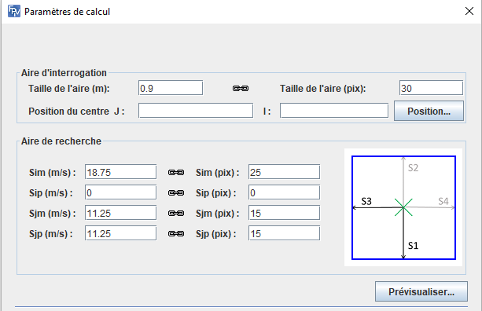
Uncertainty in velocity and discharge : LSPIV (Large Scale Particle Image Velocimetry)
I. Sensitivity analysis of Google Maps reference points relative to a thoroughly documented case study.
2. Change the source GRP points from Le Boursicaud et al., 2016:
2D Orthorectification with 6 reference points.
Table. Coordinates of real points x, y, z, with a unique z value acquired via GPS.
Spatial visualization of reference points.
Definition of the parameter for calculating the tracer's displacement.
Definition of the size of the interrogation area :
Definition of the size of the search area

Slide 6
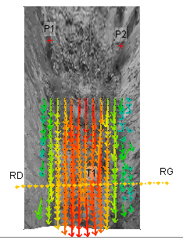
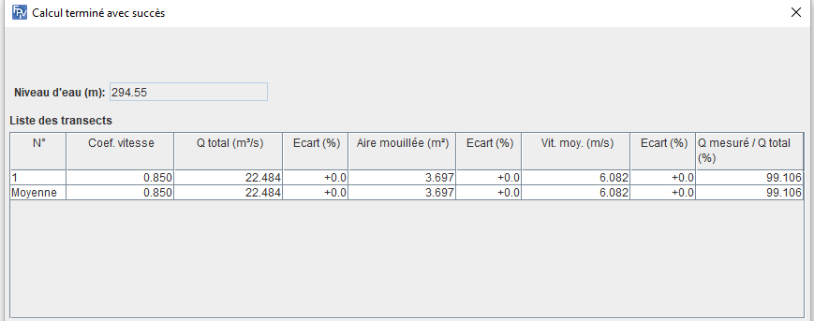
Uncertainty in velocity and discharge : LSPIV (Large Scale Particle Image Velocimetry)
I. Sensitivity analysis of Google Maps reference points relative to a thoroughly documented case study.
2. Change the source GRP points from Le Boursicaud et al., 2016:
Specification of a bathymetric transect.
Results table of the estimation.
0.8% deviation in the average velocity compared to the results of Le Boursicaud et al., 2016.
Visualization of velocity vectors along with the transect.

Slide 7
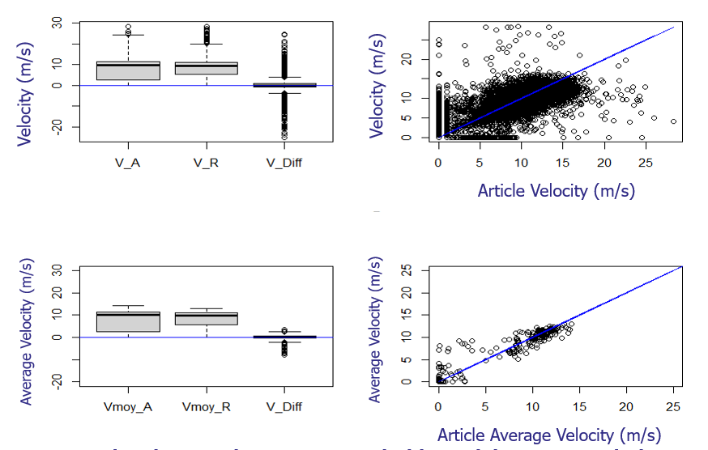
Comparison between instantaneous velocities and the average velocity.
Uncertainty in velocity and discharge : LSPIV (Large Scale Particle Image Velocimetry)
I. Sensitivity analysis of Google Maps reference points relative to a thoroughly documented case study.
2. Change the source GRP points from Le Boursicaud et al., 2016:

Slide 8
Uncertainty in velocity and discharge : LSPIV (Large Scale Particle Image Velocimetry)
I. Sensitivity analysis of Google Maps reference points relative to a thoroughly documented case study.
3. Perturbation of the GRP Theodolite point (Le Boursicaud et al., 2016) and the GRP Google Maps point :
Simulate possible positioning errors of the reference points on the image (for example, manual marking errors or measurement inaccuracies).
Each original image coordinate (i, j) is randomly disturbed within a radius around its position. The radius is determined by a standard deviation corresponding to a reasonable uncertainty based on the image scale and resolution.
The circular disturbance is stretched into an ellipse to better represent directional errors along the waterline edge.
Observe the impact of these errors on the orthorectification and on the velocity calculations:
Recalculate a new set of DLT coefficients to reproject the image for each random draw.
Recalculate velocities and discharges.

Slide 9
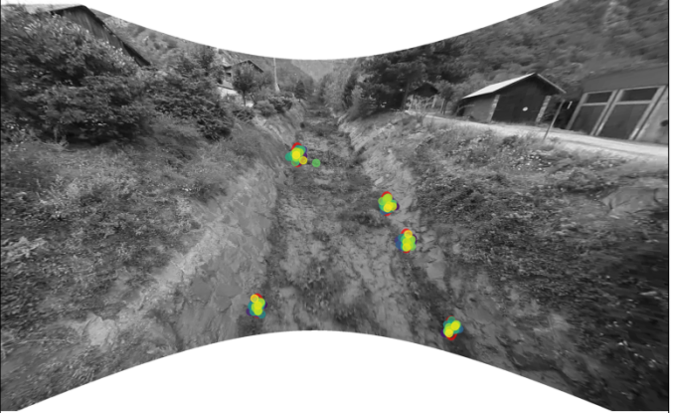
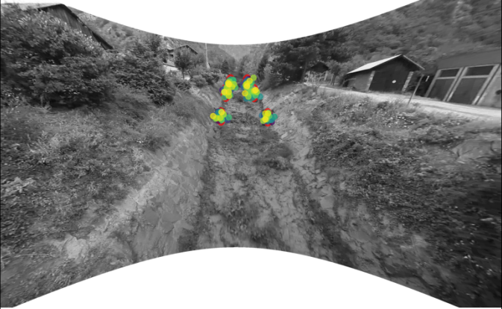
Uncertainty in velocity and discharge : LSPIV (Large Scale Particle Image Velocimetry)
I. Sensitivity analysis of Google Maps reference points relative to a thoroughly documented case study.
3. Perturbation of the GRP Theodolite point (Le Boursicaud et al., 2016) and the GRP Google Maps point : std_dev -> 17.5 Pixels
Computation cross-section
Computation cross-section
From field survey : total station
From Google maps

Slide 10
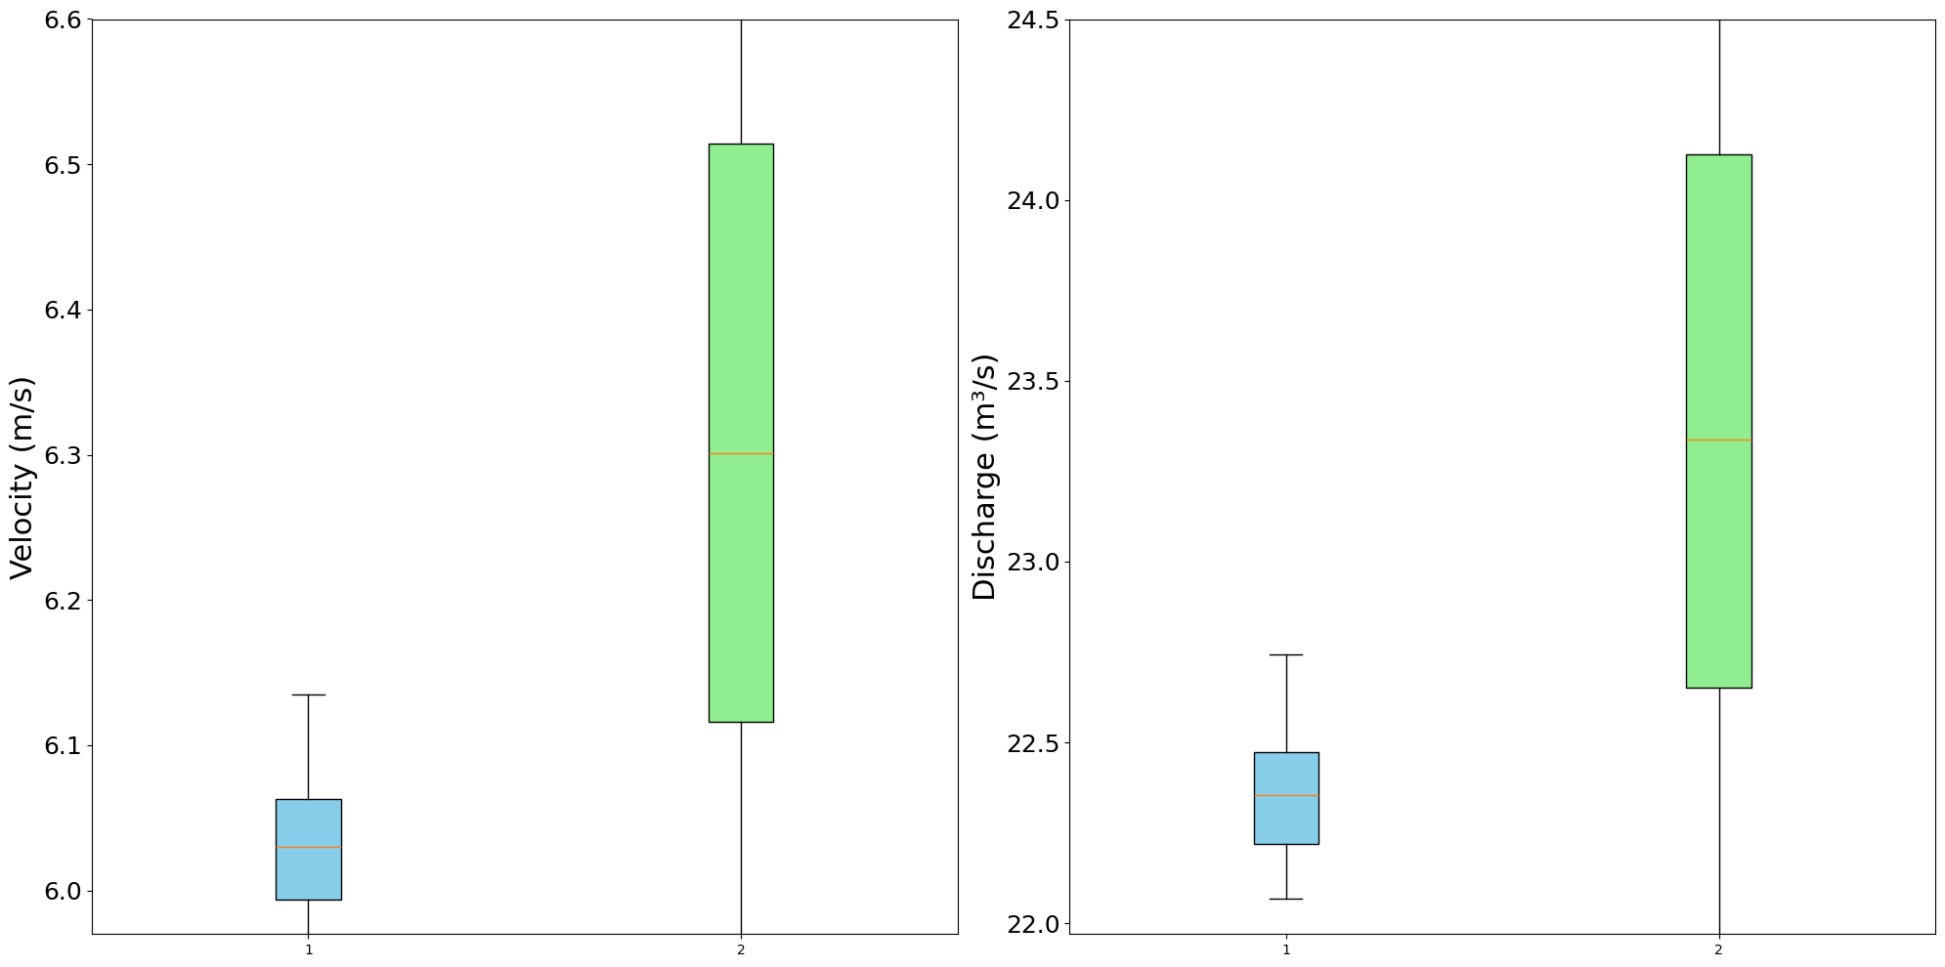
Uncertainty in velocity and discharge : LSPIV (Large Scale Particle Image Velocimetry)
I. Sensitivity analysis of Google Maps reference points relative to a thoroughly documented case study.
3. Perturbation of the GRP Theodolite point (Le Boursicaud et al., 2016) and the GRP Google Maps point :
The mean velocity obtained from both sets of perturbed reference points remains close to 6 m/s. As expected, the velocities derived from Google Maps control points exhibit greater dispersion compared to those obtained from Géoportail references; however, this variability remains generally acceptable given the intended objectives.
Average cross-sectional velocity
Discharges
Regarding discharge measurements, the discrepancies observed can be attributed, on the one hand, to the lack of integration of transect data associated with Google Maps information on the LiDAR-derived Digital Elevation Model (DEM), and on the other hand, to the absence of applied correction coefficients necessary for the adjustment of the measurements.
Total station
Google Maps
Total station
Google Maps

Slide 11
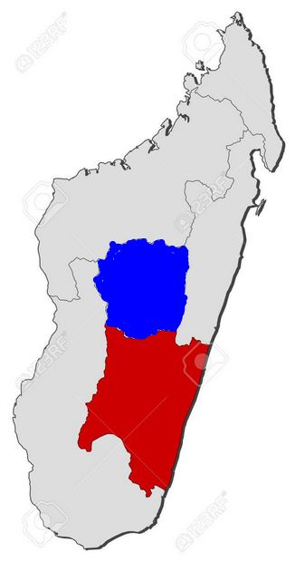
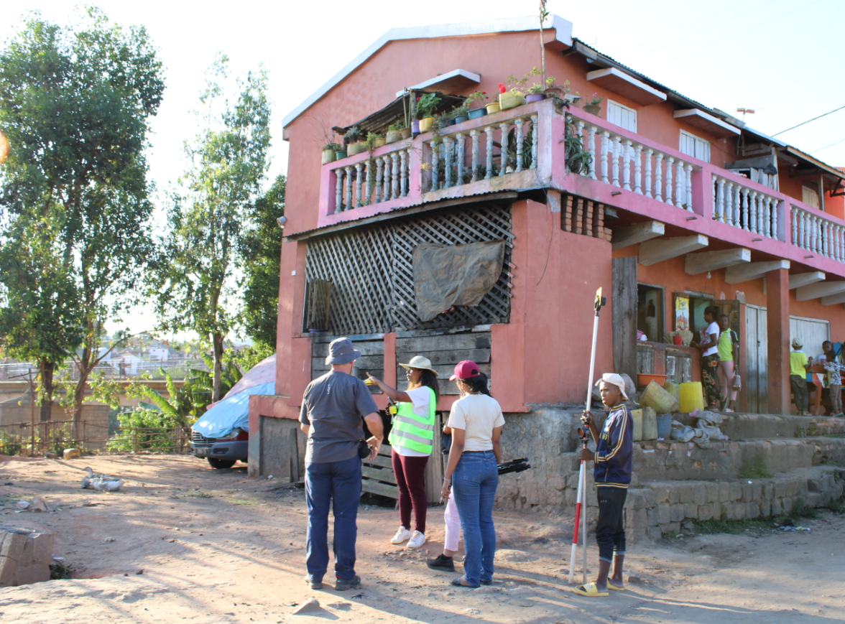
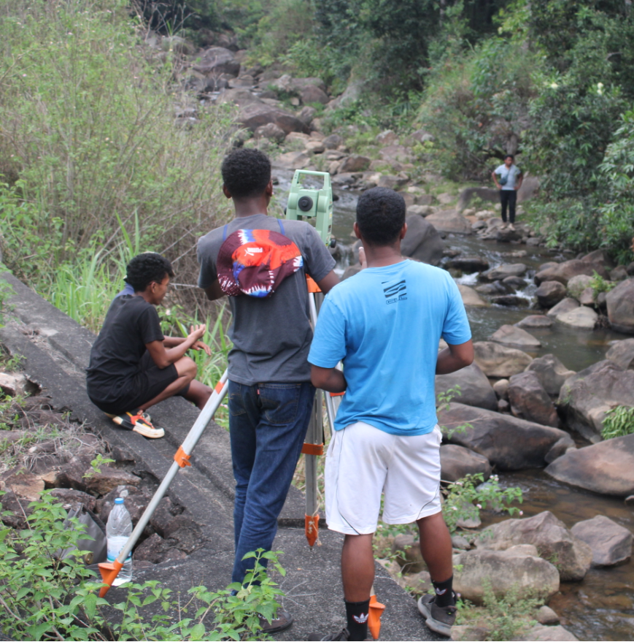
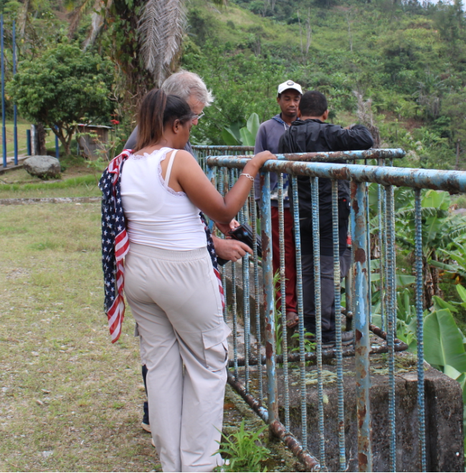
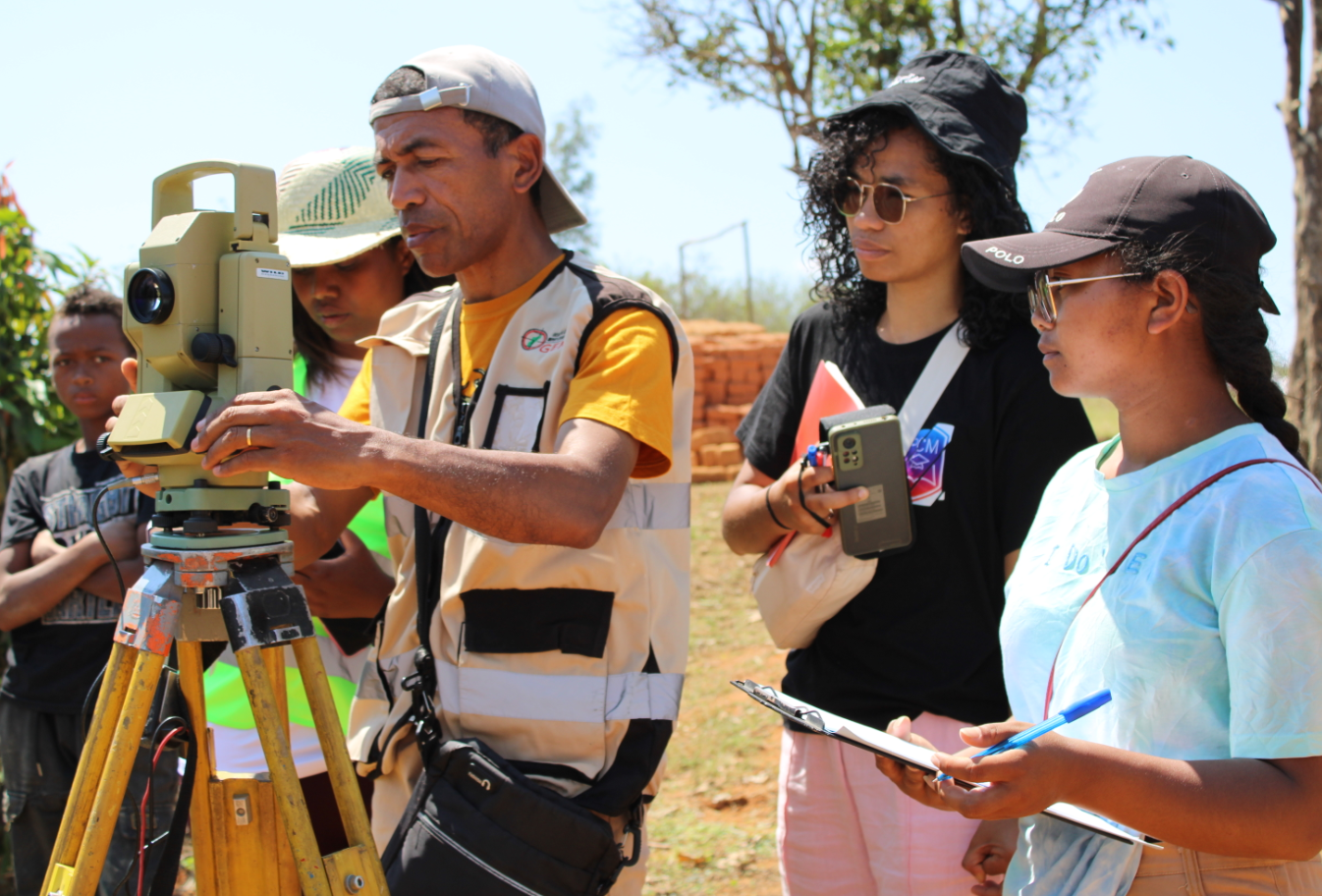
Uncertainty in velocity and discharge : LSPIV (Large Scale Particle Image Velocimetry)
II. Application to Madagascar.
1. Collection of video data and Theodolite GRPs.
Identification of sites of interest
Existing amateur videos of floods.
Sites of interest for discharges.
Identification of flood marks
Antananarivo
Surveying of GRPs and transects using a Theodolite.
Fianarantsoa
Velocity estimation using RADAR

Slide 12
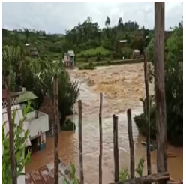
Uncertainty in velocity and discharge : LSPIV (Large Scale Particle Image Velocimetry)
II. Application à Madagascar
2. Perturbation point theodolite vs point Google maps
Vidéos de crue, cyclone Batsirai, 6 Février 2022 Andriamboasary
From field survey : total station
From Google maps
21°24'29.5"S 47°04'26.3"E

Slide 13
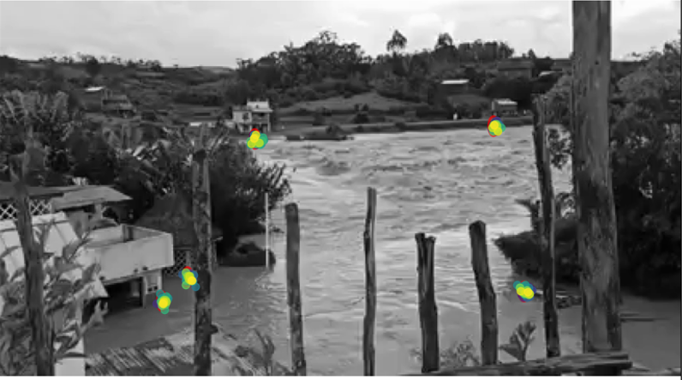
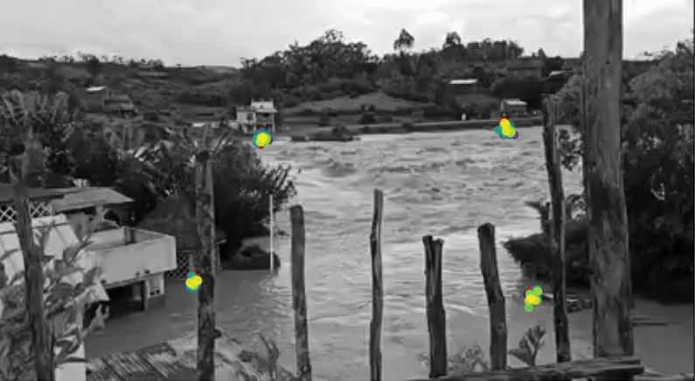
Uncertainty in velocity and discharge : LSPIV (Large Scale Particle Image Velocimetry)
II. Application à Madagascar
2. Perturbation point theodolite vs point Google maps : : std_dev -> 2 Pixels
Vidéos de crue, cyclone Batsirai, 6 Février 2022 Andriamboasary
From field survey : total station
From Google maps
21°24'29.5"S 47°04'26.3"E

Slide 14
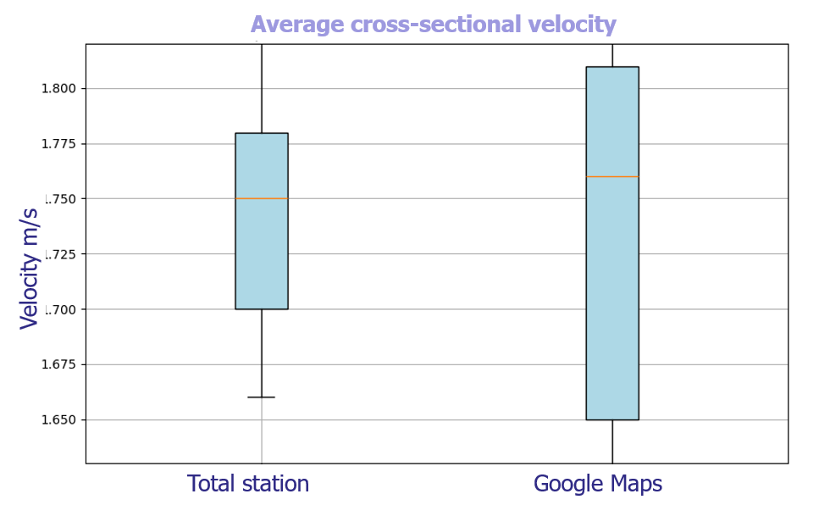
Uncertainty in velocity and discharge : LSPIV (Large Scale Particle Image Velocimetry)
II. Application à Madagascar
2. Perturbation point theodolite vs point Google maps : : std_dev -> 2 Pixels
The average velocities obtained from the two sources of perturbed points remain relatively close, with values ranging between 1.7 and 1.8. As expected, the velocities derived using perturbed points extracted from Google Maps show greater dispersion compared to those obtained from precise points (such as theodolite measurements or local sources).
However, this dispersion remains acceptable, especially considering the context: this concerns a large flood site, where the impact of a 2-pixel error is relatively moderate at the scale of the entire site. Overall, even with a standard deviation of about 2 pixels, the quality of the results remains satisfactory for large-scale hydrological analysis, with reasonable relative deviations in both velocity

