Slide 1
Tuesday, 29 Apr, 08:41–08:43 (CEST)
PICO spot 3, PICO3.3

Slide 2
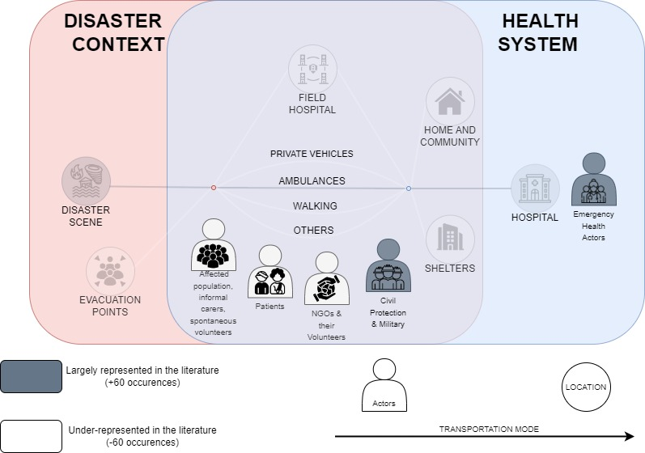

Slide 3
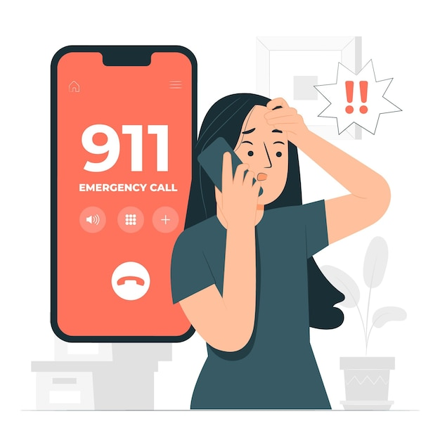
Locals A.K.A Communities
Quantity
Now
Knowledge
Motivated

Slide 4
HOW DO WE DEAL WITH RISKS ?
FIGHT
FLIGHT

Slide 5
Heroes or not ?
ALTRUISM
EGOISM
PROSPECT THEORY
RISK IS OKAY
TOO RISKY
PROTEC MOTIV THEORY
I CAN MANAGE
I CAN’T MANAGE
SOCIAL IDENTITY THEORY
=
CONVERGENCE THEORY
=
AFFECTIVE EVENTS THEORY
HELPING OTHERS
HELPING MYSELF or not
COLLECTIVE
BEHAV THEORY
Notes:
Prospect Theory (Kahneman & Tversky, 1979) – Explains how people make decisions under uncertainty, particularly how fear and perceived risks influence decision-making. In disasters, affected communities might take irrational or unexpected actions due to loss aversion and different risk perceptions.
Protection Motivation Theory (Rogers, 1975) – Describes how fear and perceived severity influence people's responses to threats. Communities might act in unexpected ways based on their perceived vulnerability and ability to cope.
Social Identity Theory (Tajfel & Turner, 1979) – Suggests that people’s group identity influences their decisions. In disasters, informal responders might prioritize helping those they identify with (family, neighborhood, ethnic group), leading to selective and sometimes seemingly irrational responses.
Convergence Theory (Fritz & Mathewson, 1957) – Explains why large numbers of people spontaneously converge on disaster sites, often acting unpredictably. This theory helps explain why informal responders self-organize and engage in immediate but sometimes chaotic actions.
Emergent Norm Theory (Turner & Killian, 1957) – Suggests that in crisis situations, new social norms emerge, leading to unconventional behavior. Communities may create their own rules of engagement, sometimes conflicting with formal response strategies.
Affective Events Theory (Weiss & Cropanzano, 1996) – Highlights how emotions drive decision-making. Fear, anxiety, or past trauma can shape community responses, making their actions appear inconsistent or unpredictable.
Collective Behavior Theory (Smelser, 1962) – Examines how groups behave in unusual situations, explaining spontaneous actions and why communities might resist formal structures or interventions.
Bounded Rationality (Simon, 1957) – Suggests that people make decisions with limited information and cognitive capacity. In disaster contexts, informal actors might make "weird" choices simply because they lack complete situational awareness.

Slide 6
Not only up to you and your actions

Slide 7
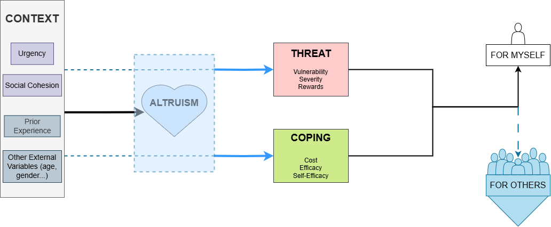

Slide 8
Tuesday, 29 Apr, 08:41–08:43 (CEST)
PICO spot 3, PICO3.3

Slide 9
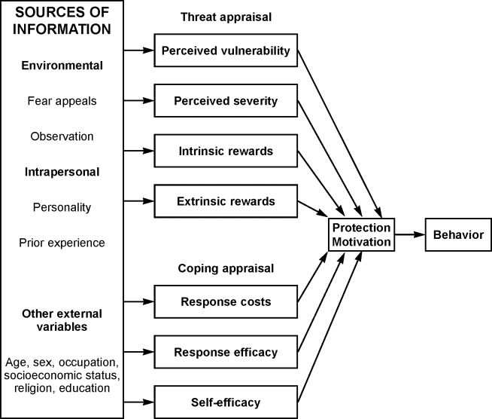

Slide 10
WHO ?
TO DO WHAT?
WHEN ?
ALTRUISM ?

Slide 11
What do we want to know ?
What drives people to act for themselves / for others ?
Context
Threat
Coping
Altruism

Slide 12
1
2
3
5
4

Slide 13
Hypothesis
1
Urgency Shapes Responses
2
Social Cohesion Influences Responses
3
Altruism Does Not Change Threat Appraisal
4
Altruism Does Not Change Coping Appraisal
5
Threat & Coping Don’t Motivate to Help Others

Slide 14
Methods
Survey (PMT) testing Hypothesis (on development)
Distribution in recent flood disasters areas in Europe
Hypothesis Test with Survey Results (SEM, factor analysis, regressions…)
Scenario Based Survey to include more respondents
With Qualtrics and distribution with company (Yougov…)

Slide 16
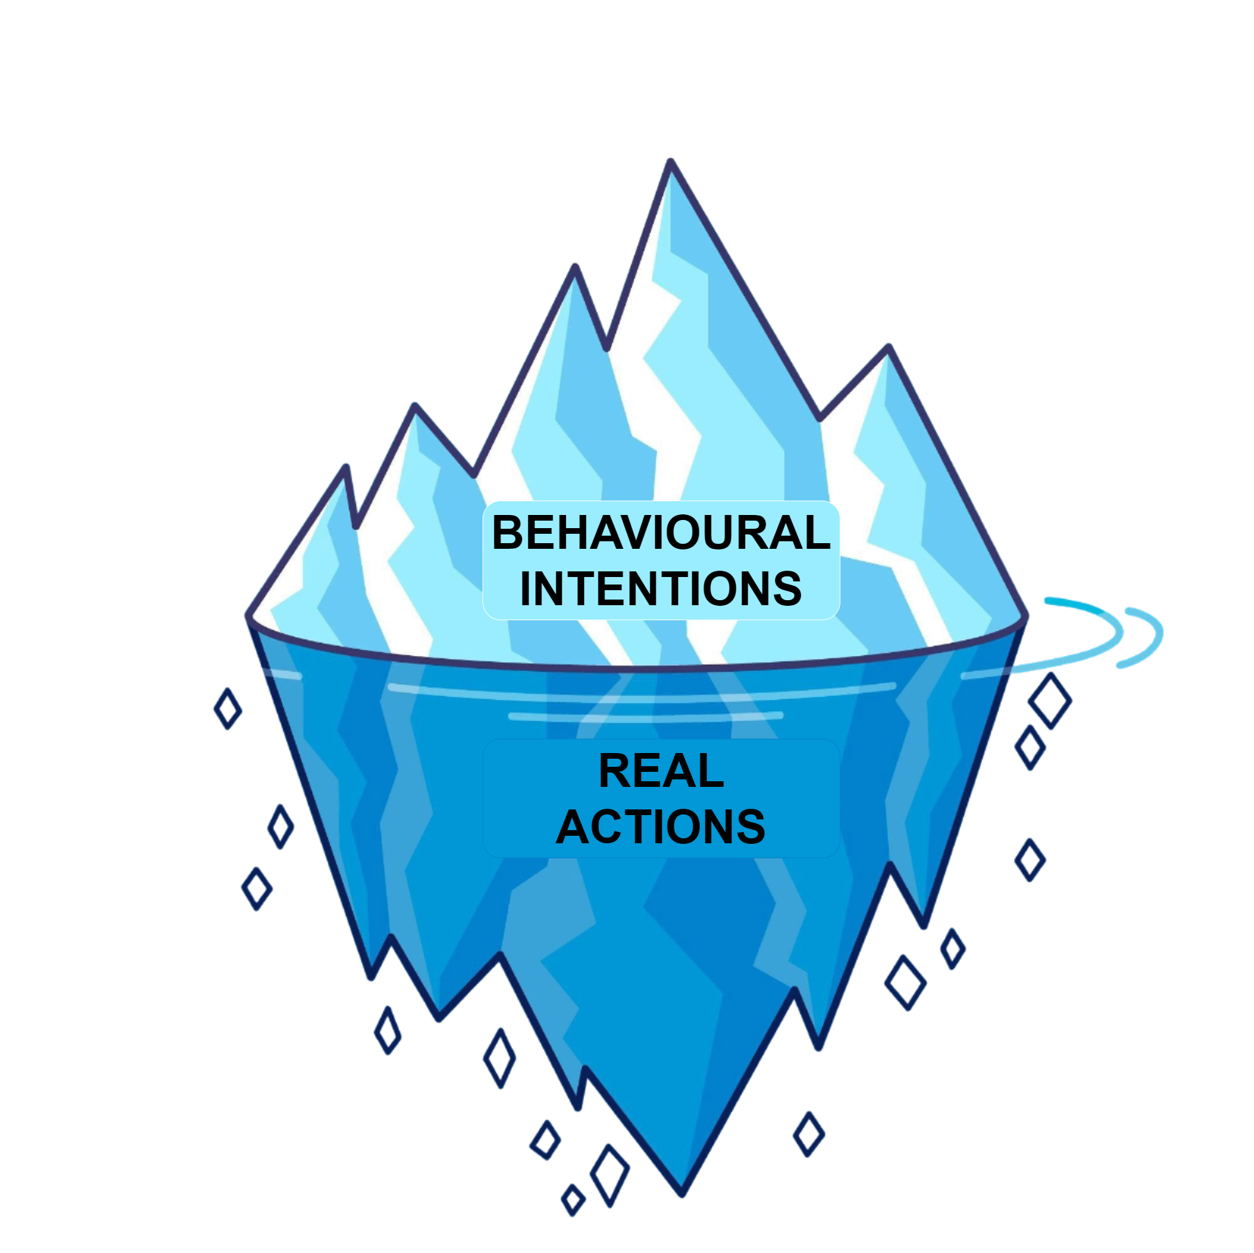
I WILL ≠ I CAN

Slide 17
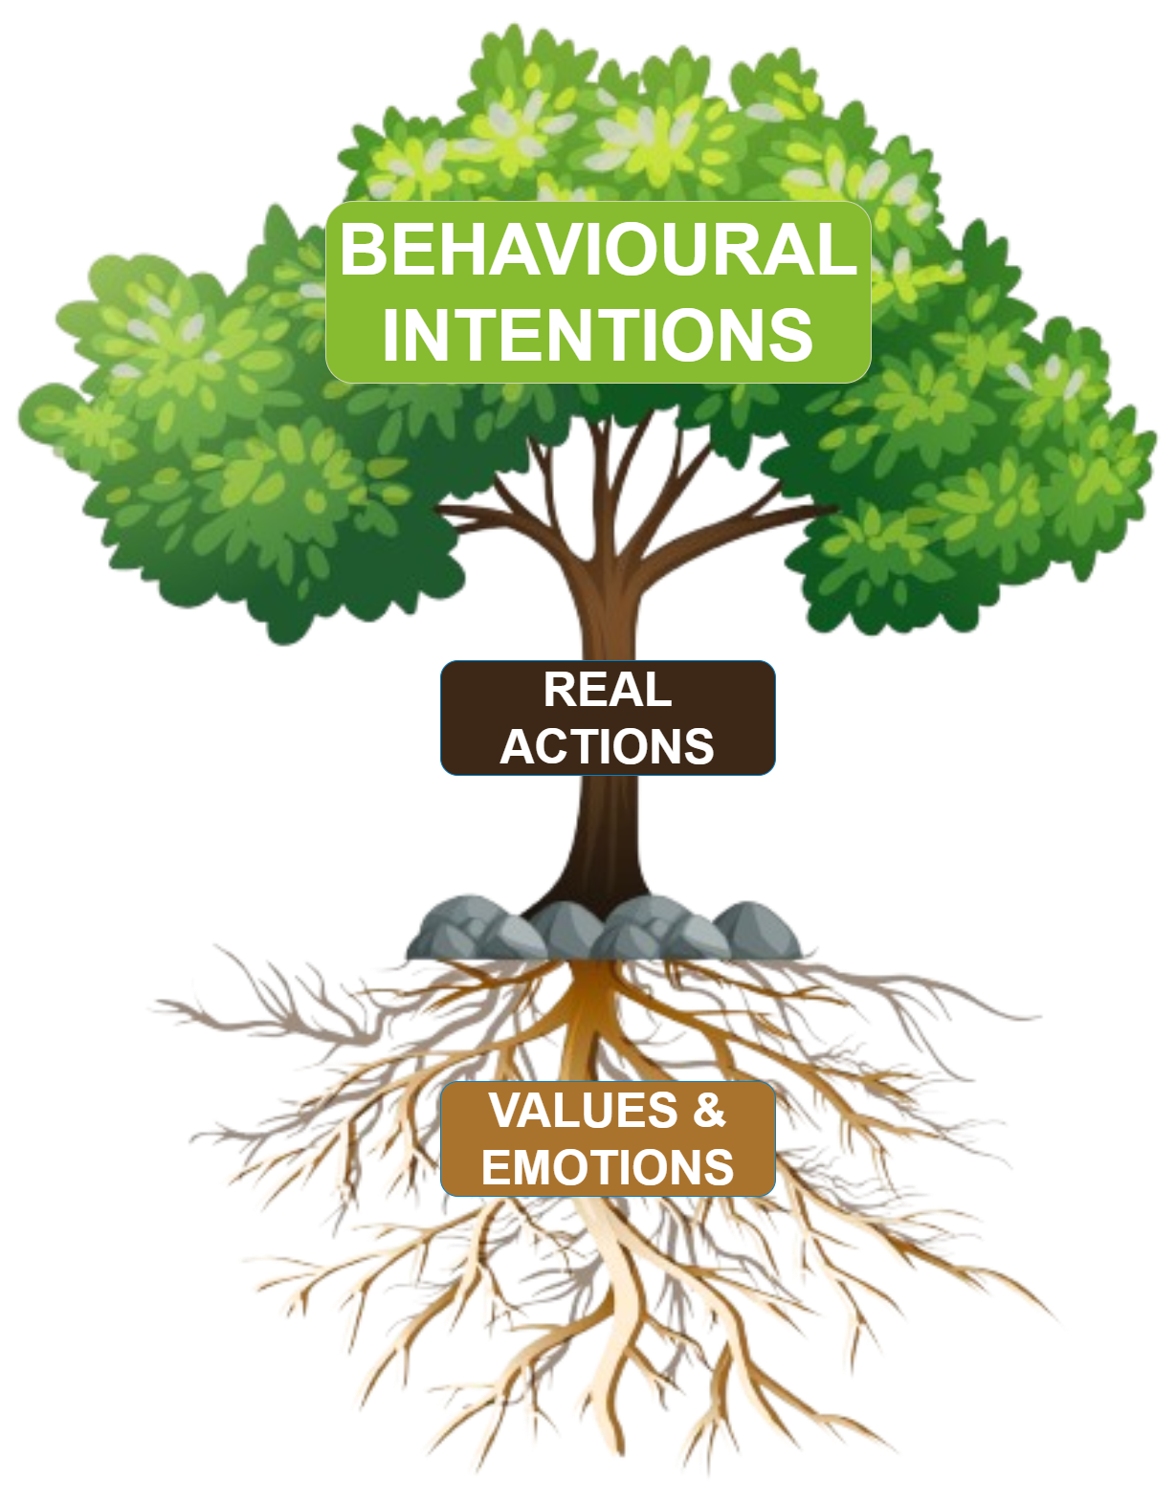

Slide 18
Tuesday, 29 Apr, 08:41–08:43 (CEST)
PICO spot 3, PICO3.3

