Slide 1
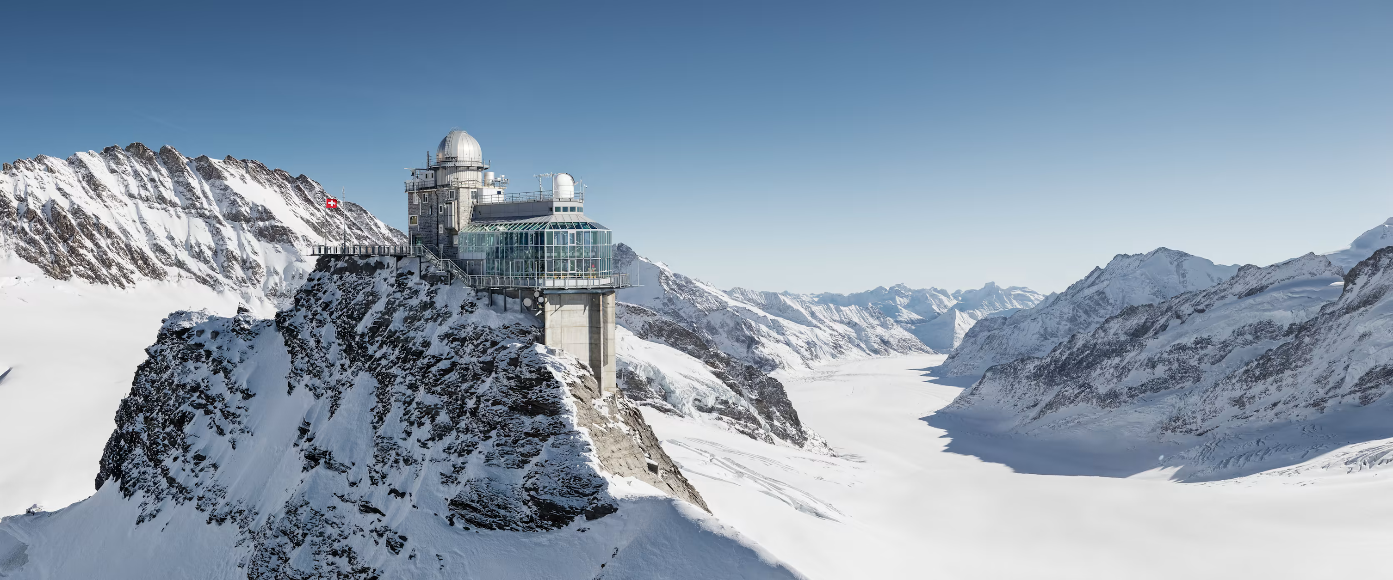




Temporal Dynamics of Atmospheric Microbial Communities in the Alps: Insights from 11-Years of High-Altitude Sampling
Marie Labat Saint Vincent; Patrik Winiger; Julian Weng; Stephan C. Schuster; Christoph Hueglin; Sophie Darfeuil; Pauline Bros-Rolere; Patrick Ginot; Claudia Mohr; Jean-Luc Jaffrezo; Imad El-Haddad; Aurélien Dommergue; Catherine Larose
PALEO-MARE
Credit: https://www.jungfrau.ch/en-gb/jungfraujoch-top-of-europe/
Notes:
In this project we analyzed 11 years of atmospheric samples (2010–2021) at Jungfraujoch, a mountain in the Swiss Alps (3500 m a.s.l.), and we are trying to understand the temporal dynamics of Atmospheric microbial communities.

Slide 2



Atmospheric Microbial Dynamics at High Altitude: 11 Years at Jungfraujoch (Swiss Alps)
Objectives with this data:
  Variation in microbial DNA concentration
  Community changes (Taxa and Functions) over time
  Linking it to atmospheric chemistry and meteorology
⟶ Today’s focus: bacterial DNA concentration dynamics
Result Highlights
The concentration of bacterial DNA in the atmosphere of Jungfraujoch is influenced by :
Dust Events
Notes:
Pas mettre hypothese mais que result highlight c'est correlation avec dust

Slide 3
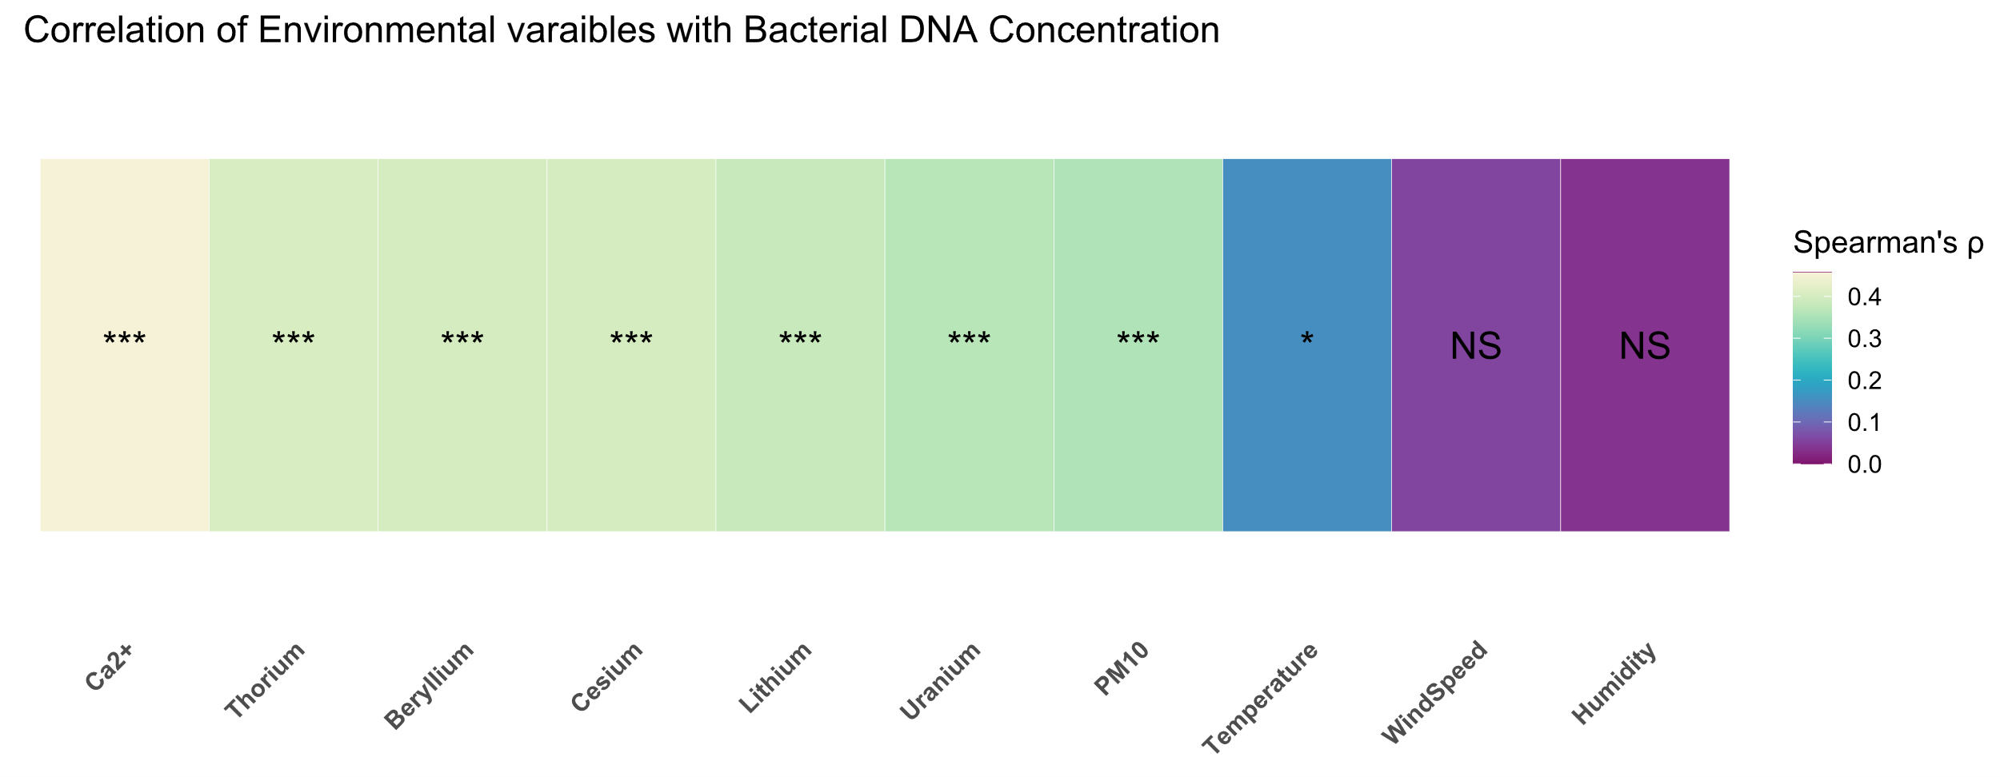
Dust events as microbial highways to glaciers?
  Among meteorological and chemical analyses, the highest correlations for bacterial DNA concentrations were found with mineral dust tracers (Ca²⁺, Thorium, Beryllium, Cesium, Lithium, PM10).
  The meteorological factors are not the main driver of bacterial abundance at Jungfraujoch
This suggests that Dust is a major driver of bacterial abundance in our samples.
p-value < 0.001 = *** ; p-value < 0.01 = ** ; p-value < 0.05 = * ; p-value > 0.05 = NS

Slide 4
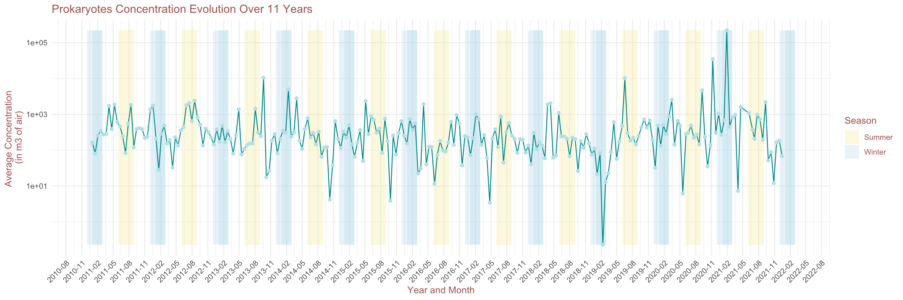
Time series plot of bacterial DNA concentration
DNA concentrations stable overall but show episodic increases and decreases.
No strong seasonal or monthly trend detected (Kruskal-Wallis, p-value = NS).

Slide 5
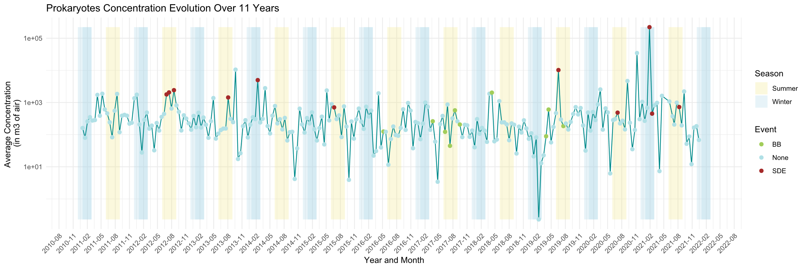
Time series plot of bacterial DNA concentration
DNA concentrations stable overall but show episodic increases and decreases
No strong seasonal or monthly trend detected (Kruskal-Wallis, p-value = NS)
Saharan Dust Events (SDE) cause significant DNA concentration increases (Kruskal-Wallis, p-value =***)

Slide 6

Home
Thank you for your attention!
Marie Labat Saint Vincent; Patrik Winiger; Julian Weng; Stephan C. Schuster; Christoph Hueglin; Sophie Darfeuil; Pauline Bros-Rolere; Patrick Ginot; Claudia Mohr; Jean-Luc Jaffrezo; Imad El-Haddad; Aurélien Dommergue; Catherine Larose

Slide 7


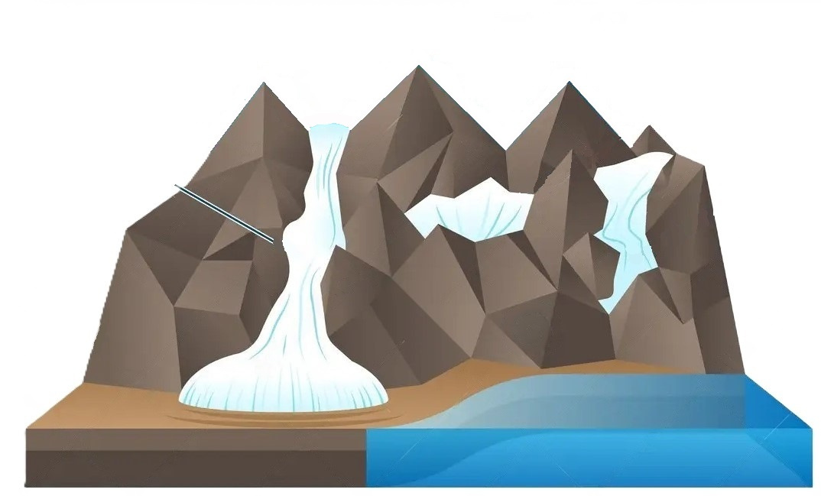

CONTEXT
Home
Alpin glacier
Physical and chemical measurements
Mesures physiques et chimiques
  Temperatures
  Water isotopes
  Gas concentrations
Reconstruction of Earth's climatic history
What about microorganisms?

Slide 8


CONTEXT
Home
  Microorganisms and particles are transported by the atmosphere
2. Snowfall encourages the deposition of micro-organisms and particles on land surfaces.
3. Snow accumulates over time and transforms into ice with a time-resolved layered structure.
Layers represent seasonal to annual stratification

Slide 9
CENTRAL QUESTION OF THE THESIS
Home
How do communities evolve between their initial deposition on the snow and their final incorporation into the ice?
%?
Quantifying the fidelity with which communities trapped in ice reflect those in the atmosphere at a given time
  Reconstructing past microbial ecosystems
  Reconstructing the environments that shaped them

Slide 10
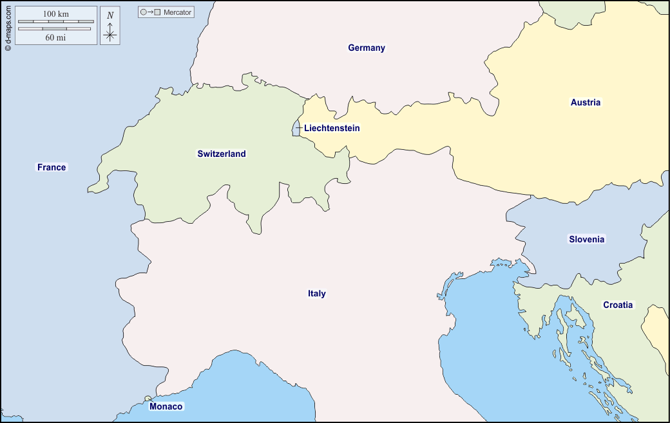
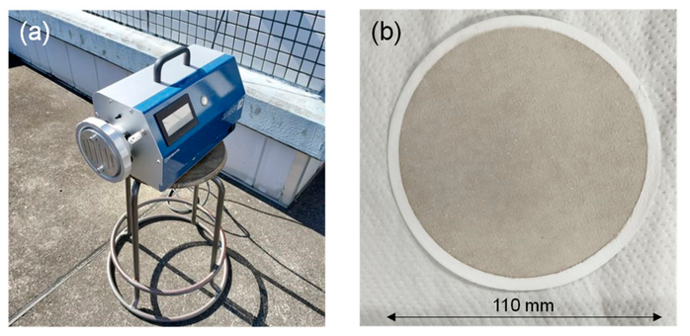
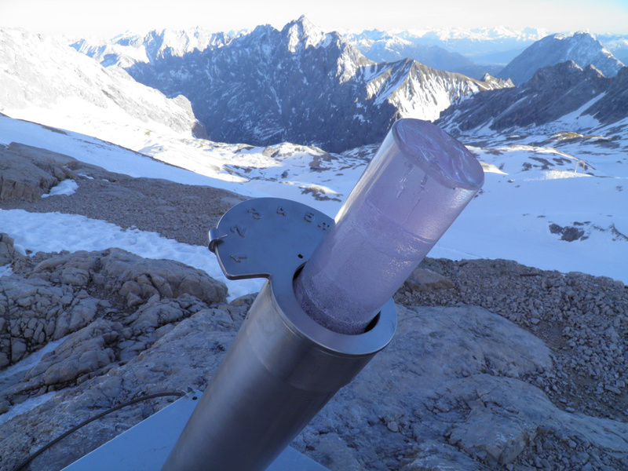

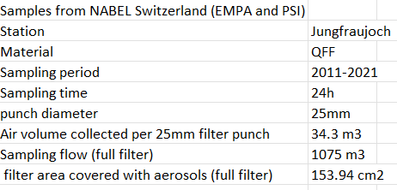

SAMPLING SITES
Home
2 ice cores per site, covering the 11 years
11 years of atmospheric particulate samples (quartz filters) sampled every 4 days, for 24h.
Jungfraujoch
(3500m)
Col du Dôme
Colle Gnifetti
(4350m)
(4550m)
On these filters: We extracted DNA and performed quantitative PCR (qPCR) to quantify microbial abundance.

Slide 11
ANALYSIS - CHEMISTRY
Sugars and Sugar Alcohols
Home
Metal Elements
Major Ions
Organic Acids
Element Symbol | Name
Li | Lithium
Be | Beryllium
B | Boron
Na | Sodium
Mg | Magnesium
Al | Aluminum
P | Phosphorus
S | Sulfur
K | Potassium
Ca | Calcium
Sc | Scandium
Ti | Titanium
V | Vanadium
Cr | Chromium
Mn | Manganese
Fe | Iron
Co | Cobalt
Ni | Nickel
Cu | Copper
Zn | Zinc
Ga | Gallium
Ge | Germanium
As | Arsenic
Element Symbol | Name
Se | Selenium
Br | Bromine
Rb | Rubidium
Sr | Strontium
Y | Yttrium
Zr | Zirconium
Mo | Molybdenum
Rhodium | Rhodium
Cd | Cadmium
Sn | Tin
Sb | Antimony
Cs | Cesium
Ba | Barium
La | Lanthanum
Ce | Cerium
Sm | Samarium
Tb | Terbium
Ho | Holmium
Pt | Platinum
Pb | Lead
Bi | Bismuth
Th | Thorium
U | Uranium
Ion | Name
Na⁺ | Sodium ion
NH₄⁺ | Ammonium ion
K⁺ | Potassium ion
Mg²⁺ | Magnesium ion
Ca²⁺ | Calcium ion
Cl⁻ | Chloride ion
Br⁻ | Bromide ion
NO₃⁻ | Nitrate ion
SO₄²⁻ | Sulfate ion
Compound
Gluconate
Glycolate
Formate
MSA (Methanesulfonic acid)
Sulfamic acid
Pyruvate
Cis-Pinonic acid
3-Hydroxyglutaric acid
Glutaric acid
4-Oxoheptanoic acid
Adipic acid
Succinic acid
Malic acid
Tartarate
Malonic acid
Oxalate
Azelaic acid
Phthalic acid
Compound
Vanillic acid
3-MBTCA
Sebacic acid
Citrate
4-Hydroxybenzoic acid
4-Methylphthalic acid
Compound
Adonitol
Arabitol
Erythrulose
Fructose
Galactosan + Mannosan
Glucose
Glycerol
Inositol
Lactose
Levoglucosan
Maltitol
Maltose
Mannitol
Mannose
Melezitose
Rhamnose
Ribose
Sedoheptulosan
Compound
Sedoheptulosan
Sorbitol
Sucrose
Threitol + Erythritol
Trehalose
Xylose
2-Methyltetrols

Slide 12
ANALYSIS - METEOROLOGY
Home
Variable | Units
Temperature | °C
Relative Humidity | %
Wind Speed | m/s
Wind Direction | Degrees (°)
Wind Speed max | m/s
Solar Radiation | W/m²
Atmospheric Pressure | hPa
PM10 | µg/m³
Next ⟶ changes in the Planetary Boundary Layer (PBL)

Slide 13
ANALYSIS - MICROBIOLOGY
Home
qPCR 16S and 18S (done)
To explore microbial DNA abundance in the atmosphere and its changes over time.
Metagenomics sequencing (ongoing) & analysis
To see the evolution of taxa and functions over time.
⟶ Hypothesis:
  Seasonality in the taxonomic composition
  Link of some sugars w/ fungi
  Metabolic pathways correlated w/ some environmental factors

Slide 14
OBJECTIVE
Home
Today’s talk was part of one of my main objectives: To correlate changes observed in communities with geo-physical-chemical data (e.g. concentrations of heavy metals, major and minor ions, organic acids, dust and carbon), and to understand the influence of factors such as seasons, pollution events, etc.
The next slides will display statistics and visualization of the impact on temporal and geo-chemical variables on the prokaryotic DNA concentration

Slide 15
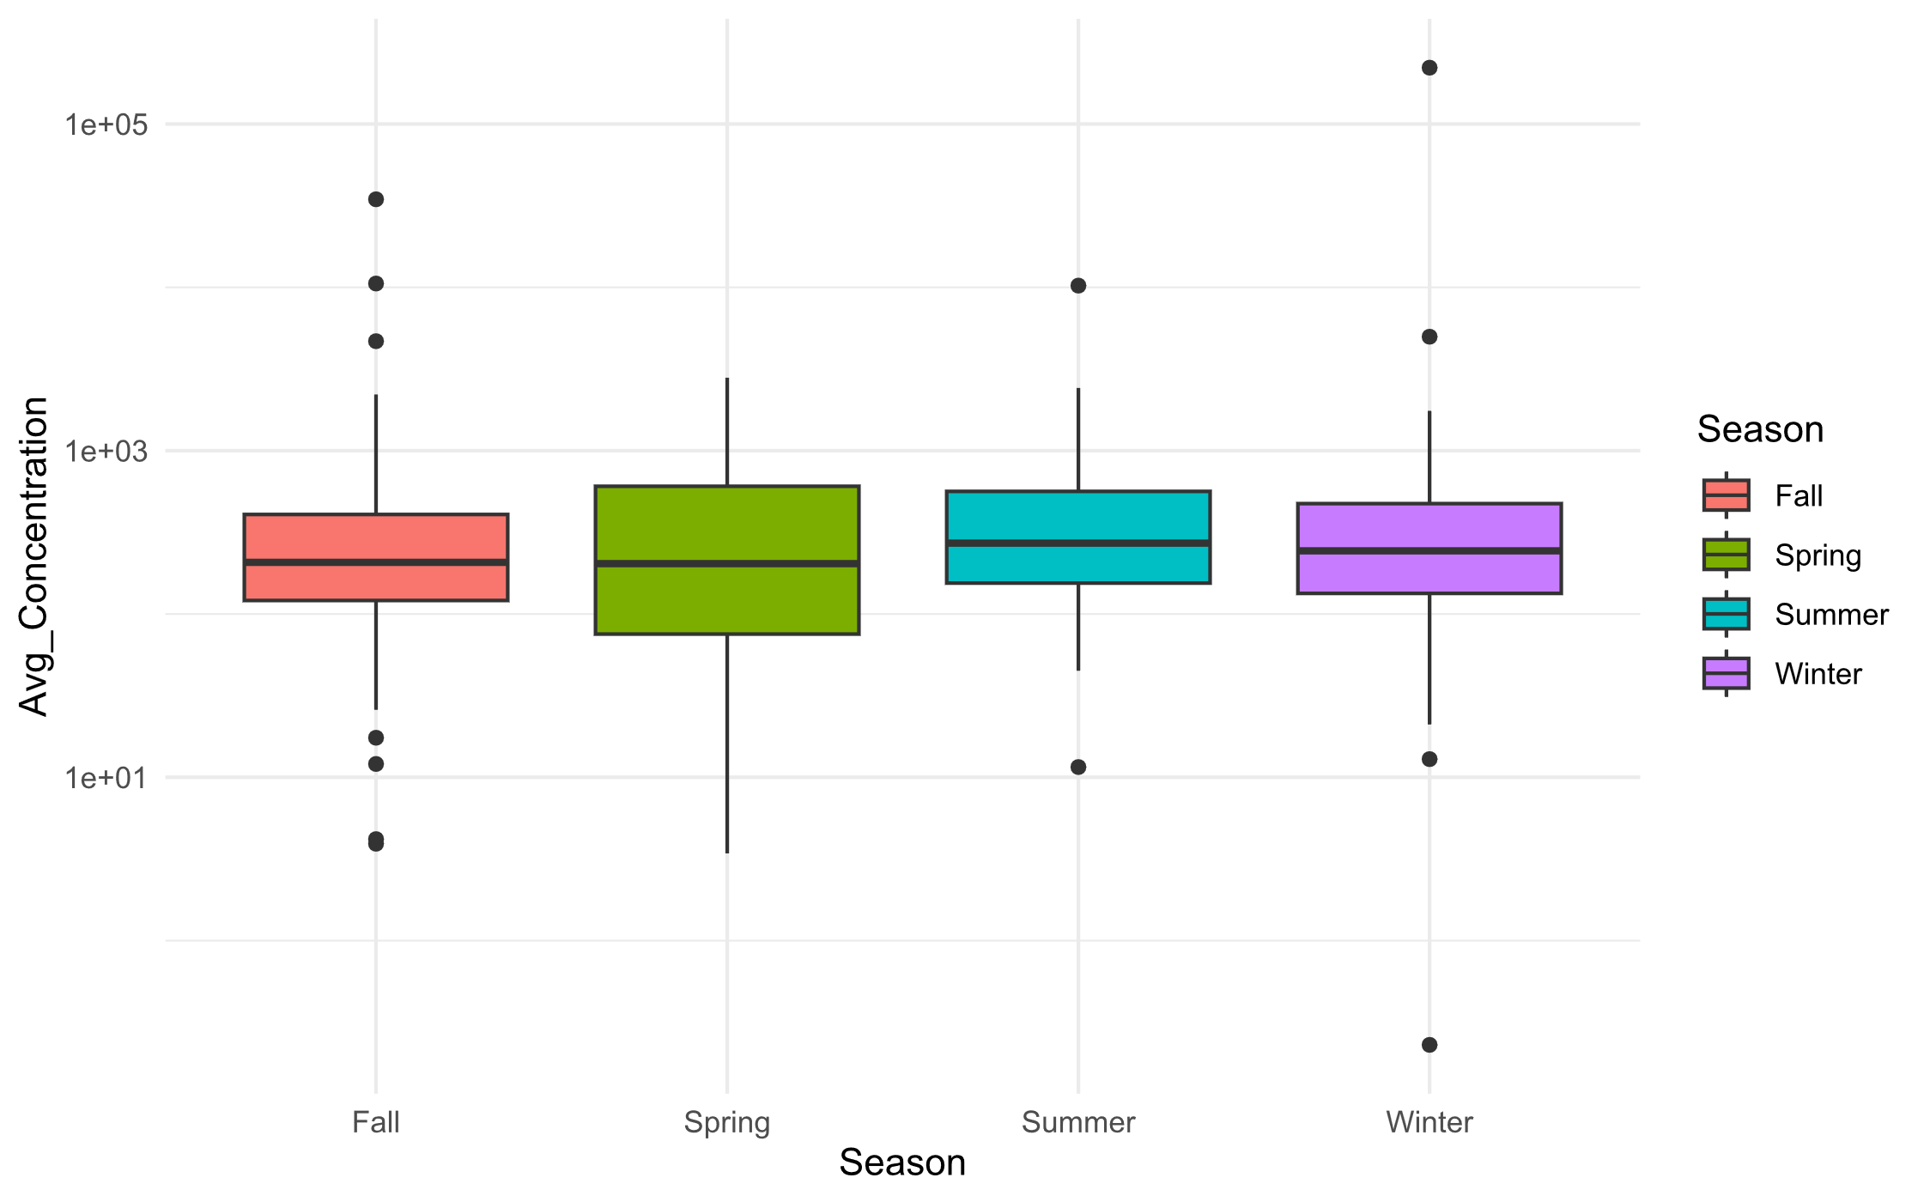
RESULTS
Home
By Season - Kruskal-Wallis: p-value = NS

Slide 16
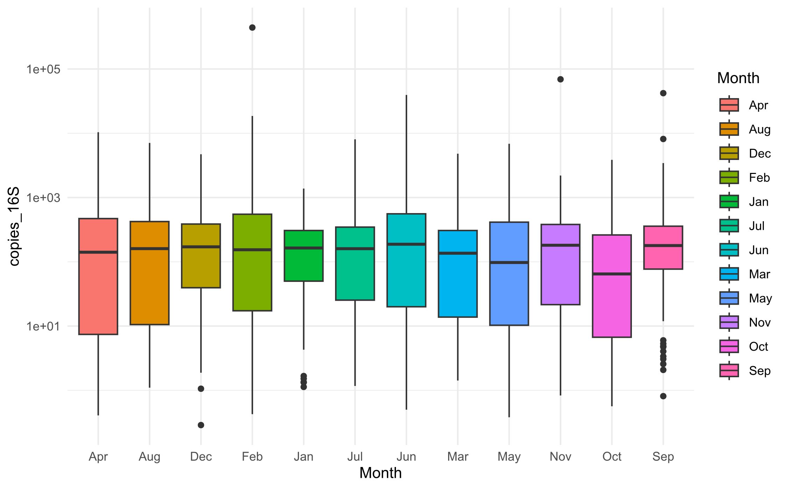
RESULTS
Home
By Month - Kruskal-Wallis: p-value = NS

Slide 17
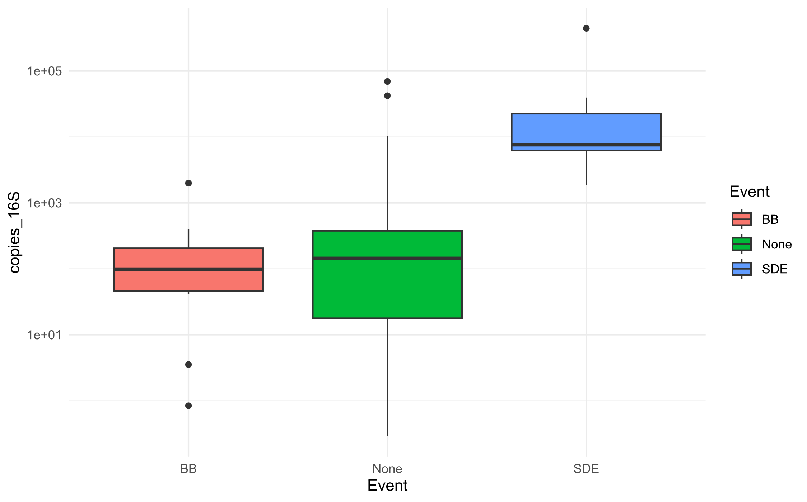
RESULTS
Home
By Event - Kruskal-Wallis: p-value = ***

Slide 18
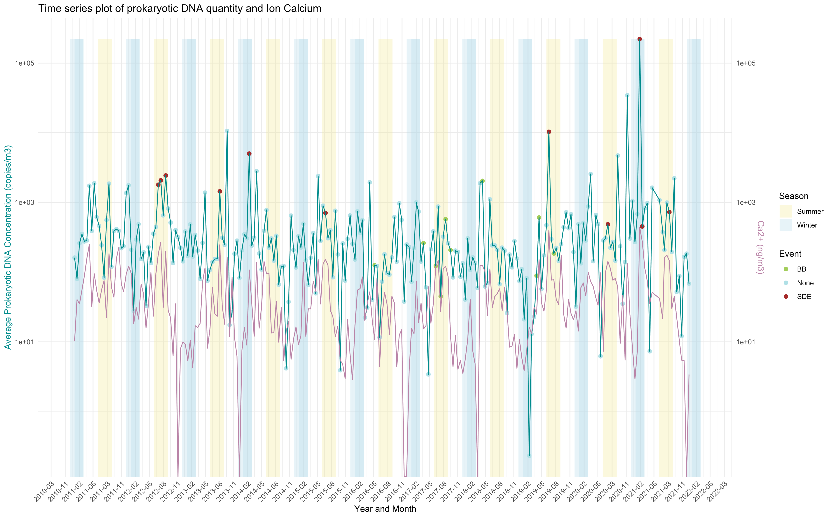
RESULTS
Home
Calcium ions (Ca2+) and 16S DNA concentration are positively correlated
Spearman’s rank correlation: p-value = 3.24e-14 ; rho = 0.4564162

Slide 19
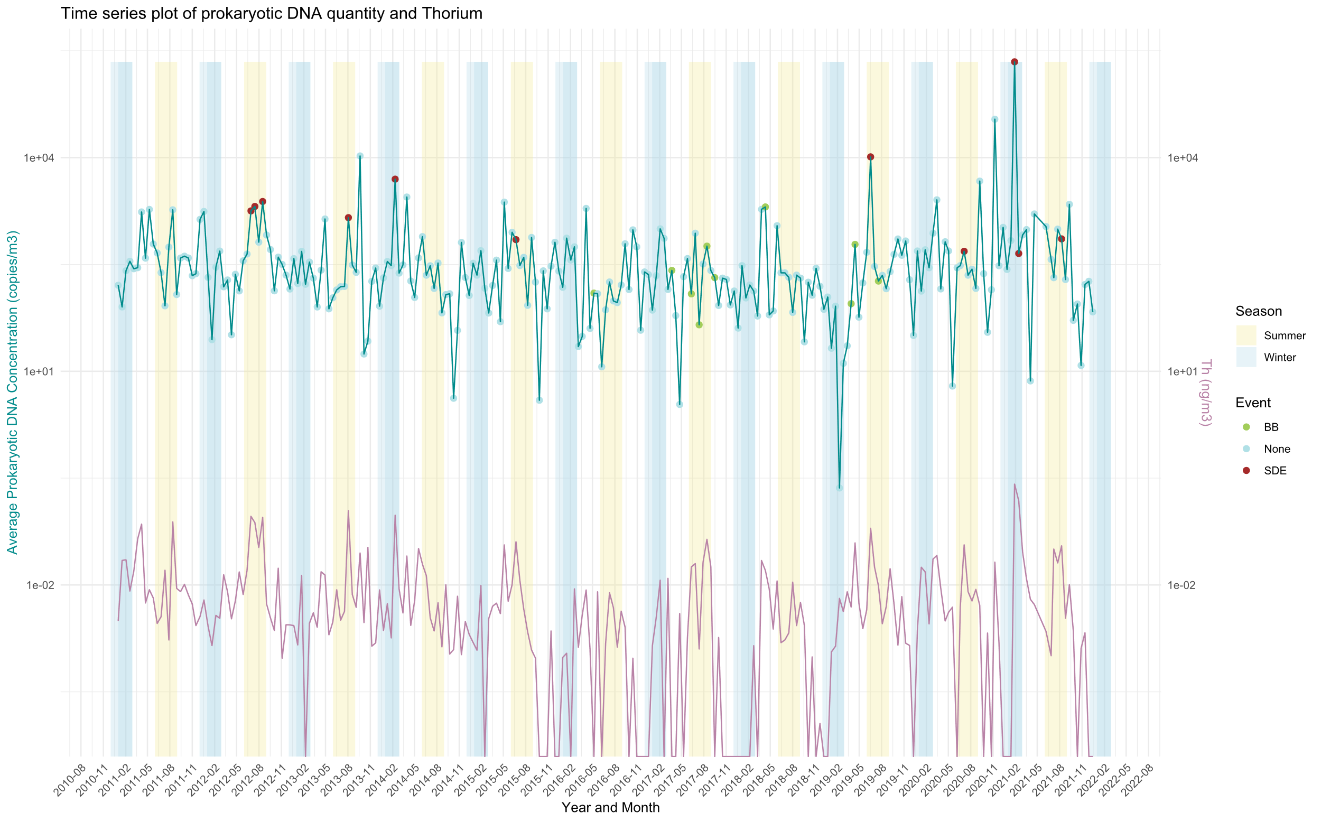
RESULTS
Home
Thorium (Th) and 16S DNA concentration are positively correlated
Spearman’s rank correlation: p-value = 2.924e-11 ; rho = 0.4052666

Slide 20
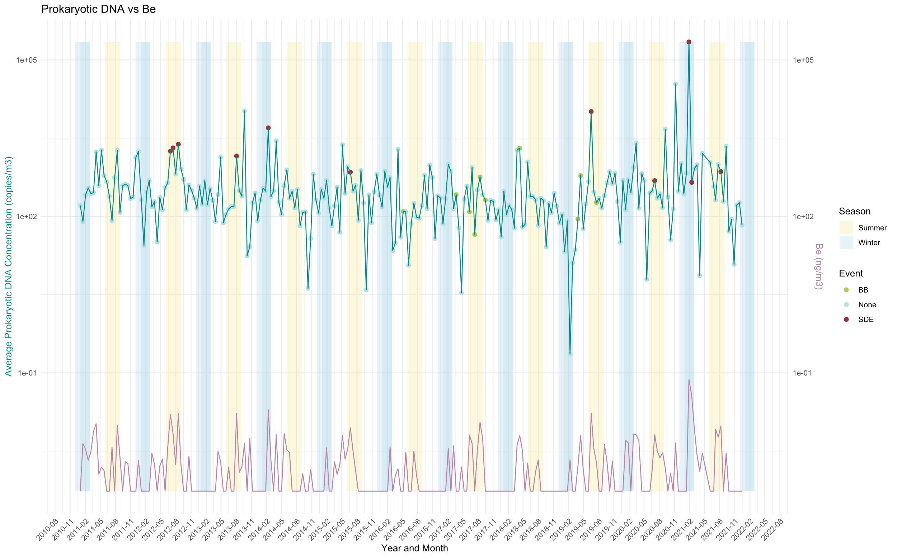
RESULTS
Home
Beryllium (Be) and 16S DNA concentration are positively correlated
Spearman’s rank correlation: p-value = 6.1e-11 ; rho = 0.3991835

Slide 21
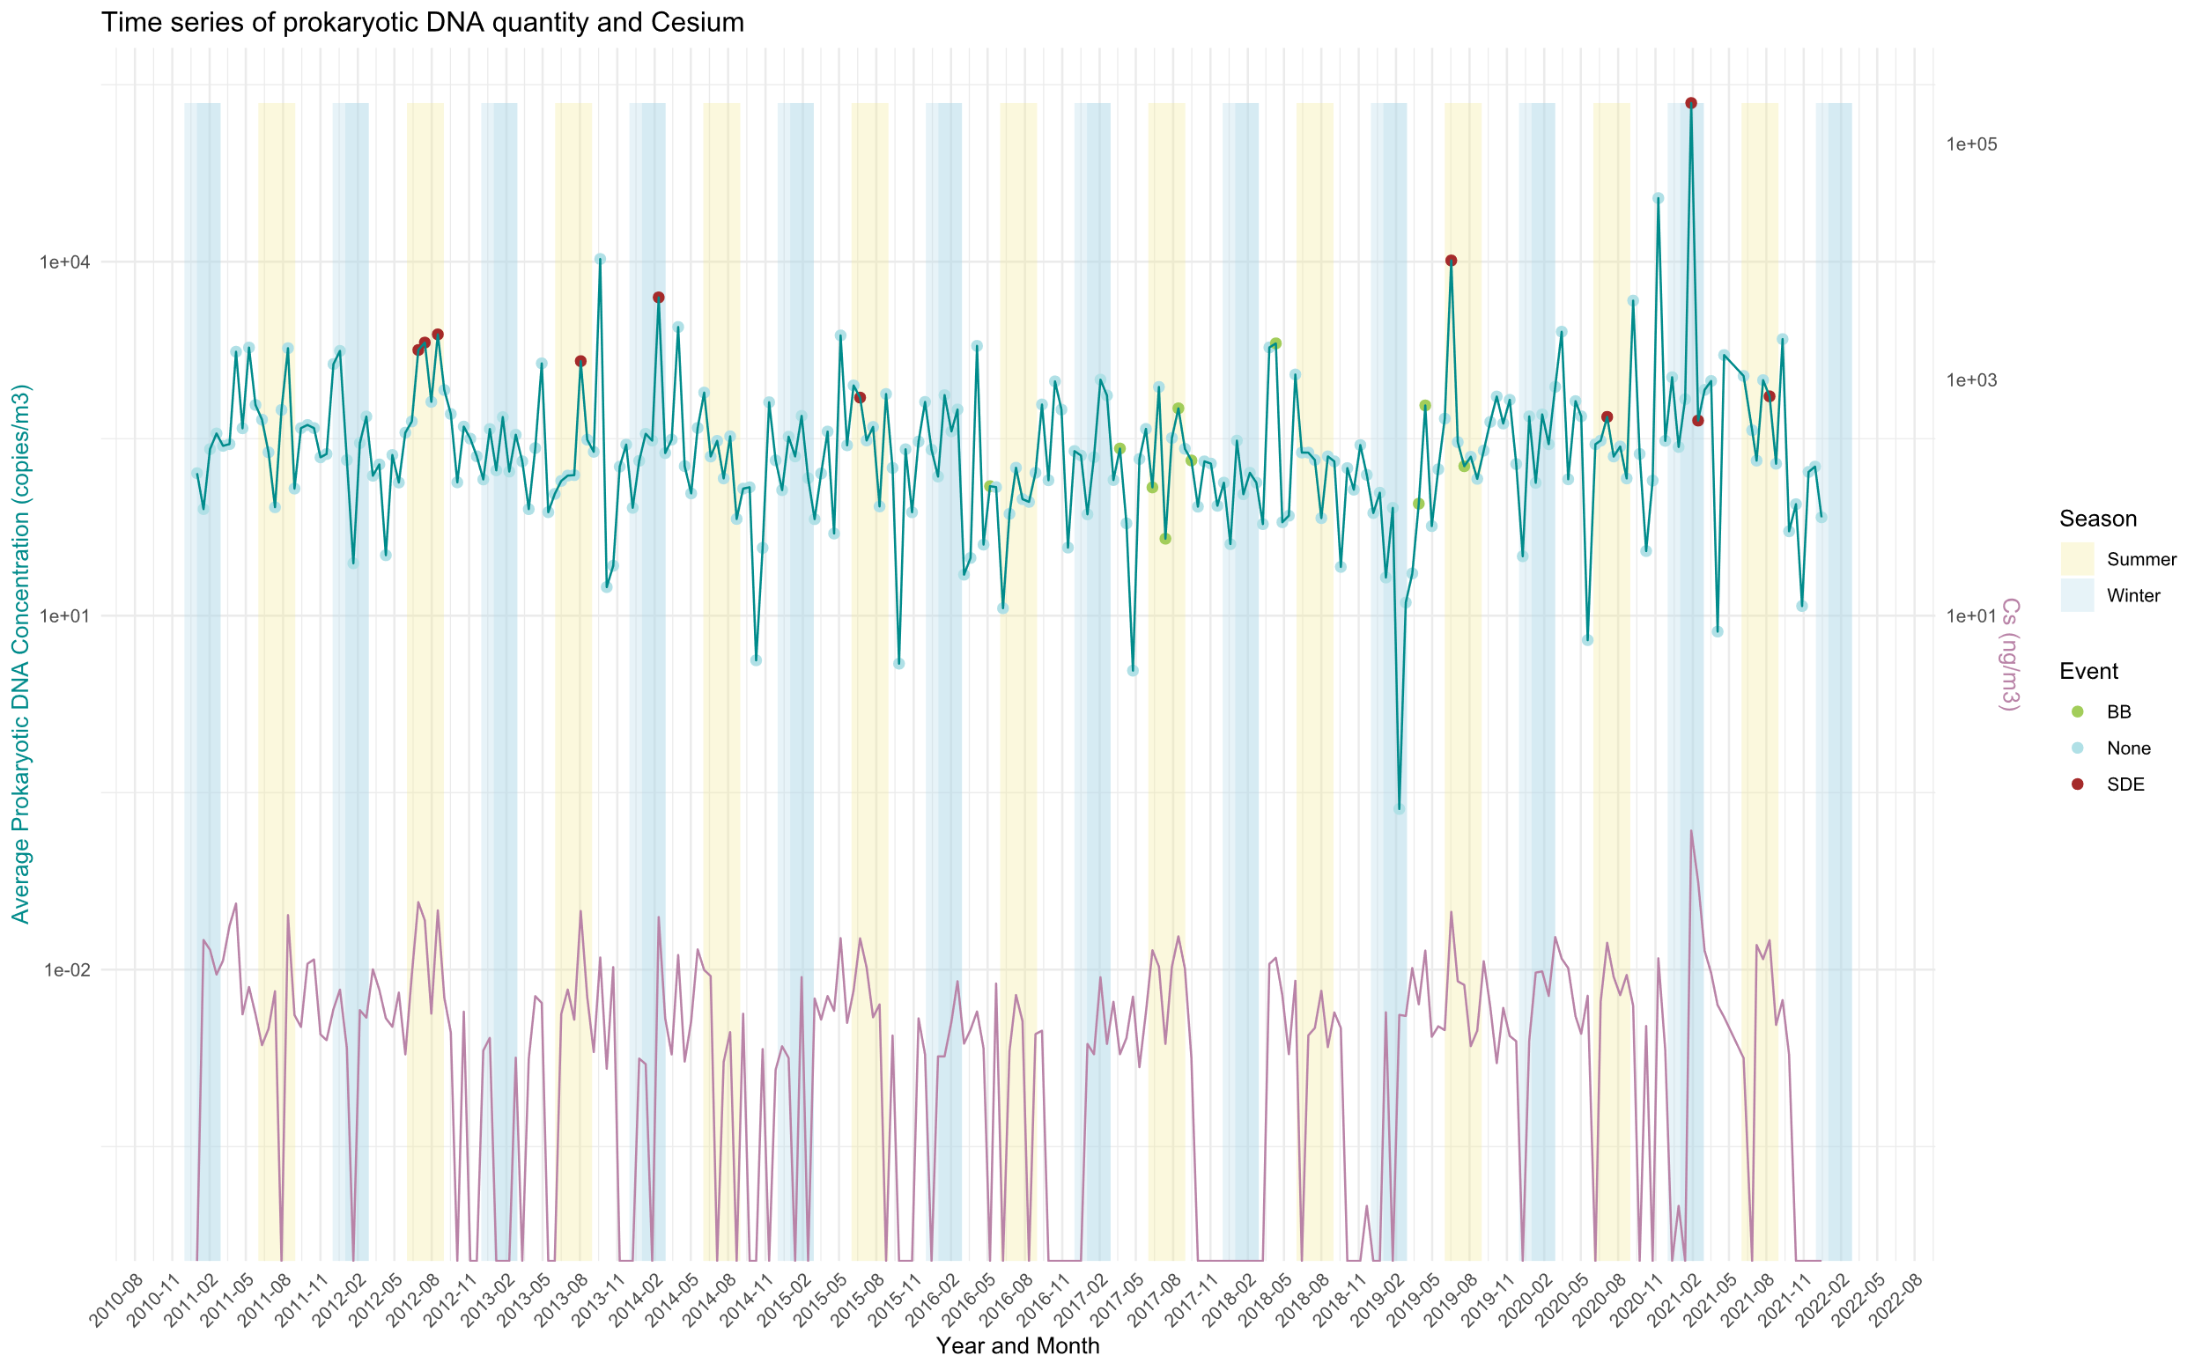
RESULTS
Home
Cesium (Cs) and 16S DNA concentration are positively correlated
Spearman’s rank correlation: p-value = 6.889e-11 ; rho = 0.3981655

Slide 22
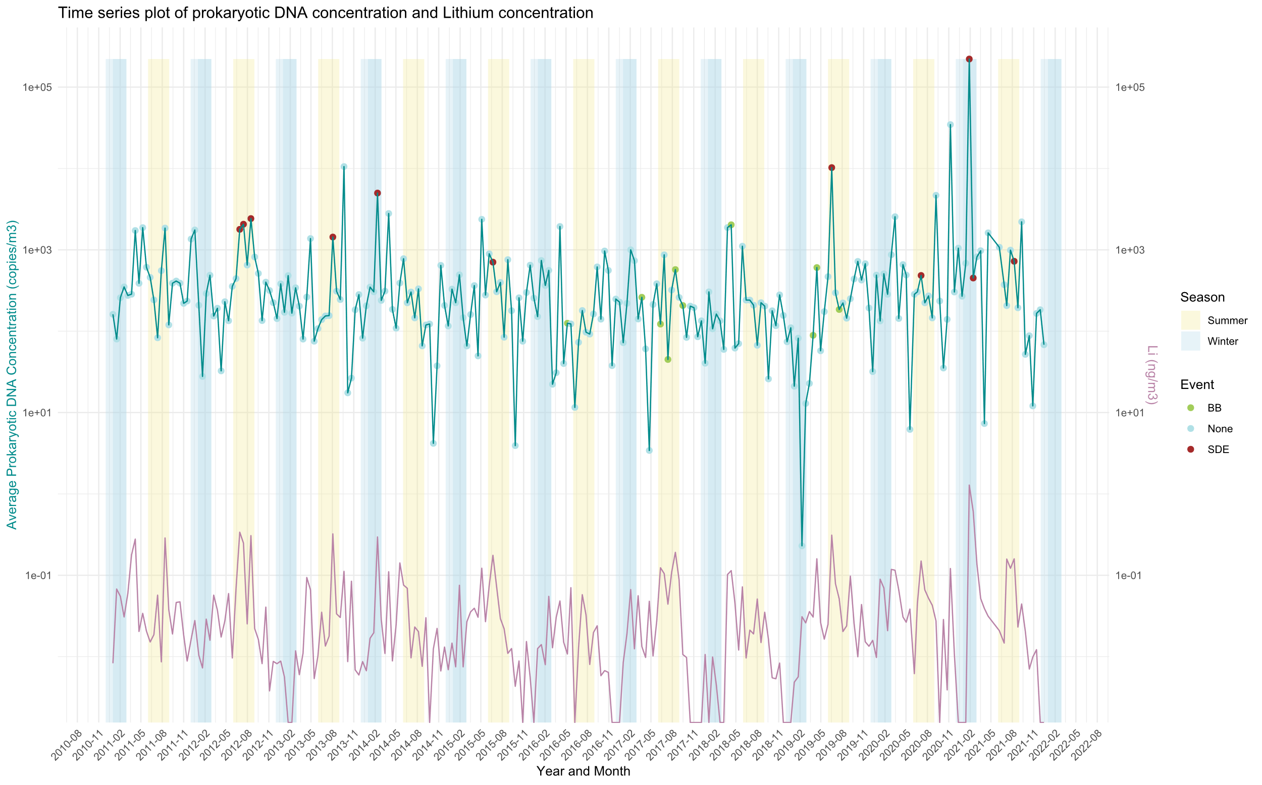
RESULTS
Home
Lithium (Li) and 16S DNA concentration are positively correlated
Spearman’s rank correlation: p-value = 4.43e-10 ; rho = 0.39821385

Slide 23
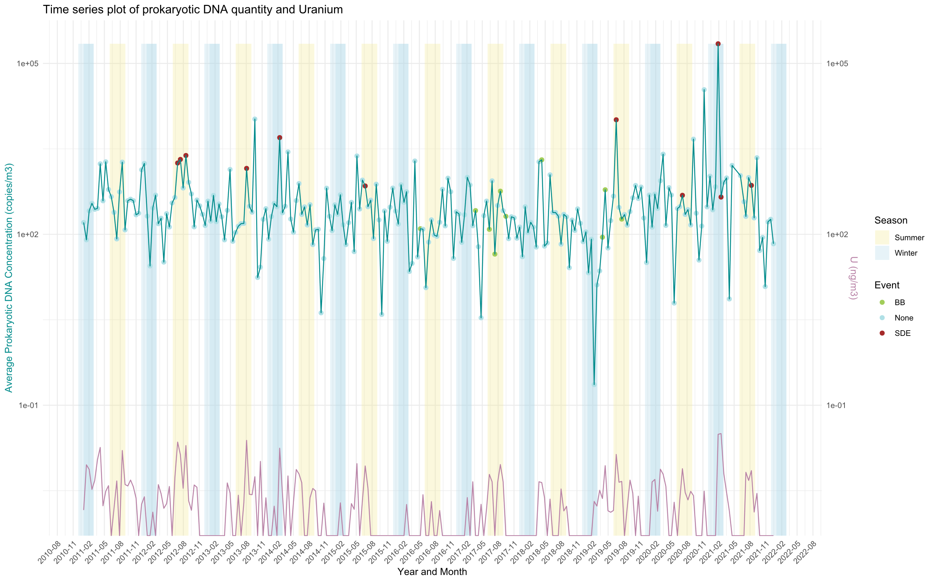
RESULTS
Home
Uranium (U) and 16S DNA concentration are positively correlated
Spearman’s rank correlation: p-value =2.912e-09 ; rho = 0.3649884

Slide 24
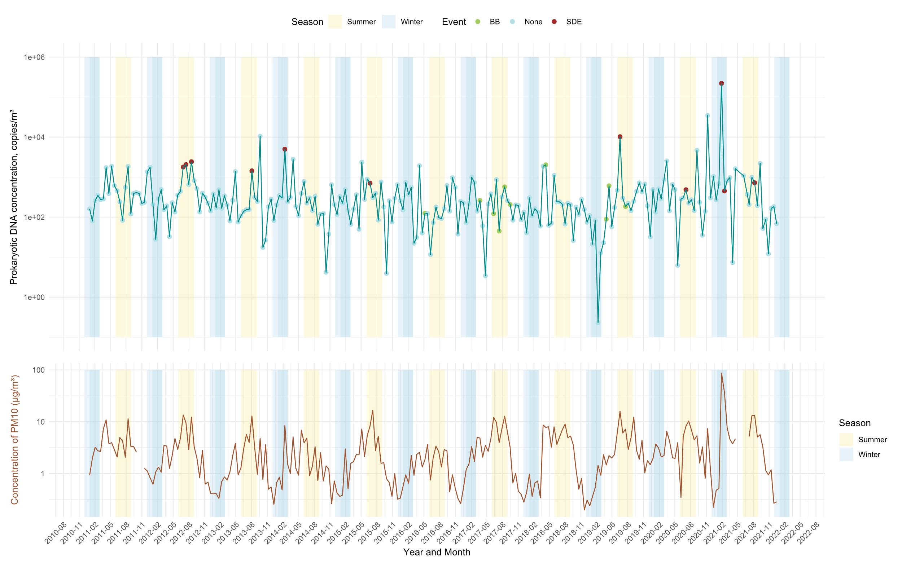
RESULTS
Home
Particulate Matter (PM) and 16S DNA concentration are positively correlated
Spearman’s rank correlation: p-value = 1.475e-08 ; rho = 0.3543521

Slide 25
Dust and Mineral Transport Markers
Ca²⁺ (Calcium):
⟶ Strong marker of mineral dust, especially Saharan dust and crustal sources.
Often associated with carbonate-rich soils and desert-derived aerosols.
Thorium (Th), Beryllium (Be), Cesium (Cs), Uranium (U), Lithium (Li):
⟶ All are trace metals or radionuclides commonly enriched in long-range transported mineral dust, especially from Saharan or arid regions.
PM10:
⟶ Particulate Matter of size 10 um. Can help capturing dust events.
Home
Saharan Dust
The Saharan region is the world’s largest source of wind-blown dust particles (Goudie and Middleton, 2001) and European countries, among them France, are subject to these outbreaks (Coudé-Gaussen, 1991).

