Slide 1
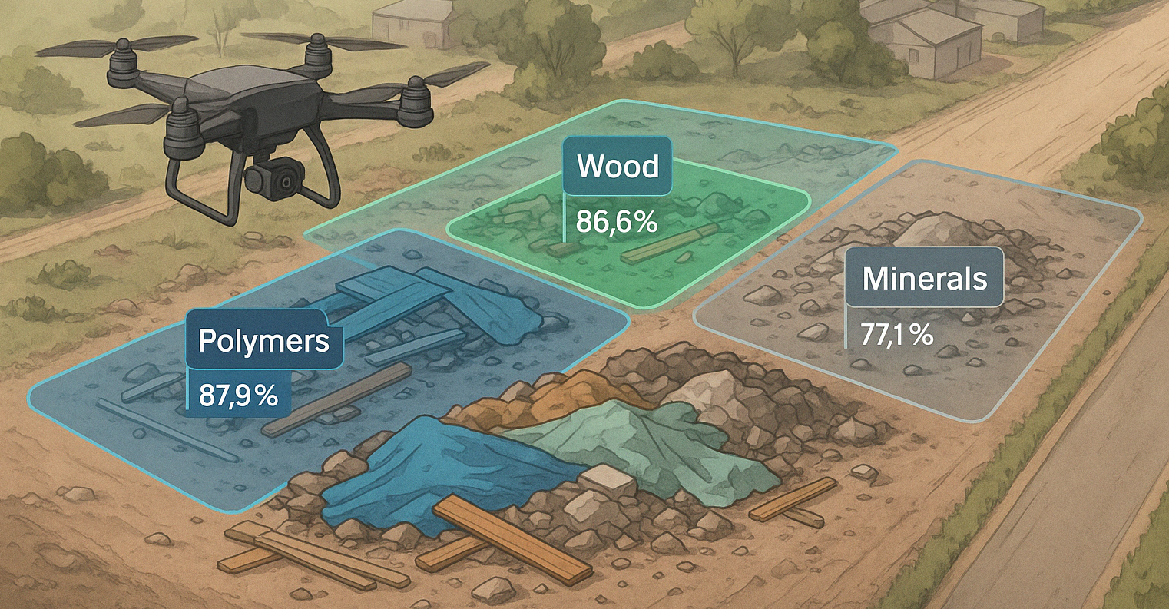
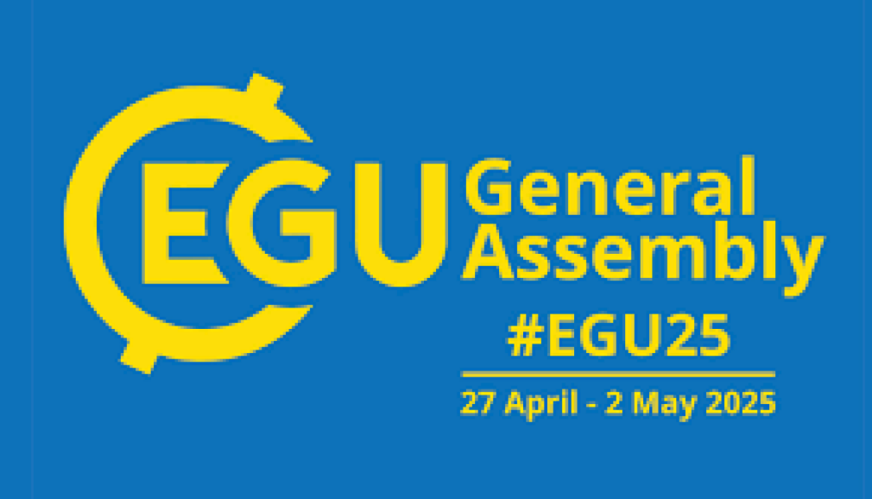


Identifying materials in spatial unauthorized waste sites for local circular economy enhancement
• Aerial imagery utilized as a tool for environmental analysis and decision-making in waste management
• Semantic segmentation of illegally disposed construction waste in aerial images
• Support circular economy initiatives through waste detection and analysis
• Utilized Meta's Segment Anything Model (SAM) to create precise segmentation masks from drone imagery
• Created dataset of over 46,000 manually labeled masks
• Trained and evaluated a ResNet-50 classification model to identify eight different types of construction waste
Source: Mager, Adi, et al. “Identifying Materials in Spatial Unauthorized Waste Sites for Local Circular Economy Enhancement.” Resources, Conservation and Recycling, vol. 215, 2025, pp. 108163-, https:10.1016/j.resconrec.2025.108163
Source of image: Gamma.app
Research team:
Adi Mager, Aryeh Gorun, Yoni Tsur, Dr. Moni Shahar, Tel Aviv University, Israel
Prof. Vered Blass, Tel Aviv University, Israel and IIASA, Austria
1

Slide 2
The Global Construction Waste Crisis
30-40%
67%
Global CDW
US CDW
Construction and demolition waste represents 30-40% of total solid waste worldwide
In the United States, CDW accounts for 67% (534 million tons) of total waste
60%
7.3M
European CDW
Israel CDW
In Europe, CDW accounts for approximately 60% of total waste produced
In Israel, approximately 7.3 million tons of construction waste were generated in 2023
The accelerated growth in population, economic development, and consumption has significantly increased global waste generation. Construction and demolition waste (CDW) - includes recyclable materials such as wood, glass, steel, and aluminum. In Israel, despite regulatory measures, over 1.1 million tons of CDW are illegally discarded annually, with severe environmental and public health implications.
2

Slide 3





Methodology: AI-Powered Waste Image Identification
Data Collection
Drone imagery captured from three illegal waste sites in Israel using DJI Mavic 3E RTK drone with high-resolution cameras
Image Segmentation
Images divided into 16 parts and processed using META's Segment Anything Model (SAM) to generate accurate masks around objects
Manual Labeling
46,252 masks manually labeled into eight categories: metal, wood, cardboard/paper, rigid polymers, flexible polymers, minerals, background, and other
Model Training
ResNet-50 classification model fine-tuned to classify the masks, with specialized detectors for rare waste types
3

Slide 4
Economic Potential of Waste Recovery
Concrete Recycling
Tire Recovery
Economic Formula
At the "Gezer site", 382 tons of mineral waste (concrete) was identified. Treatment costs range from $1,833-$5,080, with cleanup costs of $7,182 and potential recovery value of $0-$4,573.
Recycled rubber can be sold for up to $3,196 per ton, while improper disposal risks fines of $263-$7,520 per ton under Israel's extended producer
responsibility law.
Net Benefit = Recovery value - (Cleanup Cost + Treatment Cost). Current systems often result in costs rather than profits, highlighting the need for more efficient processes.
Identifying the types and quantities of materials allows for investigation into the economic potential present at illegal waste sites. The analysis demonstrates that proper disposal and recycling could be economically beneficial, especially for materials like tires. However, calculations don't include environmental costs, which could further impact the overall economic outcome.
4

Slide 5



Conclusions and Future Directions
Proven Technology
Circular Economy Support
Broader Applications
Integration of aerial imagery and AI models is feasible for waste image identification
Relevant for countries dealing with waste from conflicts or natural disasters
Accurate waste identification enables better resource recovery and recycling
This study highlights the potential of combining aerial imagery with machine learning for advancing waste management. Future research should assess the socio-environmental and economic impacts, enhance data quality, and refine model accuracy. Accurate waste composition data can inform policy and support targeted incentives, fostering sustainable practices and strengthening circular economy efforts.
5

Slide 6
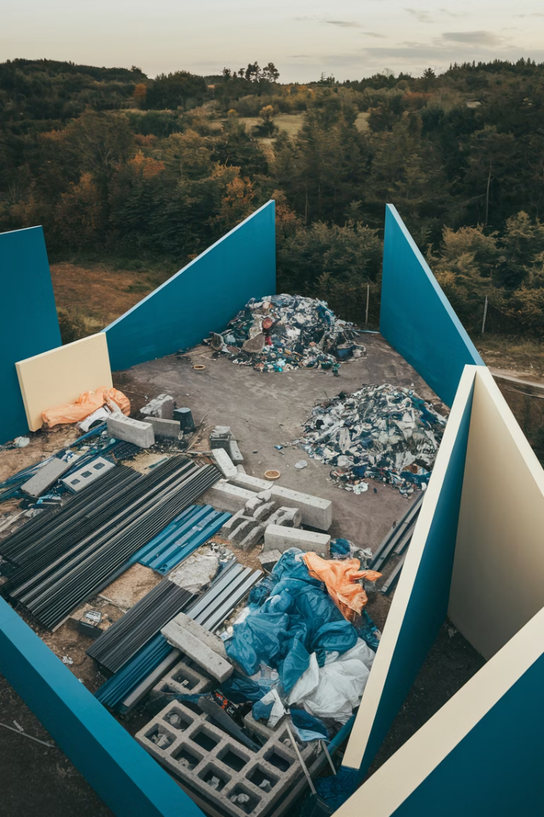
Identifying materials in spatial unauthorized waste sites for local circular economy enhancement
Adi Mager, PhD candidate
Adimager@mail.tau.ac.il
https://www.linkedin.com/in/adi-mager-plesser
Mager, Adi, et al. “Identifying Materials in Spatial Unauthorized Waste Sites for Local Circular Economy Enhancement.” Resources, Conservation and Recycling, vol. 215, 2025, pp. 108163-, https://doi.org/10.1016/j.resconrec.2025.108163.
Source of image: Gamma.app

Slide 7
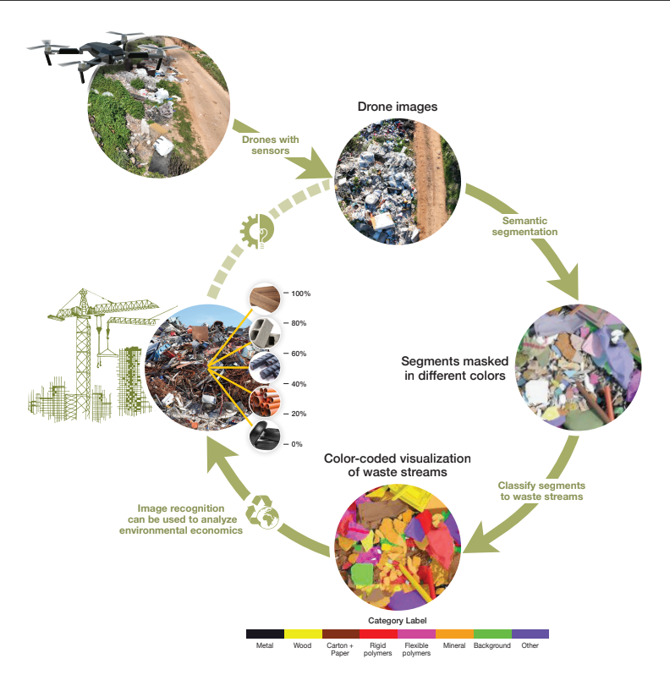
Identifying materials in spatial unauthorized waste sites for local circular economy enhancement.
Adi Mager, Aryeh Gorun, Yoni Tsur, Dr. Moni Shahar, Tel Aviv University, Israel; Prof. Vered Blass, Tel Aviv University, Israel and IIASA, Austria
Source: Mager, Adi, et al. “Identifying Materials in Spatial Unauthorized Waste Sites for Local Circular Economy Enhancement.” Resources, Conservation and Recycling, vol. 215, 2025, pp. 108163-, https:10.1016/j.resconrec.2025.108163

Slide 8
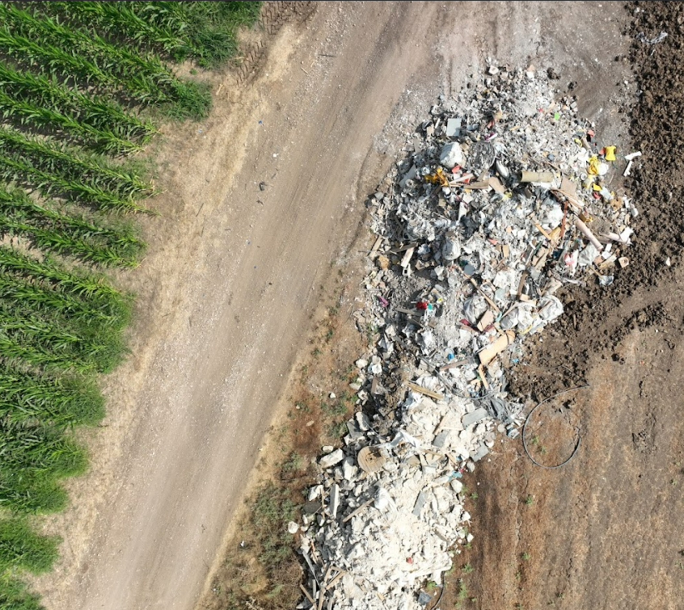
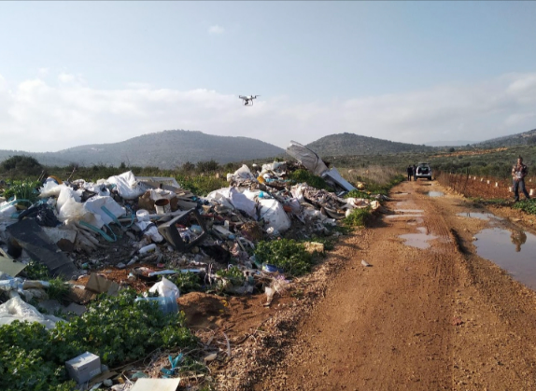
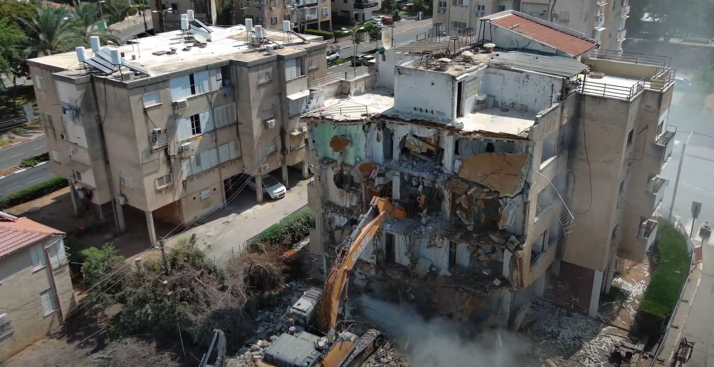
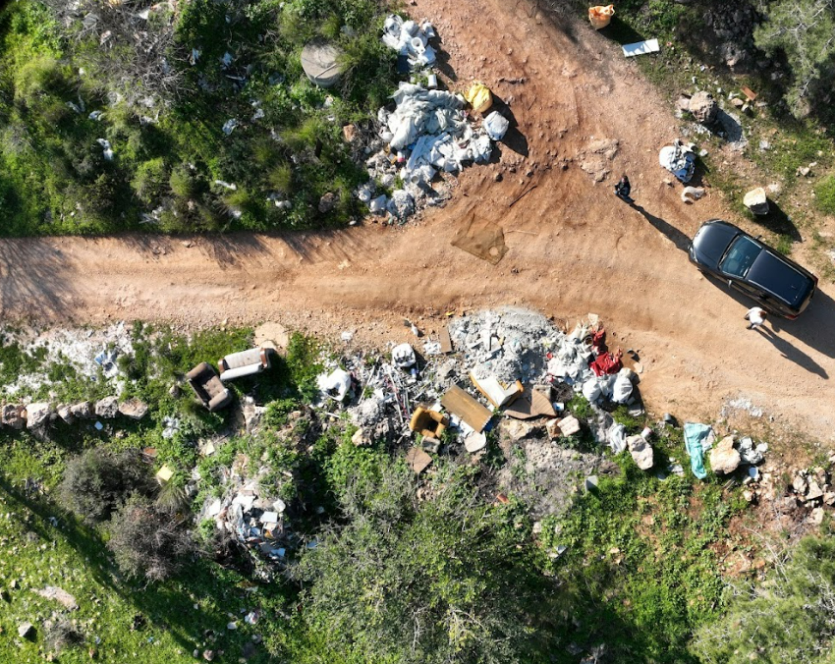
Identifying materials in spatial unauthorized waste sites for local circular economy enhancement.
Adi Mager, Aryeh Gorun, Yoni Tsur, Dr. Moni Shahar, Tel Aviv University, Israel; Prof. Vered Blass, Tel Aviv University, Israel and IIASA, Austria

Slide 9
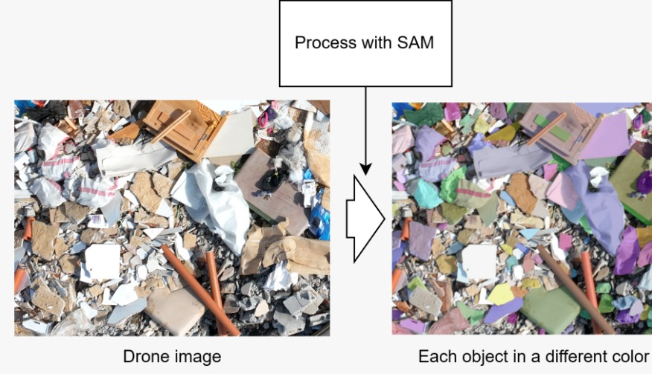
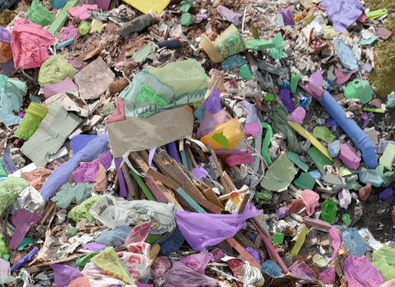
Identifying materials in spatial unauthorized waste sites for local circular economy enhancement.
Adi Mager, Aryeh Gorun, Yoni Tsur, Dr. Moni Shahar, Tel Aviv University, Israel; Prof. Vered Blass, Tel Aviv University, Israel and IIASA, Austria

Slide 10
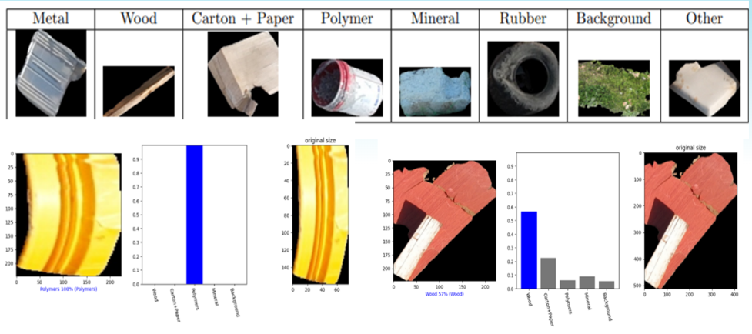
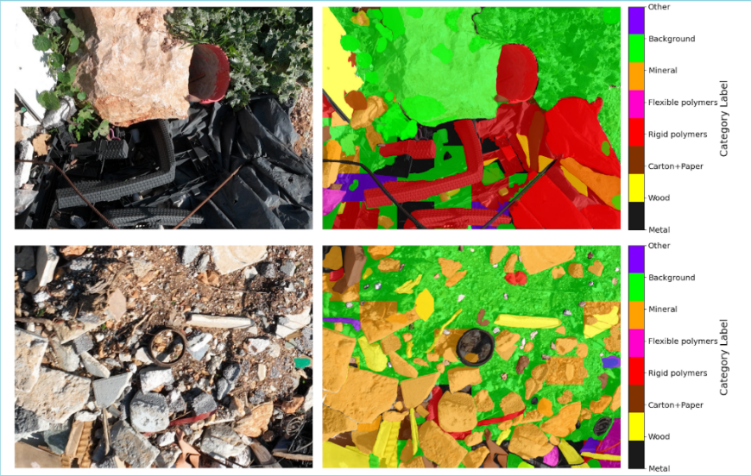
Identifying materials in spatial unauthorized waste sites for local circular economy enhancement.
Adi Mager, Aryeh Gorun, Yoni Tsur, Dr. Moni Shahar, Tel Aviv University, Israel; Prof. Vered Blass, Tel Aviv University, Israel and IIASA, Austria

Slide 11
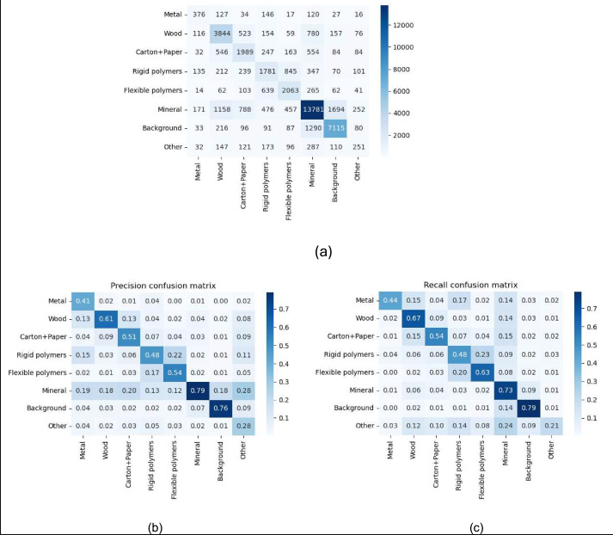
Identifying materials in spatial unauthorized waste sites for local circular economy enhancement.
Adi Mager, Aryeh Gorun, Yoni Tsur, Dr. Moni Shahar, Tel Aviv University, Israel; Prof. Vered Blass, Tel Aviv University, Israel and IIASA, Austria
Fig. 1. (a) A true-false matrix, the legend indicates the total count of masks per cell (note: the row denotes the true label, and the column denotes the predicted label by the model); Confusion matrices (b) Precision (Column-Normalized) and; (c) Recall (Row-Normalized).

