Slide 1
Supplementary material
Impact of Recurrent Drought
on the Water Use and Growth Dynamics
of Larch and Spruce
Álex Tuñas Corzón, Bernice Hwang,
Florian Oberleitner, Andreas Bär,
Gerhard Wieser, Walter Oberhuber,
Stefan Mayr, and Michael Bahn

Slide 2
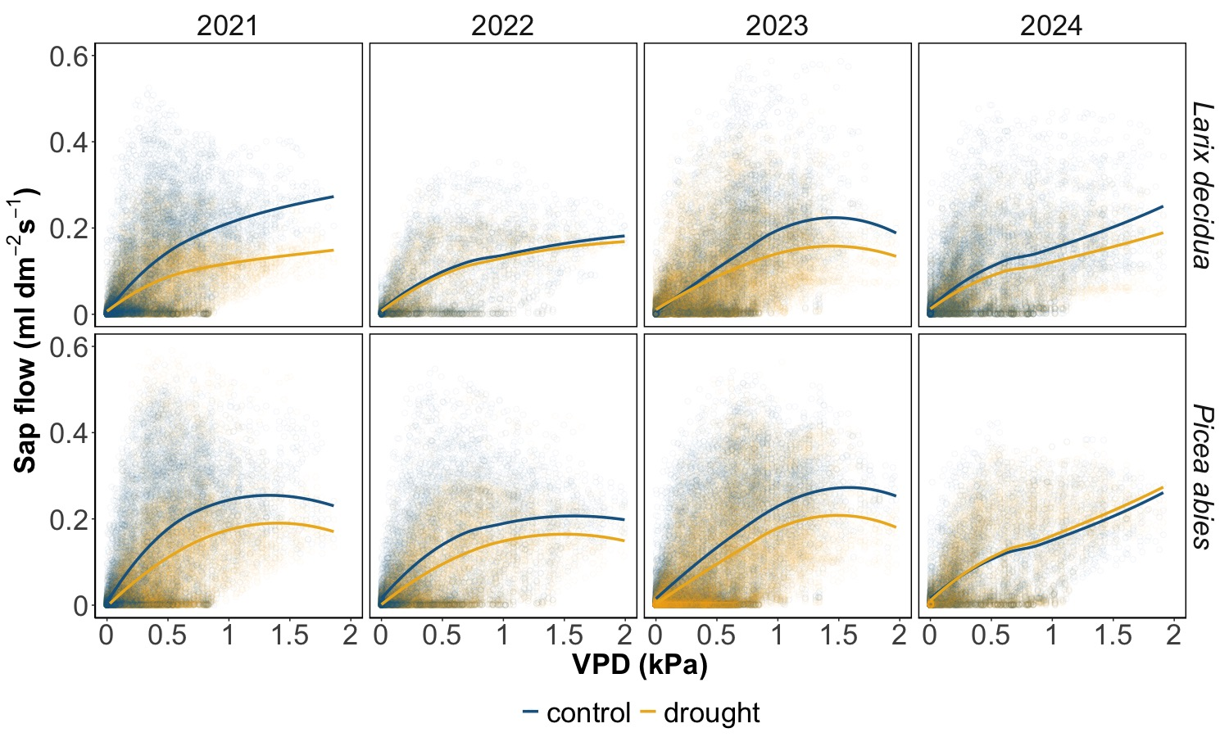
June & July
Fig. S1. Daily mean values of sap flow as a function of VPD; values were pulled by treatment, filtered in 2024 to show only values from June and July (wet period)

Slide 3
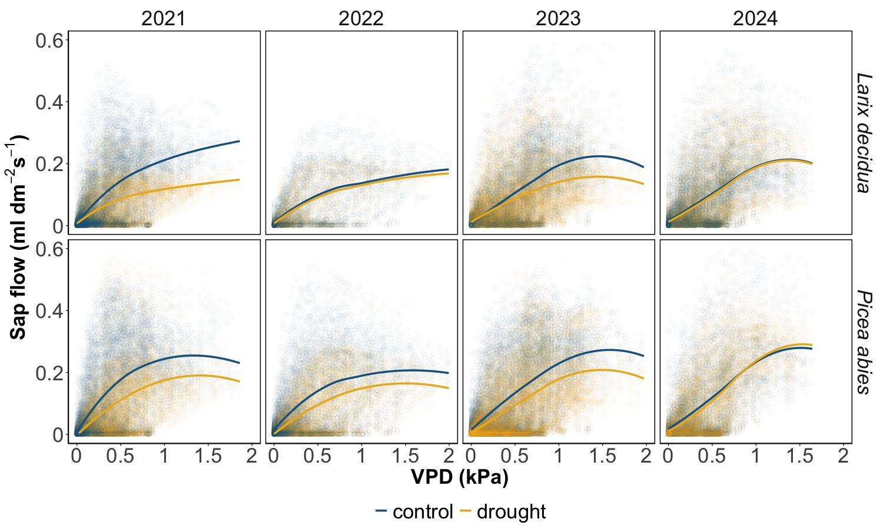
Aug & Sept
Fig. S2. Daily mean values of sap flow as a function of VPD; values were pulled by treatment, filtered in 2024 to show only values from August and September (dry period; natural drought)

Slide 4
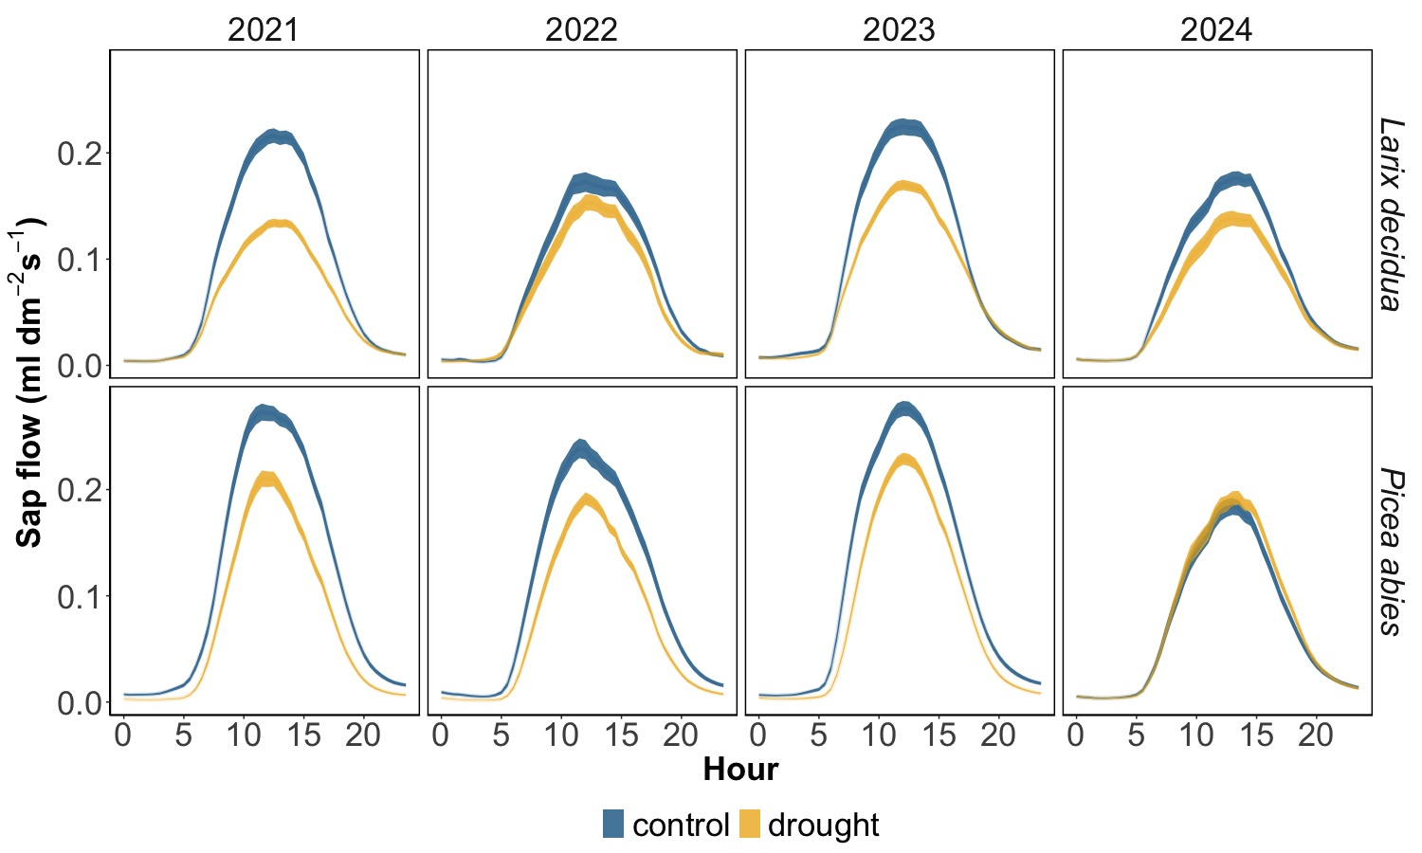
June & July
Fig. S3. Sap flow throughout the day, pulled by treatment; lines show mean and standard errors, filtered in 2024 to show only values from June and July (wet period)

Slide 5
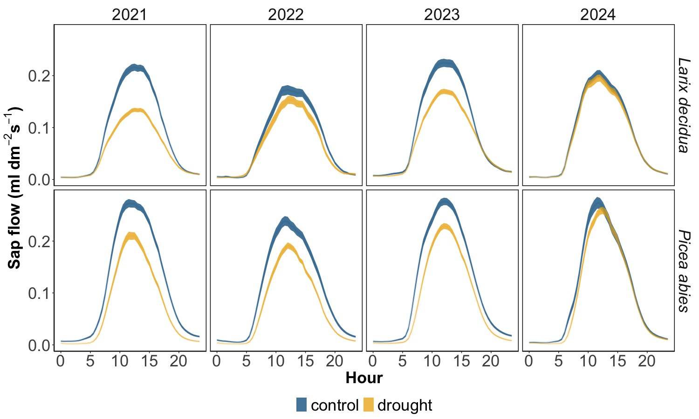
Aug & Sept
Fig. S4. Sap flow throughout the day, pulled by treatment; lines show mean and standard errors, filtered in 2024 to show only values from August and September (dry period; natural drought)

Slide 6
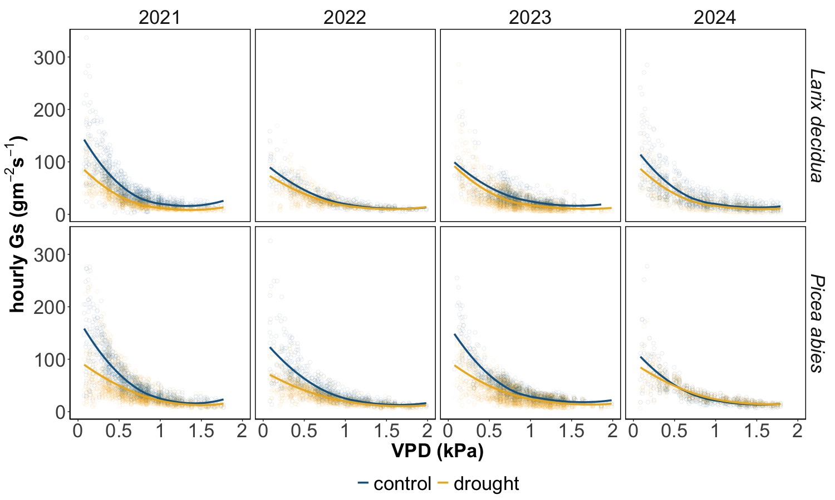
June & July
Fig. S5. Conductance as a function of VPD, pulled by treatment; filtered in 2024 to show only values from June and July (wet period)

Slide 7
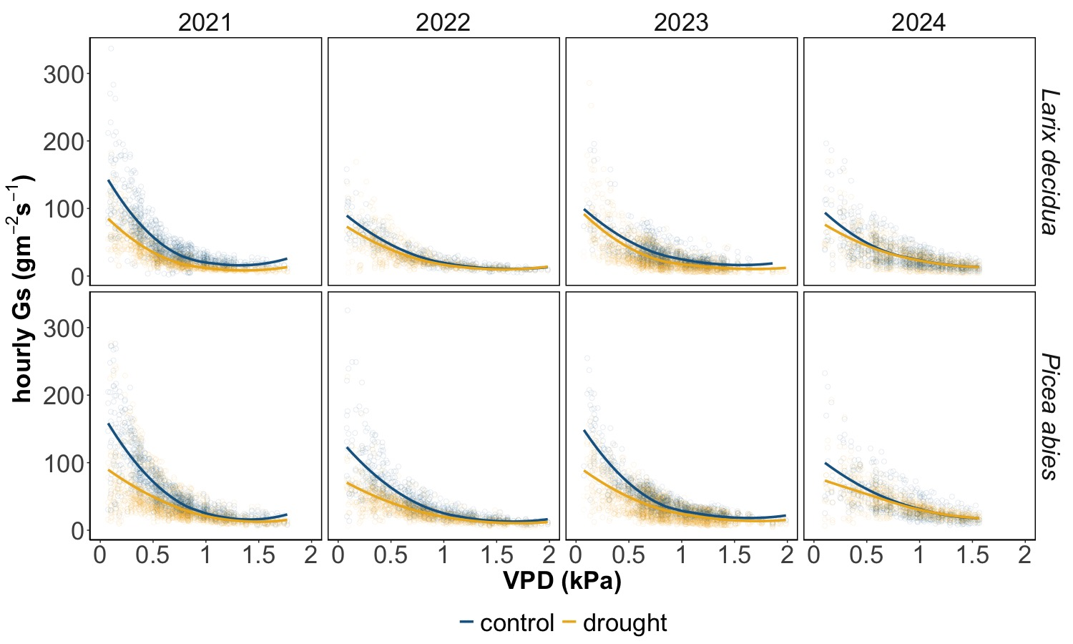
Aug & Sept
Fig. S6. Conductance as a function of VPD, pulled by treatment; filtered in 2024 to show only values from August and September (dry period; natural drought)

Slide 8
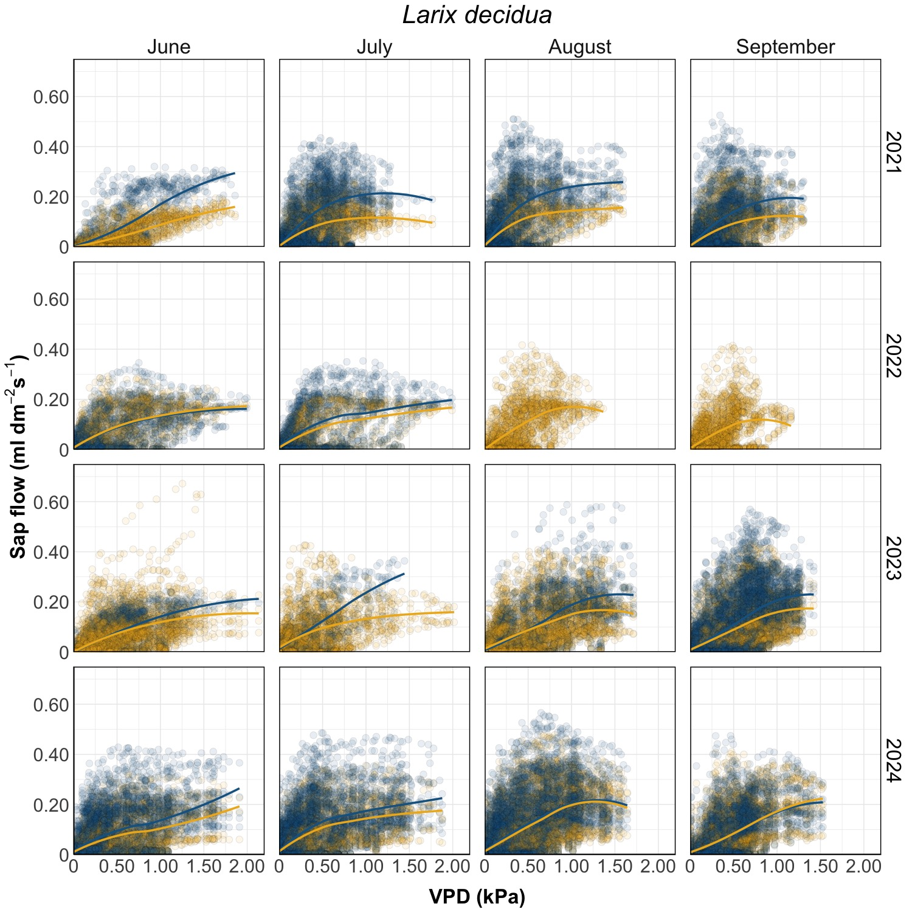
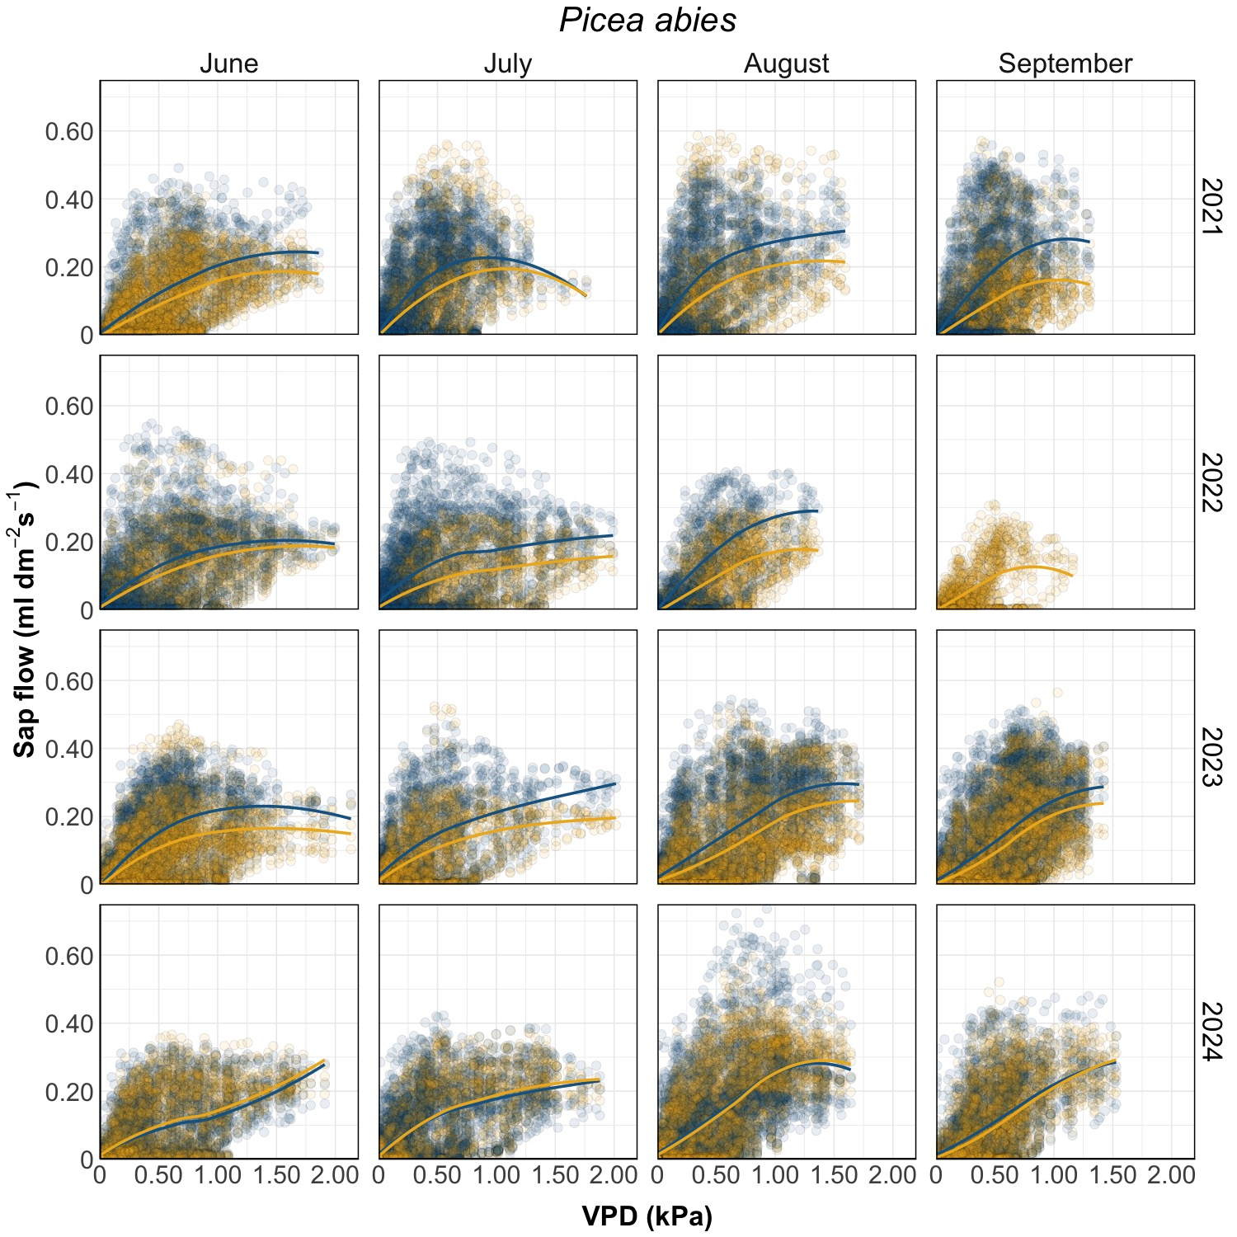
Fig. S7. Sap flow by month and year

Slide 9
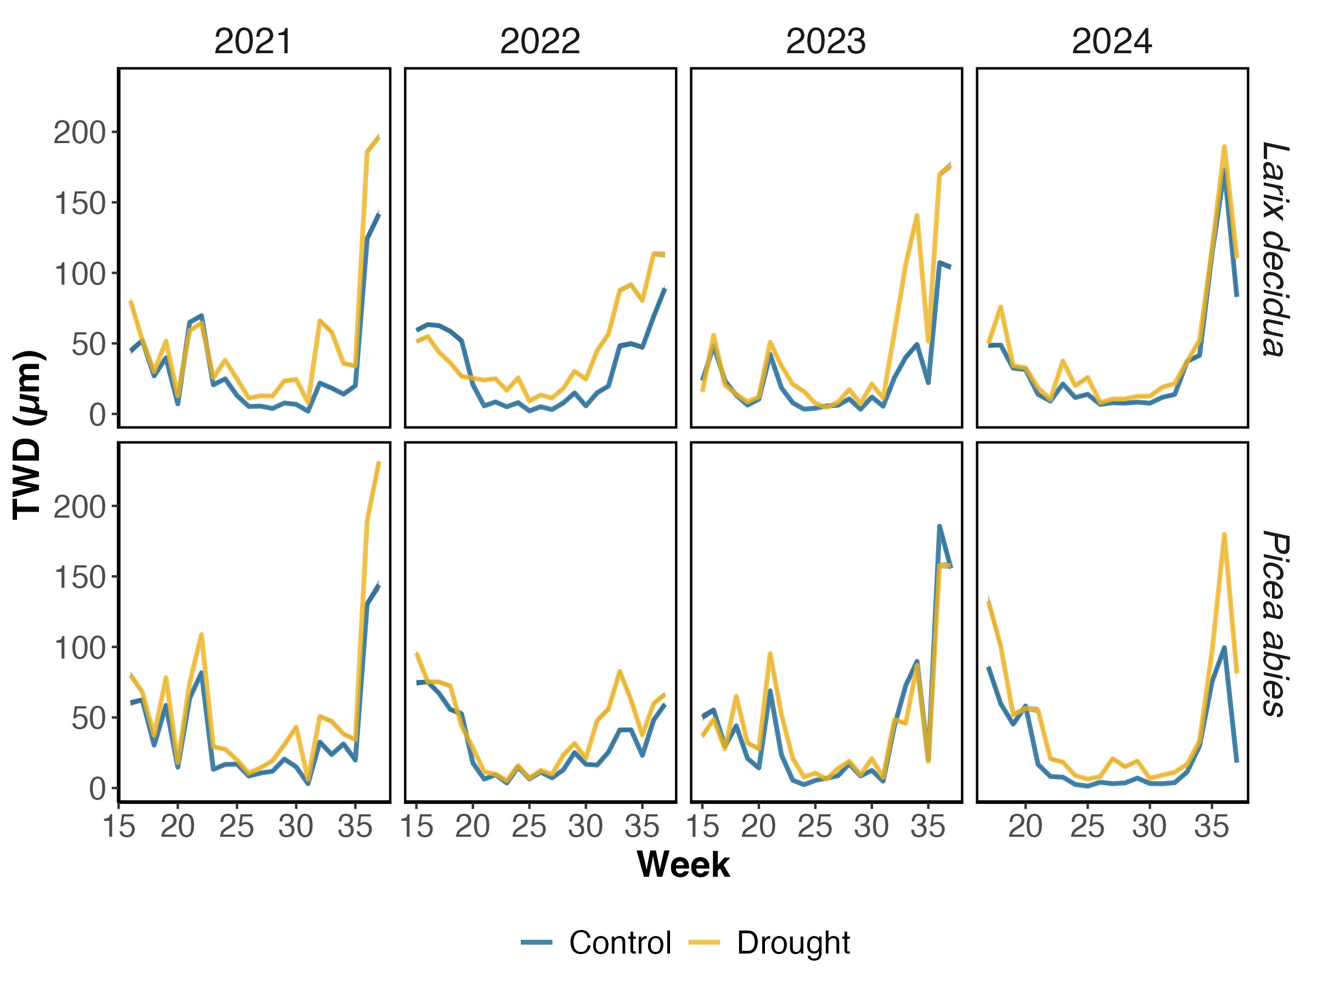
Fig. S8. Tree Water deficit, calculated as the difference of each value with respect to the last radial maximum, whenever the value was lower than the maximum

Slide 10
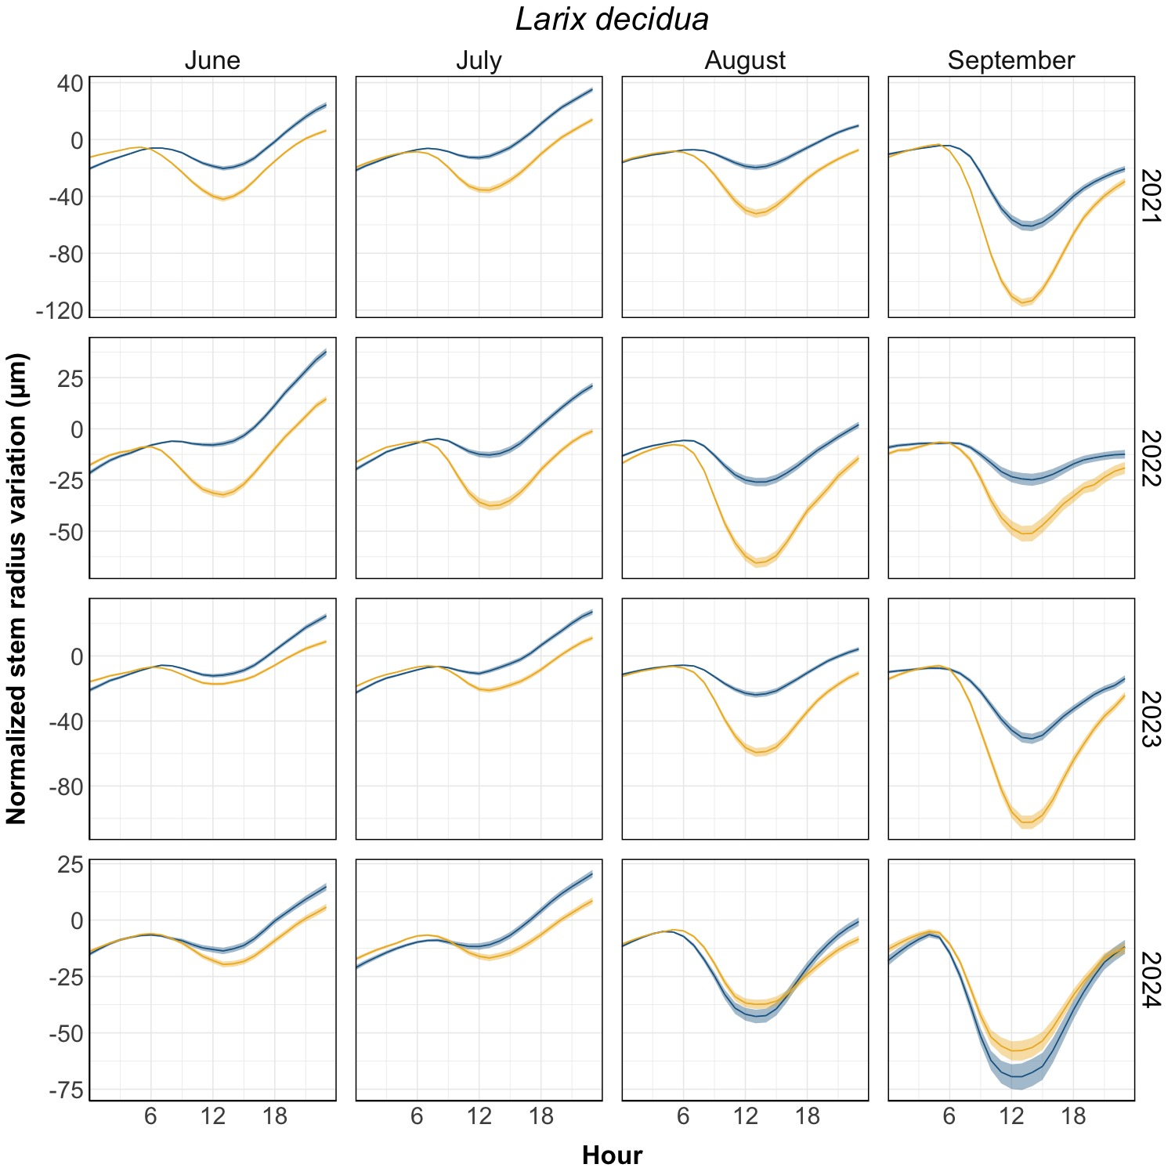
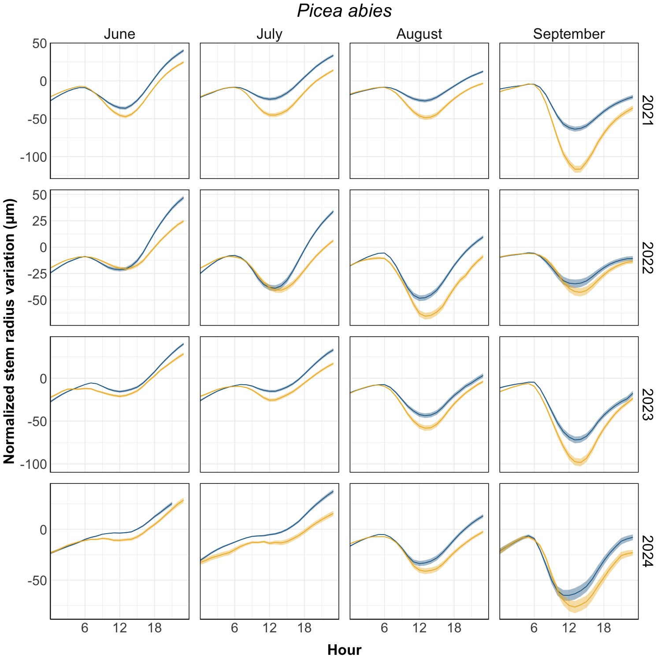
Fig. S9. Normalized stem radius variations, by month and by year

