Slide 1
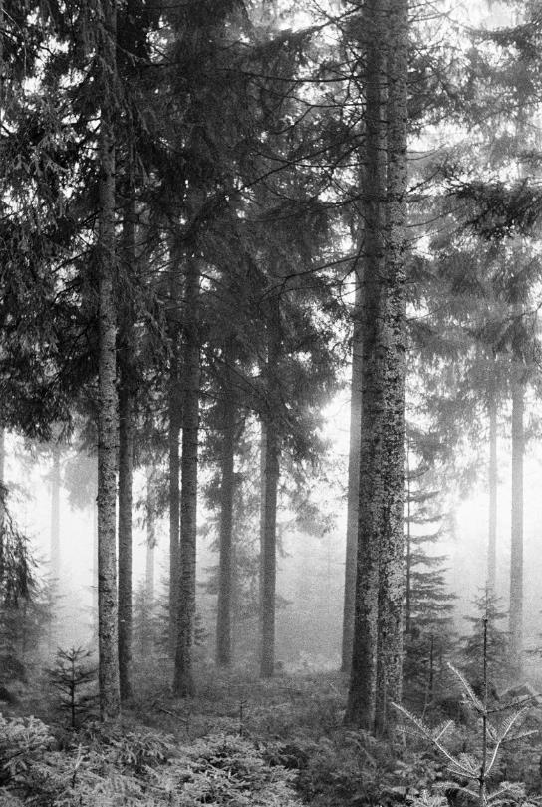
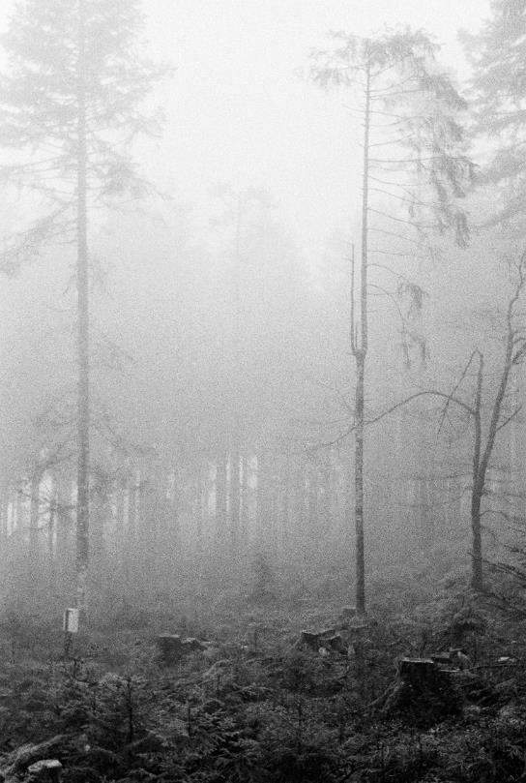


Century of Forest Conservation Sequesters Wood-Derived Particulate Organic Matter Supplement
Kenton Stutz¹, Lilian Benz¹, Klaus Kaiser², Bruno Glaser³, Flavius Popa⁴
¹ Chair of Soil Ecology, Albert-Ludwigs-Universität Freiburg;
³ Soil Science and Soil Protection & ⁴ Soil Biogeochemistry, Martin-Luther-Universität Halle-Wittenberg;
⁴ Ecological Monitoring, Research and Species Conservation, Black Forest National Park
EGU 2025 – Exploring Soil Biogeochemical Processes, Vienna 01.05.2025
Fichtenwald, NP Schwarzwald (Stutz 2023)
Waldlücken, NP Schwarzwald (Stutz 2023)

Slide 2
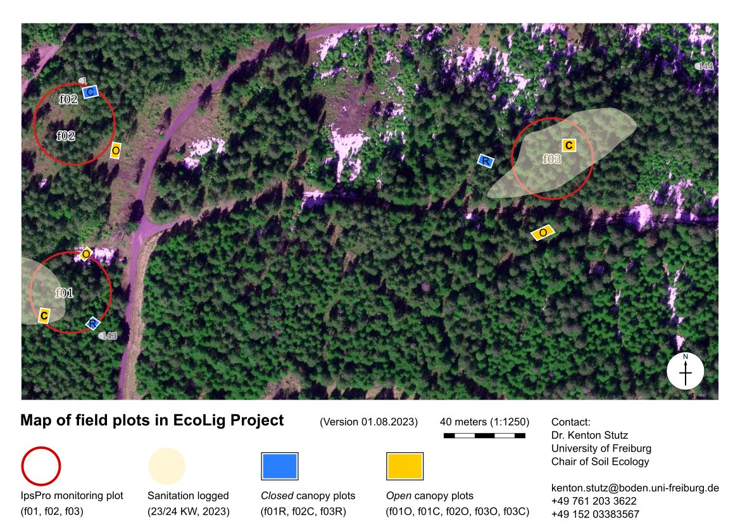
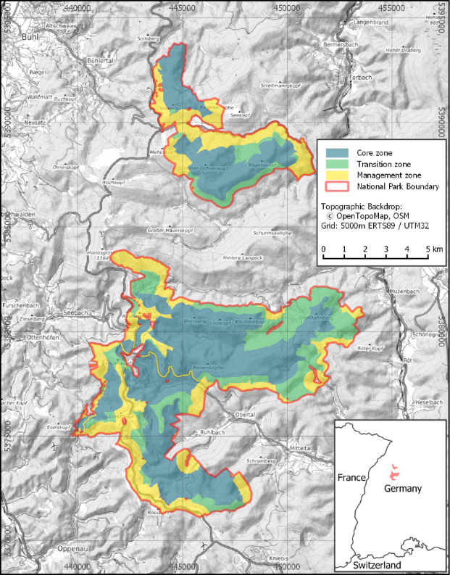
Map of Study Sites
Wildersee (1030 masl)
Protected since 1911
Seehalde (940 masl)
Managed for bark beetles

Slide 3
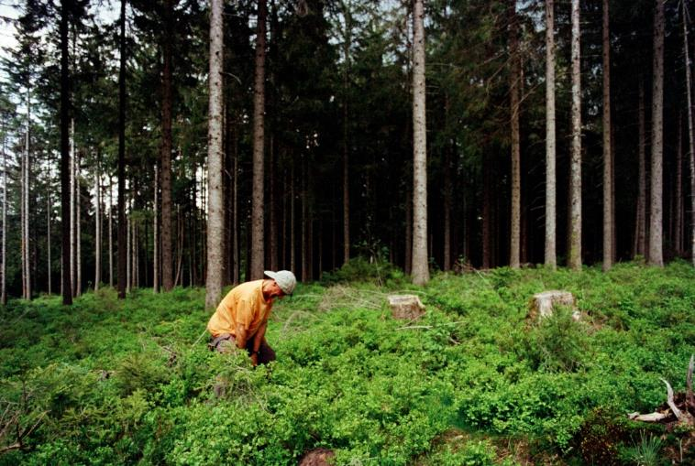
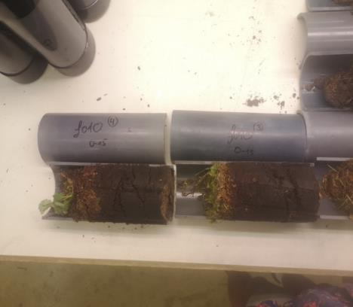
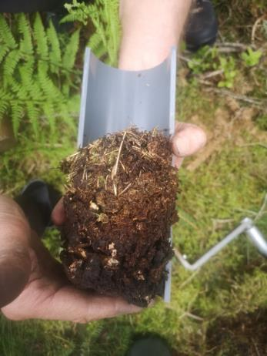
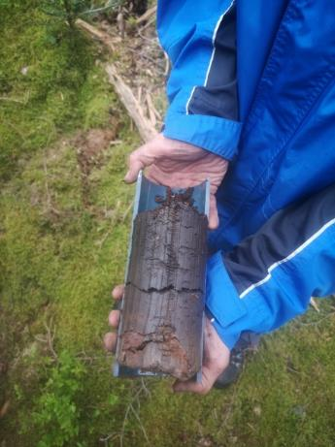
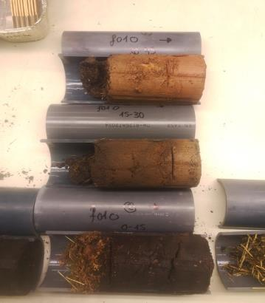
Soil Sampling
∅ 8 cm soil cores to 45 cm deep
Separated into horizons in the lab
Horizons: L, OF, OH, AE, BS, (Cv)
Weighed and dried at 40°C for circa 5 day and
sieved < 2mm
Linear mixed effects (LME) models for significant differences with pair as random factor
Prof. Glaser at work, NP Schwarzwald (Stutz 2023)

Slide 4
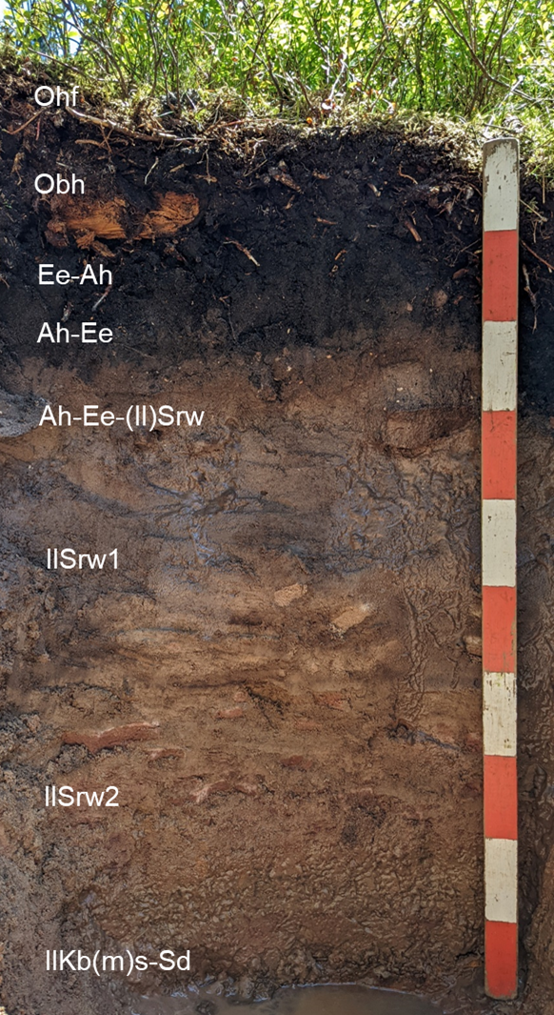
Soil Profile – Seehalde
Depth
Horizon
Soil Texture
Stones
Struct-ure
Lime
Color
Lang et al. (2025), DBG Excursion Guide, Figs. P.5.1 & Table P.5.2
Notes:
Facts…

Slide 5
Soil Profile – Seehalde
 | Particle Size Distribution [Mass %]
Depth cm | Coar. Sand | Medium Sand | Fine Sand | Coar. Silt | Med. Silt | Fine Silt | Clay | Silt | Sand | Soil Texture
10-9 | … | … | … | … | … | … | … | … | … | …
9-5 | … | … | … | … | … | … | … | … | … | …
5-0 | … | … | … | … | … | … | … | … | … | …
0-8 | 8,5 | 58,5 | 19,9 | 1,9 | 2,2 | 1,0 | 8,1 | 5,1 | 86,9 | St2
-18 | 11,0 | 55,3 | 21,0 | 4,9 | 0,0 | 1,2 | 6,5 | 6,1 | 87,4 | St2
-36 | 9,5 | 42,0 | 28,4 | 3,5 | 3,2 | 1,7 | 11,6 | 8,4 | 80,0 | St2
-50 | 4,5 | 39,0 | 32,7 | 6,4 | 3,9 | 3,5 | 10,0 | 13,9 | 76,1 | Sl3
-85 | 4,8 | 54,7 | 28,6 | 1,4 | 1,2 | 1,2 | 8,0 | 3,8 | 88,2 | St2
-88 | 2,8 | 45,4 | 21,6 | 4,7 | 4,0 | 3,6 | 17,9 | 12,3 | 69,8 | St3
>88 | 0,2 | 23,4 | 49,3 | 9,6 | 3,9 | 0,9 | 12,7 | 14,4 | 72,9 | Sl4
Lang et al. (2025), DBG Excursion Guide, Table P.5.3
Notes:
Facts…

Slide 6
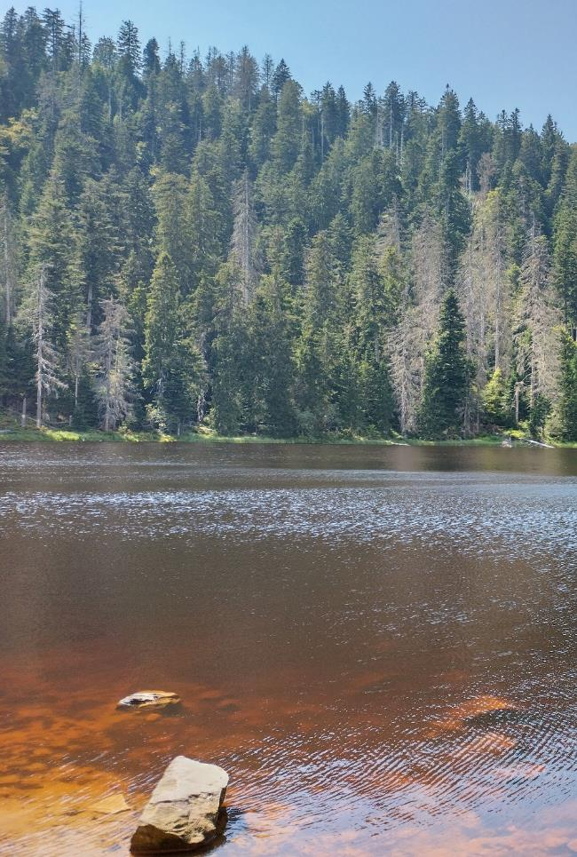
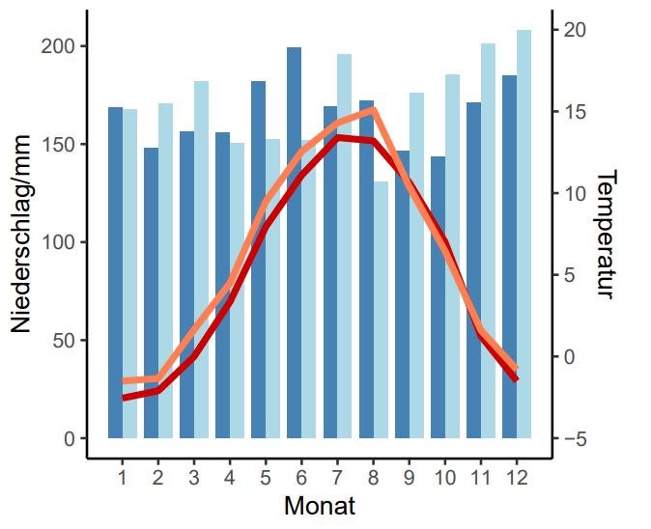


Macro-Climate
Temperature [°C]
Precipitation [mm]
Month
Lang et al. (2025), DBG Excursion Guide, Figs. P.4.1
Wildersee, Nationalpark Schwarzwald (Stutz, 2024)
Notes:
Facts…

Slide 7
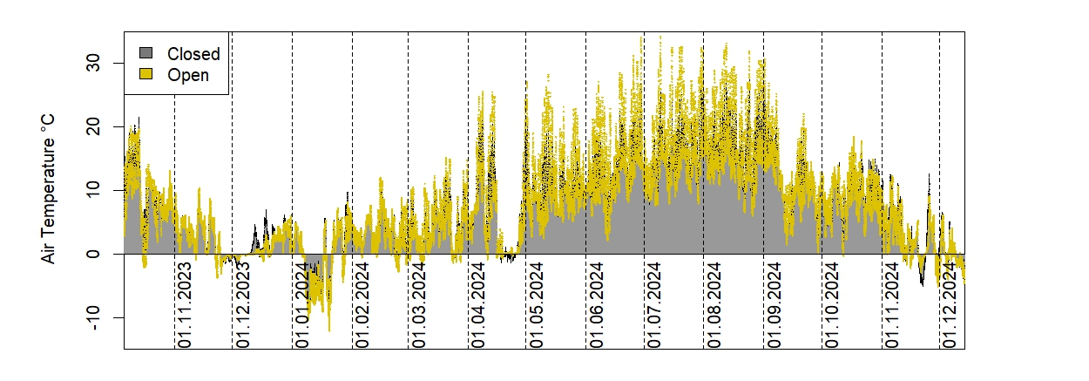
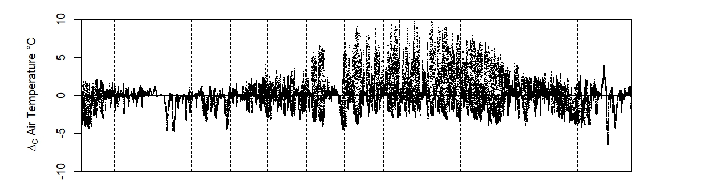
Near-Surface Air Temperature – Seehalde
06.10.2023 to 13.12.2024…
Closed = 7.176 ± 0.031 °C
Δ_{C} = –0.101 ± 0.008 °C
Max = 41.7 °C (f03 open)
Min = –12.6 °C (f01 open)
Stutz et al. (in prep.)

Slide 8
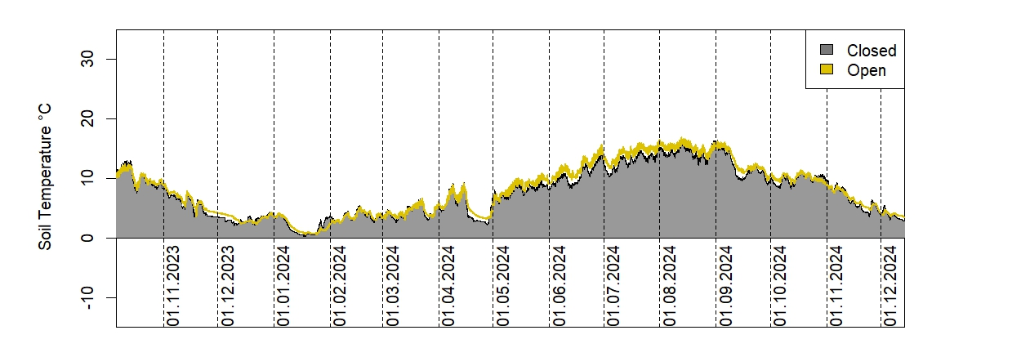
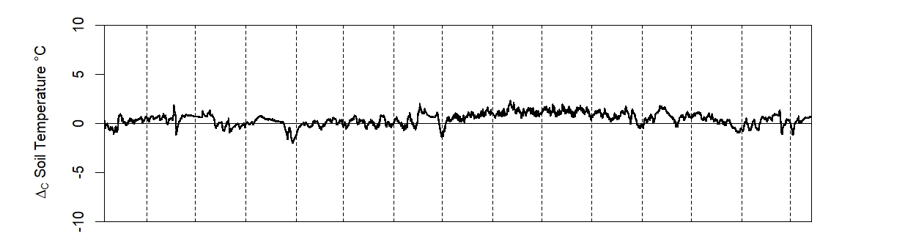
Forest Floor Temperature – Seehalde
06.10.2023 to 13.12.2024…
Closed = 6.885 ± 0.019 °C
Δ_{C} = +0.450 ± 0.004 °C
Max = 18.6 °C (f03 closed)
Min = –0.31 °C (f03 open)
Stutz et al. (in prep.)

Slide 9
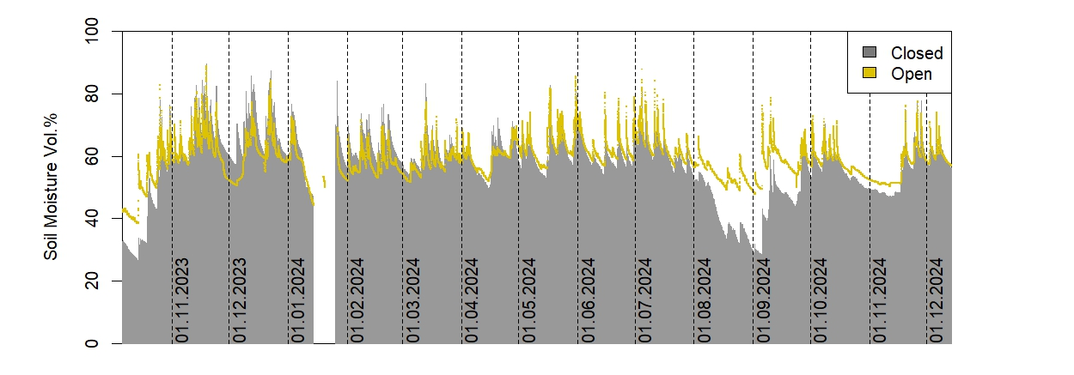
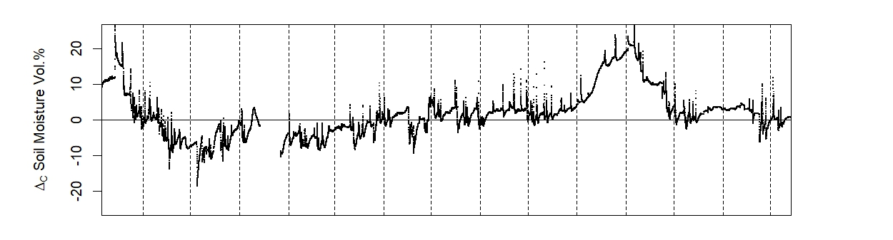
Forest Floor Moisture – Seehalde
06.10.2023 to 13.12.2024…
Closed θ = 57.16 ± 0.04 V%
Δ_{C} θ = +1.727 ± 0.027 V%
Stutz et al. (in prep.)

