Slide 1
Operational ML-based Fire Danger Index
California wildfires, December 2017
Source: Copernicus Sentinel data
Image processed by: Pierre Markuse
Shahbaz Alvi
CMCC Foundation, Lecce, Italy
shahbaz.alvi@cmcc.it
Collaborators:
Gabriele Accarino, Italo Epicoco
EGU 2025
Session: NH7.2 – Rethinking wildfire risk: global and European innovations across the fire risk management continuum
Notes:
Good morning everyone!
My name is Shahbaz Alvi and I am junior scientist at the CMCC foundation.
Thank you for the opportunity to present at the EGU conference.
Today I will talk about an operational pipeline for the daily computation of ml-based fire danger index.

Slide 2
What is SILVANUS?
Vision
To develop an integrated technology platform with innovative toolkits that provide decision-making support in preparedness, response and recovery phase of wildfire management and enhancing the human, environment, and economic resilience to wildfires​.
Technology and scientific innovation
Preservation and restoration
Societal resilience
Phase A Prevention and preparedness to wildfire.​
Phase B
Fire detection and response coordination.
Phase C
Forest restoration and adaptation policies.
Shahbaz Alvi, shahbaz.alvi@cmcc.it
Notes:
SILVANUS is a wildfire management platform which is funded by the European green deal initiative.
The vision of the SILVANUS project has been to develop an integrated approach to wildfire management which consists of a set of integrated tool kits which assist the decision making in preparedness, response and recovery phase of the wildfire management.
The platform aims to enhance the human, environment and economic resilience to wildfires.
The SILVANUS integrated fire management plaform consists of three phases.
Phase A concerns preparedness and prevention, phase B consists of fire detection and response, and phase C is rehabilitation after a fire event.

Slide 3
Fire Danger Index (FDI): What is FDI?
Daily Fire Danger Index (FDI)
The daily fire danger index represents the risk of fire occurrence on a given day.
Phase A Prevention and preparedness to wildfire.​
Estimating Fire Danger Index using ML and Big Data methods.
Shahbaz Alvi, shahbaz.alvi@cmcc.it
Notes:
The fire danger index is a index which encapsulates the risk of forest fire occurrence in a given day.
It gives a measure of the probability of fire occurrence in a given pixel.
Given this, the fire danger index covers the phase A activity of SILAVANUS as it assist in judging the severity of the fire there by supporting several initiatives such as,

Slide 4
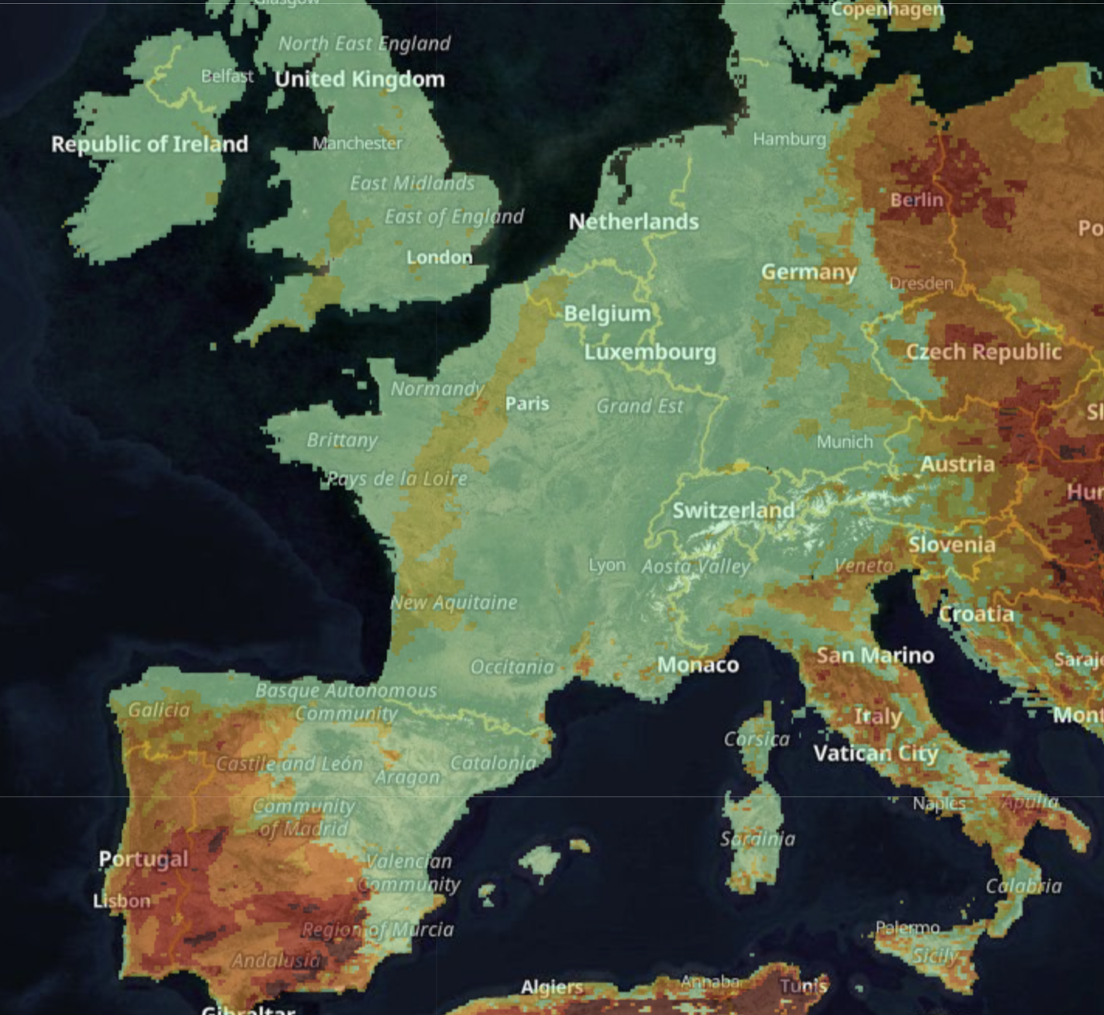
Fire Danger Index (FDI): What is FDI?
Daily Fire Danger Index (FDI)
The daily fire danger index represents the risk of fire occurrence on a given day.
Phase A Prevention and preparedness to wildfire.​
Estimating Fire Danger Index using ML and Big Data methods.
FDI is useful for,
Public awareness - provide a daily forecast in wildfire prone area in high-risk season.
FDI map from EFFIS of the mediterranean region on 4th September 2024
Shahbaz Alvi, shahbaz.alvi@cmcc.it
Notes:
Informing the general public during fire season on the location which are at a high risk of fires on the days when fire danger is particularly high.

Slide 5
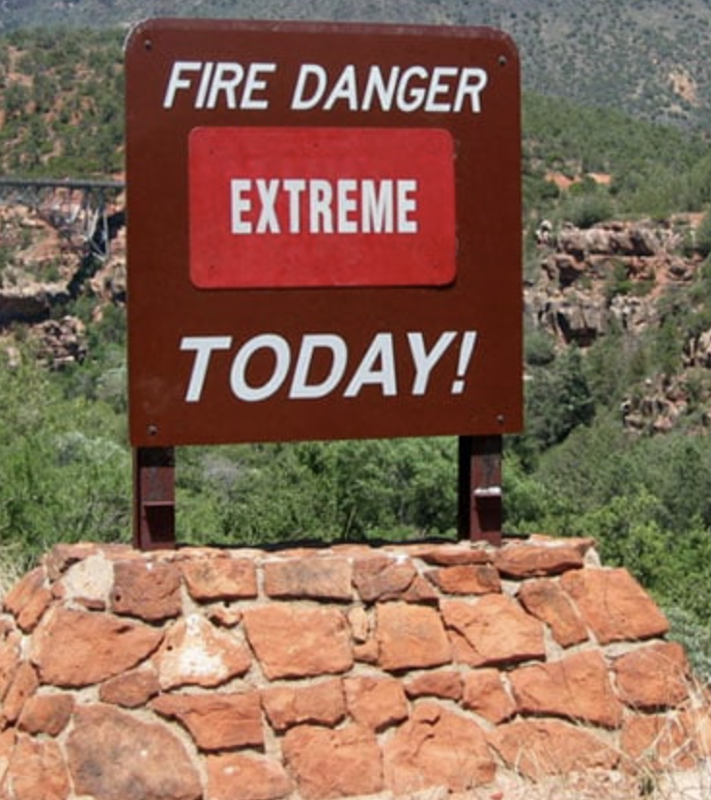
Fire Danger Index (FDI): What is FDI?
Daily Fire Danger Index (FDI)
The daily fire danger index represents the risk of fire occurrence on a given day.
Phase A Prevention and preparedness to wildfire.​
Estimating Fire Danger Index using ML and Big Data methods.
FDI is useful for,
Public awareness - provide a daily forecast in wildfire prone area in high-risk season.
Early warning system - preparedness against wildfire occurrence.
Shahbaz Alvi, shahbaz.alvi@cmcc.it
Notes:
- FDI can be integrated into the early warning system to help prepare the authorities days in advance of a possible fire event.

Slide 6
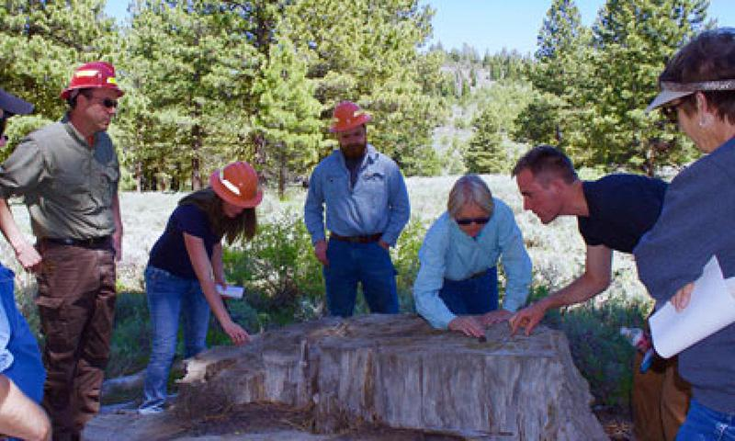
Fire Danger Index (FDI): What is FDI?
Daily Fire Danger Index (FDI)
The daily fire danger index represents the risk of fire occurrence on a given day.
Phase A Prevention and preparedness to wildfire.​
Estimating Fire Danger Index using ML and Big Data methods.
FDI is useful for,
Public awareness - provide a daily forecast in wildfire prone area in high-risk season.
Early warning system - preparedness against wildfire occurrence.
Better management of resources by the fire fighting authorities.
Shahbaz Alvi, shahbaz.alvi@cmcc.it
Notes:
- This in turn allows the civil services to better plan and allocate resources given the changing level of fire risk across the geographic region.

Slide 7
ML-based FDI
ML-based FDI shows strong potential to perform better than traditional methods of estimating fire danger index like the Canadian FWI.
Shahbaz Alvi, shahbaz.alvi@cmcc.it
Notes:
Canonical FWI index generally utilize weather variables to assess the risk of forest fires.
The canonical methods, thus, provide a measure of fire weather – weather conducive to fire erruption
Furthermore, canonical fwi often over-estimate the risk of fire eruption.

Slide 8
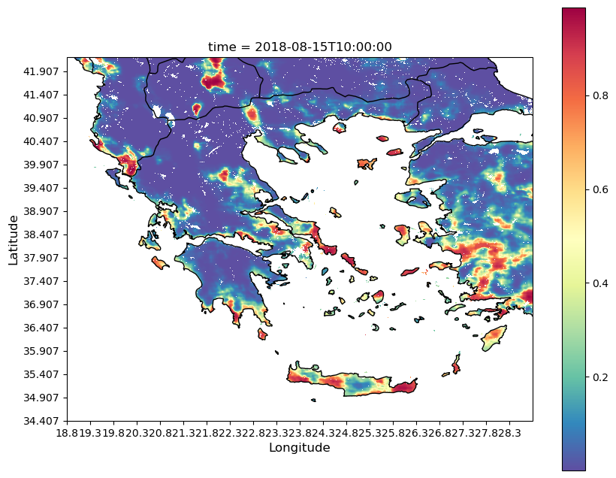
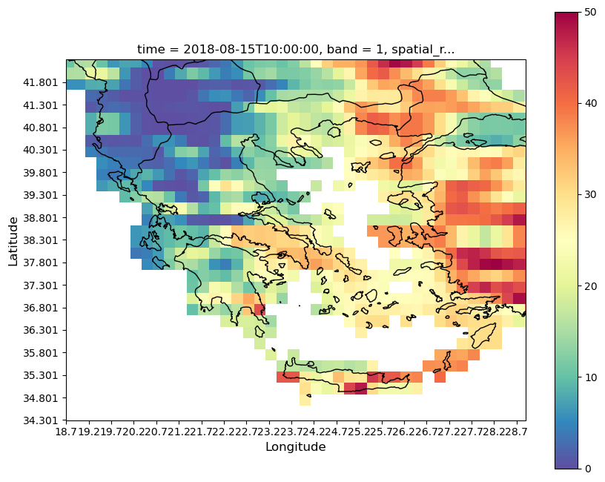
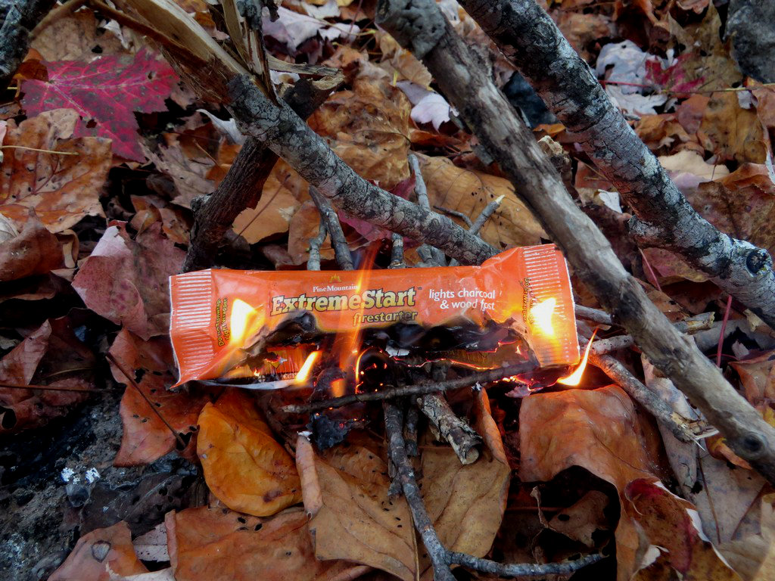
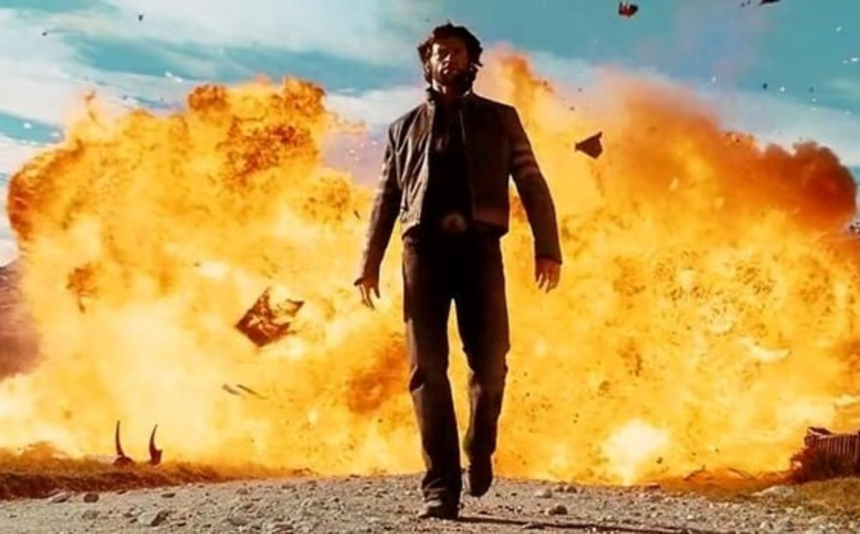
ML-based FDI
ML-based FDI shows strong potential to perform better than traditional methods of estimating fire danger index like the Canadian FWI.
Provides a more detailed and precise representation of fire danger compared to the traditional Canadian FWI.
Fire Danger Index
Canadian Fire Weather Index*
Shahbaz Alvi, shahbaz.alvi@cmcc.it
Notes:
Ml-based fdi index gives directly the measure of fire activity thus a direct measure of fire occurrence.

Slide 9
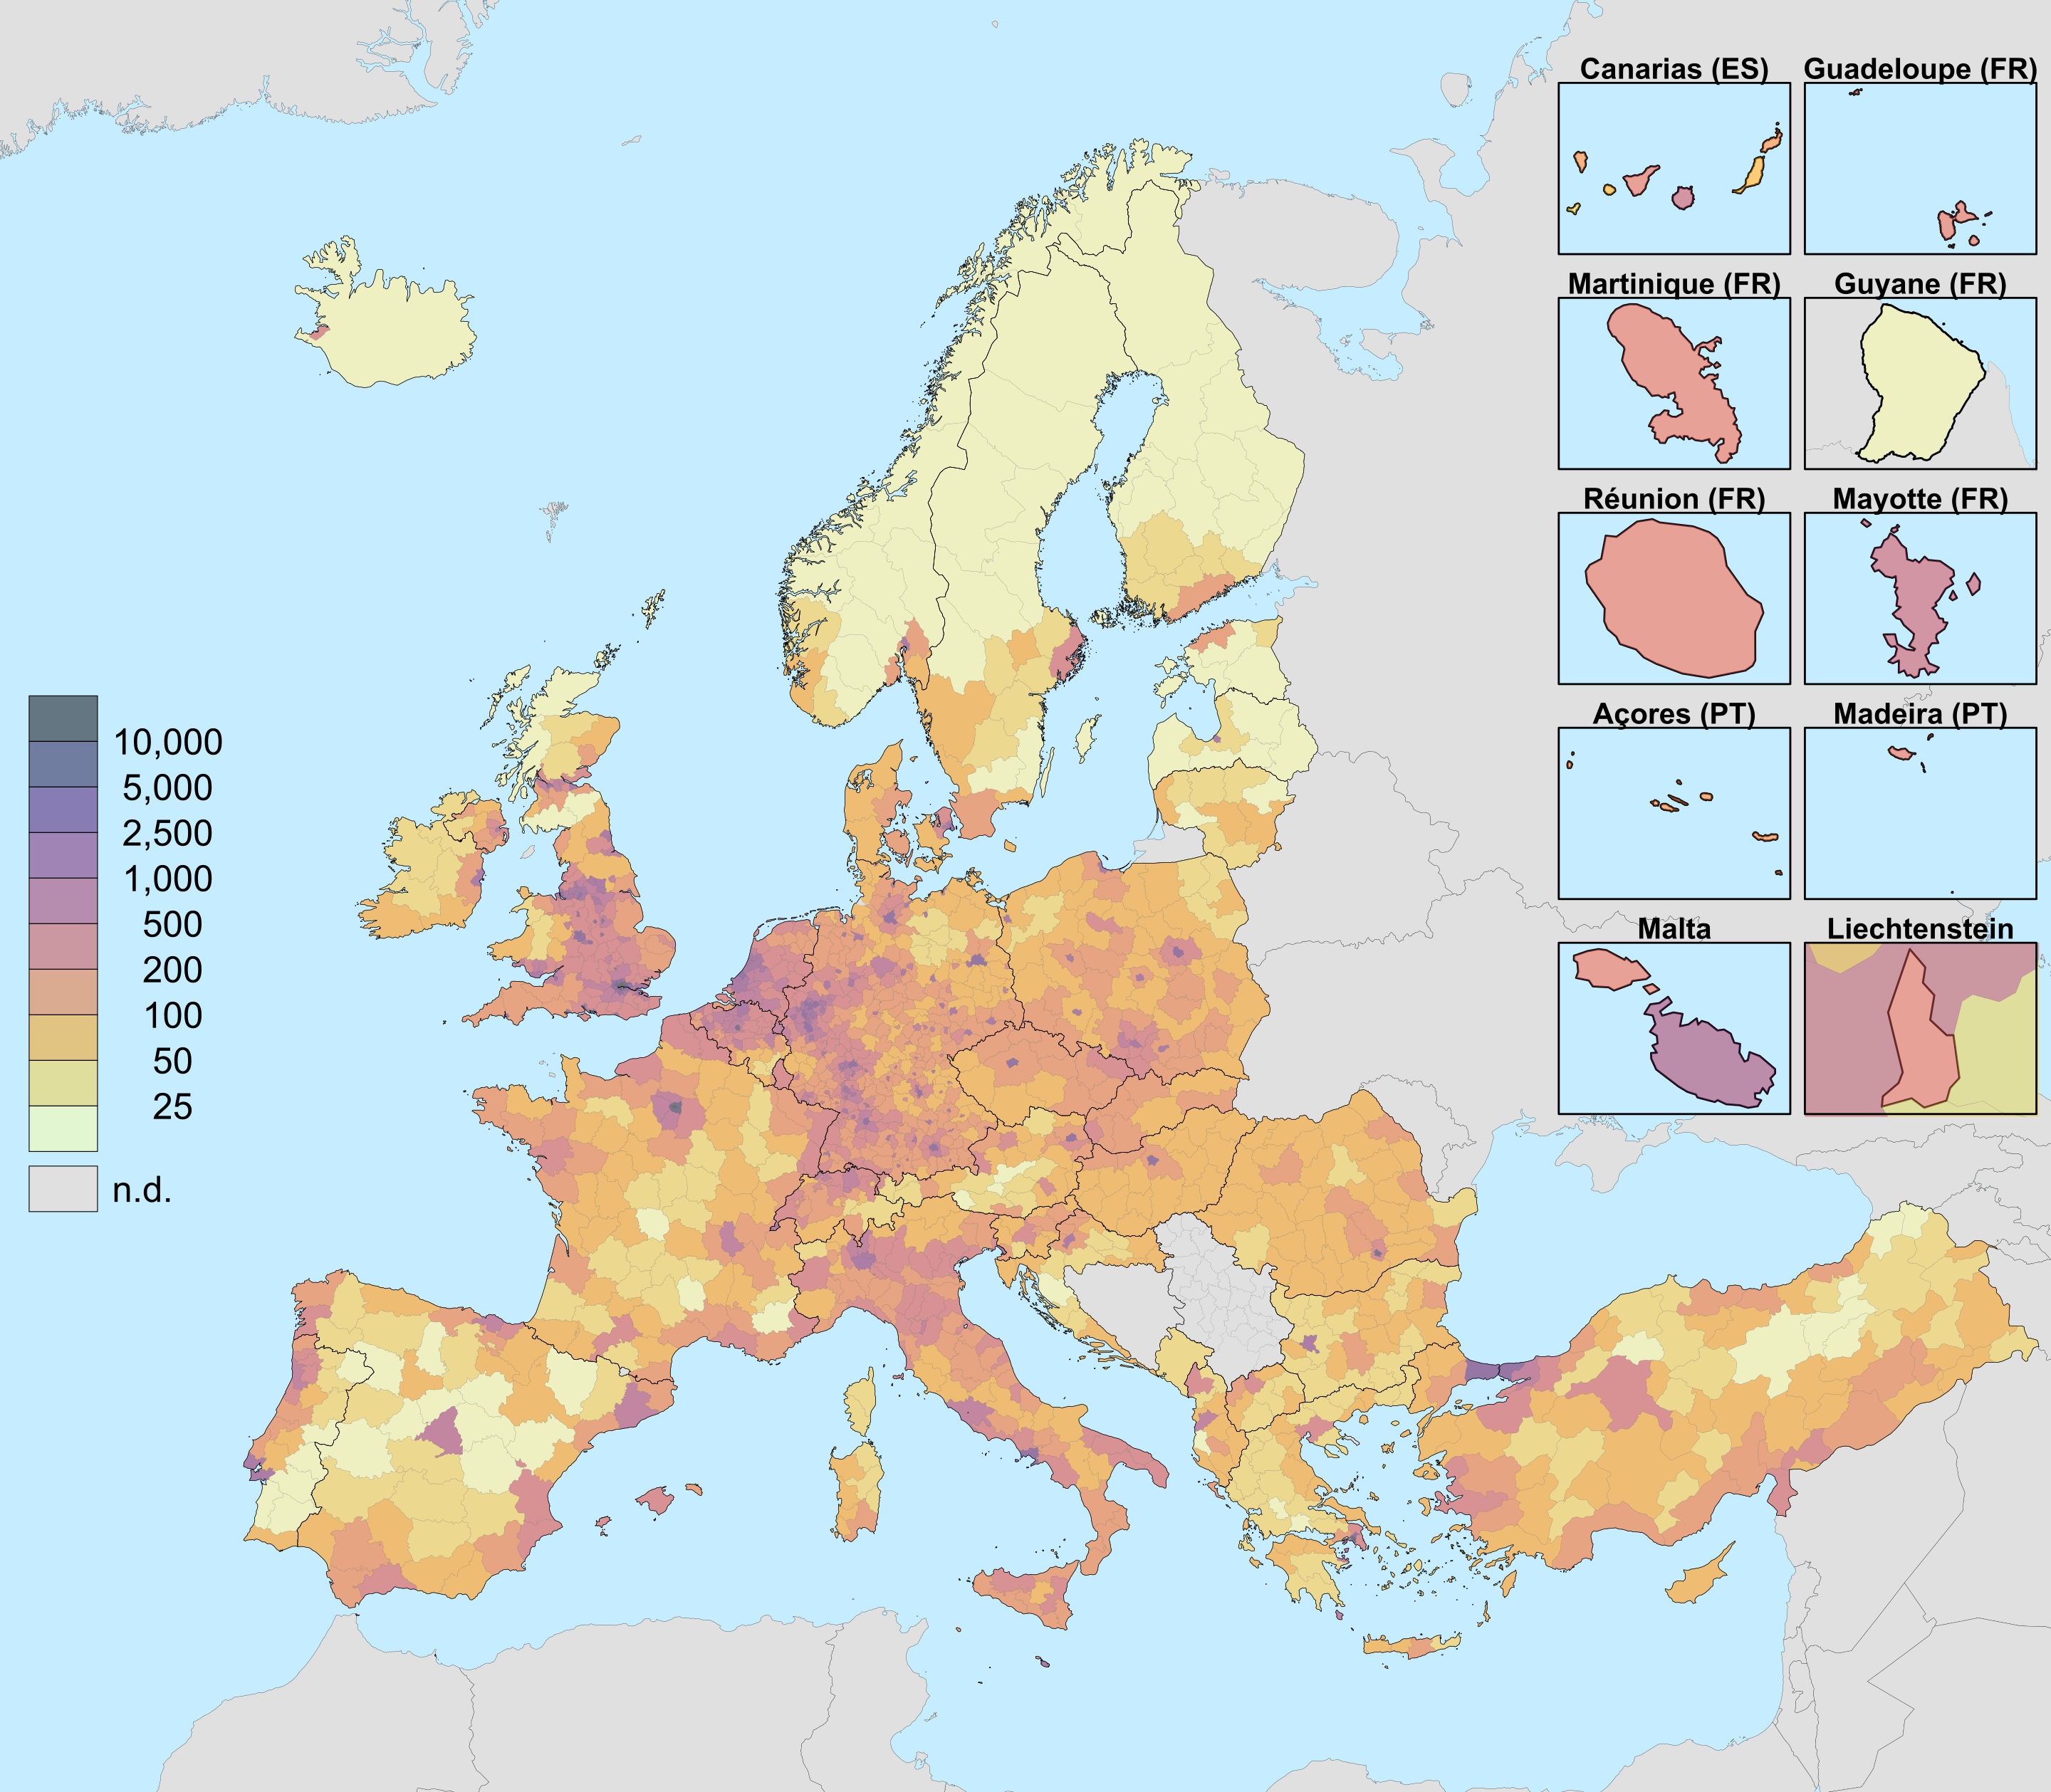
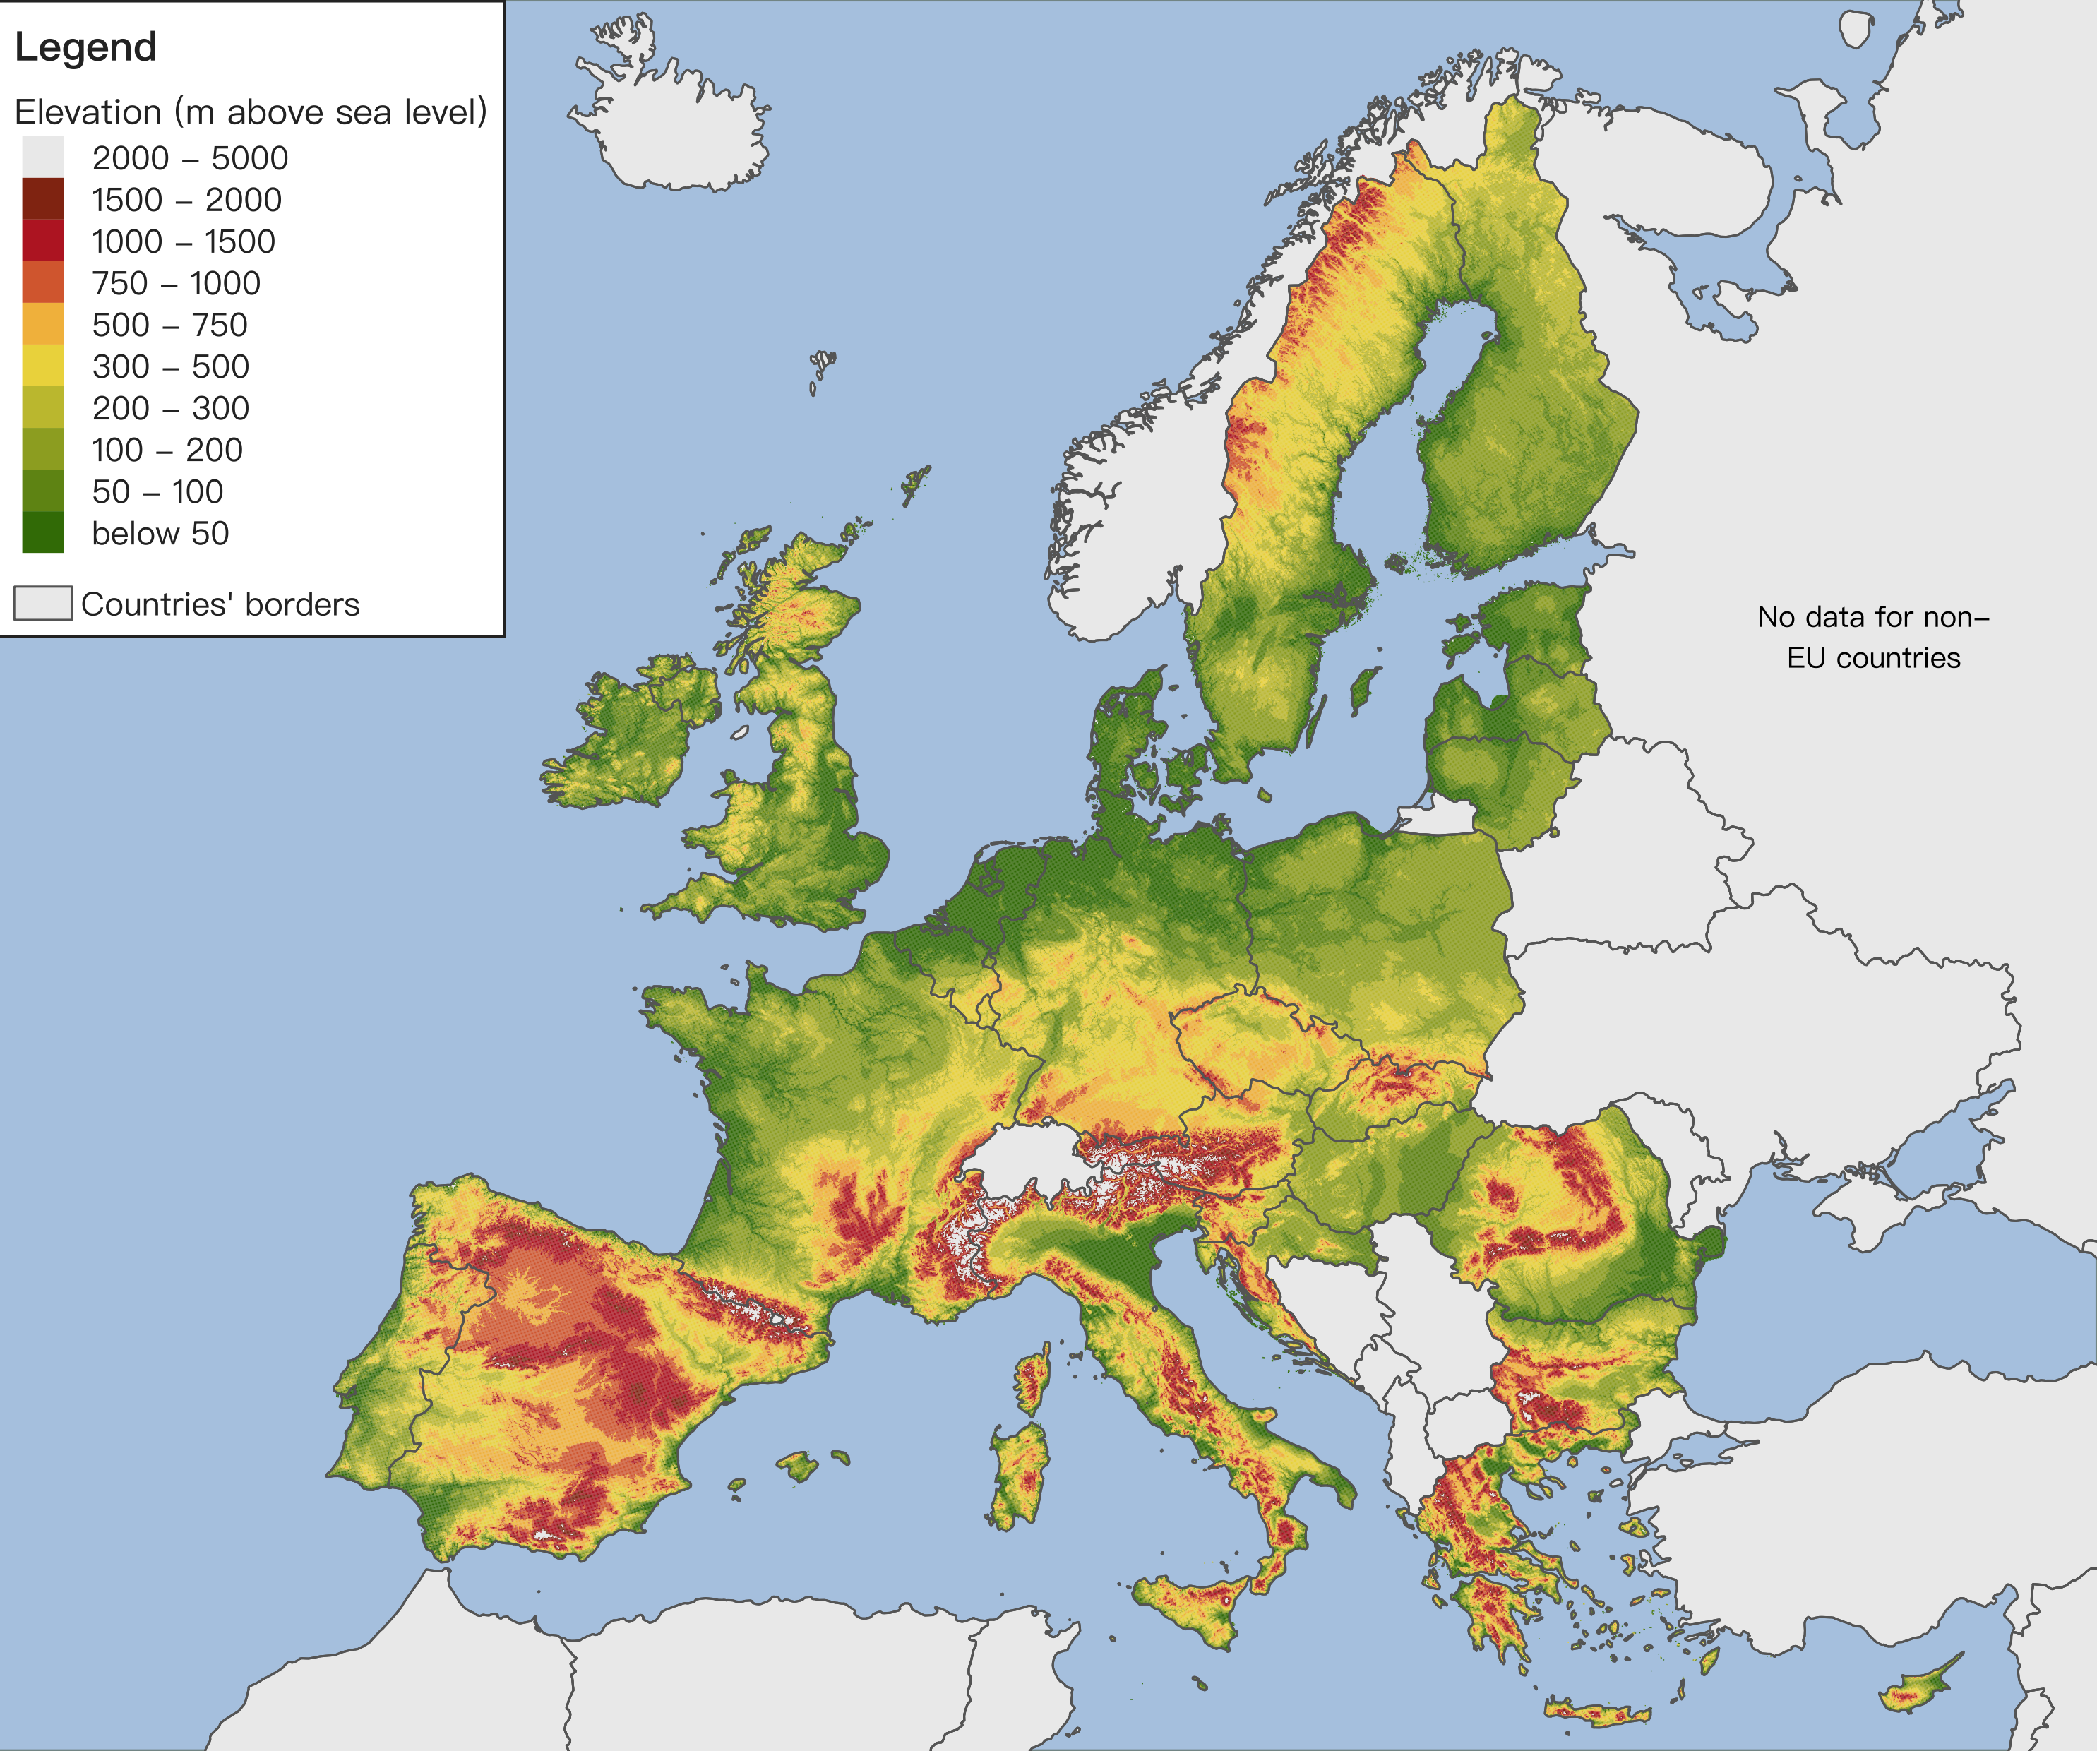
ML-based FDI
ML-based FDI shows strong potential to perform better than traditional methods of estimating fire danger index like the Canadian FWI.
Provides a more detailed and precise representation of fire danger compared to the traditional Canadian FWI.
Possibility to include anthropogenic and topographical factors in wildfire occurrence which are ignored in the standard FWI framework.
Fire Danger Index
Canadian Fire Weather Index*
Population density
Elevation
Shahbaz Alvi, shahbaz.alvi@cmcc.it
Notes:
- This is achieved by factoring essential variables like anthropogenic activities that 1) reduce the false positives but factoring variables essential for fire activity, 2) predict directly fire activity rather the fire weather like the canadian fwi.

Slide 10
ML-based FDI
ML-based FDI shows strong potential to perform better than traditional methods of estimating fire danger index like the Canadian FWI.
Provides a more detailed and precise representation of fire danger compared to the traditional Canadian FWI.
Possibility to include anthropogenic and topographical factors in wildfire occurrence which are ignored in the standard FWI framework.
ML methods can adapt to diverse climates, while FWI is primarily tailored for Canada’s ecosystem.
Fire Danger Index
Canadian Fire Weather Index*
Shahbaz Alvi, shahbaz.alvi@cmcc.it
Notes:
- Futhermore, ml-based models can easily adopt to different climates while the canonial method, like the canadian fwi index are caliberated for specific ecosystem and climate.

Slide 11
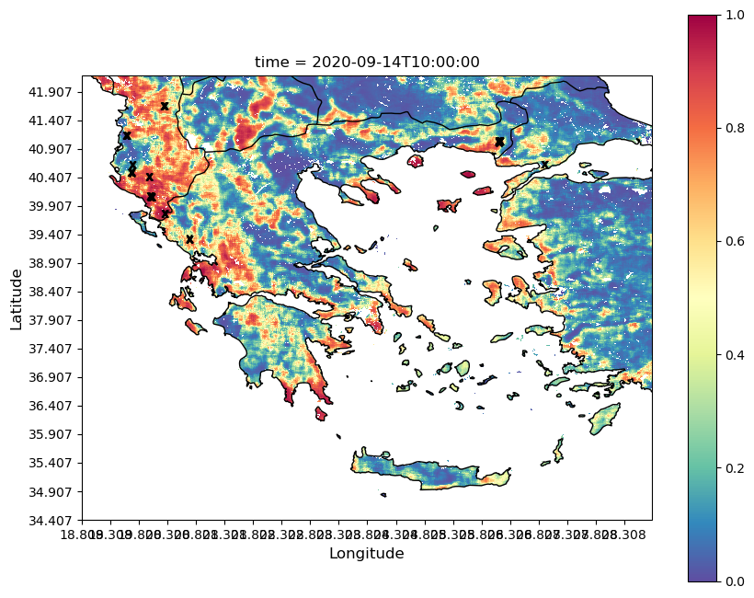
Computing Daily FDI: Challenges
Computing the daily FDI requires static (e.g. topography, and anthropogenic variables) and dynamic (weather, vegetation) variables.
Daily FDI
Shahbaz Alvi, shahbaz.alvi@cmcc.it
Notes:
Typically in ml-based daily fdi different fire predictors change on different temporal scales.
Static variables remains the same for a longer period (like topography) and dynamic variables change on a much shorter scale (like weather and vegetation).

Slide 12
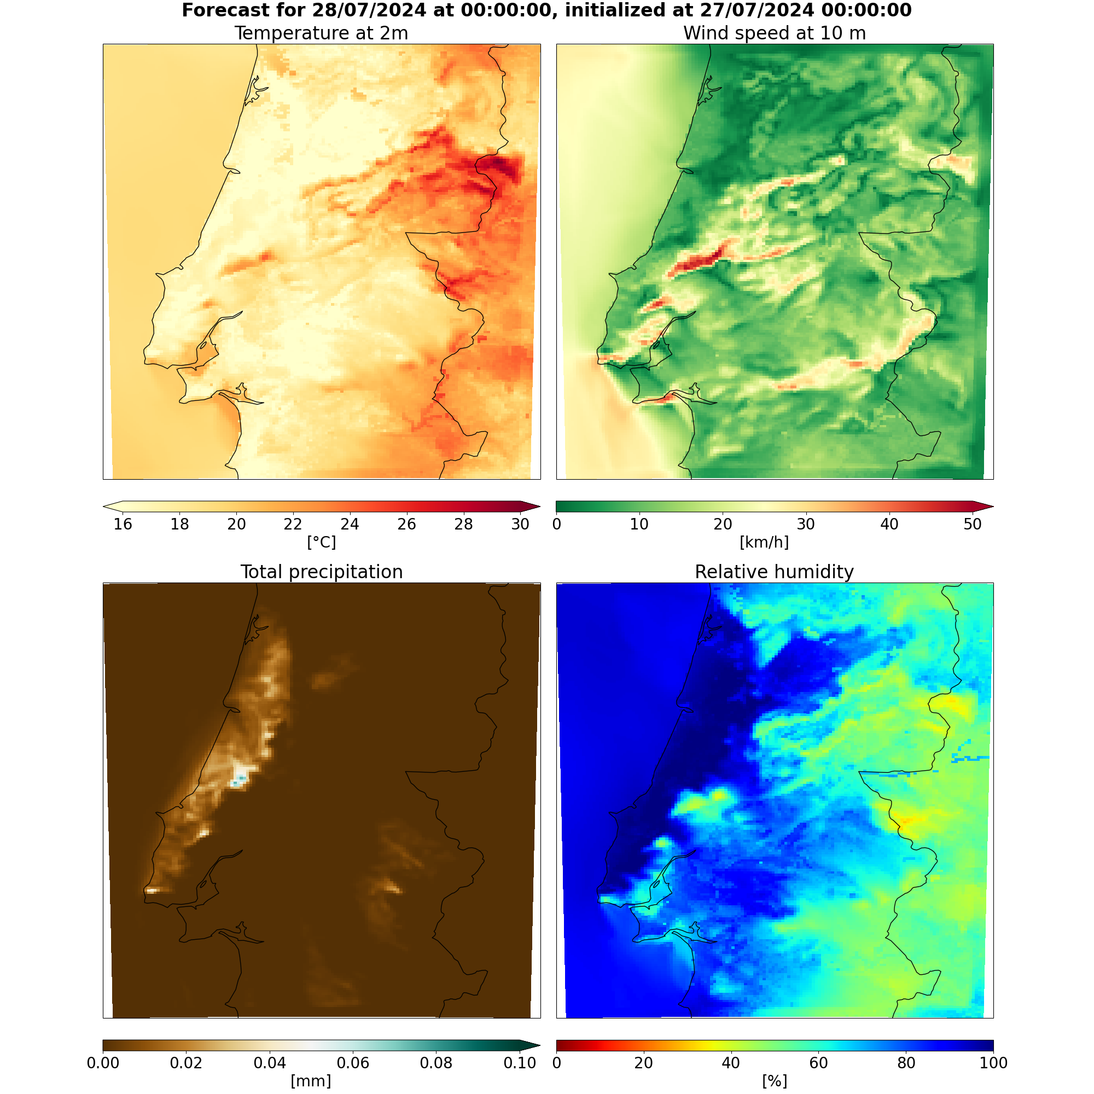
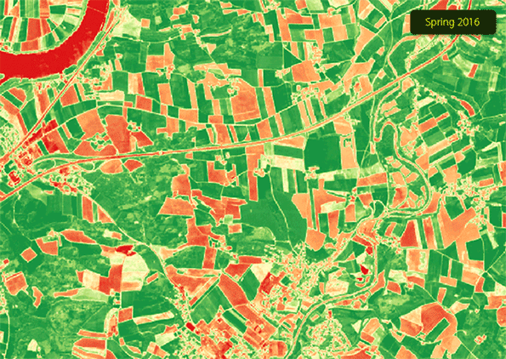
Computing Daily FDI: Challenges
Normalized Difference Vegetation Index
(NDVI)
Computing the daily FDI requires static (e.g. topography, and anthropogenic variables) and dynamic (weather, vegetation) variables.
Dynamic variables must be updated more frequently as they vary on a shorter course of time.
Population density
Elevation
Shahbaz Alvi, shahbaz.alvi@cmcc.it
Notes:
That is to predict the daily FDI, the dynamic variables, such as the weather forecast, are required on a daily basis.

Slide 13
Computing Daily FDI: Challenges
Computing the daily FDI requires static (e.g. topography, and anthropogenic variables) and dynamic (weather, vegetation) variables.
Dynamic variables must be updated more frequently as they vary on a shorter course of time.
Fire predictors from diverse data repositories need to be collected, pre-processed prior to computing the daily FDI.
A datastore is needed to collect, and preprocess the data with metadata retrieval method.
Weather
Vegetation
Topography
Anthropogenic variables
Pre-processing
Storing
Data Repository
Data consumption
Shahbaz Alvi, shahbaz.alvi@cmcc.it
Notes:
These fire predictors are often gathered from different autonomous data repositories.
Thus a datastore is needed to collect, aggregate, and possibly also pre-process, ingested variables from data repositories.
The datastore must posses a method of metadata retrieval method to allows for a pipeline to consume these stored variables.

Slide 14
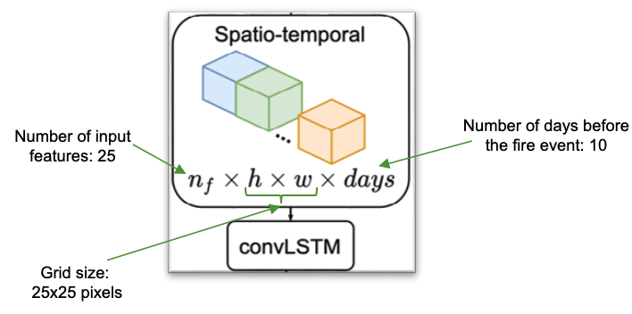
Daily FDI in SILVANUS: Training and Model
For the Silvanus FDI product,
The ML model input features include for training,
weather variables,
NDVI,
land surface temperature, and
human infrastructure
at 1 km resolution.
We use convolutional LSTM (CLSTM) neural network - exploiting both spatial and temporal correlations between fire predictors around a fire event.
24
Shahbaz Alvi, shahbaz.alvi@cmcc.it
Notes:
I will now talk a little bit about how we train our model for FDI in SIVLANUS.
We utilize 24 fire predictors which can be categorized into these 4 categories – weather, vegetation, land surface temperature and human infrastructure.
Since different fire predictors act on different time scales, we have utilized a convolutional LSTM to exploit both spatial and temporal correlation between fire predictors.

Slide 15
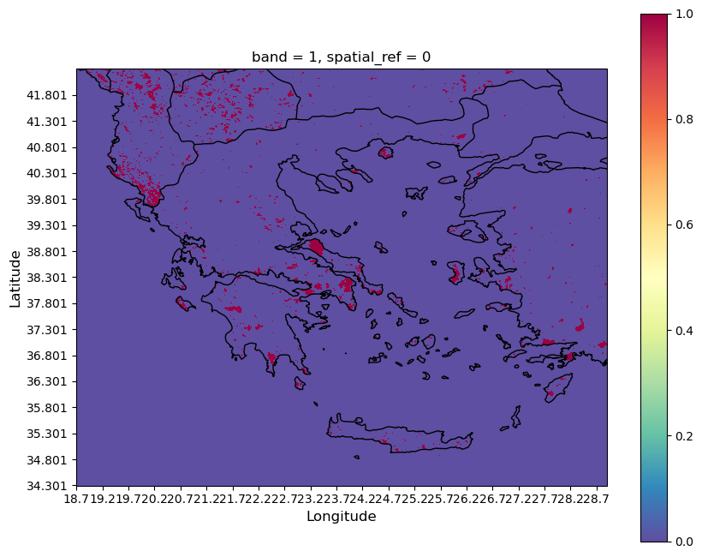
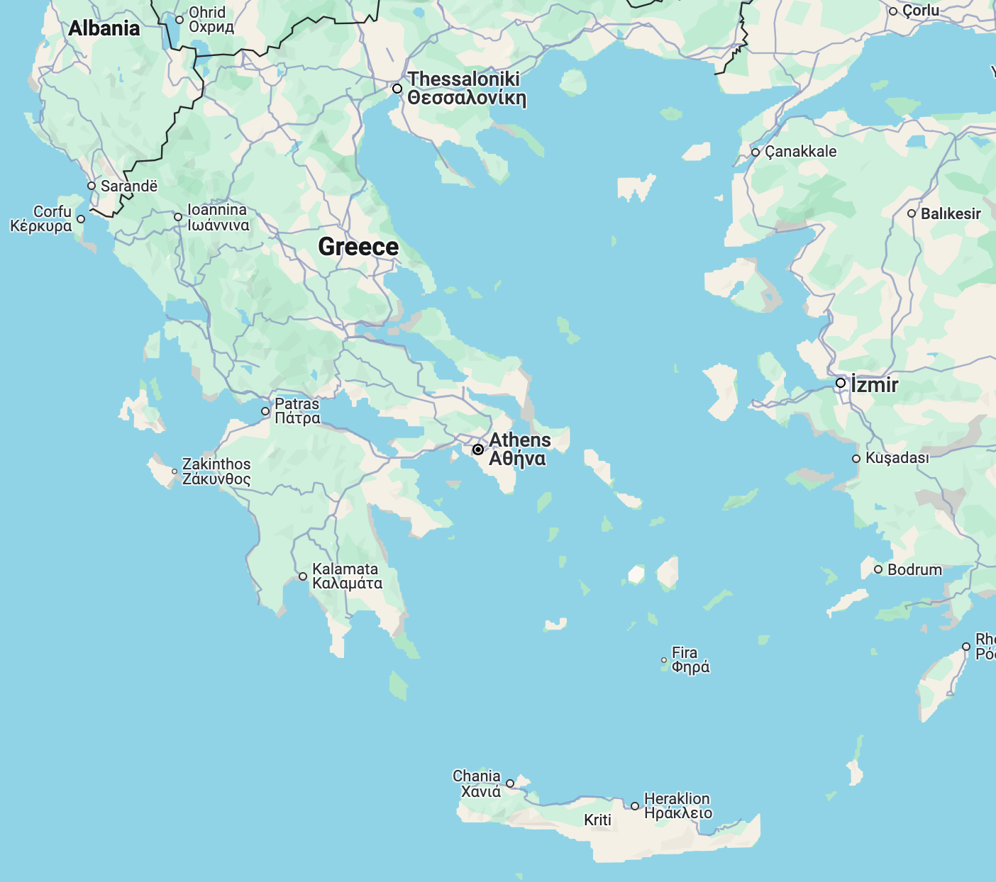
Daily FDI in SILVANUS: Training and Model
For the Silvanus FDI product,
The ML model input features include for training,
weather variables,
NDVI,
land surface temperature, and
human infrastructure
at 1 km resolution.
We use convolutional LSTM (CLSTM) neural network - exploiting both spatial and temporal correlations between fire predictors around a fire event.
Model trained on historical fires in the mediterranean region around Greece, Albania, parts of Macedonia, west Turkey from the period of 2009 to 2021*.
24
*Kondylatos et al. 2022
Shahbaz Alvi, shahbaz.alvi@cmcc.it
Notes:
The dataset that we utilized consists of historical fires in the mediterranean region between 2009 and 2021.
The geographical area is centered around Greece, and also includes parts of Albania, Macedonia, and Turkey,
The large geographical area and 13 years of data provides a large enough dataset for the training the network on a variety of fire events.

Slide 16
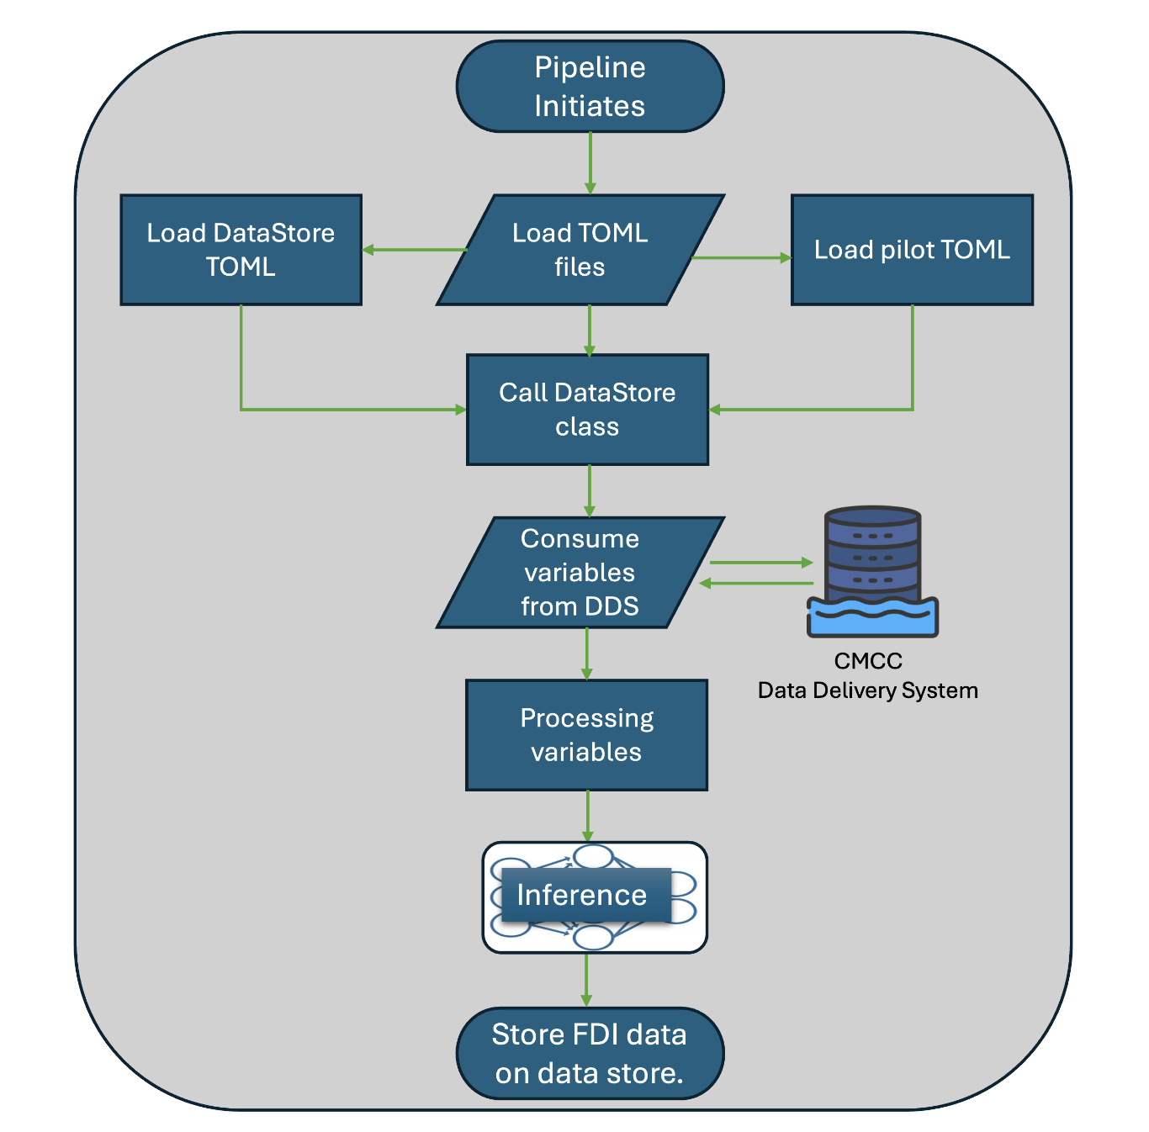
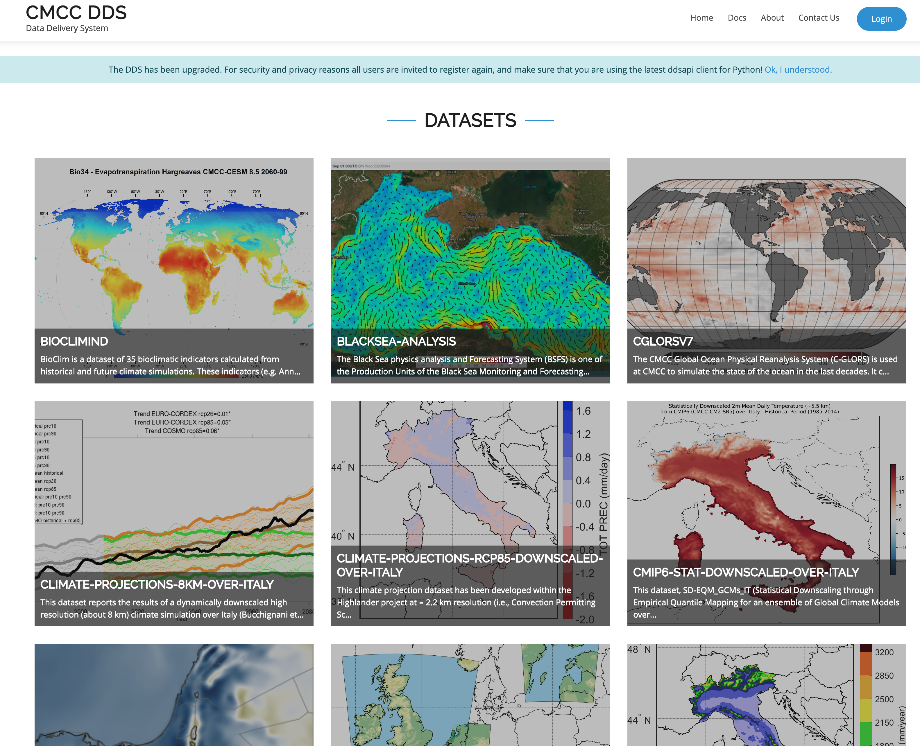
Daily FDI in SILVANUS: Daily FDI pipeline
The pipeline uses CMCC DDS service as the data store to ingest the fire predictors for the pilots every day to make the prediction for the following day.
dds-support@cmcc.it
Shahbaz Alvi, shahbaz.alvi@cmcc.it
Notes:
Our FDI pipeline uses CMCC DDS service as the datastore from where the data and metadata for the the fire predictors is retrieved.
Everyday, the DDS services attempts to retrieve the lates dataset from the parent repository.

Slide 17
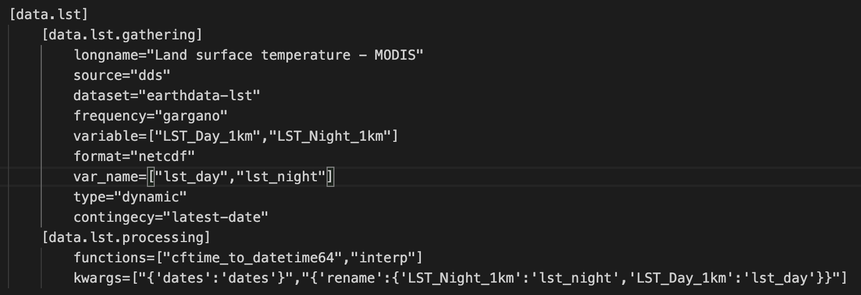
Daily FDI in SILVANUS: Daily FDI pipeline
The pipeline uses CMCC DDS service as the data store to ingest the fire predictors for the pilots every day to make the prediction for the following day.
The configuration for the retrieval of a variable from DDS is stored in TOML file format.
Shahbaz Alvi, shahbaz.alvi@cmcc.it
Notes:
The configuration for the retrieval of the variables from DDS is stored in TOML which are easily configurable.
This flexible format allows the ingestion of different fire predictors from different datastores.
The default format assumed for the dataset is xarray netcdf object.
As you can see that the pipeline is developed primarily for CMCC DDS service.

Slide 18
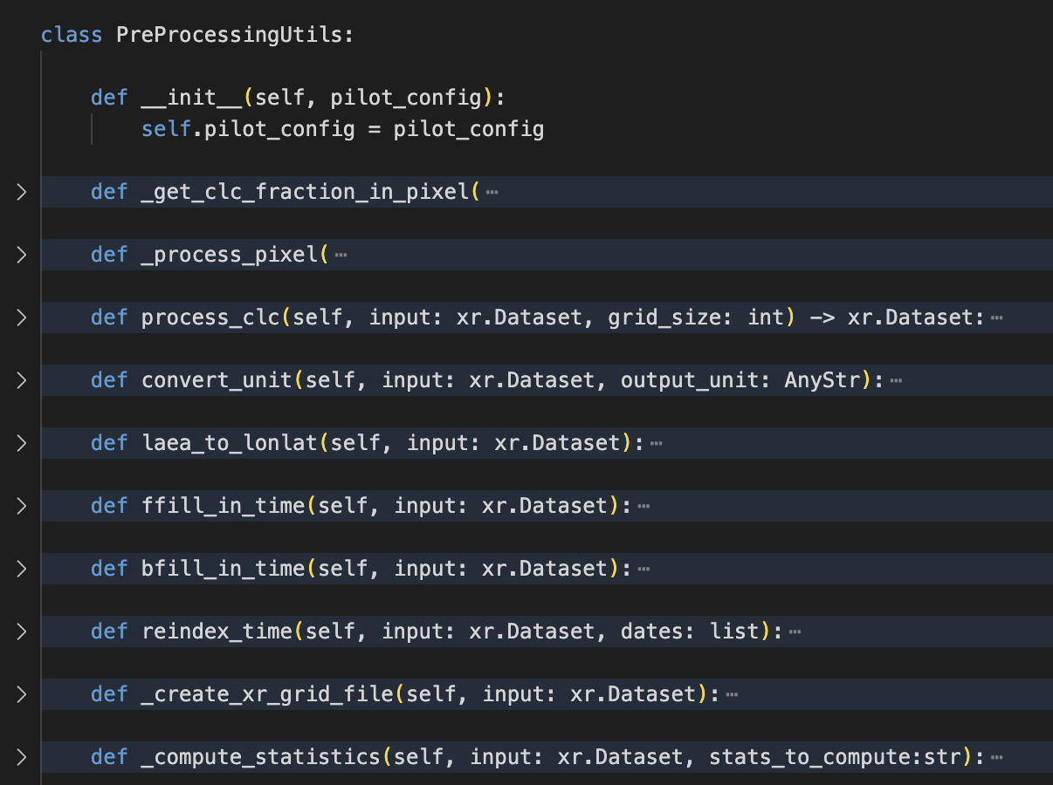
Daily FDI in SILVANUS: Daily FDI pipeline
The pipeline uses CMCC DDS service as the data store to ingest the fire predictors for the pilots every day to make the prediction for the following day.
The configuration for the retrieval of a variable from DDS is stored in TOML file format.
The consumed fire predictors are pre-processed “on-the-fly” and fed to the ML model to make the prediction of FDI for the given day.
Shahbaz Alvi, shahbaz.alvi@cmcc.it
Notes:
Data that is consumed from the datastore might require pre-processig before passing it for inference to the ml-model.
A flexible class exists in the pipeline in which one can code the transformations to be applied to the consumed variable.
Explain the image….

Slide 19
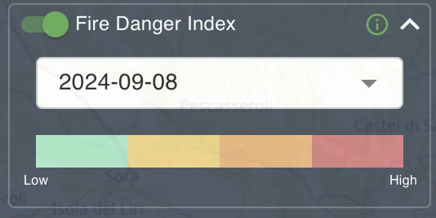
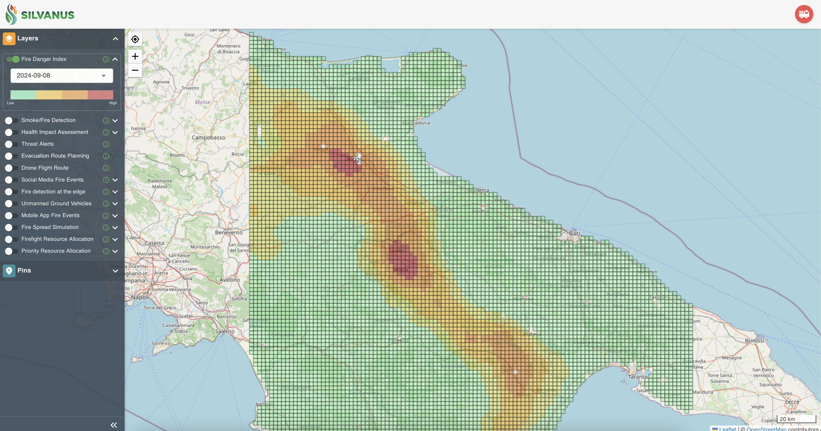
Daily FDI in SILVANUS: Daily FDI pipeline
The pipeline uses CMCC DDS service as the data store to ingest the fire predictors for the pilots every day to make the prediction for the following day.
The configuration for the retrieval of a variable from DDS is stored in TOML file format.
The consumed fire predictors are pre-processed “on-the-fly” and fed to the ML model to make the prediction of FDI for the given day.
Once the FDI forecast has been computed, it is pushed to the SILVANUS storage from where it can be visualized on the platform*.
*development of the platform is not developed by CMCC
Shahbaz Alvi, shahbaz.alvi@cmcc.it
Notes:
The inference from the ml-model is stored in the SILVANUS storage from where it is visualized on the dashboard.

Slide 20
Daily FDI in SILVANUS: Daily FDI pipeline
The pipeline uses CMCC DDS service as the data store to ingest the fire predictors for the pilots every day to make the prediction for the following day.
The configuration for the retrieval of a variable from DDS is stored in TOML file format.
The consumed fire predictors are pre-processed “on-the-fly” and fed to the ML model to make the prediction of FDI for the given day.
Once the FDI forecast has been computed, it is pushed to the SILVANUS storage from where it can be visualized on the platform*.
The pipeline can dockerized and deployed on cluster environment like k8s for automated computation of the FDI.
*development of the kubernetes cluster no done by CMCC.
Shahbaz Alvi, shahbaz.alvi@cmcc.it
Notes:
- The pipeline, which is entirely based on python, can be dockerized and deployed on a cluster environment for autonomous computation of fdi forecast daily.

Slide 21
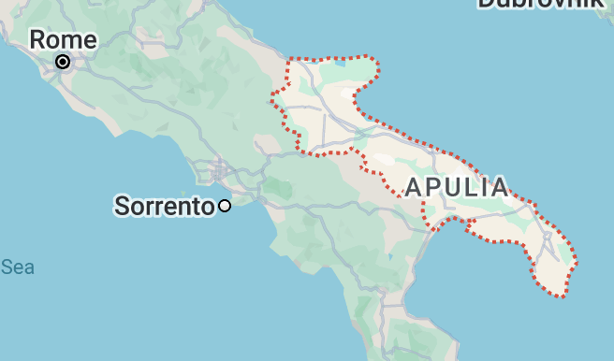
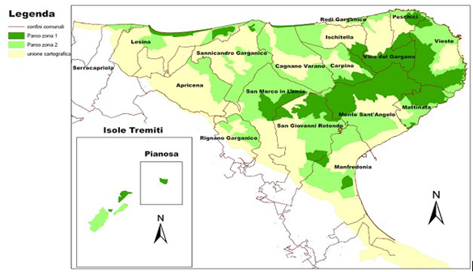
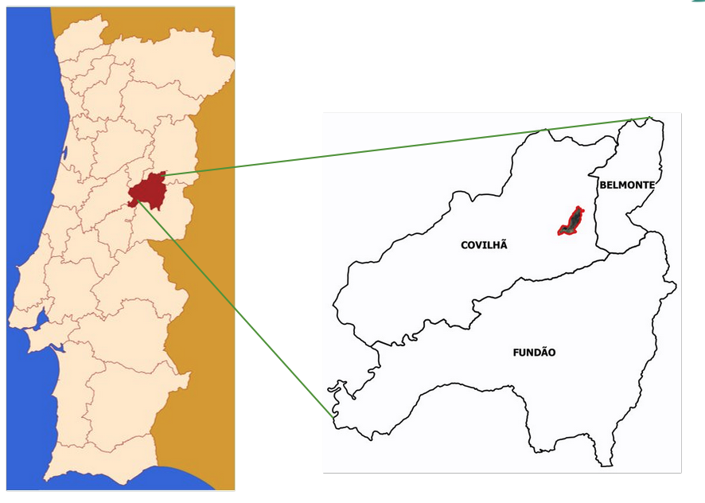
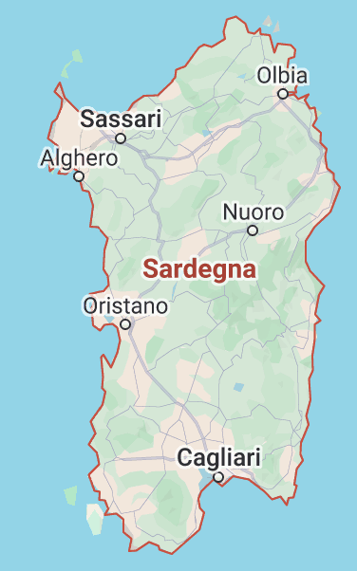
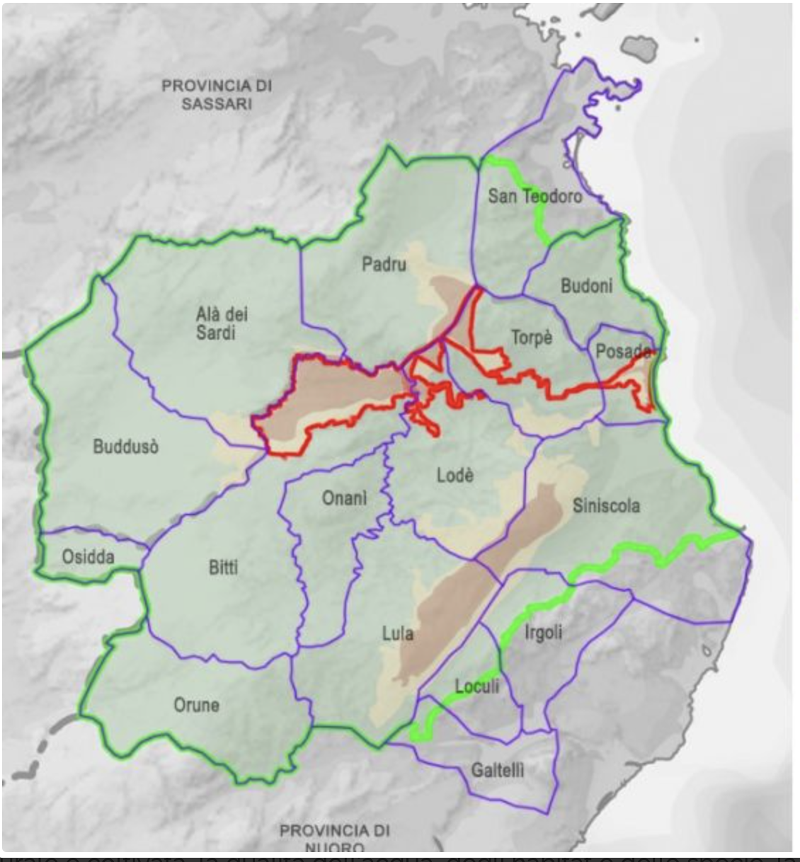
Daily FDI in SILVANUS: Some results
We deploy our FDI user product on three different pilots sites in Europe,
Gargano, Apulia
Tepilora, Sardinia
Covilhã, Portugal
Portugal
Shahbaz Alvi, shahbaz.alvi@cmcc.it
Notes:
- I will now show you some results from the FDI pipeline which were generated using the presented FDI pipeline.
- The pipeline was deployed over the three pilot sites in the SILVANUS project namely, Gargano and Sardinia in Italy and Covilha in portugal.

Slide 22
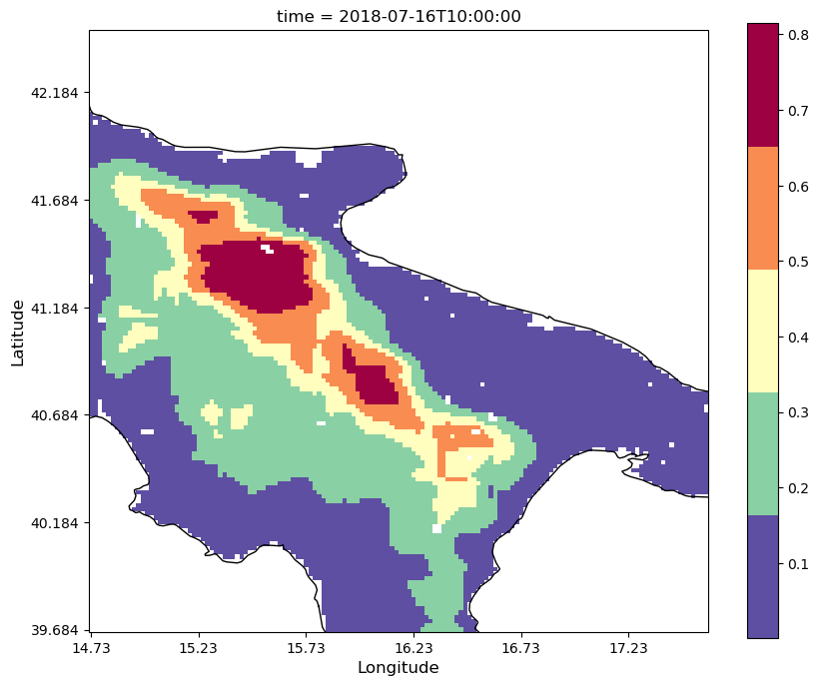
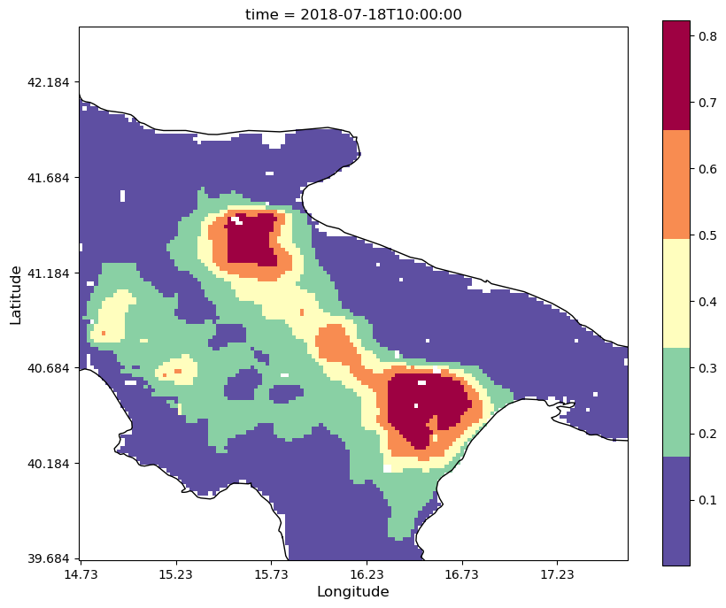
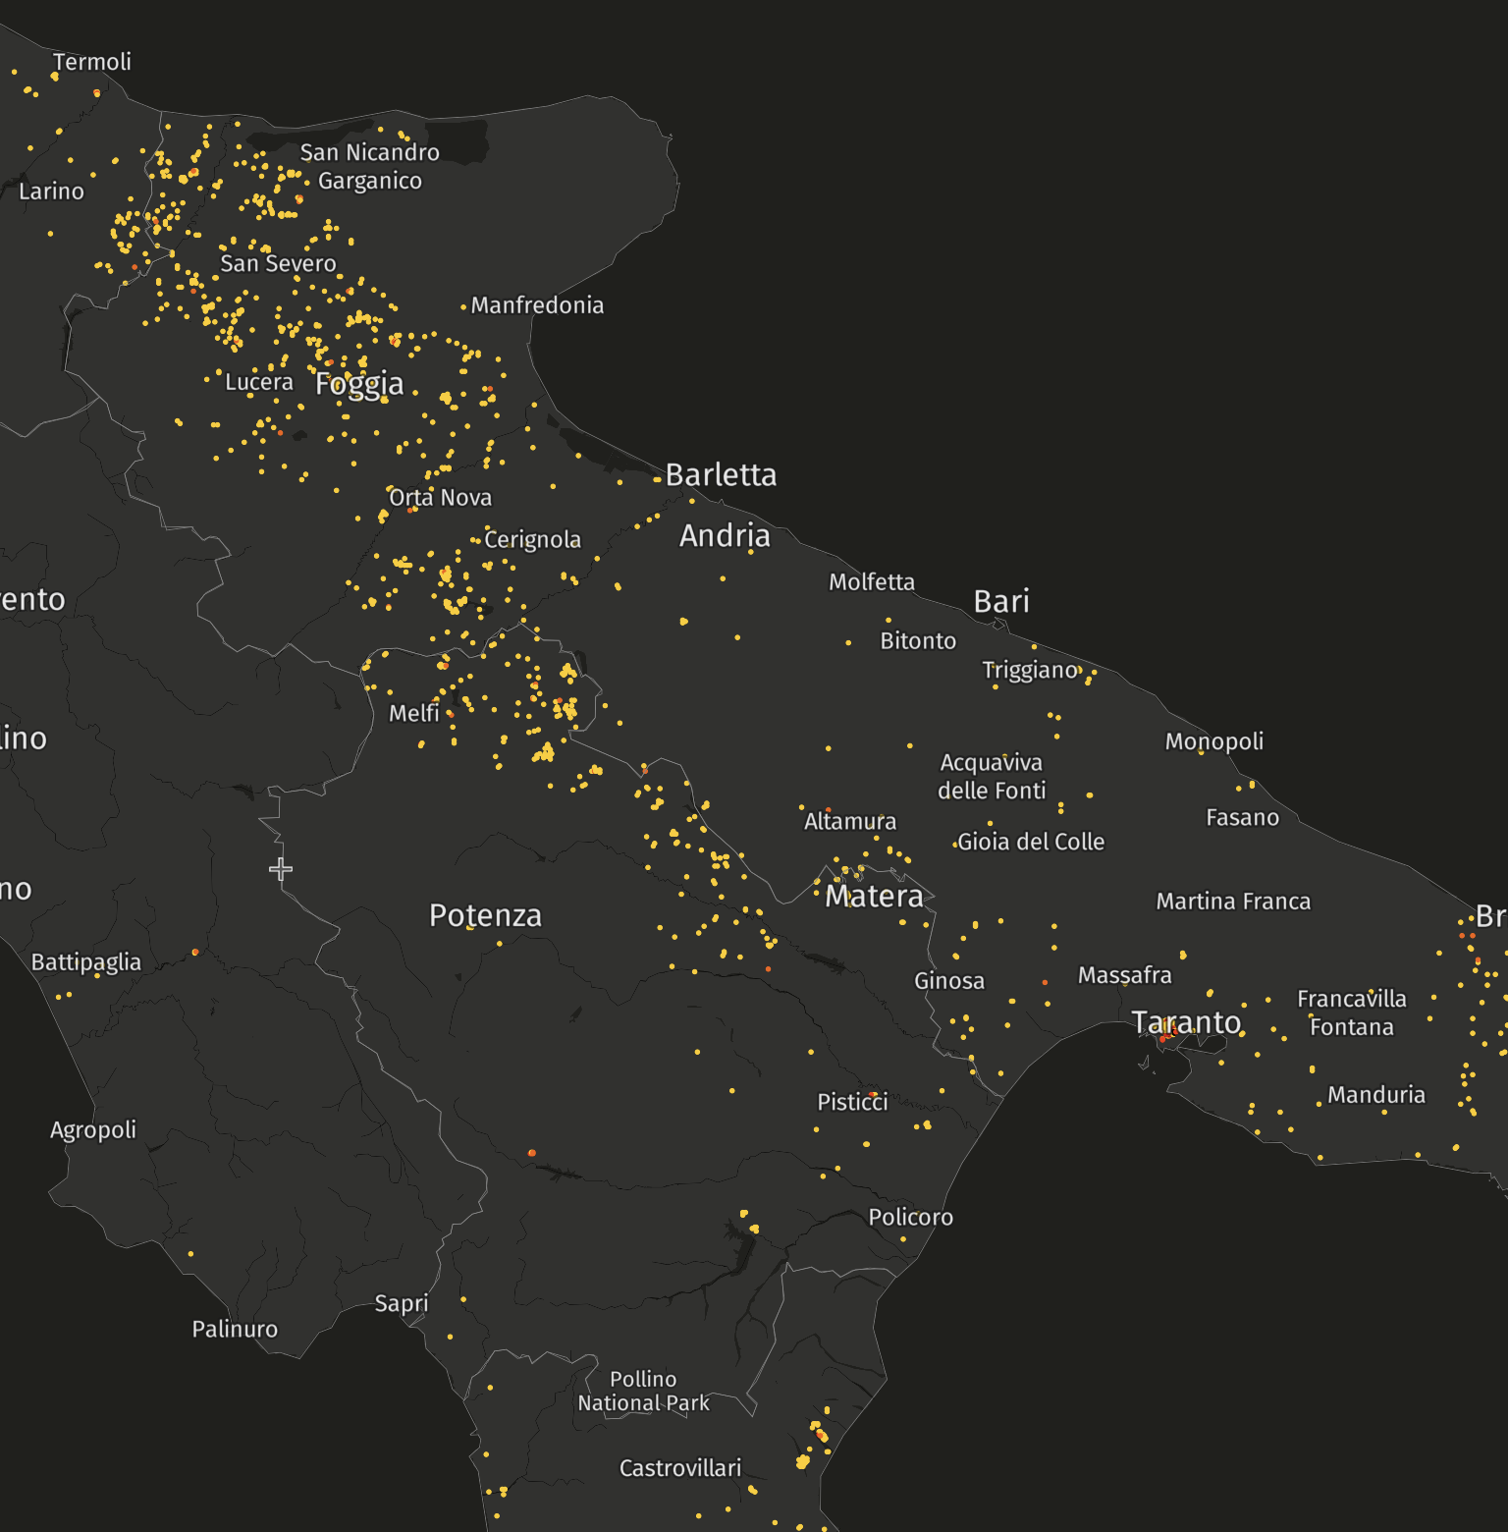
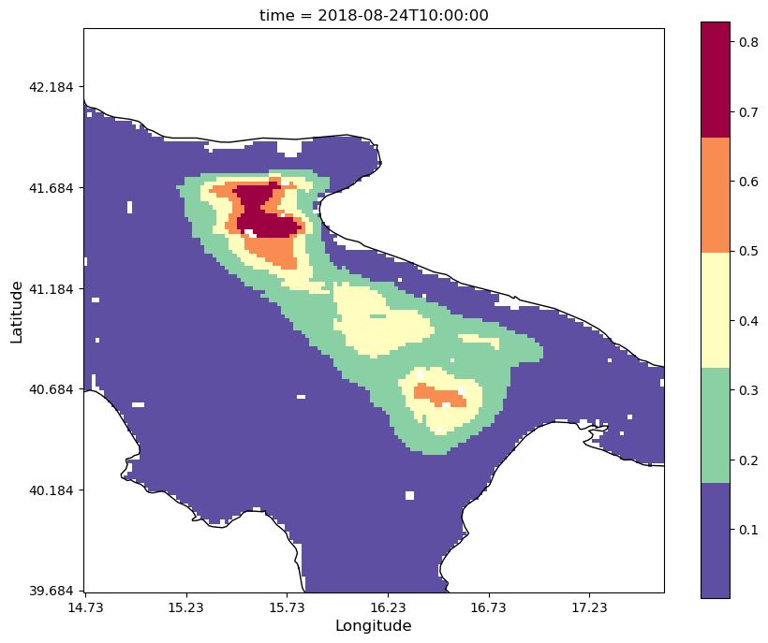
Daily FDI in SILVANUS: Some results and validation
We deploy our FDI user product on three different pilots sites in Europe,
Gargano, Apulia
Tepilora, Sardinia
Covilhã, Portugal
The results are validated more qualitatively, comparing the maps in the same month with VIIRS active fire alerts.
VIIRS active fires alerts
@Global Forest Watch
Shahbaz Alvi, shahbaz.alvi@cmcc.it
Notes:
- Explain the images…..

Slide 23
Conclusion
The pipeline presents operational tool for autonomously compute the daily FDI over a geographic region.
The pipeline uses TOML files which are easily configurable.
The pipeline can be configured with a different ML model, and even a data store other than DDS.
Paper in writing* – stay tunned!
*git code may be released with the paper!
Shahbaz Alvi, shahbaz.alvi@cmcc.it
Notes:
I will quickly summarized the presentation:
I presented a functional pipeline for the autonomous computation of the FDI based on Python and PyTorch lightning setup.
The pipeline is highly configurable because a ml-model different from our usecase can be very quickly configured.
One can use different data store for different pilot sites. Most of the code however is written for the CMCC DDS datastore but with minimal changes any other datastore can also be configured.
The pipeline can further be deployed in a cluster environment for autonomous computation of FDI.

Slide 24
Lessons learned
Availability of dataset from autonomous data repository presents a serious bottleneck to the continuous deployment of the pipeline – backup options needed.
Model lifecycle management is required to assess the impact of cliate change.
Shahbaz Alvi, shahbaz.alvi@cmcc.it
Notes:
I will take a moment to talk about the lessons learned during the development of the project.
Data ingestion from the autonomous data repository can cause a bottleneck in the continuous operation of the pipeline.
Model life cycle management is needed for monitor the performance of the model and perhaps also train the model.

Slide 25
Thank you!
Questions?
Shahbaz Alvi
CMCC Foundation, Lecce, Italy
shahbaz.alvi@cmcc.it

Slide 26
Daily FDI in SILVANUS: CMCC DDS
dds-support@cmcc.it
We use the CMCC Data Delivery System (DDS) for the ingestion and eventual consumption of the fire predictors.
The DDS system allows to ingest the latest dataset available on the parent repository with metadata recovery methods.
The DDS system ingests, processes and stores the dataset on CMCC local premises from where the metadata can be retrieved for the fire predictors of the pilot sites.
Shahbaz Alvi, shahbaz.alvi@cmcc.it
Notes:
- To consume the latest fire predictors for creating the forecast

Slide 27
Thank you

Slide 28
Extra slides

Slide 29
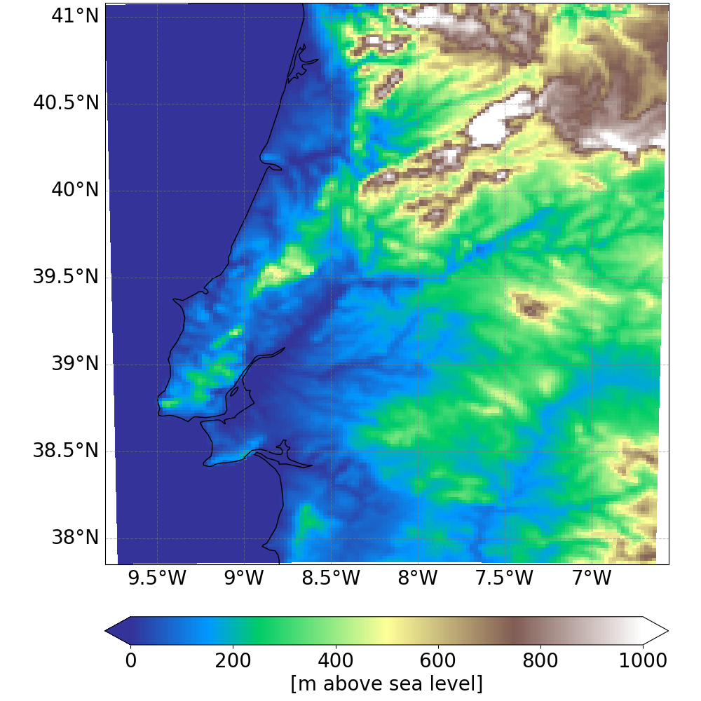
Numerical Weather Prediction: overview
Simulated domain
The Numerical Weather Prediction (NWP) model adopted in the project is the numerical Weather Research and Forecasting Model WRF v4.2.1
Simulations performed using Global Forecast System (GFS) forcings over a domain around the Cova da Beira subregion
The output contains several variables to allow the definition of a ML based Fire Danger Index (FDI).
1
Notes:
Explain what this chart is
Show that we are currently here.
Tasks, and how they are mapped to the delivered.
Time line.

