Slide 1
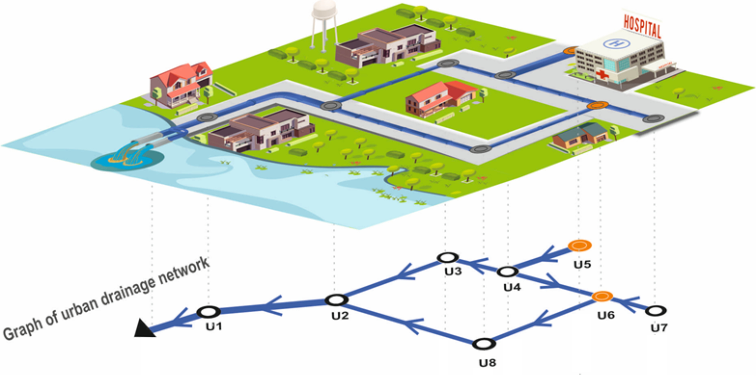
Urban Drainage Network Modeling Based on Physics-Informed Graph Analysis
Mohammad Rajabi¹, Mohsen Hajibabaei¹ and Robert Sitzenfrei^{1*}
¹Department of Infrastructure Engineering, University of Innsbruck, Innsbruck, Austria

Slide 2
Application of the proposed graph-based urban drainage network model
Optimization of flood mitigation projects by calculating objective functions in different scenarios, such as:
LID (Low Impact Development) placement
Network design
Network Rehabilitation
Calculation of reward values in reinforcement learning methods
Global resilience analysis
Urban Drainage Network Modeling Based on Physics-Informed Graph Analysis
EGU General Assembly, May 2025, Vienna, Austria
1
Application
2
Flow routing
3
Results

Slide 3
Flow routing in urban drainage network
Legend
Inlet
Outlet
Subcatchment 1
Subcatchment 3
Conduit
2
1
Subcatchment 2
Hydrologic Model
Hydraulic Model
4
Nonlinear Reservoir Model
Hydrodynamic Model
Subcatchment 4
Subcatchment 5
3
5
Physics-Informed Graph Network
Urban Drainage Network Modeling Based on Physics-Informed Graph Analysis
EGU General Assembly, May 2025, Vienna, Austria
1
Application
2
Flow routing
3
Results

Slide 4
Legend
Flow routing in urban drainage network
Inlet
Outlet
Q (m³/s)
Max flow1
Q (m³/s)
Flow
0.5
0.5
Conduit
Max flow2
Max flow3
Q (m³/s)
Max flow3
t (s)
Max flow2
2
0.7
1
2
1
t (s)
Max flow2
Q (m³/s)
Max flow4
Q (m³/s)
Max flow5
0.5
4
0.5
4
Max flow4
Max flow5
3
5
3
5
Urban Drainage Network Modeling Based on Physics-Informed Graph Analysis
EGU General Assembly, May 2025, Vienna, Austria
1
Application
2
Flow routing
3
Results

Slide 5
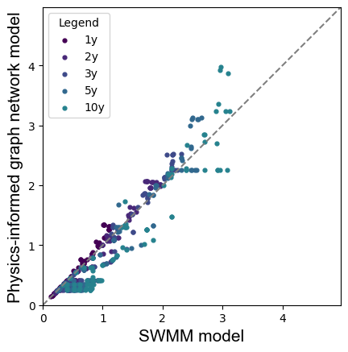
Results
Q ($\frac{m^{3}}{s})$
Q ($\frac{m^{3}}{s})$
Maximum Flow of Pipes Based on the SWMM and graph-based model
Urban Drainage Network Modeling Based on Physics-Informed Graph Analysis
EGU General Assembly, May 2025, Vienna, Austria
1
Application
2
Flow routing
3
Results

Slide 6
Contact
Mohammad Rajabi
PICOA.12 University of Innsbruck, Austria E-Mail: Mohammad.Rajabi@uibk.ac.at
Acknowledgments
This research is part of the ‘RESTORE’ project and is funded by the Austrian Science Fund (FWF) P 36737-N.

Slide 7
Urban Drainage Network Modeling Based on Physics-Informed Graph Analysis
Mohammad Rajabi¹, Mohsen Hajibabaei¹ and Robert Sitzenfrei^{1*}
¹Department of Infrastructure Engineering, University of Innsbruck, Innsbruck, Austria

Slide 8
Research gaps
Paper | Failure | Model | Research aim
(Mugume and Butler, 2017) | Global functional failures | SWMM | Resilience assessment
(Li and Burian, 2023) | Functional failure | SWMM | Real-time flood control
(Haghbin and Mahjouri, 2023) | Functional failure | SWMM | Resilience enhancement with LID location
(Xu et al. 2024) | Global functional failures | SWMM | Resilience assessment
(Zhang et al., 2025) | Functional failures | SWMM | Resilience enhancement with LID location
(Mugume et al., 2015) | Global structural failures | SWMM | Resilience assessment
(Osheen et al., 2023) | Structural and functional failures | SWMM | Resilience assessment
(Dastgir et al., 2023) | Structural failures | Graph-based method | Critical pipe analysis
(Valizadeh et al., 2023) | Structural failures | Graph-based method | Resilience assessment
Urban Drainage Network Modeling Based on Physics-Informed Graph Analysis
EGU General Assembly, May 2025, Vienna, Austria
1
Research gaps
2
Research aims
3
Application

Slide 9
Research gaps
Paper | Failure | Model | Research aim
(Mugume and Butler, 2017) | Global functional failures | SWMM | Resilience assessment
(Li and Burian, 2023) | Functional failure | SWMM | Real-time flood control
(Haghbin and Mahjouri, 2023) | Functional failure | SWMM | Resilience enhancement with LID location
(Xu et al. 2024) | Global functional failures | SWMM | Resilience assessment
(Zhang et al., 2025) | Functional failures | SWMM | Resilience enhancement with LID location
(Mugume et al., 2015) | Global structural failures | SWMM | Resilience assessment
(Osheen et al., 2023) | Structural and functional failures | SWMM | Resilience assessment
(Dastgir et al., 2023) | Structural failures | Graph-based method | Critical pipe analysis
(Valizadeh et al., 2023) | Structural failures | Graph-based method | Resilience assessment
Current paper | Functional and structural | Graph-based method | Resilience assessment
Urban Drainage Network Modeling Based on Physics-Informed Graph Analysis
EGU General Assembly, May 2025, Vienna, Austria
1
Research gaps
2
Research aims
3
Application

Slide 10
Research aims
A novel physics-informed graph theory model for flow routing under normal and failure conditions is developed and validated using the Storm Water Management Model (SWMM).
Hydraulically informed graph metrics are developed using weighted shortest path results to enhance the accuracy of flow estimation.
Urban Drainage Network Modeling Based on Physics-Informed Graph Analysis
EGU General Assembly, May 2025, Vienna, Austria
1
Research gaps
2
Research aims
3
Application

Slide 11
Application of the proposed graph-based urban drainage network model
Optimization of flood mitigation projects by calculating objective functions in different scenarios, such as:
LID (Low Impact Development) placement
Network design
Network Rehabilitation
Calculation of reward values in reinforcement learning methods
Global resilience analysis
Urban Drainage Network Modeling Based on Physics-Informed Graph Analysis
EGU General Assembly, May 2025, Vienna, Austria
1
Research gaps
2
Research aims
3
Application

Slide 12
Graph-based Model of Urban Drainage Network
Legend
Inlet
Outlet
Subcatchment 1
Subcatchment 3
Conduit
2
1
Subcatchment 2
4
Subcatchment 4
Subcatchment 5
3
5
Urban Drainage Network Modeling Based on Physics-Informed Graph Analysis
EGU General Assembly, May 2025, Vienna, Austria
4
Graph analysis
5
6
Results
Case study

Slide 13
Graph-based Model of Urban Drainage Network
Legend
Inlet
Outlet
Conduite
2
Capacity: 0.4m³/s
Travel Time: 2.5 min
1
Capacity: 0.4m³/s
Travel Time: 2 min
4
Capacity: 0.2m³/s
Travel Time: 1 min
Capacity: 0.6m³/s
Travel Time: 1.5 min
3
5
Capacity: 1 m³/s
Travel Time: 2 min
Urban Drainage Network Modeling Based on Physics-Informed Graph Analysis
EGU General Assembly, May 2025, Vienna, Austria
4
Graph analysis
5
6
Results
Case study

Slide 14
Graph-based Model of Urban Drainage Network
Legend
Inlet
Outlet
Q (m³/s)
Q (m³/s)
Conduite
0.5
0.5
2
t (s)
1
t (s)
Q (m³/s)
0.7
4
t (s)
Q (m³/s)
Q (m³/s)
0.3
0.8
3
t (s)
5
t (s)
Urban Drainage Network Modeling Based on Physics-Informed Graph Analysis
EGU General Assembly, May 2025, Vienna, Austria
4
Graph analysis
5
6
Results
Case study

Slide 15
Graph-based Model of Urban Drainage Network
Legend
Inlet
Runoff edge betweenness centrality (REBC): inflows from upstream nodes that accumulated because they go through the same edge
Outlet
Flow
Max flow1
Max flow3
Conduite
2
1
Max flow2
4
Max flow4
Max flow5
3
5
Urban Drainage Network Modeling Based on Physics-Informed Graph Analysis
EGU General Assembly, May 2025, Vienna, Austria
4
Graph analysis
5
6
Results
Case study

Slide 16
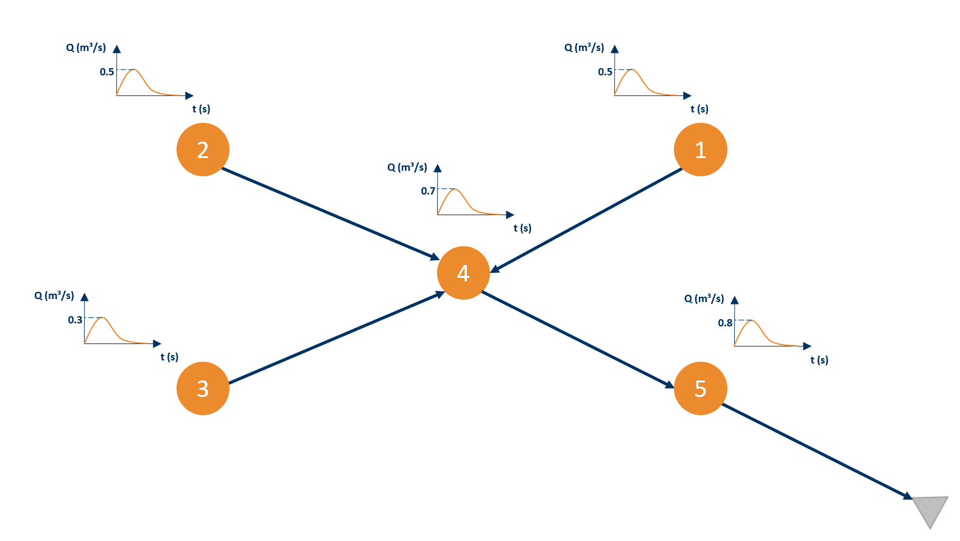
Legend
Graph-based Model of Urban Drainage Network
Inlet
Outlet
Conduit
2
REBC: 0.5 m³/s
1
REBC: 0.5 m³/s
4
REBC: 0.3 m³/s
REBC: 2 m³/s
3
5
REBC: 2.8 m³/s
Urban Drainage Network Modeling Based on Physics-Informed Graph Analysis
EGU General Assembly, May 2025, Vienna, Austria
4
Graph analysis
5
6
Results
Case study

Slide 17
Legend
Graph-based Model of Urban Drainage Network
Inlet
Outlet
Conduit
0.1 m³/s
Capacity: 0.4m³/s
Travel Time: 2.5 min
Capacity: 0.4m³/s
Travel Time: 2 min
2
1
2
REBC: 0.5 m³/s
REBC: 0.5 m³/s
2
1
REBC*: 0.4 m³/s
REBC*: 0.5 m³/s
Capacity: 0.2m³/s
Travel Time: 1 min
4
Capacity: 0.6m³/s
Travel Time: 1.5 min
4
4
REBC: 0.3 m³/s
REBC: 2 m³/s
REBC*: 0.3 m³/s
REBC*: 1.9 m³/s
3
5
Capacity: 1 m³/s
Travel Time: 2 min
3
5
5
REBC: 2.8 m³/s
REBC*: 2.8 m³/s
Urban Drainage Network Modeling Based on Physics-Informed Graph Analysis
EGU General Assembly, May 2025, Vienna, Austria
4
Graph analysis
5
6
Results
Case study

Slide 18
Legend
Graph-based Model of Urban Drainage Network
Inlet
Outlet
Conduit
0.1 m³/s
0.1 m³/s
0.1 m³/s
Capacity: 0.4m³/s
Travel Time: 2.5 min
Capacity: 0.4m³/s
Travel Time: 2 min
2
2
1
2
1
REBC*: 0.4 m³/s
REBC*: 0.5 m³/s
1
REBC*: 0.4 m³/s
REBC*: 0.4 m³/s
Capacity: 0.2m³/s
Travel Time: 1 min
4
Capacity: 0.6m³/s
Travel Time: 1.5 min
4
4
4
REBC*: 0.3 m³/s
REBC*: 1.9 m³/s
REBC*: 0.3 m³/s
REBC*: 1.8 m³/s
Capacity: 1 m³/s
Travel Time: 2 min
3
5
5
3
5
REBC*: 2.8 m³/s
5
REBC*: 2.8 m³/s
Urban Drainage Network Modeling Based on Physics-Informed Graph Analysis
EGU General Assembly, May 2025, Vienna, Austria
4
Graph analysis
5
6
Results
Case study

Slide 19
Graph-based Model of Urban Drainage Network
0.1 m³/s
0.1 m³/s
2
1
2
1
REBC*: 0.4 m³/s
0.1 m³/s
REBC*: 0.4 m³/s
4
4
0.1 m³/s
0.6 m³/s
REBC*: 0.2 m³/s
REBC*: 0.6 m³/s
3
3
5
5
REBC*: 1 m³/s
Urban Drainage Network Modeling Based on Physics-Informed Graph Analysis
EGU General Assembly, May 2025, Vienna, Austria
4
Graph analysis
5
6
Results
Case study
Notes:
Model-Based → Simulates water network behavior and compares with real sensor data to find leaks.

Slide 20
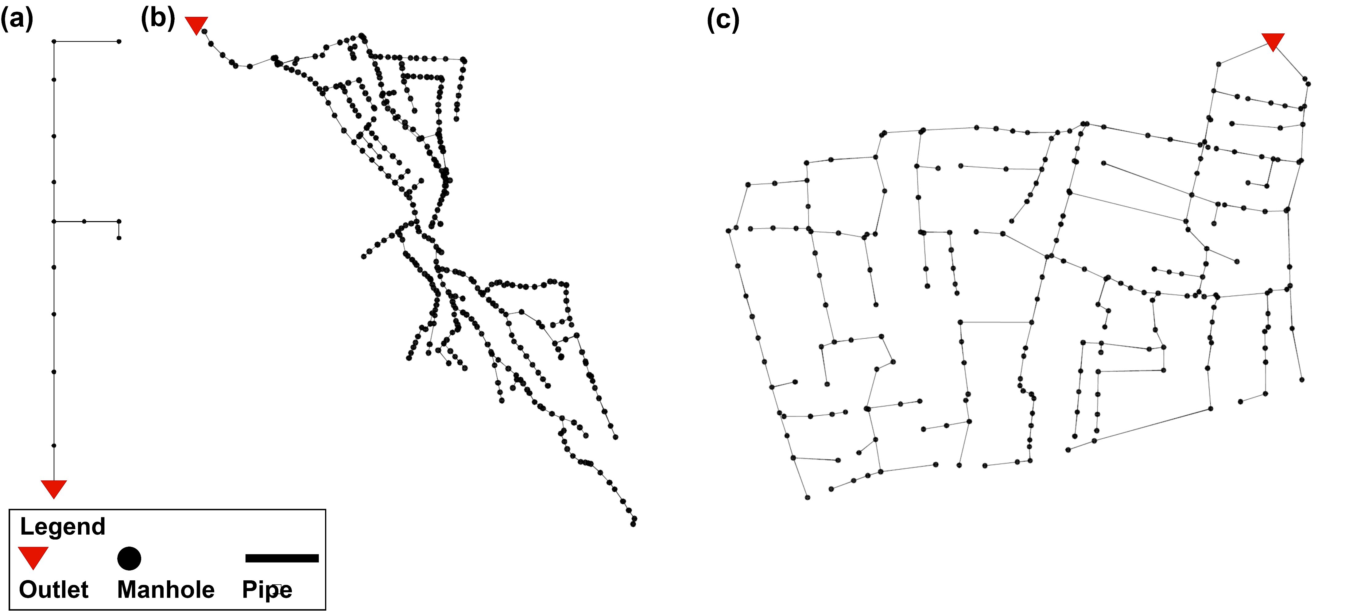
Case Studies
Urban Drainage Network Modeling Based on Physics-Informed Graph Analysis
EGU General Assembly, May 2025, Vienna, Austria
4
Graph analysis
5
6
Results
Case study

Slide 21
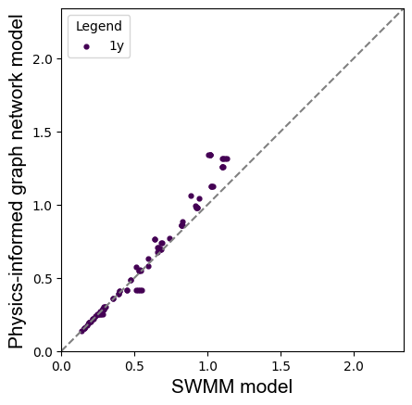
Case Studies
Maximum flow of the pipes for the case study (a) with the damping effect (FSMI=0.2* Rainfall duration)
Urban Drainage Network Modeling Based on Physics-Informed Graph Analysis
EGU General Assembly, May 2025, Vienna, Austria
4
Graph analysis
5
6
Results
Case study

Slide 22
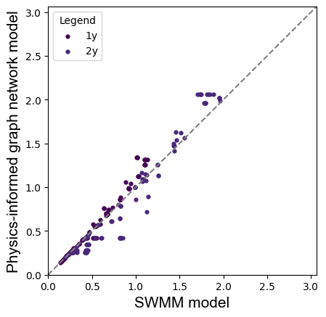
Case Studies
Maximum flow of the pipes for the case study (a) with the damping effect (FSMI=0.2* Rainfall duration)
Urban Drainage Network Modeling Based on Physics-Informed Graph Analysis
EGU General Assembly, May 2025, Vienna, Austria
4
Graph analysis
5
6
Results
Case study

Slide 23
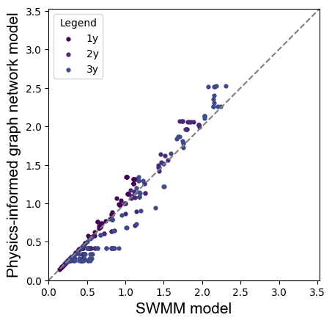
Case Studies
Maximum flow of the pipes for the case study (a) with the damping effect (FSMI=0.2* Rainfall duration)
Urban Drainage Network Modeling Based on Physics-Informed Graph Analysis
EGU General Assembly, May 2025, Vienna, Austria
4
Graph analysis
5
6
Results
Case study

Slide 24
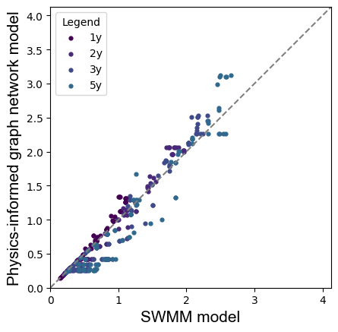
Case Studies
Maximum flow of the pipes for the case study (a) with the damping effect (FSMI=0.2* Rainfall duration)
Urban Drainage Network Modeling Based on Physics-Informed Graph Analysis
EGU General Assembly, May 2025, Vienna, Austria
4
Graph analysis
5
6
Results
Case study

Slide 25
Case Studies
Maximum flow of the pipes for the case study (a) with the damping effect (FSMI=0.2* Rainfall duration)
Urban Drainage Network Modeling Based on Physics-Informed Graph Analysis
EGU General Assembly, May 2025, Vienna, Austria
4
Graph analysis
5
6
Results
Case study

Slide 26
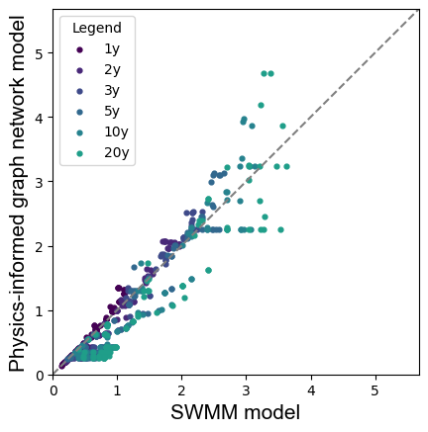
Case Studies
Maximum flow of the pipes for the case study (a) with the damping effect (FSMI=0.2* Rainfall duration)
Urban Drainage Network Modeling Based on Physics-Informed Graph Analysis
EGU General Assembly, May 2025, Vienna, Austria
4
Graph analysis
5
6
Results
Case study

Slide 27
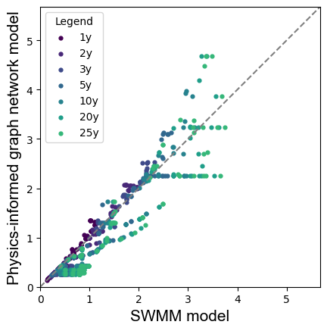
Case Studies
Maximum flow of the pipes for the case study (a) with the damping effect (FSMI=0.2* Rainfall duration)
Urban Drainage Network Modeling Based on Physics-Informed Graph Analysis
EGU General Assembly, May 2025, Vienna, Austria
4
Graph analysis
5
6
Results
Case study

Slide 28
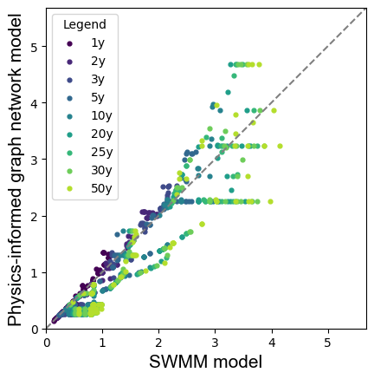
Case Studies
Maximum flow of the pipes for the case study (a) with the damping effect (FSMI=0.2* Rainfall duration)
Urban Drainage Network Modeling Based on Physics-Informed Graph Analysis
EGU General Assembly, May 2025, Vienna, Austria
4
Graph analysis
5
6
Results
Case study

Slide 29
Case Studies
Maximum flow of the pipes for the case study (a) with the damping effect (FSMI=0.2* Rainfall duration)
Urban Drainage Network Modeling Based on Physics-Informed Graph Analysis
EGU General Assembly, May 2025, Vienna, Austria
4
Graph analysis
5
6
Results
Case study

Slide 30
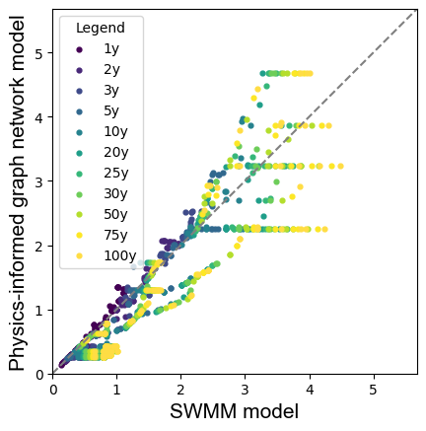
Case Studies
Maximum flow of the pipes for the case study (a) with the damping effect (FSMI=0.2* Rainfall duration)
Urban Drainage Network Modeling Based on Physics-Informed Graph Analysis
EGU General Assembly, May 2025, Vienna, Austria
4
Graph analysis
5
6
Results
Case study

Slide 31
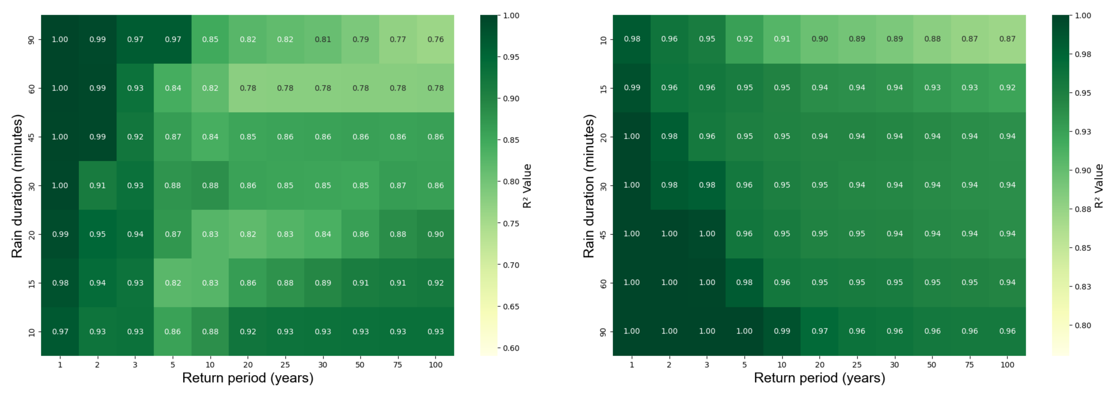
Case Studies
Case study (b)
Case study (c)
Heat map of $R^{2}$ values for pipe flow in real-world case studies (FSMI=0.2*duration)
Urban Drainage Network Modeling Based on Physics-Informed Graph Analysis
EGU General Assembly, May 2025, Vienna, Austria
4
Graph analysis
5
6
Results
Case study

Slide 32
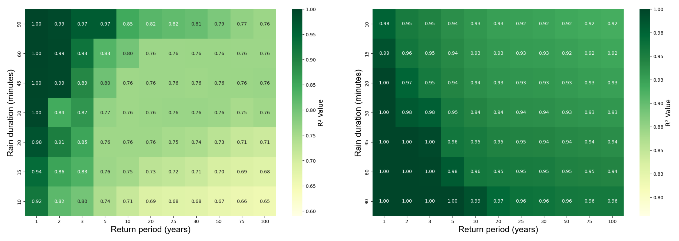
Case Studies
Case study (b)
Case study (c)
Heat map of $R^{2}$ values for pipe flow in real-world case studies (FSMI=∞)
Urban Drainage Network Modeling Based on Physics-Informed Graph Analysis
EGU General Assembly, May 2025, Vienna, Austria
4
Graph analysis
5
6
Results
Case study

Slide 33
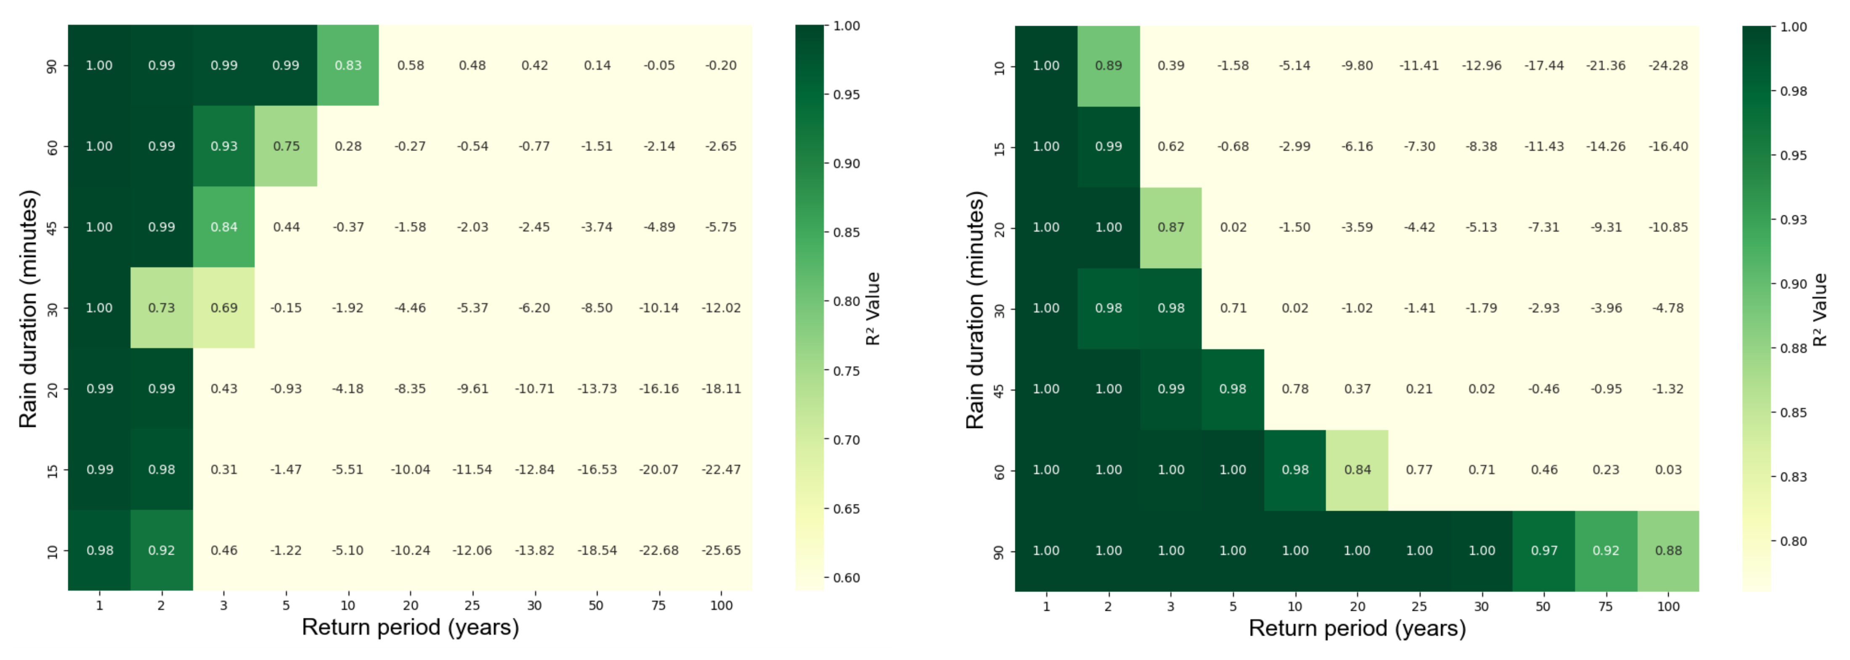
Case Studies
Case study (b)
Case study (c)
Heat map of $R^{2}$ values for pipe flow in real-world case studies (FSMI=0)
Urban Drainage Network Modeling Based on Physics-Informed Graph Analysis
EGU General Assembly, May 2025, Vienna, Austria
4
Graph analysis
5
6
Results
Case study

Slide 34
Contact
Mohammad Rajabi
PICOA.12 University of Innsbruck, Austria E-Mail: Mohammad.Rajabi@uibk.ac.at
Acknowledgments
This research is part of the ‘RESTORE’ project and is funded by the Austrian Science Fund (FWF) P 36737-N.

