Slide 1
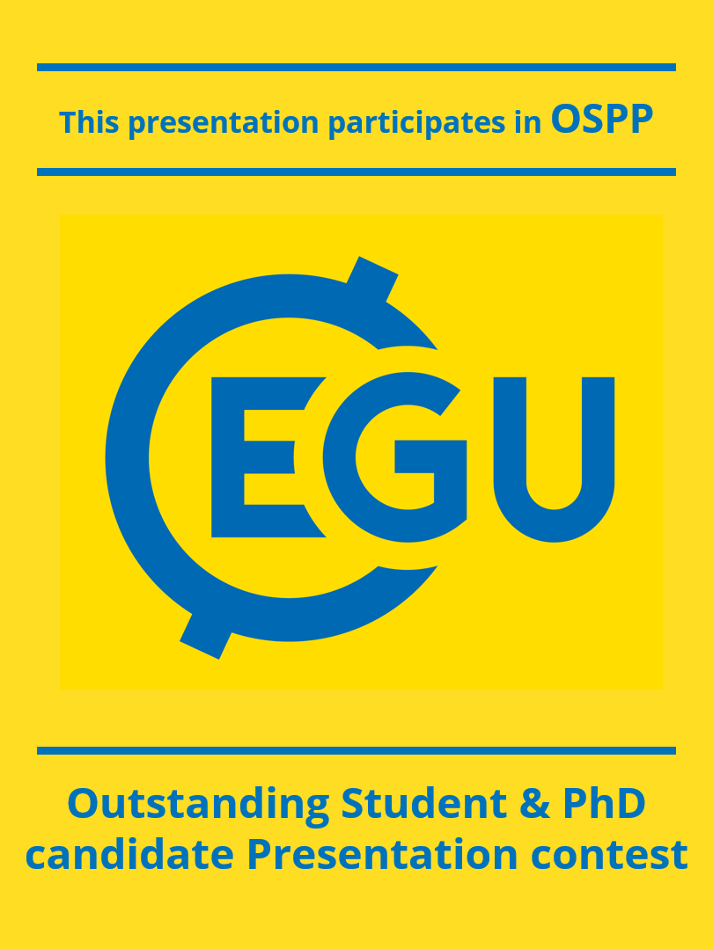
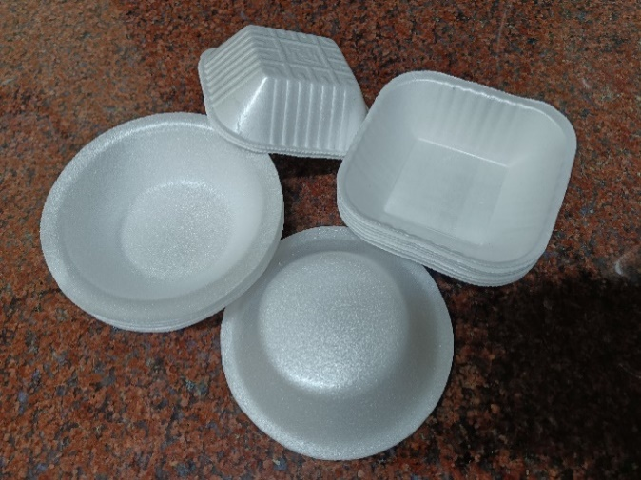
.
Adsorption Dynamics of Atrazine on realistic Polystyrene Nanoplastics: Insights into Co-Contamination Risks
Thasleema k¹, Seetha Narayanan² and Sudha Goel¹
¹Department of Civil Engineering, Indian Institute of Technology Kharagpur, West Bengal–721302, India
²Department of Civil Engineering, Indian Institute of Technology Hyderabad, Telengana- 502284, India
Background and Motivation
Effect of Salinity
Environmental Concern: Fragmented plastics like micro- and nanoplastics are increasingly detected in water, soil, and even the human body, posing serious health and ecological risks.
Most studies use idealised, spherical plastic beads; this study uses realistic polystyrene nanoplastics to better understand atrazine adsorption.
Polystyrene (PS)
Polypropylene (PP)
Polyethylene Terephthalate (PET)
Polyamide (PA)
Polylactic Acid (PLA)
Polyvinyl Chloride (PVC)
Polytetrafluoroethylene (PTFE)
Polymethyl Methacrylate (PMMA)
Conclusions
Atrazine shows significant adsorption onto PS nanoparticles (PSNPs), with maximum adsorption capacity observed at an initial concentration of 2 mg/L, beyond which saturation occurs.
Higher PSNP concentrations (244–266 mg/L) increased the overall adsorption efficiency of atrazine, especially over a 24-hour contact period, highlighting the importance of adsorbent dose in pesticide removal.
Contact time significantly affects adsorption, with equilibrium reached around 24 hours, showing gradual stabilization of atrazine concentration in the solution.
Salinity negatively impacts atrazine adsorption, indicating competitive interactions between salt ions and atrazine molecules for binding sites on PSNPs.
These results suggest that PSNPs can act as carriers or sinks for hydrophobic pesticides like atrazine, potentially affecting their fate and transport in aquatic environments
Objective
To investigate the adsorption behavior of atrazine on realistic, irregularly shaped polystyrene nanoplastics (PSNPs) under environmentally relevant conditions.
Distribution of micro/nano plastic shapes (spherical vs. non-spherical) used in adsorption and transport experiments.
Results and Discussion
Materials and Methods
Effect of initial concentration of atrazine
Source of Polystyrene: Single-use Polystyrene (PS) bowls and plates were sourced from local markets. These items, commonly discarded after one-time use, were selected to simulate environmentally realistic PS nanoplastics (PSNPs)
Material Confirmation: The plastic type was confirmed as Polystyrene using Fourier Transform Infrared Spectroscopy (FTIR) analysis.
Particle Size Analysis: The lab produced suspension showed consistent particle sizes below 1 µm, with good colloidal stability.
Effect of Adsorbent dose
References
Schwaferts, C., Niessner, R., Elsner, M., & Ivleva, N. P. (2019). Methods for the analysis of submicrometer- and nanoplastic particles in the environment. TrAC Trends in Analytical Chemistry, 112, 52–65. https://doi.org/10.1016/J.TRAC.2018.12.014
Wang, L., Wu, W.-M., Bolan, N. S., Tsang, D. C. W., Li, Y., Qin, M., & Hou, D. (2020). Environmental fate, toxicity and risk management strategies of nanoplastics in the environment: Current status and future perspectives. https://doi.org/10.1016/j.jhazmat.2020.123415
Effect of contact Time
Acknowledgements
Thasleema k is thankful to her close friends, supervisors , and Ministry of Education, Govt. of India for providing Doctoral Fellowship.
A chart representing different types
of plastics used for adsorption/transport studies
PS Bowls

